Slide 1
Computer Literacy
Chapter 1

Slide 2
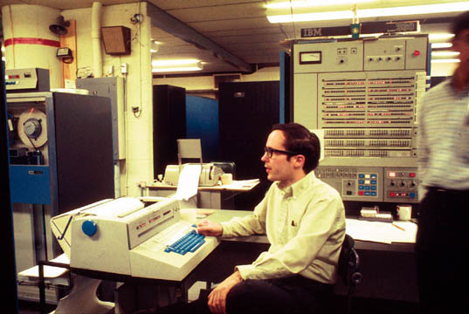
IBM 360
~1970 About 2 MB (1/500 GB) memory
Notes:
http://en.wikipedia.org/wiki/File:IBM360-67AtUmichWithMikeAlexander.jpg

Slide 3
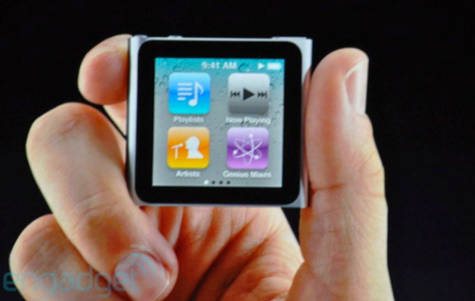
Putting That Into Perspective
1/500 GB
1970
16 GB
2012
Notes:
http://reflectzyn.com/gagdets/2010/09/01/new-ipod-nano-with-touchscreen/attachment/ipod-nano-6th-generation-2010-5/

Slide 4
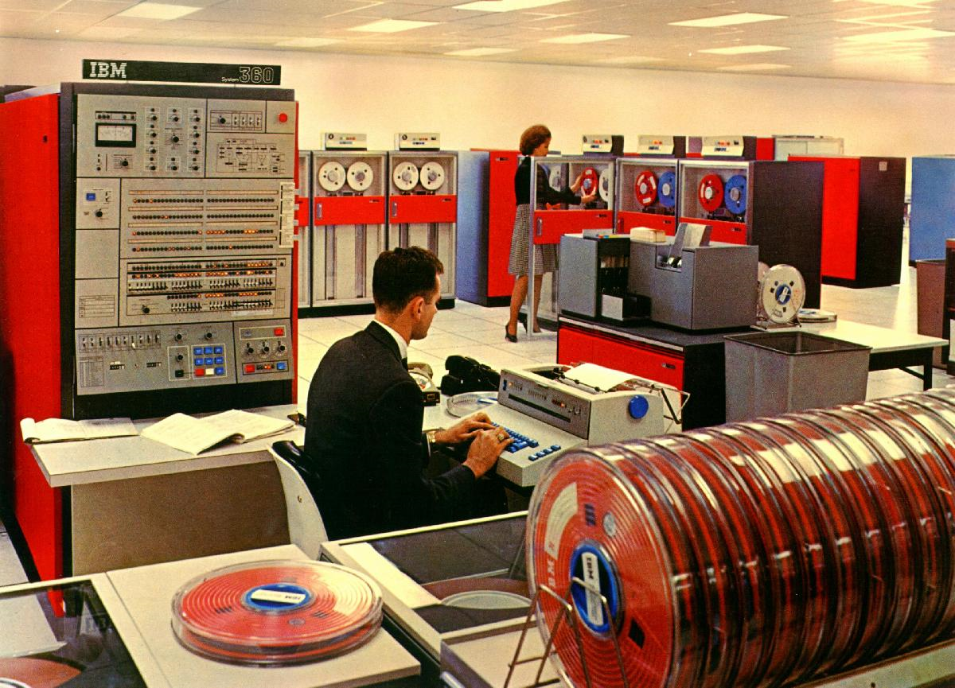
IBM 360
Notes:
Show this one because of all the reels of tape. Lead into Brown Corpus of English discussion. But first mention card reader.
http://thedigitallifeshow.com/wp-content/uploads/2009/10/ibm_360.jpg

Slide 5
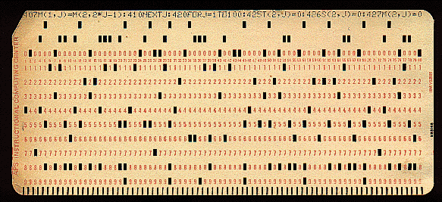
Input to the Machine
Notes:
http://www.tcpiplab.com/new/sites/default/files/pictures/ibm-punchcard.gif

Slide 6
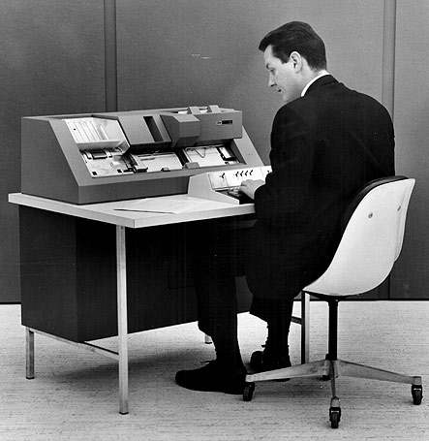
Input to the Machine
Notes:
http://www.tcpiplab.com/new/sites/default/files/pictures/ibm-punchcard.gif
http://www.members.shaw.ca/albertkallal/BatchJobs/4506VV4002.jpg

Slide 7
Programming the 360
//MYJOB JOB (COMPRESS),
'VOLKER BANDKE',CLASS=P,COND=(0,NE)
//BACKUP EXEC PGM=IEBCOPY
//SYSPRINT DD SYSOUT=*
//SYSUT1 DD DISP=SHR,DSN=MY.IMPORTNT.PDS
//SYSUT2 DD DISP=(,CATLG),
DSN=MY.IMPORTNT.PDS.BACKUP,
// UNIT=3350,VOL=SER=DISK01,
// DCB=MY.IMPORTNT.PDS,
SPACE=(CYL,(10,10,20))
//COMPRESS EXEC PGM=IEBCOPY
//SYSPRINT DD SYSOUT=*
//MYPDS DD DISP=OLD,DSN=*.BACKUP.SYSUT1
//SYSIN DD *
COPY INDD=MYPDS,OUTDD=MYPDS
//DELETE2 EXEC PGM=IEFBR14
//BACKPDS DD DISP=(OLD,DELETE,DELETE),
DSN=MY.IMPORTNT.PDS.BACKUP
Notes:
Safely reorganizes and compresses a partitioned dataset

Slide 8
Why Can’t We Just Use English?
Reorganize and partition my dataset.
Sort the class by exam score.
Put the children’s cereal on the bottom shelves.
How many hits did David Ortiz get?
Notes:
One problem: The machine needs more detail about what to do and why.
Second problem: Analyzing English itself.

Slide 9
Structure in English
S
NP VP
Nominal V NP
Adjs N Nominal
Adj N
the smart cat smells chocolate

Slide 10
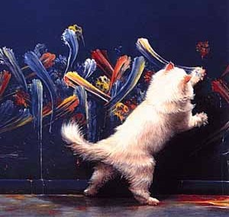
Why Cats Paint

Slide 11
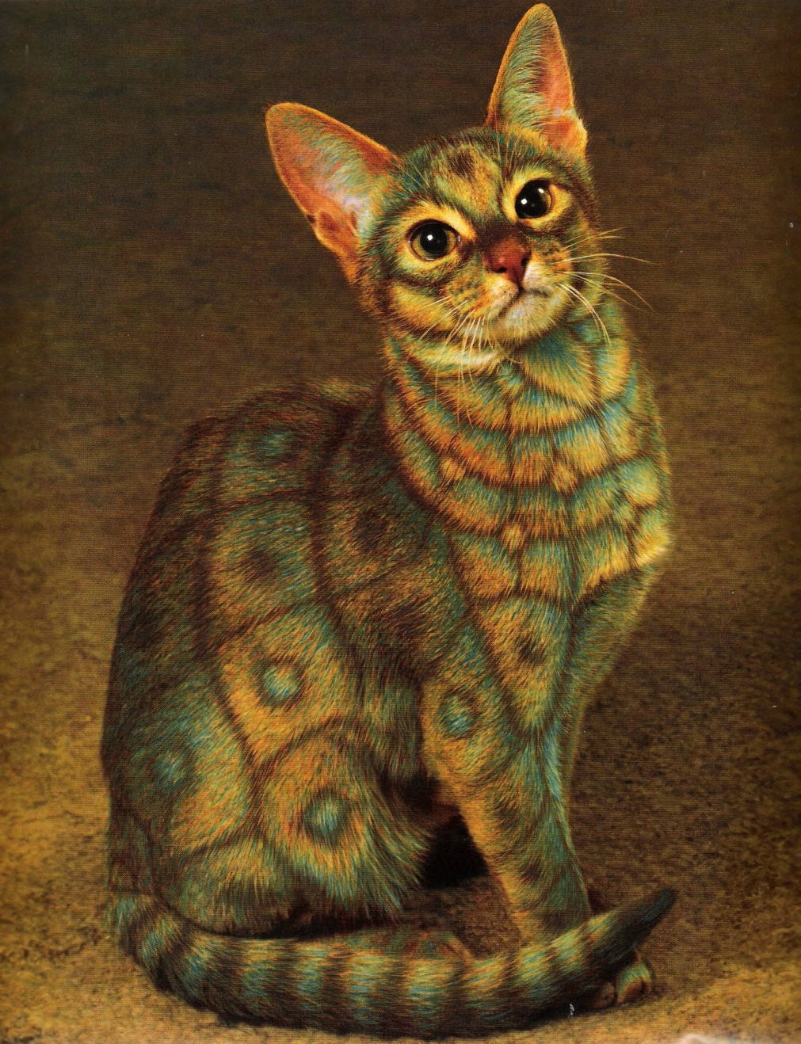
Why Paint Cats

Slide 12
Why Does Analyzing the English Matter?
Find me all the:
Lawyers whose clients committed fraud
vs
Lawyers who committed fraud
vs
Clients whose lawyers committed fraud

Slide 13
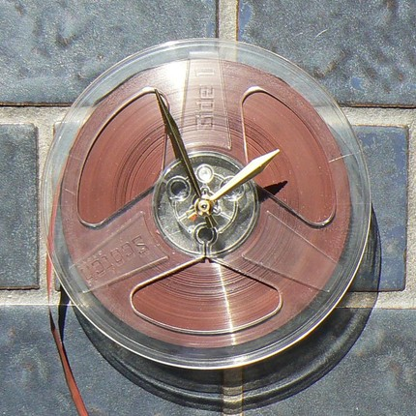
Back to the Reels of Tape in 1970
The Brown University Standard Corpus of Present-Day American English:
1,014,312 words
http://en.wikipedia.org/wiki/Brown_Corpus
Notes:
Sort of funny, most searches turned up these things turned into modern art clocks
First project was to count frequencies. Next was part of speech tagging, for example “hits”.
http://www.alternativeconsumer.com/wp-content/uploads/Ross/2009/Jan_Feb_2009/reeltapeclock.jpg

Slide 14
How Silly 1,000,000 Words Seem Today
War and Peace: 460,000 words
Bible: 774,746 words
1,214,746 words
Brown corpus: 1,014,312 words
Notes:
War and Peace: http://bits.blogs.nytimes.com/2009/12/09/the-american-diet-34-gigabytes-a-day/
Bible: http://www.funtrivia.com/askft/Question3824.html

Slide 15
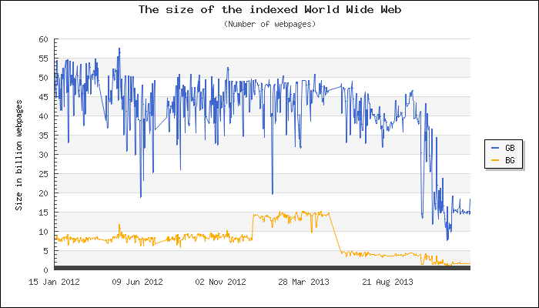
How Silly 1,000,000 Words Seem Today
http://www.worldwidewebsize.com/

Slide 16
So What’s Next?
1970
2012
2052
?
Notes:
When you’re my age, what should you expect?

Slide 17
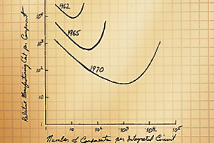
Moore’s Law
http://www.intel.com/technology/mooreslaw/

Slide 18
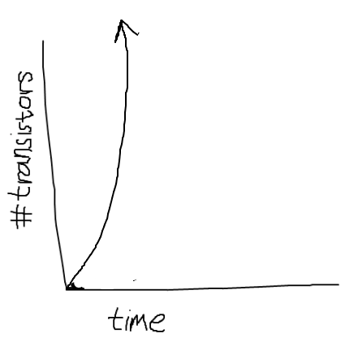
Another View

Slide 19
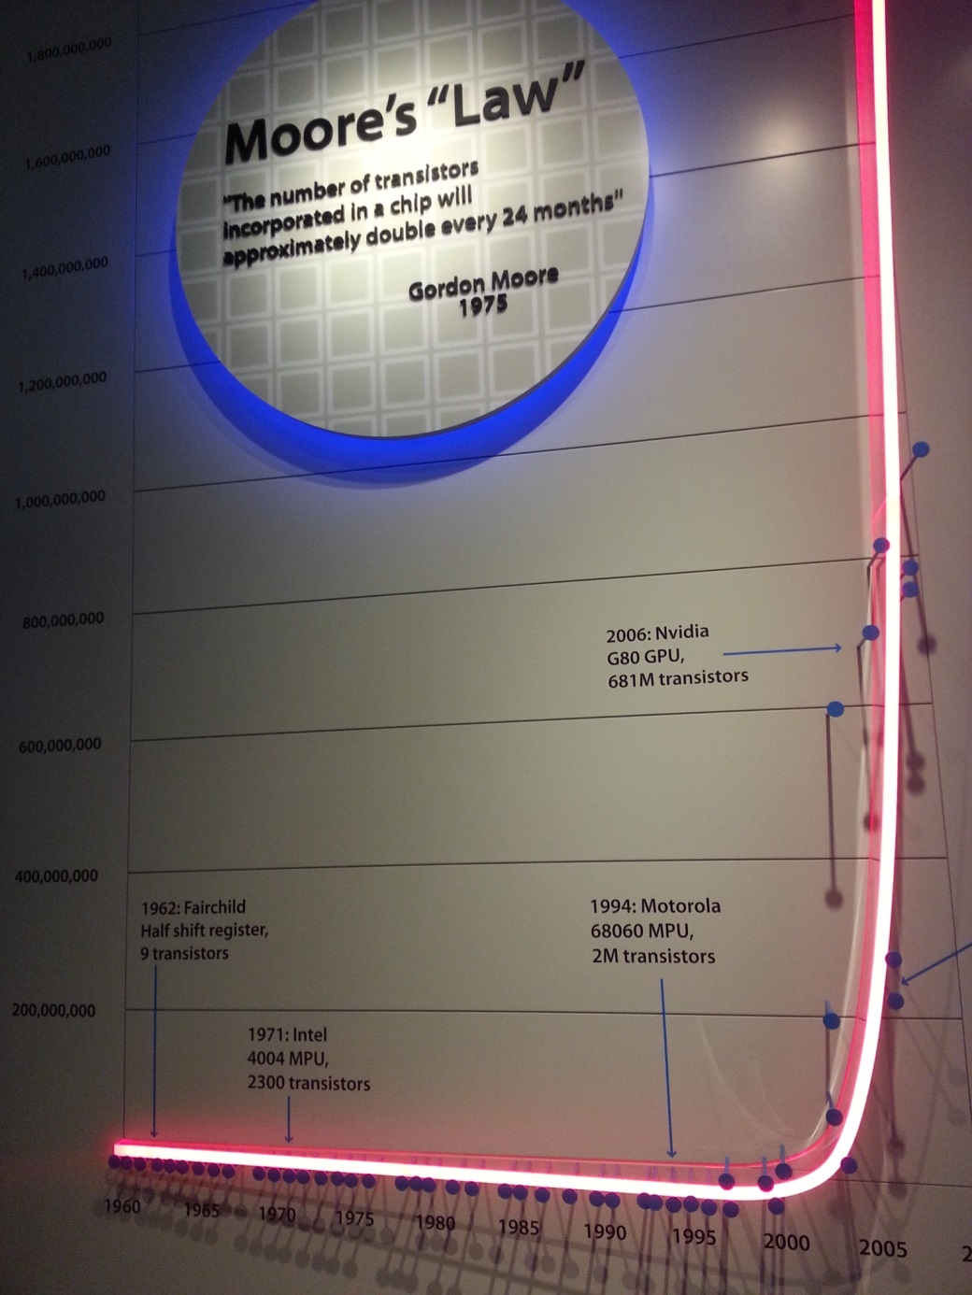
How It Has Happened
Notes:
Taken at the Computer Museum

Slide 20
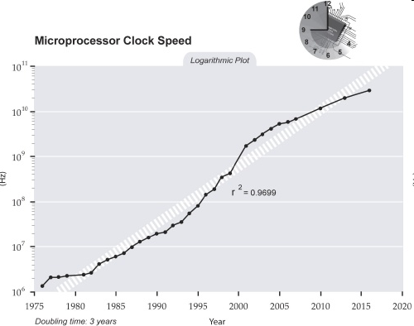
How It Has Happened
Notes:
http://singularity.com/charts/page61.html

Slide 21
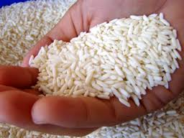
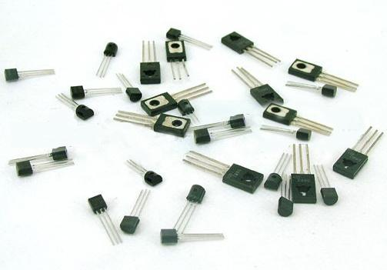
Exactly How Many?
Notes:
Rice: http://www.khiewchanta.com/images/sticky-rice-grains.jpg
Transistors: http://img.diytrade.com/cdimg/787546/6773200/0/1220080438/transistors.jpg

Slide 22
Exactly How Many?
In 2009, more transistors were put on chips than grains of rice were grown in the world.
http://www.amplified09.com/2010/09/more-transistors-than-grains-of-rice/
Notes:
Rice: http://www.khiewchanta.com/images/sticky-rice-grains.jpg
Transistors: http://img.diytrade.com/cdimg/787546/6773200/0/1220080438/transistors.jpg

Slide 23
And It’s Not Just Transistors
Notes:
Data from: http://www.isc.org/solutions/survey/history
Alan put it in Excel and made the graph. Ear\Cswork\CS302\Slides\Images\InternetHostsData.xls

Slide 24
Is it Still Happening?
http://cartesianproduct.wordpress.com/2013/04/15/the-end-of-dennard-scaling/

Slide 25
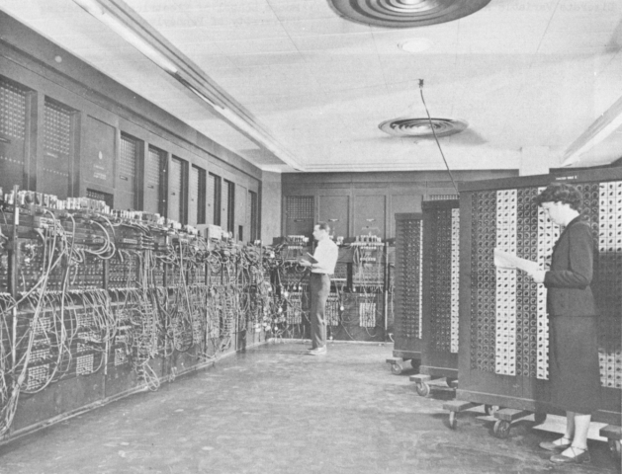
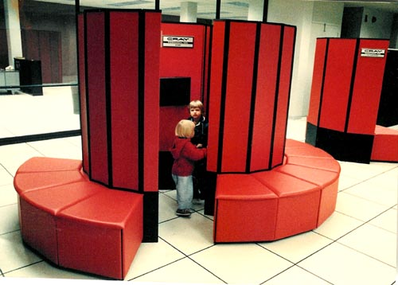
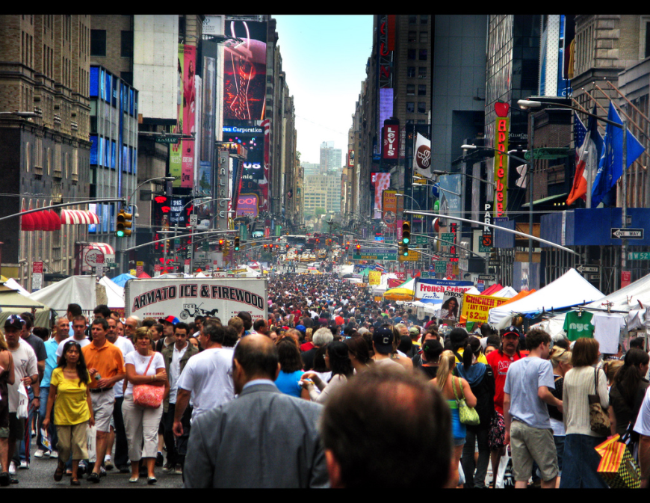
Where Are the Computers?
C 1970
1945
C 1982
Notes:
1945 ENIAC
C 1970 IBM 360
C 1982 Cray http://www.craysupercomputers.com/images/Systems/CrayXMP/CrayXMP_015.jpg
People picture: http://farm4.static.flickr.com/3098/2734995429_8e20c0b4ba_b.jpg

Slide 26
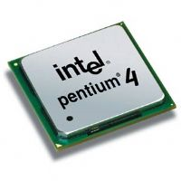
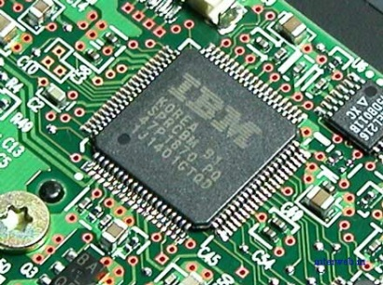
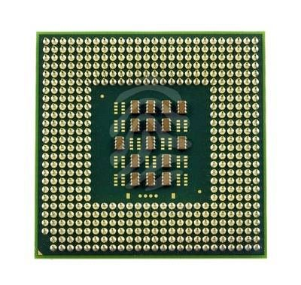
Exactly What IS a Computer?
Processor

Slide 27
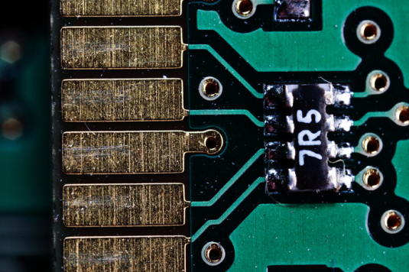
Exactly What IS a Computer?
Processor
Memory

Slide 28
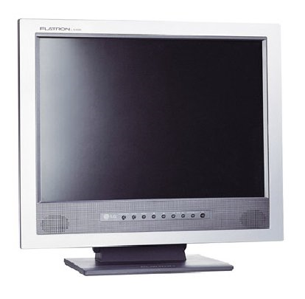
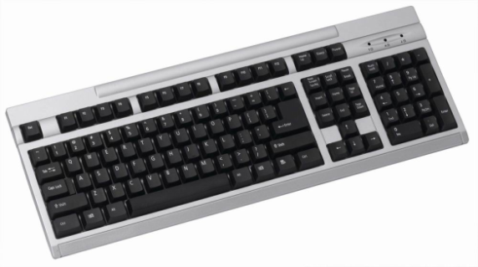
Exactly What IS a Computer?
Processor
Memory
I/O
Notes:
These are the obvious I/O devices that we used to think about. But what about others?

Slide 29
Exactly What IS a Computer?
Processor
Memory
I/O

Slide 30
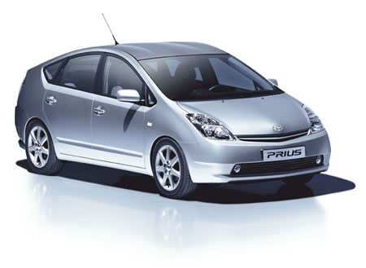
Exactly What IS a Computer?
Processor
Memory
I/O

Slide 31
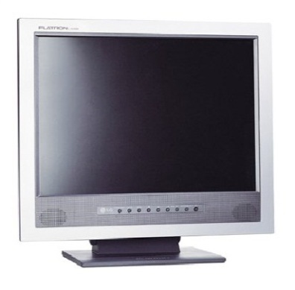
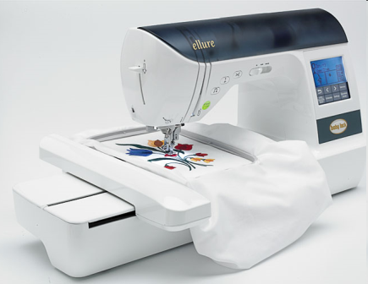
Exactly What IS a Computer?
Processor
Memory
I/O

Slide 32
How Do Computers Do Useful Things?
People write programs (software).
Notes:
Can I show you a picture of a program? It’s a set of instructions. It’s written as text. It is stored in the computer’s memory and then then run.

Slide 33
How Do Computers Do Useful Things?
People write programs (software).
def chess():
while game_on:
internal_board = scan(board)
move = choose(internal_board)
play(move, board)

Slide 34
How Do Computers Do Useful Things?
People write programs (software).
Computers run the programs.
def chess():
while game_on:
internal_board = scan(board)
move = choose(internal_board)
play(move, board)

Slide 35
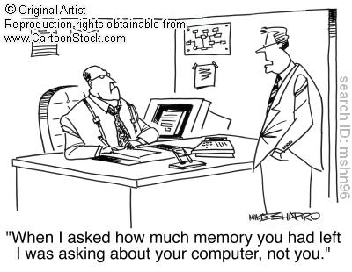
Exactly What IS a Computer?
Notes:
But we are going to limit ourselves to devices that are not composed of biological cells.

Slide 36
Predictions Gone Very Wrong
There is no reason why anyone would want to have a computer in their home. (Ken Olsen, President of Digital Equipment Corporation, 1977)
I went to my first computer conference at the New York Hilton about 20 years ago. When somebody there predicted the market for microprocessors would eventually be in the millions, someone else said, “Where are they all going to go? It’s not like you need a computer in every doorknob!” Years later, I went back to the same hotel. I noticed the room keys had been replaced by electronic cards you slide into slots in the doors. There was a computer in every doorknob. (Danny Hillis, circa 1999)
Notes:
Olsen quoted in Snyder, p. 247
Hillis quoted in Reed, p. 293

Slide 37
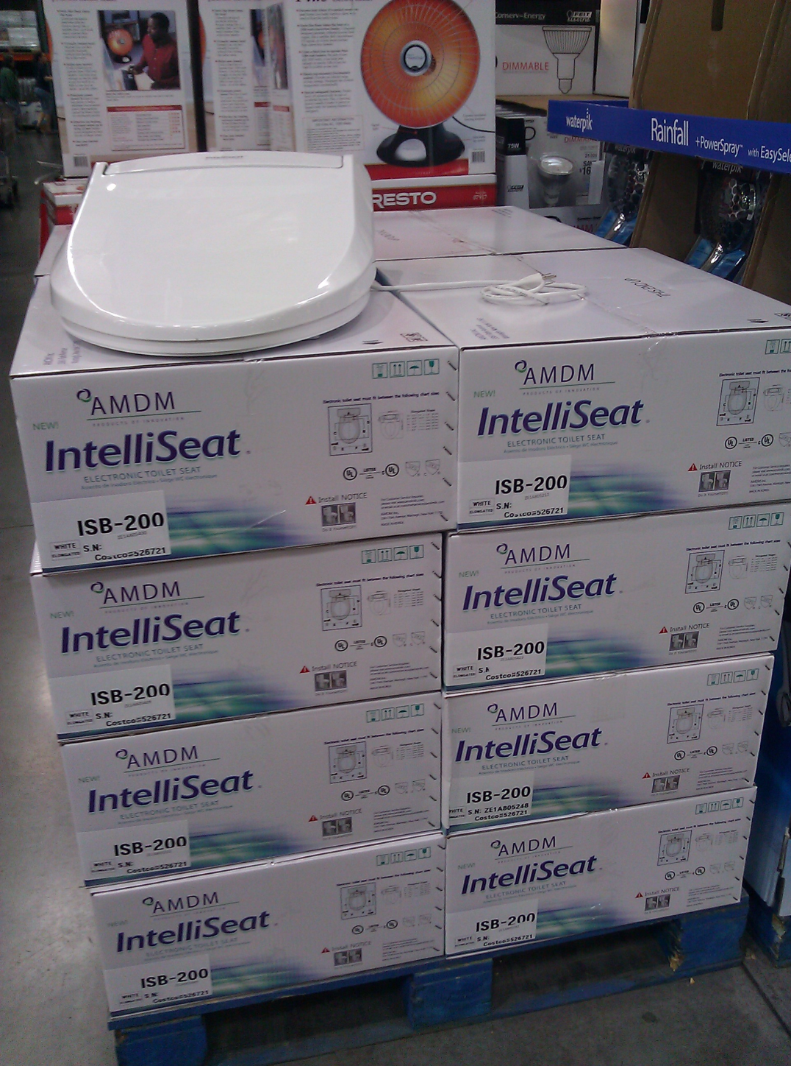
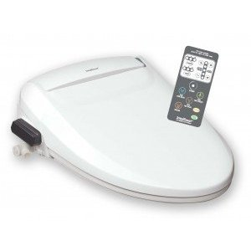
More On Computers Everywhere
$294.00
Safety On/Off Sensor
Self-Cleaning Nozzles
Quick Release Seat for Easy Cleaning
Energy Save Mode
Programmable
Energy Saver Night Light
Personalized Controls
Universal Design
Notes:
Taken at Costco January 21, 2012

Slide 38
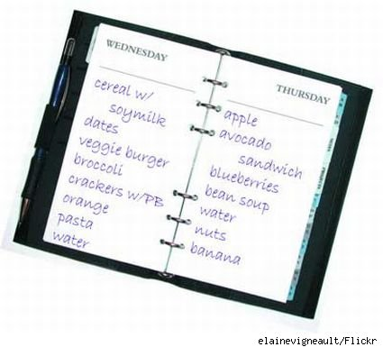
Ubiquitous Computing
Homework for next time:
http://www.cs.utexas.edu/~ear/cs302/Homeworks/UbiquitousComputing.html
Notes:
http://www.blogcdn.com/www.slashfood.com/media/2008/07/food-diary.jpg

Slide 39
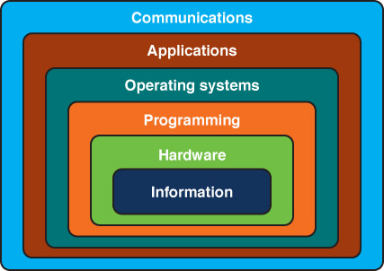
This Class

Slide 40
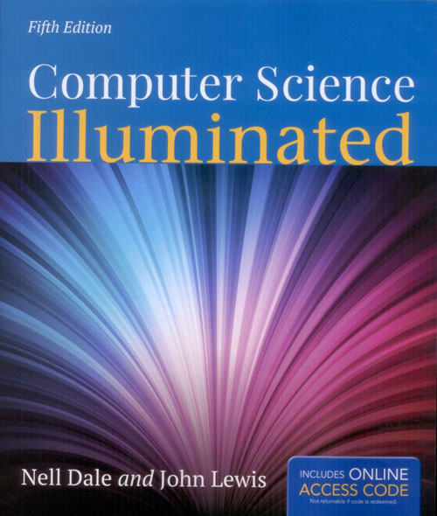

Slide 41
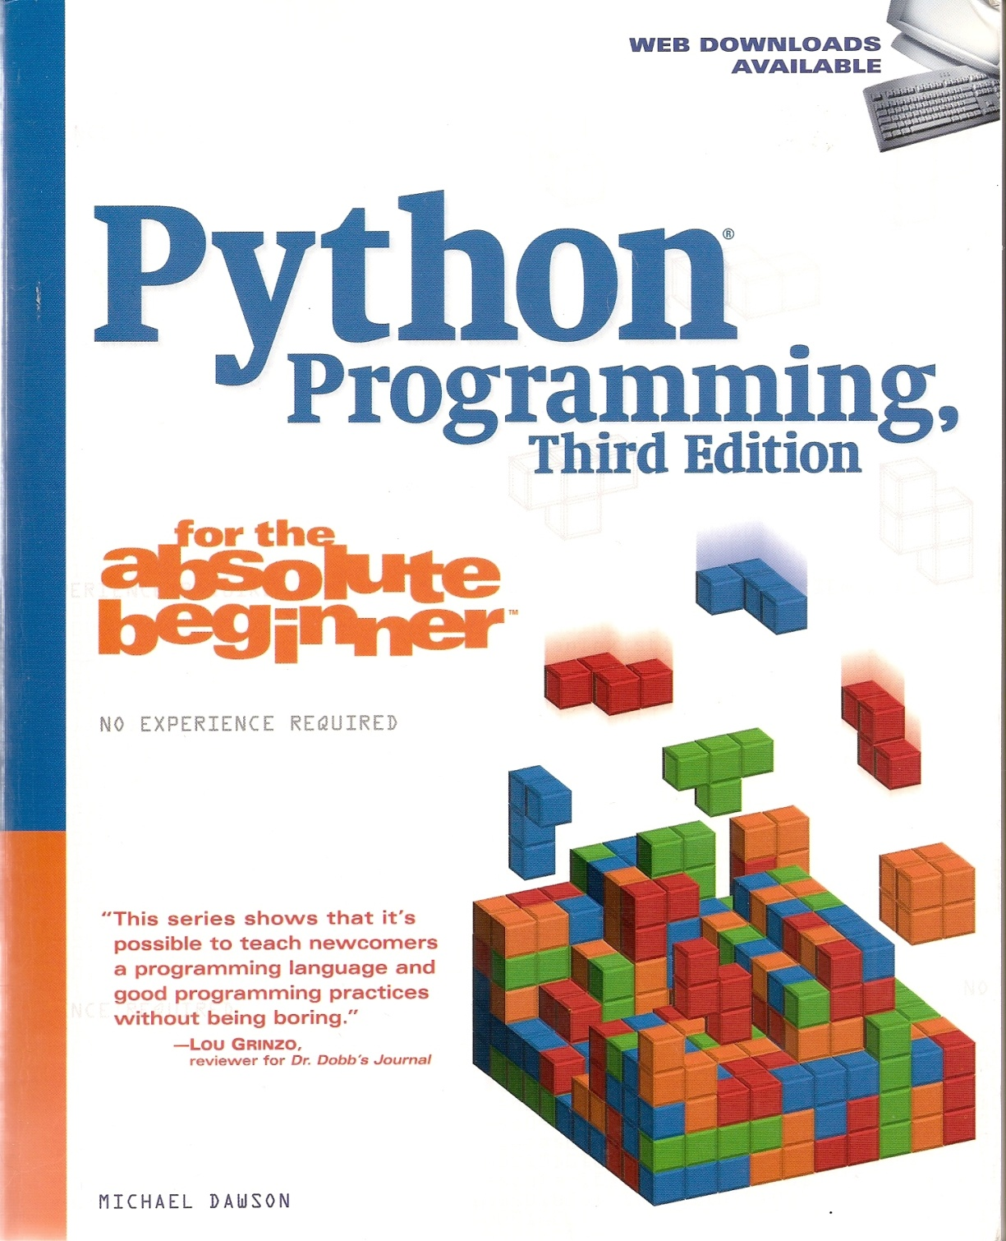

Slide 42
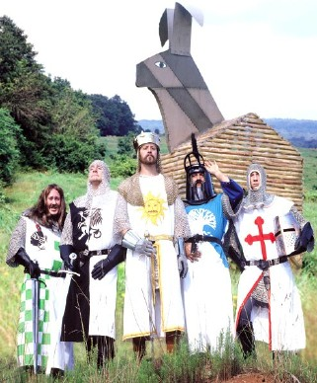
Monty Python’s Flying Circus
http://www.youtube.com/watch?v=npjOSLCR2hE
Notes:
http://64.78.12.184/subpage.asp?ID=588

Slide 43
Programming Won’t Look Like This
//MYJOB JOB (COMPRESS),
'VOLKER BANDKE',CLASS=P,COND=(0,NE)
//BACKUP EXEC PGM=IEBCOPY
//SYSPRINT DD SYSOUT=*
//SYSUT1 DD DISP=SHR,DSN=MY.IMPORTNT.PDS
//SYSUT2 DD DISP=(,CATLG),
DSN=MY.IMPORTNT.PDS.BACKUP,
// UNIT=3350,VOL=SER=DISK01,
// DCB=MY.IMPORTNT.PDS,
SPACE=(CYL,(10,10,20))
//COMPRESS EXEC PGM=IEBCOPY
//SYSPRINT DD SYSOUT=*
//MYPDS DD DISP=OLD,DSN=*.BACKUP.SYSUT1
//SYSIN DD *
COPY INDD=MYPDS,OUTDD=MYPDS
//DELETE2 EXEC PGM=IEFBR14
//BACKPDS DD DISP=(OLD,DELETE,DELETE),
DSN=MY.IMPORTNT.PDS.BACKUP

Slide 44
It Will Look Like This
def mystery(numbers):
sum = 0
for num in numbers:
sum = sum + num
return(sum//len(numbers))

Slide 45
Or This
def chess():
while game_on:
internal_board = scan(board)
move = choose(internal_board)
play(move, board)

Slide 46
Class Information
Class website:
http://www.cs.utexas.edu/~ear/cs302/

Slide 47
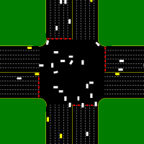
What Do You Trust?
Autonomous intersection management

Slide 48
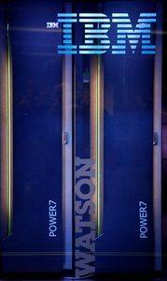
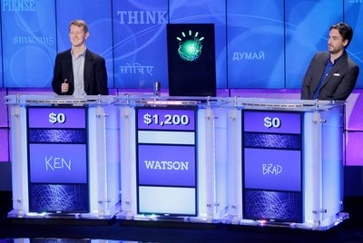
Watson
Intro : http://www.youtube.com/watch?v=FC3IryWr4c8
Another good intro with examples: http://www.youtube.com/watch?v=gKqfUPcaiM0
Day one: http://www.youtube.com/watch?v=qpKoIfTukrA
The airport question: www.youtube.com/watch?v=mwkoabTl3vM&feature=relmfu
How does Watson win: http://www.youtube.com/watch?v=d_yXV22O6n4
Notes:
Show the first one now. The others later in AI.

Slide 49
Dr. Watson
A machine like that is like 500,000 of me sitting at Google and Pubmed.
http://www.wired.com/wiredscience/2012/10/watson-for-medicine/
Notes:
Jeopardy may seem trivial as a measure of “humanness”. But what about medical diagnosis?

