Slide 1
Python

Slide 2
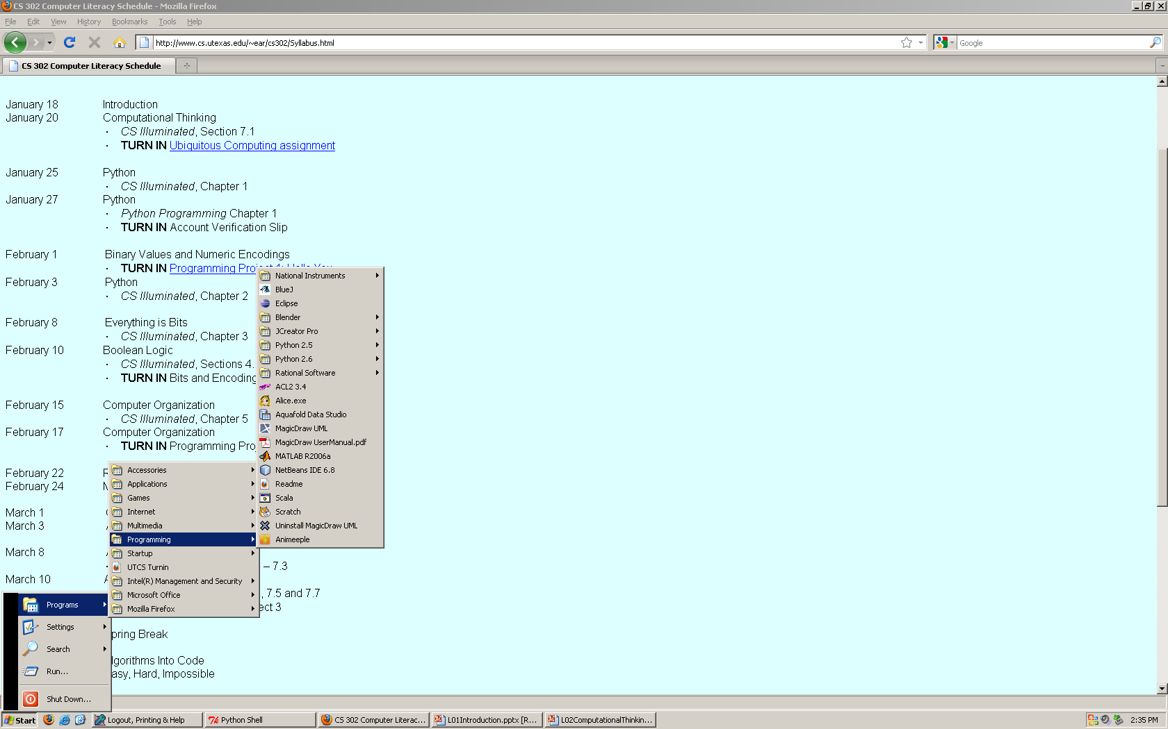
Choose Python 3.x

Slide 3
Main Program and Functions
def initialize():
# set board to opening configuration.
return(board)
def scan(board):
# do the image processing and return internal board.
def play(move, board):
# physically move the chosen piece.
def choose(intboard):
# choose a move and return it.
game_on = True # Main program
board = initialize()
while game_on:
internal_board = scan(board)
move = choose(internal_board)
play(move, board)

Slide 4
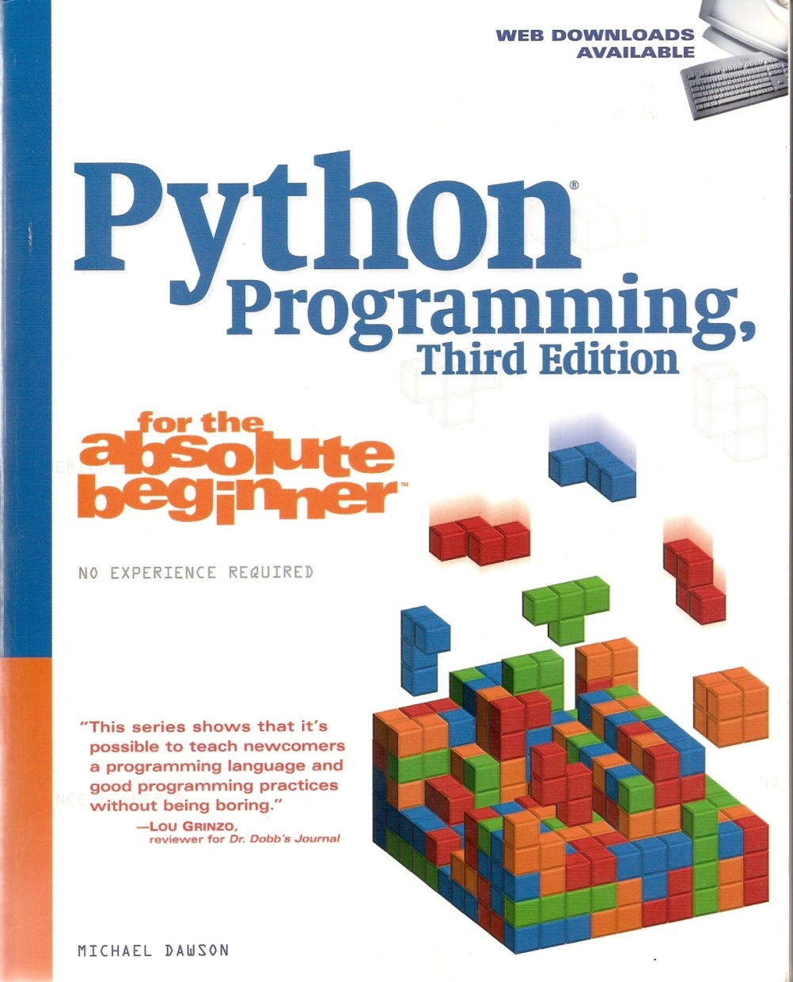
The Book’s Website
www.courseptr.com/downloads
Notes:
Copy the whole directory to some reasonable directory (like where you keep your python programs). Then you can open any module you want in IDLE.

Slide 5
Comparing Python to Java
def average(numbers):
sum = 0
for num in numbers:
sum = sum + num
return(sum/len(numbers))
public static double
avg(int numbers[])
{
double sum = 0;
for (double num : numbers)
{
sum = sum + num;
}
return sum/numbers.length;
}

Slide 6
Output of Vowels
F**r sc*r* *nd s*v*n ***rs *g* **r f*th*rs br**ght f*rth *n th*s c*nt*n*nt, * n*w n*t**n, c*nc**v*d *n L*b*rt*, *nd d*d*c*t*d t* th* pr*p*s*t**n th*t *ll m*n *r* cr**t*d *q**l.

Slide 7

Output of Vowels
F**r sc*r* *nd s*v*n ***rs *g* **r f*th*rs br**ght f*rth *n th*s c*nt*n*nt, * n*w n*t**n, c*nc**v*d *n L*b*rt*, *nd d*d*c*t*d t* th* pr*p*s*t**n th*t *ll m*n *r* cr**t*d *q**l.
Notes:
http://0.tqn.com/d/usparks/1/0/B/-/1/gettysburg6.jpg

Slide 8
People Are Flexible
The batterys must position so that the poles are to correspond to the like poles mark on the device. This will failure or damage device if not done so correctly.
Notes:
http://stoeptalk.wordpress.com/2009/05/02/japlish-and-chinglese-irresistible/

Slide 9
People Are Flexible
When passenger on foot heave in sight, tootle the horn. Trumpet him melodiously at first, but if he still obstacles your passage, then tootle him with vigor. (Brochure of a car rental firm in Tokyo - courtesy of Far Eastern Economic Review) .
Notes:
http://klarbooks.com/jet-program-teaching-english-japan-book/japlish-examples-funny-english.html

Slide 10
While Loops
def whilest():
while True:
st = input("$$$$$>") # then do something

