Slide 1
Binary Values
Chapter 2

Slide 2
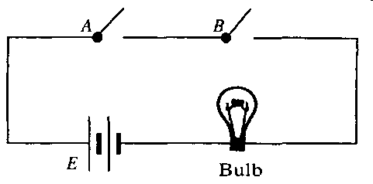
Why Binary?
Electrical devices are most reliable when they are built with 2 states that are hard to confuse:
• gate open / gate closed
Notes:
But we don’t physically open gates in electronic circuits. So:
http://upload.vipulg.com/Physics/483/Chapter%2035_files/Chapter%2035-11.png

Slide 3
Why Binary?
Electrical devices are most reliable when they are built with 2 states that are hard to confuse:
• gate open / gate closed
• full on / full off
• fully charged / fully discharged
• charged positively / charged negatively
• magnetized / nonmagnetized
• magnetized clockwise / magnetized ccw
These states are separated by a huge energy barrier.

Slide 4
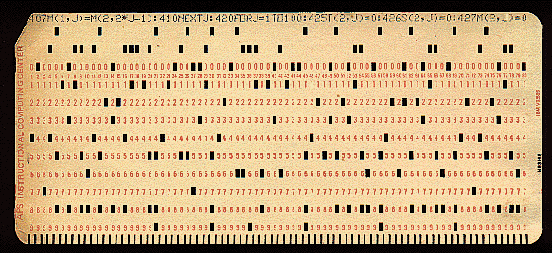
Punch Cards
hole
No hole
Notes:
http://www.tcpiplab.com/new/sites/default/files/pictures/ibm-punchcard.gif

Slide 5
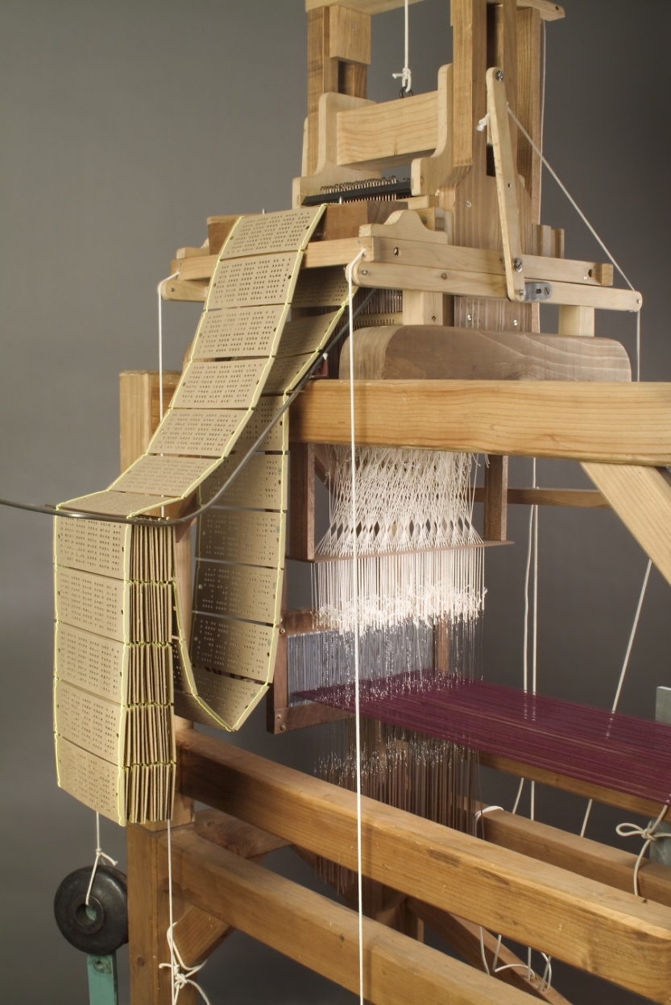

Jacquard Loom
Invented in 1801
Notes:
The point: binary was useful even before computers.
http://www.haintex.com/cgi/search-en.cgi?f=product_en+company_en_1_&t=product_en&w=product_en&cate2=Jacquard%20fabric%20series&n=3

Slide 6
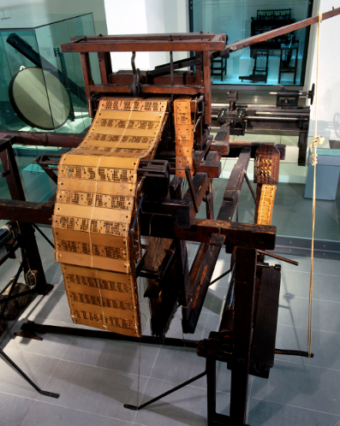
Jacquard Loom
Invented in 1801
Notes:
The point: binary was useful even before computers.
Picture on left from David Reed. A Balanced Introduction to Computer Science.
http://www.haintex.com/cgi/search-en.cgi?f=product_en+company_en_1_&t=product_en&w=product_en&cate2=Jacquard%20fabric%20series&n=3

Slide 7
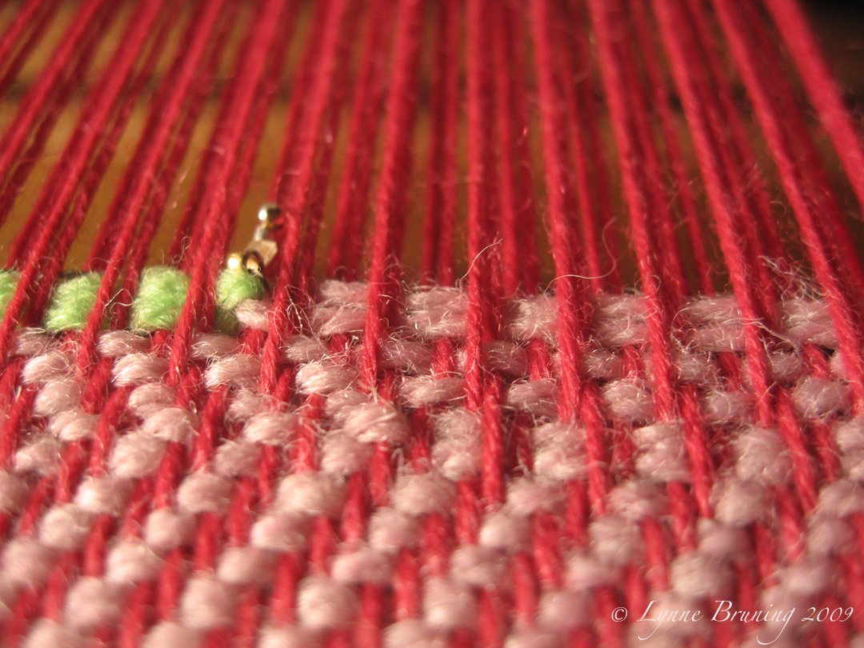
Why Weaving is Binary
Notes:
http://www.sparkfun.com/tutorial/news/Weaving.jpg

Slide 8
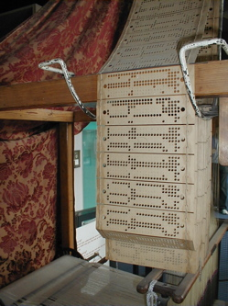
Holes Were Binary But Encodings Were Not
Notes:
Binary encodings could have produced cards with too many holes punched. They wouldn’t have been stable. Not a problem in internal representations.

Slide 9
Holes Were Binary But Encodings Were Not
11111111111101111111111111111110
Notes:
Binary encodings could have produced cards with too many holes punched. They wouldn’t have been stable. Not a problem in internal representations.

Slide 10
Everyday Binary Things
Examples:
Notes:
Light bulb
Door locked
Refrigerator door closed
A/C on
Dishes dirty or clean
Garage door open
Alarm system set

Slide 11
Everyday Binary Things
Examples:
Light bulb on/off
Door locked/unlocked
Garage door up/down
Refrigerator door open/closed
A/C on/off
Dishes dirty/clean
Alarm set/unset
Notes:
Light bulb
Door locked
Refrigerator door closed
A/C on
Dishes dirty or clean
Garage door open
Alarm system set

Slide 12
Binary (Boolean) Logic
If: customer’s account is at least five years old, and
customer has made no late payments this year
or
customer’s late payments have been forgiven, and
customer’s current credit score is at least 700
Then: Approve request for limit increase.
Notes:
Point here: Boolean logic has two values: T and F

Slide 13
Exponential Notation
4² = 4 * 4 =
4³ = 4 * 4 * 4 =
10³ =
10¹¹ = 100,000,000,000
Notes:
Picked 10^11 because it’s about the number of neurons in human brain

Slide 14
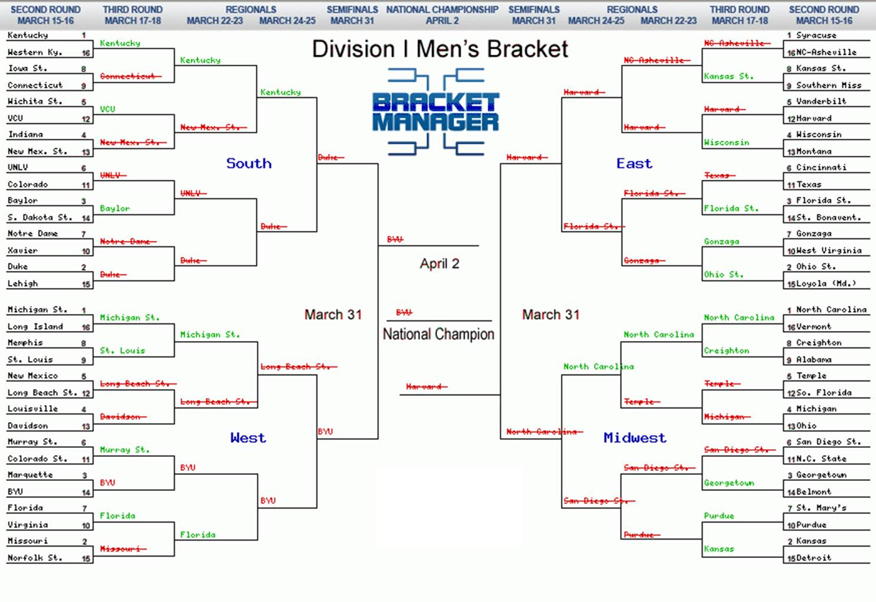
Powers of Two
Notes:
How many champions? How many teams in the championship? How many in the semi-finals? And so forth?
http://www.quickanded.com/2012/04/kentucky-wins-students-lose.html/march-madness-2

Slide 15
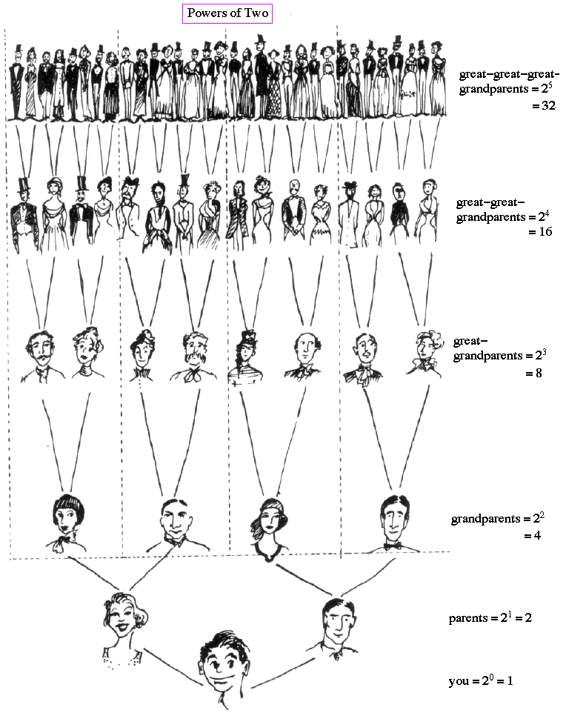
Powers of Two
Notes:
http://abyss.uoregon.edu/~js/images/powers_of_2.gif

Slide 16
Powers of Two
0 | 1
1 | 2
2 | 4
3 | 8
4 | 16
5 | 32
6 | 64
7 | 128
8 | 256
9 | 512
10 | 1024
11 | 2048
12 | 4096
13 | 8192
14 | 16384
Notes:
http://abyss.uoregon.edu/~js/images/powers_of_2.gif

Slide 17
Positional Notation
2473 = 2 * 1000 (10³) = 2000
+ 4 * 100 (10²) = 400
+ 7 * 10 (10¹) = 70
+ 3 * 1 (10⁰) = 3
2473
= 2 * 10³ + 4 * 10² + 7 * 10¹ + 3 * 10⁰
Base 10

Slide 18
Base 8 (Octal)
512
remainder
93 = 1 * 64 (8²) = 64 29
+ 3 * 8 (8¹) = 24 5
+ 5 * 1 (8⁰) = 5 0
93
93 = 135₈
Notes:
Added 512 so it’s easy to see that 64 is the largest power of 8 that we can use in this case.

Slide 19
Base 3 (Ternary)
remainder
95 = 1 * 81 (3⁴) = 81 14
+ 0 * 27 (3³) = 0 14
+ 1 * 9 (3²) = 9 5
+ 1 * 3 (3¹) = 3 2
+ 2 * 1 (10⁰) = 0 0
93
93 = 10112₃

Slide 20
Base 2 (Binary)
128
remainder
93 = 1 * 64 (2⁶) = 64 29
+ 0 * 32 (2⁵) = 0 29
+ 1 * 16 (2⁴) = 16 13
+ 1 * 8 (2³) = 8 5
+ 1 * 4 (2²) = 4 1
+ 0 * 2 (3¹) = 0 1
+ 1 * 1 (10⁰) = 1 0
93
93 = 1011101₂
Notes:
But this assumes that we knew to start with 64.

Slide 21
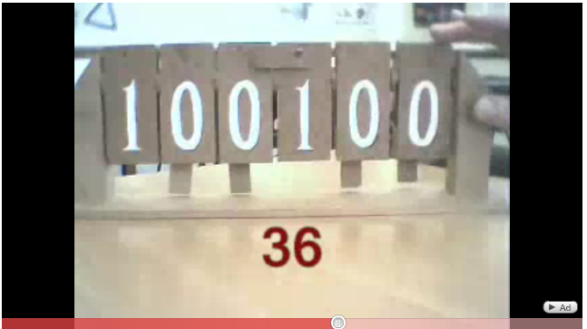
Counting in Binary
http://www.youtube.com/watch?v=zELAfmp3fXY

Slide 22
A Conversion Algorithm
def dec_to_bin(n):
answer = ""
while n != 0:
remainder = n % 2
n = n //2
answer = str(remainder) + answer
return(answer)
Notes:
Get into IDLE and load dec_to_bin and play with it.

Slide 23
Running the Tracing Algorithm
Try:
13
64
1234
345731

Slide 24
An Easier Way to Do it by Hand
1
2
4
8
16
32
64
128
256
512
1,024
2,048
4,096
8,192
16,384
Notes:
Show how to do it without having to divide. We can just subtract, given that we’ve got this table. This is the way I did it several slides ago.

Slide 25
The Powers of 2
1
2
4
8
16
32
64
128
256
512
1,024
2,048
4,096
8,192
16,384
Now you try the examples on the handout.

Slide 26
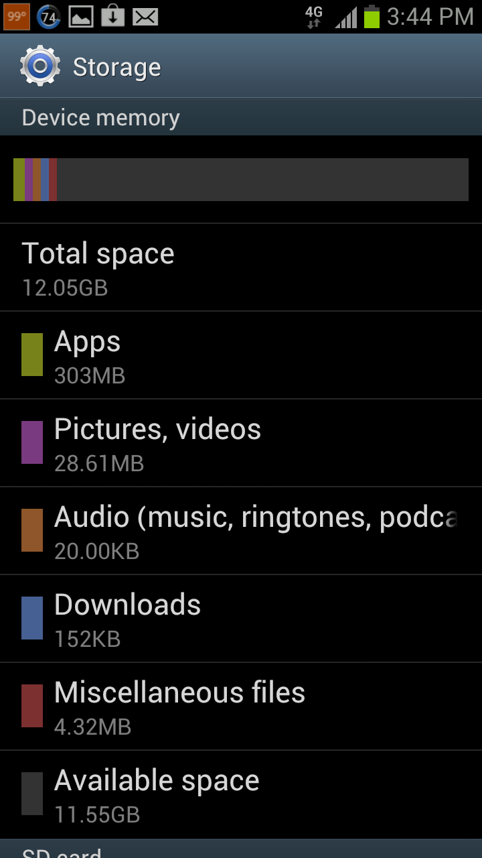
My Android Phone
Notes:
Ask students which category is bigger? Get them to sort of KB vs MB vs GB.

Slide 27
Naming the Quantities
10³ = 1000
2¹⁰ = 1024
See Dale and Lewis, page 124.
Notes:
10^15 = 1000^5.

Slide 28
How Many Bits Does It Take?
To encode 12 values:
To encode 52 values:
To encode 3 values:
Notes:
12: months of the year 52: weeks in a year 3: see next slide

Slide 29
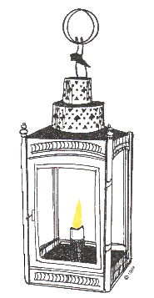
A Famous 3-Value Example
Notes:
Four values: 00 (no British) 01 and 10 (one if by land) 11 (two if by sea). There are four values, so we exploit the “extra” one for redundancy,
Important because a viewer wouldn’t be able to tell the difference between 10 and 01.
http://paulreverebiography.com/
Lantern: http://www.barefootsworld.net/commonsense2.html

Slide 30
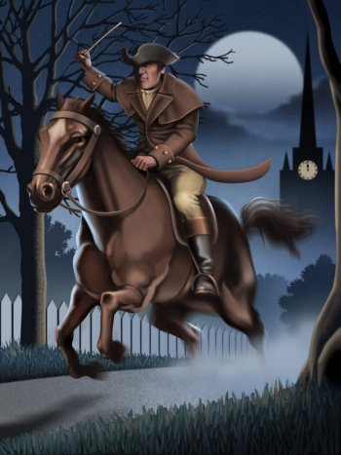
A Famous 3-Value Example
One, if by land, and two, if by sea; And I on the opposite shore will be,
Notes:
http://paulreverebiography.com/
Lantern: http://www.barefootsworld.net/commonsense2.html

Slide 31

Braille
Notes:
http://sam-carter.blogspot.com/2008_03_01_archive.html

Slide 32
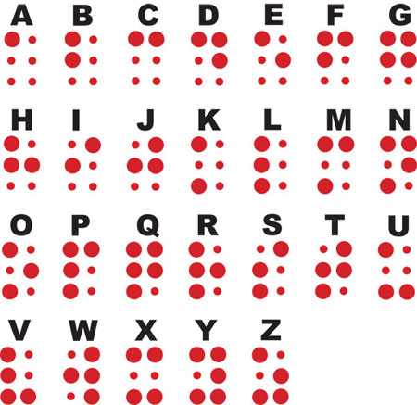
Braille
With six bits, how many symbols can be encoded?
Notes:
2^6 = 64 So Braille uses escape characters to indicate a larger alphabet.
http://louisbraillebiography.com/

Slide 33

Braille Escape Sequences
Indicates that the next symbol is capitalized.
Notes:
Discuss general importance of escape sequences in encodings.
http://louisbraillebiography.com/
Escape dot 6 from: http://en.wikipedia.org/wiki/Braille

Slide 34
Binary Strings Can Get Really Long
111111110011110110010110
Notes:
Long, but why do we care?

Slide 35

Binary Strings Can Get Really Long
111111110011110110010110
Notes:
Long, but why do we care?

Slide 36
Base 16 (Hexadecimal)
52 = 110100 already hard for us to read
Notes:
Problem: binary strings are long and annoying to deal with for people

Slide 37
Base 16 (Hexadecimal)
52 = 110100 already hard for us to read
= 11 0100
3 4
Notes:
Problem: binary strings are long and annoying to deal with for people
Flash to hex for colors also hex corresponds to four bits. So two hex symbols is one 8-bit byte.

Slide 38
Base 16 (Hexadecimal)
52 = 110100
Notes:
We can convert directly or go to binary first.

Slide 39
Base 16 (Hexadecimal)
52 = 110100
= 3 * 16 (16¹) = 48 4
+ 4 * 1 (16⁰) = 4 0
52
52 = 34₁₆
256
Notes:
We can convert directly or go to binary first.

Slide 40
Base 16 (Hexadecimal)
4096
2337 = 9 * 256 (16²) = 2304 33 + 2 * 16 (16¹) = 32 1
+ 1 * 1 (16⁰) = 1 0
2337
2337 = 921₁₆
2337 = 1001 0010 0001₂

Slide 41
Base 16 (Hexadecimal)
31 = 1 * 16 (16¹) = 16 15
+ ? * 1 (16⁰) = 15 0
31
31 = 3 ₁₆?
We need more digits:
0, 1, 2, 3, 4, 5, 6, 7, 8, 9,

Slide 42
Base 16 (Hexadecimal)
31 = 1 * 16 (16¹) = 16 15
+ ? * 1 (16⁰) = 15 0
31
31 = 3 ₁₆?
We need more digits:
0, 1, 2, 3, 4, 5, 6, 7, 8, 9, A, B, C, D, E, F
31 = 1F₁₆

Slide 43
Base 16 (Hexadecimal)
1111 1111 0011 1101 1001 0110
F F 3 D 9 6
Notes:
Problem: binary strings are long and annoying to deal with for people
Flash to hex for colors also hex corresponds to four bits. So two hex symbols is one 8-bit byte.

Slide 44
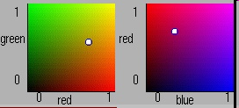
A Very Visible Use of Hex
http://lectureonline.cl.msu.edu/~mmp/applist/RGBColor/c.htm
http://easycalculation.com/color-coder.php
Notes:
Now use first one listed here.
I used to use this one: http://www.cbu.edu/~jvarrian/applets/color1/colors_g.htm
It is in Java. First control holds blue at 0. Second one hold green at 0. From: http://hydra.nac.uci.edu/~wiedeman/cspace/me/inforgb.html . But it doesn’t seem to exist any more.
Second applet is not in Java.
Now do the hex worksheet.

Slide 45
Binary, Octal, Hex
8 = 2³
So one octal digit corresponds to three binary ones.
Binary to octal: 1 011 111 95
1 3 7

Slide 46
Binary, Octal, Hex
8 = 2³
So one octal digit corresponds to three binary ones.
Binary to octal: 1 011 111 95
1 3 7
Octal to binary: 2 1 5
10 001 101

Slide 47
Binary, Octal, Hex
16 = 2⁴
So one hex digit corresponds to four binary ones.
Binary to hex: 101 1111 95
5 F
Notes:
Notice how much shorter the hex string is

Slide 48
Binary, Octal, Hex
16 = 2⁴
So one hex digit corresponds to four binary ones.
Binary to hex: 101 1111 95
5 F
Binary to hex: 101 1110 1111
5 E F
Notes:
Notice how much shorter the hex string is

Slide 49
Binary, Octal, Hex
16 = 2⁴
So one hex digit corresponds to four binary ones.
Binary to hex: 1011111 95
5 F
Binary to hex: 0101 1110 1111 1519
5 E F
byte
Notes:
Notice how much shorter the hex string is

Slide 50
Binary, Octal, Hex
16 = 2⁴
So one hex digit corresponds to four binary ones.
Hex to decimal: 5 F
0101 1111 then to decimal: 95

Slide 51
Binary Arithmetic
Addition:
11010
+ 1001

Slide 52
Binary Arithmetic
Multiplication:
11010
* 11

Slide 53
Binary Arithmetic
Multiplication by 2:
11010
* 10
Notes:
Note that multiplication is just a left shift.

Slide 54
Binary Arithmetic
Multiplication by 2:
11010
* 10
Division by 2:
11010
// 10
Notes:
Note that division is just a right shift.

Slide 55
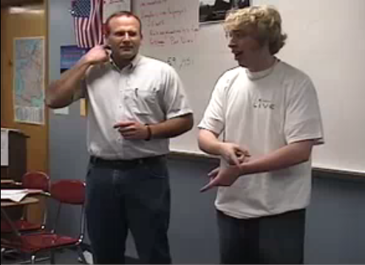
Computer Humor
http://www.youtube.com/watch?v=WGWmh1fK87A

