Slide 1
Boolean Logic
Chapter 4 (Sections 4.1 and 4.2)

Slide 2
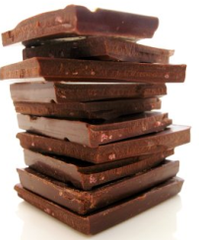
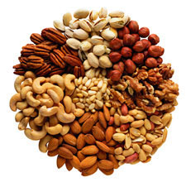
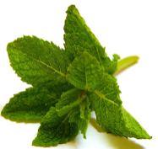
The Roots: Logic
1848 George Boole The Calculus of Logic
chocolate and ¬nuts and mint
Notes:
http://www.chewonthatblog.com/2009/04/20/the-cyclical-chocolate-conundrum/
http://cookalmostanything.blogspot.com/2006_10_01_archive.html
http://www.fredlyn.com/

Slide 3
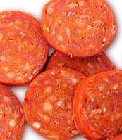
The Roots: Logic
cheese and (pepperoni or sausage)
Notes:
We mean inclusive or
http://www.free-extras.com/tags/1/cheese.htm
http://www.talamospizza1.com/menu1.html
http://www.rusticocooking.com/molise.htm

Slide 4
Boolean Searching
crane silk
Washington (pin,button,charm)
Notes:
Silk one: add –robe - shirt
Washington: add –redskins –rock –capitals –seattle –lions –wizards –state -nationals

Slide 5
Boolean Searching
Notes:
Try “Lynda Trader” then add –Linda Show Boolean expression for this.

Slide 6
Truth Tables
cheese and (pepperoni or sausage)
Ch | Pe | Sa | Pe ∨ Sa | Ch ∧ (Pe ∨ Sa)
True | True | True | True | True
True | True | False | True | True
True | False | True | True | True
True | False | False | False | False
False | True | True | True | False
False | True | False | True | False
False | False | True | True | False
False | False | False | False | False

Slide 7
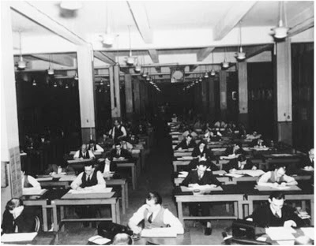
What’s the “Native Language” of Our Computers?
The first “computers” were actually people who crunched numbers.
The Mathematical Tables Project
NY in the 1940’s
http://gridtalk-project.blogspot.com/2010/09/when-computers-were-human.html
Top Secret Rosies:
http://www.cnn.com/2011/TECH/innovation/02/08/women.rosies.math/index.html?hpt=C2

Slide 8
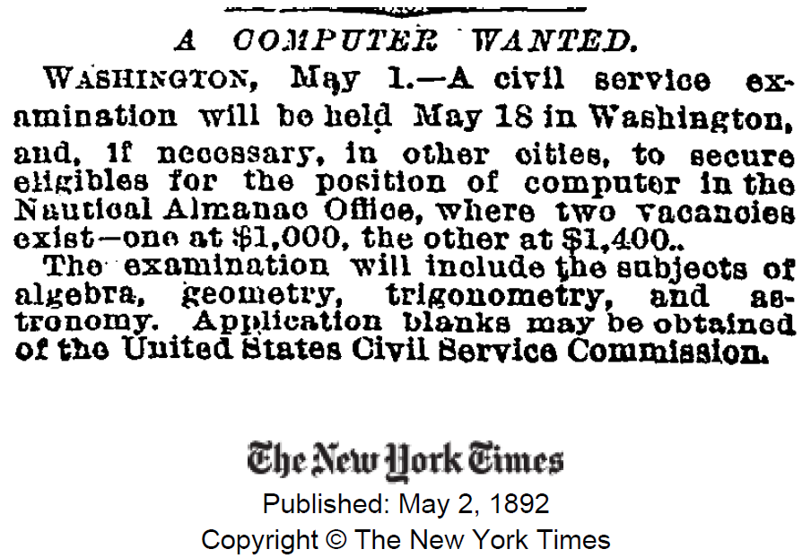
Would You Like the Job?
Notes:
http://query.nytimes.com/mem/archive-free/pdf?res=9F07E0D81438E233A25751C0A9639C94639ED7CF

Slide 9
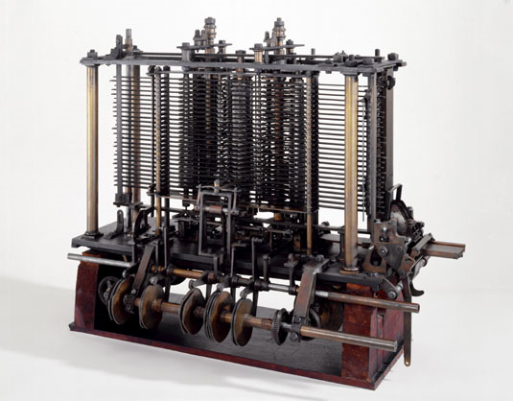
Babbage’s Analytical Engine
In 1833 Charles Babbage (1791-1871) conceived a plan for a general purpose calculating machine. It was designed to contain a store, a mill, capable of performing the four operations of arithmetic, an input/output system which used punched cards, and a printer to display the results. The engine would have been steam-driven and programmed by the punched cards. It was designed in great detail on paper but it was never completed. This is a portion of the mill with a printing mechanism.
Notes:
http://www.sciencemuseum.org.uk/images/I030/10297676.aspx
http://www-03.ibm.com/ibm/history/exhibits/attic2/attic2_182.html

Slide 10
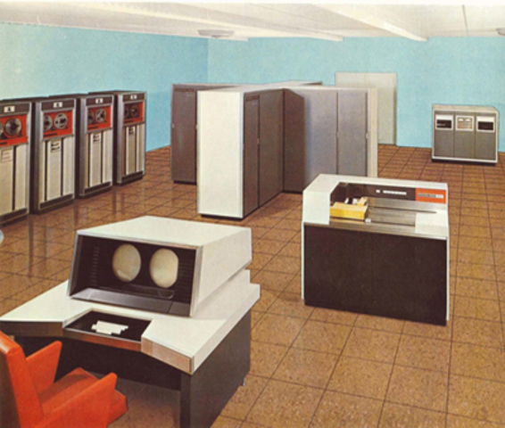
What’s the “Native Language” of Our Computers?
CDC 6600 c. 1980
Notes:
Tell the story of the Faculty Computer Committee: Computers are for crunching numbers for physicists. None of this text stuff. This machine couldn’t even represent upper and lower case characters because it used a 6-bit character code. Okay with them.
http://pufal.net/Histoire-Informatique/Ordinateurs%20Institutionels/index.html

Slide 11
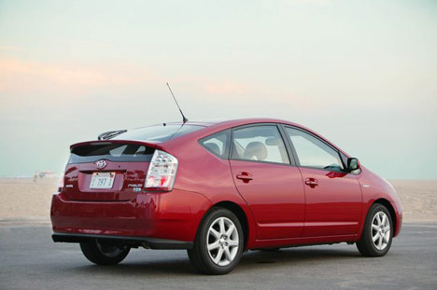
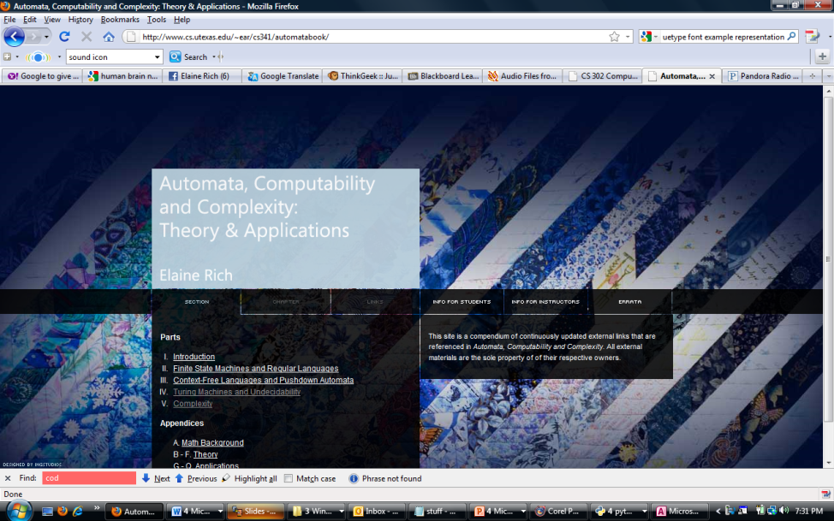
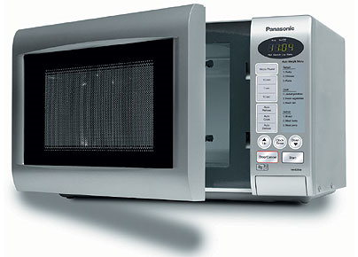
Computing Today
Notes:
Computing today is much more than solving physics problems. But is it true that numbers are at the bottom of everything else? Answer no. Bits are. It’s all about Boolean logic.
Microwave: http://aavaas.com/2007/10/25/microwave-oven-introduction/
Prius: http://www.treehugger.com/files/2008/05/toyota-prius-hybrid-car-1-million-sold.php
Avatar: http://www.photoshopstar.com/graphics/creating-avatar-movie-wallpaper/

Slide 12
Computing Is About Boolean Logic
The rules of the logic tell us how to manipulate inputs and produce outputs.
We define the rules so that we get answers that are useful to us.

Slide 13
Boolean Operators
NOT
P | ¬
True
False

Slide 14
Boolean Operators
NOT
P | ¬
True | False
False | True

Slide 15
Boolean Operators
AND
P | Q | P ∧ Q
True | True
True | False
False | True
False | False

Slide 16
Boolean Operators
AND
P | Q | P ∧ Q
True | True | True
True | False | False
False | True | False
False | False | False

Slide 17
Boolean Operators
OR
P | Q | P ∨ Q
True | True
True | False
False | True
False | False

Slide 18
Boolean Operators
OR
P | Q | P ∨ Q
True | True | True
True | False | True
False | True | True
False | False | False

Slide 19
Boolean Operators
IMPLIES
P | Q | P → Q
True | True
True | False
False | True
False | False

Slide 20
Boolean Operators
IMPLIES
P | Q | P → Q
True | True | True
True | False | False
False | True | True
False | False | True

Slide 21
Boolean Operators
EQUIVALENCE
P | Q | P ↔ Q
True | True
True | False
False | True
False | False

Slide 22
Boolean Operators
EQUIVALENCE
P | Q | P ↔ Q
True | True | True
True | False | False
False | True | False
False | False | True

Slide 23
Boolean Logic
P | Q | ¬P | P ∨ Q | P ∧ Q | P → Q | P ↔ Q
True | True | False | True | True | True | True
True | False | False | True | False | False | False
False | True | True | True | False | True | False
False | False | True | False | False | True | True

Slide 24
Using Boolean Logic
P | Q | ¬P
True | True
True | False
False | True
False | False
¬P ∧ ((P ∨ Q)→ Q)

Slide 25
Using Boolean Logic
P | Q | ¬P | P ∨ Q
True | True | False
True | False | False
False | True | True
False | False | True
¬P ∧ ((P ∨ Q)→ Q)

Slide 26
Using Boolean Logic
P | Q | ¬P | P ∨ Q | P → Q
True | True | False | True
True | False | False | True
False | True | True | True
False | False | True | False
¬P ∧ ((P ∨ Q)→ Q)

Slide 27
Using Boolean Logic
P | Q | ¬P | P ∨ Q | A → B | (P ∨ Q)→ Q
True | True | False | True | True
True | False | False | True | False
False | True | True | True | True
False | False | True | False | True
¬P ∧ ((P ∨ Q)→ Q)

Slide 28
Using Boolean Logic
P | Q | ¬P | P ∨ Q | P → Q | (P ∨ Q)→ Q | ¬P ∧ ((P ∨ Q)→ Q)
True | True | False | True | True | True
True | False | False | True | False | False
False | True | True | True | True | True
False | False | True | False | True | True
¬P ∧ ((P ∨ Q)→ Q)

Slide 29
Using Boolean Logic
P | Q | ¬P | P ∨ Q | P → Q | (P ∨ Q)→ Q | ¬P ∧ ((P ∨ Q)→ Q)
True | True | False | True | True | True | False
True | False | False | True | False | False | False
False | True | True | True | True | True | True
False | False | True | False | True | True | True
¬P ∧ ((P ∨ Q)→ Q)

Slide 30
Another Example
E | H | N | S | E ∧ H |  | ((E ∧ H) ∨ N → S
True | True | True | True | True
True | True | True | True | True
True | False | True | True
True | False | True | True
True | True | True |  | True
True | True | True |  | True
True | False | True
True | False | True
•••
Notes:
Okay, so you’re thinking I couldn’t possibly care about a thing like this. But …..

Slide 31
Another Example
E | H | N | S | E ∧ H |  | ((E ∧ H) ∨ N → S
True | True | True | True | True
True | True | True | True | True
True | False | True | True
True | False | True | True
True | True | True |  | True
True | True | True |  | True
True | False | True
True | False | True
•••
((Exhausted ∧ HidingPlaceNearby) ∨ Nightime) → StopToSleep

Slide 32
Boolean Logic
P | Q | ¬P | P ∨ Q | P ∧ Q | P → Q | P ↔ Q
True | True | False | True | True | True | True
True | False | False | True | False | False | False
False | True | True | True | False | True | False
False | False | True | False | False | True | True
Let’s practice.

Slide 33
Booleans in Python
def chocolate():
password = input("Type your password: ")
while password != "chocolate":
password = input("Try again: ")
print("Got it!!")

Slide 34
Booleans in Python
def for_dummies():
password = input("Type your password: ")
tries = 0
while password != "chocolate" and tries < 5:
password = input("Try again: ")
tries +=1
if tries == 5:
print("Okay, you've tried hard enough")
else:
print("Got it!!")
Notes:
Load my file chocolate_password to try this.

Slide 35
Booleans in Python
def for_dummies1():
password = input("Type your password: ")
tries = 0
while not(password == "chocolate" or tries >= 5):
password = input("Try again: ")
tries +=1
if tries == 5:
print("Okay, you've tried hard enough")
else:
print("Got it!!")

Slide 36
Boolean Identities
This notation:
Multiply for AND
Add for OR
Notes:
This is from Dale and Lewis, so keep the notation.
Point out that it is simple to prove these. We just use truth tables. Prove the first De Morgan’s law.

Slide 37
Proving These Things
Prove the first of deMorgan’s laws:
¬(A ∧ B) ≡ ¬A ∨ ¬B
A | B | A ∧ B | ¬(A ∧ B)
True | True | True | False
True | False | False | True
False | True | False | True
False | False | False | True
A | B | ¬A | ¬B | ¬A ∨ ¬B
True | True | False | False | False
True | False | False | True | True
False | True | True | False | True
False | False | True | True | True
Notes:
Emphasize that the original tables are simply definitions. Everything else is rote.

Slide 38
Proving These Things
Prove the first of deMorgan’s laws:
¬(A ∧ B) ≡ ¬A ∨ ¬B
A | B | A ∧ B | ¬(A ∧ B)
True | True | True | False
True | False | False | True
False | True | False | True
False | False | False | True
A | B | ¬A | ¬B | ¬A ∨ ¬B
True | True | False | False | False
True | False | False | True | True
False | True | True | False | True
False | False | True | True | True
Notes:
Emphasize that the original tables are simply definitions. Everything else is rote.

Slide 39
Satisfiability
A Boolean formula is satisfiable if and only if there is some row of the truth table that is T.
P | Q | ¬P | P ∨ Q | P → Q | (P ∨ Q)→ Q | ¬P ∧ ((P ∨ Q)→ Q)
True | True | False | True | True | True | False
True | False | False | True | False | False | False
False | True | True | True | True | True | True
False | False | True | False | True | True | True
The job of a SAT solver is to determine satisfiability.

Slide 40
Using Boolean Expressions
(¬W ∧ C ∧¬D) ∨ (W ∧ A ∧ D)
Is this expression satisfiable?

Slide 41
Using Boolean Expressions
(¬Wounded ∧ CanRun ∧¬Daylight) ∨
(Wounded ∧ InAmbulance ∧ Daylight)
Is this expression satisfiable?

Slide 42
Binary Boolean Operators
P | Q |  | ∨ |  |  | → |  | ↔ | ∧
T | T | T | T | T | T | T | T | T | T | F | F | F | F | F | F | F | F
T | F | T | T | T | T | F | F | F | F | T | T | T | T | F | F | F | F
F | T | T | T | F | F | T | T | F | F | T | T | F | F | T | T | F | F
F | F | T | F | T | F | T | F | T | F | T | F | T | F | T | F | T | F
What about the other 12 columns?

Slide 43
Boolean Operators
Exclusive Or XOR
P | Q | P ⊕ Q
True | True
True | False
False | True
False | False
Chips OR Fries

Slide 44
Boolean Operators
Exclusive Or XOR
P | Q | P ⊕ Q
True | True | False
True | False | True
False | True | True
False | False | False
Chips OR Fries

Slide 45
Boolean Operators
Not And NAND
P | Q | ∧ | NAND
True | True | True
True | False | False
False | True | False
False | False | False

Slide 46
Boolean Operators
Not And NAND
P | Q | ∧ | NAND
True | True | True | False
True | False | False | True
False | True | False | True
False | False | False | True

Slide 47
Boolean Operators
Not Or NOR
P | Q | ∨ | NOR
True | True | True
True | False | True
False | True | True
False | False | False

Slide 48
Boolean Operators
Not Or NOR
P | Q | ∨ | NOR
True | True | True | False
True | False | True | False
False | True | True | False
False | False | False | True

Slide 49
Binary Boolean Operators
P | Q |  | ∨ |  |  | → |  | ↔ | ∧ | NAND | ⊕ |  |  |  |  | NOR
T | T | T | T | T | T | T | T | T | T | F | F | F | F | F | F | F | F
T | F | T | T | T | T | F | F | F | F | T | T | T | T | F | F | F | F
F | T | T | T | F | F | T | T | F | F | T | T | F | F | T | T | F | F
F | F | T | F | T | F | T | F | T | F | T | F | T | F | T | F | T | F
Notes:
The others aren’t very useful.

Slide 50
Boolean Circuits
NOT

Slide 51
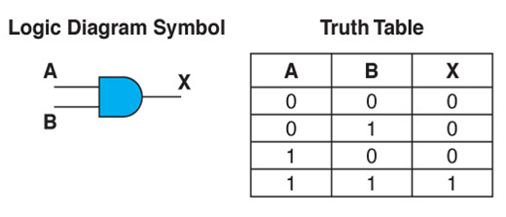
Boolean Circuits
AND

Slide 52
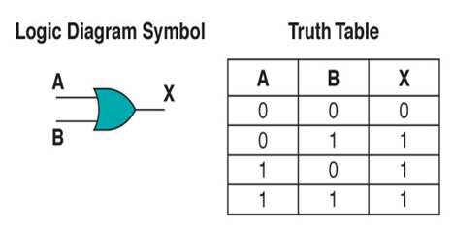
Boolean Circuits
OR

Slide 53
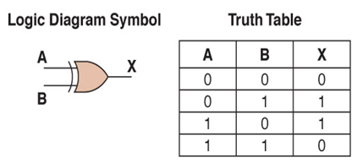
Boolean Circuits
XOR

Slide 54
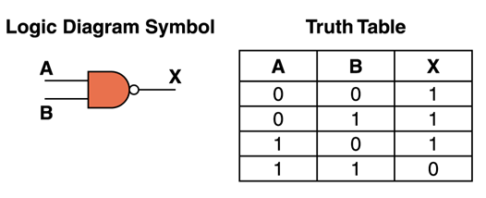
Boolean Circuits
NAND
Notes:
Can be made from a single transistor and is complete.

Slide 55
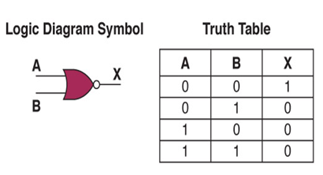
Boolean Circuits
NOR

Slide 56
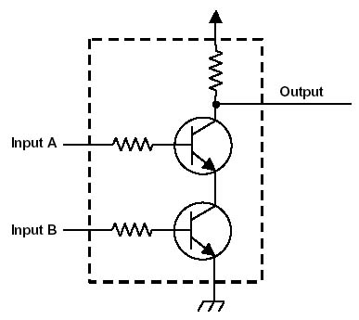
Why NAND and NOR?
NAND
Let’s try them: http://www.spsu.edu/cs/faculty/bbrown/web_lectures/transistors/
Notes:
Can implement with one transistor. Logically complete.
NAND: http://cpuville.com/logic_gates.htm
For NOR, connect the two inputs in parallel rather than in sequence.

Slide 57
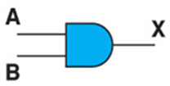
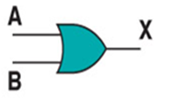
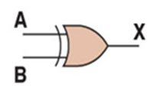
Boolean Gates
Not
And
Or
XOR
NAND
NOR

Slide 58
Circuits That Compute Building an Adder
0 0 1 1
+ 0 + 1 + 0 + 1
0 1 1 1 0
A half adder:
Notes:
The sum is just XOR. The carry is AND. A half adder because it doesn’t take a carry as input.

Slide 59
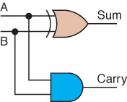
Circuits That Compute Building an Adder
0 0 1 1
+ 0 + 1 + 0 + 1
0 1 1 1 0
A half adder:
Notes:
The sum is just XOR. The carry is AND. A half adder because it doesn’t take a carry as input.

Slide 60
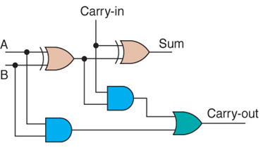
Circuits That Compute Building an Adder
0 0 1 1
+ 0 + 1 + 0 + 1
0 1 1 1 0
A full adder:
Notes:
The sum is just XOR. The carry is AND.

Slide 61
Reasoning About Circuits (and Programs)
Circuit_{A} → Specification
Program_{B} → Specification

Slide 62
Satisfiability
Recall: A Boolean formula is satisfiable if and only if there is some row of the truth table that is T.
P | Q | ¬P | P ∨ Q | P → Q | (P ∨ Q)→ Q | ¬P ∧ ((P ∨ Q)→ Q)
True | True | False | True | True | True | False
True | False | False | True | False | False | False
False | True | True | True | True | True | True
False | False | True | False | True | True | True
The job of a SAT solver is to determine satisfiability.

Slide 63
Reasoning About Circuits (and Programs)
Circuit_{A} → Specification
Program_{B} → Specification
So we want to assure that:
¬(Circuit_{A} → Specification)
is not satisfiable.

Slide 64
Other Applications of SAT Solvers
Cryptography
Artificial Intelligence:
Plan_{c} → Problem solved
Is new fact₁ consistent with what we already know?

Slide 65
Other Applications of SAT Solvers
Is new fact₁ consistent with what we already know?
(T ∧¬ A) → L
H → T
D → T
U → ¬A
U ∧ H ∧ ¬L
Put another way, is the following formula satisfiable?
((T ∧¬ A) → L) ∧ (H → T) ∧ (D → T ) ∧ (U → ¬A ) ∧ (U ∧ H ∧ ¬L )

Slide 66
Other Applications of SAT Solvers
Is new fact₁ consistent with what we already know?
(T ∧¬ A) → L (Texan ∧¬ Aggie) → Longhorn
H → T Houston → Texan
D → T Dallas → Texan
U → ¬A UT → ¬Aggie
U ∧ H ∧ ¬L UT ∧ Houston ∧ ¬Longhorn
So what’s the problem? Write out the truth table and we are done.

Slide 67
How Big Are the Truth Tables?
P | Q | R
True | True | True
True | True | False
True | False | True
True | False | False
False | True | True
False | True | False
False | False | True
False | False | False

Slide 68
Back to the Longhorn Problem
(T ∧¬ A) → L
H → T
D → T
U → ¬A
U ∧ H ∧ ¬L
How many rows in the truth table for this?

Slide 69
The Longhorn Problem
T | A | L | H | D | U
True | True | True | True | True | True
True | True | True | True | True
True | False | True | True |  | True
True | False | True | True
True | True | True |  | True | True
True | True | True |  | True
True | False | True |  |  | True
True | False | True
•••
Notes:
How many rows in this table? 64

Slide 70
2^{n}

Slide 71
But Practical Solutions Exist
They routinely solve problems with hundreds of thousands of variables.

