Slide 1
Computer Organization
Section 4.3, Chapter 5
Sections 6.1 – 6.2 (Optional)

Slide 2
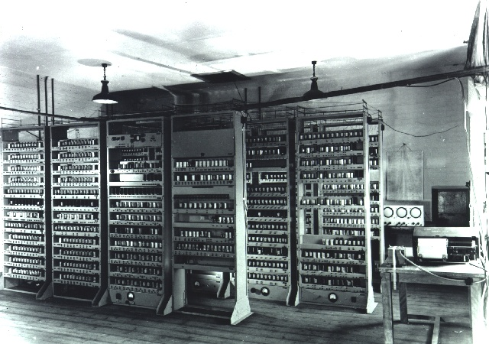
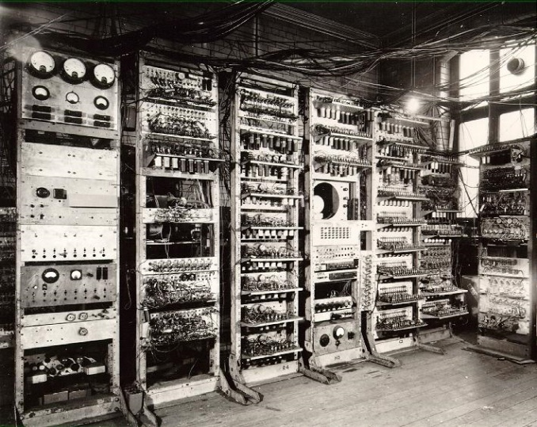
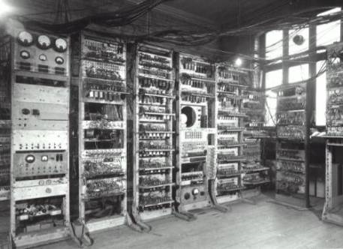
Preliminary Discussion of the Logical Design of an Electronic Computing Instrument
Cambridge EDSAC 1949
Manchester Mark 1, 1948
EDVAC, 1947
17,300 lbs
Arthur W. Burks / Herman H. Goldstine / John von Neumann, 1946
Notes:
Key point here: basic design hasn’t changed. Stored program idea.
Mark 1: http://www.computer50.org/kgill/mark1/mark1.jpg
EDSAC: http://www.cl.cam.ac.uk/relics/jpegs/edsac99.9.jpg
EDVAC: http://4.bp.blogspot.com/_Zx0SO3YqO2g/TCL9uBiHj4I/AAAAAAAAACE/aEu7yesIKV8/s1600/edvac.jpg Univ. of Penn. Designed by Eckert, Mauchley and von Neumann
Specs for EDVAC: http://ftp.arl.army.mil/~mike/comphist/61ordnance/app2.html

Slide 3
Then and Now
Vacuum tubes
Huge
Slow
Unreliable
Transistors
Tiny
Fast
Reliable

Slide 4
Then and Now
“Where a calculator on the ENIAC is equipped with 18,000 vacuum tubes and weighs 30 tons, computers in the future may have only 1,000 vacuum tubes and weigh only 1 ½ tons.”
Popular Mechanics, 1949
Notes:
Quoted in David Reed, A Balanced Introduction to Computer Science, p. 100

Slide 5
Then and Now
“What we didn’t realize then was that the integrated circuit would reduce the cost of electronic functions by a factor of a million to one; nothing had ever done that for anything before.”
Jack Kilby
Notes:
Kilby won a Nobel prize in physics in 2000 for his invention of the IC
Quoted in David Reed, A Balanced Introduction to Computer Science, p. 293

Slide 6
Then and Now
“If the automobile had followed the same development cycle as the computer, a Rolls Royce would today cost $100, get one million miles to the gallon, and explode once a year, killing everyone inside.”
Robert X. Cringely, InfoWorld
before 2005
Notes:
Quoted in David Reed, A Balanced Introduction to Computer Science, p. 100

Slide 7
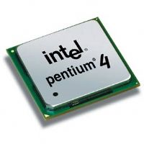
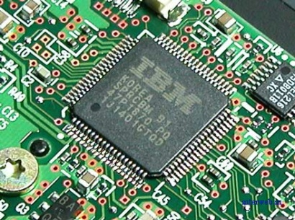
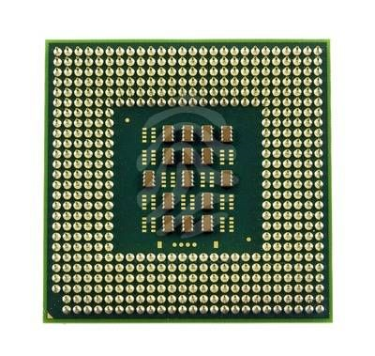
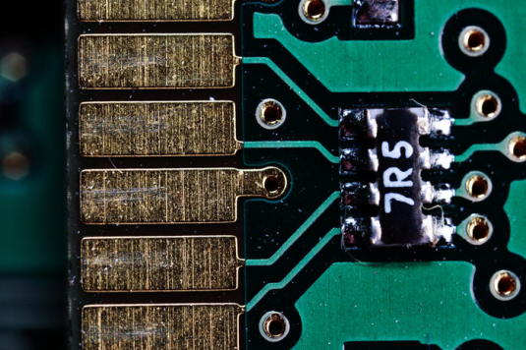
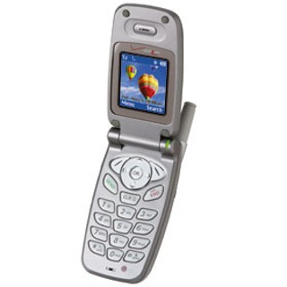
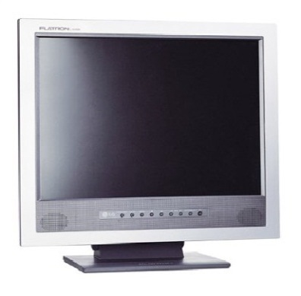
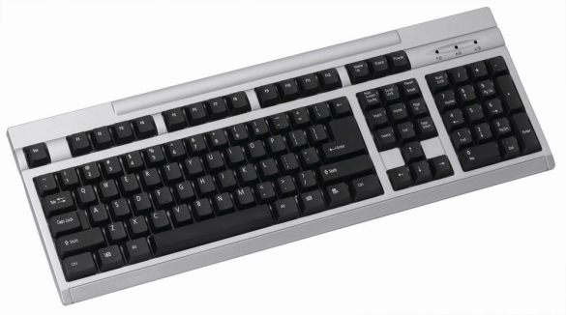
Exactly What IS a Computer?
Processor
Memory
I/O

Slide 8
Structure that Works
Complex systems have hierarchical structure.
We observe this in the physical world.
Artificial systems need it in order to “work”.

Slide 9
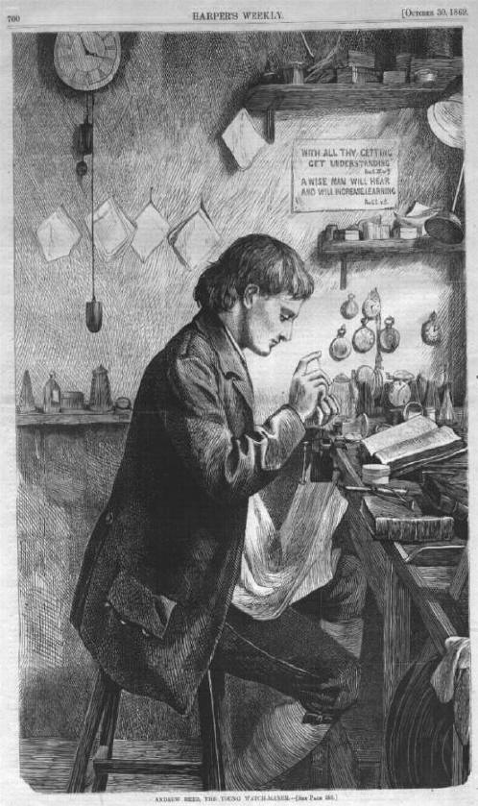
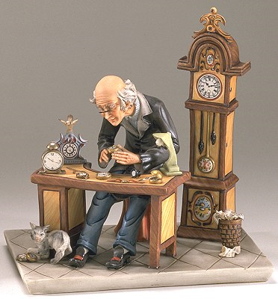
Tempus and Hora
1000 parts in a watch
Notes:
Hora – subassemblies of 10 parts each
http://23650.lifewaylink.com/templates/lif01aq/default.asp?id=23650
http://www.horologist.com/gallery_10.htm

Slide 10
Tempus and Hora
Tempus
Hora
p = probability of interruption
t = time to add one part
111 assemblies; 10 parts each
Prob(no interrupt) = (1 – p)¹⁰
Cost/interrupt = t * 5
1 assemply; 1000 parts
Prob(no interrupt) = (1 – p)¹⁰⁰⁰
Cost/interrupt = t * (1/p)
Notes:
Architecture of Complexity essay
Hora – subassemblies of 10 parts each
http://23650.lifewaylink.com/templates/lif01aq/default.asp?id=23650
http://www.horologist.com/gallery_10.htm

Slide 11
Tempus and Hora
Tempus
Hora
p = .01
t = time to add one part
111 assemblies; 10 parts each
Prob(no interrupt) = (.99)¹⁰ = .9
Cost/interrupt = t * 5
1 assemply; 1000 parts
Prob(no interrupt) = (.99)¹⁰⁰⁰ = 44 * 10⁻⁶
Cost/interrupt = t * 500
It will take Tempus 4,000 times as long to build one watch as it takes Hora.
Notes:
Architecture of Complexity essay
Hora – subassemblies of 10 parts each
http://23650.lifewaylink.com/templates/lif01aq/default.asp?id=23650
http://www.horologist.com/gallery_10.htm

Slide 12
The Main Components
Data Bus
Memory
(RAM)
Central
Processing
Unit (CPU)
Input/Output
I/O
Secondary Storage

Slide 13
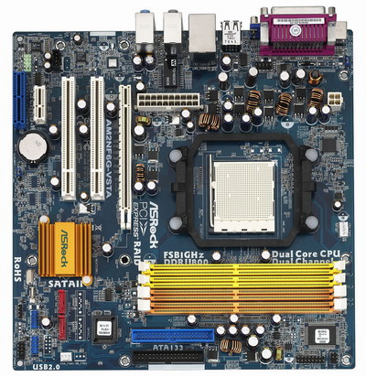
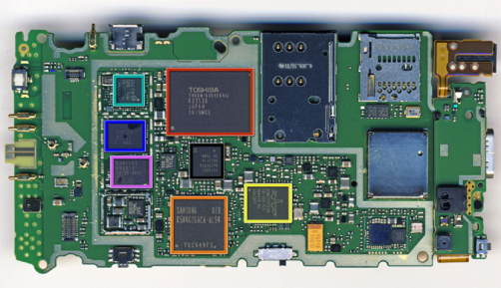
Motherboards: PC and Phone
Notes:
Phone motherboard: http://www.brightsideofnews.com/news/2010/10/22/analysis-windows-31-deja-vu--jumpin-jack-flash.aspx
PC motherboard: http://www.cyberindian.net/2006/10/01/abacus-launches-asrock-am2nf6g-vsta-motherboard/

Slide 14
The Main Components
Data Bus
Memory
(RAM)
Central
Processing
Unit (CPU)
Input/Output
I/O
Secondary Storage

Slide 15
Main Memory
0
22 6F B2 1E
24 E6 07 5C
12 76 84 70
33 68 FD 3C
4
56 09 40 77
89 4A B5 42
61 04 AA 5E
AB 43 71 1C
8
70 DF 32 2D
40 1F 69 C0
8A 7C 0F E9
90 9D 39 2E
C
4D 1F 60 9A
09 7D 10 4C
93 6F 81 B5
6A 9F 0A 1C
•••
Word addressing
F8B
96 1A 89 AC
71 52 0C F3
8B 81 B2 D1
65 04 A5 18
Notes:
Here’s the memory of a machine with a 32 bit word.

Slide 16
Main Memory
0
22 6F B2 1E
24 E6 07 5C
12 76 84 70
33 68 FD 3C
10
56 09 40 77
89 4A B5 42
61 04 AA 5E
AB 43 71 1C
20
70 DF 32 2D
40 1F 69 C0
8A 7C 0F E9
90 9D 39 2E
30
4D 1F 60 9A
09 7D 10 4C
93 6F 81 B5
6A 9F 0A 1C
•••
Byte addressing
3E2C
96 1A 89 AC
71 52 0C F3
8B 81 B2 D1
65 04 A5 18
Notes:
Here’s the memory of a machine with a 32 bit word but with byte addressabilty. Trade off – more flexibility. Addresses are longer.
Note that byte addresses are in hex

Slide 17
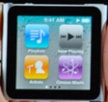
Address Spaces
Let’s say we have a 16GB memory.
That’s 2⁴ (16) * 2³⁰ (giga) = 2³⁴ bytes.
To specify that many addresses, we need 34 bits. Oops, more than a whole word.
Possible solutions:
Use 64 bit words.
Use hierarchical address definitions.

Slide 18
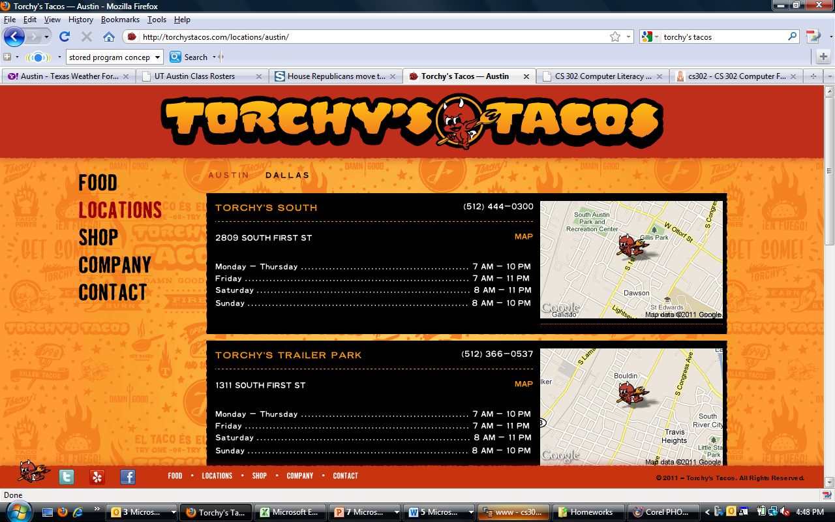
Hierarchical Addresses
Notes:
Note that the individual addresses don’t say Austin.

Slide 19
The Main Components
Data Bus
Memory
(RAM)
Central
Processing
Unit (CPU)
Input/Output
I/O
Secondary Storage

Slide 20
CPU
Central Processing Unit
Control Unit
Cache
Arithmetic/Logic Unit

Slide 21
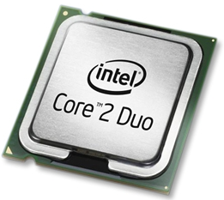
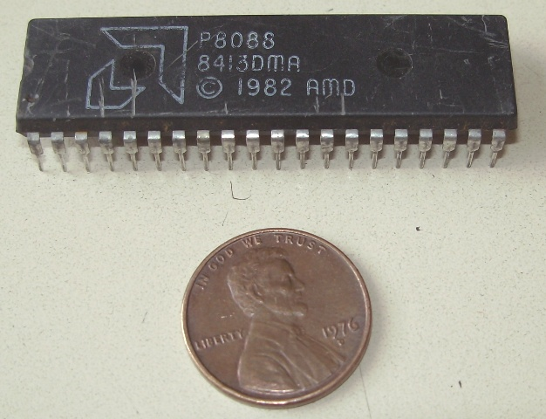
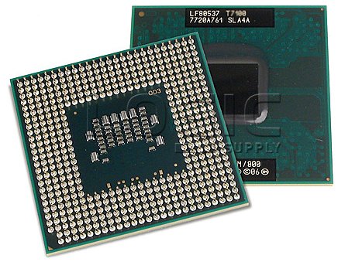
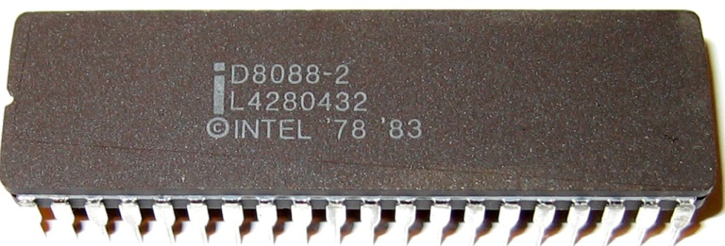
Processor Chips
Notes:
Core 2 Duo is 31.75mm square a penny is 20 mm So all these pictures are to the same scale.
Intel 8088: http://commons.wikimedia.org/wiki/File:I8088.jpg
AMD 8088: http://uk.ebid.net/for-sale/amd-intel-p8088-8088-5mhz-cpu-processor-chip-1982-8643047.htm
Core 2 Duo Processor:http://www.logicsupply.com/products/t7500_oem
http://www.techfuels.com/motherboards-memory/2805-intel-e6300-core-2-duo-processor.html

Slide 22
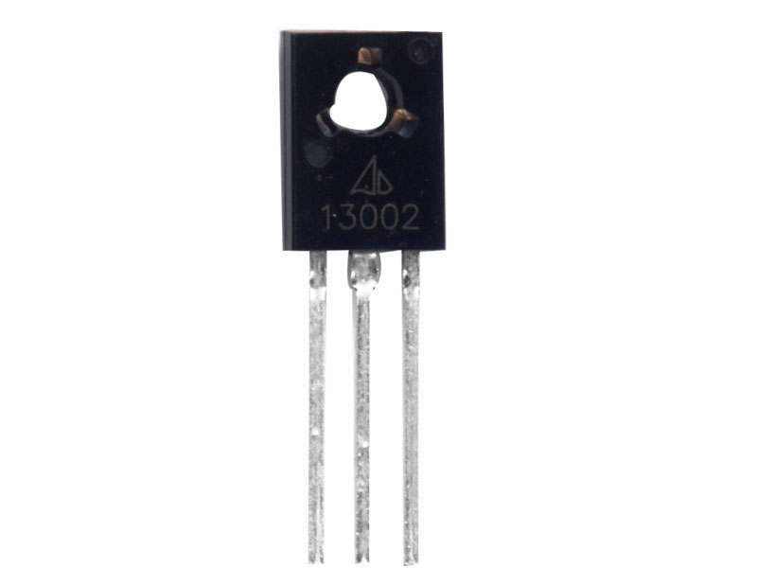
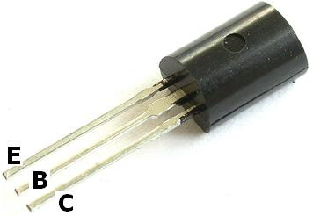
Transistors
The Intel® Core 2 Duo processor has 291 million transistors, more than 10,000 times as many transistors as the Intel 8088 CPU in the first IBM PC which had only 29,000 transistors.
Notes:
http://www.intel.com/museum/archives/pcturns25.htm

Slide 23
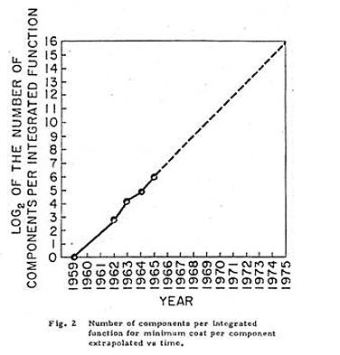
Moore’s Law
http://computer.howstuffworks.com/moores-law.htm
http://www.intel.com/pressroom/kits/events/moores_law_40th/index.htm
Notes:
Watch the video from howstuffworks. Go to the Intel site (where the image comes from ) and scroll down for posters.
Image: http://www.intel.com/pressroom/kits/events/moores_law_40th/index.htm

Slide 24
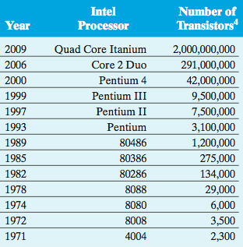
Transistors in Intel Processors
Notes:
From David Reed, A Balanced Introduction to Computer Science

Slide 25
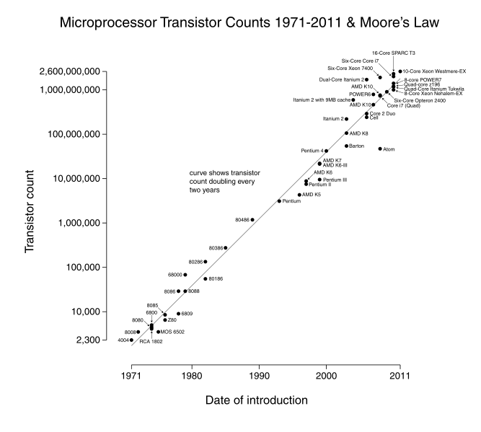
How It Has Happened
Notes:
http://en.wikipedia.org/wiki/File:Transistor_Count_and_Moore%27s_Law_-_2011.svg

Slide 26
CPU
Central Processing Unit
Control Unit
Cache
Arithmetic/Logic Unit

Slide 27
ALU
Registers
Accumulator
Program counter
Instruction register
Address register
Calculator

Slide 28
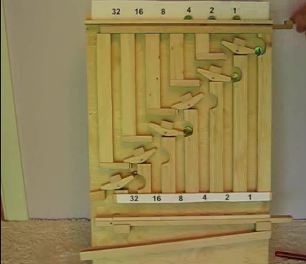
Binary Addition
http://www.youtube.com/watch?v=GcDshWmhF4A

Slide 29
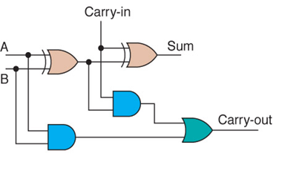
Implementing It in Silicon
XOR
XOR
AND
OR
AND
One Bit Binary Adder

Slide 30
Control – Or How to Program the Thing
Central Processing Unit
Control Unit
Cache
Arithmetic/Logic Unit

Slide 31
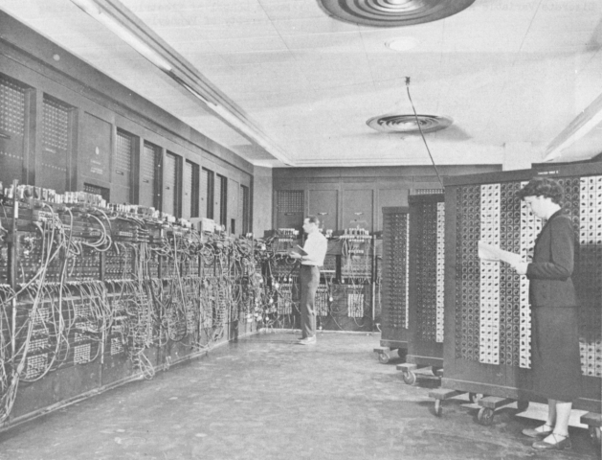
The Old Way
ENIAC 1945
Notes:
Electronic but not stored program. Had to rewire.

Slide 32
The Stored Program Concept
0
22 6F B2 1E
24 E6 07 5C
12 76 84 70
33 68 FD 3C
10
56 09 40 77
89 4A B5 42
61 04 AA 5E
AB 43 71 1C
20
70 DF 32 2D
40 1F 69 C0
8A 7C 0F E9
90 9D 39 2E
30
4D 1F 60 9A
09 7D 10 4C
93 6F 81 B5
6A 9F 0A 1C
Notes:
Here’s the memory of a machine with a 32 bit word. We can’t tell what this is. It could be a program. It could be data.

Slide 33
The Stored Program Concept
0
22 6F B2 1E
24 E6 07 5C
12 76 84 70
33 68 FD 3C
10
56 09 40 77
89 4A B5 42
61 04 AA 5E
AB 43 71 1C
20
70 DF 32 2D
40 1F 69 C0
8A 7C 0F E9
90 9D 39 2E
30
4D 1F 60 9A
09 7D 10 4C
93 6F 81 B5
6A 9F 0A 1C
Operation code: 40
Memory address: 1F69C0
Notes:
Suppose this word is part of a program.

Slide 34
Fetch – Increment - Execute
0
22 6F B2 1E
24 E6 07 5C
12 76 84 70
33 68 FD 3C
10
56 09 40 77
89 4A B5 42
61 04 AA 5E
AB 43 71 1C
20
70 DF 32 2D
40 1F 69 C0
8A 7C 0F E9
90 9D 39 2E
30
4D 1F 60 9A
09 7D 10 4C
93 6F 81 B5
6A 9F 0A 1C
Program counter | 00000024
Instruction register
Address register
Accumulator | 7F
Fetch next instruction
Increment program counter
Decode instruction
? Fetch additional data
Execute

Slide 35
Fetch – Increment - Execute
0
22 6F B2 1E
24 E6 07 5C
12 76 84 70
33 68 FD 3C
10
56 09 40 77
89 4A B5 42
61 04 AA 5E
AB 43 71 1C
20
70 DF 32 2D
40 1F 69 C0
8A 7C 0F E9
90 9D 39 2E
30
4D 1F 60 9A
09 7D 10 4C
93 6F 81 B5
6A 9F 0A 1C
Program counter | 00000028
Instruction register | 401F69C0
Address register
Accumulator | 7F
✓
Fetch next instruction
Increment program counter
Decode instruction
? Fetch additional data
Execute
✓

Slide 36
Fetch – Increment - Execute
0
22 6F B2 1E
24 E6 07 5C
12 76 84 70
33 68 FD 3C
10
56 09 40 77
89 4A B5 42
61 04 AA 5E
AB 43 71 1C
20
70 DF 32 2D
40 1F 69 C0
8A 7C 0F E9
90 9D 39 2E
30
4D 1F 60 9A
09 7D 10 4C
93 6F 81 B5
6A 9F 0A 1C
Program counter | 00000028
Instruction register | 401F69C0
Address register | 1F69C0
Accumulator | 7F
✓
Fetch next instruction
Increment program counter
Decode instruction
? Fetch additional data
Execute
✓
✓

Slide 37
Add
0
22 6F B2 1E
24 E6 07 5C
12 76 84 70
33 68 FD 3C
10
56 09 40 77
89 4A B5 42
61 04 AA 5E
AB 43 71 1C
20
70 DF 32 2D
40 1F 69 C0
8A 7C 0F E9
90 9D 39 2E
30
4D 1F 60 9A
09 7D 10 4C
93 6F 81 B5
6A 9F 0A 1C
Program counter | 00000028
Instruction register | 401F69C0
Address register | 1F69C0
Accumulator | 3EF
✓
Fetch next instruction
Increment program counter
Decode instruction
? Fetch additional data
Execute
✓
✓
✓
✓
Notes:
Suppose the instrution is ADD, then this is what happens.

Slide 38
Fetch – Increment - Execute
0
22 6F B2 1E
24 E6 07 5C
12 76 84 70
33 68 FD 3C
10
56 09 40 77
89 4A B5 42
61 04 AA 5E
AB 43 71 1C
20
70 DF 32 2D
35 1F 69 C0
8A 7C 0F E9
90 9D 39 2E
30
4D 1F 60 9A
09 7D 10 4C
93 6F 81 B5
6A 9F 0A 1C
Program counter | 00000028
Instruction register | 351F69C0
Address register | 1F69C0
Accumulator | 7F
✓
Fetch next instruction
Increment program counter
Decode instruction
? Fetch additional data
Execute
✓
✓
Notes:
So now the opcode is different. This time we jump.

Slide 39
Jump
0
22 6F B2 1E
24 E6 07 5C
12 76 84 70
33 68 FD 3C
10
56 09 40 77
89 4A B5 42
61 04 AA 5E
AB 43 71 1C
20
70 DF 32 2D
40 1F 69 C0
8A 7C 0F E9
90 9D 39 2E
30
4D 1F 60 9A
09 7D 10 4C
93 6F 81 B5
6A 9F 0A 1C
Program counter | 001F69C0
Instruction register | 401F69C0
Address register | 1F69C0
Accumulator | 7F
✓
Fetch next instruction
Increment program counter
Decode instruction
? Fetch additional data
Execute
✓
✓
✓
✓
Notes:
Do exercise on handout StoredProgram.

Slide 40
When Do Things Happen?
Fetch next instruction
Increment program counter
Decode instruction
? Fetch additional data
Execute
Notes:
When does each note start?
We need a conductor. The conductor can conduct slowly or quickly. The metronome is like a computer clock.
http://www.di-arezzo.co.uk/sheet+music/film+music+and+musicals/sheet+music-for-piano/CHEST00042.html
http://isaraobba.wordpress.com/

Slide 41
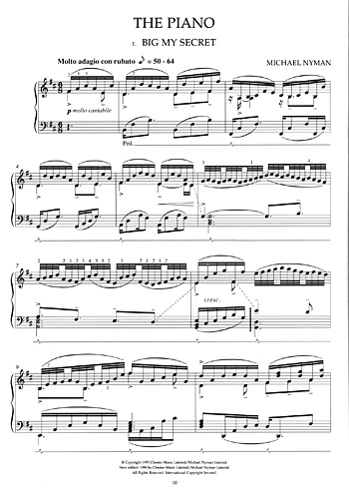
When Do Things Happen?
Fetch next instruction
Increment program counter
Decode instruction
? Fetch additional data
Execute
Notes:
When does each note start?
We need a conductor. The conductor can conduct slowly or quickly. The metronome is like a computer clock.
http://www.di-arezzo.co.uk/sheet+music/film+music+and+musicals/sheet+music-for-piano/CHEST00042.html
http://isaraobba.wordpress.com/

Slide 42
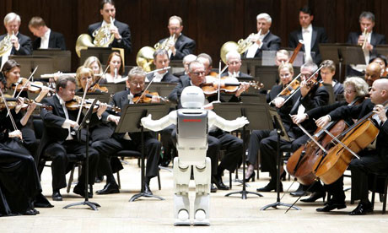
When Do Things Happen?
Fetch next instruction
Increment program counter
Decode instruction
? Fetch additional data
Execute
Notes:
When does each note start?
We need a conductor. The conductor can conduct slowly or quickly. The metronome is like a computer clock.
http://www.di-arezzo.co.uk/sheet+music/film+music+and+musicals/sheet+music-for-piano/CHEST00042.html
http://isaraobba.wordpress.com/

Slide 43
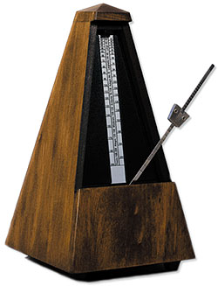
When Do Things Happen?
Fetch next instruction
Increment program counter
Decode instruction
? Fetch additional data
Execute
Notes:
When does each note start?
We need a conductor. The conductor can conduct slowly or quickly. The metronome is like a computer clock.
http://www.di-arezzo.co.uk/sheet+music/film+music+and+musicals/sheet+music-for-piano/CHEST00042.html
http://techinmusiced.wordpress.com/2010/06/16/nine-metronomes/

Slide 44
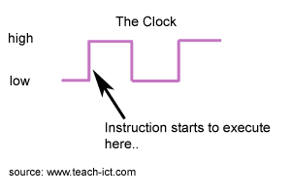
The Computer’s Clock
Let’s watch the clock on this machine:
from time import clock
def clock_it(n):
for i in range(n):
rand = clock()
print(rand)
Notes:
Go to IDLE and run this code or grab module clock.py

Slide 45
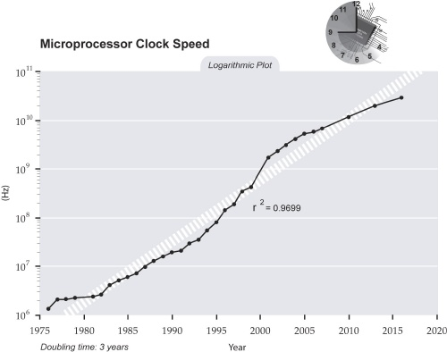
Clock Speed
Notes:
http://www.futuretimeline.net/21stcentury/2000-2009.htm

Slide 46
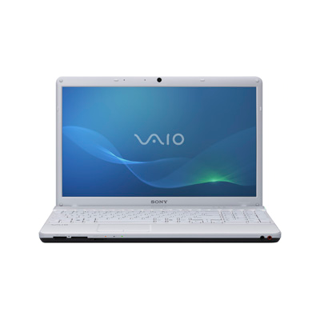
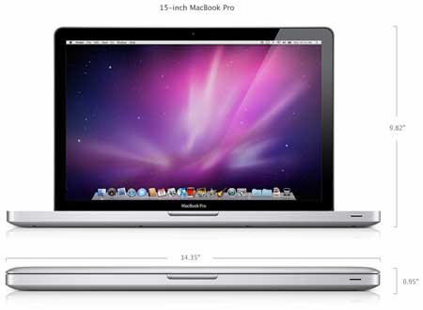
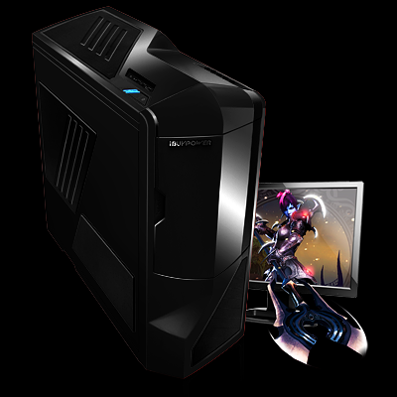
Clock Speeds
Apple Mac Book Pro
Intel® Core™ i3 - 370M processor (2.40GHz )
2011 Pallidin F
2.53 GHz
4Q 2012: Intel® Core™ i7 3970X Processor (6x 3.250GHz/15MB L3 Cache)
Intel® Core™ i7 970 Processor (6x 3.20GHz/12MB L3 Cache)
Notes:
Point out that slightly faster clock speeds do not necessarily mean faster computing. The Core i7 has 4 cores. Core i3 has 2 cores.
Gaming system at: http://www.ibuypower.com/Store/2011_Paladin_F

Slide 47
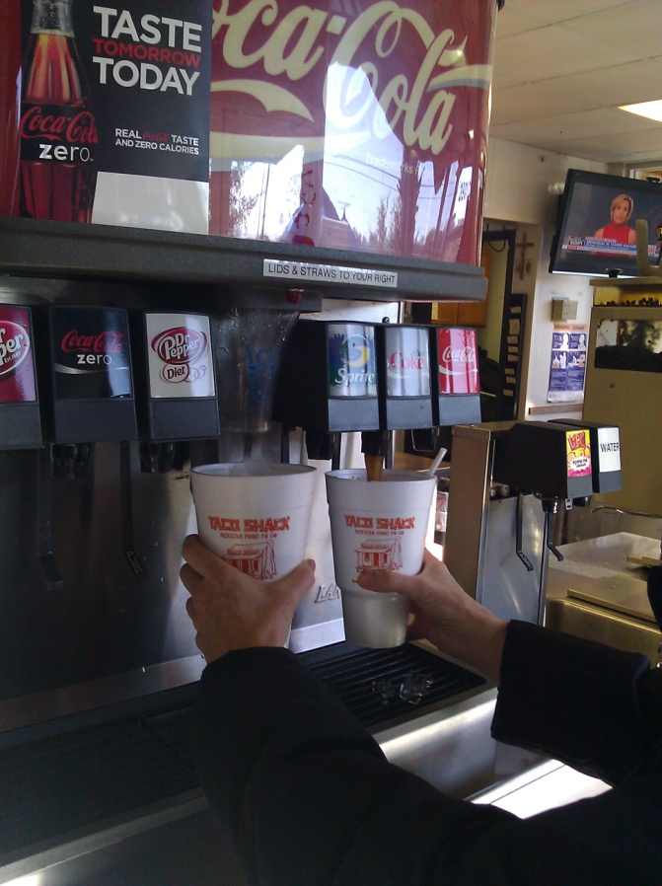
What’s Going on Here?
Parallelism
Notes:
It doesn’t take quite twice as much time to fill two cups as one because I’m exploiting parallelism. In particular, pipelining.

Slide 48
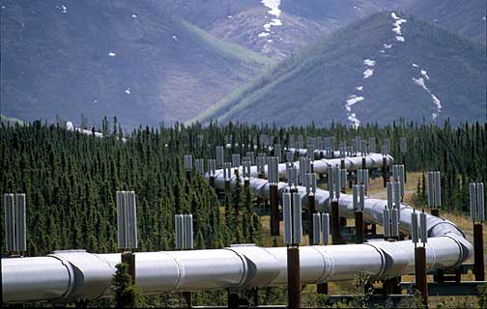
Pipelining
Fill two cups of Diet Coke
Build a housing development
Can you think of more?
Notes:
Housing development: Assume you have one framing team, one roofing team, one electrical team, etc.
http://www.solarstorms.org/Spipeline.html

Slide 49
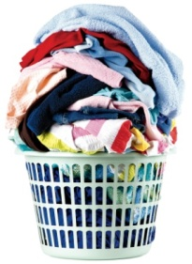
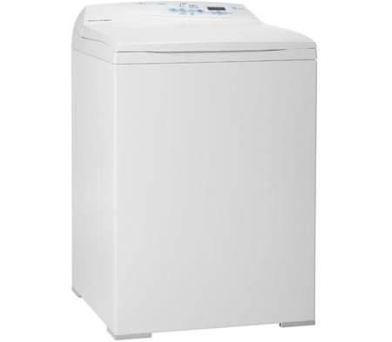
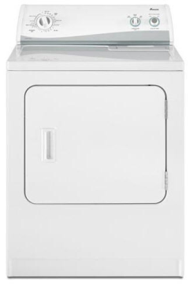
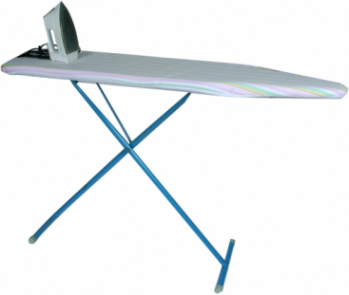
Pipelining
Fill two cups of Diet Coke
Build a housing development
Laundry
Notes:
Is there a problem? Yes. Ironing is the bottleneck.
http://www.solarstorms.org/Spipeline.html
http://www.gizmodiva.com/home_gadgets/ecofriendly_washing_machine_from_fisher_paykel.php
http://www.manataka.org/page1269.html
http://blog.tinyprints.com/Cards/funny/ - laundry basket

Slide 50
Pipelining
Bottlenecks
We can solve this problem by adding a new kind of parallelism.
Notes:
Is there a problem? Yes. Ironing is the bottleneck.
http://www.solarstorms.org/Spipeline.html
http://www.gizmodiva.com/home_gadgets/ecofriendly_washing_machine_from_fisher_paykel.php
http://www.manataka.org/page1269.html
http://blog.tinyprints.com/Cards/funny/ - laundry basket

Slide 51
Adding Them Up
9
76
21
94
19
80
67
72
28
Notes:
Get each student to write down a number on a piece of paper. Problem: how can we sum all the numbers. Lead them to:
Sequentially call them out and a single adder at the board does a running sum.
Get a second adder and divide the class in half. Then add the two subtotals.
Suggest getting two more adders and dividng the class into fourths.

Slide 52
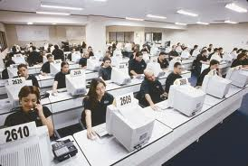
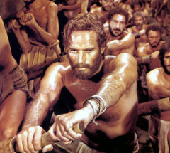
Single Instruction Stream Multiple Data Stream (SIMD)
Add numbers
Process insurance claims
Rowing
Notes:
http://www.google.com/images?hl=en&biw=1280&bih=617&gbv=2&tbs=isch%3A1&sa=1&q=office+clerks&aq=f&aqi=&aql=&oq=
http://themoviegourmet.wordpress.com/the-movie-gourmets-other-movie-lists-2/best-sports-movies/

Slide 53
SIMD to Funnel
UT admissions
Notes:
Parallel examination of applications to dump into piles: definitely yes, definitely no, maybe. But then must come together because there’s a shared resource: The number of spots.
http://www.learnersdictionary.com/search/funnel
Woman with papers: http://s3.images.com/huge.43.217183.JPG

Slide 54
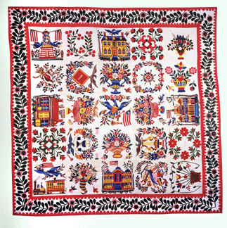
SIMD in Football
A quilt of blocks
Notes:
Idea: Must do one task at the beginning. Then farm out subtasks. Then must collect and compute in one place at the end.
http://www.insidesocal.com/tomhoffarth/archives/2007/12/the-call-on-mor.html
http://antiquesandthearts.com/2007-01-16__15-30-20.html&page=2

Slide 55
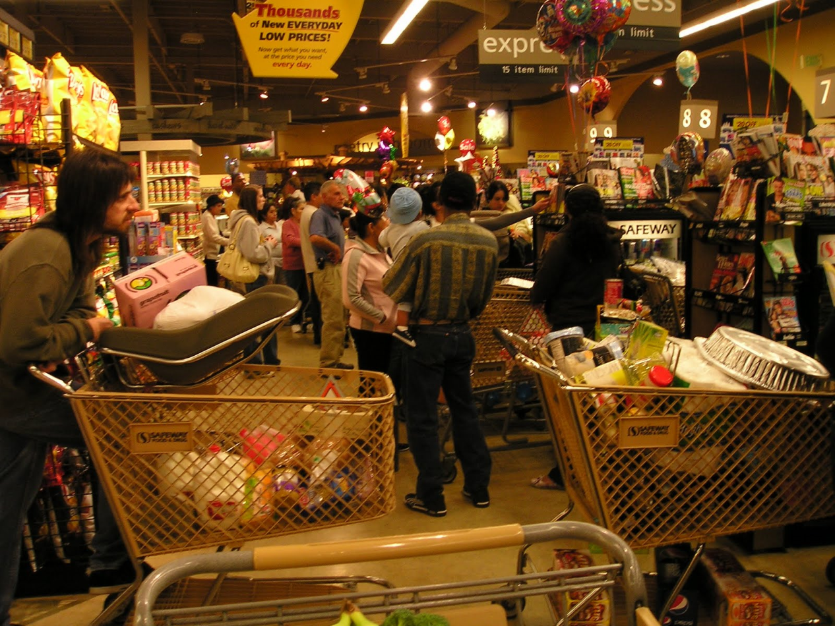
Increasing Parallelism in SIMD
Problem: Bottlenecks
Notes:
http://dogblog.finchester.org/2009/11/big-eating-equals-big-shopping.html

Slide 56
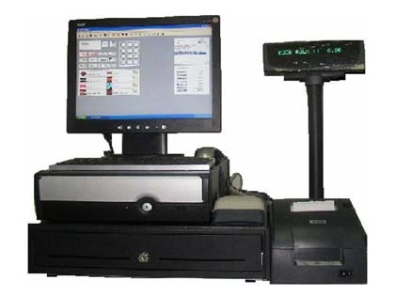
Eliminating Bottlenecks
Solution: Add more processors.
Benefit: Faster throughput at peak times.
Cost:
Notes:
But these expensive processors may be idle at nonpeak times. So, in general, if you double the number of processors, you won’t necessarily double your overall throughput.
http://cheapcashregister.org/cash-register-counter/

Slide 57
The Essential SIMD Property
Notes:
http://www.baltimorequiltlady.com/
No data dependencies.

Slide 58
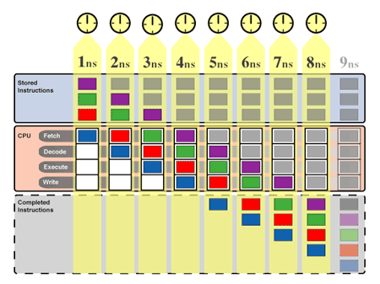
Back to CPUs
Pipelining in a single CPU:
Notes:
But note that if there’s a jump, we have clear the pipeline and start over.
http://arstechnica.com/old/content/2004/09/pipelining-1.ars/4

Slide 59
What About Multicore CPUs?
Rendering in gaming
Sorting your gmail
Multiple browser tabs
Weather modeling
Watson (http://www.youtube.com/watch?v=o6oS64Bpx0g )

Slide 60
The Main Components
Data Bus
Memory
(RAM)
Central
Processing
Unit (CPU)
Input/Output
I/O
Secondary Storage

Slide 61
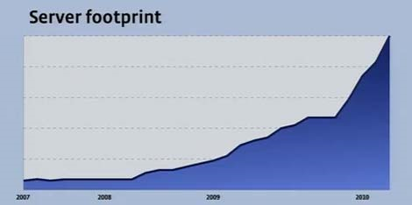
How Much Data Storage for Facebook?
People share more than 2.5 billion pieces of content on Facebook each day (August, 2012).
At least 60,000 in 6/2010
Notes:
http://www.datacenterknowledge.com/the-facebook-data-center-faq/

Slide 62
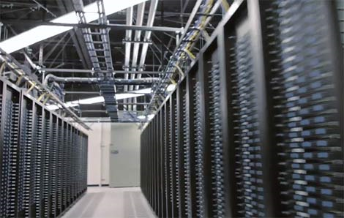
How Much Data Storage for Facebook?
People share more than 30 billion pieces of content on Facebook each month.
Notes:
http://www.datacenterknowledge.com/the-facebook-data-center-faq/

Slide 63
Data Centers Slurp Up Power
http://gizmodo.com/5880804/facebooks-oregon-data-center-uses-as-much-power-as-the-entire-county

Slide 64
Memory Hierarchy
Notes:
http://www.ts.avnet.com/uk/products_and_solutions/storage/hierarchy.html

Slide 65
The Beer Model
Glass
Notes:
Guy in chair: http://cache3.asset-cache.net/xc/JL3421-001.jpg?v=1&c=IWSAsset&k=2&d=2AC75F6FAA20674C17A77FA5322511745F9F20DE76EFD54A49207362A3F24453
Small cooler: http://www.bassboatalarm.com/images/cooler.gif
Refrigerator: http://www.countryliving.com/cm/countryliving/images/Fisher-Paykel-refrigerator-MKOVR0905-de.jpg
Grocery store beer aisle: http://www.mutineermagazine.com/img/blog/grocery_store_beer.jpg

Slide 66
The Beer Model
Glass
Cooler
Notes:
Guy in chair: http://cache3.asset-cache.net/xc/JL3421-001.jpg?v=1&c=IWSAsset&k=2&d=2AC75F6FAA20674C17A77FA5322511745F9F20DE76EFD54A49207362A3F24453
Small cooler: http://www.bassboatalarm.com/images/cooler.gif
Refrigerator: http://www.countryliving.com/cm/countryliving/images/Fisher-Paykel-refrigerator-MKOVR0905-de.jpg
Grocery store beer aisle: http://www.mutineermagazine.com/img/blog/grocery_store_beer.jpg

Slide 67
The Beer Model
Glass
Cooler
Refrigerator
Notes:
Guy in chair: http://cache3.asset-cache.net/xc/JL3421-001.jpg?v=1&c=IWSAsset&k=2&d=2AC75F6FAA20674C17A77FA5322511745F9F20DE76EFD54A49207362A3F24453
Small cooler: http://www.bassboatalarm.com/images/cooler.gif
Refrigerator: http://www.countryliving.com/cm/countryliving/images/Fisher-Paykel-refrigerator-MKOVR0905-de.jpg
Grocery store beer aisle: http://www.mutineermagazine.com/img/blog/grocery_store_beer.jpg

Slide 68
The Beer Model
Glass
Cooler
Refrigerator
Grocery Store
Notes:
Guy in chair: http://cache3.asset-cache.net/xc/JL3421-001.jpg?v=1&c=IWSAsset&k=2&d=2AC75F6FAA20674C17A77FA5322511745F9F20DE76EFD54A49207362A3F24453
Small cooler: http://www.bassboatalarm.com/images/cooler.gif
Refrigerator: http://www.countryliving.com/cm/countryliving/images/Fisher-Paykel-refrigerator-MKOVR0905-de.jpg
Grocery store beer aisle: http://www.mutineermagazine.com/img/blog/grocery_store_beer.jpg

Slide 69
Memory Hierarchy
Notes:
http://www.ts.avnet.com/uk/products_and_solutions/storage/hierarchy.html

Slide 70
What Happens When The Power Goes Off?
These loose data:
Boot from these?

Slide 71
Booting Up
IBM 701
1952
Thomas Watson, Sr. (seated)
Notes:
The 701 booted from punched cards. The first one loaded the second, and so forth.
Card reader: http://www-03.ibm.com/ibm/history/exhibits/701/701_1415bx11.html
T J Watson: http://www.cedmagic.com/history/ibm-701-watson.html
Card: http://www.landley.net/history/mirror/pre/punchedcards/collection/i-program.html

Slide 72
Booting Up
CDC 6600
1964
The first
“supercomputer”
Price: $6 – 10 million
Notes:
Deadstart panel: http://www.diycalculator.com/popup-m-hrrgcomp.shtml

Slide 73
Booting Up Today
These loose data:
Add another kind of memory:
fast, nonvolatile
Notes:
The chip on the left is the flash memory: http://en.wikipedia.org/wiki/Flash_memory

Slide 74
The Main Components
Data Bus
Memory
(RAM)
Central
Processing
Unit (CPU)
Input/Output
I/O
Secondary Storage
Notes:
Key is that there be a standard so parts can plug and play.
Speed of bus may be a limiting factor.

Slide 75
The Data Bus
Four bytes being transmitted in parallel on a 32 bit bus.
Suppose we had a 64 bit bus?
Or only an 8 bit one?
Notes:
http://webster.cs.ucr.edu/AoA/Windows/HTML/SystemOrganizationa2.html

Slide 76
The Data Bus
Notes:
http://zone.ni.com/devzone/cda/tut/p/id/6428

Slide 77
An Example of an (Evolving) Standard - USB
USB 1.0 - January 1996.
Data transfer rate: 1.5 Mbit/s.
USB 1.1 -September 1998.
Data transfer rate: 12 Mbit/s for higher-speed devices or 1.5 Mbit/s for low bandwidth devices such as joysticks.
USB 2.0 - April 2000.
Data transfer rate of 480 Mbit/s.
USB 3.0 - 12 November 2008.
Data transfer rate of 3200 Mbit/s (5 Gbit/s).
Notes:
Note that a competitor is Apples’s Firewire.
http://www.novopc.com/2008/10/usb/
Symbol: http://www.skuggen.com/2010/11/usb-is-the-mark-of-satan-claims-evangelical-cult/

Slide 78
System Configuration
ASUS K60I-RBBBR05 Notebook PC Refurbished
Smart Choice
• 16” high definition LED-backlit widescreen and equipped with reddot design award winning ergonomic chocolate keyboard
• ASUS Infusion gives you eye-catching style and scratch resistant protection
• Experience Windows® 7 Home Premium (64-bit) for fast performance, intuitive control, and increased battery life
Notes:
From a Frys ad 1/31/2011 for $449.99

Slide 79
System Configuration
ASUS K60I-RBBBR05 Notebook PC Refurbished
Specifications:
Operating System: Windows® 7 Home Premium 64-bit
Processor: Intel® Pentium Dual Core T4400 Mobile
Processor (2.2GHz, 1MB L2 Cache, 800MHz FSB)
Graphics: Intel® Graphics Media Accelerator 4500M Integrated Graphics
Memory: 4GB RAM (4GB Maximum)
Display: 16.0” HD LED-backlit (1366x768) Widescreen
Hard Drive: 500GB HDD Hard Drive
Optical Drive: SuperMulti DVDRW Drive
Audio: Built-in Azalia compliant audio chip
Camera: Integrated webcam & microphone
Card Slots: SD, MS, MMC w/ push/push type
Ports: 4 USB 2.0 Ports, 1 VGA Port, 1 Headphone-out (Stereo) jack,
1 Microphone-in jack, 1 Lan RJ45
Communications: 802.11b/g/n Wi-Fi, 10/100/1000 Mbps Fast Ethernet
Battery: 6-cell 2.2 AH K-Series, up to 3 hour and 31 minute battery life
Notes:
Optical drive means dvd

Slide 80
System Configuration
ASUS K60I-RBBBR05 Notebook PC Refurbished
Card Slots:
SD
MS
MMC w/ push/push type
Notes:
Optical drive means dvd

Slide 81
System Configuration
ASUS K60I-RBBBR05 Notebook PC Refurbished
Ports:
4 USB 2.0 Ports,
1 VGA Port,
1 Headphone-out (Stereo) jack,
1 Microphone-in jack, 1 Lan RJ45
Notes:
Optical drive means dvd

