Slide 1
Assemblers, Compilers, Operating Systems
Chapter 6 (Section 6.4 - Optional)
Chapter 9 (Section 9.2)
Chapter 10 (Section 10.1)
Chapter 11 (Sections 11.1, 11.2)

Slide 2
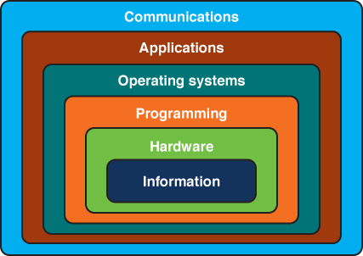
Layered Systems
Notes:
But it’s not just in things you think of as computers.

Slide 3
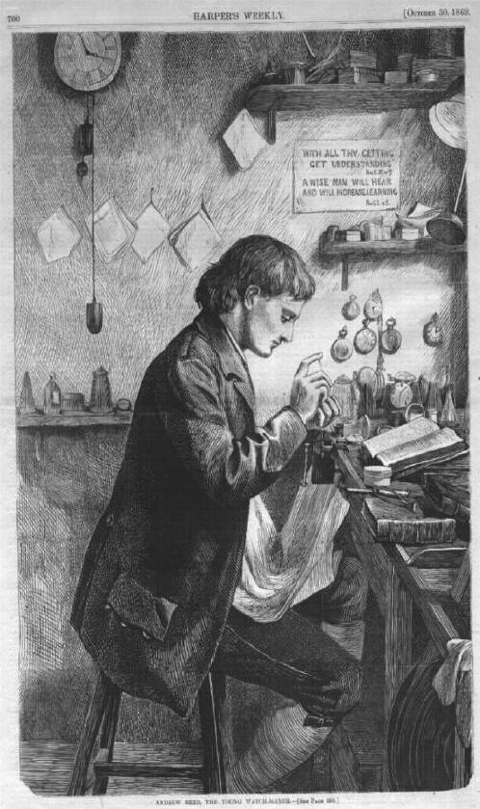
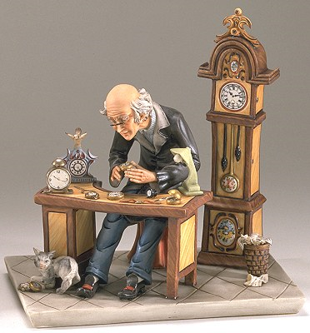
Tempus and Hora
1000 parts in a watch
Notes:
Recall this: We did it in architecture, but let’s remind ourselves here.
Hora – subassemblies of 10 parts each
http://23650.lifewaylink.com/templates/lif01aq/default.asp?id=23650
http://www.horologist.com/gallery_10.htm

Slide 4

Tempus and Hora
Tempus
Hora
p = probability of interruption
t = time to add one part
111 assemblies; 10 parts each
Prob(no interrupt) = (1 – p)¹⁰
Cost/interrupt = t * 5
1 assemply; 1000 parts
Prob(no interrupt) = (1 – p)¹⁰⁰⁰
Cost/interrupt = t * (1/p)
Notes:
Architecture of Complexity essay
Hora – subassemblies of 10 parts each
http://23650.lifewaylink.com/templates/lif01aq/default.asp?id=23650
http://www.horologist.com/gallery_10.htm

Slide 5
Tempus and Hora
Tempus
Hora
p = .01
t = time to add one part
111 assemblies; 10 parts each
Prob(no interrupt) = (.99)¹⁰ = .9
Cost/interrupt = t * 5
1 assemply; 1000 parts
Prob(no interrupt) = (.99)¹⁰⁰⁰ = 44 * 10⁻⁶
Cost/interrupt = t * (100)
It will take Tempus 4,000 times as long to build one watch as it takes Hora.
Notes:
Architecture of Complexity essay
Hora – subassemblies of 10 parts each
http://23650.lifewaylink.com/templates/lif01aq/default.asp?id=23650
http://www.horologist.com/gallery_10.htm

Slide 6
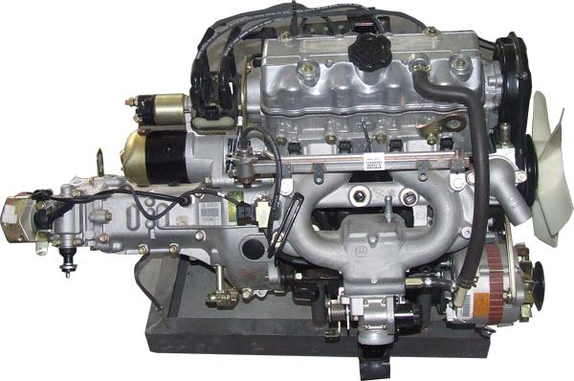
Layered Systems
Notes:
http://www.ecvv.com/product/1404665.html

Slide 7
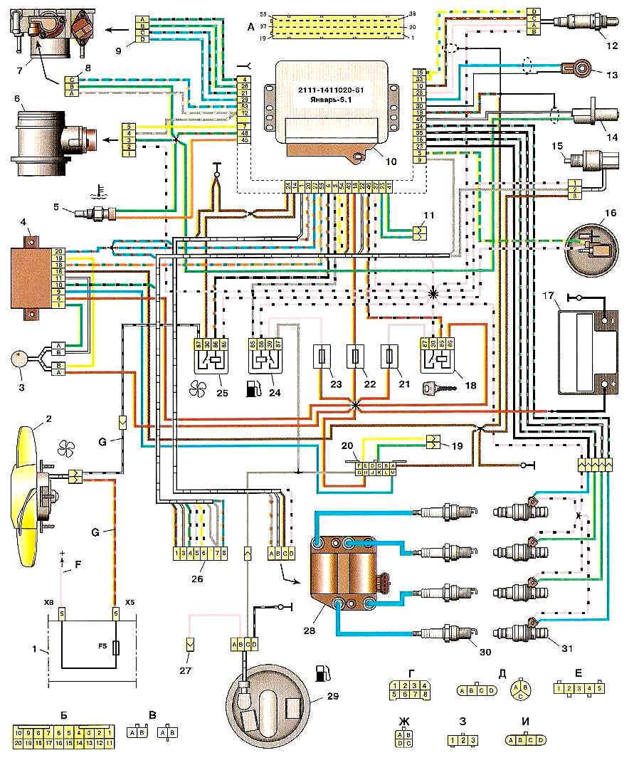
Layered Systems
Notes:
http://en.shematic.net/page-66.html

Slide 8
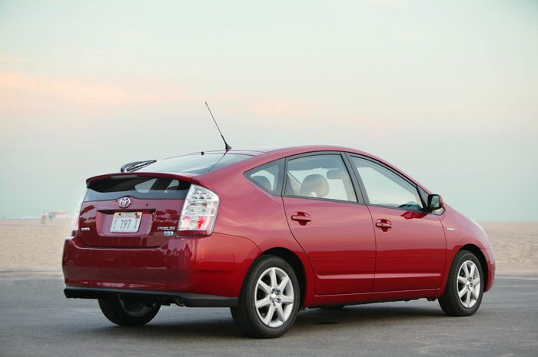
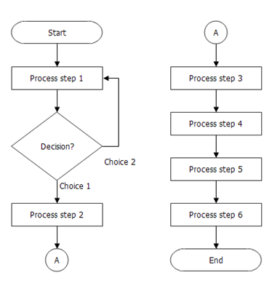
Layered Systems
def rand_simple():
rand = clock()
print(rand)
strand = str(rand)
i = 0
while strand[i] != ".":
i +=1
strand = strand[0 : i] + strand[i+1:
len(strand)]
i = len(strand)
while i !=-1 and strand[i-1] !="e":
i -= 1
strand = strand[0 : i-1]
Notes:
http://www.breezetree.com/flow-charts/flowchart.htm
http://hembaba.com/reviews/2008/08/automobile/toyota-prius-india/

Slide 9
Layered Systems
2010: Got recall notice for software patch.
2011: Government report clears electronic components of blame for accelerator problems.
Notes:
The point: we are relying on more and more sophisticated hardware/software systems for critical tasks.
http://www.washingtonpost.com/wp-dyn/content/article/2011/02/08/AR2011020800540.html?nav=rss_email/components
http://hembaba.com/reviews/2008/08/automobile/toyota-prius-india/

Slide 10
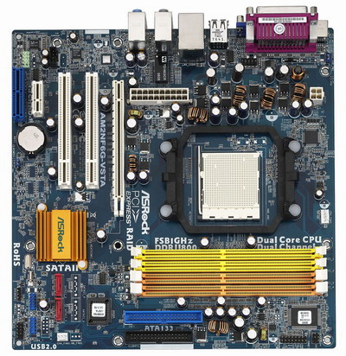
Programming Layers
Python
Byte codes
Machine code
def factorial(n):
result = 1
for j in range(1,n+1):
result *= j
return (result)
.
.
.
1011000001110000011 …

Slide 11
Assembly Language
Product
0
22 6F B2 1E
24 E6 07 5C
12 76 84 70
33 68 FD 3C
10
56 09 40 77
89 4A B5 42
61 04 AA 5E
AB 43 71 1C
20
70 DF 32 2D
40 1F 69 C0
8A 7C 0F E9
90 9D 39 2E
30
4D 1F 60 9A
09 7D 10 4C
93 6F 81 B5
6A 9F 0A 1C
Add Product
Jump Next
Next: Load Counter
Next
•
•
•
Notes:
Recall machine code from last lecture. Now we can make it easier to write.
Before high-level languages, or if they were thought too inefficient, programmers had to program pretty much at the machine level. But making it symbolic helped a lot.

Slide 12
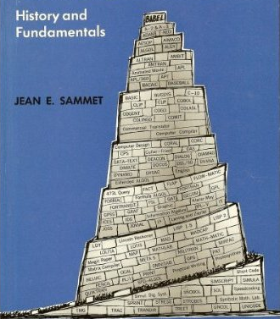
High-Level Languages
Over 2500 documented programming languages
1969
Notes:
http://www.amazon.com/gp/product/0137299885?ie=UTF8&redirect=true&tag=wrrrldwideweb
http://oreilly.com/news/languageposter_0504.html

Slide 13
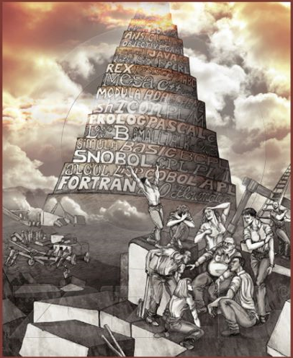
High-Level Languages
Over 2500 documented programming languages
Notes:
http://www.zazzle.com/programming_languages_tower_of_babel_poster-228429219625016391
http://oreilly.com/news/languageposter_0504.html

Slide 14
Fortran
real a(4), f(3)
c
c test of rat
c
rat = 2.5
f(1) = rat*rat-1.
f(2) = rat**4-1.
f(3) = rat**6-1.
1 read *, (a(i), i = 1, 4)
if (a(1) .eq. 0.) stop
do 2 k = 1, 3
do 2 i = 1, 4-k
a(i) = a(i+1)+(a(i+1)-a(i))/f(k)
if (a(i) .eq. 0.) then
print *, 'zero found'
else
print *, a(i)
end if
2 continue
go to 1
end

Slide 15
Fortran
real a(4), f(3)
c
c test of rat
c
rat = 2.5
f(1) = rat*rat-1.
f(2) = rat**4-1.
f(3) = rat**6-1.
1 read *, (a(i), i = 1, 4)
if (a(1) .eq. 0.) stop
do 2 k = 1, 3
do 2 i = 1, 4-k
a(i) = a(i+1)+(a(i+1)-a(i))/f(k)
if (a(i) .eq. 0.) then
print *, 'zero found'
else
print *, a(i)
end if
2 continue
go to 1
end
Notes:
Note: Explicit end statements

Slide 16
Fortran
real a(4), f(3)
c
c test of rat
c
rat = 2.5
f(1) = rat*rat-1.
f(2) = rat**4-1.
f(3) = rat**6-1.
1 read *, (a(i), i = 1, 4)
if (a(1) .eq. 0.) stop
do 2 k = 1, 3
do 2 i = 1, 4-k
a(i) = a(i+1)+(a(i+1)-a(i))/f(k)
if (a(i) .eq. 0.) then
print *, 'zero found'
else
print *, a(i)
end if
2 continue
go to 1
end
Notes:
Much more important in terms of writing correct code: no while loop. Used go to.

Slide 17

APL
Notes:
Returns 1 if the largest element in a three-element vector is greater than the sum of the other two. Otherwise, returns 0.

Slide 18
APL
Returns 1 if the largest element in a three-element vector is greater than the sum of the other two. Otherwise, returns 0.

Slide 19
Java
public static double
avg(int numbers[])
{
double sum = 0;
for (double num : numbers)
{
sum = sum + num;
}
return sum/numbers.length;
}
Notes:
Again, note explicit delimiters. But otherwise looks a lot like Python.

Slide 20
Matlab
function test = InConvexHull (V, vp, vpp)
% tests to see if zero is in the convex hull of vpp %ith n of the columns of V and vp
% on return
% test = 0 indicates zero is not in the convex hull
% test = j indicate zero is in the convex hull with %the jth column omitted.
%
n = size(V);
x = -V\vpp;
if x>= 0
test = n;
else
for k = 1:n
Vb = [V(:,1:k-1) V(:,k+1:n) vp];
x = -Vb\vpp;
test = k;
if x >= 0;
break;
end
test = 0;
end
end
Notes:
-V\vpp solves linear system in that one step. Slices like in Python. Semicolons interesting: not needed. But if absent, interpreter
will print result of executing that line. Useful for debugging.

Slide 21
Mapping Python to the Machine, or:
How Does a Compiler Work?
Lexical analysis
Parsing
Code generation
Optimization
def easy_sum(n):
sum = 0
for i in range(1,n+1):
sum += i
return(sum)
Notes:
Point out that, in the case of Python, there’s yet another intermediate layer. But we can still do a simple example.
Show examples of how things can go wrong at each step.

Slide 22
Mapping Python to the Machine, or:
How Does a Compiler Work?
Lexical analysis
Parsing
Code generation
Optimization
def easy_sum(n):
sum = 0
for i in range(1,n+1):
sum += i
return(sum)
def easy_sum ( n ) :
sum = 0
for i in range ( 1 , n + 1 ) :
sum += i
return ( sum )
Notes:
Point out that, in the case of Python, there’s yet another intermediate layer. But we can still do a simple example.

Slide 23
Mapping Python to the Machine, or:
How Does a Compiler Work?
Lexical analysis
Parsing
Code generation
Optimization
def easy_sum(n):
sum = 0
for i in range(1,n+1):
sum = sum + i
return(sum)
=
sum
+
sum
i
Notes:
This is where you get error messages when you Run Module.

Slide 24
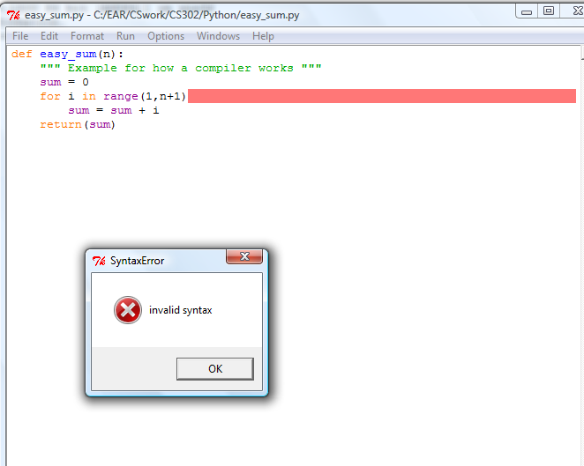
Mapping Python to the Machine, or:
How Does a Compiler Work?
Lexical analysis
Parsing
Code generation
Optimization
Notes:
This is where you get error messages when you Run Module.

Slide 25
Mapping Python to the Machine, or:
How Does a Compiler Work?
Lexical analysis
Parsing
Code generation
Optimization
def easy_sum(n):
sum = 0
for i in range(1,n+1):
sum += i
return(sum)
Load Sum
Add I
Store Sum

Slide 26
Mapping Python to the Machine, or:
How Does a Compiler Work?
Lexical analysis
Parsing
Code generation
Optimization
def easy_sum(n):
sum = 0
for i in range(1, n+1):
sum += i
return(sum)
Notes:
Do we have to compute n+1 every time through the loop? We would if n were changed in the loop, but it isn’t.

Slide 27
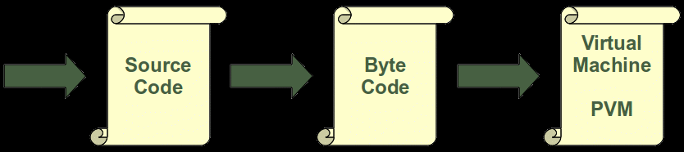
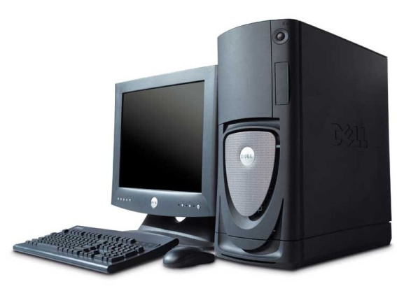
Python is Interpreted, not Fully Compiled
Notes:
http://www.python-course.eu/execute_script.php
http://www.sb.fsu.edu/~xray/Xrf/anaconda.html

Slide 28
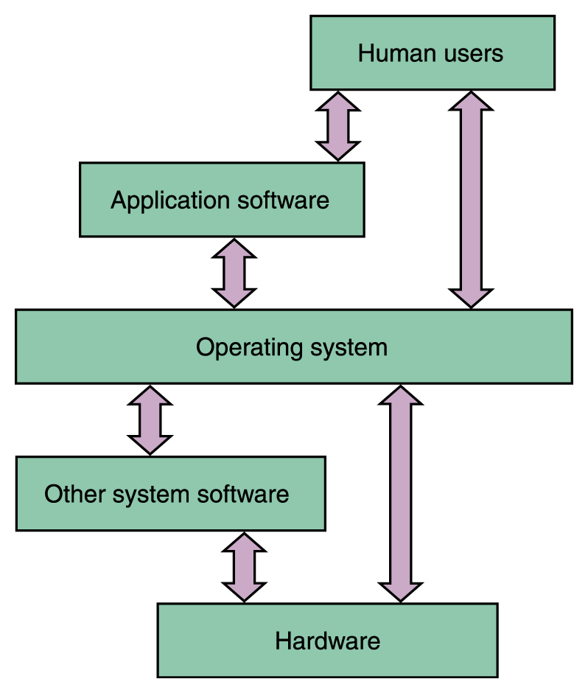
The Operating System (OS)
Notes:
But even the “real computer” comes with layers above its hardware.

Slide 29
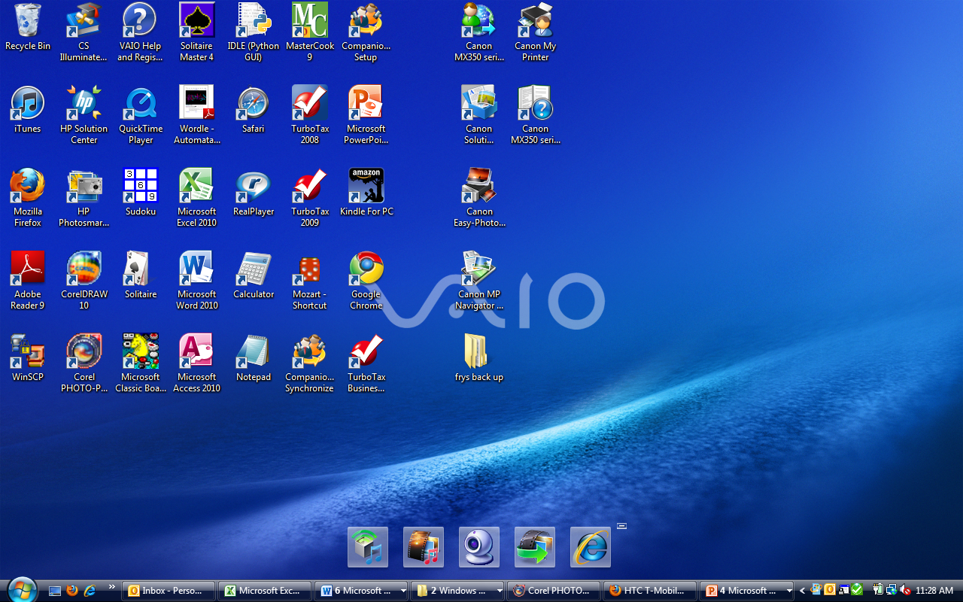
Managing the User Interface
Notes:
When you see this, you think “Windows” because this is the UI it presents.

Slide 30
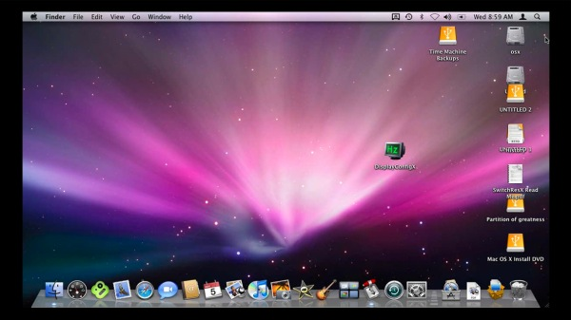
Managing the User Interface
Notes:
And is what you think of when you think of Mac OS
http://rhftech.com/blog/2009/05/i-should-have-gotten-a-windows-computer-instead-of-a-mac-pro/

Slide 31
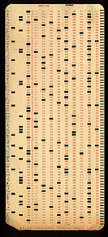
OS 360 JCL
//MYJOB JOB (COMPRESS),
'VOLKER BANDKE',CLASS=P,COND=(0,NE)
//BACKUP EXEC PGM=IEBCOPY
//SYSPRINT DD SYSOUT=*
//SYSUT1 DD DISP=SHR,DSN=MY.IMPORTNT.PDS
//SYSUT2 DD DISP=(,CATLG),
DSN=MY.IMPORTNT.PDS.BACKUP,
// UNIT=3350,VOL=SER=DISK01,
// DCB=MY.IMPORTNT.PDS,
SPACE=(CYL,(10,10,20))
//COMPRESS EXEC PGM=IEBCOPY
//SYSPRINT DD SYSOUT=*
//MYPDS DD DISP=OLD,DSN=*.BACKUP.SYSUT1
//SYSIN DD *
COPY INDD=MYPDS,OUTDD=MYPDS
//DELETE2 EXEC PGM=IEFBR14
//BACKPDS DD DISP=(OLD,DELETE,DELETE),
DSN=MY.IMPORTNT.PDS.BACKUP

Slide 32
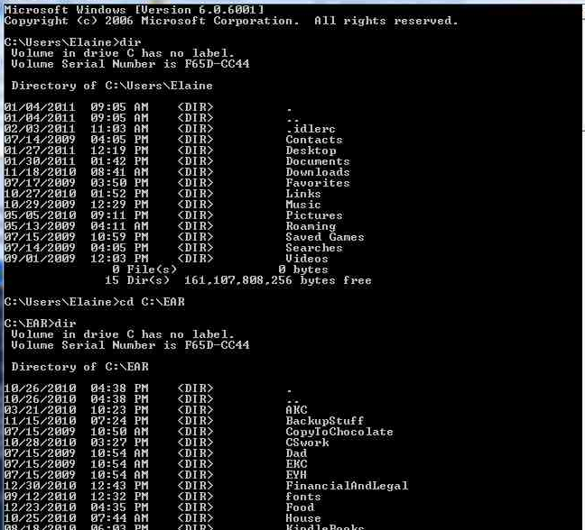
MS-DOS and Early PCs

Slide 33
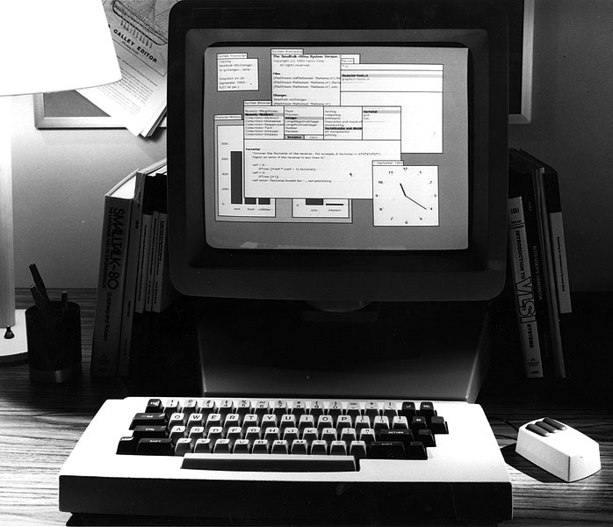
Xerox Alto - 1973
Notes:
http://www.digibarn.com/collections/software/alto/index.html Note overlapping (not tiled) windows. Overlapping won.

Slide 34
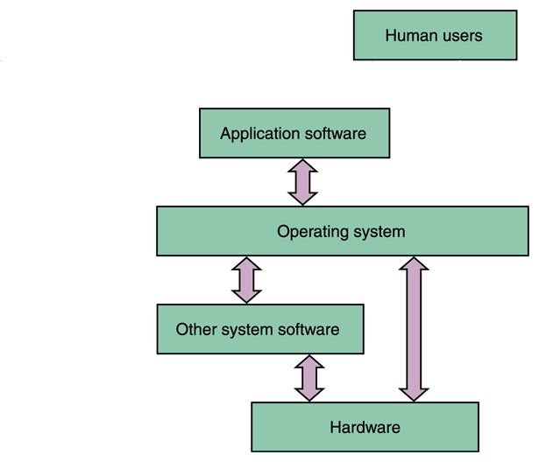
The Operating System (OS)
Notes:
But now let’s look at the part that isn’t just about managing the interaction with the user.

Slide 35
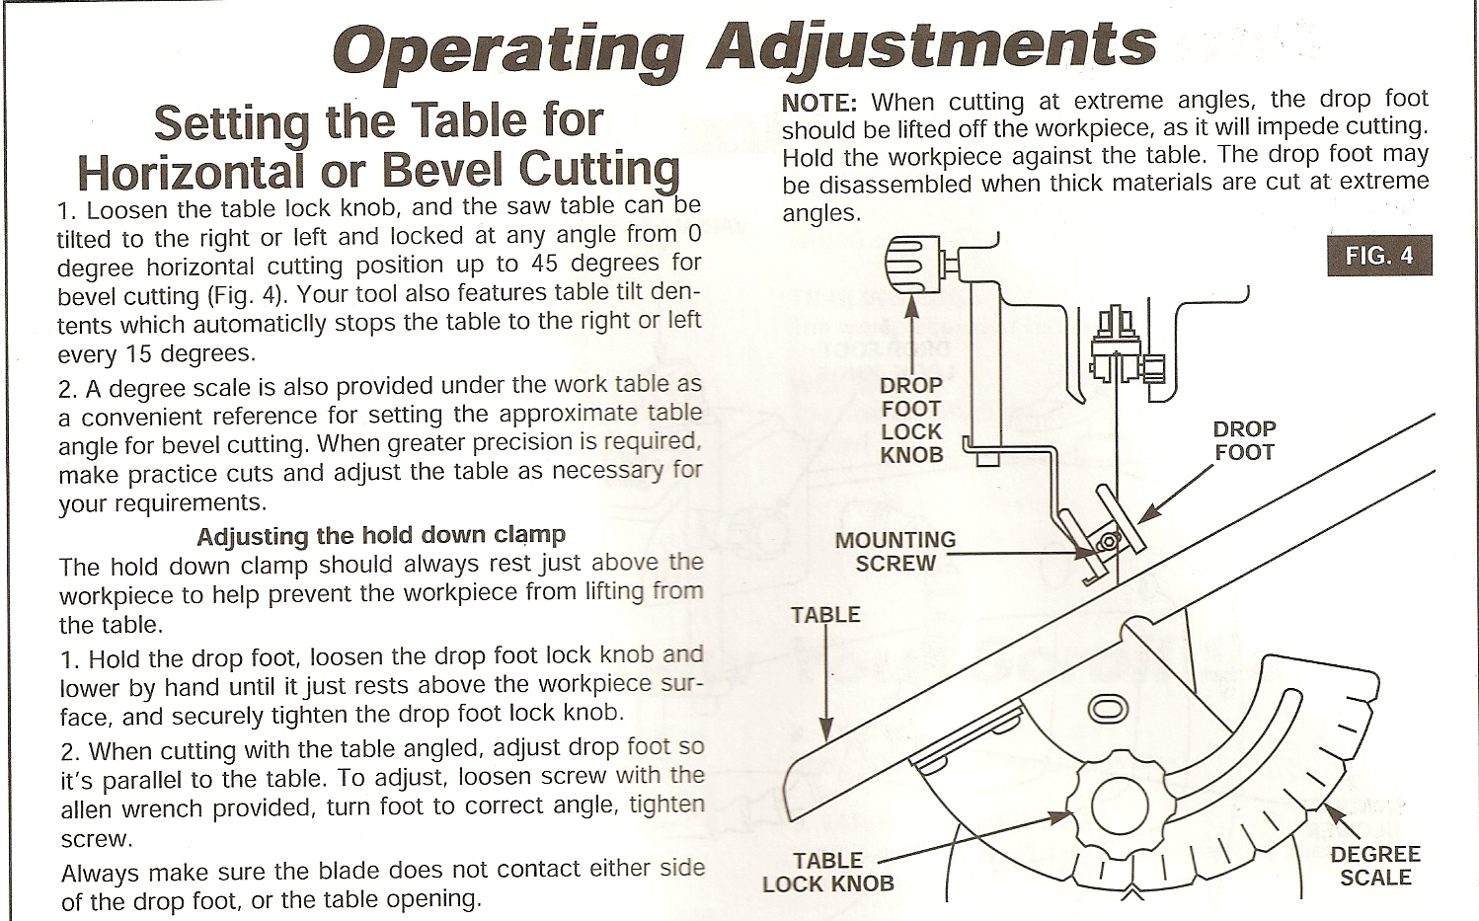
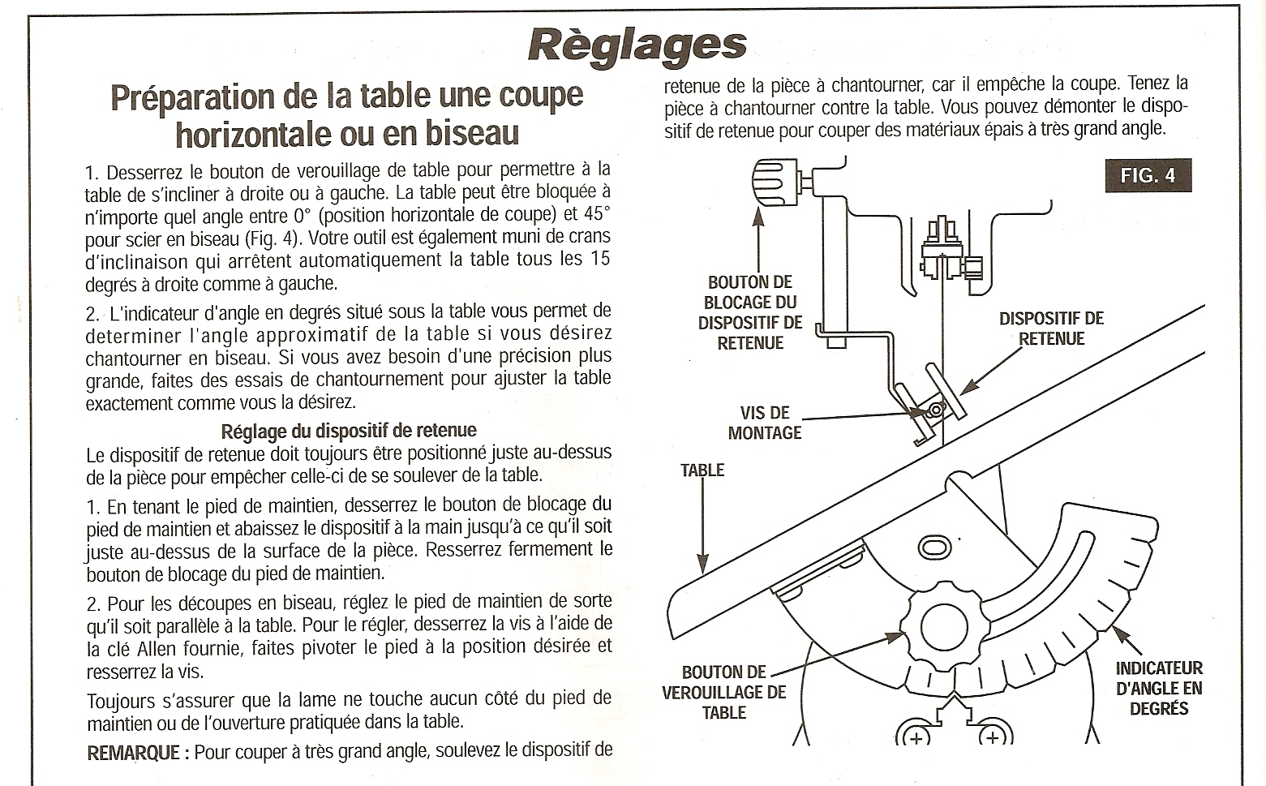
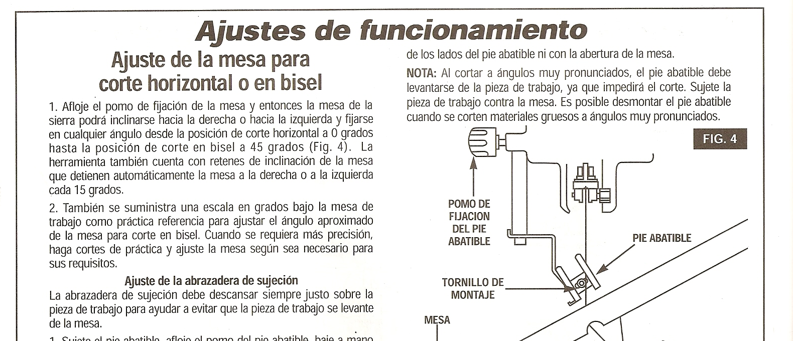
Notes:
Dremel Scroll Saw: The point: Need to do the same thing in all of these. But they must use different primitives (words) when speaking to differently programmed machines (people).

Slide 36
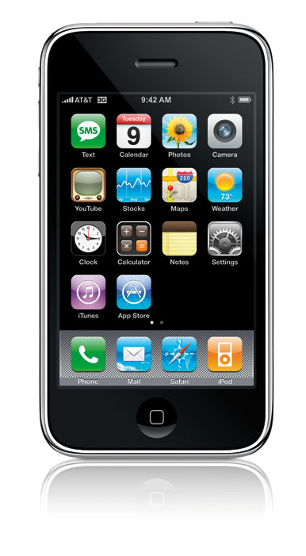
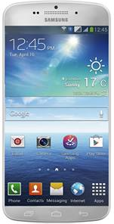
Closer to Home
Notes:
Yes, they look a little bit different to the users.
iPhone: http://www.macworld.com/article/134482/2008/07/iphone3g_review.html
Galaxy S5

Slide 37
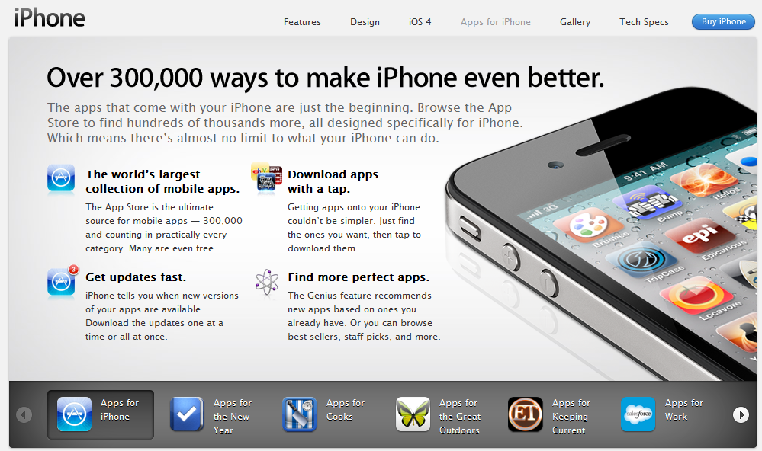
Notes:
Compare Apple App store to Android Market

Slide 38
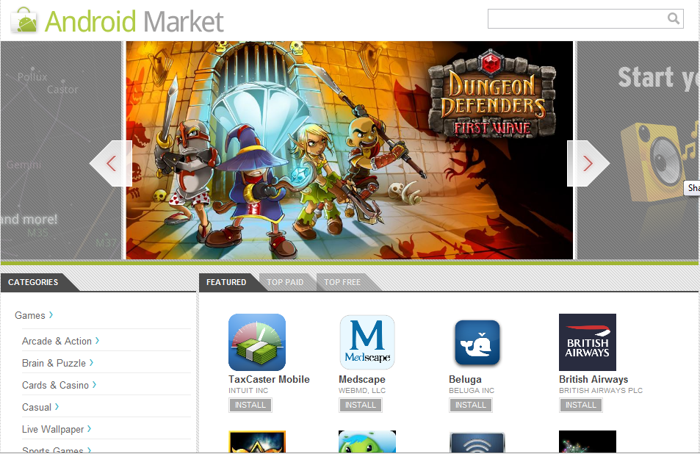
Notes:
Why can’t you buy an app in one store and run it on the other platform?

Slide 39
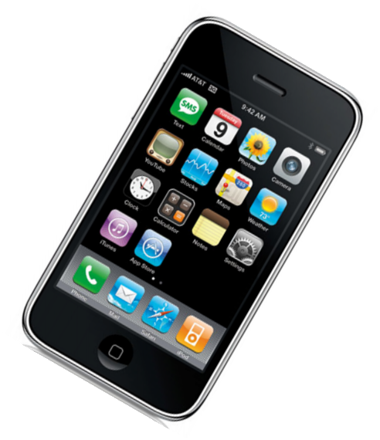
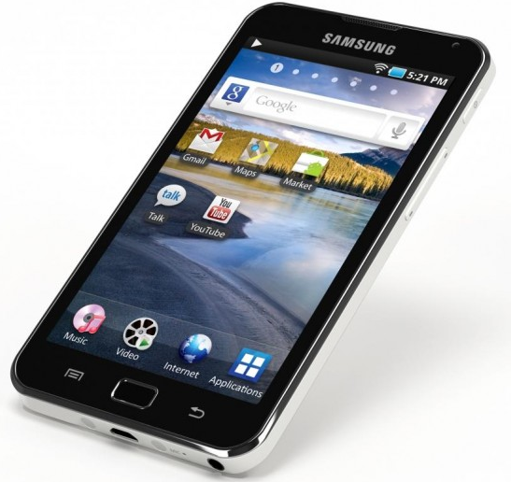
iPhone vs. Android
Apps
iOS
Apps
Android OS
Notes:
This is why you can’t run an app on a different platform.

Slide 40
iPhone vs. Android
package com.amaanp.helloandroid;
import android.app.Activity;
import android.os.Bundle;
import android.widget.TextView;
public class HelloAndroid extends Activity {
/** Called when the activity is first created. */
@Override
public void onCreate(Bundle savedInstanceState) {
super.onCreate(savedInstanceState);
setContentView(R.layout.main);
TextView tv = new TextView(this);
tv.setText("Hello, Texas");
setContentView(tv);
}
}
http://www.youtube.com/watch?v=0E9ie2RP9Xo
Notes:
This is why you can’t run an app on a different platform. Written in Java.

Slide 41
iPhone vs. Android
#import "Hello_iOS_2AppDelegate.h"
@implementation Hello_iOS_2AppDelegate
@synthesize window;
#pragma mark -
#pragma mark Application lifecycle
- (BOOL)application:(UIApplication *)application didFinishLaunchingWithOptions:(NSDictionary *)launchOptions {
UILabel* label = [[UILabel alloc] initWithFrame:CGRectMake(10.0 , 30.0f, self.window.frame.size.width, 21.0f)];
label.text = @"Hello, World!";
[self.window addSubview:label];
[self.window makeKeyAndVisible];
return YES;
}
- (void)dealloc {
[window release];
[super dealloc];
}
@end
http://www.youtube.com/watch?v=cs2AYXHqHFA
Notes:
This is why you can’t run an app on a different platform. Note, for example, that while the Android mentions OnCreate, Iphone talks about launching.

Slide 42
iPhone vs. Android
Apps
Android OS
Apps
iOS
iOS simulator
Notes:
This is technically possible. But Apple would come after you big time.

Slide 43
OS Functionality
Memory management
File system management
Process management
CPU scheduling
I/O device control

Slide 44
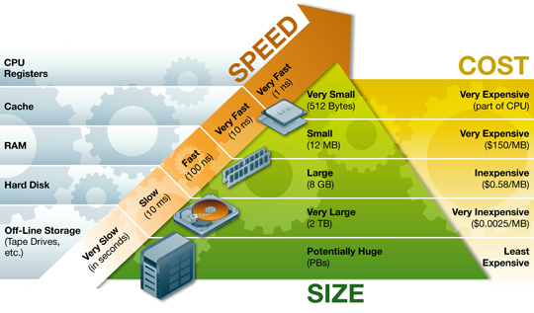
Recall the Memory Hierarchy
Notes:
The OS figures out how to use the cache and when to swap out to disk.
http://www.ts.avnet.com/uk/products_and_solutions/storage/hierarchy.html

Slide 45
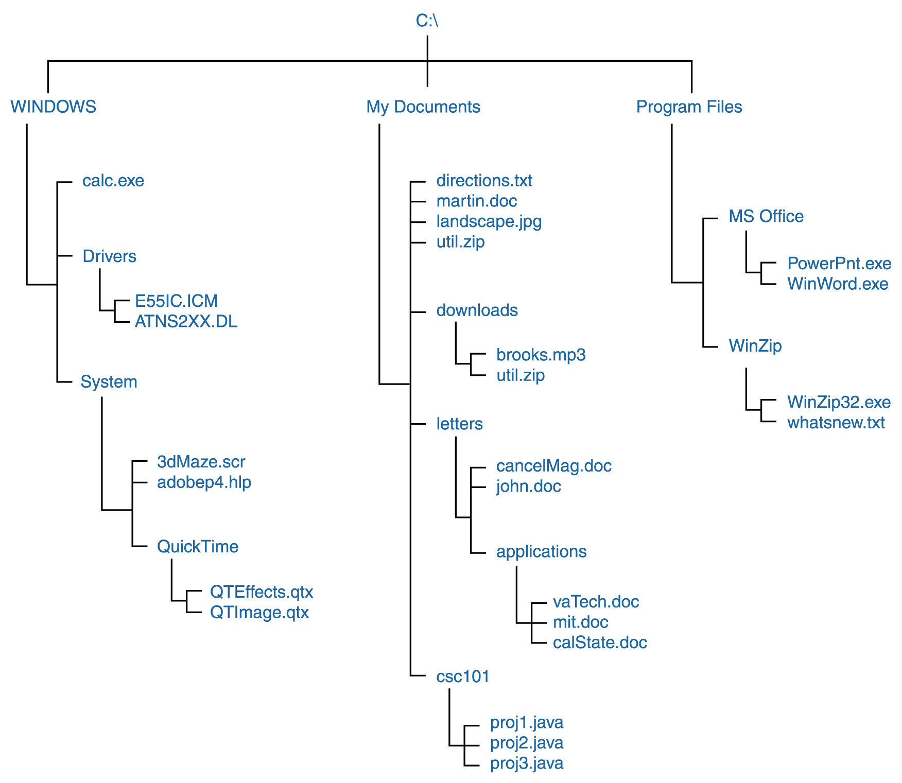
File System Directory Structure
root
Notes:
On a Windows machine

Slide 46
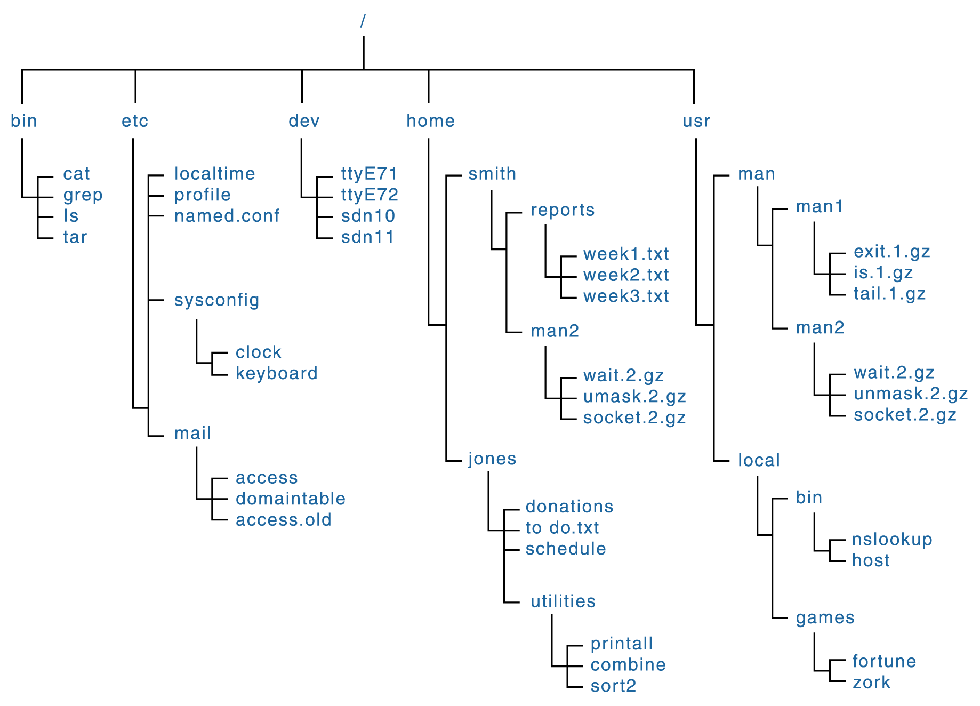
File System Directory Structure
root
Notes:
On a Unix machine

Slide 47
Why Structure?

Slide 48
Why Structure?
Organize
Permissions

Slide 49
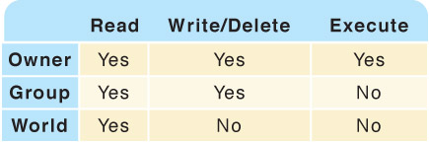
Permissions
Notes:
Point out that the OS manages all kinds of permissions, like the right to various parts of memory, the right to various I/O devices, etc.

Slide 50
Rooting Your Phone?
Notes:
Ask whether anyone has tried it. It gives you more permissions.

Slide 51
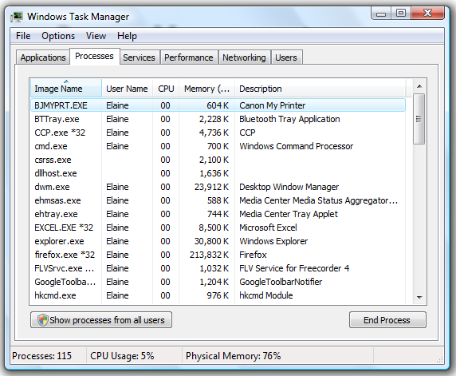
Process Management
Notes:
Go do it and watch what is happening.

Slide 52
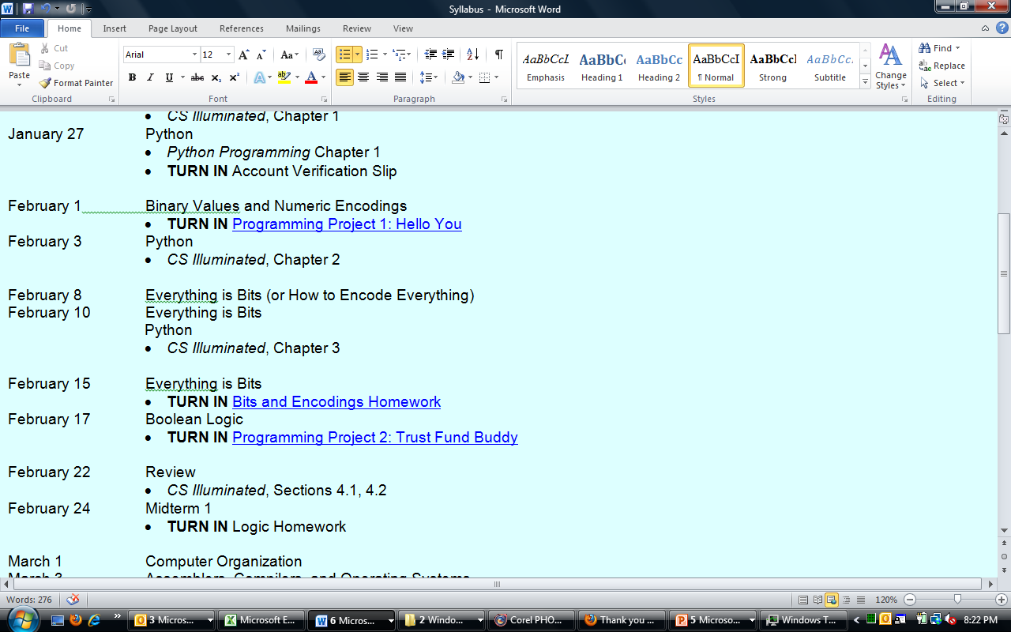
CPU Management
Notes:
Word is a foreground task. But it doesn’t need the CPU all the time. At other times, other processes can run. For example, checking mail.

Slide 53
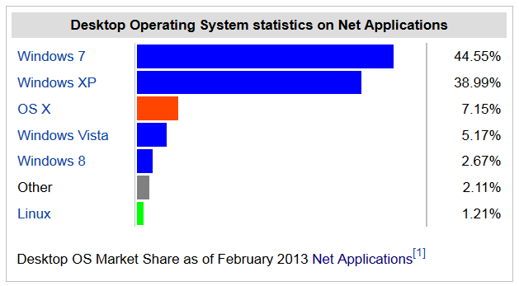
Modern Operating Systems
Notes:
Note that this doesn’t tell the whole story. Servers tend to run Linux.
http://en.wikipedia.org/wiki/Usage_share_of_operating_systems

Slide 54
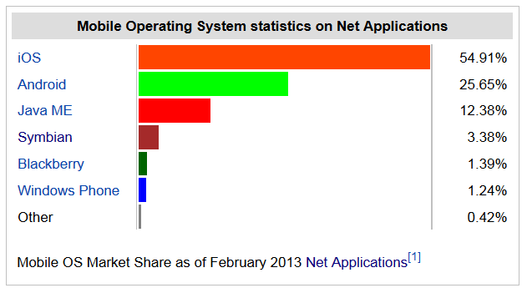
Modern Operating Systems
Notes:
Note that this doesn’t tell the whole story. Servers tend to run Linux.
http://en.wikipedia.org/wiki/Usage_share_of_operating_systems

Slide 55
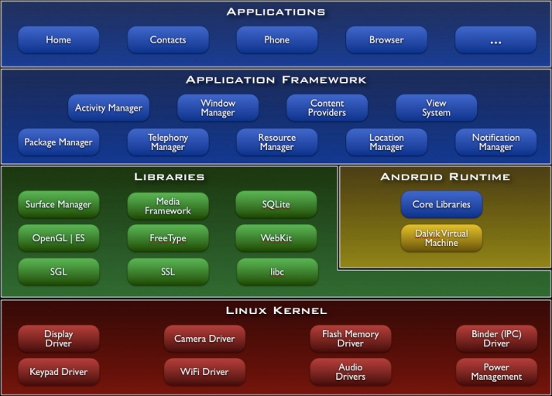
The Android Stack
Notes:
An example of building open source on top of other open source.
http://developer.android.com/guide/basics/what-is-android.html

Slide 56
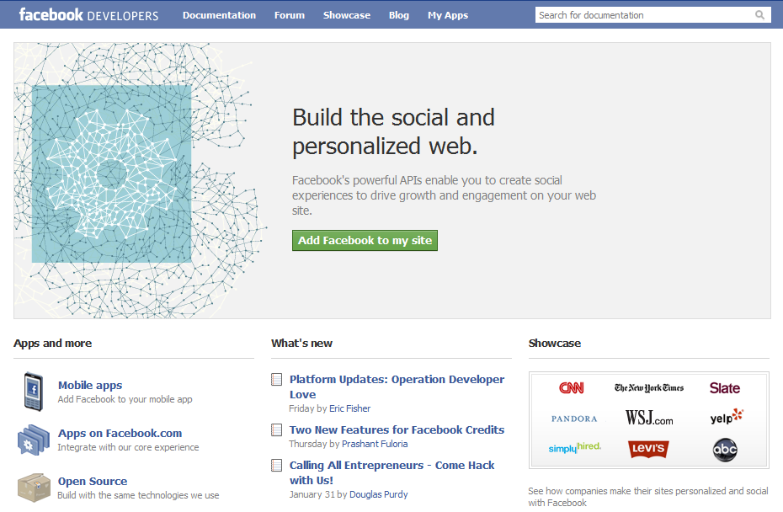
An Aside – Another Open Source Home Run
https://developers.facebook.com/opensource/
Notes:
Follow the link to see all the open source code on which Facebook depends. Ask students why open source can make business sense.
https://developers.facebook.com/

