Slide 1
Algorithms and Software
Chapter 7
Some of Chapter 8
Sections 17.2, 17.3

Slide 2
What If There Isn’t an “Obvious” Way

Slide 3

Square Root
$\sqrt{9}$ =
$\sqrt{16}$ =
Notes:
These are easy. Try the integers.

Slide 4

Square Root
$\sqrt{9}$ =
$\sqrt{12}$ =
$\sqrt{16}$ =
Notes:
This is harder. If we had a candidate, we could square it to see how close we are, but there’s an infinite number of candidates to try.

Slide 5
Square Root

Slide 6
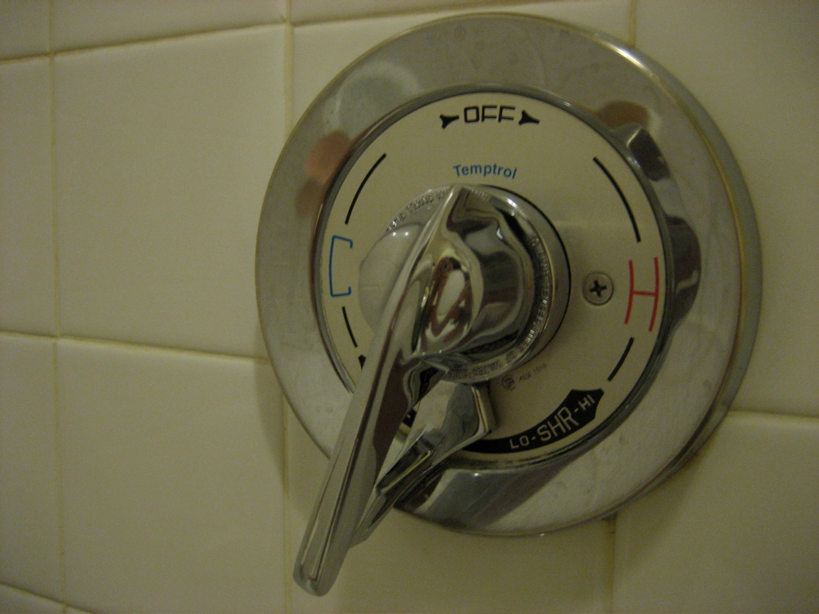
Hot Water
Iteration
Notes:
Iterate: price to pay if try too hot, so generally approach from the bottom.
http://www.flickr.com/photos/seanosullivan/439290922/in/set-72157600035876367/

Slide 7
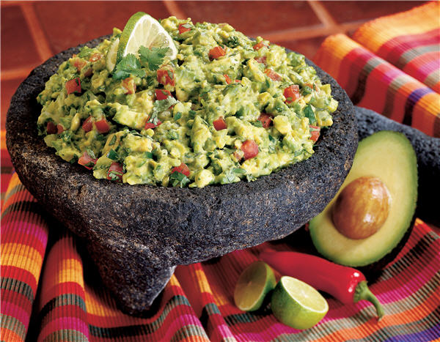
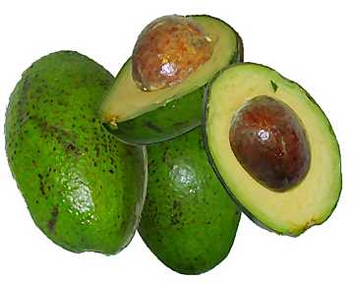

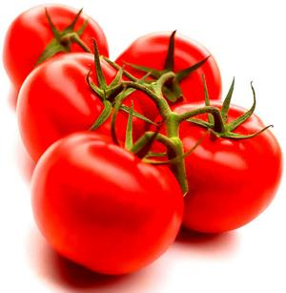
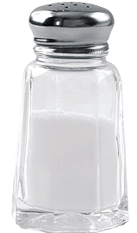
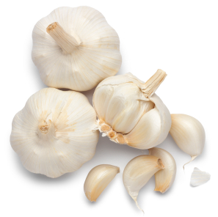
Guacamole
Iteration
Notes:
Can’t have literal recipe because of variation among avocados.
No subtraction operator. If too much salt, only fix is to add more avocados.
Guacamole: http://www.laaloosh.com/2009/02/05/weight-watchers-guacamole-recipe/
http://factoidz.com/heart-healthy-food-avocado-for-heart/
http://www.realsimple.com/home-organizing/new-uses-for-old-things/28-uses-for-every-day-items-00000000007991/page3.html
http://countrystore.tabasco.com/prodinfo.asp?number=03009
http://lukehoney.typepad.com/the_greasy_spoon/2008/03/garlic.html
http://www.ifood.tv/blog/history-of-tomatoes-as-food

Slide 8
Iteration
The key idea:
Make a first guess.
Until answer is good enough:
  See how close guess is to being right.
  If not good enough, see how to move and choose a next guess.

Slide 9
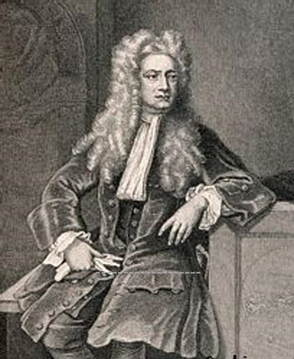
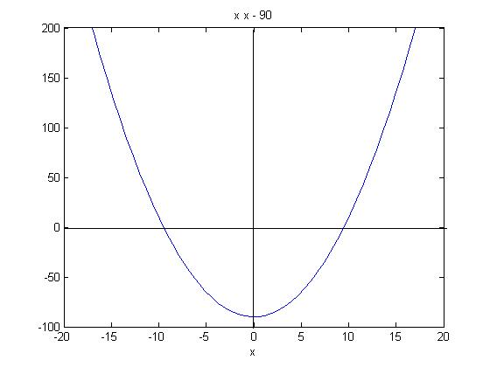
Square Root
1643 – 1727
Idea here: Newton’s Method:
Approximate with straight lines.
Notes:
This plot: Try to find square root of 90. What we are plotting here is x² – 90.
Actually known to Babylonians
http://www.personal.psu.edu/mad10/astro001.html

Slide 10
Riding the Line
•
•
f(x) = x - 1
Notes:
Let’s try the idea with a straight line. We want to find out where f(x) = x – 1 crosses the x axis. We guess 0. We compute f. Now we’re on the line. Ride it up until it crosses.

Slide 11
Riding the Line
•
•
•
f(x) = x - 1
Notes:
Now read off the correct x value. Of course, for a line, no need to do this. Just solve.

Slide 12
Square Root
Example:
f(x) = x² - 90
•
•
Make a first guess, let’s say: 1. We want to ride the curve up to where it crosses the x-axis. But we don’t know how to.
So pretend it were a straight line and ride it up.
Notes:
Next we compute f there, which is not on the chart. To see how this works, we’ll now skip to a place where we’re closer.

Slide 13
Square Root
Example:
f(x) = x² - 90
•
•
•
Start at 5.
Pretend the curve were a straight line and ride it up to 12.

Slide 14
Square Root
Example:
f(x) = x² - 90
•
•
Start at 12.
Pretend the curve were a straight line and ride it down to 9.

Slide 15
Square Root
Doing this more generally to find sqrt(n):
f(x) = x² – n
f′(x)= 2x
•
•
•
x_{i}
The line we have drawn: y = f(x_{i}) + (x_{i+1} – x_{i})*2x_{i}
To find where it crosses: 0 = f(x_{i}) + (x_{i+1} – x_{i})*2x_{i}
Notes:
Where does the 2x_{i} factor come from? It’s the derivative of the function, taken at x_{i}.

Slide 16
Square Root
The line we have drawn: y = f(x_{i}) + (x_{i+1} – x_{i})*2x_{i}
To find where it crosses: 0 = f(x_{i}) + (x_{i+1} – x_{i})*2x_{i}
0 = x_{i}² – n + (x_{i+1} – x_{i})*2x_{i}
0 = x_{i}² – n + 2x_{i+1}x_{i} – 2x_{i}²
x_{i}² + n = 2x_{i+1}x_{i}
x_{i}² + n = x_{i+1}
2x_{i}
x_{i} + n
x_{i} = x_{i+1}
2
f(x) = x² – n
Notes:
Reasons for last step: 1) We don’t want to have to square xi. 2) We only want to divide by 2 once.

Slide 17
Square Root
•
•
•
x_{i}
def newton(n):
guess = 1
while guess not good enough:
guess = (guess + n/guess)/2
return(guess)

Slide 18
Square Root
•
•
•
x_{i}
def newton(n):
guess = 1
while abs(guess**2 - n) > .00000001*n:
guess = (guess + n/guess)/2
return(guess)
http://balance3e.com/Ch8/Newton.html
Notes:
Go to IDLE and load my module newton. Try starting at 1 (default). Try other things. Notice that it doesn’t make much difference to number of steps. It does change the final answer a little bit. Or you can use the app at this link. It does the same thing.
Note that, for tolerance, we have to do it proportionately to n. If we pick some fixed tolerance, we’ll never get there with the precision that we’re using. I tried it with .00001 and it infinite looped on a 15 digit number.

Slide 19
Correctness
How do we know that our loops will halt?
def newton(n):
guess = 1
while abs(guess**2 - n) > .00000001*n:
guess = (guess + n/guess)/2
return(guess)
Harder here. It is possible to prove that it will converge and in fact that it will do so very quickly.

Slide 20
The Beauty of an Algorithm
def newton(n):
guess = 1
while abs(guess**2 - n) > .00000001*n:
guess = (guess + n/guess)/2
return(guess)
It’s not necessary to undertstand why it is correct in order to execute it. You can execute it without understanding. So can a computer.
Of course, someone has to prove once that it is correct or we wouldn’t trust our key systems to it.

Slide 21


Invariants
Notes:
Can you cover this board with dominos?

Slide 22
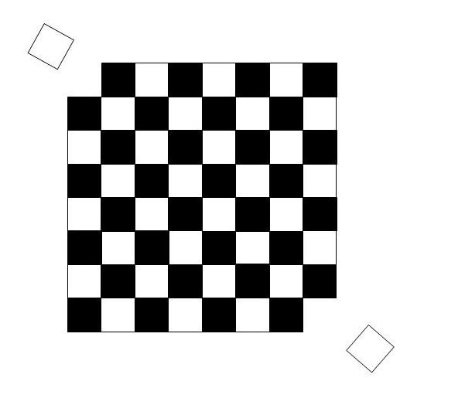
Invariants
Notes:
http://commons.wikimedia.org/wiki/File:Mutilated_checkerboard_3.jpg
Can you cover the mutilated board with dominos? Because each domino covers one black and one white square. Invariant: difference between whites and blacks never changes.

Slide 23
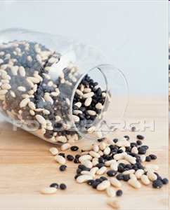
Invariants
Until no further beans can be removed:
Randomly choose two beans.
If the two beans are the same color:
Throw both away and add a new black bean.
If the two beans are different colors:
Throw away the black one and return the white one.
What color will the remaining bean be?
The Coffee Can Problem
Notes:
Hand out cups and beans and have groups try it. Have them write down, for each experiment, starting numbers of blacks and whites, and then outcome. Tally on the board.
Load coffee_can.py. Run it to watch simulated games.
Due to David Gries, 1989. All operators preserve parity of white beans. So if odd whites initially, then white. Else black.
http://www.fotosearch.com/FSD315/x15520195/

Slide 24
Invariants
We have run a distributed (parallel) Monte Carlo simulation.
What did we observe?
Preserve parity of whites. So:
Odd whites: white
Even whites: black
The Coffee Can Problem
Notes:
Hand out cups and beans and have groups try it. Have them right down, for each experiment, starting numbers of blacks and whites, and then outcome. Tally on the board.
Load coffee_can.py. Run it to watch simulated games.
Due to David Gries, 1989. All operators preserve parity of white beans. So if odd whites initially, then white. Else black.
http://www.fotosearch.com/FSD315/x15520195/

Slide 25
The Trivia Challenge Project
http://www.cs.utexas.edu/~ear/cs302/trivia.txt
An Episode You Can't Refuse
On the Run With a Mammal
Let's say you turn state's evidence and need to "get on the lamb." If you wait /too long, what will happen?
You'll end up on the sheep
You'll end up on the cow
You'll end up on the goat
You'll end up on the emu
1
Lambs are baby sheep.
http://www.cs.utexas.edu/~ear/cs302/Homeworks/Trivia.html

Slide 26
Key Ideas
Divide and conquer
Read input from a file
Handling exceptions

Slide 27
Key Ideas
Divide and conquer

Slide 28
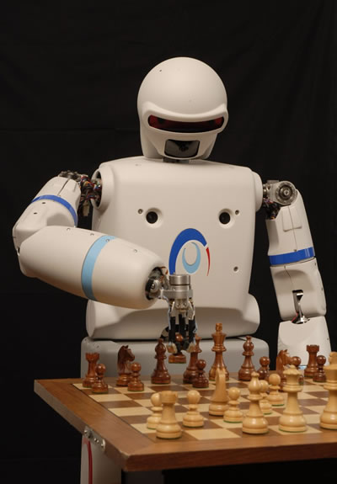
Divide and Conquer
def chess(board):
while game_on:
internal_board = scan(board)
move = choose(internal_board)
play(move, board)
Recall the idea: decompose into pieces that make sense.
Notes:
Recall this one. We broke it apart into its major pieces.

Slide 29
Divide and Conquer
Guacamole
Salsa
Chips
Smoked brisket
Cole slaw
Potato salad
Chocolate cake
Apple pie
Moolenium crunch
Joe
Bill
Sarah
Jim
Casey
Allison

Slide 30
Key Ideas
Divide and conquer
Read input from a file
Handling exceptions

Slide 31
Let’s Look at the Code
http://www.cs.utexas.edu/~ear/cs302/triviagameprogram.txt

Slide 32
Searching
8 | 76 | 45 | 3 | 12 | 98 | 52 | 87 | 66 | 4 | 9 | 55 | 21 | 34 | 63 | 93 | 96 | 55 | 1 | 88
How many steps to look for 55?
How many steps to look for 88?
How many steps to look for 77?
How many steps on average for a list of length n?
Notes:
Do sequential search.

Slide 33
Searching
8 | 76 | 45 | 3 | 12 | 98 | 52 | 87 | 66 | 4 | 9 | 55 | 21 | 34 | 63 | 93 | 96 | 55 | 1 | 88
How many steps to look for 55?
How many steps to look for 88?
How many steps to look for 77?
How many steps on average for a list of length n?
O(n/2) or just O(n)
Notes:
Do sequential search.

Slide 34

Searching a Sorted List
Notes:
Get someone up in front to look up something in a phone book.

Slide 35
Binary Search
2 | 9 | 13 | 17 | 19 | 22 | 28 | 30 | 35 | 40 | 43 | 55 | 61 | 69 | 73 | 83 | 86 | 91 | 93 | 99
mid
1st compare
Look for 93.
Notes:
Note that we assume we don’t know where 93 is (i.e., that it’s one of the biggest numbers). So, without such information, we simply start in the middle.

Slide 36
Binary Search
2 | 9 | 13 | 17 | 19 | 22 | 28 | 30 | 35 | 40 | 43 | 55 | 61 | 69 | 73 | 83 | 86 | 91 | 93 | 99
mid
2nd compare
Look for 93.

Slide 37
Binary Search
2 | 9 | 13 | 17 | 19 | 22 | 28 | 30 | 35 | 40 | 43 | 55 | 61 | 69 | 73 | 83 | 86 | 91 | 93 | 99
mid
3rd compare
Look for 93.

Slide 38
Binary Search
2 | 9 | 13 | 17 | 19 | 22 | 28 | 30 | 35 | 40 | 43 | 55 | 61 | 69 | 73 | 83 | 86 | 91 | 93 | 99
mid
4th compare
Look for 93.

Slide 39
Binary Search
def binary_search(list,object):
first = 0
last = len(list) - 1 # one is numbered 0.
mid = first + (last - first)//2
found = False
while(mid >= first and mid <= last):
if object == list[mid]:
print("Found at position ", mid + 1)
found = True
break
elif object > list[mid]:
first = mid + 1
else:
last = mid - 1
mid = first + (last - first)//2
if not found:
print("Not found")
How many steps on average does it take?
Notes:
Load my module binary_search.py Invoke binary_search(lists,6). Show that it finds 6 in more steps than linear would. But then show how fast it finds out that 200 isn’t there.
Walk through showing why it’s O(log n)

Slide 40
Binary Search
def binary_search(list,object):
first = 0
last = len(list) - 1 # one is numbered 0.
mid = first + (last - first)//2
found = False
while(mid >= first and mid <= last):
if object == list[mid]:
print("Found at position ", mid + 1)
found = True
break
elif object > list[mid]:
first = mid + 1
else:
last = mid - 1
mid = first + (last - first)//2
if not found:
print("Not found")
How many steps on average does it take?
O(log₂ n)
Notes:
Load my module binary_search.py. Show that it finds 6 in more steps than linear would. But then show how fast it finds out that 200 isn’t there.
Walk through showing why it’s O(log n)

Slide 41
Searching Huge Files
1000 | 9.965784
2000 | 10.96578
3000 | 11.55075
4000 | 11.96578
5000 | 12.28771
6000 | 12.55075
7000 | 12.77314
8000 | 12.96578
9000 | 13.13571
10000 | 13.28771
11000 | 13.42522
12000 | 13.55075
13000 | 13.66622
14000 | 13.77314
15000 | 13.87267
16000 | 13.96578
17000 | 14.05325
18000 | 14.13571
19000 | 14.21371
100,000 | 16.60964
1,000,000 | 19.93157
Comparing:
O(n) to O(log₂ n)

Slide 42
But Is It Correct?
2 | 9 | 13 | 17 | 19 | 22 | 28 | 30 | 35 | 40 | 43 | 55 | 61 | 69 | 73 | 83 | 86 | 91 | 93 | 99
2 | 9 | 13 | 17 | 19 | 22 | 28 | 30 | 35 | 40 | 43 | 55 | 61 | 69 | 73 | 83 | 86 | 91 | 93 | 99
2 | 9 | 13 | 17 | 19 | 22 | 28 | 30 | 35 | 40 | 43 | 55 | 61 | 69 | 73 | 83 | 86 | 91 | 93 | 99
2 | 9 | 13 | 17 | 19 | 22 | 28 | 30 | 35 | 40 | 43 | 55 | 61 | 69 | 73 | 83 | 86 | 91 | 93 | 99
Search for 93.
Invariant:
Notes:
Invariant: desired number, if present, must be between first and last.

Slide 43
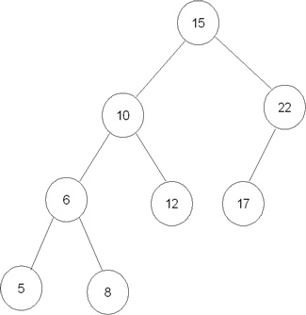
Binary Search Trees
Notes:
Beats a list because we can add and remove objects without having to shift anything. Note how important it is to have the “middle” element at the top.
http://www.ibm.com/developerworks/websphere/library/techarticles/0511_ma/0511_ma.html

Slide 44
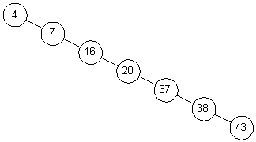
Binary Search Trees
Notes:
Note how important it is to have the “middle” element at the top. This one is pathological.
http://www.oopweb.com/Algorithms/Documents/Sman/Volume/BinarySearchTrees_files/title_data/fig33.gif

Slide 45
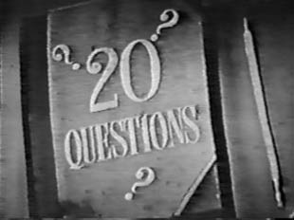
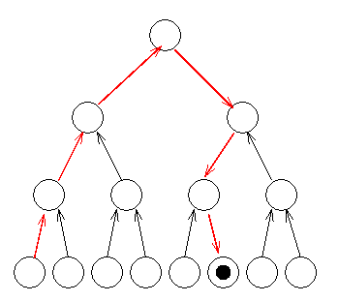
Binary Search Trees
Notes:
Talk about how important to ask questions that divide the field in half.
Opening titles on the 20 Questions television panel show (1949–1955) http://en.wikipedia.org/wiki/Twenty_Questions
Tree image: http://www.cs.fsu.edu/~xyuan/cop5611/lecture8.html

Slide 46
Binary Search Trees
How many leaves of the tree with 20 questions?
Notes:
Opening titles on the 20 Questions television panel show (1949–1955) http://en.wikipedia.org/wiki/Twenty_Questions
Tree image: http://www.cs.fsu.edu/~xyuan/cop5611/lecture8.html

Slide 47
Binary Search Trees
How many leaves of the tree with 20 questions?
2²⁰ = 1,048,576
Notes:
Opening titles on the 20 Questions television panel show (1949–1955) http://en.wikipedia.org/wiki/Twenty_Questions
Tree image: http://www.cs.fsu.edu/~xyuan/cop5611/lecture8.html

Slide 48
Information Theory – or
Making Every Bit Count
In English, they don’t:
F**r sc*r* *nd s*v*n ***rs *g* **r f*th*rs br**ght f*rth *n th*s c*nt*n*nt, * n*w n*t**n, c*nc**v*d *n L*b*rt*, *nd d*d*c*t*d t* th* pr*p*s*t**n th*t *ll m*n *r* cr**t*d *q**l.
Notes:
But there’s also a tradeoff with error correction.

Slide 49
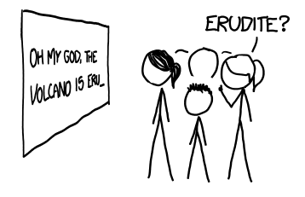
Making Every Bit Count
Based on the rates of correct guesses—and rigorous mathematical analysis—Shannon determined that the information content of typical written English was around 1.0 to 1.2 bits per letter. This means that a good compression algorithm should be able to compress ASCII English text—which is eight bits per letter—to about 1/8th of its original size. Indeed, if you use a good file compressor on a .txt ebook, that’s about what you’ll find.
Notes:
http://what-if.xkcd.com/34/

Slide 50
Information Theory – or
Making Every Bit Count
Machine to machine communication that is hidden from you:
Compressing text, images and video
Sending messages along cables
Cryptography

Slide 51
Information Theory – or
Making Every Bit Count
Machine to machine communication that is hidden from you:
Compressing text, images and video
Sending messages along cables
Cryptography
But when people are involved, we have to think about it:

Slide 52
Information Theory – or
Making Every Bit Count
Machine to machine communication that is hidden from you:
Compressing images and video
Sending messages along cables
Cryptography
But when people are involved, we have to think about it:
Doctor asking patient about symptoms
Telephone help desk
Notes:
Doctor – first question is not, out of the blue, “Do your toes tingle?”

Slide 53
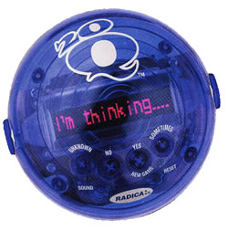
Ternary Search Trees
http://www.20q.net/
Notes:
There’s an app on the website.
Let’s play. The skill is in dividing the field evenly each time. I have four games we can use.
Modern game: image:http://www.nolandgrab.org/archives/2007/04/questions_ratne.html
Game itself: http://www.20qgame.com/ 2005 runner up "Game of the Year" and "Most Innovative Toy of the Year" award winner.

Slide 54
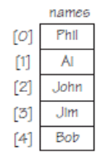
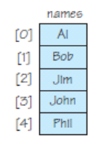
Sorting
Notes:
Remind them of how we swap.

Slide 55
Bubble Sort
http://math.hws.edu/TMCM/java/labs/xSortLabLab.html
Notes:
Click the button to launch xSortLab. Then choose bubble sort. Note that the applet bubbles largest element to bottom first.

Slide 56
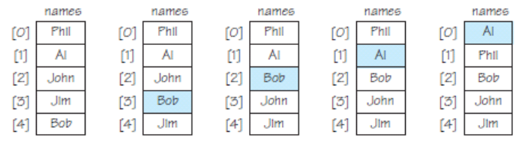
Bubble Sort
Bubbling Bob
Bubbling Al
Notes:
If we swap positions, we still keep bubbling the same element up. If we don’t swap, we do switch which element we bubble.

Slide 57
Bubble Sort
Here’s how we bubble the smallest element to the top:
for value₁ in sequence (from the bottom):
for value₂ in sequence above value₁ :
if value₁ < value₂:
swap positions of value₁ and value₂
else:
value₁ = value₂ # Switch; push the smaller one.
Notes:
Go here. Choose bubble sort.

Slide 58
Bubble Sort
Here’s how we bubble the whole sequence:
for i in range(len(sequence)):
for value₁ in sequence (from the bottom):
for value₂ in sequence above value₁ ignoring top i ones:
if value₁ < value₂:
swap positions of value₁ and value₂
else:
value₁ = value₂ # Switch; push the smaller one.
How many operations (swaps)?

Slide 59
Bubble Sort
Here’s how we bubble the whole sequence:
for i in range(len(sequence)):
for value₁ in sequence (from the bottom):
for value₂ in sequence above value₁ ignoring top i ones:
if value₁ < value₂:
swap positions of value₁ and value₂
else:
value₁ = value₂ # Switch; push the smaller one.
How many operations (swaps)?
O(n²)

Slide 60
Sorting Faster
Remember the lesson from this guy:
def chess(board):
while game_on:
internal_board = scan(board)
move = choose(internal_board)
play(move, board)
Notes:
Divide and conquer.

Slide 61
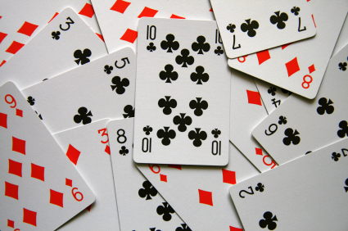
Sorting Faster
Remember the lesson from this guy:
Notes:
Get someone to sort a deck of cards. Obvious thing is bin sort into suits first.
http://leadinganswers.typepad.com/photos/uncategorized/2008/04/16/planning_poker_cards_3.jpg

Slide 62
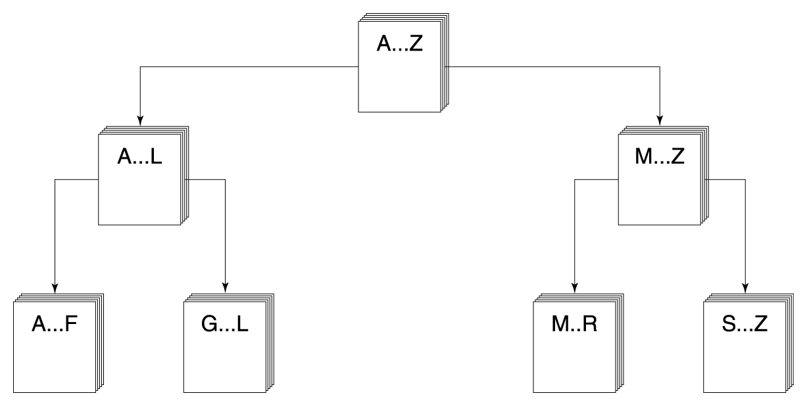
Quicksort

Slide 63
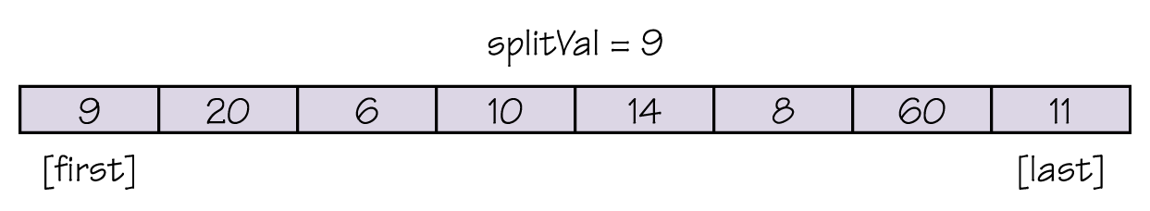
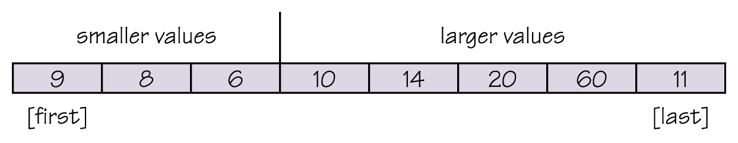
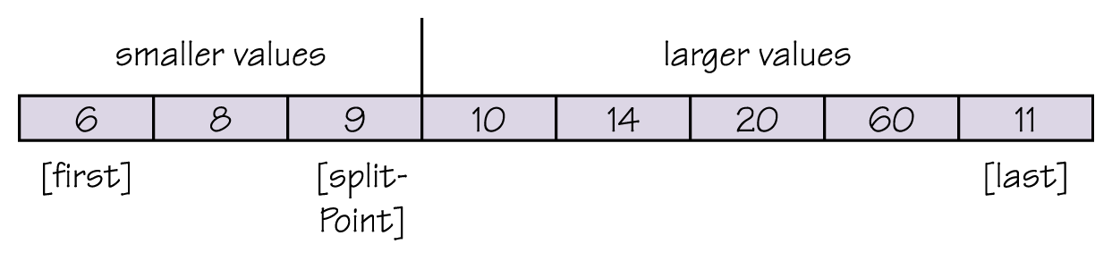
Quicksort
Notes:
Initial situation. For lack of a better idea, choose the first element as splitVal, but this is a dumb thing to do if the list is close to sorted.
Move everyone to left or right.
Then make splitval the last element on the right.
Then do it again for the the two sides.

Slide 64
Quicksort
def quicksort(first, last):
if first < last: # There is more than one item
select splitVal
split (splitVal) # Array between first and
# splitPoint–1 <= splitVal
# data[splitPoint] = splitVal
# Array between splitPoint + 1
# and last > splitVal
quicksort (first, splitPoint - 1)
quicksort (splitPoint + 1, last)
http://math.hws.edu/TMCM/java/labs/xSortLabLab.html
Notes:
Go here. Choose quicksort from the pulldown.

Slide 65
Quicksort
How many operations (swaps)?
O(n log n)
Notes:
Point out that we can prove that we can’t do a comparison sort in less time than this.

Slide 66
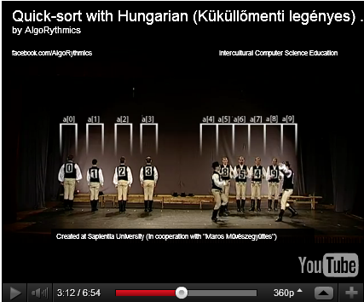
Quicksort
www.youtube.com/watch?v=ywWBy6J5gz8&feature=player_embedded#!
Notes:
Point out that the two sides, once separate, could easily operate in parallel.
Hungarian dancers doing quicksort
http://www.improbable.com/2012/01/01/sorting-algorithms-embodied-in-dance/

Slide 67
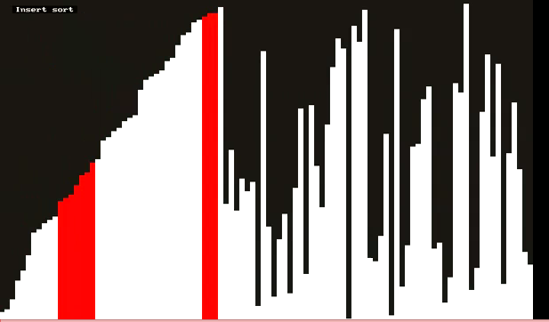
Comparing Sorting Algorithms
http://www.youtube.com/watch?v=t8g-iYGHpEA&feature=related

Slide 68
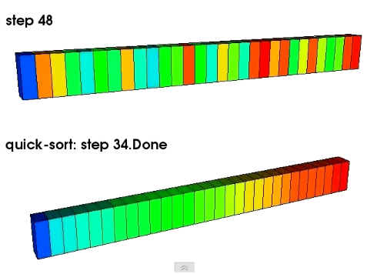
Comparing Sorting Algorithms
http://www.youtube.com/watch?v=F-7kk4lY_mQ&NR=1&feature=fvwp

Slide 69
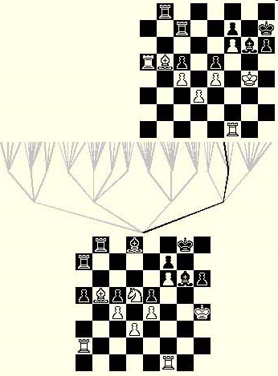
Heuristic Search
Notes:
Recall the idea of searching a space. For problems like chess, we must explore many branches. We will return to Chess in EasyHardImpossible. The key is that we use knowledge to guide the search.

Slide 70
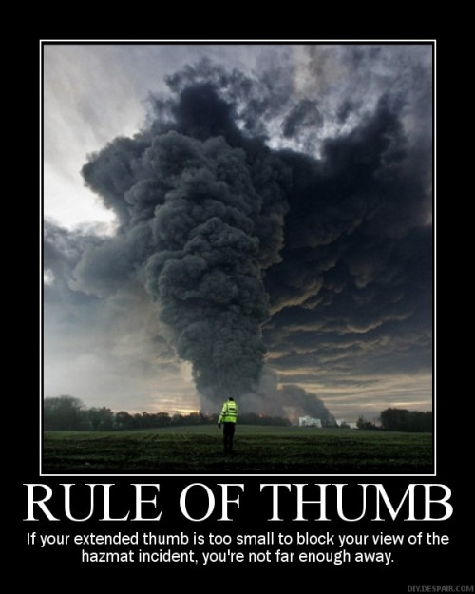
What is a Heuristic?
Notes:
http://www.scmfocus.com/sapplanning/2008/09/21/ppds-and-snp-heuristics/

Slide 71
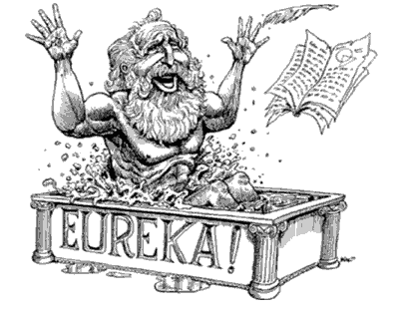
What is a Heuristic?
The word heuristic comes from the Greek word ευρισκειν (heuriskein), meaning “to discover”, which is also the origin of eureka, derived from Archimedes’ reputed exclamation, heurika (“I have found”), uttered when he had discovered that the volume of water displaced in the bath equals the volume of whatever (him) got put in the water. This could be used as a method for determining the purity of gold.
Notes:
http://itsjustnc.blogspot.com/2010_02_01_archive.html

Slide 72
What is a Heuristic?
The word heuristic comes from the Greek word ευρισκειν (heuriskein), meaning “to discover”, which is also the origin of eureka, derived from Archimedes’ reputed exclamation, heurika (“I have found”), uttered when he had discovered that the volume of water displaced in the bath equals the volume of whatever (him) got put in the water. This could be used as a method for determining the purity of gold.
A heuristic is a rule that helps us find something.
Notes:
http://itsjustnc.blogspot.com/2010_02_01_archive.html

Slide 73
Heuristic Search on the Web
Searches you use everyday:
Notes:
Google (page rank), netflix, Facebook We’ll look at a much smaller, simpler problem next.

Slide 74
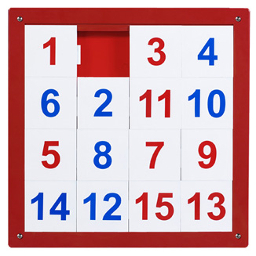
The 15-Puzzle
http://www.javaonthebrain.com/java/puzz15/
Notes:
Hand out puzzles. Let students try. Or follow the link for an applet.
http://www.apluseducationaltoys.com/store-products-SKU%3A-NPZ7719-Number-1-15-Puzzle-Wall-Panel_41303944.html

Slide 75
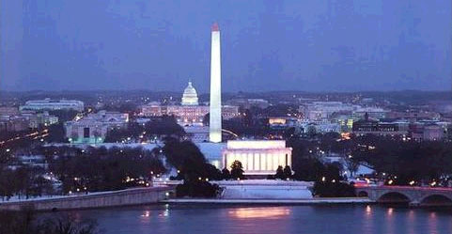
Hill Climbing
Problem: You have just arrived in Washington, D.C. You’re in your car, trying to get downtown to the Washington Monument.

Slide 76
Objective (Heuristic) Functions
To guide our search, we need something to measure. Then we can seek to maximize (or minimize).

Slide 77
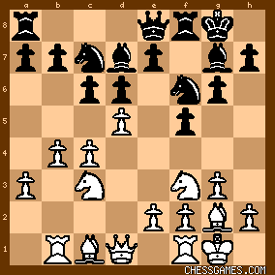
An Objective (Heuristic) Function for Chess
c₁ * material +
c₂ * mobility +
c₃ * king safety +
c₄ * center control + ...
Computing material:
Pawn 100
Knight 320
Bishop 325
Rook 500
Queen 975
King 32767
Notes:
Recall that we saw this back in Computational Thinking.
Evaluation function: http://en.wikipedia.org/wiki/Evaluation_function
Material: http://www.chessbin.com/post/Chess-Board-Evaluation.aspx

Slide 78
An Objective (Heuristic )Function for Driving
Notes:
What do you use?

Slide 79
An Objective (Heuristic) Function for the 15-Puzzle
Notes:
What sort of “distance” measure can we use?
http://www.apluseducationaltoys.com/store-products-SKU%3A-NPZ7719-Number-1-15-Puzzle-Wall-Panel_41303944.html

Slide 80
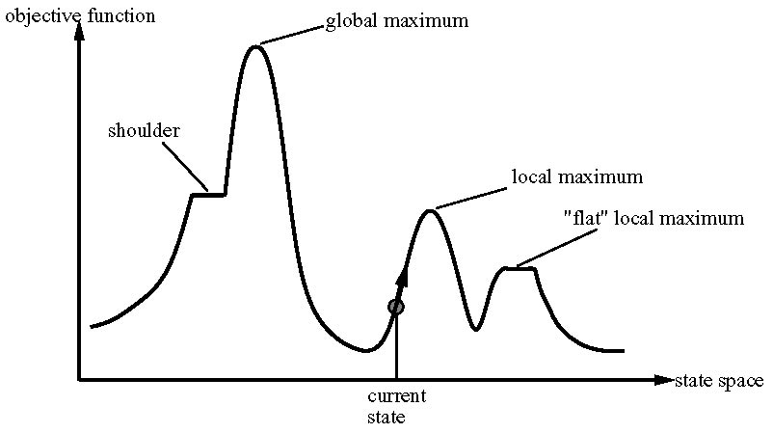
Hill Climbing – Some Problems
Notes:
Various ways of getting stuck.

Slide 81
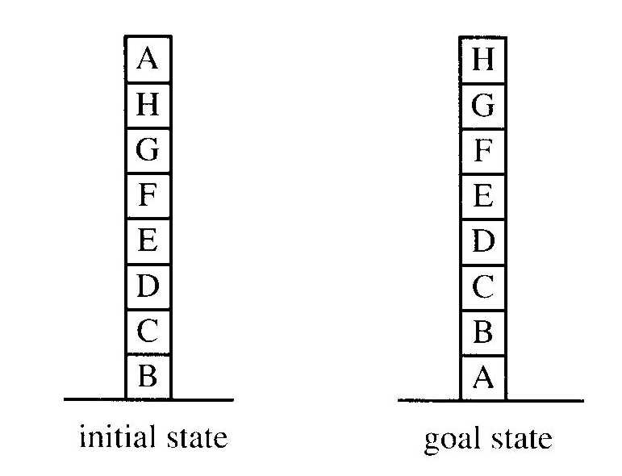
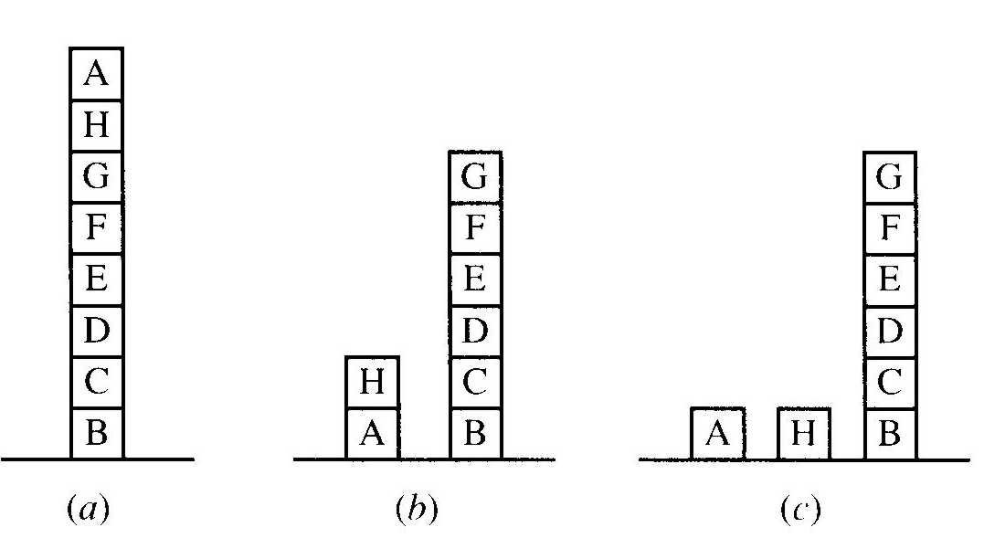
Let’s Try This One
From the initial state, move A to the table. Three choices for what to do next.
A local heuristic function: Add one point for every block that is resting on the thing it is supposed to be resting on. Subtract one point for every block that is sitting on the wrong thing.
Notes:
The goal state has a score of 8. The initial state has a score of 4. After move 1, the score 6. But now all successor states are worse. Try a more global function: For each block that has the correct support structure (i. e., the complete structure underneath it is exactly as it should be), add one point for every block in the support structure. For each block that has an incorrect support structure, subtract one point for every block in the existing support structure.

Slide 82
“Randomness”
Computers behave in a predicatble way.
But some processes are naturally random.
Notes:
Isn’t computer behavior supposed to be predictable? But can we simulate random processes.

Slide 83
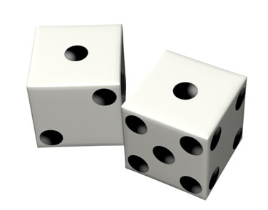
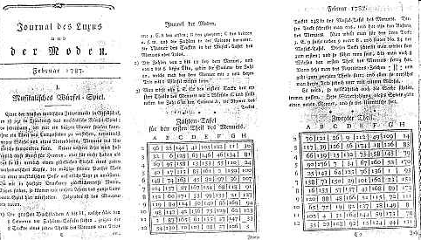
Musikalisches Würfelspiel
A musical dice game
Notes:
Download the Mozart app from http://www.amaranthpublishing.com/MozartDiceGame.htm (also where image of original score came from)

Slide 84
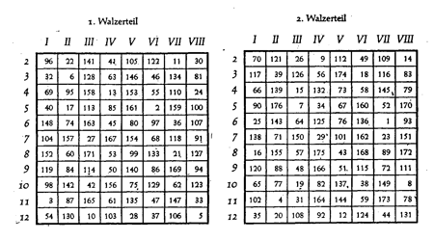
Musikalisches Würfelspiel
A musical dice game
Notes:
http://www.lettermodel.org/wordpress/?p=1644

Slide 85
Musikalisches Würfelspiel
An algorithm to generate a piece of music:
def musical_dice(table):
for i in range(len(table)):
table[i] = roll_dice()
Notes:
Download the Mozart app from http://www.amaranthpublishing.com/MozartDiceGame.htm (also where image of original score came from)

Slide 86
Musikalisches Würfelspiel
An algorithm to generate a piece of music:
import random
def musical_dice(table):
for i in range(len(table)):
table[i] = roll_dice()
def roll_dice():
x = random.randint(1,6)
y = random.randint(1,6)
return(x + y)
Notes:
Why not just call randint once to get a number between 1 and 12? Because then all numbers would be equally likely. Remember the dice program we already did.

Slide 87
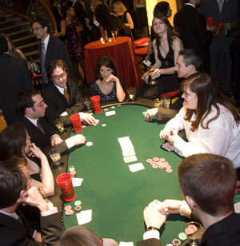
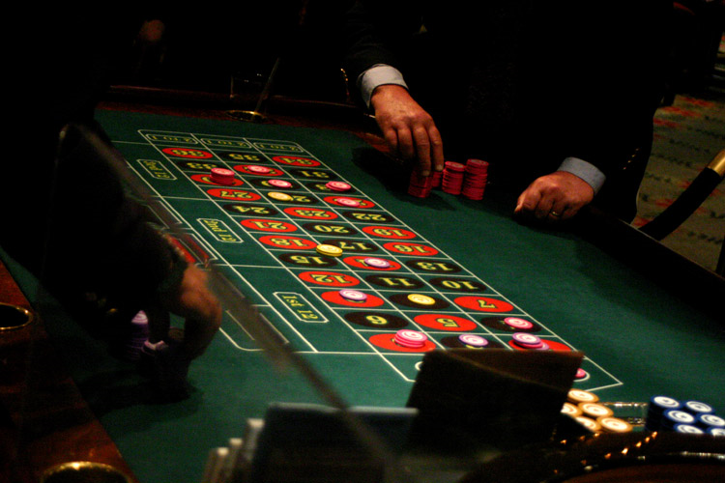
Recall Monte Carlo Methods
Notes:
Talk about how a computer can generate random numbers. Musical_dice.py has my code for the dice but also a simple random number generator. Can illustrate how it works.
Monte carlo: http://www.tripadvisor.com/Tourism-g190409-Monte_Carlo-Vacations.html
Blackjack: http://www.rhsmith.umd.edu/news/stories/2009/montecarlonight.aspx
http://www.montecarloarcade.com/About_Us.html

Slide 88
Applications of Monte Carlo Methods
Very useful for complex problems that we don’t know how to model exactly:
Weather
Oil exploration
Engineering design, e.g., a new network
Financial systems

Slide 89

SIMD Parallelism
Weather
Oil exploration
Engineering design, e.g., a new network
Financial systems
Notes:
We can run the experiment in parallel on many processors, then just aggregate the results.
Consider, at this point, showing monte carlo simulation to find value of pi.

Slide 90
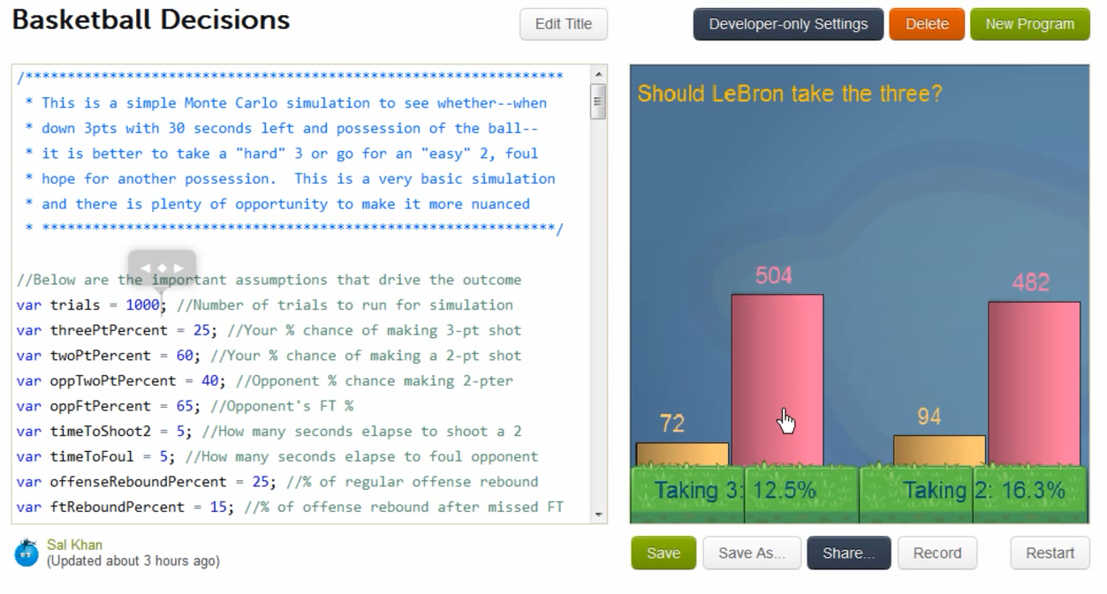
A Monte Carlo Example
http://www.youtube.com/watch?v=-fCVxTTAtFQ Intro, then skip to 6:36

Slide 91
Real Programs
 | Lines of Code | Developers
OpenOffice | 9 million
Android OS | http://www.gubatron.com/blog/2010/05/23/how-many-lines-of-code-does-it-take-to-create-the-android-os/
GNU/Linux | 30 million
Windows Vista | 50 million | 2000
Mac OS X 10.4 | 86 million
Lucent 5ESS Switch | 100 million | 5000
Notes:
Windows XP : http://en.wikipedia.org/wiki/Source_lines_of_code
OpenOffice:http://www.openoffice.org/FAQs/build_faq.html#source
GNU/Linux: http://www.dwheeler.com/sloc/
Lucent switch and Windows Vista: http://brianmackay.name/post/2009/01/14/The-Worlds-Largest-Software-Project.aspx
MAC OS X http://en.wikipedia.org/wiki/Source_lines_of_code

Slide 92
Divide and Conquer
def chess(board):
while game_on:
internal_board = scan(board)
move = choose(internal_board)
play(move, board)
Notes:
Recall this one. We broke it apart into its major pieces. It’s the key in big systems.

Slide 93
Coding and Debugging
“Debugging is twice as hard as writing the code in the first place. Therefore, if you write the code as cleverly as possible, you are, by definition, not smart enough to debug it.”
Brian Kernighan
Notes:
So we try to get around this by writing good code in the first place.
Quoted in David Reed, A Balanced Introduction to Computer Science, p. 79

Slide 94
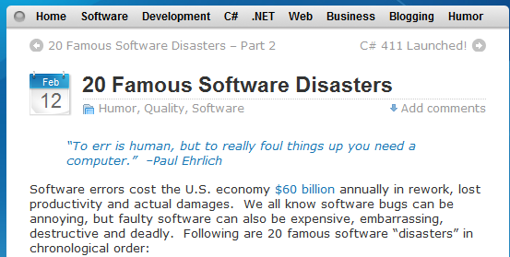
20 Famous Software Disasters
http://www.devtopics.com/20-famous-software-disasters/

Slide 95
Robustness
Does your program work no matter what?
Alternatively: What preconditions must hold in order for your program to work?

Slide 96
A Simple Program - Average
def average(numbers):
sum = 0
for num in numbers:
sum = sum + num
return(sum/len(numbers))
Notes:
Recall that we did this in our first discussion of Python. Load my function average. Try it with bad input.

Slide 97
A Simple Program - Average
def average_better(numbers):
try:
sum = 0
for num in numbers:
sum = sum + num
return(sum/len(numbers))
except:
print("Only defined for list of numbers")
return(0)
Notes:
Load my file averagewitherrorchecking . The function is average_better. See if we can break it.
It will break if we call it on a, where a is an undefined variable. Also if called with more than one argument, e.g., (1,3,4).
It will work on strings. On list of length 0. It will break on numbers too large. Try 5e+400.

Slide 98
3n + 1
until n is 1:
if n is even: n = n/2
if n is odd: n = 3n+1
What happens on: n = 7
Notes:
Go to IDLE and load my module threenplus1.py.
Threen(-7) will infinite loop.

Slide 99
3n + 1
until n is 1:
if n is even: n = n/2
if n is odd: n = 3n+1
def threen(value):
# compute 3n+1
while value != 1:
if value % 2 == 0:
value = value//2
else:
value = 3 * value + 1
print(int(value))
http://math.carleton.ca/%7Eamingare/mathzone/3n+1.html
Notes:
Go to IDLE and load my module threenplus1.py.

Slide 100
3n + 1
until n is 1:
if n is even: n = n/2
if n is odd: n = 3n+1
def threen(value):
# compute 3n+1
while value != 1:
if value % 2 == 0:
value = value//2
else:
value = 3 * value + 1
print(int(value))
Collatz Conjecture: This program always halts.
Notes:
Go to IDLE and load my module threenplus1.py.
Or go to: http://math.carleton.ca/%7Eamingare/mathzone/3n+1.html

Slide 101
3n + 1
until n is 1:
if n is even: n = n/2
if n is odd: n = 3n+1
def threen(value):
# compute 3n+1
while value != 1:
if value % 2 == 0:
value = value//2
else:
value = 3 * value + 1
print(int(value))
But what happens on:
threen(-7)?
Notes:
Go to IDLE and load my module threenplus1.py.
Threen(-7) will infinite loop.

Slide 102
Robustness
Recall:
def threen(value):
# compute 3n+1
while value != 1:
if value % 2 == 0:
value = value//2
else:
value = 3 * value + 1
print(value)
What happens on:
threen(7.5)?
Notes:
Threen(7.5) will eventually converge but not the way you’d expect because fractions are never equal to 0 mod 2.

Slide 103
Robustness
Recall:
def threen(value):
# compute 3n+1
while value != 1:
if value % 2 == 0:
value = value//2
else:
value = 3 * value + 1
print(value)
What happens on:
threen(“a”)?
Notes:
Threen(“a”) will crash.

Slide 104
Robustness
Recall:
def threen(value):
# compute 3n+1
while value != 1:
if value % 2 == 0:
value = value//2
else:
value = 3 * value + 1
print(value)
What happens on:
threen(37373738383737373837378382982748028272784646)?
Notes:
Perhaps surprisingly, this works.

Slide 105
A More Robust Version
def threen1():
start = input("\nEnter 0 to quit or a starting value with
no more than 15 digits: ")
while start != "0":
if len(start) > 15:
start = input("\nInput is too large. Try a
shorter one: ")
continue
value = int(start)
if value < 1:
start = input("\nInput must be a positive
integer. Try again: ")
continue
while value != 1:
if value % 2 == 0:
value = value//2
else:
value = 3 * value + 1
print(value)
start = input("\nEnter 0 to quit or a starting
value with no more than 15 digits: ")
Notes:
Will break on 7.5 and “a”

Slide 106
An Even More Robust Version
def threen2():
start = input("\nEnter 0 to quit or a positive integer: ")
while start != "0":
needinput = 1
while needinput == 1
try:
value = int(float(start))
except ValueError:
start = input("Input must be a number. Try again: “)
continue
if len(start) > 15:
start = input("\nInput is too large. Try a shorter one: ")
elif value < 1:
start = input("\nInput must be a positive integer.Try again: ")
elif float(value) != float(start):
start = input("\nInput must be a positive INTEGER.Try again: ")
else:
needinput = 0
while value != 1:
if value % 2 == 0:
value = value//2
else:
value = 3 * value + 1
print(value)
start = input("\nEnter 0 to quit or a positive integer : ")
Notes:
Doesn’t break (I think)

