Slide 1
Networks
Chapters 15 and 16

Slide 2
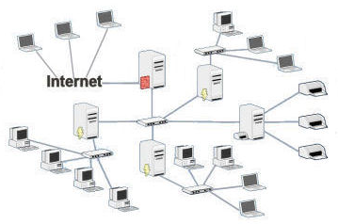
Physical Networks
Notes:
http://pacificcomputersolutions.com/ManagedServices.aspx
Notice hierarchical structure.
First we’ll talk about linking computers together. Then we’ll talk about hypertext. Then we can discuss the World Wide Web.

Slide 3
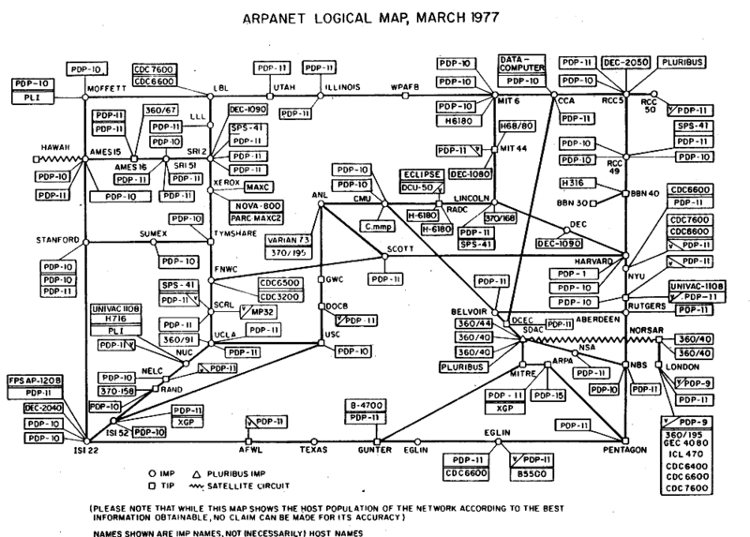
Notes:
http://en.wikipedia.org/wiki/File:Arpanet_logical_map,_march_1977.png

Slide 4
How Far Fetched?
1981
http://www.youtube.com/watch?feature=player_embedded&v=5WCTn4FljUQ

Slide 5
The Ubiquitous Web
“When I took office, only high energy physicists had ever heard of what is called the Worldwide Web…. Now even my cat has its own page.”
- President Bill Clinton, 1996
Notes:
Taken from David Reed A Balanced Introduction to Computer Science. P. 43.

Slide 6
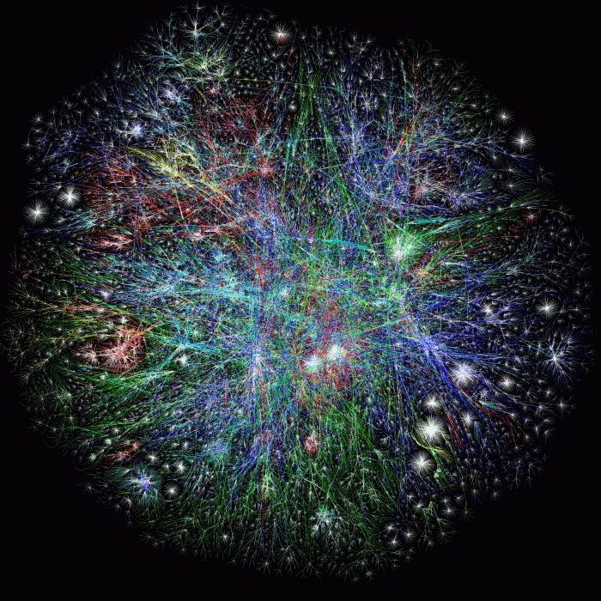
World Wide Web 2005
Notes:
http://entropychaos.wordpress.com/

Slide 7
How Many?
This is a topic that is important to us at Cisco. We believe the number of internet connected devices reached:
8.7 billion
in 2012.
Notes:
http://www.forbes.com/sites/quora/2013/01/07/how-many-things-are-currently-connected-to-the-internet-of-things-iot/

Slide 8
How Many?
Country | Population
USA | 315,718,000
Canada | 35,056,064
France | 65,619,000
Japan | 127,360,000
India | 1,354,040,000
China | 1,354,040,000
The world | 6,952,794,452
The Internet | 8,700,000,000
Notes:
Compare that to number of people.
http://en.wikipedia.org/wiki/List_of_countries_by_population

Slide 9
Internet All Over the World
Africa
Asia
Europe
Latin America/Carribean
Middle East
North America
Oceania/Australia
Notes:
Guess order with respect to internet penetration rate?
http://www.internetworldstats.com/stats.htm

Slide 10
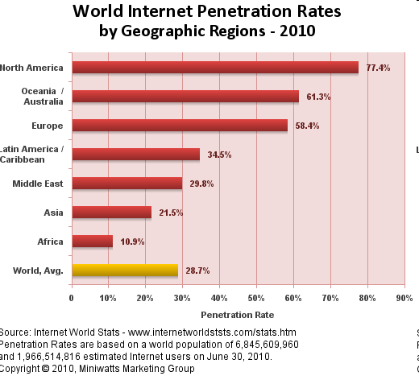
Internet All Over the World
Notes:
http://www.internetworldstats.com/stats.htm

Slide 11
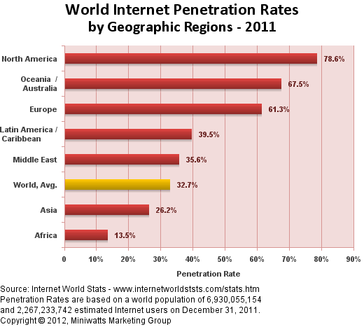
Internet All Over the World
By country: http://www.internetworldstats.com/top25.htm
Notes:
http://www.internetworldstats.com/stats.htm

Slide 12
Languages of the Internet
Arabic
Chinese
English
French
German
Japanese
Korean
Portugese
Russian
Spanish
Everything else
Notes:
http://www.internetworldstats.com/stats7.htm

Slide 13
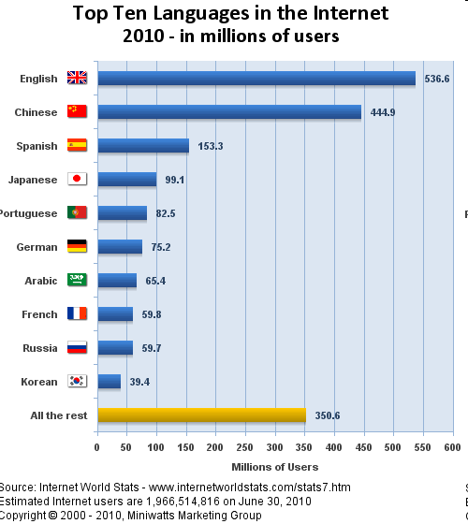
Languages of the Internet
Notes:
http://www.internetworldstats.com/stats7.htm

Slide 14
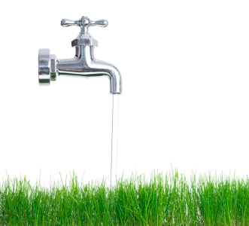
Basic Connectivity
Circuit switching
Notes:
Turn on the faucet. Dedicated path. Of course, the big difference is that the grass cannot send water back up.
http://www.cityofpflugerville.com/index.aspx?NID=1066

Slide 15
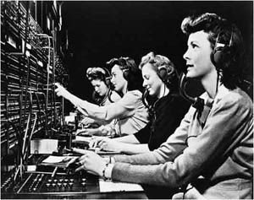
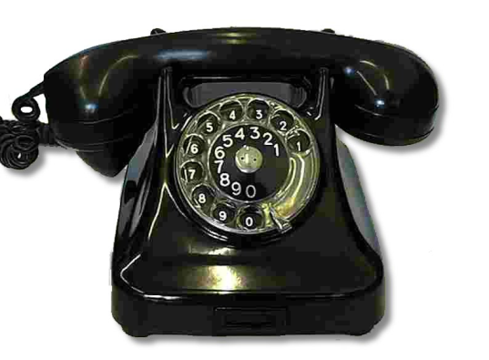
Basic Connectivity
Circuit switching
Notes:
Phone: http://dandelionmama.wordpress.com/2008/10/24/ten-things-that-drive-me-batty/
Operators: http://www.thepomoblog.com/papers/pomo92.htm

Slide 16
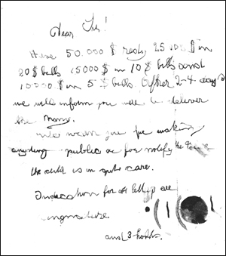
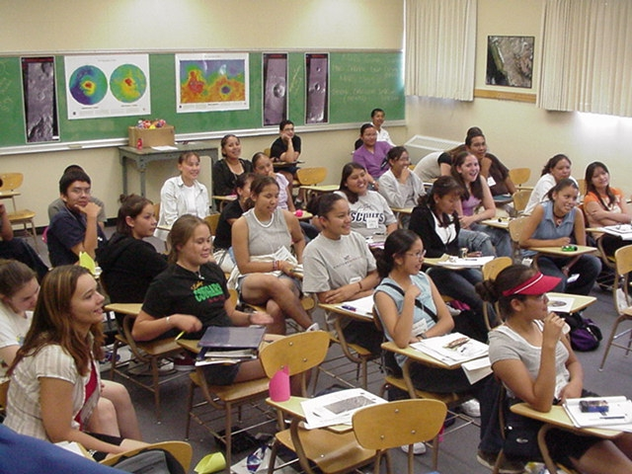
Basic Connectivity
Packet switching
Notes:
Ransom note: http://www.fbi.gov/news/stories/2008/march/lindbergh_030308
Classroom: http://classroomchoreography.wordpress.com/

Slide 17
Basic Connectivity
Packet switching
Notes:
http://www.countryliving.com/antiques/the-good-old-days-1110

Slide 18
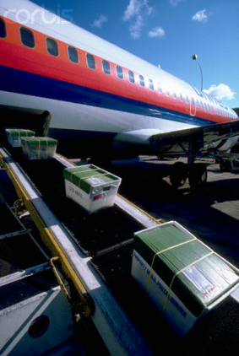
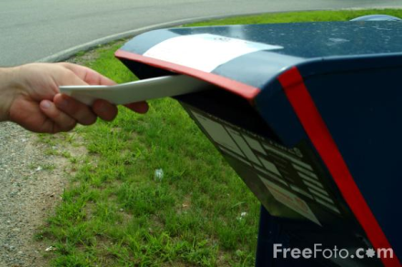
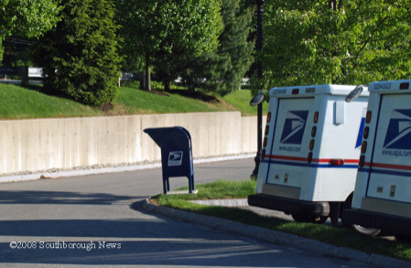
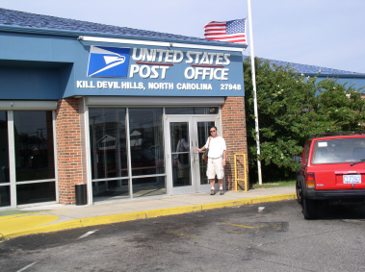
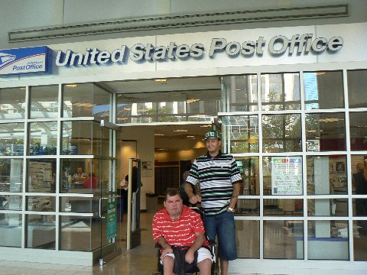
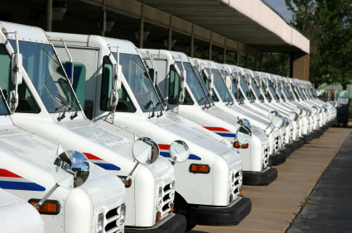
Basic Connectivity
Packet switching
Notes:
In mail box: http://djorbit.blogspot.com/2010_01_01_archive.html
Trucks: http://www.southboroughnews.com/Archivedpage55southboronews.htm
Post office: http://www.gyan.com/trip_progress.htm
Conveyor: http://www.corbisimages.com/Enlargement/69298.html
Post office: http://thetravelingwheelchair.com/us-post-office-at-prudential-center/
More trucks: http://racetalkblog.com/2008/07/23/can-green-save-the-us-postal-service-probably-not/
Mail slot: http://bayandgablevictorian.wordpress.com/2008/12/04/findings-and-refinishing-antique-hardware/dsc01791/

Slide 19
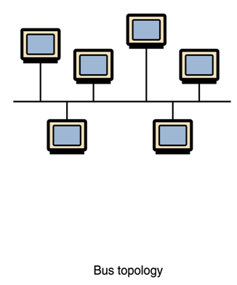
LAN Topologies
Notes:
LAN = Local Area Network
Problems: No redundancy. Bottlenecks.

Slide 20
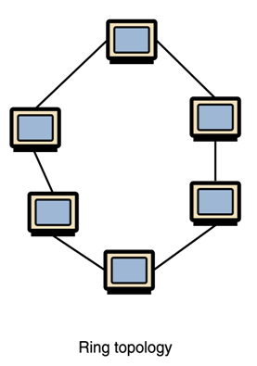
LAN Topologies
Notes:
Problems: No redundancy. Bottlenecks.

Slide 21
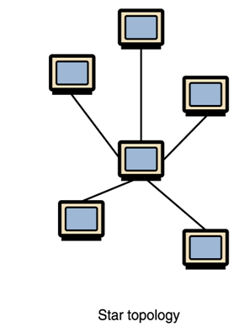
LAN Topologies
Notes:
Problems: No redundancy. Bottlenecks.

Slide 22
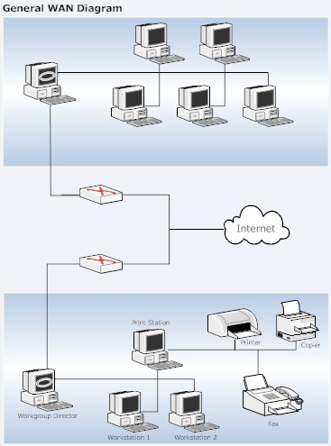
WANs
Notes:
http://kristin-itgs.wikispaces.com/LAN+and+WAN

Slide 23
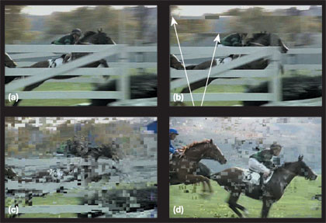
When Do You Notice Packets?
When transmitting MPEGs, if the reference frame packet is lost, it isn’t possible to resolve the relative descriptions.
Notes:
Particularly bad because of the way compression works.
http://www.tmworld.com/article/325225-IPTV_Video_s_latest_test_frontier.php

Slide 24
Bandwidth
Rate at which data are transmitted across a network.
Usually measured in bits/sec.
“Goodput” will be less than physical throughput.
Is limited by the weakest link in the chain.

Slide 25
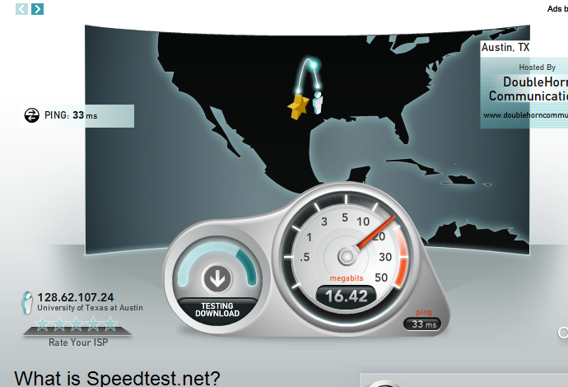
Bandwidth
http://www.speedtest.net/

Slide 26
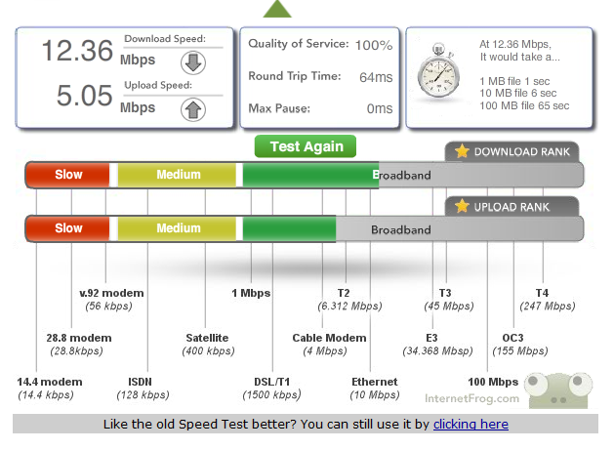
Bandwidth
http://www.internetfrog.com/mypc/speedtest/
Notes:
This one shows results compared to maxima.

Slide 27
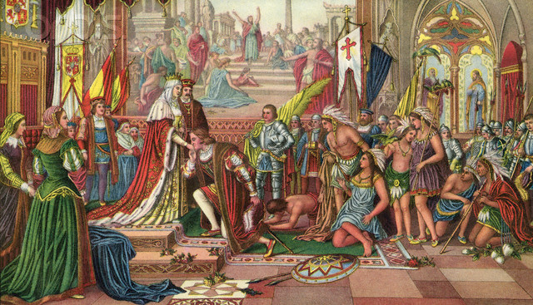
Protocols
Notes:
Note that there were protocols that Columbus had to follow.
Columbus at Barcelona: http://www.corbisimages.com/Enlargement/42-21545800.html

Slide 28
The Restaurant Protocol
Enter the restaurant.
Wait until greeted and taken to table.
Sit. Wait for menus.
Order drinks.
Order food.
Wait for food to come, then eat.
Ask for bill.
Pay bill.
Leave
Notes:
Note that this is simplified. It doesn’t specify what to do if something goes wrong. For example, any of the waiting steps could TIME OUT. Note that this is conventional. It could work some other way (like pay first). We’ve just all AGREED to do it this way.
Also note that there is an opening act (enter the restaurant) and a closing act (leave). Everything else must happen between two events. Network communication protocols share this property.

Slide 29
English Is a Communication Protocol
Put the children’s cereal on the bottom shelves.
Notes:
Problem: it takes substantial extra knowledge to know what these statements mean.

Slide 30
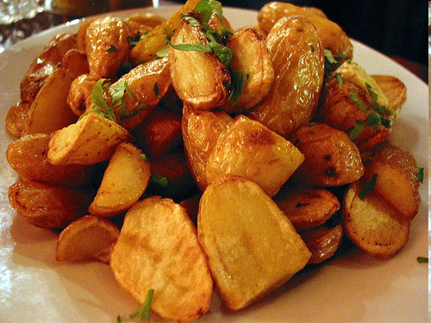
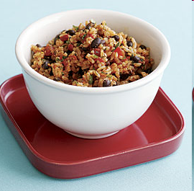
Ambiguity
You can have potatoes or rice and beans.
or
Notes:
http://dessertcomesfirst.com/?p=434 (potatoes)
http://www.taunton.com/finecooking/Recipes/Side-dishes/Black-beans/50044-52494.aspx?channel=1 (rice and beans)

Slide 31
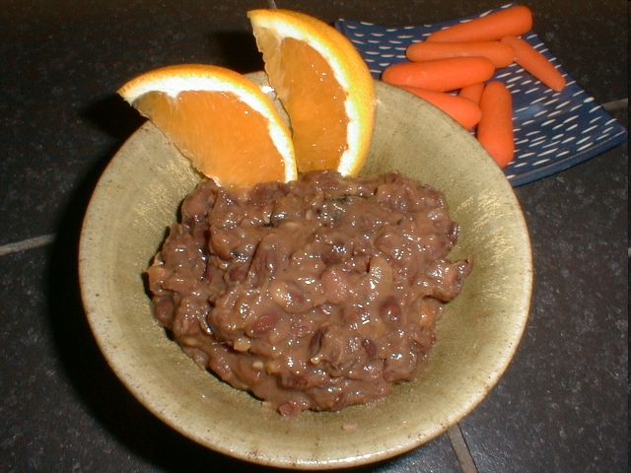
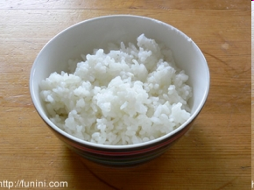
Ambiguity
You can have potatoes or rice and beans.
and
or
Notes:
http://dessertcomesfirst.com/?p=434 (potatoes)
http://readingwritingliving.wordpress.com/2007/11/16/rice-for-words/ (rice)
http://www.vitalita.com/foodpicts.html (beans)

Slide 32
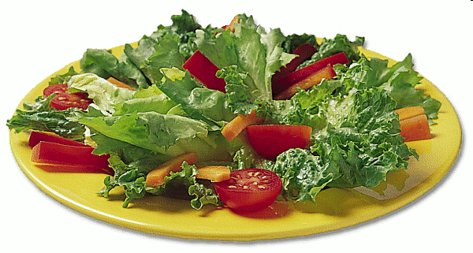
Ambiguity
You can have potatoes or rice and salad.
and
or
Notes:
http://dessertcomesfirst.com/?p=434 (potatoes)
http://readingwritingliving.wordpress.com/2007/11/16/rice-for-words/ (rice)
http://www.cksinfo.com/clipart/food/salads/side-salad.png (salad)

Slide 33
Robustness
The audio speaker is so construction that a sound of volume will come out of it when a key is depressed due to the finger. This is due to an electricity of alternate flowing in the coil in it.
Notes:
Point: people aren’t picky. But computers are.
http://stoeptalk.wordpress.com/2009/05/02/japlish-and-chinglese-irresistible/

Slide 34
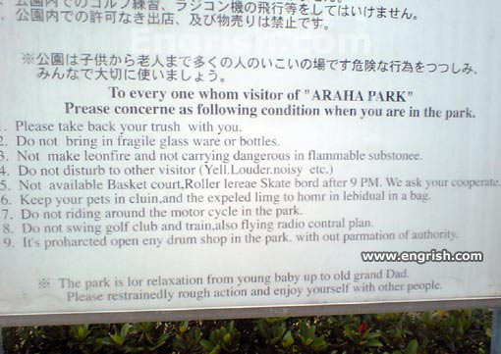
Robustness
Notes:
http://www.engrish.com/2007/11/araha-park-instructions/

Slide 35
Network Protocols
We need a protocol that is:
Efficient
Unambiguous
Robust

Slide 36
Communication Protocols You May Have Heard Of
tcp
ip
http
https
Notes:
Computers aren’t so flexible, so we need to specify precise protocols.

Slide 37
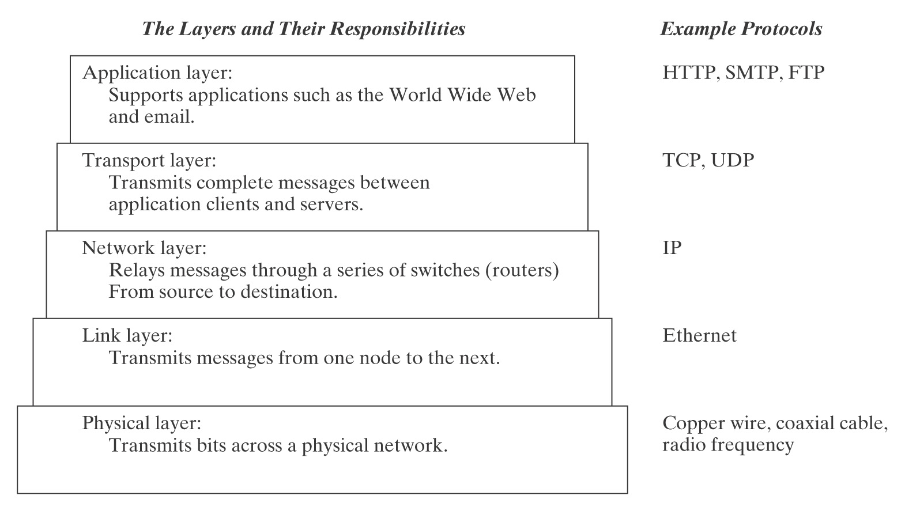
The Internet Protocol Stack
TLS/SSL
Notes:
http://upload.wikimedia.org/wikipedia/commons/e/e3/Computer_Memory_Hierarchy.svg
I added the TLS/SSL layer since its vulnerability has been in the news this week.

Slide 38
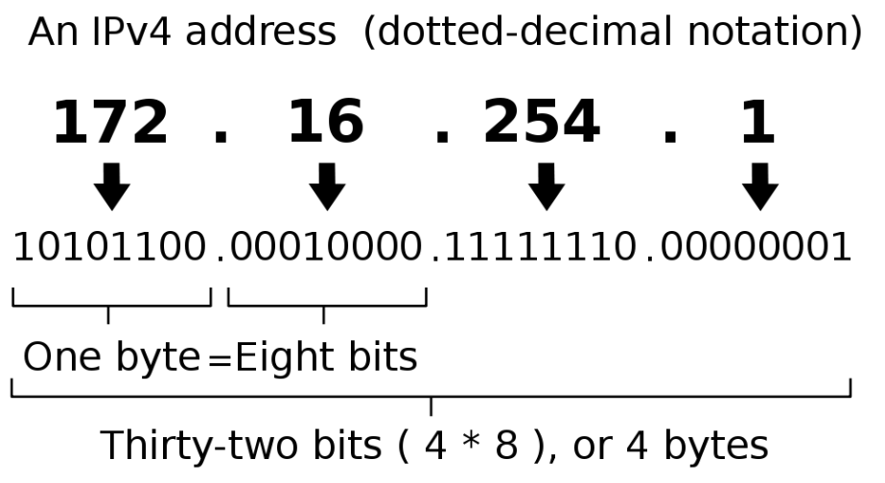
IP Addresses
2³² = 4,294,967,296 different ip addresses
Notes:
http://en.wikipedia.org/wiki/IP_address
Are we running out?

Slide 39
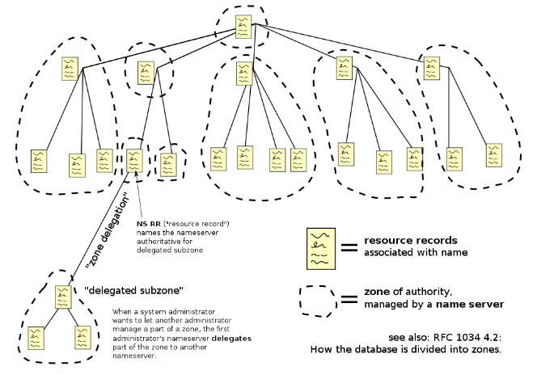
Human Friendly Domain Names
Notes:
http://upload.wikimedia.org/wikipedia/commons/thumb/b/b1/Domain_name_space.svg/1000px-Domain_name_space.svg.png

Slide 40
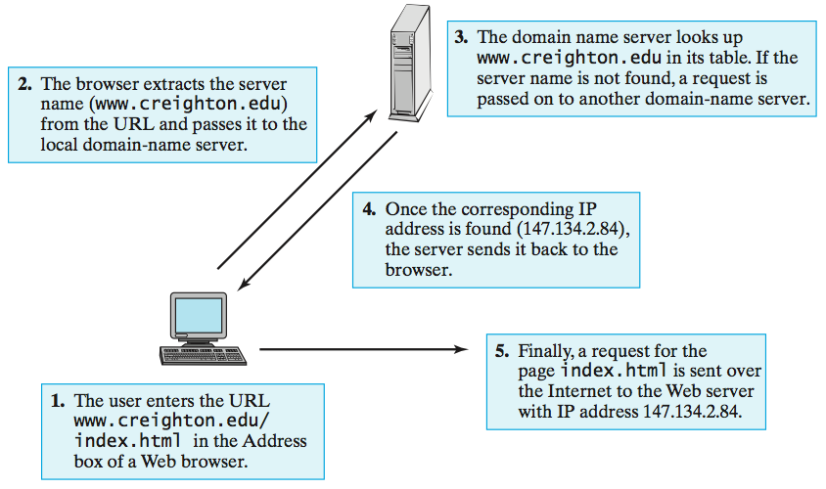
Domain Name Servers
Notes:
David Reed, A Balanced Introduction to Computer Science

Slide 41
A Very Simple Communication Protocol
Notes:
What happens if a packet gets lost? Or if the sender is sending faster than the receiver can receive?

Slide 42
ARQ Protocols
Automatic Repeat reQuest (or ARQ) protocols:
Exploit feedback from receiver back to sender.
A simple subfamily of ARQ protocols is called Stop-and-Wait.

Slide 43
Stop-and-Wait

Slide 44
Analyzing Stop-and-Wait
Stop-and-wait solves:
the flow control problem.
one error control problem: a message gets lost.
But what happens:
if a data message arrives successfully but its corresponding ACK message gets lost?
if delay causes confusion, as shown on next slide?

Slide 45
A Delayed Message Finally Appears

Slide 46
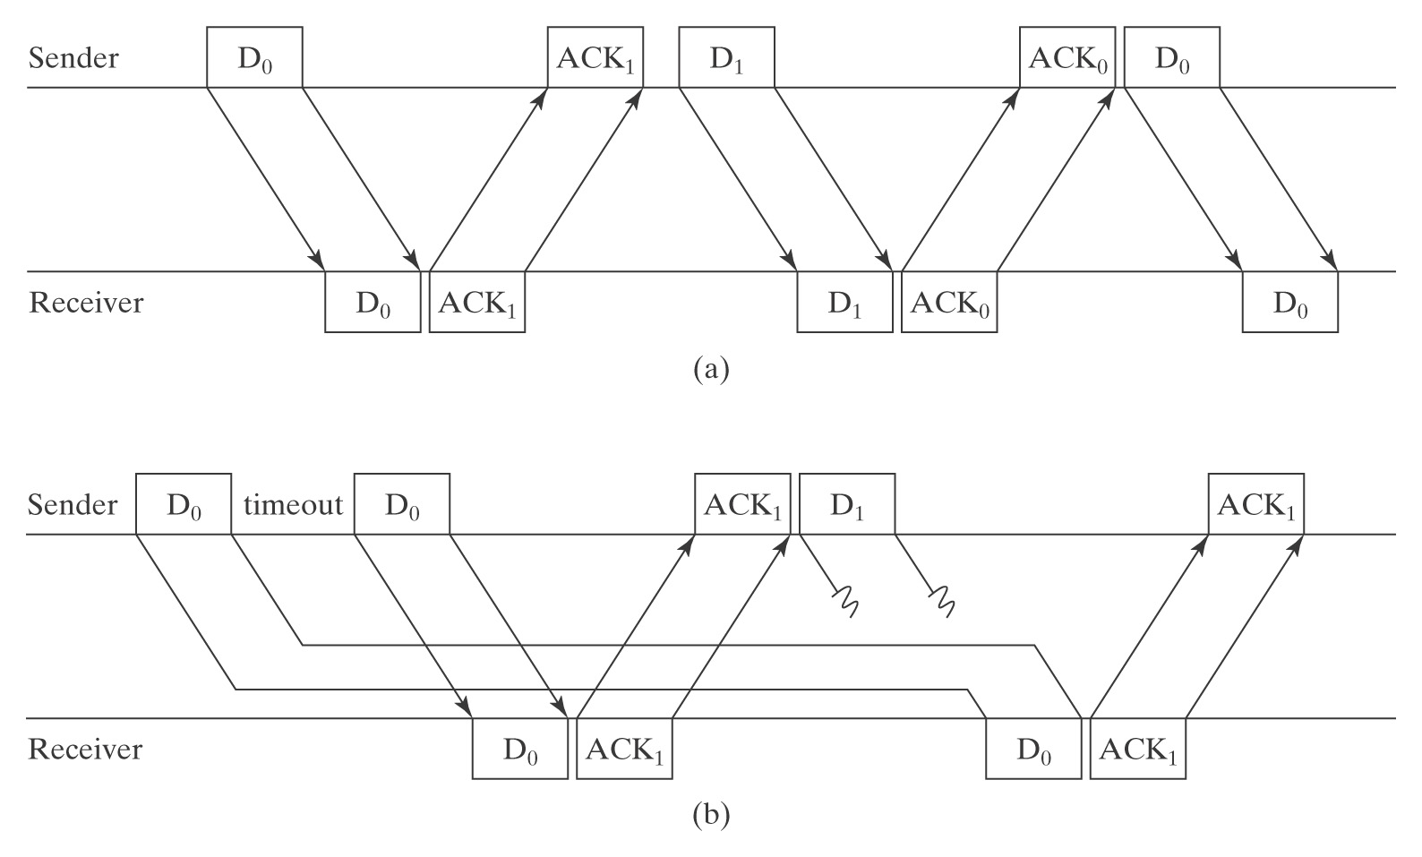
Alternating Bit Protocol

Slide 47
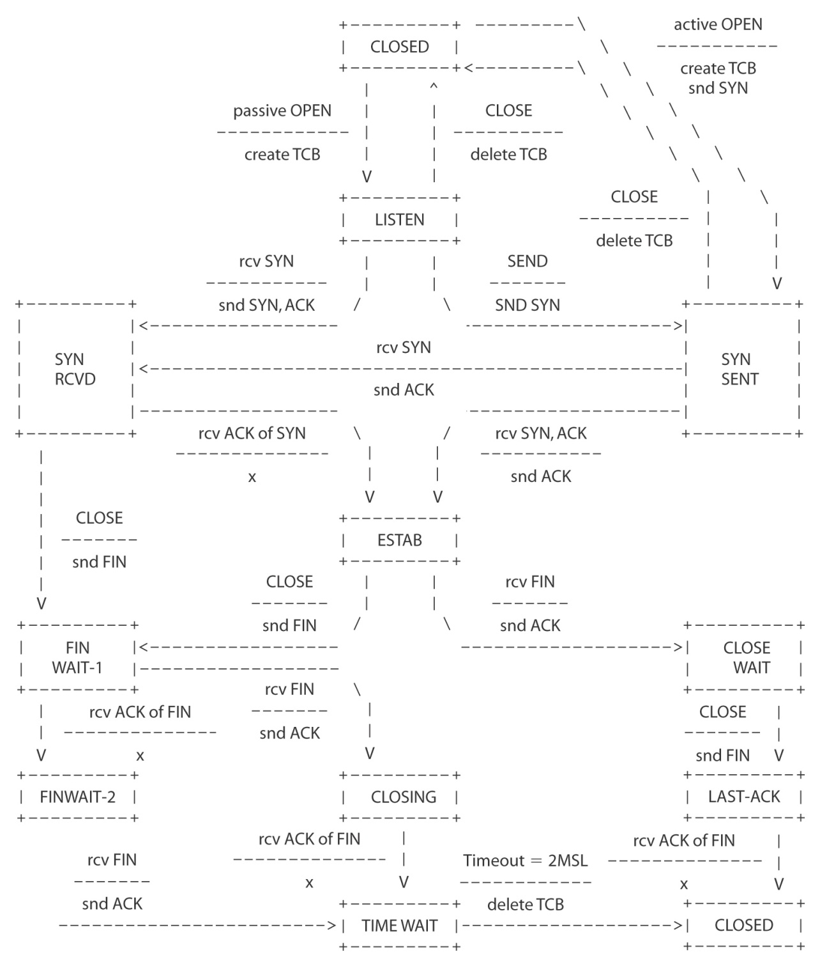
TCP
Notes:
Transmission Control Protocol

Slide 48
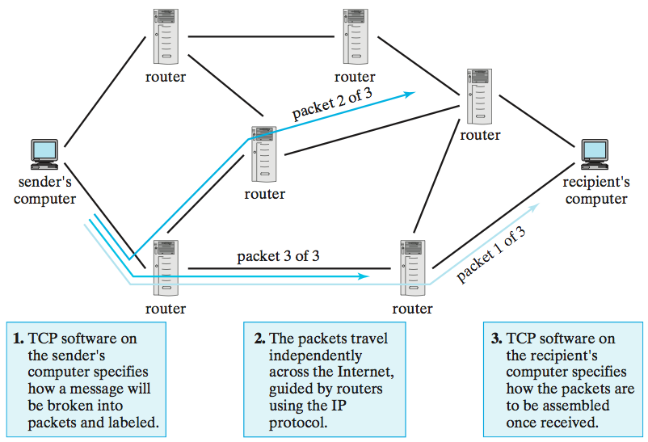
TCP/IP
Notes:
David Reed A Balanced Introduction to Computer Science p. 51

Slide 49
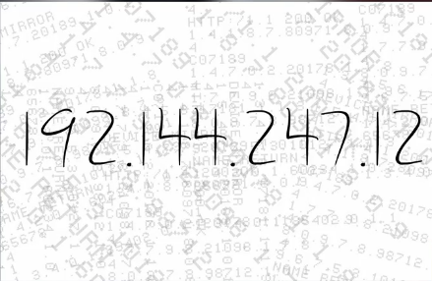
Watching It Work
http://www.wimp.com/internetworks/

Slide 50
The Internet Protocol Stack
TLS/SSL

Slide 51
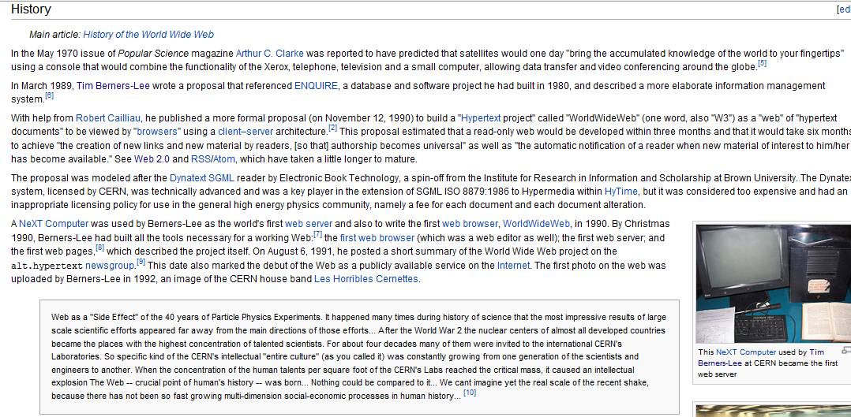
World Wide Web
Notes:
So far, talking about the physical network. Now let’s talk about useful layers on top of it.

Slide 52
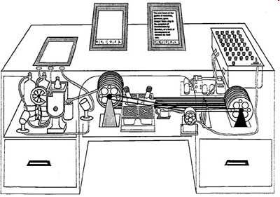
Memex
Vannevar Bush’s Memex machine, described in the essay, “As We May Think” in 1945.
http://en.wikipedia.org/wiki/Vannevar_Bush
Notes:
http://www.hirank.com/semantic-indexing-project/presentations/etcon/slide0002.htm
Brewster Kayle quoted in Lauckner and Linter, 2nd edition p. 241.

Slide 53
Memex
Vannevar Bush’s Memex machine, described in the essay, “As We May Think” in 1945.
“Bush’s great insight was realizing that there’s more value in the connections between data than in the data itself.” - Brewster Kayle (Wired)
http://en.wikipedia.org/wiki/Vannevar_Bush
Notes:
http://www.hirank.com/semantic-indexing-project/presentations/etcon/slide0002.htm
Brewster Kayle quoted in Lauckner and Linter, 2nd edition p. 241.

Slide 54
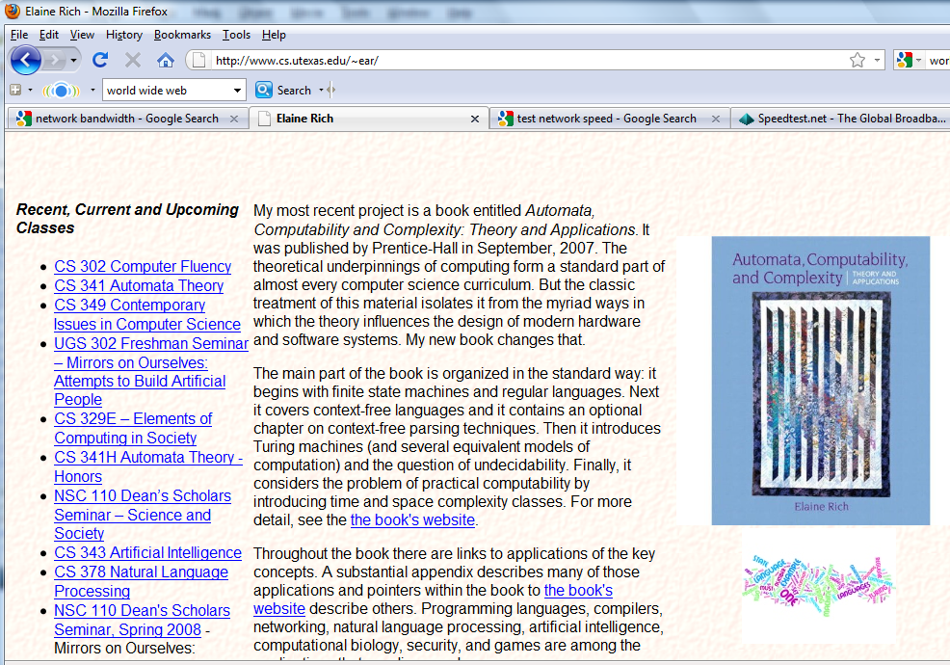
Hypertext
http://www.cs.utexas.edu/~ear/
Notes:
Talk about structure and links, not about display. Go to the site. Click around to see structure. Then make the window smaller to see how the physical display changes. We need a way to describe functional units independent of exact display structure. Unlike a page layout program.

Slide 55
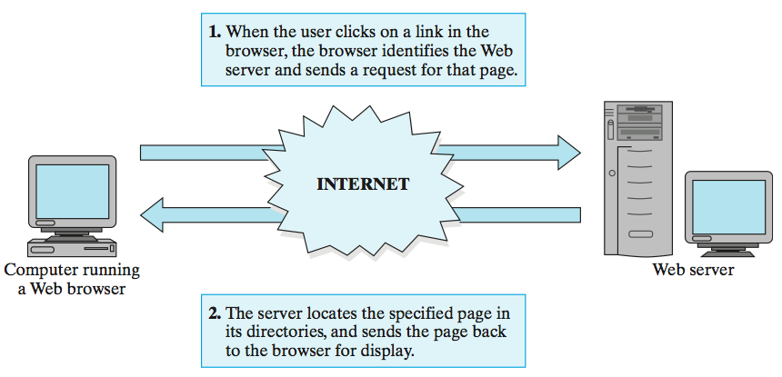
Hypertext Transfer Protocol (HTTP)
Client
Server
Notes:
Talk about client/server model.
David Reed A Balanced Introduction to Computer Science

Slide 56
HTML
Our project:
http://www.cs.utexas.edu/~ear/cs302/Homeworks/WebpageProject.html

Slide 57
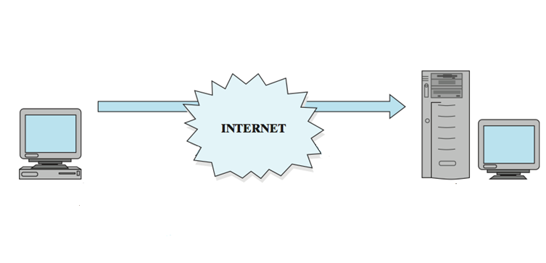
Building and Publishing a Site
FTP
Site Builder
Server
Notes:
Talk about client/server model.
David Reed A Balanced Introduction to Computer Science

Slide 58
Secure Communication
http://www.statesman.com
https://www.bankofamerica.com
Notes:
The s at the end matters.

Slide 59
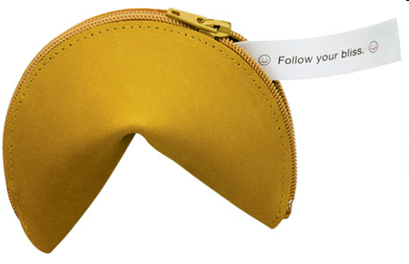
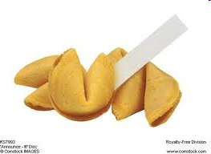
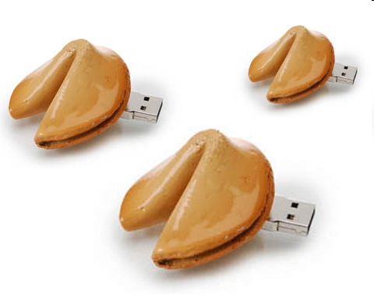
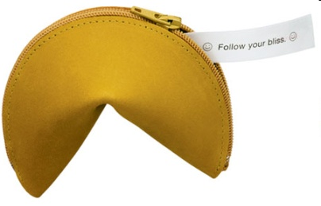
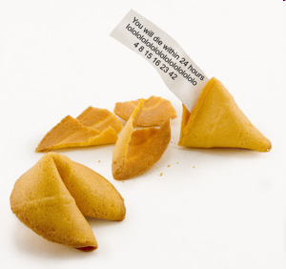
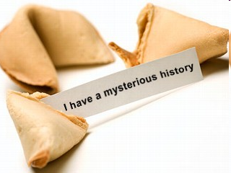
Cookies
Notes:
Usb cookies: http://technabob.com/blog/2007/11/27/fortune-cookie-usb-drives-save-memories-in-bed/
http://www.forums.editingarchive.com/images/archiveitems/4fortune-big.jpg
http://www.sodahead.com/united-states/so-do-you-think-obamas-presidentcy-is-doomed-regardlesss-is-health-care-passes-or-fails/question-827417/?link=ibaf&imgurl=http://a.abcnews.com/images/GMA/fortune_cookie_080808_mn.jpg&q=fortune%2Bcookie
Zippered one: http://www.puppiesandflowers.com/blogimages/09/02/fortuneCookieCoinPurse2.jpg

Slide 60
Cookies
GET /index.html HTTP/1.1 Host: www.example.org
HTTP/1.1 200 OK Content-type: text/html Set-Cookie: name=value (content of page)
GET /spec.html HTTP/1.1 Host: www.example.org Cookie: name=value Accept: */*
Notes:
Example from: http://en.wikipedia.org/wiki/HTTP_cookie
Images same as later slide on preferences

Slide 61
Cookies
Check whether this is a new or returning user
Shopping cart
First generation:
Cookie:
Little Red Book
How to Make a Bomb
Notes:
Shopping cart: http://sellfiles.org/wp-content/uploads/2010/09/shopping-cart.jpg

Slide 62
Cookies
Check whether this is a new or returning user
Shopping cart
Second generation:
Cookie:
Session id: 754623598761
Backend DB: id = 754623598761
order = Little Red Book
How to Make a Bomb

Slide 63
Cookies
Check whether this is a new or returning user
Shopping cart
Remember user name/password

Slide 64
Cookies
Check whether this is a new or returning user
Shopping cart
Remember user name/password
Preferences
webpage
clicks
Notes:
Stick figure: http://www.megansteidl.com/images/stick_figure.gif
Laptop: http://chaselaw.nku.edu/images/admissions/laptop.jpg
Server: http://www.uni-muenster.de/ZIV/inforum/jubilaeum-2004/a23.html

Slide 65
Cookies
Check whether this is a new or returning user
Shopping cart
Remember user name/password
Preferences
Tracking
id
request, id
id, url, date/time, ???
Id, url, date/time, ???
………
Notes:
Stick figure: http://www.megansteidl.com/images/stick_figure.gif
Laptop: http://chaselaw.nku.edu/images/admissions/laptop.jpg
Server: http://www.uni-muenster.de/ZIV/inforum/jubilaeum-2004/a23.html

Slide 66
Third-Party Cookies
Today:
MegaId#, ad
www.site1.com
Tomorrow:
#77654, site1
#77654, site2
ad
MegaId#
www.site2.com
Notes:
SoMegaAd Corp now knows that the same person who visited site1 (and maybe looked for a particular thing) also visited site 2.
Dollar sign building: http://www.corbisimages.com/images/67/D3D6B439-D962-44F7-A76D-4FE87D1002FD/42-19826901.jpg

Slide 67
Cookies
Cookies can have other attributes:
Can cookies infect your computer with viruses?
Set-Cookie: RMID=732423sdfs73242;
expires=Fri, 31-Dec-2010 23:59:59 GMT;
path=/; domain=.example.net
Notes:
Continues example from http://en.wikipedia.org/wiki/HTTP_cookie

Slide 68
Disabling Cookies
Let’s try it: http://www.washingtonpost.com
Mozilla help: http://support.mozilla.com/en-US/kb/Enabling+and+disabling+cookies?s=cookies&as=s

Slide 69
Flash Cookies
Let’s try it:
http://www.macromedia.com/support/documentation/en/flashplayer/help/settings_manager07.html
Notes:
Lawsuits now. Most users don’t know about this and what they can do about it.

Slide 70
Computing in the Cloud
Notes:
http://computer.howstuffworks.com/cloud-computing.htm

Slide 71
Computing in the Cloud
Notes:
http://oakleafblog.blogspot.com/2009/03/windows-azure-and-cloud-computing-posts_25.html

