Slide 1
Robots

Slide 2
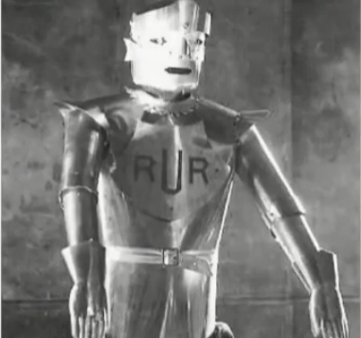
A Very Quick Introduction
http://www.youtube.com/watch?v=mbHy7TZ06_s
Notes:
Point that “firsts” are often controversial. It depends on what you count. But this is still a good very fast (just over one minute) view of the evolution of robots.

Slide 3
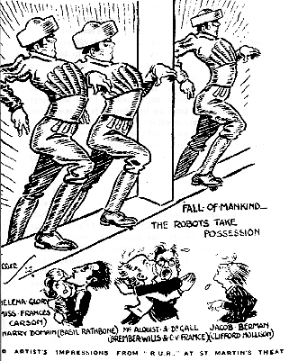
Rossum’s Universal Robots
A play by Karel Čapek, 1920
Notes:
Good synopsis on Wikipedia The word “robot” first used here.

Slide 4
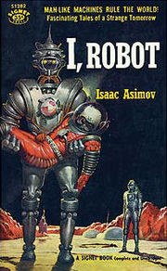
The Three Laws of Robotics
1942

Slide 5
The Three Laws of Robotics
A robot may not injure a human being or, through inaction, allow a human being to come to harm.
A robot must obey orders given to it by human beings except where such orders would conflict with the First Law.
A robot must protect its own existence as long as such protection does not conflict with the First or Second Law.

Slide 6
The Three Laws of Robotics
A robot may not injure a human being or, through inaction, allow a human being to come to harm.
A robot must obey orders given to it by human beings except where such orders would conflict with the First Law.
A robot must protect its own existence as long as such protection does not conflict with the First or Second Law.
What if it doesn’t know?

Slide 7
The Three Laws of Robotics
A robot may not injure a human being or, through inaction, allow a human being to come to harm.
A robot must obey orders given to it by human beings except where such orders would conflict with the First Law.
A robot must protect its own existence as long as such protection does not conflict with the First or Second Law.
Realistically, can a robot prevent all harm? Can a robot stop a war?

Slide 8
The Three Laws of Robotics
A robot may not injure a human being or, through inaction, allow a human being to come to harm.
A robot must obey orders given to it by human beings except where such orders would conflict with the First Law.
A robot must protect its own existence as long as such protection does not conflict with the First or Second Law.

Slide 9
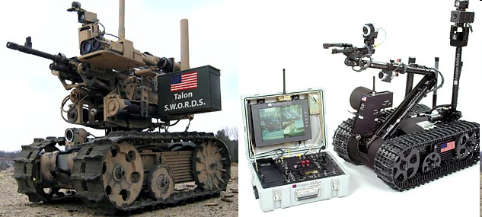
Military Robots
http://www.youtube.com/watch?v=YO8dLk_QGsM
Notes:
Picture from: http://www.news.com.au/technology/story/0,25642,23284564-5014239,00.html

Slide 10
The Three Laws of Robotics
A robot may not injure a human being or, through inaction, allow a human being to come to harm.
A robot must obey orders given to it by human beings except where such orders would conflict with the First Law.
A robot must protect its own existence as long as such protection does not conflict with the First or Second Law.
Should a military robot follow orders?

Slide 11
The Three Laws of Robotics
A robot may not injure a human being or, through inaction, allow a human being to come to harm.
A robot must obey orders given to it by human beings except where such orders would conflict with the First Law.
A robot must protect its own existence as long as such protection does not conflict with the First or Second Law.
What about orders from capricious or malicious people?

Slide 12
The Three Laws of Robotics
0. A robot may not injure humanity, or, through inaction, allow humanity to come to harm.
A robot may not injure a human being or, through inaction, allow a human being to come to harm except if such orders would conflict with the Zero^{th} Law.
A robot must obey orders given to it by human beings except where such orders would conflict with the First Law.
A robot must protect its own existence as long as such protection does not conflict with the First or Second Law.
Notes:
So the 0th law would say that it is okay for a robot to a kill a murderer or a terrorist.

Slide 13
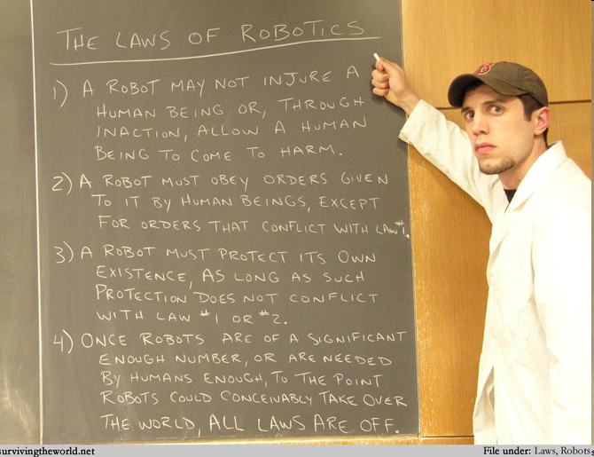
Or Is There a 4th?
Notes:
http://survivingtheworld.net/Lesson317.html

Slide 14
Asimov’s Laws as a Literary Device
The three laws make good stories.
But they only work in practice if/when robots possess at least human levels of awareness, reason, and ethics.
The work of David Woods and Robin Murphy: http://researchnews.osu.edu/archive/roblaw.htm

Slide 15
Woods and Murphy’s New Set of Laws
A human may not deploy a robot without the human-robot work system meeting the highest legal and professional standards of safety and ethics.
A robot must respond to humans as appropriate for their roles.
A robot must be endowed with sufficient situated autonomy to protect its own existence as long as such protection provides smooth transfer of control which does not conflict with the First and Second Laws.

Slide 16
Special-Purpose Robots

Slide 17
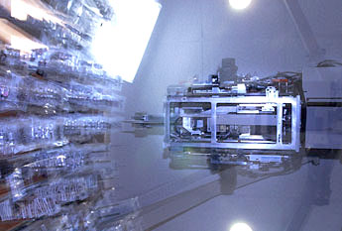
Robotic Pharmacists
Phil c 2003
Simple demo of one robot:
http://www.youtube.com/watch?v=RzLDs4nJK0U
Short documentary about Brigham and Women’s:
http://www.youtube.com/watch?v=xhm0Cn7Q5NQ
Notes:
Doctors will write the equivalent of 10 prescriptions for every person in the country, and as the population ages and drugs are more aggressively marketed, the numbers are growing.
A shortage of pharmacists needed to keep up with the demand hit its peak two years ago, but it still exists in some areas. There are about 5,000 open pharmacy positions nationwide.
And because of the paperwork and overwork associated with the enormous volume of prescriptions, mistakes still are being made. Most estimates put the number of mistakes at about 4 percent.
Still, that represents more than 100-million mistakes a year - sometimes with tragic consequences.

Slide 18
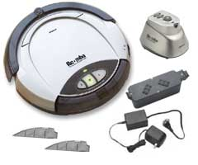
At the Other End of the Spectrum – Roomba
2001 A robot vacuum cleaner

Slide 19
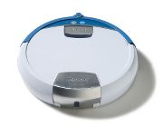
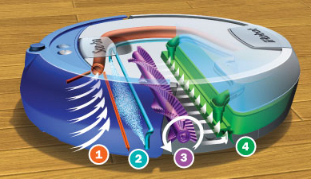
And Then There’s – Scooba

Slide 20
Exploiting Household Robots
Intended consequence:
Create free time.
Unintended consequence:

Slide 21
Exploiting Household Robots
Intended consequence:
Create free time.
Unintended consequence:
Increase birthrate?

Slide 22
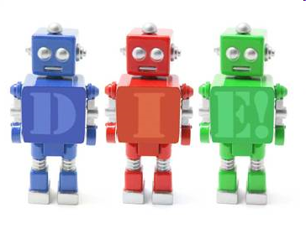
A Good Robot Gone Bad?
http://www.msnbc.msn.com/id/33510503
Notes:
This is an article. No video to watch.

Slide 23
Industrial Robots

Slide 24
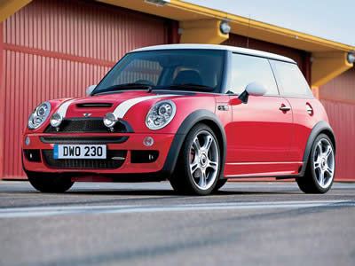
Factory Automation
http://videos.streetfire.net/video/82D220A1-BAB7-4BAA-AD46-72209AD5F6F3.htm

Slide 25
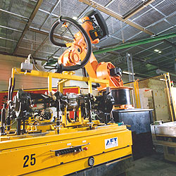
Factory Automation
http://www.kuka.com/usa/en/solutions/solutions_search/L_R251_Handling_Of_Front_And_Rear_Axles_And_Car_Doors.htm

Slide 26
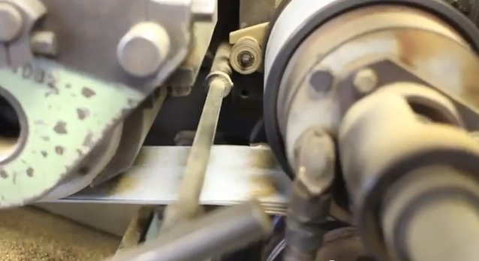
Celestial Seasonings
http://www.youtube.com/watch?v=ZR0gc8tvomk (Skip to 1:00)
Notes:
Watch this video. Way cool how the bags are made.
Note that these machines don’t look at all like people. They just do the work that people used to do.

Slide 27
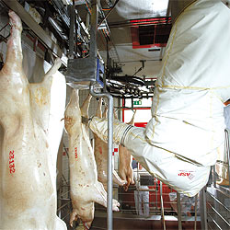
An Unpleasant Task
http://www.kuka.com/usa/en/solutions/solutions_search/L_R232_Robot_optimizes_cutting_of_pork_sides.htm
Notes:
Harder than making cars since each pig is different.

Slide 28
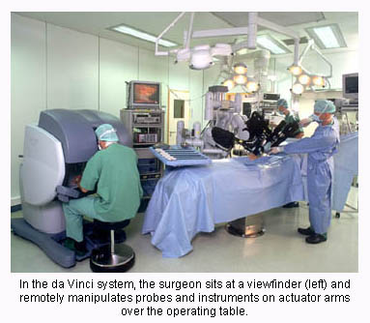
Robotic Surgery
http://www.youtube.com/watch?v=JPPzrrtIZjI
http://www.youtube.com/watch?v=sS4hRxxKQlk
An aside on the da Vinci system: http://video.google.com/videoplay?docid=-5997080660276538391
Notes:
Key here is that the process is still under the control of a human surgeon.
http://www.progressiveengineer.com/PEWebBackissues2005/PEWeb%2064%20Jul%2005-2/Intuitive.htm

Slide 29
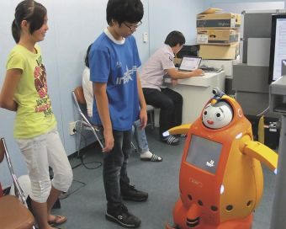
Teaching Children
Teaching English in Korea
Video: http://link.brightcove.com/services/player/bcpid605082692001?bclid=0&bctid=609816961001
Notes:
Image from: http://chronicle.com/article/Robot-Teachers-Are-the-Latest/125102/ which has description of the project.

Slide 30
Elder Care

Slide 31
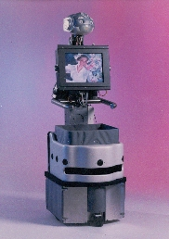
Nursebot
http://www-2.cs.cmu.edu/~nursebot/web/video.html

Slide 32
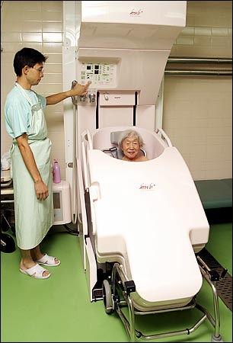
Bathbot
http://www.nytimes.com/2004/03/05/international/asia/05JAPA.html?ex=1393822800&en=eb854fe2a4e6c9bd&ei=5007&partner=USERLAND

Slide 33
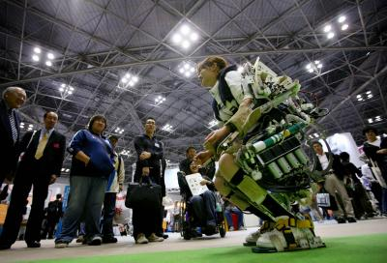
Helping Yourself

Slide 34
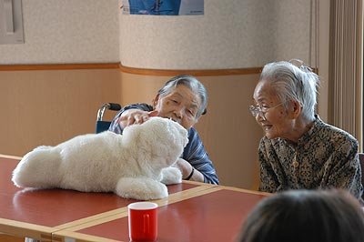
Paro
http://paro.jp/english/index.html

Slide 35
Hominoid (or Animoid) Robots

Slide 36
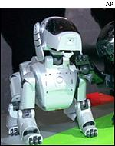
Aibo
1999 Sony’s Aibo pet dog
Notes:
http://news.bbc.co.uk/1/hi/in_depth/sci_tech/2001/artificial_intelligence/1531432.stm

Slide 37
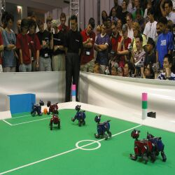
What Can You Do with an Aibo?
1997 – First official Rob-Cup soccer match
Picture from 2003 competition
Notes:
Hid because we saw Naos in Easy, Hard, Impossible

Slide 38
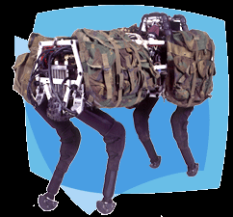
Big Dog
Boston Dynamics: http://www.bdi.com/content/sec.php?section=BigDog
A shorter video: http://www.youtube.com/watch?v=4lenvylxvkk&feature=related
Notes:
I’ve hidden this because we saw it in Easy, Hard, Impossible

Slide 39
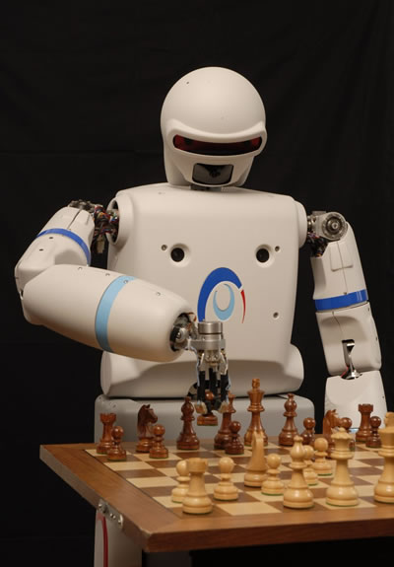
REEM-A
http://www.technovelgy.com/ct/Science-Fiction-News.asp?NewsNum=1212

Slide 40
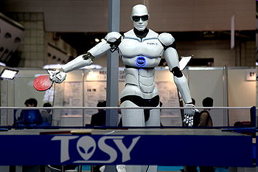
Topio
http://www.youtube.com/watch?v=W5g1IIAOZqs
Notes:
Image from: http://en.wikipedia.org/wiki/TOPIO

Slide 41
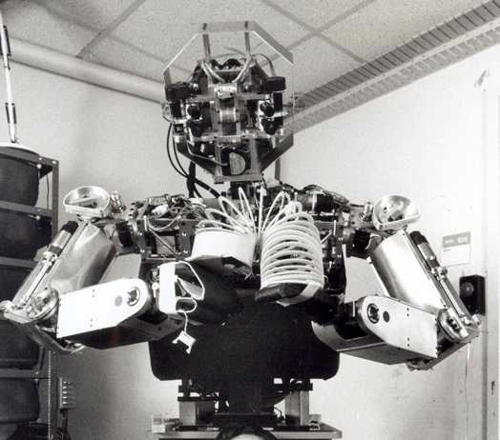
Cog
1998 – now Cog
Humanoid intelligence requires humanoid interactions with the world.
http://www.ai.mit.edu/projects/humanoid-robotics-group/

Slide 42
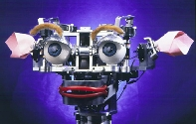
Kismet
http://www.ai.mit.edu/projects/humanoid-robotics-group/kismet/kismet.html
http://www.ai.mit.edu/projects/kismet/affectSpeech_web.mov
http://www.iwaswondering.org/cynthia_video.html

Slide 43
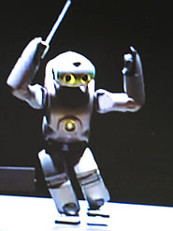
QRIO
http://www.newscientist.com/article/dn4845.html
Dancing: http://www.youtube.com/watch?v=n_0I4nr4u3A
http://www.youtube.com/watch?v=fGtxPmcsXfg&feature=related

Slide 44
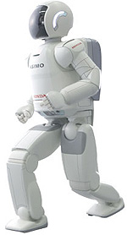
Asimo
2005
http://world.honda.com/HDTV/ASIMO/200712-press-demo/
Notes:
Hid this one because we saw the naos in Easy, Hard, Impossible.

Slide 45
Einstein
http://www.calit2.net/newsroom/release.php?id=1469
Notes:
Image and text from: http://dwave.wordpress.com/2008/09/12/conditional-robot-response-based-on-camera-input/
For example, you could acquire a Hansen Robotics Einstein, sit it him on your desk, train a camera on your face, use an anger feature detector that causes the Einstein robot to laugh harder the angrier you get.

Slide 46
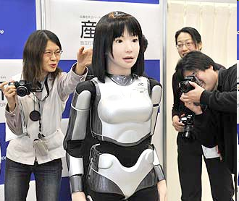
Fashion Model
HRP-4C
http://www.pinktentacle.com/2009/03/video-hrp-4c-fashion-model-robot/
Notes:
picture from: http://www.engadget.com/2009/03/16/japans-hrp-4c-fashion-model-robot-unveiled-already-harassed/

Slide 47
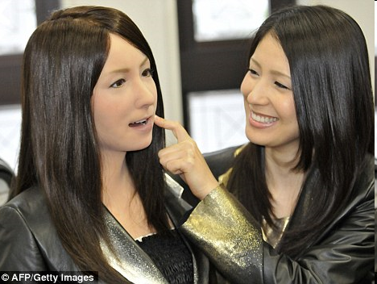
In Her Image
Geminoid-F
http://www.dailymail.co.uk/sciencetech/article-1263267/Walking-talking-living-doll-Japanese-scientists-unveil-female-android.html

Slide 48
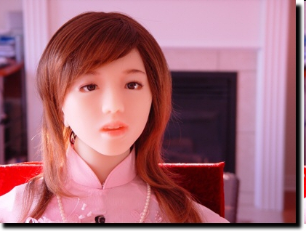
Aiko
http://www.projectaiko.com/

Slide 49
The Uncanny Valley
Are we spooked by “almost us”?
Ernst Jentsch's 1906 essay, "On the Psychology of the Uncanny." Jentsch's conception was famously elaborated on by Sigmund Freud in his 1919 essay "The Uncanny" ("Das Unheimliche").
Notes:
http://thisrecording.squarespace.com/science-corner/2008/10/16/in-which-robots-are-your-homies.html

Slide 50
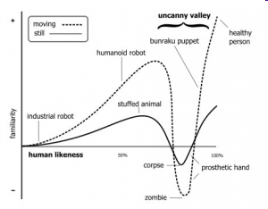
The Uncanny Valley
Masahiro Mori, 1970, "Bukimi No Tani" (不気味の谷 The Uncanny Valley)
Notes:
http://thisrecording.squarespace.com/science-corner/2008/10/16/in-which-robots-are-your-homies.html

Slide 51
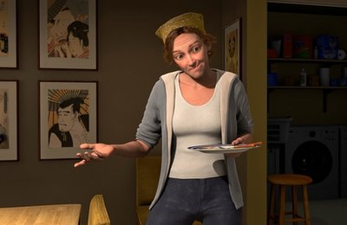
Has Disney Gotten There?
Mars Needs Moms, 2011
http://news.yahoo.com/s/ap/20110404/ap_on_hi_te/us_tec_creepy_animation
Trailer: http://www.youtube.com/watch?v=_aS5W___Ezk
Notes:
Story is about Hollywood getting to close for comfort.

Slide 52
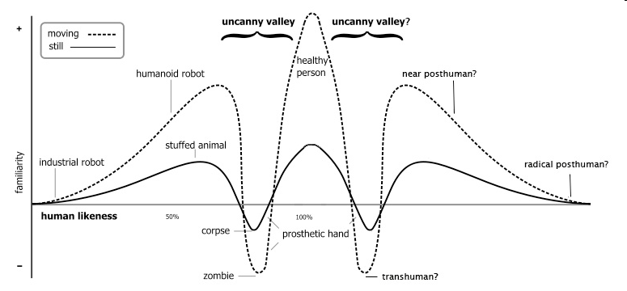
Is There a Second Uncanny Valley?
What happens when we move past healthy humans?
Notes:
http://thisrecording.squarespace.com/science-corner/2008/10/16/in-which-robots-are-your-homies.html

Slide 53
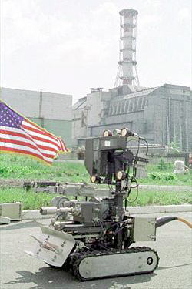
Pioneer
1986: At the Chernobyl power plant.
http://www.frc.ri.cmu.edu/projects/pioneer/

Slide 54
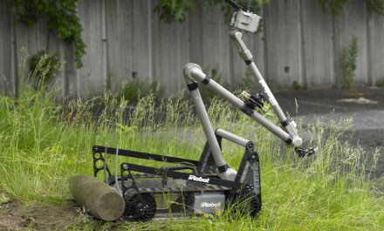
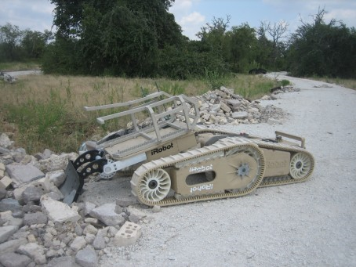
Modern Nuclear Disasters
710 Warrior
510 PackBot
2011: Disaster robots from iRobot go to Japan
http://news.yahoo.com/s/ap/20110418/ap_on_bi_ge/as_japan_earthquake
Notes:
Article talks about the PackBots going into the reactor and determining that radiation levels are too high for humans.

Slide 55
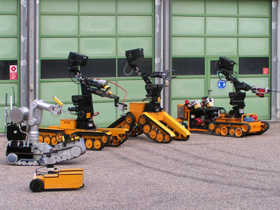
Modern Nuclear Disasters
KHG Kerntechnische Hilfsdienste GmbH (Nuclear Technology Support Services)
Disaster robots in Europe: http://robotland.blogspot.com/2011/03/nuclear-emergency-robots-from-europe.html
Notes:
http://robotland.blogspot.com/2011/03/nuclear-emergency-robots-from-europe.html

Slide 56
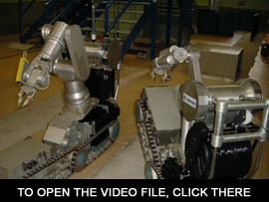
Modern Nuclear Disasters
Disaster robots in France: http://www.groupe-intra.com/pages2/intervention/moyens3.htm
Notes:
Go to the site. Scroll down to find a video. Watch it. While in French, it shows many of the things that the robots can do. Video gone.

Slide 57
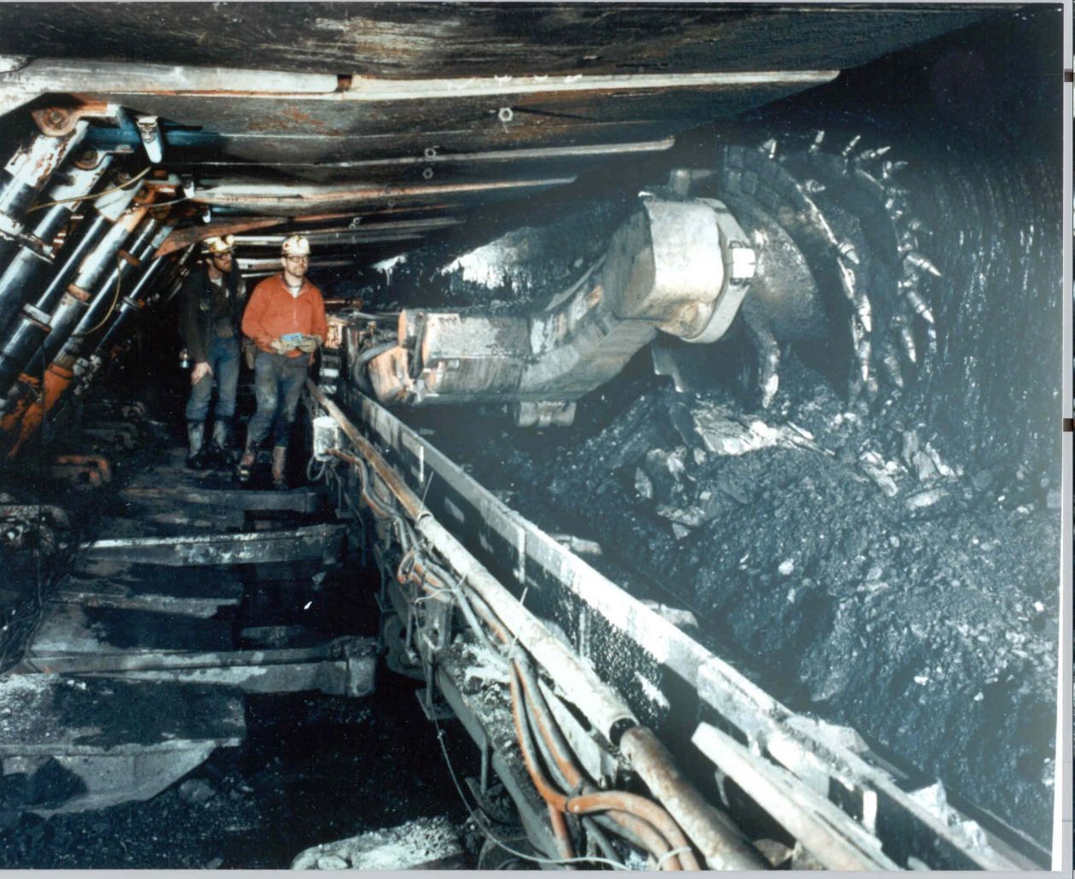
Miners
25 dead in W.Va. mine blast, worst since 1984
April 5, 2010

Slide 58
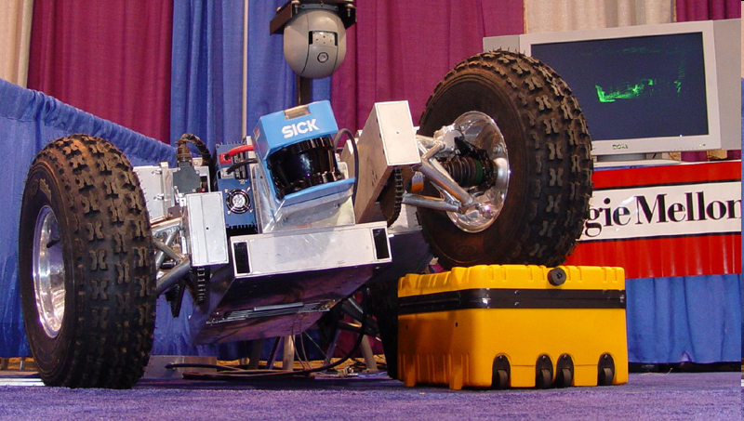
Cave Crawler
Notes:
Image from: http://www.cs.cmu.edu/~groundhog/robots_cc.html

Slide 59
Military Missions
http://www.irobot.com/sp.cfm?pageid=109
Robots at war

Slide 60
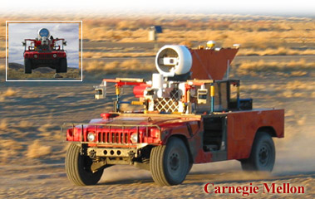
Sandstorm
March 13, 2004 - A DARPA Grand Challenge: an unmanned offroad race, 142 miles from Barstow to Las Vegas.
http://www.redteamracing.org/
Notes:
Sandstorm is a modified Humvee. It cost $3M. The prize for the grand challenge is $1M. Sandstorm made it 9 miles. 15 teams entered. Sandstorm got the farthest of all: At mile 7.4, on switchbacks in a mountainous section, vehicle went off course, got caught on a berm and rubber on the front wheels caught fire, which was quickly extinguished. Vehicle was command-disabled.

Slide 61
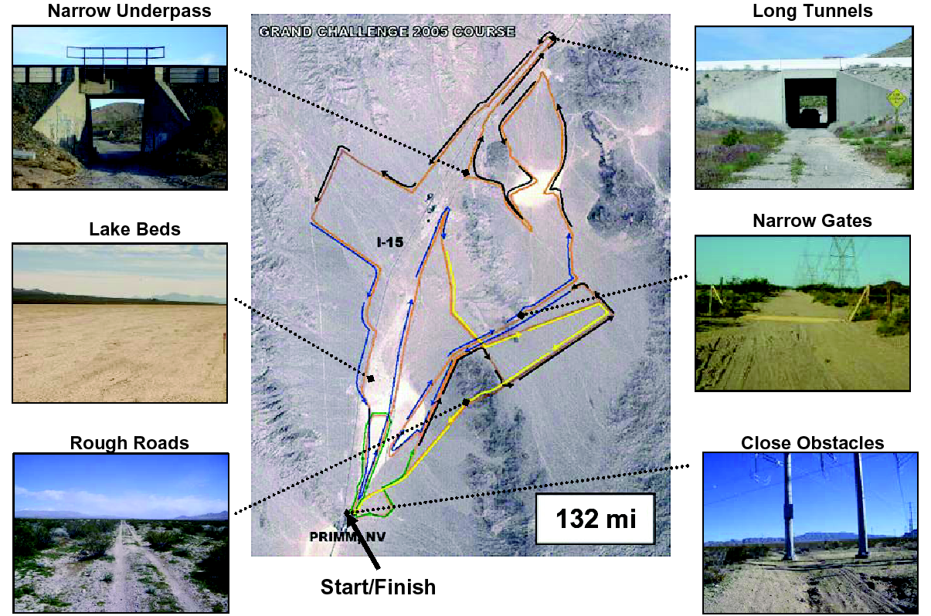
The 2005 Course

Slide 62
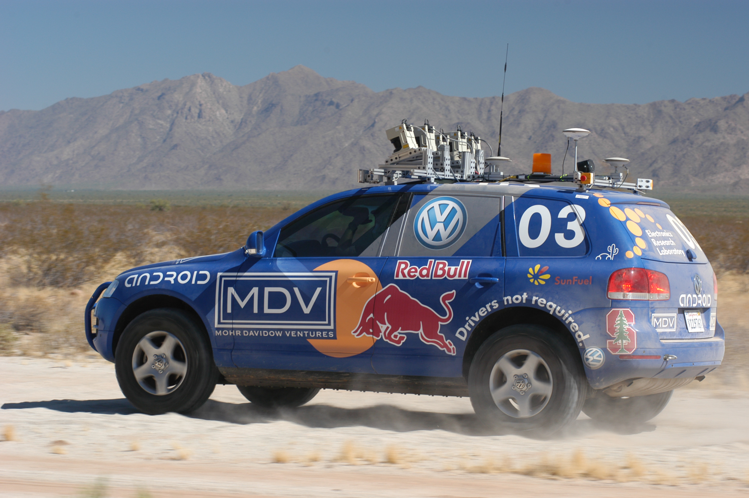
Stanley – the Winner
Completed the course in 6 hours, 53 minutes.

Slide 63
The 2007 Urban Grand Challenge
Autonomous ground vehicles must safely complete a 60-mile urban area course in fewer than six hours. First prize is $2 million, second prize is $500,000 and third prize is $250,000. To succeed, vehicles must autonomously obey traffic laws while merging into moving traffic, navigating traffic circles, negotiating busy intersections and avoiding obstacles.

Slide 64
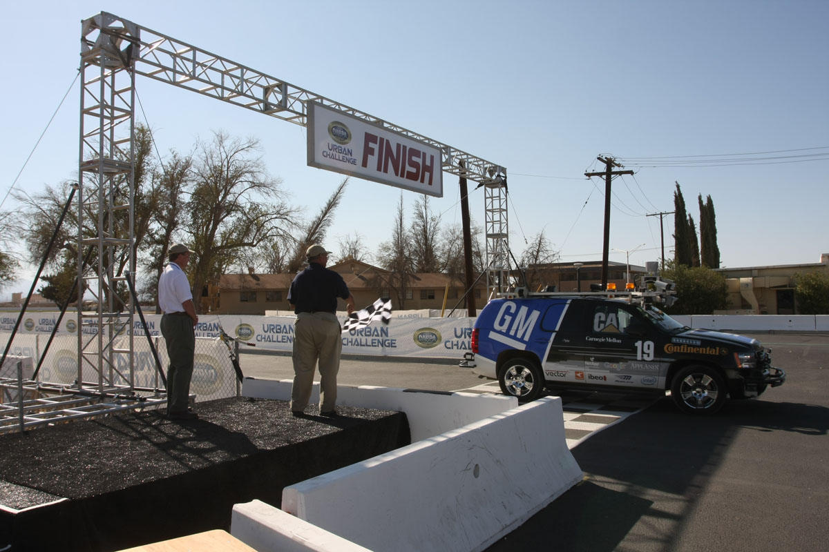
The 2007 Urban Grand Challenge

Slide 65
Some Videos
Little Ben navigating the course
Hitting a rail
A collision

Slide 66
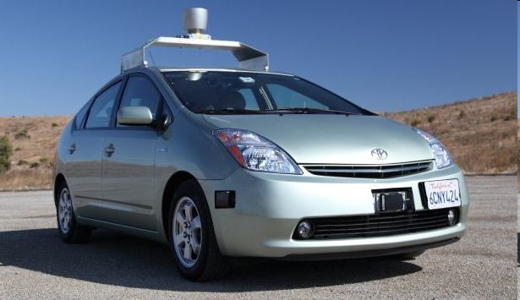
The Google Self-Driving Car
http://www.youtube.com/watch?v=Atmk07Otu9U
http://www.youtube.com/watch?v=cdgQpa1pUUE
Notes:
But we already saw this in Easy, Hard, Impossible.
http://www.pocket-lint.com/news/36131/google-self-driving-automated-car

Slide 67
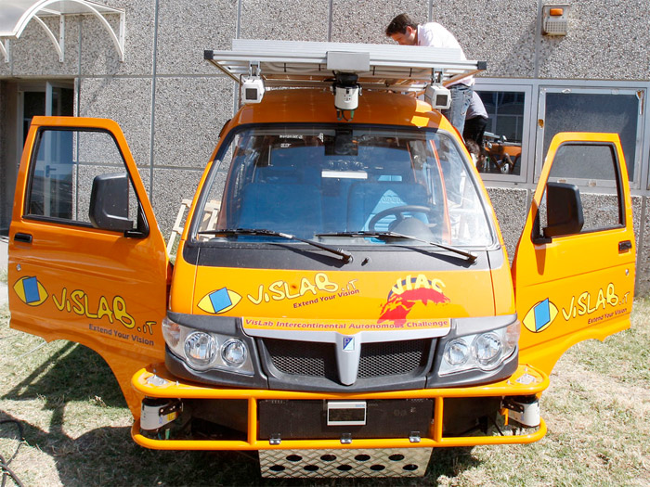
The European Self-Driving Van
Oct. 28, 2010 Driverless vans end 8,000-mile test drive
to China
Notes:
http://www.google.com/hostednews/ap/article/ALeqM5jcdacJzQ12_HQd8dWqi7P0L31vYw?docId=a1c245e4484e4c329e9e054d9b60eda3
Image from: http://www.mobilemag.com/wp-content/uploads/2010/07/driverless-car-01.jpg

Slide 68
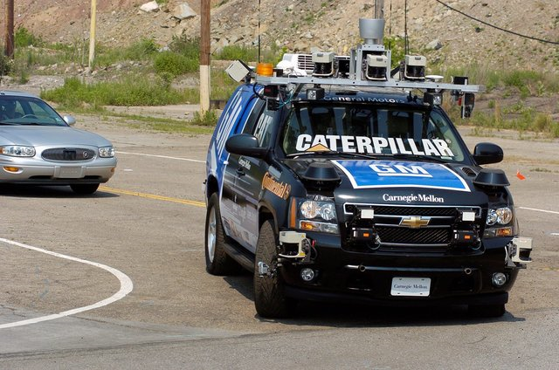
GM’s Plans
http://www.washingtontimes.com/news/2011/mar/8/self-driving-car-on-road-out-of-science-fiction/
Notes:
CMU GM car. Article has predictions of when GM could sell a fully autonomous car.

Slide 69
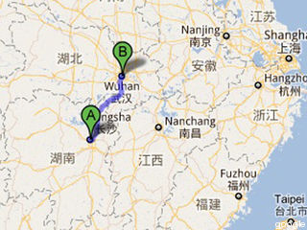
Risk and Trust
Summer, 2011
Notes:
http://idealab.talkingpointsmemo.com/2011/08/china-builds-and-tests-its-own-robot-car.php?ref=fpblg
Image from: http://www.caranddriver.com/features/10q1/china_gets_rolling_the_big_players_in_what_will_soon_be_the_largest_car_market_-feature/gallery/faw_hongqi_hq3_photo_81

Slide 70
They’re Already Legal
As of 1 March, 2012, Nevada allows driverless cars provided they sport a special red licence plate, and the owners pay a $1 to $3 million insurance bond. Similar legislation is being considered in California, Arizona, Florida, Hawaii and Oklahoma.
http://www.newscientist.com/article/mg21328585.300-driverless-cars-ready-to-hit-our-roads.html
Notes:
There’s also material on autonomous cars in the risk slides.
http://travelnevada.com/travel-tools/nevada-maps/

Slide 71
Risk and Trust
Intersection management
http://www.cs.utexas.edu/~aim/?p=video

Slide 72
How Much Compute Power Does it Take?
•
Watson
From Hans Moravec, Robot Mere Machine to Transcendent Mind 1998.
Notes:
Info on Watson: http://gcn.com/articles/2011/02/10/watson-vs-human-brain-tale-of-the-tape.aspx
Its memory:1.5 * 10^ megabytes. Its processing power: 8*10^7 MIPS

Slide 73
How Much Compute Power is There?
Hans Moravec: http://www.frc.ri.cmu.edu/~hpm/talks/revo.slides/power.aug.curve/power.aug.gif

Slide 74
How Much Compute Power Is There?
Notes:
A newer one from: http://www.donbot.com/Futurebot/NewTech/NT01370MoravecsGraphUpdated2020.html
Note that it puts people at 1000 times more compute power than Moravec, yet still projects matching them before 2020.

