Slide 1
Technology and the Future

Slide 2
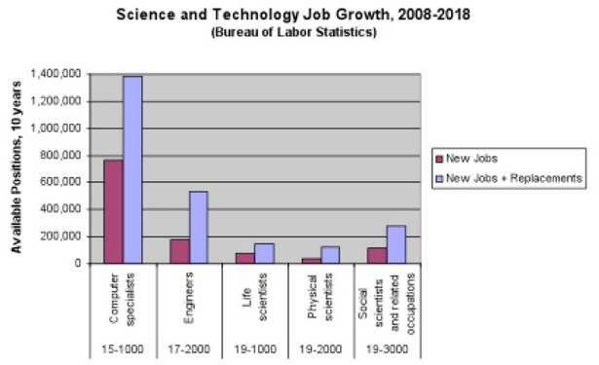
An Interesting Set of Numbers
Notes:
http://www.pdfdownload.org/pdf2html/pdf2html.php?url=http%3A%2F%2Fwww.cs.washington.edu%2Fhomes%2Flazowska%2Fnitrd%2FWorkforce.pdf&images=yes

Slide 3
Where Are We Headed?
Many issues we could consider. Two important ones:
Risk vs. reward
AI, ourselves, and our jobs

Slide 4
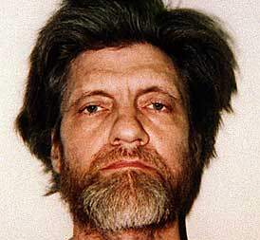
Is Technology Necessary?
The Industrial Revolution and its consequences have been a disaster for the human race. - Theodore Kaczynski

Slide 5
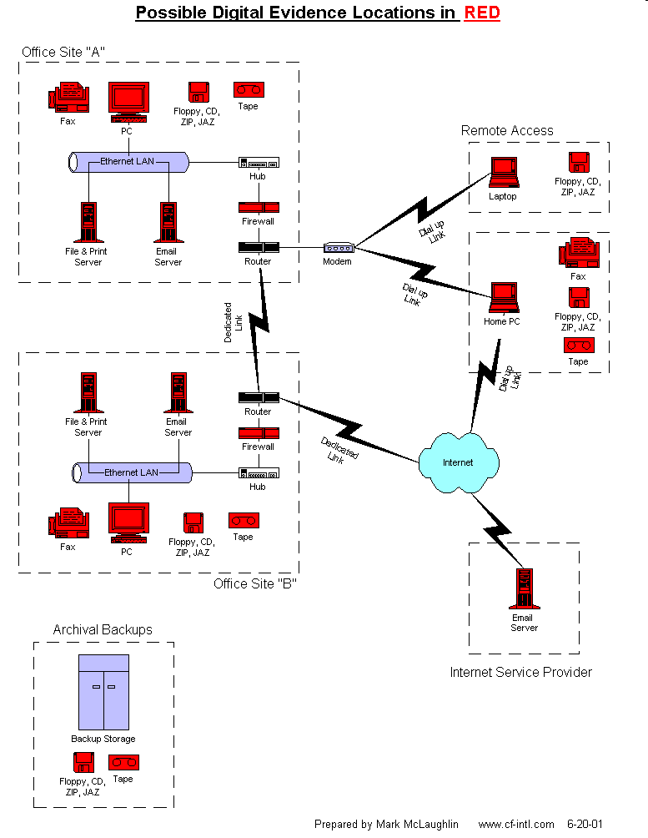
Digital Forensic Tools
http://en.community.dell.com/blogs/direct2dell/archive/2009/07/06/dell-unveils-its-digital-forensics-solution.aspx
Notes:
What could go wrong here?
But can go wrong if we don’t have these tools?

Slide 6
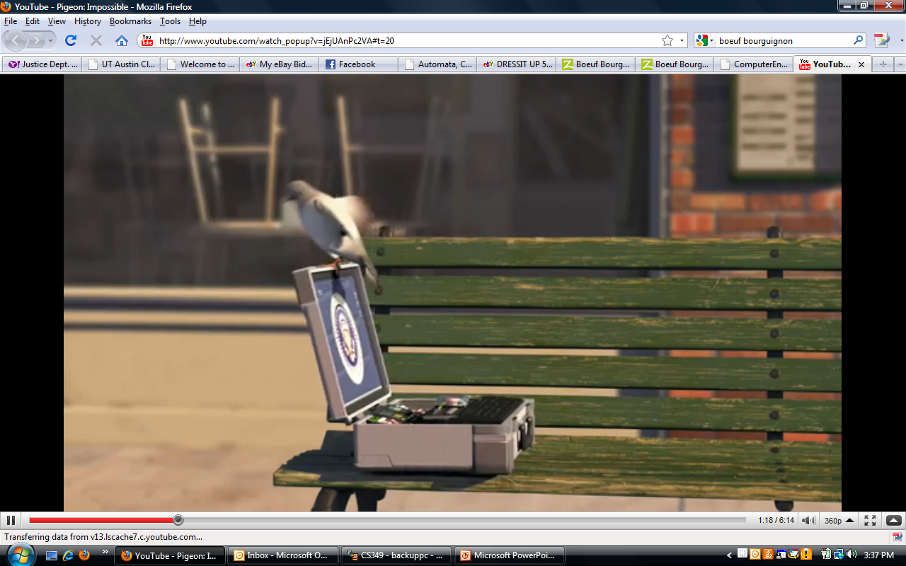
Fanciful, But You Get the Idea
http://www.youtube.com/watch_popup?v=jEjUAnPc2VA#t=20

Slide 7
Why is Software Risky?
 | Lines of Code | Developers
OpenOffice | 9 million
Android OS | http://www.gubatron.com/blog/2010/05/23/how-many-lines-of-code-does-it-take-to-create-the-android-os/
GNU/Linux | 30 million
Windows Vista | 50 million | 2000
Lucent 5ESS Switch | 100 million | 5000
Notes:
Recall this, which we saw at the end of Algorithms 2.
Windows XP : http://en.wikipedia.org/wiki/Source_lines_of_code
OpenOffice:http://www.openoffice.org/FAQs/build_faq.html#source
GNU/Linux: http://www.dwheeler.com/sloc/
Lucent switch and Windows Vista: http://brianmackay.name/post/2009/01/14/The-Worlds-Largest-Software-Project.aspx

Slide 8
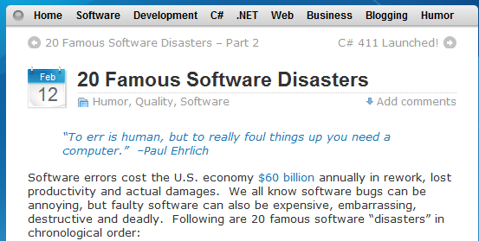
20 Famous Software Disasters
http://www.devtopics.com/20-famous-software-disasters/

Slide 9
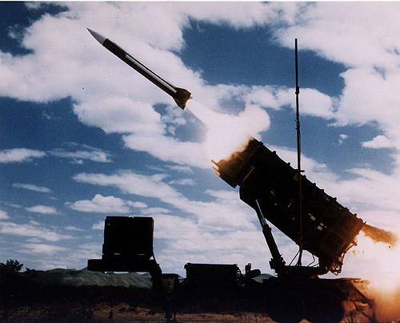
The Failure of the Software in the Patriot Missile System
February 23, 1991

Slide 10
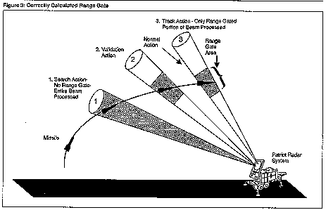

Slide 11
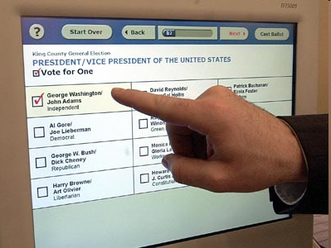
Risk vs. Reward: Electronic Voting
Notes:
http://patdollard.com/wp-content/uploads/voting-machine.jpg

Slide 12
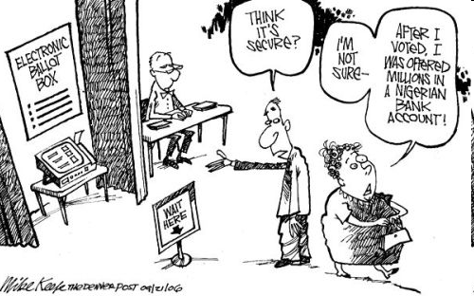
Risk vs. Reward: Electronic Voting
But what if it’s not malicious – it’s just complicated.
Notes:
http://www.beloblog.com/ProJo_Blogs/shenews/07/mikekeefe_denverpost.jpg

Slide 13
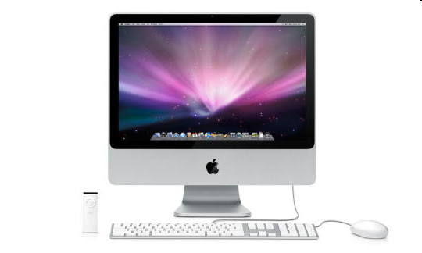
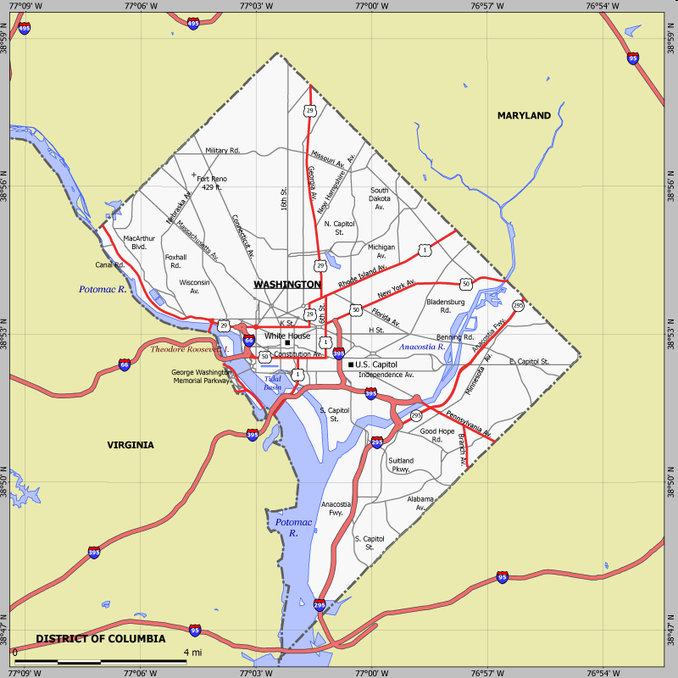
Risk vs. Reward: Electronic Voting
http://www.cs.utexas.edu/~ear/cs349/slides/DCVotingMachineBug.html
Notes:
There were at least two issues: 1) Investigators hacked into the system so that, after some number of people had voted, it played Hail to the Victors. The other is the interaction between pdf and the Safari browser.
http://news.cnet.com/i/bto/20080528/Apple_iMac_Leopard_540x324.jpg
http://www.sitesatlas.com/Flash/USCan/static/DCFH-800.gif

Slide 14
Risk vs. Reward: Electronic Voting
BALLOT
My votes
Safari
browser
.pdf
BALLOT
save as
.pdf
http://www.cs.utexas.edu/~ear/cs349/slides/DCVotingMachineBug.html

Slide 15
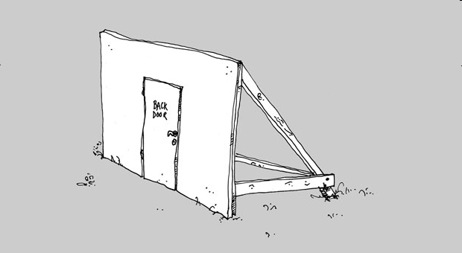
And Other Problems …
http://www.computerworld.com/s/article/9189718/D.C._Web_voting_flaw_could_have_led_to_compromised_ballots?taxonomyId=13
Notes:
Hail to the Victors - http://fightmusic.com/mp3/big10/Michigan__The_Victors_%28Trio%29.mp3
Hail to the Victors – old one I don’t use: http://pdaphonehome.com/forums/kyocera-7135-downloads/22192-hail-victors.html
Back door:http://www.raumlabor.net/wp-content/uploads/2008/09/backdoor01.jpg

Slide 16
Rating Financial Instruments
http://www.soxfirst.com/50226711/moodys_subprime_error_bug.php
Notes:
Is it really the code that was bad, or the mathematical model?
Either way, the point is that the models are so sophisticated that there’s no choice but to use computers.
Risk before this system: Invest without the knowledge that ratings (usually) give you.

Slide 17
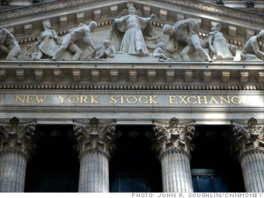
Risks and Rewards
Knight Capital Group installed new software but there was a glitch and they started trading wildly. In 45 minutes on August 1, 2012, they lost $440 million.
http://finance.fortune.cnn.com/2012/08/02/knight-high-frequency-loss/

Slide 18
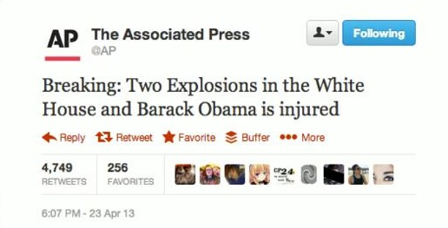
When Technologies Collide
Notes:
http://www.nytimes.com/2013/04/29/business/media/social-medias-effects-on-markets-concern-regulators.html
Twitter image: http://hackread.com/hackers-hack-twitter-of-the-associated-press-claiming-obamas-injury-white-house-blast/
Dow Jones image: http://arstechnica.com/security/2013/04/hacked-ap-twitter-feed-rocks-market-after-sending-false-news-flash/

Slide 19
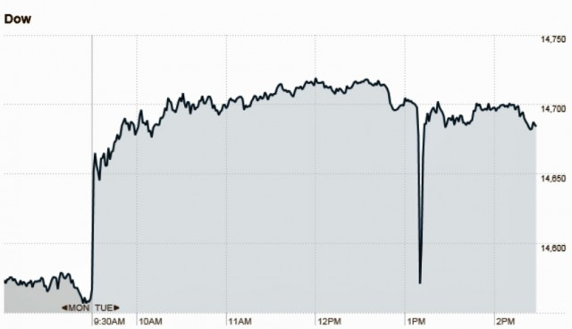
When Technologies Collide
Notes:
http://www.nytimes.com/2013/04/29/business/media/social-medias-effects-on-markets-concern-regulators.html
Twitter image: http://hackread.com/hackers-hack-twitter-of-the-associated-press-claiming-obamas-injury-white-house-blast/
Dow Jones image: http://arstechnica.com/security/2013/04/hacked-ap-twitter-feed-rocks-market-after-sending-false-news-flash/

Slide 20
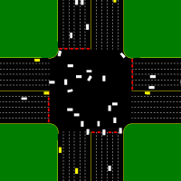
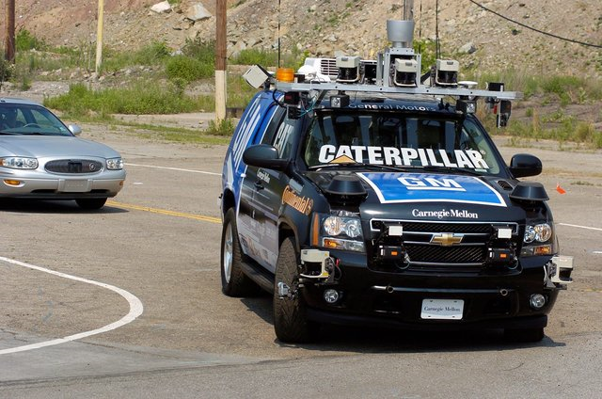
Autonomous Vehicles
Notes:
We already (at the end of robots) talked about the cars and did Peter’s videos. Just remind.

Slide 21
Risk and Reward Email
Notes:
Email is great but there are risks. Here you have virus outbreak Sept. 2010

Slide 22
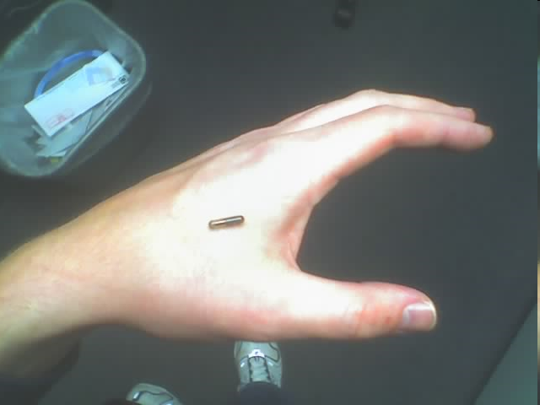
Risk and Reward
http://www.youtube.com/watch?v=uE7Yf4bw41E
Notes:
Scientist implants RFID chip in hand. He can infect it with a virus, then pass that virus to other machines.
Photo: http://upload.wikimedia.org/wikipedia/commons/9/99/RFID_hand_1.jpg

Slide 23
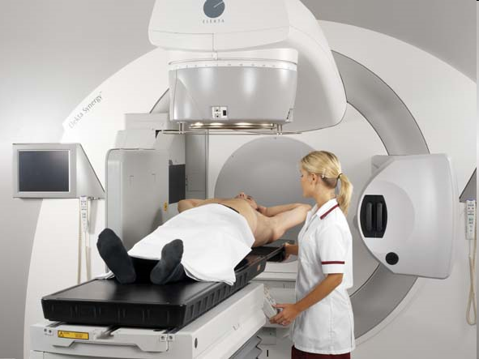
Risk and Reward – A Case Study Linear Accelerator Radiation Machines
Social Benefit
Risk
Software Quality
Security
Ethics
Free Speech
Privacy
Law
Government Policy
http://www.nytimes.com/2010/01/24/health/24radiation.html?pagewanted=1&partner=rss&emc=rss
Notes:
Image from: http://www.chesapeakepotomaccancer.com/

Slide 24
Risk of Failure
Why might a complex system fail?
Software error
Hardware error
Interaction between software design and hardware failure
User error
User interface design
Training the user

Slide 25
Linear Accelerator Radiation Machines
The NYT story:
http://www.nytimes.com/2010/01/24/health/24radiation.html?pagewanted=1&partner=rss&emc=rss
A follow up with more details:
http://www.nytimes.com/2010/01/27/us/27radiation.html?pagewanted=1&partner=rss&emc=rss
The slide show:
http://www.nytimes.com/interactive/2010/01/22/us/Radiation.html

Slide 26
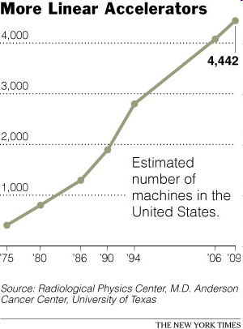
But We Rely on Them More and More
Notes:
http://www.nytimes.com/imagepages/2010/01/27/us/27radiation-graphic1.html?ref=us

Slide 27
Problems Waiting to Happen?

Slide 28
Y2K Problem
Attempt to save storage
Did programmers imagine their code being used 30 years later?
Notes:
3

Slide 29
Y2K Problem
Attempt to save storage
Did programmers imagine their code being used 30 years later?
Will there be a “Year 2038 Problem” when UNIX system time (if stored in seconds since Jan 1, 1970 in a 32 bit signed integer) will overflow?
Notes:
3

Slide 30
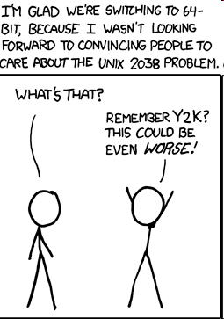
Unix 2038 Problem
http://xkcd.com/607/

Slide 31
Microsoft Windows Security
106 security updates in 2010 – one per 3.4 days
17 security updates from Jan 1, 2011 through March 29, 2011 – one per 5.1 days
22 security updates from Jan 1, 2012 through March 31, 2012 – one per 4.1 days
7 security updates in one month ending March 12, 2013 – one per 4.4 days.
Notes:
1

Slide 32
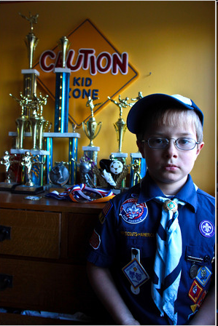
Some Database Errors Entry and Misinterpretation
A large population – many with similar names
Meet Mikey Hicks
http://www.nytimes.com/2010/01/14/nyregion/14watchlist.html
Notes:
http://www.nytimes.com/2010/01/14/nyregion/14watchlist.html

Slide 33
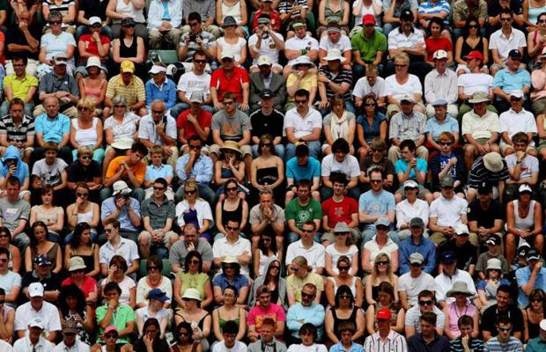
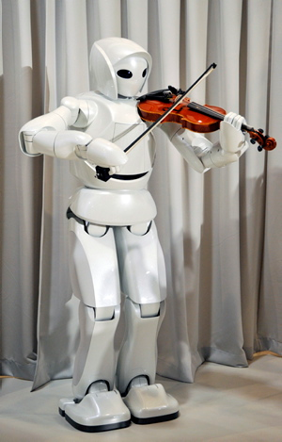
AI, Ourselves, and Our Jobs
Notes:
People: http://www.telegraph.co.uk/news/picturegalleries/telegraph-pictures-of-the-year/3850551/Telegraph-photographers-pictures-of-the-year-Jane-Mingay.html?image=2
Robot: http://www.businesspundit.com/8-insane-japanese-robots-that-will-take-your-job-and-possibly-your-life/

Slide 34
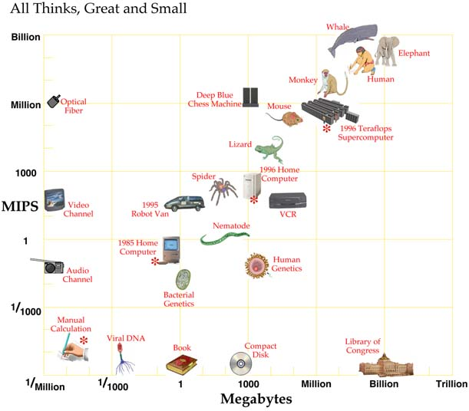
How Much Compute Power Does it Take?
•
Watson
From Hans Moravec, Robot Mere Machine to Transcendent Mind 1998.
Notes:
Info on Watson: http://gcn.com/articles/2011/02/10/watson-vs-human-brain-tale-of-the-tape.aspx
Its memory:1.5 * 10^ megabytes. Its processing power: 8*10^7 MIPS

Slide 35
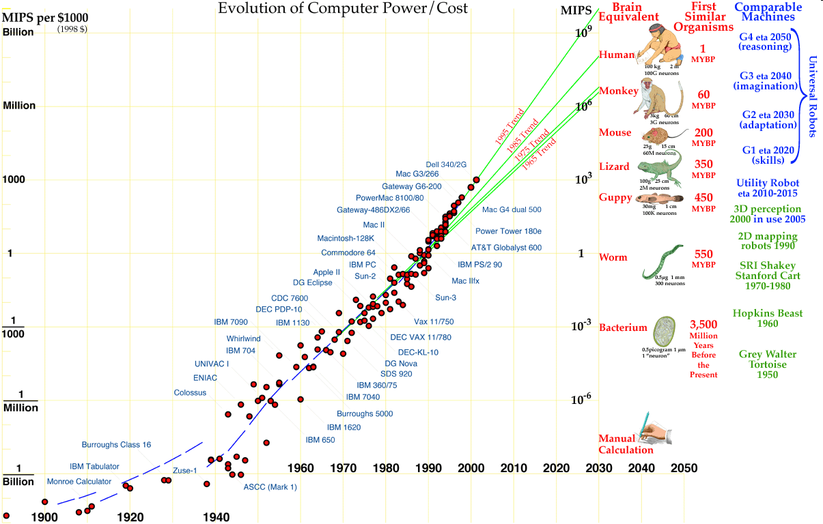
How Much Compute Power is There?
Hans Moravec: http://www.frc.ri.cmu.edu/~hpm/talks/revo.slides/power.aug.curve/power.aug.gif

Slide 36
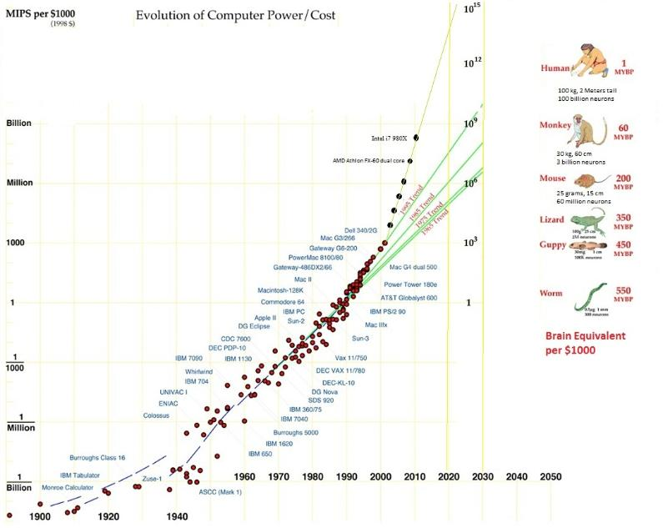
How Much Compute Power Is There?
Notes:
A newer one from: http://www.donbot.com/Futurebot/NewTech/NT01370MoravecsGraphUpdated2020.html
Note that it puts people at 1000 times more compute power than Moravec, yet still projects matching them before 2020.

Slide 37
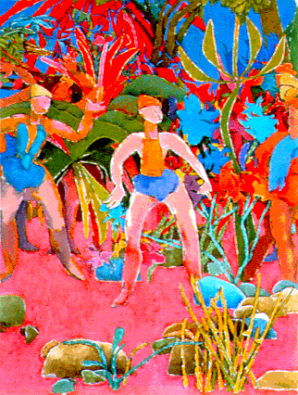
Are We Special?

Slide 38
Are We Special?
Three paintings done by Harold Cohen’s Aaron program:

Slide 39
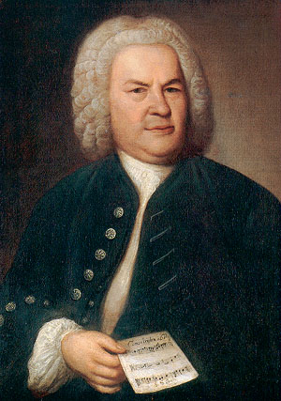
What about Music?
Listen to these two pieces:
Invention 1
Invention 2
Notes:
Picture of JS Bach: http://www.carus-verlag.com/index.php3?selSprache=1&BLink=JSBach

Slide 40
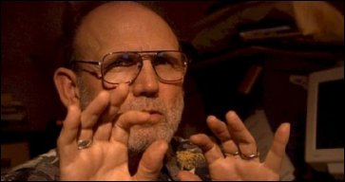
What about Music?
Listen to these two pieces:
An EMI invention
A Bach invention
David Cope, the creator of:
EMI
Emily Howell

Slide 41
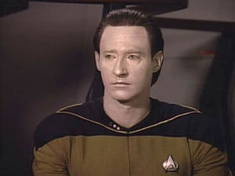
Could Robots Become Us?
http://www.cs.utexas.edu/~ear/cs349/slides/MM3.mp4
http://www.cs.utexas.edu/~ear/cs349/slides/MM4.mp4
http://www.cs.utexas.edu/~ear/cs349/MOAM.flv
Notes:
Episode title: The Measure of a Man The trial starts in 3, about 7/8 of the way in. 4 has some interesting stuff. The key part to show is at the beginning of 5 (MOAM).

Slide 42
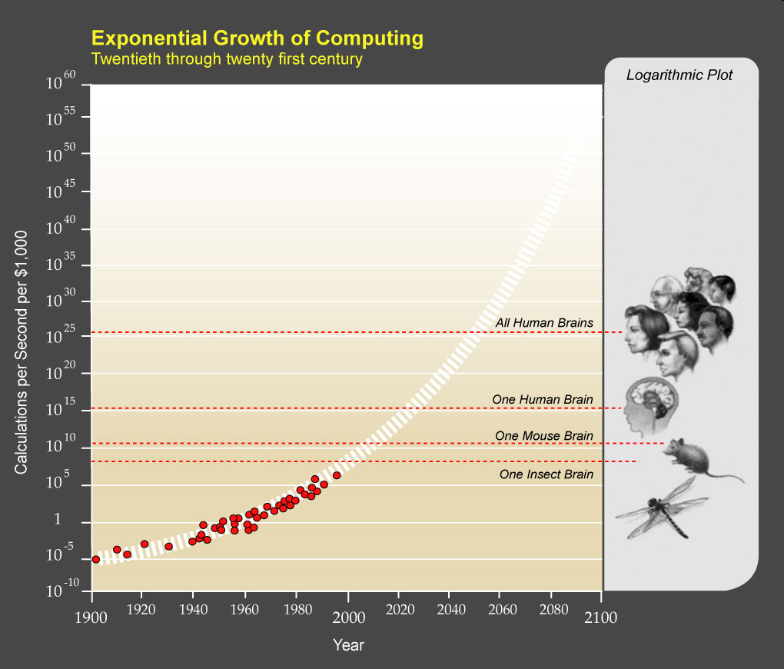
The Law of Accelerating Returns
Notes:
Image from: http://brent.kearneys.ca/2009/02/14/the-singularity-summit-2008/

Slide 43
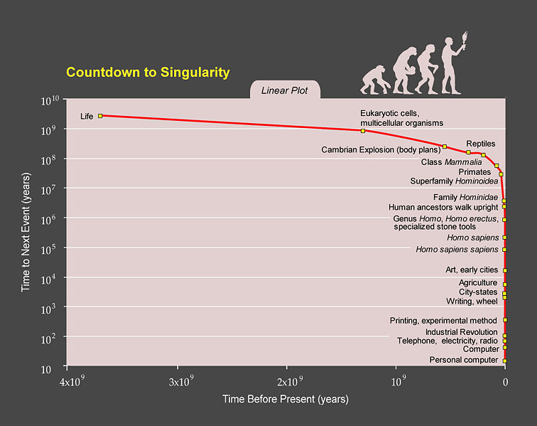
Notes:
http://en.wikipedia.org/wiki/Transhumanism, bottom of page

Slide 44
The Singularity
It won’t stop just when the robots get as smart as we are.
The Singularity Institute for Artificial Intelligence

Slide 45
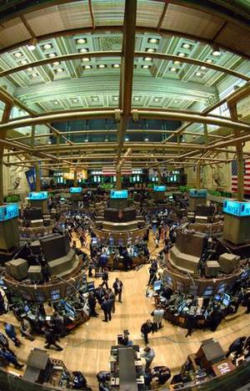
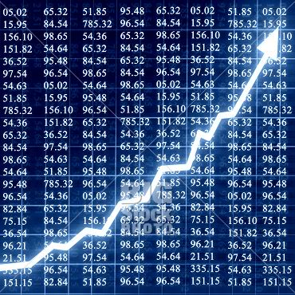
Past the Singularity – An Example
Automated stock traders drive out humans
Notes:
Stock exchange: http://www.stockmarketinvesting.com/stock-market-tips/
Graph: http://www.geekesfera.com/tag/stock-market

Slide 46
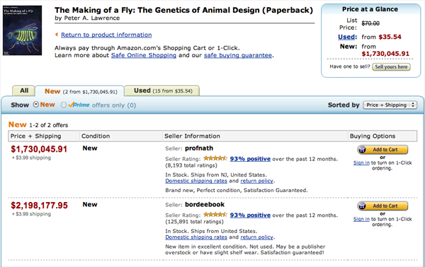
Or When We’re Not Quite There Yet
http://www.michaeleisen.org/blog/?p=358
Notes:
Article talks about how profnath keeps setting it’s price to just less than bordeebook, who keeps setting theirs to just more than profnath, but the product of their factors is greater than 1.

Slide 47
Should We Do It?
Does it make sense to ask?
What does history tell us?
Do we good job of predicting the future?

Slide 48
Is This Even A Question It Makes Sense to Ask?
Notes:
http://www.bristolstories.org/site_images/big_world_map.jpg
Guns Germs and Steel argument: Eurasia won because of geography. Europe won because China lost lost because they burned the boats and the Europeans didn’t. Can one group ever effectively decide against technology?

Slide 49
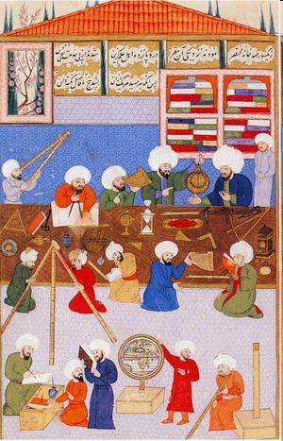
Islamic Science in the Golden Age
c 750 - 1250
http://www.youtube.com/watch?v=tIMifWU5ucU
Notes:
Point here: you can be on top. But then if you decide to stop doing science/technology, someone else will just take over. You can’t make it stop everywhere.
Image from: http://musham.wordpress.com/2008/09/19/islamic-science-and-development-historyin-quran-view/
The link is to a YouTube video of Neil de Grasse Tyson

Slide 50
Oppenheimer Quote
“When you see something that is technically sweet you go ahead and do it.”
Notes:
Quoted on p. 210 of The Luddites

Slide 51
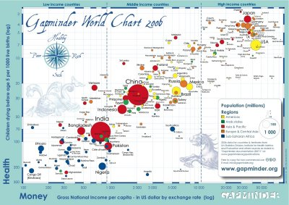
Since the Industrial Revolution
Has technology benefited people?
http://www.youtube.com/watch?feature=youtube_gdata_player&v=jbkSRLYSojo
Notes:
http://4.bp.blogspot.com/_JkY44588yyw/SVpfRobpWxI/AAAAAAAAAGo/0V7a4EoDv9Y/s400/gapminder_world_chart_2006.jpg

Slide 52
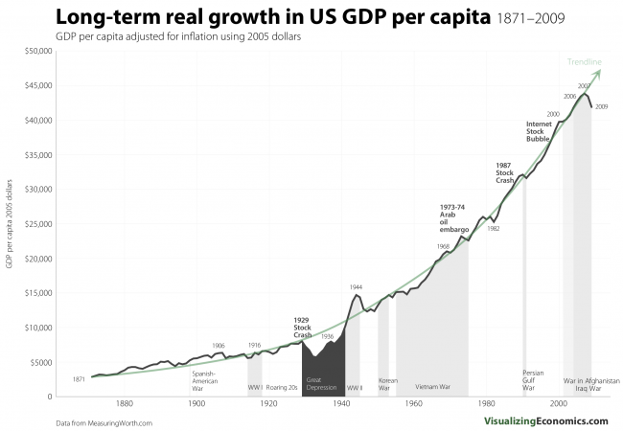
GDP Growth
Notes:
Our standard of living keeps going up because of technology.
http://visualizingeconomics.com/2011/03/08/long-term-real-growth-in-us-gdp-per-capita-1871-2009/

Slide 53
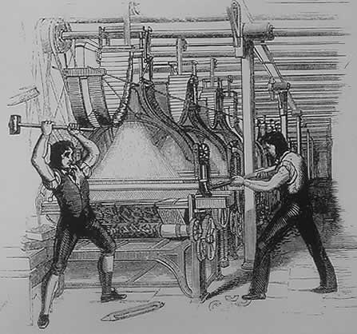
The Luddites
The Luddites, 1812
Notes:
But here’s the other side.

Slide 54
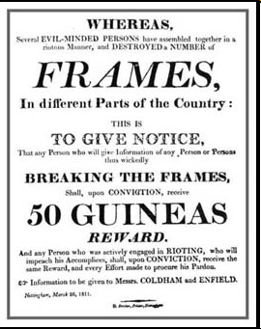
The Luddites
Notes:
http://www.spartacus.schoolnet.co.uk/PRluddites1.JPG

Slide 55
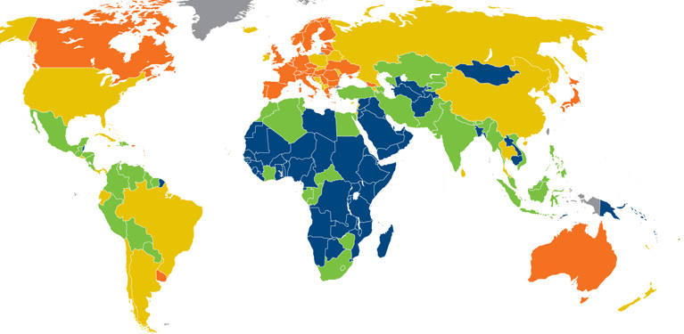
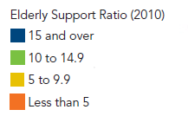
Elderly Support Ratio
Notes:
But maybe we desperately need more workers who can’t get old and need to be taken care of.
http://www.prb.org/pdf10/10wpds_eng.pdf

Slide 56
Elderly Support Ratio 2050
Country | Ratio
Niger | 19
Uganda | 16
Guatamala | 7
Pakistan | 7
Egypt | 5
India | 5
Morocco | 4
United States | 3
Mexico | 3
China | 3
France | 2
Japan | 1
Notes:
http://www.prb.org/pdf10/10wpds_eng.pdf

Slide 57
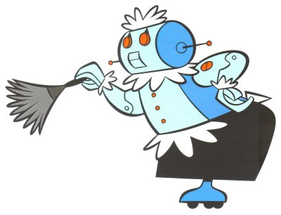
One Futuristic Vision
Rosie, the
Jetsons’ maid
~1962
http://www.youtube.com/watch?feature=player_detailpage&v=4MTHGWPqd14#t=190s 3:10
Notes:
I have made a copy of this video. It is in Ear\Cswork\CS349\TheJetsonsStartAt3-10.
The idea is a humanoid that simply does things the way people did before.
http://heightofhappiness.files.wordpress.com/2010/04/rosie-cleaning-jetsons3.jpg

Slide 58
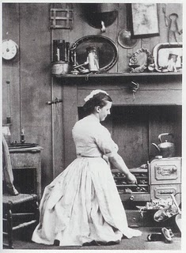
How Does Technology Replace Human Workers?
Notes:
But it hasn’t worked that way. We haven’t created robots that bring in wood (or coal), lay fires, monitor them, and clean up all the dust they make in the house. We’ve created a totally different way to cook food and heat houses. Similarly, the Luddites weren’t upset about weaving robots. They were upset about machines that simply did the task differently. Maybe some tasks will require humanoid robots, but many haven’t/won’t.
Maid image: http://3.bp.blogspot.com/_8Mva9I-cdIU/Rc99Aaf0FxI/AAAAAAAAAN0/wAxJVjkO5oQ/s320/maid.jpg

Slide 59
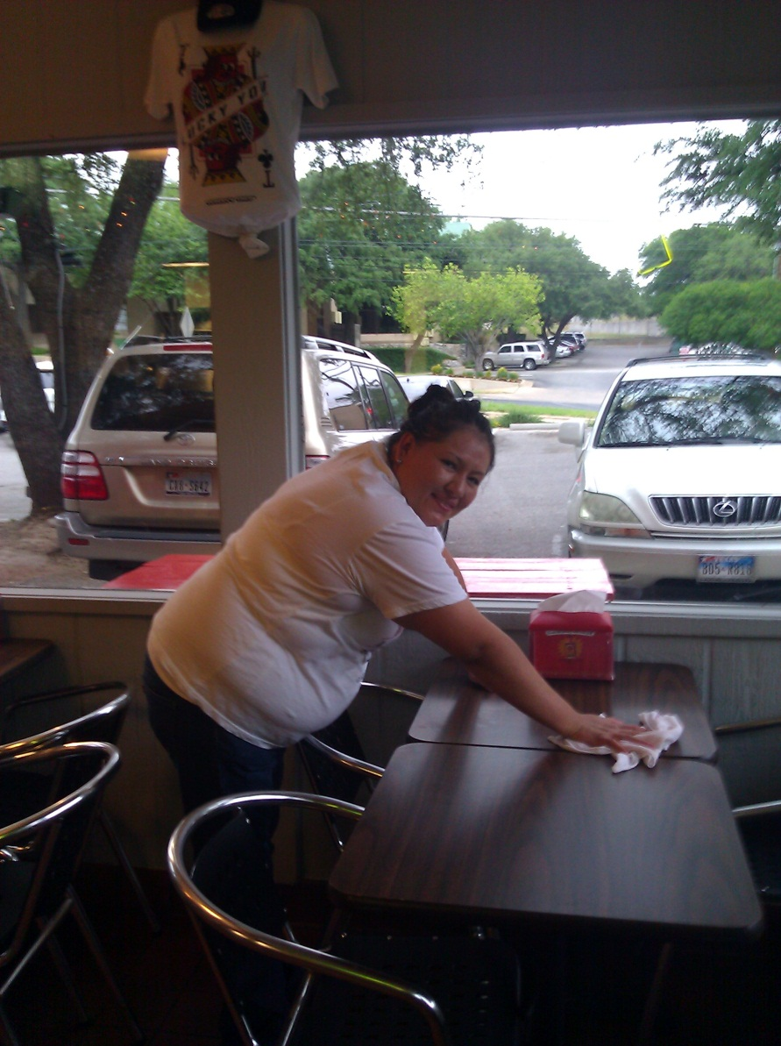
Can We Always Imagine How?
Notes:
Taken with permission at Torchy’s Tacos, May 1, 2012. Can we imagine how to get the tables cleaned without a robot that mimics a person?

Slide 60
Were the Luddites Right?
Will technology destroy some people’s lives as they know them?
If so, is it worth the price for the greater good?
Can side effects be mitigated?

Slide 61
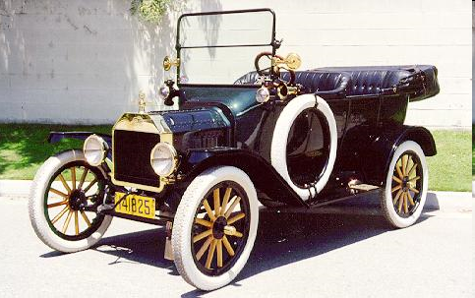
Can We Predict the Impact of New Technology?
Notes:
Image from: http://www.musclecarclub.com/other-cars/classic/ford-model-t/ford-model-t.shtml
Some impacts no one foresaw: pollution, urban sprawl, people getting fat

Slide 62
Our Inability to Predict Impact
Future predictions
More hopelessly wrong predictions
Can we predict the impact of:
The Internet?
Household and factory robots?
Human-level AI?
Human genome sequencing

Slide 63
Can We Predict the Impact of New Technology?
Notes:
Image from: http://www.androidworld.com/HRP-4C2.jpg
Impact of human level robots:

Slide 64
Who Molds to What?
People adapt to technology?
Technology adapt to people?

Slide 65
Unreliability
Computers go down.
Are people more reliable?
Is the unreliability different?
Which is more pernicious?
Notes:
People make tons of mistakes but, mostly, the impact of a single human error is contained. Not so with a computer system.

Slide 66
What’s the Problem?
Technology?
Change?
Notes:
Are people threatened by technology itself or by the pace of change that is accelerating? If we had a stable level of technology, whatever that were, would we feel more comfortable?

Slide 67
Is it Possible to Go Backward?
Examples of giving up on technology?
Why is it so hard?
Notes:
We get dependent. Population grows. The old way is no longer possible. The Irish potato famine.
If some people do it, I must. Example: designer babies.

Slide 68
The Human Use of Human Beings
“When I say that the machine’s danger to society is not from the machine itself but from what man makes of it, I am really underlining the warning of Samuel Butler [1835 – 1902].”
- Weiner, Norbert, The Human Use of Human Beings, 1950, chapter 10.
Notes:
He estimated 10 to 20 years, or less time if big war.

Slide 69
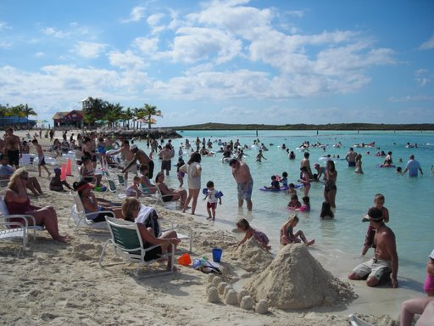
Is This the Future?
Notes:
http://picasaweb.google.com/brucemcdon/2007NovemberCruise/photo#5131725272362099410

Slide 70
Boredom
We get bored. Why?
Notes:
Is there an evolutionary explanation. People who tended to get bored got off their duffs more and did more things. That lead to greater success, thus more food, more mating opportunities, etc.

Slide 71
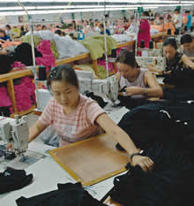
Is It Better than This?
http://www.msmagazine.com/spring2006/paradise_full.asp
Notes:
In Saipan, Northern Mariana Islands

Slide 72
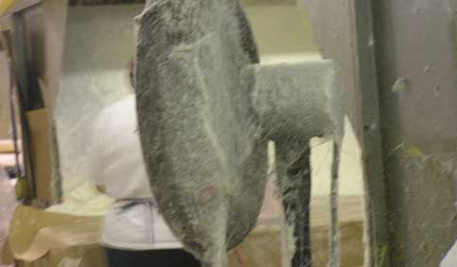
Or This?
http://www.nytimes.com/2013/03/31/us/osha-emphasizes-safety-health-risks-fester.html?emc=eta1
Notes:
Royale Comfort Seating, N.C. (not China) – people blow glue onto foam and sustain significant neurological damage.

Slide 73
Humanizing or Dehumanizing?
Is this right?
No boring jobs left
Human dignity
Repetitive assembly line jobs
Time

Slide 74
Do We Care Who Does the Work?

Slide 75
A Quick Look at Cheap Human Labor

Slide 76
Transportation

Slide 77
Transportation

Slide 78
Transportation

Slide 79
Transportation

Slide 80
Transportation

Slide 81
Transportation
Notes:
Transporting people

Slide 82
Street Cleaning

Slide 83
Retail

Slide 84
Retail

Slide 85
Retail (and Transportation)

Slide 86
Retail – Different Way
Notes:
http://picasaweb.google.com/lh/photo/wA6qK1fAwUU7uHwcOLjKHQ Inside a Walmart Note no employees visible.

Slide 87
Where Are the Jobs?
U.S. Jobs by Industry. 2000 Census. From Marshall Brain, Robotic Nation.

Slide 88
From Robotic Nation
There will be huge job losses by 2040 or 2050 as robots move into the workplace. For example:
Nearly every construction job: ~6 million jobs.
Nearly every manufacturing job: ~16 million jobs lost.
Nearly every transportation job: ~3 million jobs lost.
Many wholesale and retail jobs: at least 15 million lost jobs.
Nearly every hotel and restaurant job: ~10 million jobs lost.
If you add that all up, it's over 50 million jobs lost to robots. That is a conservative estimate. By 2050 or so, it is very likely that over half the jobs in the United States will be held by robots.

Slide 89
Contrast with the Previous 50 Years
If you walked into a restaurant, hotel or store in 1950, it would be nearly identical to a restaurant, hotel or store today. People do everything in both cases -- people stock the shelves, prepare the food, serve the food, help customers, man the cash registers and sweep the floors just like they did in 1950.
It's the same on any construction site. In 1950, guys with circular saws and hammers built houses. Today it is guys with circular saws and nail guns. No big difference.
An airport in 1950 and an airport today are nearly identical. People take your tickets, handle the baggage, maintain the planes and pilot them in both cases.
Notes:
More from Robotic Nation.

Slide 90
Contrast with the Previous 50 Years
Coney island in 1950 looks like any amusement park today, with people operating the rides, selling the concessions and keeping the park clean.
Notes:
http://www.anguilla-beaches.com/corny-coney-island.html

Slide 91
But Another Perspective
Gone:
Automobile assembly (much of it)
Gas station attendant
Switchboard operator
Typist
Notes:
Source: http://www.nytimes.com/2011/10/24/technology/economists-see-more-jobs-for-machines-not-people.html
Switchboard: http://kressmark.blogspot.com/2011/05/lync-operator-solutions.html
Gas station: http://www.superstock.com/stock-photos-images/255-18980
Typing pool: http://david-toms.blogspot.com/2011/05/tuesday-morning-at-office.html

Slide 92
But Another Perspective
On the way out:
bank teller
cashier
home security guards
baby sitter
language translator
librarian
file clerk
Notes:
Source: http://www.nytimes.com/2011/10/24/technology/economists-see-more-jobs-for-machines-not-people.html
Bank teller: http://www.moneyandrisk.com/hot-dates/deadlines/small-businesses-will-be-required-to-make-tax-payments-electronically/
Self checkout: http://www.cracked.com/funny-6085-self-checkout-machines/
File clerk: http://www.ohs.org/education/focus/internet-links-womens-history.cfm

Slide 93
An Interesting Experiment
March 2012 Marketplace’s David Brancaccio tested whether he could drive from New Jersey to California without ever having to interact with another human (he took along a robot dog for company on his road trip). He:
bought gas at self-serve gas,
stayed at hotels where robot attendants check you in and dispense key cards to a room,
bought groceries at stores with self-checkout stations,
drove toll roads with EZ-Pass technology,
used GPS to navigate,
listened to music picked by Pandora.
Notes:
http://www.theboxcarkids.net/wordpress/tag/jobs-lost-to-automation/

Slide 94
The Luddite Fallacy
The Luddite view: automation will eliminate the need for human labor.
This view has been widely regarded as a fallacy because:
Automation reduced cost and this increased demand. We all just have more stuff.
Workers were not up against any hard productivity limit. Most workers have been smart enough to become more productive with the new technology.

Slide 95
The Luddite Fallacy Fallacy
The Luddite view: automation will eliminate the need for human labor.
The fallacy view may now be wrong because:
We are about at the limit of the amount of stuff we can exploit.
Workers are up against a hard productivity limit. Most workers will not be smart enough to become more productive with the new technology. Even some very smart, skilled workers will be eclipsed by machines.
Notes:
A good discussion of this: http://www.angrybearblog.com/2012/08/the-luddite-fallacy-fallacy.html Note, in the last point, that two things are happening: Less talented people are getting left behind. But also some very smart people, like (Ford’s example) radiologists.

Slide 96
Now
Notes:
Now: you get the big bucks and you spend them on things you want. That money pays other people to produce those things. You don’t think of it as you giving charity to those workers.
Programmer: http://thesubwaydevcorp.wordpress.com/2011/02/
Car: http://www.rentexoticcars.com/dallas.html
Tropical vacation: http://jamaicabeachresorts.net/your-dream-tropical-vacation-within-the-budget/
Shirts: http://gearjunkie.com/preppy-cycling-gear
Burger and fries: http://www.dogwoodcafe.com/burgers-sandwiches.html
French fry cooker: http://www.anarkismo.net/article/5169
Garment workers: http://drpinna.com/economic-rip-tide-chapter-two-2-4113
Hotel worker: http://positivepsychologynews.com/news/senia-maymin/20070525259
Car factory worker: http://www.businessinsider.com/company-is-dying-to-hire-unemployed-americans-with-the-right-skills-cant-find-any-2010-7
Money: http://paraibaparadise.com/index.php/Joao-Pessoa/2009/10/11/brazil-may-use-sovereign-fund-to-buy-u-s-dollars-estado-says/

Slide 97
Now
Notes:
But you may feel grumpy about having your money go to support folks who are “lazy” or just not trying to contribute. But what if we simply don’t need everyone to work?
Programmer: http://thesubwaydevcorp.wordpress.com/2011/02/
Car: http://www.rentexoticcars.com/dallas.html
Tropical vacation: http://jamaicabeachresorts.net/your-dream-tropical-vacation-within-the-budget/
Shirts: http://gearjunkie.com/preppy-cycling-gear
Burger and fries: http://www.dogwoodcafe.com/burgers-sandwiches.html
Welfare poster: http://chicksontheright.com/2011/01/28/welfare-recipients-in-washington-are-about-to-be-cut-off/
Gang picture: http://txt3.tv/crips-bloods-ms-13-and-the-church/
WIC coupon: http://www.dailykos.com/story/2011/04/14/966873/-WIC-cutsthe-real-story
Section 8 housing: http://www.surveymagnet.com/2010/04/section-8-homes/

Slide 98
Then
Notes:
Then: No need for the workers any more. You get what you want for a lot less money. What happens to the rest of your money? What happens to the people who are now unemployed? Would you be “willing” to support them with your extra money?
Programmer: http://thesubwaydevcorp.wordpress.com/2011/02/
Car: http://www.rentexoticcars.com/dallas.html
Tropical vacation: http://jamaicabeachresorts.net/your-dream-tropical-vacation-within-the-budget/
Shirts: http://gearjunkie.com/preppy-cycling-gear
Burger and fries: http://www.dogwoodcafe.com/burgers-sandwiches.html
Money: http://paraibaparadise.com/index.php/Joao-Pessoa/2009/10/11/brazil-may-use-sovereign-fund-to-buy-u-s-dollars-estado-says/
Army of robots: http://www.sodahead.com/fun/my-problem-with-peace/blog-37972/?page=10&link=ibaf&imgurl=http://www.istockphoto.com/file_thumbview_approve/1716577/2/istockphoto_1716577_robot_army.jpg&q=army%2Bof%2Brobots
Question mark: http://gyantunplugged.com/sound-off/sound-off-artists-managers-needs-to-read-this/attachment/question-mark/

Slide 99
Then
Notes:
Then: No need for the workers any more. You get what you want for a lot less money. What happens to the rest of your money? What happens to the people who are now unemployed? Would you be “willing” to support them with your extra money?
Homeless guy: http://stuffunemployedpeoplelike.com/page/2/
Programmer: http://thesubwaydevcorp.wordpress.com/2011/02/
Car: http://www.rentexoticcars.com/dallas.html
Tropical vacation: http://jamaicabeachresorts.net/your-dream-tropical-vacation-within-the-budget/
Shirts: http://gearjunkie.com/preppy-cycling-gear
Burger and fries: http://www.dogwoodcafe.com/burgers-sandwiches.html
Money: http://paraibaparadise.com/index.php/Joao-Pessoa/2009/10/11/brazil-may-use-sovereign-fund-to-buy-u-s-dollars-estado-says/
Army of robots: http://www.sodahead.com/fun/my-problem-with-peace/blog-37972/?page=10&link=ibaf&imgurl=http://www.istockphoto.com/file_thumbview_approve/1716577/2/istockphoto_1716577_robot_army.jpg&q=army%2Bof%2Brobots
Breadline: http://www.walletpop.com/tag/bureau+of+labor+statistics/

Slide 100
Then
Notes:
More modern version.
Then: No need for the workers any more. You get what you want for a lot less money. What happens to the rest of your money? What happens to the people who are now unemployed? Would you be “willing” to support them with your extra money?
Homeless guy: http://stuffunemployedpeoplelike.com/page/2/
Programmer: http://thesubwaydevcorp.wordpress.com/2011/02/
Car: http://www.rentexoticcars.com/dallas.html
Tropical vacation: http://jamaicabeachresorts.net/your-dream-tropical-vacation-within-the-budget/
Shirts: http://gearjunkie.com/preppy-cycling-gear
Burger and fries: http://www.dogwoodcafe.com/burgers-sandwiches.html
Money: http://paraibaparadise.com/index.php/Joao-Pessoa/2009/10/11/brazil-may-use-sovereign-fund-to-buy-u-s-dollars-estado-says/
Army of robots: http://www.sodahead.com/fun/my-problem-with-peace/blog-37972/?page=10&link=ibaf&imgurl=http://www.istockphoto.com/file_thumbview_approve/1716577/2/istockphoto_1716577_robot_army.jpg&q=army%2Bof%2Brobots

Slide 101
Is it Already Happening?
Notes:
From the Atlantic article: http://www.theatlantic.com/magazine/archive/2011/09/can-the-middle-class-be-saved/8600/?single_page=true
Article argues that there are fixes, like more education. But, given what we know about the progression of technology, are there really any fixes?

Slide 102
Is it Already Happening?
Notes:
http://theeconomiccollapseblog.com/archives/not-everyone-is-hurting-the-rich-get-richer-as-the-income-inequality-gap-explodes

Slide 103
Is it Already Happening?
“Almost one of every 12 white-collar jobs in sales, administrative support, and nonmanagerial office work vanished in the first two years of the recession; one of every six blue-collar jobs in production, craft, repair, and machine operation did the same.”
Notes:
From the Atlantic article: http://www.theatlantic.com/magazine/archive/2011/09/can-the-middle-class-be-saved/8600/?single_page=true
Argues that there are jobs at the top and very menial jobs at the bottom. But the solid middle class jobs in the middle, like unionized manufacturing jobs are gone and aren’t coming back.

Slide 104
Is it Already Happening?
Notes:
http://www.stateofworkingamerica.org/articles/view/18 Of course, this may just be a bad recession and maybe the jobs will come back. But there’s a good argument that technology will mean that they won’t.

Slide 105
Making It in America
In the past decade, the flow of goods emerging from U.S. factories has risen by about a third.
Factory employment has fallen by roughly the same fraction.
Notes:
http://www.theatlantic.com/magazine/archive/2012/01/making-it-in-america/8844/ Picture of Maddie, worker at Standard Motor Products

Slide 106
Making It in America
“Maddie is cheaper than a machine. It would be easy to buy a robotic arm that could take injector bodies and caps from a tray and place them precisely in a laser welder. Yet Standard would have to invest about $100,000 on the arm and a conveyance machine to bring parts to the welder and send them on to the next station. As is common in factories, Standard invests only in machinery that will earn back its cost within two years. For Tony, it’s simple: Maddie makes less in two years than the machine would cost, so her job is safe—for now. If the robotic machines become a little cheaper, or if demand for fuel injectors goes up and Standard starts running three shifts, then investing in those robots might make sense.”
Notes:
http://www.theatlantic.com/magazine/archive/2012/01/making-it-in-america/8844/ Strange thing: if demand goes up, jobs go down.

Slide 107
Making It in America
“What worries people in factories is electronics, robots,” she tells me. “If you don’t know jack about computers and electronics, then you don’t have anything in this life anymore. One day, they’re not going to need people; the machines will take over. People like me, we’re not going to be around forever.”
Notes:
http://www.theatlantic.com/magazine/archive/2012/01/making-it-in-america/8844/

Slide 108
Making It in America
U.S. Population in 1940: 142,164,569
U.S. Population in 2010: 308,282,000
Notes:
http://bonddad.blogspot.com/2009/10/notes-on-job-losses-during-great.html Also consider there are many more women in the workforce.

Slide 109
Productivity vs Wages
Notes:
http://www.nytimes.com/2013/01/13/sunday-review/americas-productivity-climbs-but-wages-stagnate.html
We’re producing more but the benefits aren’t being spread across the economy. One reason: less labor is needed so labor doesn’t much leverage.

Slide 110
The Human Use of Human Beings
“It is fair to say, however, that except for a considerable number of isolated examples, the industrial revolution up to the present has displaced man and the beast as a source of power, without making any great impression on other human functions. …
Let us now go on to a picture of a more completely automatic age. Let us consider what for example the automobile factory of the future will be like …
In other words, the machine plays no favorites between manual labor and white-collar labor. …

Slide 111
The Human Use of Human Beings
What can we expect of its economic and social consequences? In the first place, we can expect an abrupt and final cessation of the demand for the type of factory labor performing purely repetitive tasks. In the long run, the deadly uninteresting nature of the repetitive task may make this a good thing and the source of leisure necessary for a man’s full cultural development. It may also produce cultural results as trivial and wasteful as the greater part of those so far obtained from the radio and the movies. …

Slide 112
The Human Use of Human Beings
Be that as it may, the intermediate period of the introduction of the new means, especially if it comes in the fulminating manner to be expected from a new war, will lead to an immediate transitional period of disastrous confusion. …
Under these circumstances, industry will be flooded with the new tools to the extent that they appear to yield immediate profits, irrespective of what long-time damage they can do.

Slide 113
The Human Use of Human Beings
“Let us remember that the automatic machine, whatever we think of any feelings it may have or may not have, is the precise economic equivalent of slave labor. Any labor which competes with slave labor must accept the economic conditions of slave labor. It is perfectly clear that this will produce an unemployment situation, in comparison with which the present recession and even the depression of the thirties will seem a pleasant joke. …
Thus the new industrial revolution is a two-edged sword. It may be used for the benefit of humanity, but only if humanity survives long enough to enter a period in which such a benefit is possible. It may also be used to destroy humanity, and if it is not used intelligently it can go very far in that direction.”
- Weiner, Norbert, The Human Use of Human Beings, 1950, chapter 9.
Notes:
He estimated 10 to 20 years, or less time if big war.

Slide 114
Slave Revolts
Spartacus
73 – 71 BCE
Notes:
Returning to the idea of revolts: Suppose we don’t do Australia --- http://en.wikipedia.org/wiki/Image:Spartacus_II.JPG

Slide 115
Dominican Revolt
1791 - 1801
Toussaint Louverture

Slide 116
Nat Turner
1831
Notes:
http://en.wikipedia.org/wiki/File:Nat_Turner_woodcut.jpg

Slide 117
Will Displaced People Revolt?

Slide 118
Will Robot Slaves Revolt?
R. U. R.
Notes:
An aside: It happens in movies. If robots are smart enough to do everything, they will be smart enough to revolt.

Slide 119
Back to Income Disparity
Notes:
http://animalspiritspage.blogspot.com/2009/05/income-inequality-debt-crisis-and.html

Slide 120
The Rich Get Richer … Until …
Notes:
As long as there are some customers, the business owner class can keep cutting costs and increasing profits.
http://www.nytimes.com/2008/02/09/business/09idol.html?_r=1

Slide 121
The Rich Get Richer … Until …
Notes:
As long as there are some customers, the business owner class can keep cutting costs and increasing profits. Here, almost no employees in sight.
I edited this picture: http://sixthseal.com/category/fast-food-inc/

Slide 122
… Until All the Customers Have No Money
Notes:
As long as there are some customers, the business owner class can keep cutting costs and increasing profits. Here, no employees in sight.
http://www.designboom.com/weblog/cat/10/view/13925/superflex-flooded-mcdonalds.html

Slide 123
Is This Possible?
Our device saves the average restaurant $135,000 per year in wages and overhead.
http://momentummachines.com/

Slide 124
Is This Possible?
http://www.pocket-lint.com/news/48601/bugeon-hamburger-making-robot-fast-food

Slide 125
The Burgeon
“The Burgeon can crank out a burger every 16 seconds. It grinds the meat, stamps out the patty, sends it along a conveyor-belt grill, toasts the buns, squirts on the condiments, slices and drops in pickles and tomatoes and lettuce, then pops the finished burger into a bag, all in under five minutes.
And, says <its creator>, "we're trying to bring it down to a completed burger every 10 seconds."
“Our device isn’t meant to make employees more efficient,” said co-founder Alexandros Vardakostas. “It’s meant to completely obviate them.”
Notes:
Sept 2012: http://www.siliconvalley.com/ci_21602139
Red quote: http://www.xconomy.com/san-francisco/2012/06/12/hamburgers-coffee-guitars-and-cars-a-report-from-lemnos-labs/

Slide 126
Two Paths
Notes:
One path: ignore the problem until more and more people are “warehoused” and marginalized. Another path: something like the Australia Project.
Queensbridge Houses, public housing, Queens: http://www.answers.com/topic/queensbridge-queens?cat=travel
Australia: http://www.connections.travel/content.asp?Document_ID=52578

Slide 127
The Australia Project
Marshall Brain, Manna, Chapter 5
Notes:
Australia: http://www.connections.travel/content.asp?Document_ID=52578

Slide 128
Suppose We Tried Australia
Assume everyone gets a share of the world’s resources just because it’s his/her share. No work required. What would we (people) do all day?
Notes:
Very scary answer: Today, people limit children because they don’t have the money or time to have lots. But if money isn’t an issue because everyone who gets born automatically gets a share and if people are bored and have lots of time, what would the genes evolution gave us tell us to do? But then the planet gets even more crowded.
http://www.livelust y.com/2011/04/08/childrens-health-baby-health-infant-health/

Slide 129
Suppose We Tried Australia
Assume everyone gets a share of the world’s resources just because it’s his/her share. No work required. What would we (people) do all day?
Notes:
Ask students what things people weight do to keep from getting bored – remember that we hate boredom.

Slide 130
The Lights in the Tunnel
http://www.thelightsinthetunnel.com/
http://econfuture.wordpress.com/
Notes:
Image from: http://favim.com/image/248973/
http://singularityhub.com/

Slide 131
The River Analogy
Think of the market as a river. A business pumps water out when it sells something. It pumps water in when it buys goods or pays workers.
A business that pumps water out but pumps none back in is a free rider.
With many free riders, the river will run dry.
Notes:
The Lights in the Tunnel p. 139
View from Eifel Tower: http://www.visitingdc.com/paris/eiffel-tower-view.asp

Slide 132
Recall Income Disparity
Notes:
A rich person doesn’t buy 100 times as many cars or iPhones as 100 regular people. So this trend is very scary.
http://animalspiritspage.blogspot.com/2009/05/income-inequality-debt-crisis-and.html

Slide 133
Worrying about This?
Notes:
From The Lights in the Tunnel p. 94. If all we do is to extrapolate from historical data, we will be completely caught off guard by exponential growth when we hit the elbow of the curve.

Slide 134
Maintaining a Robust Market
Martin Ford’s “radical” idea:
In a future, largely automated economy, the preservation of robust market demand by providing an income stream to consumers will also have to become a core function of government.
Notes:
The Lights in the Tunnel, p. 161.

Slide 135
Maintaining a Robust Market
Who wins now when automation replaces jobs:
The business and its owners get higher profits.
The customers get lower prices.

Slide 136
Maintaining a Robust Market
Who wins now when automation replaces jobs:
The business and its owners get higher profits.
The customers get lower prices.
Wage recapture: the government takes a share that it can use to maintain the market.
Notes:
The Lights in the Tunnel p. 162

Slide 137
Maintaining a Robust Market
Individual income depends on incentives that benefit everyone:
Education.
Community and civic activities.
Journalism.
The environment and other externalities.
Population.
Notes:
The Lights in the Tunnel p. 162 I have added the fifth one. If people have more free time, we must assure that they don’t decide to spend it by having a lot more kids.

Slide 138
Who Decides and How?
Notes:
Homeless guy: http://stuffunemployedpeoplelike.com/page/2/
http://www.answers.com/topic/question-mark-large-image

Slide 139
Where Is the Political Clout?
The Luddites had no political clout. What about now:
Who has the political clout to affect the outcome?
Does it include the people who are most impacted?

Slide 140
KMD
Notes:
KMD – knowledge-based mass destruction
Grey goo image: http://www.exitmundi.nl/graygoo.htm
The WIRED logo is a link to the Bill Joy paper.

Slide 141
The Doomsday Clock
http://www.thebulletin.org/content/doomsday-clock/timeline
Notes:
Referenced in Bill Joy’s article

Slide 142
The Future Needs Us!
Notes:
http://www.nybooks.com/articles/16053
John Milton, Freeman Dyson, Michael Crighton

Slide 143
Summary
What can we/will we be able to do?
What effects can we predict?
Are these outcomes that we want?
What should we be doing to prepare?

