Slide 1
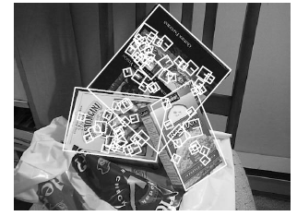
Fitting a transformation: feature-based alignment
Wed, Feb 23
Prof. Kristen Grauman
UT-Austin

Slide 2
Announcements
Reminder: Pset 2 due Wed March 2
Midterm exam is Wed March 9
(2 weeks from now)

Slide 3
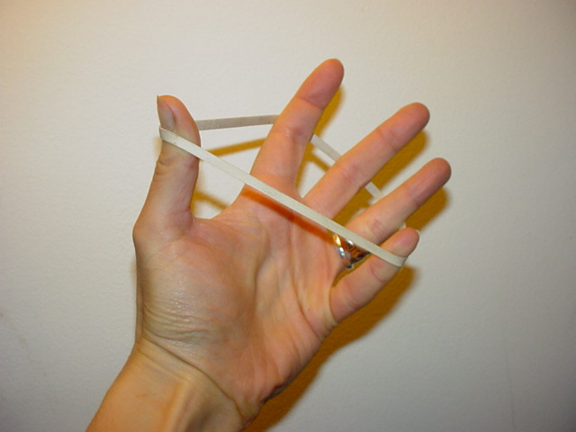
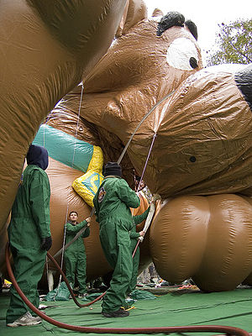
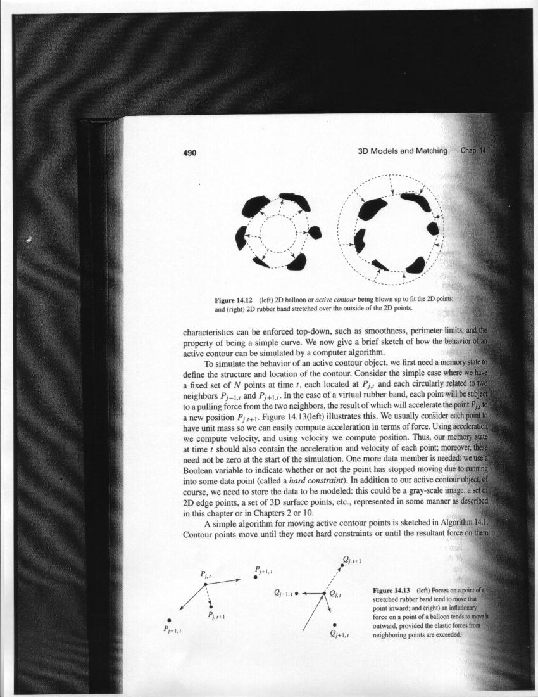
Last time: Deformable contours
Image from http://www.healthline.com/blogs/exercise_fitness/uploaded_images/HandBand2-795868.JPG
Kristen Grauman

Slide 4

Last time: Deformable contours
a.k.a. active contours, snakes
Given: initial contour (model) near desired object
Goal: evolve the contour to fit exact object boundary
Main idea: elastic band is iteratively adjusted so as to
be near image positions with high gradients, and
satisfy shape “preferences” or contour priors
[Snakes: Active contour models, Kass, Witkin, & Terzopoulos, ICCV1987]
Figure credit: Yuri Boykov

Slide 5
Last time: Deformable contours
Pros:
Useful to track and fit non-rigid shapes
Contour remains connected
Possible to fill in “subjective” contours
Flexibility in how energy function is defined, weighted.
Cons:
Must have decent initialization near true boundary, may get stuck in local minimum
Parameters of energy function must be set well based on prior information
Kristen Grauman

Slide 6
Today
Interactive segmentation
Feature-based alignment
  2D transformations
  Affine fit
  RANSAC

Slide 7

Interactive forces
How can we implement such an interactive force with deformable contours?
Kristen Grauman

Slide 8
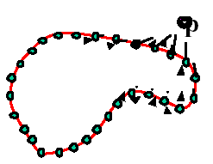
Interactive forces
An energy function can be altered online based on user input – use the cursor to push or pull the initial snake away from a point.
Modify external energy term to include:
Nearby points get pushed hardest
Kristen Grauman

Slide 9
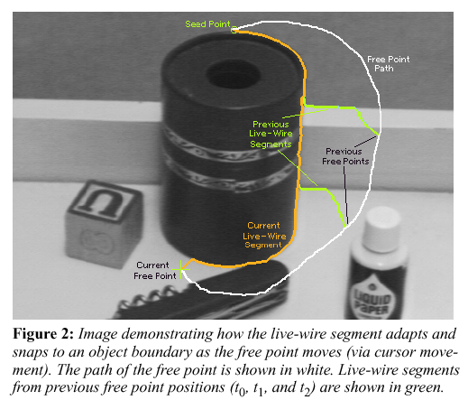
Intelligent scissors
Another form of interactive segmentation:
Compute optimal paths from every point to the seed based on edge-related costs.
[Mortensen & Barrett, SIGGRAPH 1995, CVPR 1999]

Slide 10
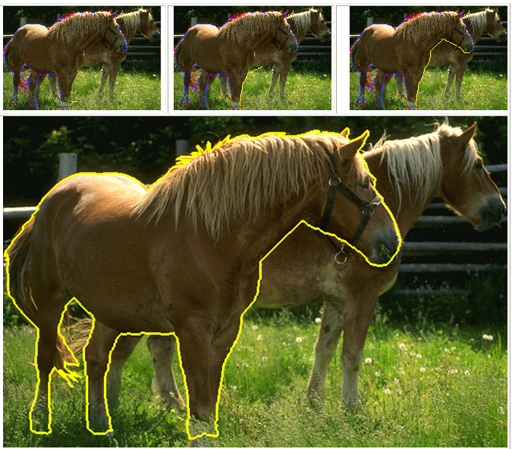
Intelligent scissors
http://rivit.cs.byu.edu/Eric/Eric.html

Slide 11
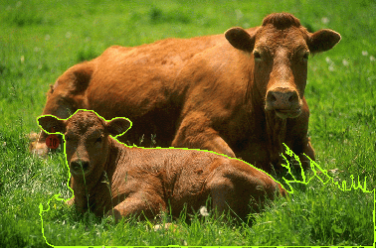
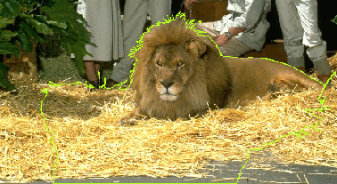
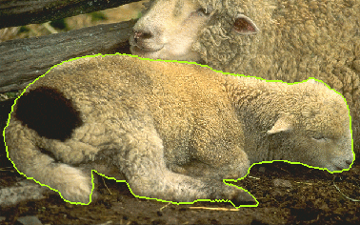
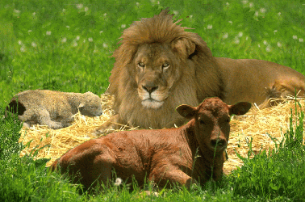
Intelligent scissors
http://rivit.cs.byu.edu/Eric/Eric.html

Slide 12
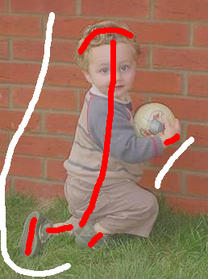
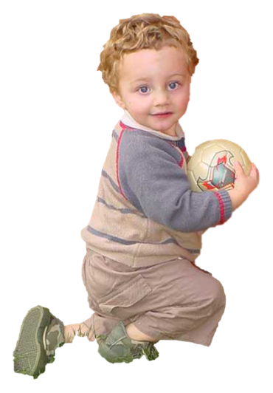
Beyond boundary snapping…
Another form of interactive guidance: specify regions
Usually taken to suggest foreground/background color distributions
User Input
Result
How to use this information?
Boykov and Jolly (2001)
Kristen Grauman

Slide 13
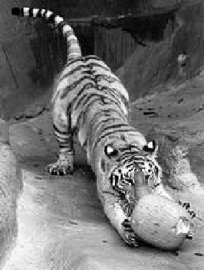
Recall: Images as graphs
q
w_{pq}
w
p
Fully-connected graph
  node for every pixel
  link between every pair of pixels, p,q
  similarity w_{pq} for each link
      similarity is inversely proportional to difference in color and position
Steve Seitz

Slide 14
Recall: Segmentation by Graph Cuts
w
A
B
C
Break graph into segments
  Delete links that cross between segments
  Easiest to break links that have low similarity
    similar pixels should be in the same segments
    dissimilar pixels should be in different segments
Steve Seitz

Slide 15
Recall: Segmentation by Graph Cuts
B
A
Link Cut
  set of links whose removal makes a graph disconnected
  cost of a cut:
Find minimum cut
  gives you a segmentation
  fast algorithms exist for doing this
Source: Steve Seitz

Slide 16
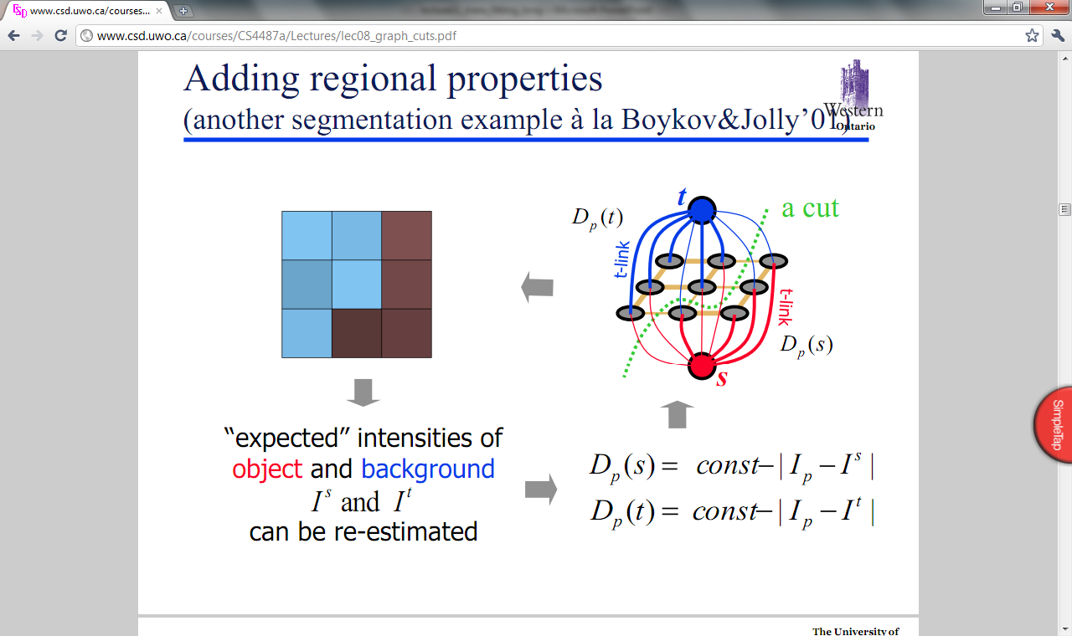
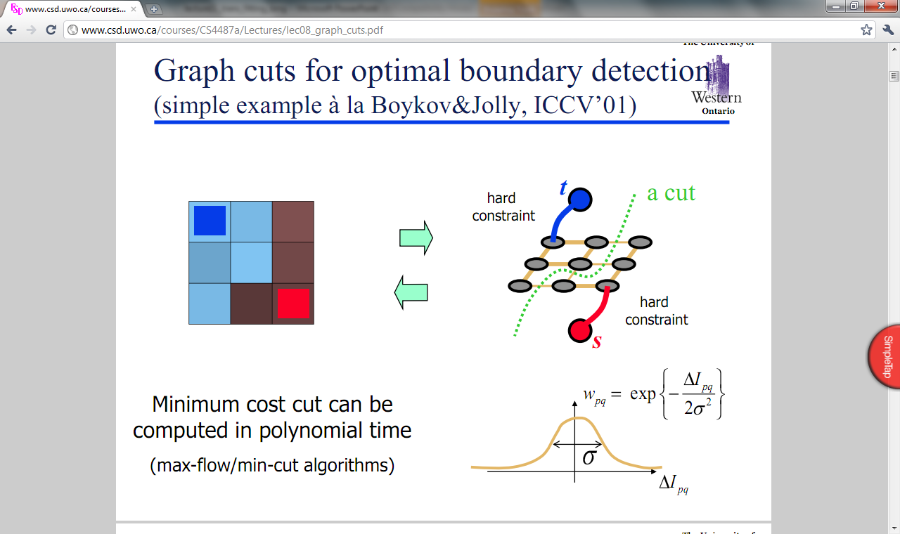
Graph cuts for interactive segmentation
Adding hard constraints:
Add two additional nodes, object and background “terminals”
Link each pixel
To both terminals
To its neighboring pixels
Yuri Boykov

Slide 17
Graph cuts for interactive segmentation
Adding hard constraints:
Let the edge weight to object or background terminal reflect similarity to the respective seed pixels.
Yuri Boykov

Slide 18
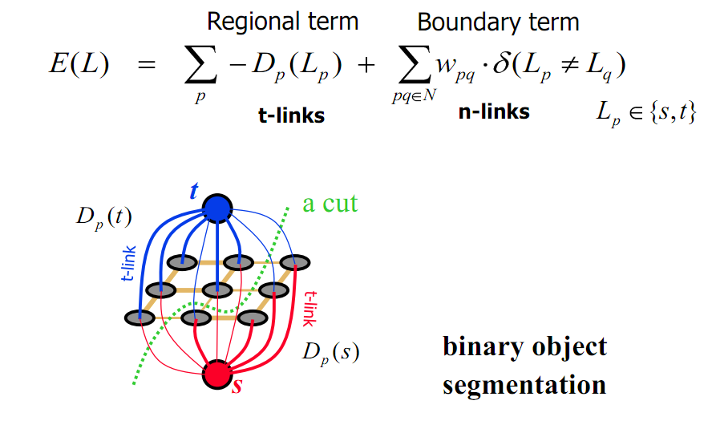
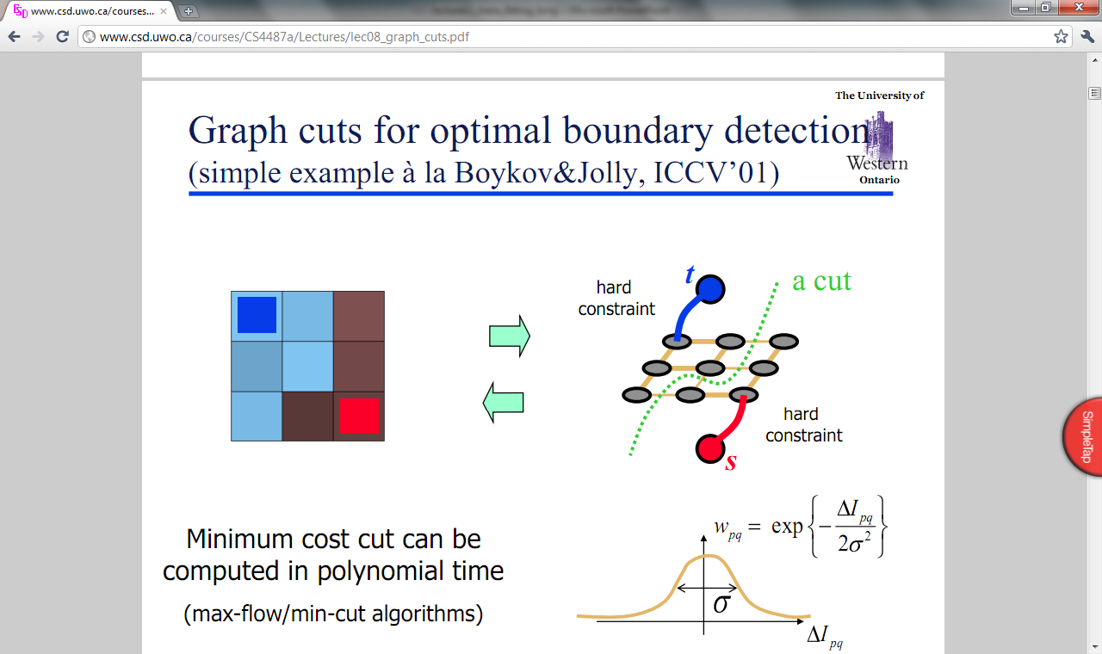
Graph cuts for interactive segmentation
Boykov and Jolly (2001)
Yuri Boykov

Slide 19
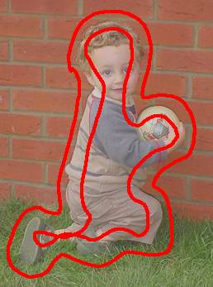
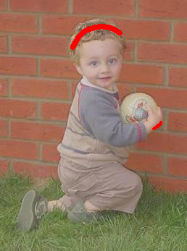
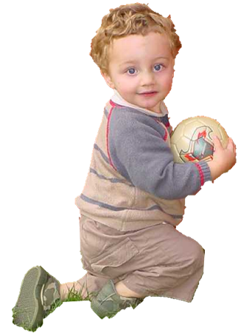

Graph cuts for interactive segmentation
Another interaction modality: specify bounding box
Intelligent Scissors
Mortensen and
Barrett (1995)
Graph Cuts
Boykov and
Jolly (2001)
GrabCut
Rother et al. (2004)

Slide 20
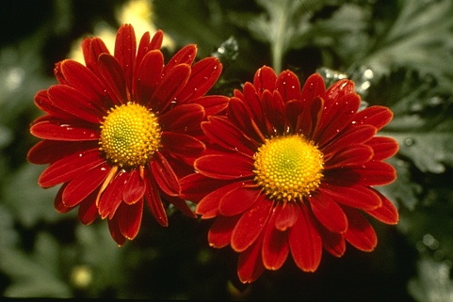

“Grab Cut”
Loosely specify foreground region
Iterated graph cut
?
User Initialisation
User initialization
Graph cuts to infer the segmentation
K-means for learning
colour distributions
Rother et al (2004)

Slide 21

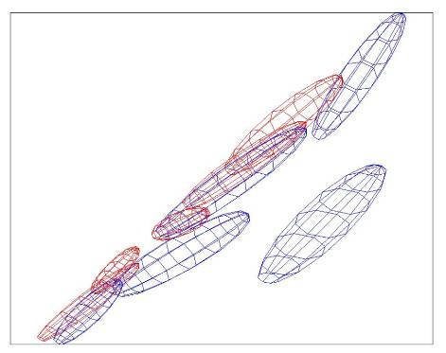
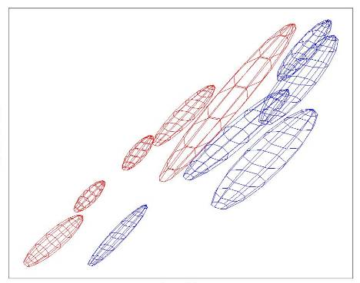
“Grab Cut”
Loosely specify foreground region
Iterated graph cut
R
R
Foreground &
Background
Iterated graph cut
Foreground
Background
G
Background
G
Gaussian Mixture Model (typically 5-8 components)
Rother et al (2004)

Slide 22
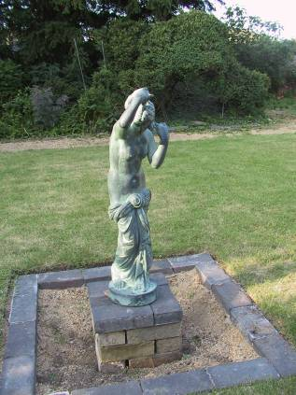
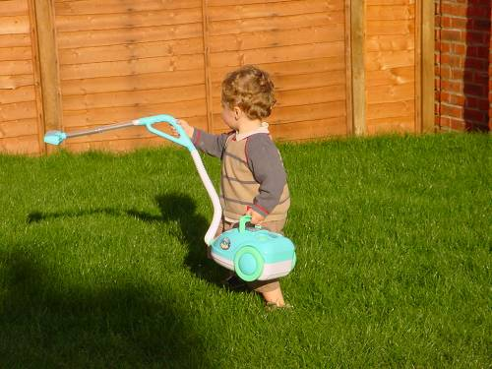
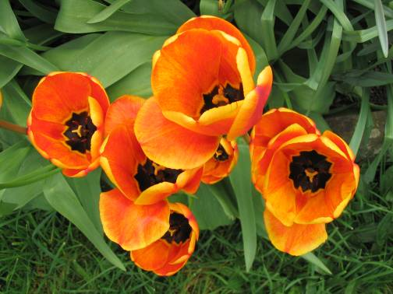
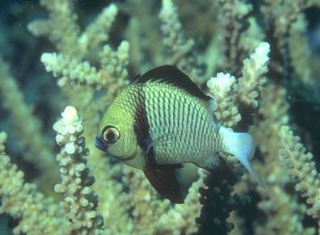
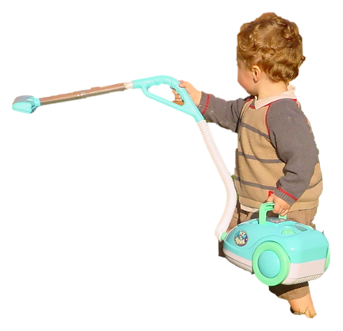
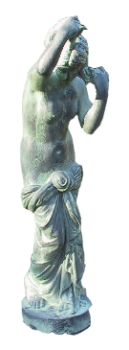

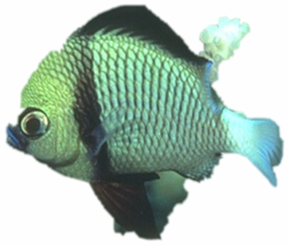
“Grab Cut”
Rother et al (2004)

Slide 23
Today
Interactive segmentation
Feature-based alignment
  2D transformations
  Affine fit
  RANSAC

Slide 24
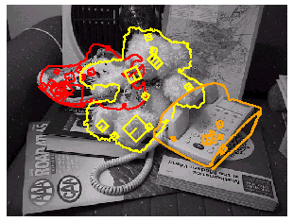
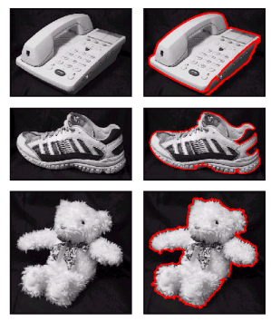
Motivation: Recognition
Figures from David Lowe

Slide 25
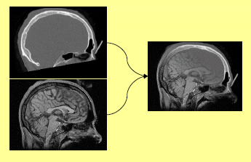
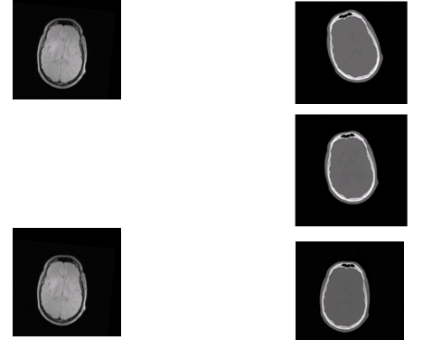
Motivation: medical image registration

Slide 26

Motivation: mosaics
(In detail next week)
Image from http://graphics.cs.cmu.edu/courses/15-463/2010_fall/

Slide 27
Alignment problem
We have previously considered how to fit a model to image evidence
  e.g., a line to edge points, or a snake to a deforming contour
In alignment, we will fit the parameters of some transformation according to a set of matching feature pairs (“correspondences”).
x_{i}
'
x_{i}
T

Slide 28




Parametric (global) warping
Examples of parametric warps:
translation
rotation
aspect
perspective
affine
Source: Alyosha Efros

Slide 29
Parametric (global) warping
T
p = (x,y)
p’ = (x’,y’)
Transformation T is a coordinate-changing machine:
p’ = T(p)
What does it mean that T is global?
  Is the same for any point p
  can be described by just a few numbers (parameters)
Let’s represent T as a matrix:
p’ = Mp
Source: Alyosha Efros

Slide 30
Scaling
Scaling a coordinate means multiplying each of its components by a scalar
Uniform scaling means this scalar is the same for all components:
× 2
Source: Alyosha Efros

Slide 31
Scaling
Non-uniform scaling: different scalars per component:
X × 2,
Y × 0.5
Source: Alyosha Efros

Slide 32
Scaling
Scaling operation:
Or, in matrix form:
scaling matrix S
Source: Alyosha Efros

Slide 33
What transformations can be represented with a 2x2 matrix?
2D Scaling?
2D Rotate around (0,0)?
2D Shear?
Source: Alyosha Efros

Slide 34
What transformations can be represented with a 2x2 matrix?
2D Mirror about Y axis?
2D Mirror over (0,0)?
2D Translation?
NO!
Source: Alyosha Efros

Slide 35
2D Linear Transformations
Only linear 2D transformations can be represented with a 2x2 matrix.
Linear transformations are combinations of …
  Scale,
  Rotation,
  Shear, and
  Mirror
Source: Alyosha Efros

Slide 36
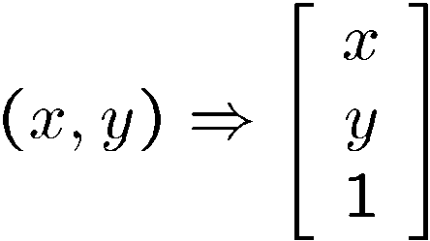
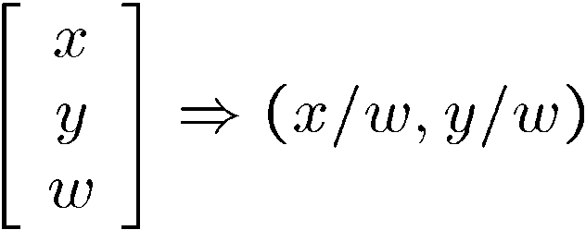
Homogeneous coordinates
To convert to homogeneous coordinates:
homogeneous image
coordinates
Converting from homogeneous coordinates

Slide 37
Homogeneous Coordinates
Q: How can we represent 2d translation as a 3x3 matrix using homogeneous coordinates?
A: Using the rightmost column:
Source: Alyosha Efros

Slide 38
Translation
Homogeneous Coordinates
t_{x} = 2
t_{y} = 1
Source: Alyosha Efros

Slide 39
Basic 2D Transformations
Basic 2D transformations as 3x3 matrices
Translate
Scale
Rotate
Shear
Source: Alyosha Efros

Slide 40
2D Affine Transformations
Affine transformations are combinations of …
  Linear transformations, and
  Translations
Parallel lines remain parallel

Slide 41
Today
Interactive segmentation
Feature-based alignment
  2D transformations
  Affine fit
  RANSAC

Slide 42
Alignment problem
We have previously considered how to fit a model to image evidence
  e.g., a line to edge points, or a snake to a deforming contour
In alignment, we will fit the parameters of some transformation according to a set of matching feature pairs (“correspondences”).
x_{i}
'
x_{i}
T
Kristen Grauman

Slide 43
Image alignment
Two broad approaches:
  Direct (pixel-based) alignment
    Search for alignment where most pixels agree
  Feature-based alignment
    Search for alignment where extracted features agree
    Can be verified using pixel-based alignment

Slide 44
Fitting an affine transformation
Assuming we know the correspondences, how do we get the transformation?

Slide 45
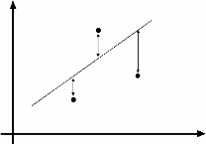
An aside: Least Squares Example
Say we have a set of data points (X1,X1’), (X2,X2’), (X3,X3’), etc. (e.g. person’s height vs. weight)
We want a nice compact formula (a line) to predict X’s from Xs: Xa + b = X’
We want to find a and b
How many (X,X’) pairs do we need?
What if the data is noisy?
Ax=B
overconstrained
Source: Alyosha Efros

Slide 46
Fitting an affine transformation
Assuming we know the correspondences, how do we get the transformation?

Slide 47
Fitting an affine transformation
How many matches (correspondence pairs) do we need to solve for the transformation parameters?
Once we have solved for the parameters, how do we compute the coordinates of the corresponding point for ?
Where do the matches come from?
Kristen Grauman

Slide 48
What are the correspondences?
?
Compare content in local patches, find best matches.
  e.g., simplest approach: scan with template, and compute SSD or correlation between list of pixel intensities in the patch
Later in the course: how to select regions according to the geometric changes, and more robust descriptors.
Kristen Grauman

Slide 49
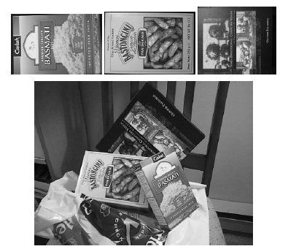
Fitting an affine transformation
Affine model approximates perspective projection of planar objects.
Figures from David Lowe, ICCV 1999

Slide 50
Today
Interactive segmentation
Feature-based alignment
  2D transformations
  Affine fit
  RANSAC

Slide 51
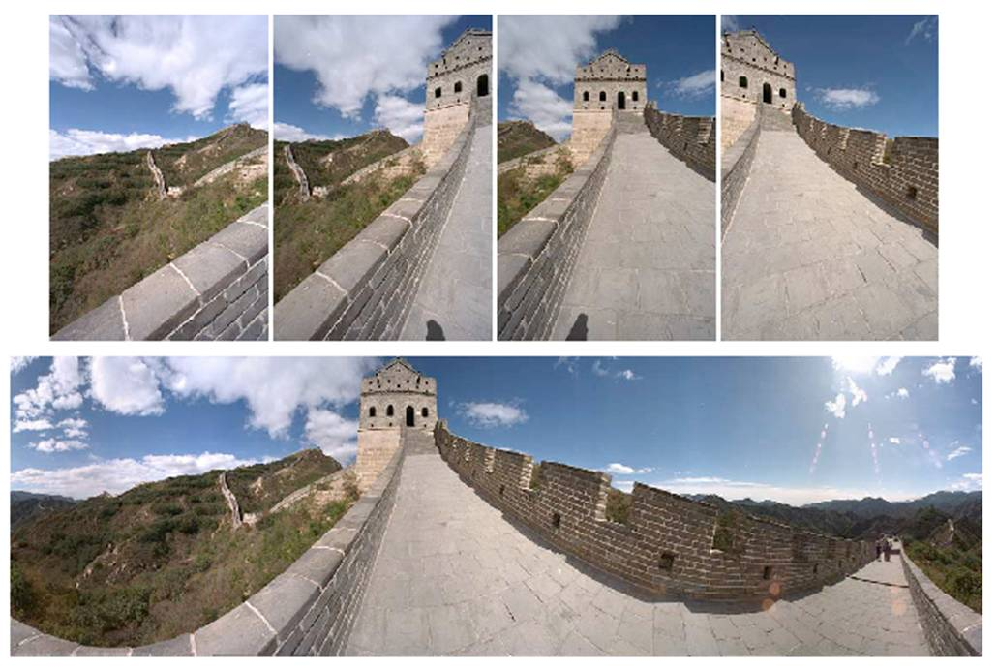
Outliers
Outliers can hurt the quality of our parameter estimates, e.g.,
  an erroneous pair of matching points from two images
  an edge point that is noise, or doesn’t belong to the line we are fitting.
Kristen Grauman

Slide 52
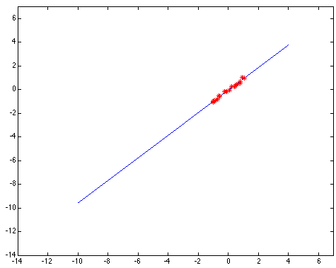
Outliers affect least squares fit
Notes:
52

Slide 53
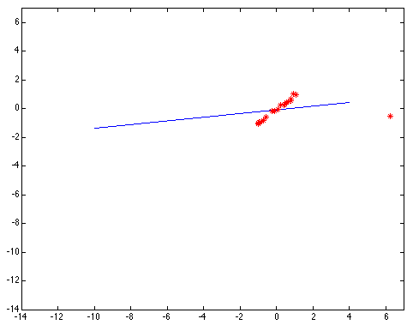
Outliers affect least squares fit
Notes:
53

Slide 54
RANSAC
RANdom Sample Consensus
Approach: we want to avoid the impact of outliers, so let’s look for “inliers”, and use those only.
Intuition: if an outlier is chosen to compute the current fit, then the resulting line won’t have much support from rest of the points.

Slide 55
RANSAC: General form
RANSAC loop:
Randomly select a seed group of points on which to base transformation estimate (e.g., a group of matches)
Compute transformation from seed group
Find inliers to this transformation
If the number of inliers is sufficiently large, re-compute estimate of transformation on all of the inliers
Keep the transformation with the largest number of inliers

Slide 56
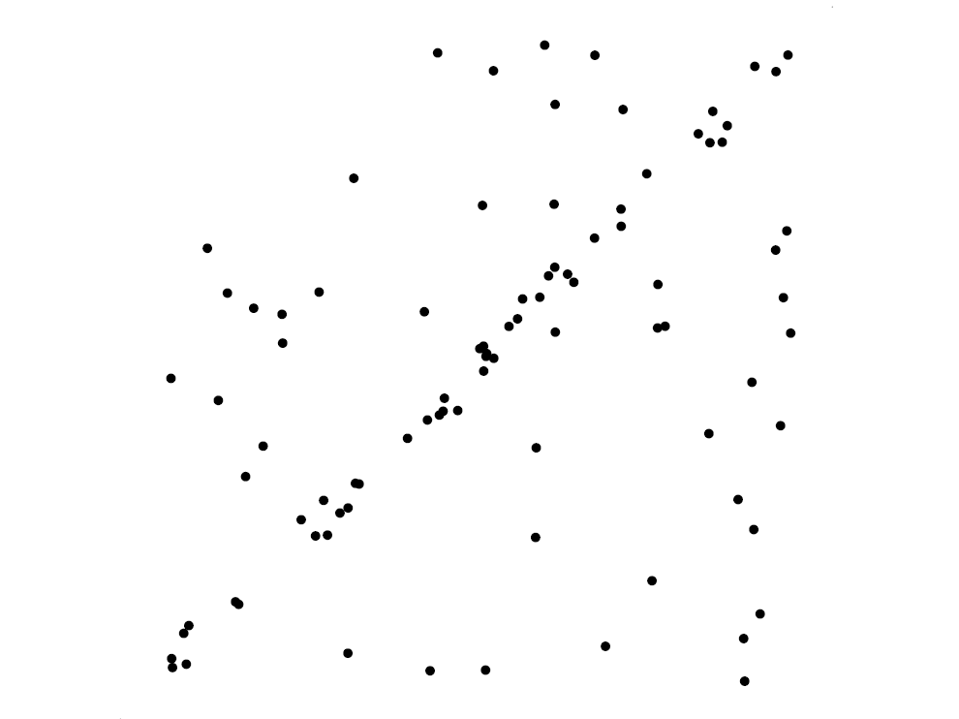
RANSAC for line fitting example
Source: R. Raguram
Lana Lazebnik

Slide 57
RANSAC for line fitting example
Least-squares fit
Source: R. Raguram
Lana Lazebnik

Slide 58
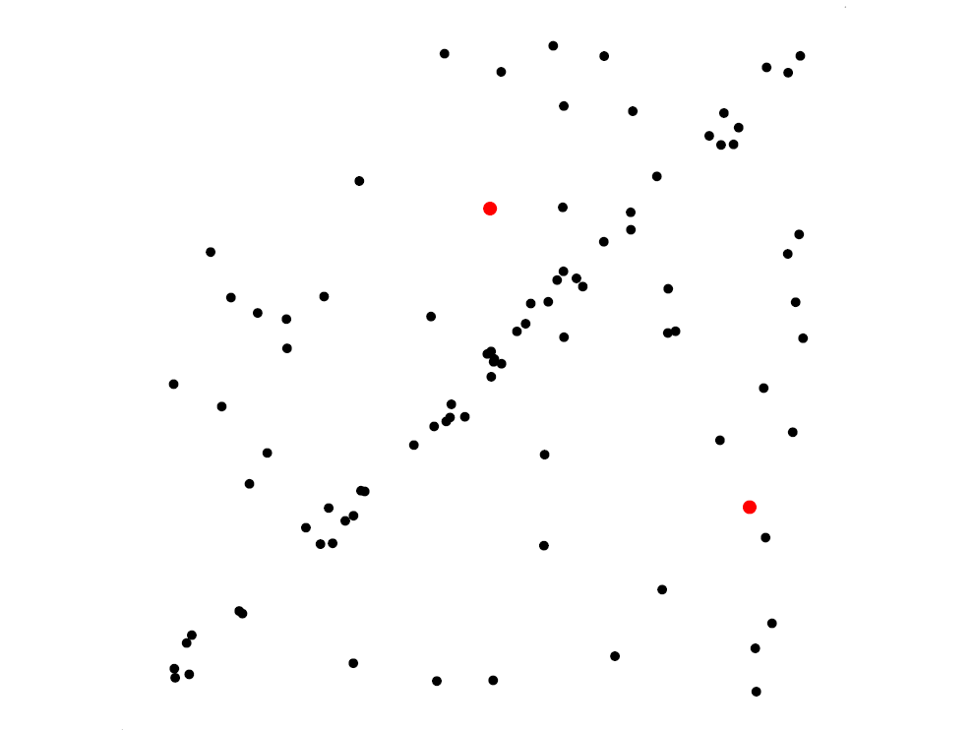
RANSAC for line fitting example
Randomly select minimal subset of points
Source: R. Raguram
Lana Lazebnik

Slide 59
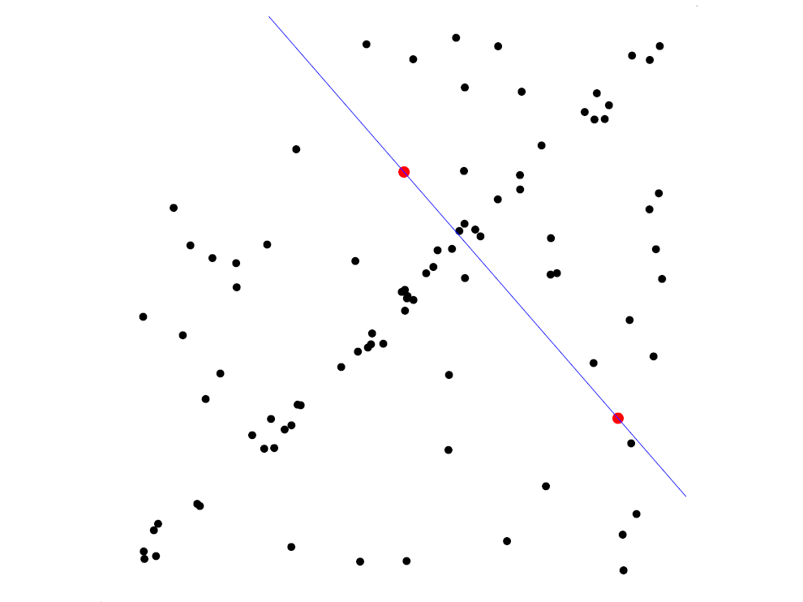
RANSAC for line fitting example
Randomly select minimal subset of points
Hypothesize a model
Source: R. Raguram
Lana Lazebnik

Slide 60
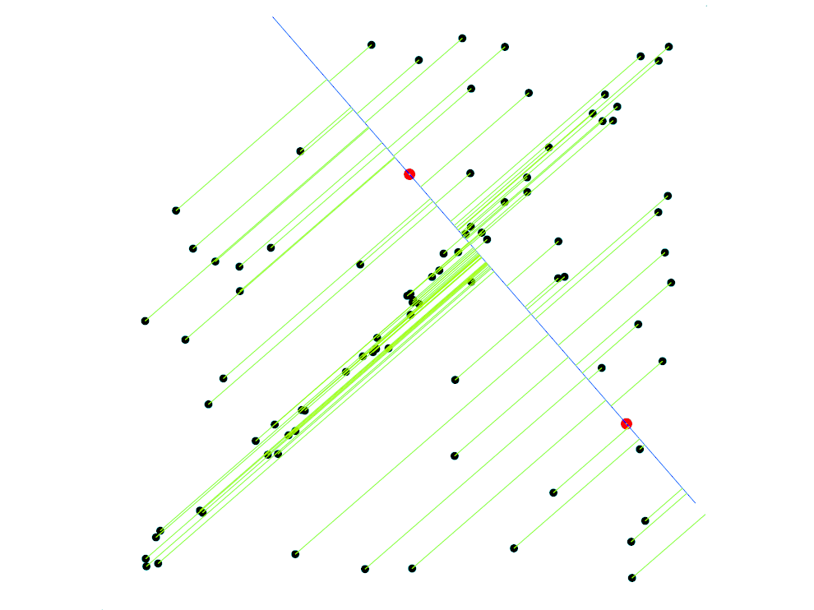
RANSAC for line fitting example
Randomly select minimal subset of points
Hypothesize a model
Compute error function
Source: R. Raguram
Lana Lazebnik

Slide 61
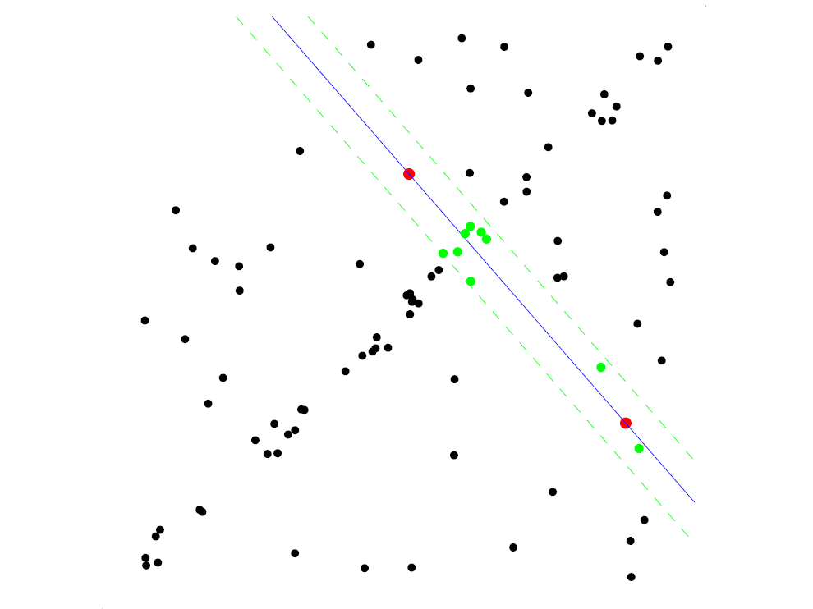
RANSAC for line fitting example
Randomly select minimal subset of points
Hypothesize a model
Compute error function
Select points consistent with model
Source: R. Raguram
Lana Lazebnik

Slide 62
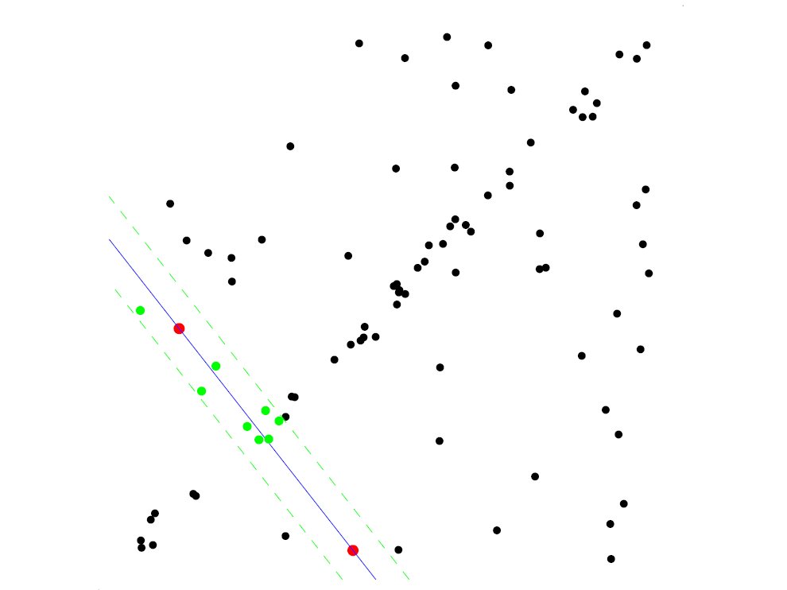
RANSAC for line fitting example
Randomly select minimal subset of points
Hypothesize a model
Compute error function
Select points consistent with model
Repeat hypothesize-and-verify loop
Source: R. Raguram
Lana Lazebnik

Slide 63
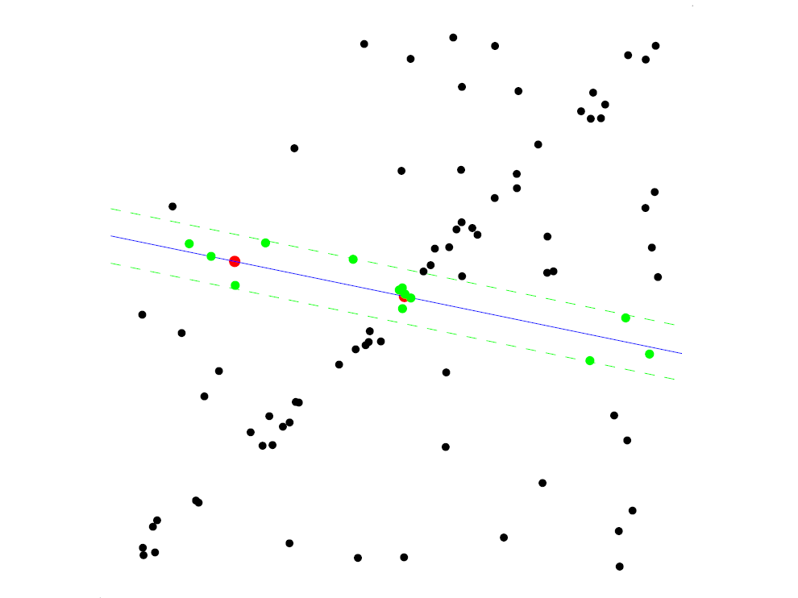
RANSAC for line fitting example
Randomly select minimal subset of points
Hypothesize a model
Compute error function
Select points consistent with model
Repeat hypothesize-and-verify loop
Source: R. Raguram
Lana Lazebnik

Slide 64
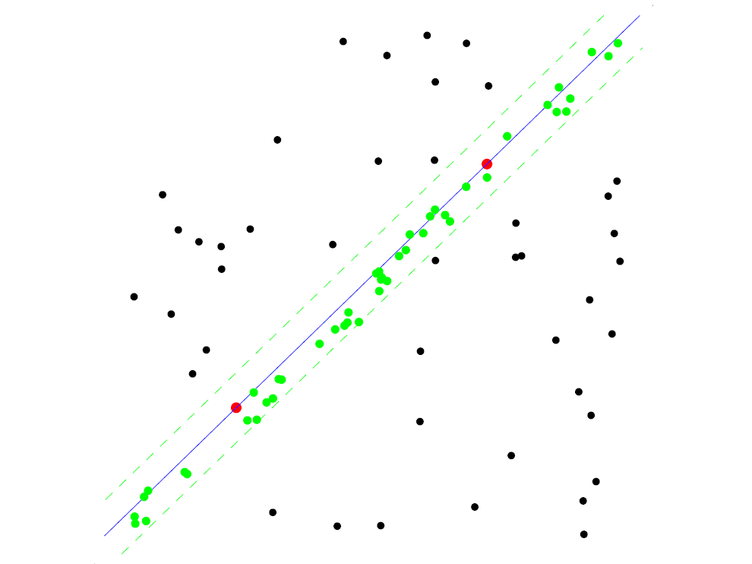
RANSAC for line fitting example
Uncontaminated sample
Randomly select minimal subset of points
Hypothesize a model
Compute error function
Select points consistent with model
Repeat hypothesize-and-verify loop
Source: R. Raguram
Lana Lazebnik

Slide 65

RANSAC for line fitting example
Randomly select minimal subset of points
Hypothesize a model
Compute error function
Select points consistent with model
Repeat hypothesize-and-verify loop
Source: R. Raguram
Lana Lazebnik
Notes:
65

Slide 66
RANSAC for line fitting
Repeat N times:
Draw s points uniformly at random
Fit line to these s points
Find inliers to this line among the remaining points (i.e., points whose distance from the line is less than t)
If there are d or more inliers, accept the line and refit using all inliers
Lana Lazebnik

Slide 67

RANSAC pros and cons
Pros
  Simple and general
  Applicable to many different problems
  Often works well in practice
Cons
  Lots of parameters to tune
  Doesn’t work well for low inlier ratios (too many iterations,
  or can fail completely)
  Can’t always get a good initialization
  of the model based on the minimum
  number of samples
Lana Lazebnik

Slide 68
Today
Interactive segmentation
Feature-based alignment
  2D transformations
  Affine fit
  RANSAC

Slide 69


Coming up: alignment and image stitching

