Slide 1
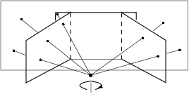
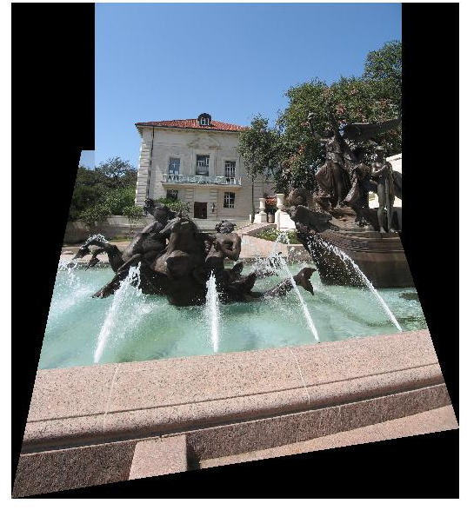
Image warping and stitching
Monday Feb 28
Prof. Kristen Grauman
UT-Austin

Slide 2
HP frames commercials
http://www.youtube.com/watch?v=2RPl5vPEoQk

Slide 3
Announcements
Reminder: Pset 2 due Wed March 2
Reminder: Midterm exam is Wed March 9
  See practice exam handout
My office hours Wed: 12:15-1:15
Matlab license issues – see course website
Pset 1 and solutions were returned last week – grades online

Slide 4
Last time
Interactive segmentation
Feature-based alignment
  2D transformations
  Affine fit
  RANSAC

Slide 5
Today
RANSAC for robust fitting
  Lines, translation
Image mosaics
  Fitting a 2D transformation
    Affine, Homography
  2D image warping
  Computing an image mosaic
  Wednesday: which local features to match?

Slide 6
Alignment problem
We have previously considered how to fit a model to image evidence
  e.g., a line to edge points, or a snake to a deforming contour
In alignment, we will fit the parameters of some transformation according to a set of matching feature pairs (“correspondences”).
x_{i}
'
x_{i}
T

Slide 7
Image alignment
Two broad approaches:
  Direct (pixel-based) alignment
    Search for alignment where most pixels agree
  Feature-based alignment
    Search for alignment where extracted features agree
    Can be verified using pixel-based alignment

Slide 8
Main questions
Alignment: Given two images, what is the transformation between them?
T
Warping: Given a source image and a transformation, what does the transformed output look like?
T

Slide 9
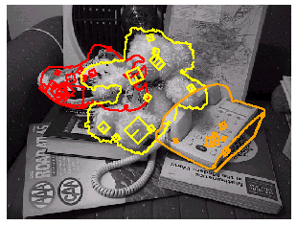
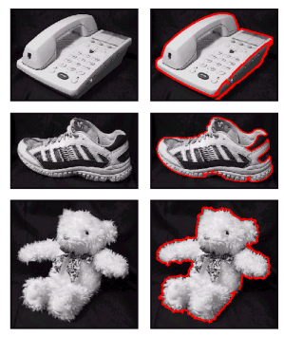
Motivation for feature-based alignment:
Recognition
Figures from David Lowe

Slide 10
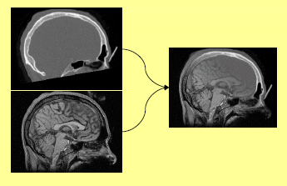
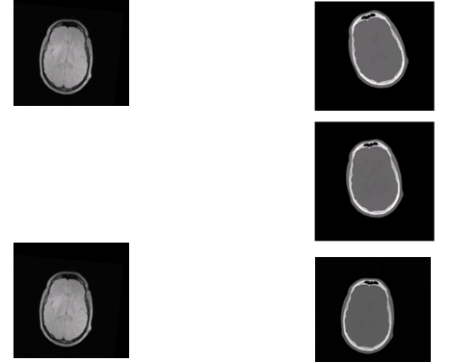
Motivation for feature-based alignment:
Medical image registration

Slide 11

Motivation for feature-based alignment:
Image mosaics
Image from http://graphics.cs.cmu.edu/courses/15-463/2010_fall/

Slide 12




Parametric (global) warping
Examples of parametric warps:
translation
rotation
aspect
perspective
affine
Source: Alyosha Efros

Slide 13
Parametric (global) warping
T
p = (x,y)
p’ = (x’,y’)
Transformation T is a coordinate-changing machine:
p’ = T(p)
What does it mean that T is global?
  Is the same for any point p
  can be described by just a few numbers (parameters)
Let’s represent T as a matrix:
p’ = Mp
Source: Alyosha Efros

Slide 14
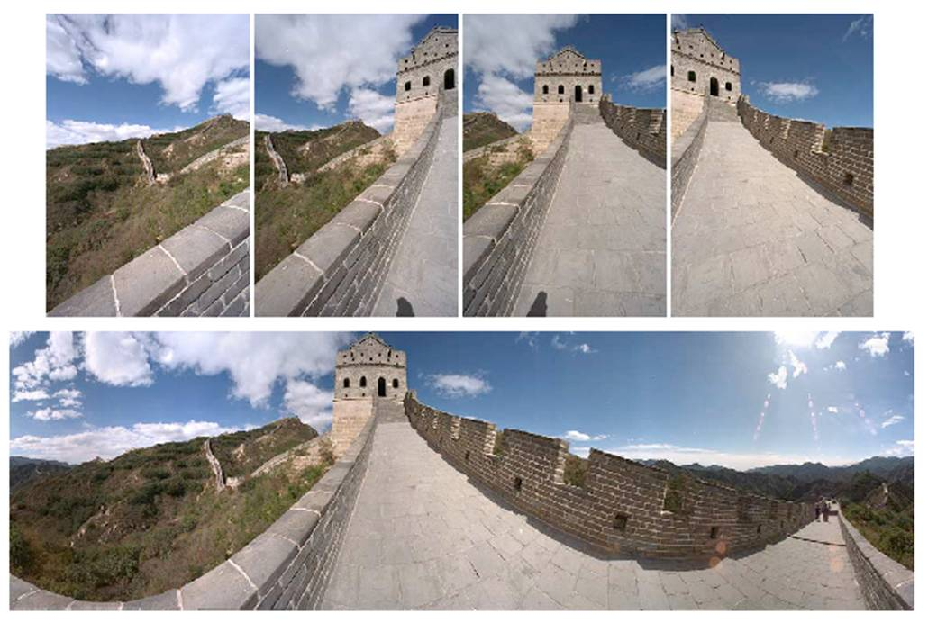
Outliers
Outliers can hurt the quality of our parameter estimates, e.g.,
  an erroneous pair of matching points from two images
  an edge point that is noise, or doesn’t belong to the line we are fitting.

Slide 15
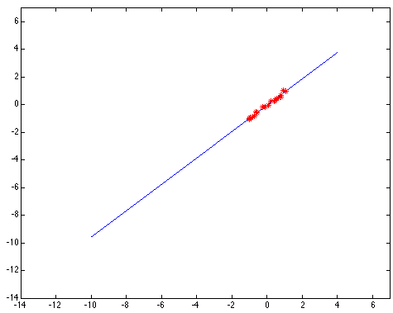
Outliers affect least squares fit
Notes:
15

Slide 16
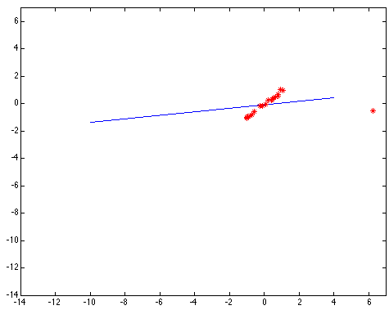
Outliers affect least squares fit
Notes:
16

Slide 17
RANSAC
RANdom Sample Consensus
Approach: we want to avoid the impact of outliers, so let’s look for “inliers”, and use those only.
Intuition: if an outlier is chosen to compute the current fit, then the resulting line won’t have much support from rest of the points.

Slide 18
RANSAC: General form
RANSAC loop:
Randomly select a seed group of points on which to base transformation estimate (e.g., a group of matches)
Compute transformation from seed group
Find inliers to this transformation
If the number of inliers is sufficiently large, re-compute estimate of transformation on all of the inliers
Keep the transformation with the largest number of inliers

Slide 19
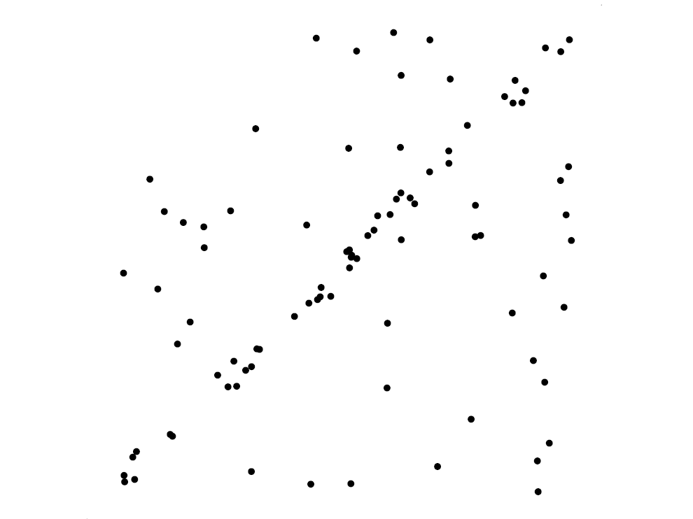
RANSAC for line fitting example
Source: R. Raguram
Lana Lazebnik

Slide 20
RANSAC for line fitting example
Least-squares fit
Source: R. Raguram
Lana Lazebnik

Slide 21
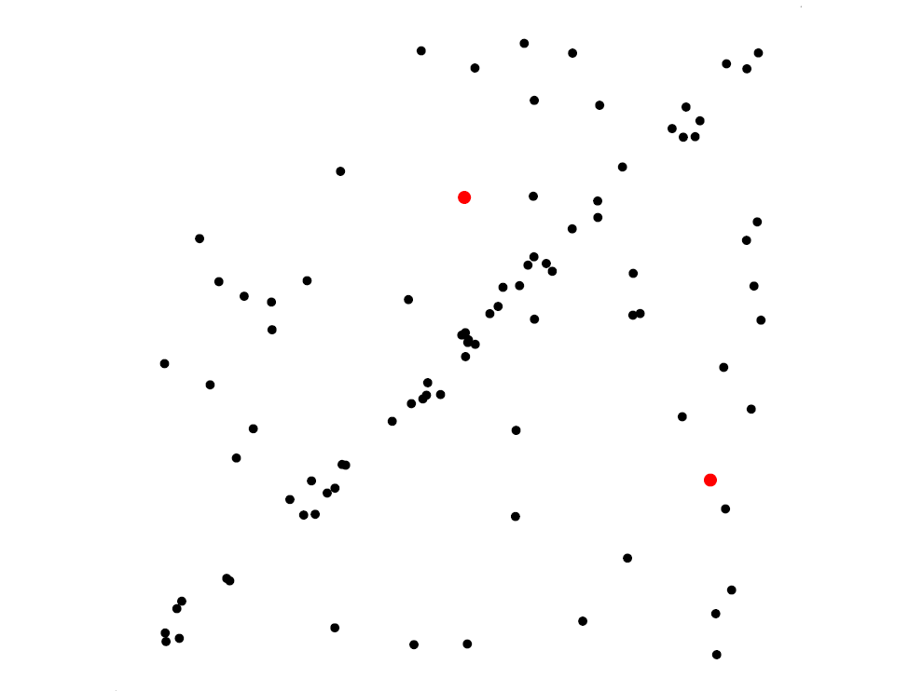
RANSAC for line fitting example
Randomly select minimal subset of points
Source: R. Raguram
Lana Lazebnik

Slide 22
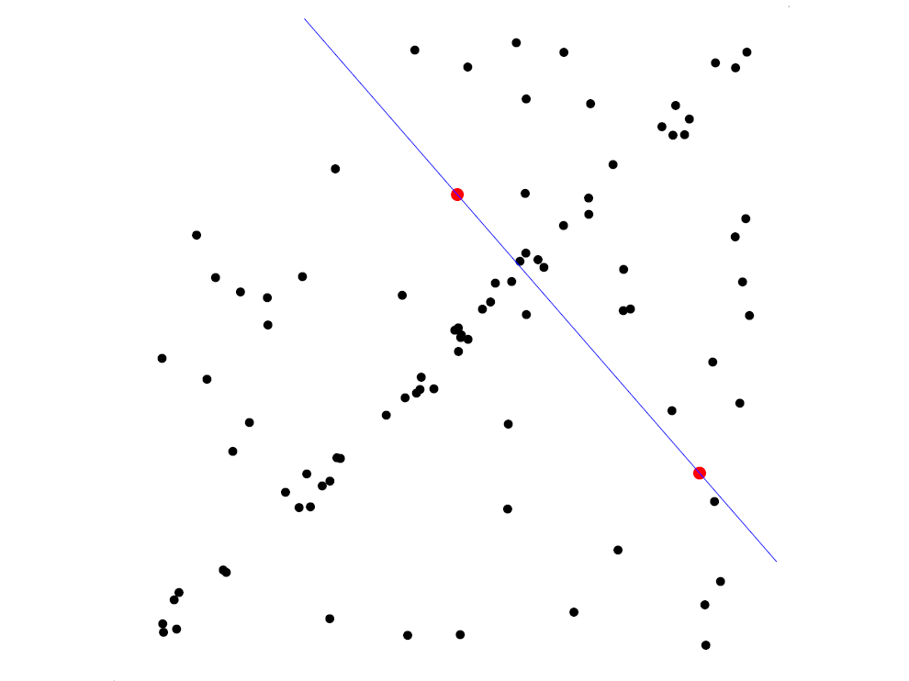
RANSAC for line fitting example
Randomly select minimal subset of points
Hypothesize a model
Source: R. Raguram
Lana Lazebnik

Slide 23
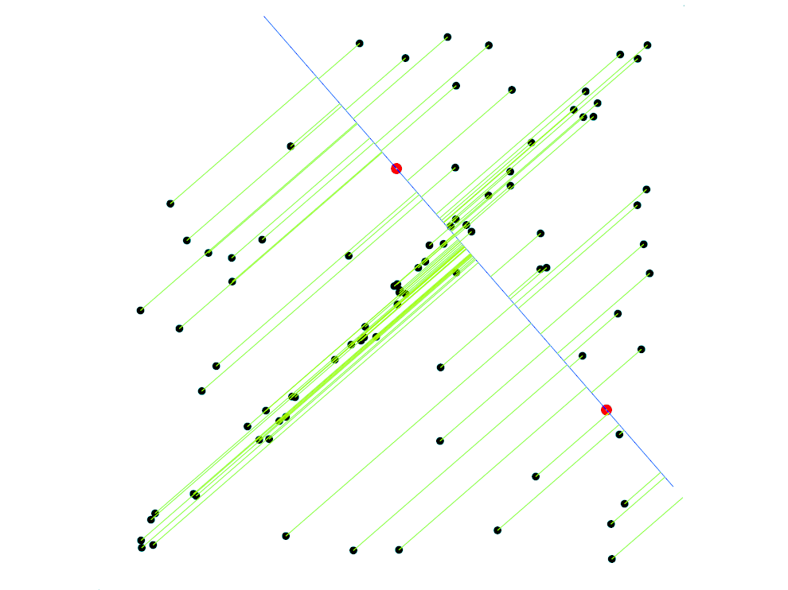
RANSAC for line fitting example
Randomly select minimal subset of points
Hypothesize a model
Compute error function
Source: R. Raguram
Lana Lazebnik

Slide 24
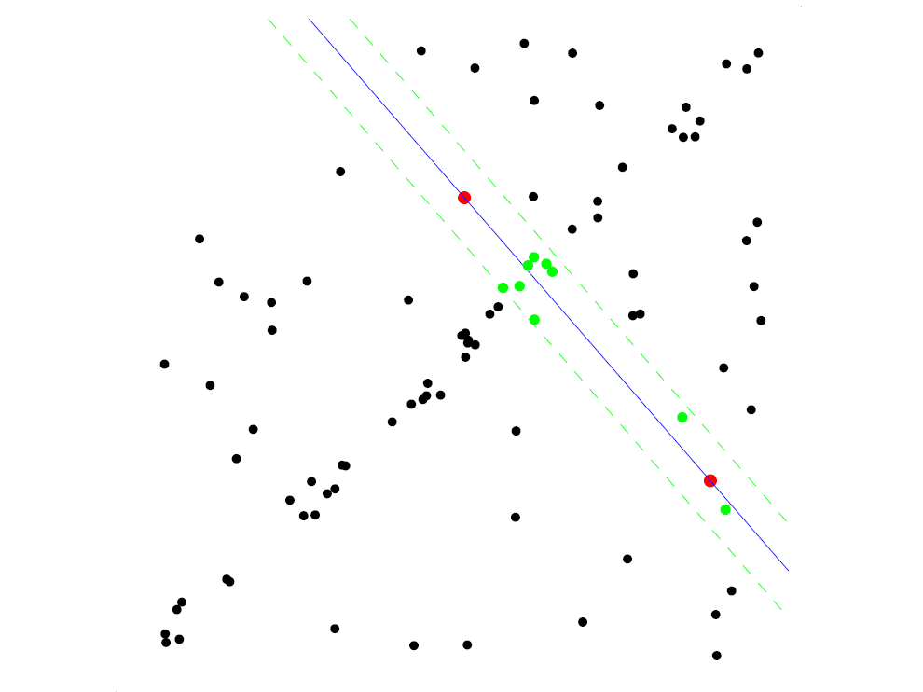
RANSAC for line fitting example
Randomly select minimal subset of points
Hypothesize a model
Compute error function
Select points consistent with model
Source: R. Raguram
Lana Lazebnik

Slide 25
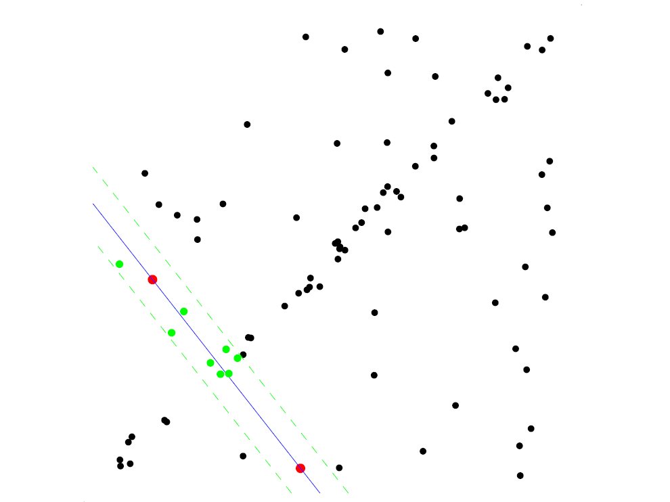
RANSAC for line fitting example
Randomly select minimal subset of points
Hypothesize a model
Compute error function
Select points consistent with model
Repeat hypothesize-and-verify loop
Source: R. Raguram
Lana Lazebnik

Slide 26
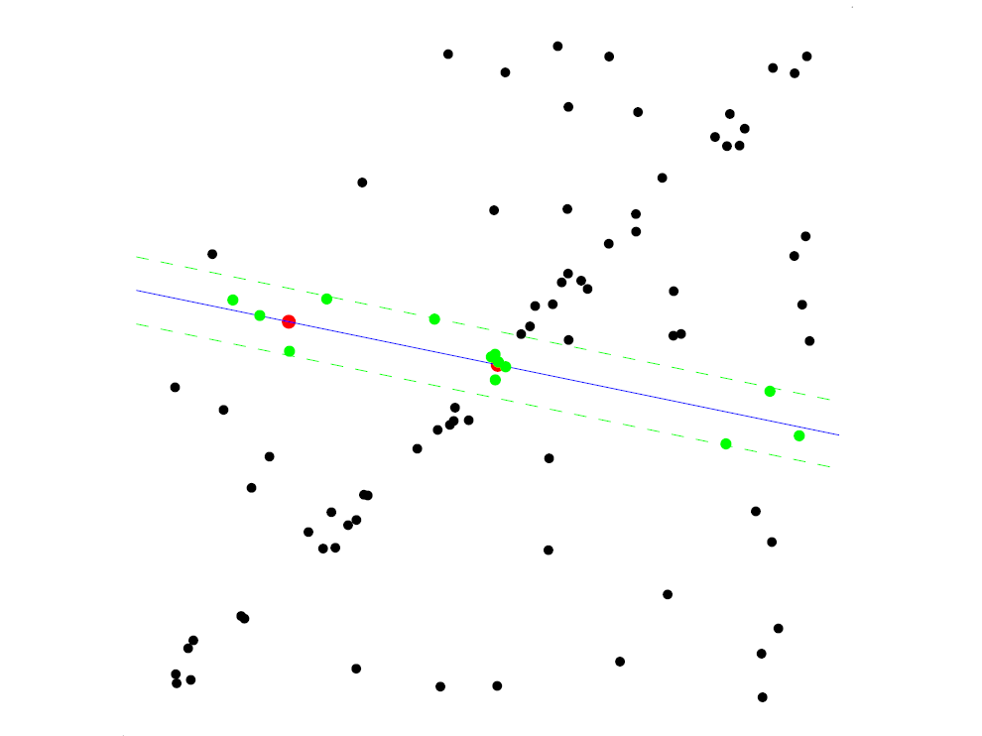
RANSAC for line fitting example
Randomly select minimal subset of points
Hypothesize a model
Compute error function
Select points consistent with model
Repeat hypothesize-and-verify loop
Source: R. Raguram
Lana Lazebnik

Slide 27
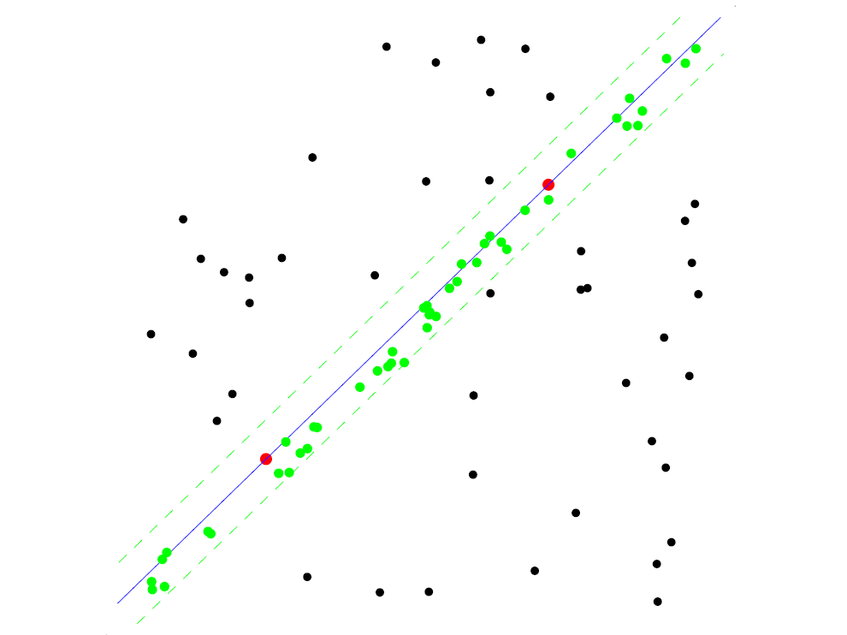
RANSAC for line fitting example
Uncontaminated sample
Randomly select minimal subset of points
Hypothesize a model
Compute error function
Select points consistent with model
Repeat hypothesize-and-verify loop
Source: R. Raguram
Lana Lazebnik

Slide 28
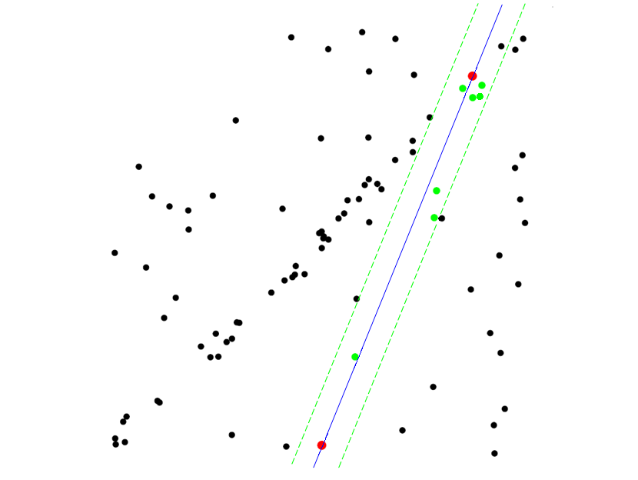
RANSAC for line fitting example
Randomly select minimal subset of points
Hypothesize a model
Compute error function
Select points consistent with model
Repeat hypothesize-and-verify loop
Source: R. Raguram
Lana Lazebnik
Notes:
28

Slide 29
RANSAC for line fitting
Repeat N times:
Draw s points uniformly at random
Fit line to these s points
Find inliers to this line among the remaining points (i.e., points whose distance from the line is less than t)
If there are d or more inliers, accept the line and refit using all inliers
Lana Lazebnik

Slide 30
That is an example fitting a model
(line)…
What about fitting a transformation (translation)?

Slide 31

RANSAC example: Translation
Putative matches
Source: Rick Szeliski

Slide 32
RANSAC example: Translation
Select one match, count inliers

Slide 33
RANSAC example: Translation
Select one match, count inliers

Slide 34
RANSAC example: Translation
Find “average” translation vector

Slide 35
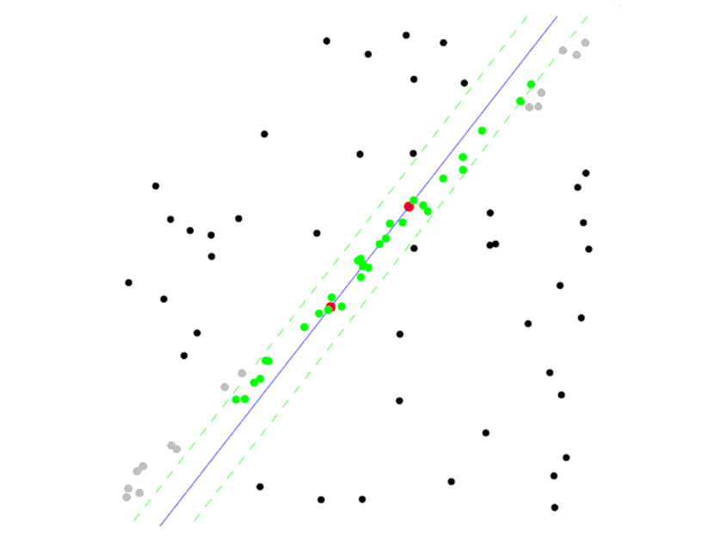
RANSAC pros and cons
Pros
  Simple and general
  Applicable to many different problems
  Often works well in practice
Cons
  Lots of parameters to tune
  Doesn’t work well for low inlier ratios (too many iterations,
  or can fail completely)
  Can’t always get a good initialization
  of the model based on the minimum
  number of samples
Lana Lazebnik

Slide 36
Today
RANSAC for robust fitting
  Lines, translation
Image mosaics
  Fitting a 2D transformation
    Affine, Homography
  2D image warping
  Computing an image mosaic

Slide 37
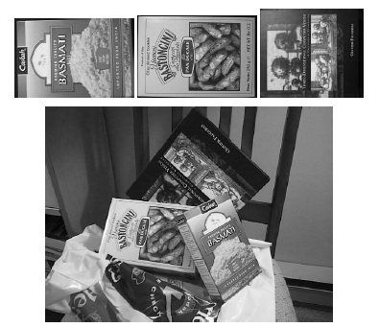
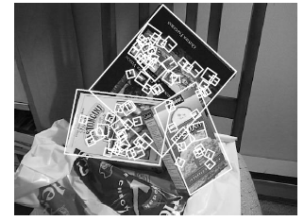
Recall: fitting an affine transformation
Affine model approximates perspective projection of planar objects.
Figures from David Lowe, ICCV 1999

Slide 38
Fitting an affine transformation
Assuming we know the correspondences, how do we get the transformation?

Slide 39
Fitting an affine transformation
Assuming we know the correspondences, how do we get the transformation?

Slide 40
2D Affine Transformations
Affine transformations are combinations of …
  Linear transformations, and
  Translations
Parallel lines remain parallel

Slide 41
Motivation for feature-based alignment:
Image mosaics
Image from http://graphics.cs.cmu.edu/courses/15-463/2010_fall/

Slide 42
Projective Transformations
Projective transformations:
  Affine transformations, and
  Projective warps
Parallel lines do not necessarily remain parallel

Slide 43

Mosaics
. . .
image from S. Seitz
Obtain a wider angle view by combining multiple images.

Slide 44
How to stitch together a panorama (a.k.a. mosaic)?
Basic Procedure
  Take a sequence of images from the same position
    Rotate the camera about its optical center
  Compute transformation between second image and first
  Transform the second image to overlap with the first
  Blend the two together to create a mosaic
  (If there are more images, repeat)
…but wait, why should this work at all?
  What about the 3D geometry of the scene?
  Why aren’t we using it?
Source: Steve Seitz

Slide 45
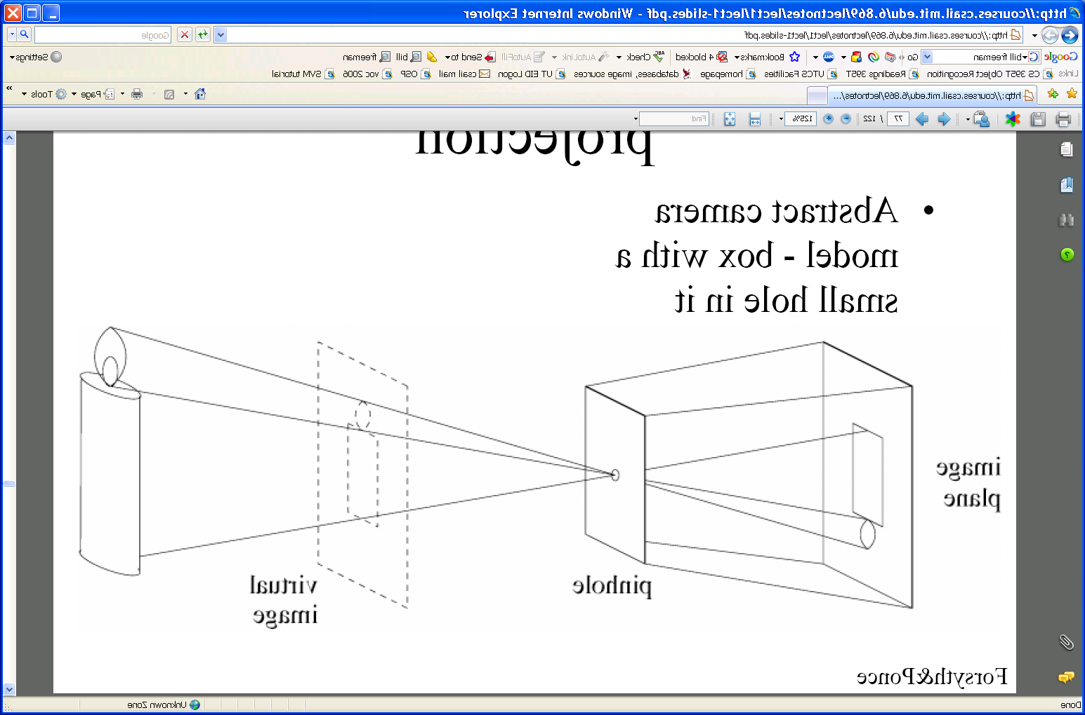
Pinhole camera
Pinhole camera is a simple model to approximate imaging process, perspective projection.
Image plane
Virtual image
pinhole
If we treat pinhole as a point, only one ray from any given point can enter the camera.
Fig from Forsyth and Ponce

Slide 46
Mosaics
. . .
image from S. Seitz
Obtain a wider angle view by combining multiple images.

Slide 47
Mosaics: generating synthetic views
real
camera
synthetic
camera
Can generate any synthetic camera view
as long as it has the same center of projection!
Source: Alyosha Efros

Slide 48
Image reprojection
mosaic PP
The mosaic has a natural interpretation in 3D
  The images are reprojected onto a common plane
  The mosaic is formed on this plane
  Mosaic is a synthetic wide-angle camera
Source: Steve Seitz

Slide 49
Image reprojection
Basic question
  How to relate two images from the same camera center?
    how to map a pixel from PP1 to PP2
PP2
Answer
  Cast a ray through each pixel in PP1
  Draw the pixel where that ray intersects PP2
Observation:
Rather than thinking of this as a 3D reprojection, think of it as a 2D image warp from one image to another.
PP1
Source: Alyosha Efros

Slide 50
Image reprojection: Homography
A projective transform is a mapping between any two PPs with the same center of projection
  rectangle should map to arbitrary quadrilateral
  parallel lines aren’t
  but must preserve straight lines
called Homography
PP2
PP1
p’
H
p
Source: Alyosha Efros

Slide 51
Homography
…
…
To compute the homography given pairs of corresponding points in the images, we need to set up an equation where the parameters of H are the unknowns…

Slide 52
Solving for homographies
p’ = Hp
Can set scale factor i=1. So, there are 8 unknowns.
Set up a system of linear equations:
Ah = b
where vector of unknowns h = [a,b,c,d,e,f,g,h]^{T}
Need at least 8 eqs, but the more the better…
Solve for h. If overconstrained, solve using least-squares:
>> help lmdivide
BOARD

Slide 53
Homography
To apply a given homography H
  Compute p’ = Hp (regular matrix multiply)
  Convert p’ from homogeneous to image coordinates
p’
H
p

Slide 54
Today
RANSAC for robust fitting
  Lines, translation
Image mosaics
  Fitting a 2D transformation
    Affine, Homography
  2D image warping
  Computing an image mosaic

Slide 55
Image warping
T(x,y)
y
y’
x
x’
f(x,y)
g(x’,y’)
Given a coordinate transform and a source image f(x,y), how do we compute a transformed image g(x’,y’) = f(T(x,y))?
Slide from Alyosha Efros, CMU

Slide 56
Forward warping
T(x,y)
y
y’
x
x’
f(x,y)
g(x’,y’)
Send each pixel f(x,y) to its corresponding location
(x’,y’) = T(x,y) in the second image
Q: what if pixel lands “between” two pixels?
Slide from Alyosha Efros, CMU

Slide 57
Forward warping
T(x,y)
y
y’
x
x’
f(x,y)
g(x’,y’)
Send each pixel f(x,y) to its corresponding location
(x’,y’) = T(x,y) in the second image
Q: what if pixel lands “between” two pixels?
A: distribute color among neighboring pixels (x’,y’)
  Known as “splatting”
Slide from Alyosha Efros, CMU

Slide 58
Inverse warping
T⁻¹(x,y)
y
y’
x
x
x’
f(x,y)
g(x’,y’)
Get each pixel g(x’,y’) from its corresponding location
(x,y) = T⁻¹(x’,y’) in the first image
Q: what if pixel comes from “between” two pixels?
Slide from Alyosha Efros, CMU

Slide 59
Inverse warping
T⁻¹(x,y)
y
y’
x
x
x’
f(x,y)
g(x’,y’)
Get each pixel g(x’,y’) from its corresponding location
(x,y) = T⁻¹(x’,y’) in the first image
Q: what if pixel comes from “between” two pixels?
A: Interpolate color value from neighbors
  nearest neighbor, bilinear…
>> help interp2
Slide from Alyosha Efros, CMU

Slide 60





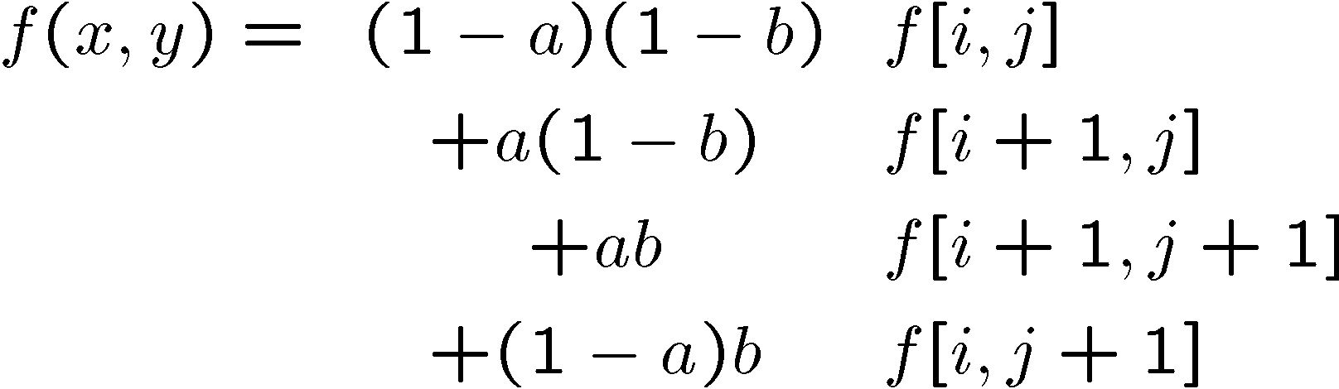
Bilinear interpolation
Sampling at f(x,y):
Slide from Alyosha Efros, CMU

Slide 61
Recap: How to stitch together a panorama (a.k.a. mosaic)?
Basic Procedure
  Take a sequence of images from the same position
    Rotate the camera about its optical center
  Compute transformation (homography) between second image and first using corresponding points.
  Transform the second image to overlap with the first.
  Blend the two together to create a mosaic.
  (If there are more images, repeat)
Source: Steve Seitz

Slide 62


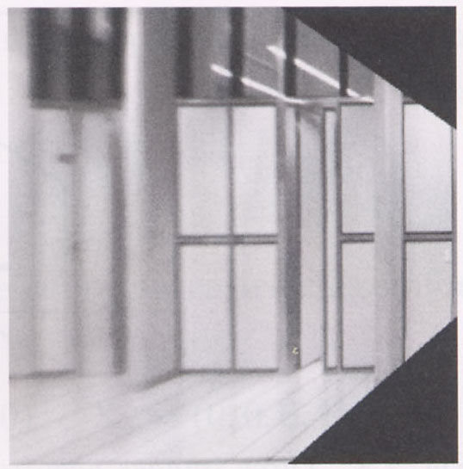
Image warping with homographies
image plane in front
image plane below
black area
where no pixel
maps to
Source: Steve Seitz

Slide 63
Image rectification
p’
p

Slide 64
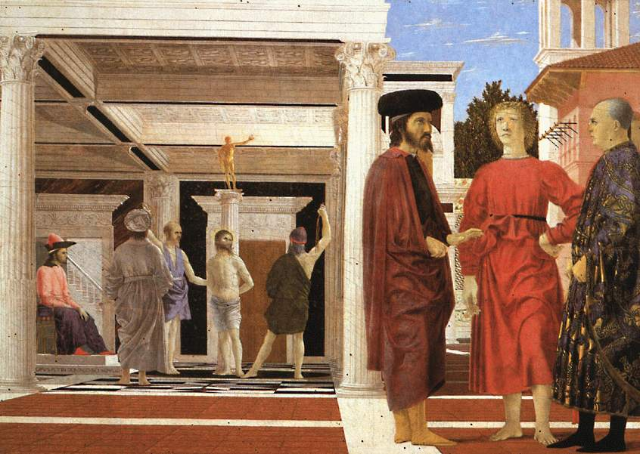
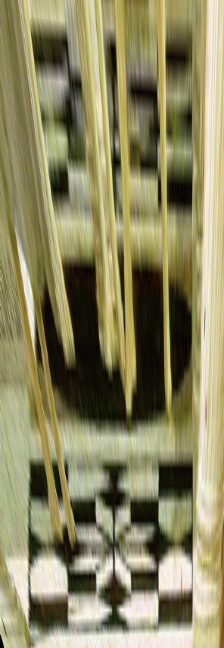

Analysing patterns and shapes
What is the shape of the b/w floor pattern?
Homography
The floor (enlarged)
Automatically
rectified floor
Slide from Antonio Criminisi

Slide 65
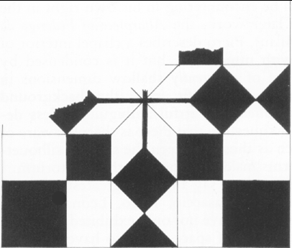
Analysing patterns and shapes
Automatic rectification
From Martin Kemp The Science of Art
(manual reconstruction)
Slide from Antonio Criminisi

Slide 66
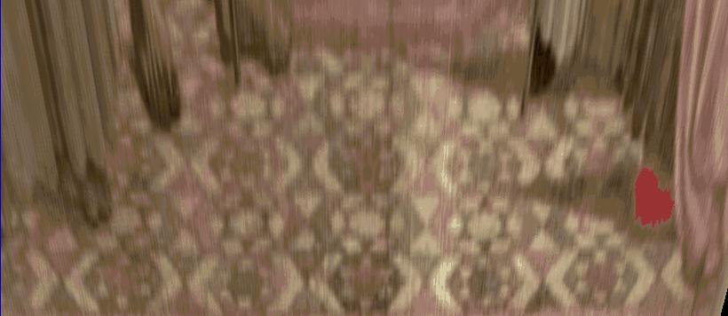
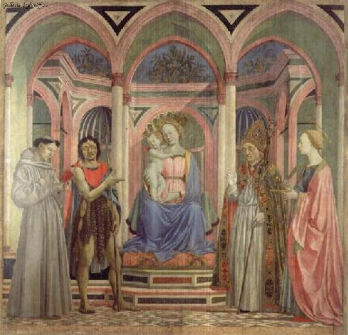
Analysing patterns and shapes
What is the (complicated)
shape of the floor pattern?
Automatically rectified floor
St. Lucy Altarpiece, D. Veneziano
Slide from Criminisi

Slide 67
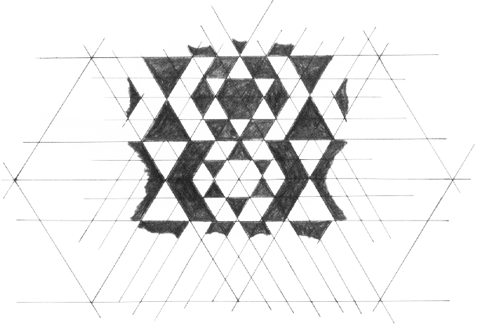
Analysing patterns and shapes
Automatic
rectification
From Martin Kemp, The Science of Art
(manual reconstruction)
Slide from Criminisi

Slide 68
Changing camera center
Does it still work?
synthetic PP
PP1
PP2
Source: Alyosha Efros

Slide 69
Recall: same camera center
real
camera
synthetic
camera
Can generate synthetic camera view
as long as it has the same center of projection.
Source: Alyosha Efros

Slide 70

…Or: Planar scene (or far away)
PP3
PP1
PP2
PP3 is a projection plane of both centers of projection, so we are OK!
This is how big aerial photographs are made
Source: Alyosha Efros

Slide 71
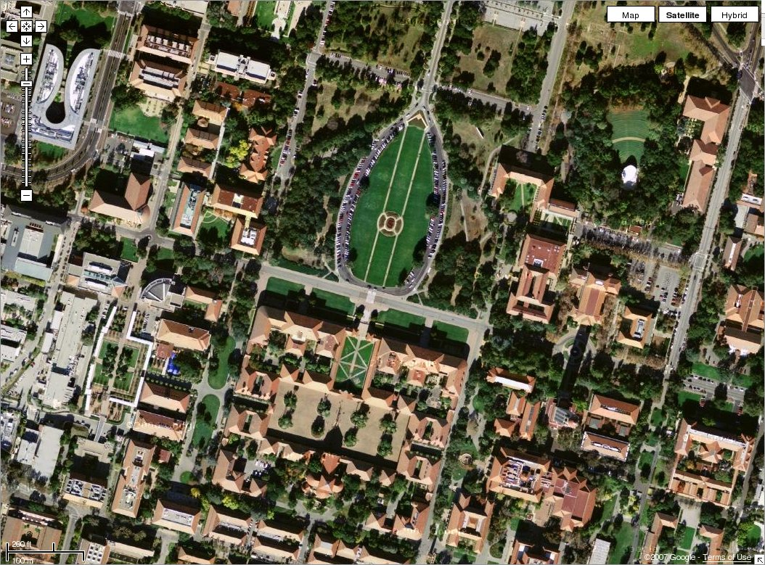

Slide 72
Summary: alignment & warping
  Write 2d transformations as matrix-vector multiplication (including translation when we use homogeneous coordinates)
  Perform image warping (forward, inverse)
  Fitting transformations: solve for unknown parameters given corresponding points from two views (affine, projective (homography)).
  Mosaics: uses homography and image warping to merge views taken from same center of projection.

Slide 73


Next time: which features should we match?

