Slide 1
Discriminative classifiers for image recognition
Wednesday, April 13
Kristen Grauman
UT-Austin

Slide 2
Outline
Last time: window-based generic object detection
basic pipeline
face detection with boosting as case study
Today: discriminative classifiers for image recognition
nearest neighbors (+ scene match app)
support vector machines (+ gender, person app)

Slide 3
Nearest Neighbor classification
Assign label of nearest training data point to each test data point
Black = negative
Red = positive
Novel test example
Closest to a positive example from the training set, so classify it as positive.
from Duda et al.
Voronoi partitioning of feature space
for 2-category 2D data

Slide 4
K-Nearest Neighbors classification
For a new point, find the k closest points from training data
Labels of the k points “vote” to classify
k = 5
Black = negative
Red = positive
If query lands here, the 5 NN consist of 3 negatives and 2 positives, so we classify it as negative.
Source: D. Lowe

Slide 5
A nearest neighbor recognition example

Slide 6
Where in the World?
[Hays and Efros. im2gps: Estimating Geographic Information from a Single Image. CVPR 2008.]
Slides: James Hays

Slide 7
Where in the World?
Slides: James Hays

Slide 8
Where in the World?
Slides: James Hays

Slide 9
6+ million geotagged photos by 109,788 photographers
Annotated by Flickr users
Slides: James Hays

Slide 10
6+ million geotagged photos by 109,788 photographers
Annotated by Flickr users
Slides: James Hays

Slide 11
Which scene properties are relevant?

Slide 12
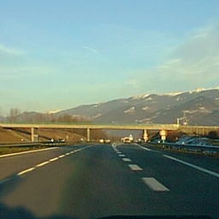
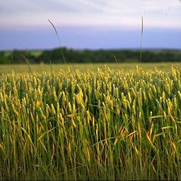
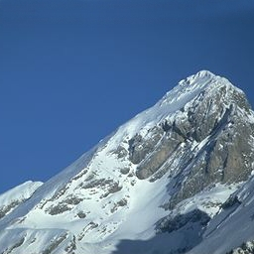
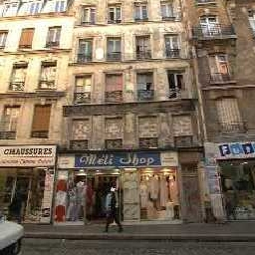
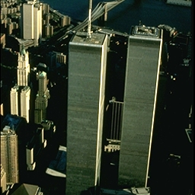
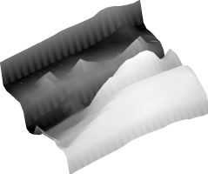
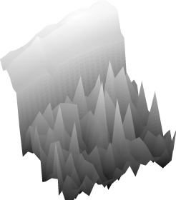
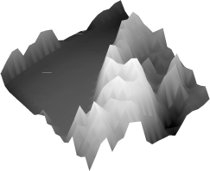
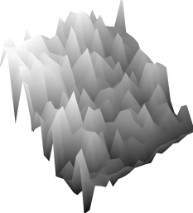
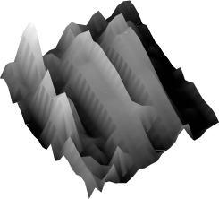
Spatial Envelope Theory of Scene Representation Oliva & Torralba (2001)
A scene is a single surface that can be
represented by global (statistical) descriptors
Slide Credit: Aude Olivia

Slide 13
Global texture: capturing the “Gist” of the scene
Capture global image properties while keeping some spatial information
Gist descriptor
Oliva & Torralba IJCV 2001, Torralba et al. CVPR 2003

Slide 14
Which scene properties are relevant?
Gist scene descriptor
Color Histograms - L*A*B* 4x14x14 histograms
Texton Histograms – 512 entry, filter bank based
Line Features – Histograms of straight line stats

Slide 15
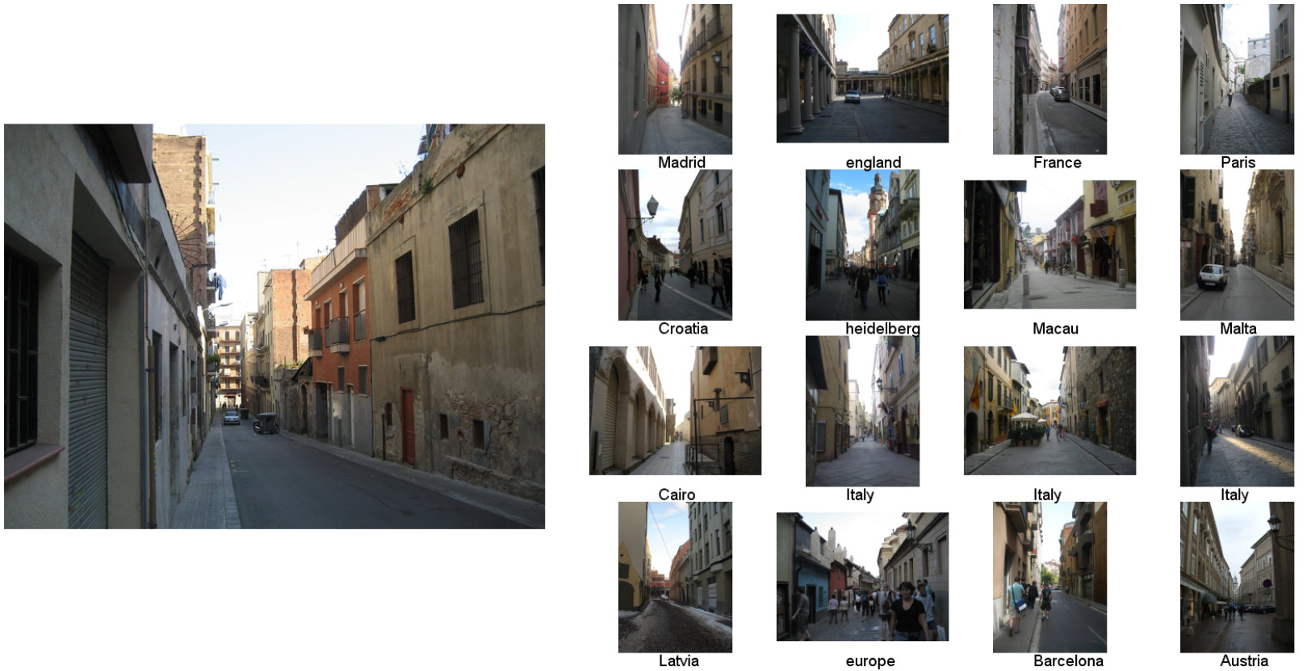
Scene Matches
Slides: James Hays
[Hays and Efros. im2gps: Estimating Geographic Information from a Single Image. CVPR 2008.]

Slide 16
Slides: James Hays

Slide 17
Scene Matches
Slides: James Hays
[Hays and Efros. im2gps: Estimating Geographic Information from a Single Image. CVPR 2008.]

Slide 18
Slides: James Hays
[Hays and Efros. im2gps: Estimating Geographic Information from a Single Image. CVPR 2008.]

Slide 19
Scene Matches
Slides: James Hays
[Hays and Efros. im2gps: Estimating Geographic Information from a Single Image. CVPR 2008.]

Slide 20
Slides: James Hays
[Hays and Efros. im2gps: Estimating Geographic Information from a Single Image. CVPR 2008.]

Slide 21
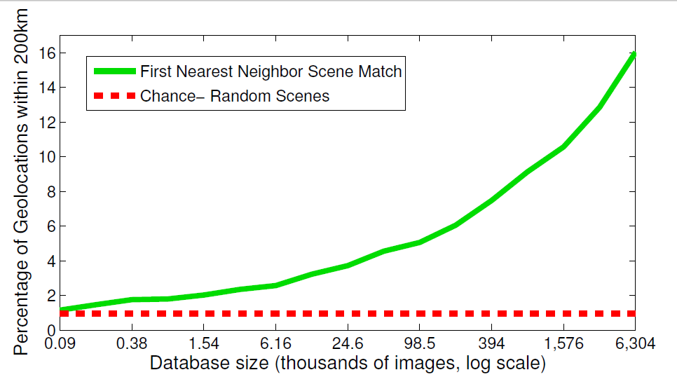
The Importance of Data
[Hays and Efros. im2gps: Estimating Geographic Information from a Single Image. CVPR 2008.]
Slides: James Hays

Slide 22
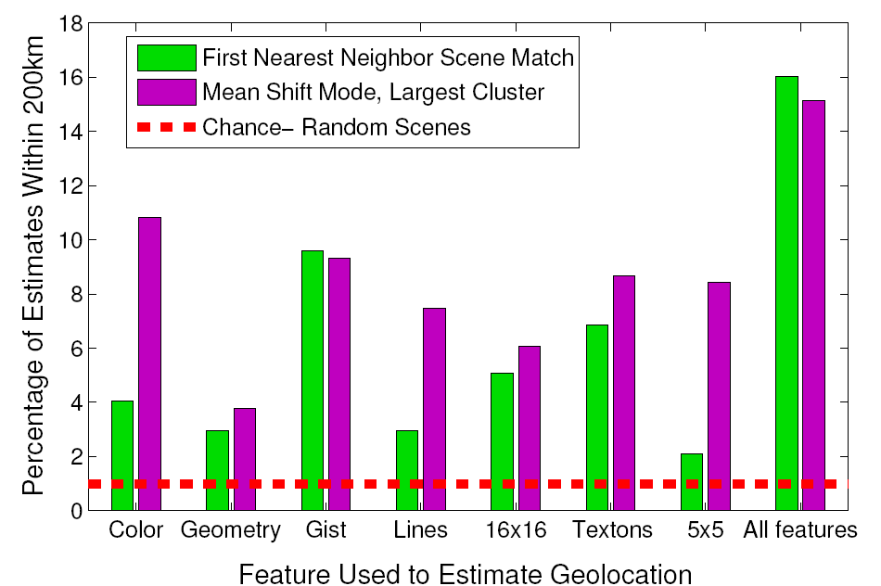
Feature Performance
Slides: James Hays

Slide 23
Nearest neighbors: pros and cons
Pros:
Simple to implement
Flexible to feature / distance choices
Naturally handles multi-class cases
Can do well in practice with enough representative data
Cons:
Large search problem to find nearest neighbors
Storage of data
Must know we have a meaningful distance function

Slide 24
Outline
Discriminative classifiers
Boosting (last time)
Nearest neighbors
Support vector machines

Slide 25
Linear classifiers

Slide 26
Lines in R²
Let

Slide 27
Lines in R²
Let

Slide 28
Lines in R²
Let

Slide 29
Lines in R²
Let
distance from point to line

Slide 30
Lines in R²
Let
distance from point to line

Slide 31
Linear classifiers
Find linear function to separate positive and negative examples
Which line is best?

Slide 32
Support Vector Machines (SVMs)
Discriminative classifier based on optimal separating line (for 2d case)
Maximize the margin between the positive and negative training examples

Slide 33
Support vector machines
Want line that maximizes the margin.
wx+b=1
wx+b=0
wx+b=-1
For support, vectors,
Support vectors
Margin
C. Burges, A Tutorial on Support Vector Machines for Pattern Recognition, Data Mining and Knowledge Discovery, 1998

Slide 34
Support vector machines
Want line that maximizes the margin.
wx+b=1
wx+b=0
wx+b=-1
For support, vectors,
Distance between point and line:
For support vectors:
Support vectors
Margin M

Slide 35
Support vector machines
Want line that maximizes the margin.
wx+b=1
wx+b=0
wx+b=-1
For support, vectors,
Distance between point and line:
Therefore, the margin is 2 / ||w||
Support vectors
Margin M

Slide 36
Finding the maximum margin line
Maximize margin 2/||w||
Correctly classify all training data points:
Quadratic optimization problem:
Minimize Subject to y_{i}(w·x_{i}+b) ≥ 1
C. Burges, A Tutorial on Support Vector Machines for Pattern Recognition, Data Mining and Knowledge Discovery, 1998

Slide 37
Finding the maximum margin line
Solution:
learned weight
Support vector
C. Burges, A Tutorial on Support Vector Machines for Pattern Recognition, Data Mining and Knowledge Discovery, 1998

Slide 38
Finding the maximum margin line
Solution: b = y_{i} – w·x_{i} (for any support vector)
Classification function:
If f(x) < 0, classify as negative, if f(x) > 0, classify as positive
C. Burges, A Tutorial on Support Vector Machines for Pattern Recognition, Data Mining and Knowledge Discovery, 1998

Slide 39
Questions
What if the features are not 2d?
What if the data is not linearly separable?
What if we have more than just two categories?

Slide 40
Questions
What if the features are not 2d?
Generalizes to d-dimensions – replace line with “hyperplane”
What if the data is not linearly separable?
What if we have more than just two categories?

Slide 41
Person detection with HoG’s & linear SVM’s
Map each grid cell in the input window to a histogram counting the gradients per orientation.
Train a linear SVM using training set of pedestrian vs. non-pedestrian windows.
Code available: http://pascal.inrialpes.fr/soft/olt/
Dalal & Triggs, CVPR 2005

Slide 42
Person detection with HoG’s & linear SVM’s
Histograms of Oriented Gradients for Human Detection, Navneet Dalal, Bill Triggs, International Conference on Computer Vision & Pattern Recognition - June 2005
http://lear.inrialpes.fr/pubs/2005/DT05/

Slide 43
Questions
What if the features are not 2d?
What if the data is not linearly separable?
What if we have more than just two categories?

Slide 44
Non-linear SVMs
Datasets that are linearly separable with some noise work out great:
But what are we going to do if the dataset is just too hard?
How about… mapping data to a higher-dimensional space:
0
x
0
x
x²
0
x

Slide 45
Non-linear SVMs: feature spaces
General idea: the original input space can be mapped to some higher-dimensional feature space where the training set is separable:
Φ: x → φ(x)
Slide from Andrew Moore’s tutorial: http://www.autonlab.org/tutorials/svm.html

Slide 46
The “Kernel Trick”
The linear classifier relies on dot product between vectors K(x_{i},x_{j})=x_{i}^{T}x_{j}
If every data point is mapped into high-dimensional space via some transformation Φ: x → φ(x), the dot product becomes:
K(x_{i},x_{j})= φ(x_{i}) ^{T}φ(x_{j})
A kernel function is similarity function that corresponds to an inner product in some expanded feature space.
Slide from Andrew Moore’s tutorial: http://www.autonlab.org/tutorials/svm.html

Slide 47
Example
2-dimensional vectors x=[x₁ x₂];
let K(x_{i},x_{j})=(1 + x_{i}^{T}x_{j})²
Need to show that K(x_{i},x_{j})= φ(x_{i}) ^{T}φ(x_{j}):
K(x_{i},x_{j})=(1 + x_{i}^{T}x_{j})²,
= 1+ x_{i1}²x_{j1}² + 2 x_{i1}x_{j1} x_{i2}x_{j2}+ x_{i2}²x_{j2}² + 2x_{i1}x_{j1} + 2x_{i2}x_{j2}
= [1 x_{i1}² √2 x_{i1}x_{i2} x_{i2}² √2x_{i1} √2x_{i2}]^{T}
[1 x_{j1}² √2 x_{j1}x_{j2} x_{j2}² √2x_{j1} √2x_{j2}]
= φ(x_{i}) ^{T}φ(x_{j}),
where φ(x) = [1 x₁² √2 x₁x₂ x₂² √2x₁ √2x₂]
from Andrew Moore’s tutorial: http://www.autonlab.org/tutorials/svm.html

Slide 48
Nonlinear SVMs
The kernel trick: instead of explicitly computing the lifting transformation φ(x), define a kernel function K such that K(x_{i} , x_{jj}) = φ(x_{i} ) · φ(x_{j})
This gives a nonlinear decision boundary in the original feature space:

Slide 49
Examples of kernel functions
Linear:
Gaussian RBF:
Histogram intersection:

Slide 50
SVMs for recognition
Define your representation for each example.
Select a kernel function.
Compute pairwise kernel values between labeled examples
Use this “kernel matrix” to solve for SVM support vectors & weights.
To classify a new example: compute kernel values between new input and support vectors, apply weights, check sign of output.

Slide 51
Example: learning gender with SVMs
Moghaddam and Yang, Learning Gender with Support Faces, TPAMI 2002.
Moghaddam and Yang, Face & Gesture 2000.

Slide 52
Face alignment processing
Processed faces
Moghaddam and Yang, Learning Gender with Support Faces, TPAMI 2002.

Slide 53
Learning gender with SVMs
Training examples:
1044 males
713 females
Experiment with various kernels, select Gaussian RBF

Slide 54
Support Faces
Moghaddam and Yang, Learning Gender with Support Faces, TPAMI 2002.

Slide 55
Moghaddam and Yang, Learning Gender with Support Faces, TPAMI 2002.

Slide 56
Gender perception experiment: How well can humans do?
Subjects:
30 people (22 male, 8 female)
Ages mid-20’s to mid-40’s
Test data:
254 face images (6 males, 4 females)
Low res and high res versions
Task:
Classify as male or female, forced choice
No time limit
Moghaddam and Yang, Face & Gesture 2000.

Slide 57
Gender perception experiment: How well can humans do?
Error
Error
Moghaddam and Yang, Face & Gesture 2000.

Slide 58
Human vs. Machine
SVMs performed better than any single human test subject, at either resolution

Slide 59
Hardest examples for humans
Moghaddam and Yang, Face & Gesture 2000.

Slide 60
Questions
What if the features are not 2d?
What if the data is not linearly separable?
What if we have more than just two categories?

Slide 61
Multi-class SVMs
Achieve multi-class classifier by combining a number of binary classifiers
One vs. all
Training: learn an SVM for each class vs. the rest
Testing: apply each SVM to test example and assign to it the class of the SVM that returns the highest decision value
One vs. one
Training: learn an SVM for each pair of classes
Testing: each learned SVM “votes” for a class to assign to the test example

Slide 62
SVMs: Pros and cons
Pros
Many publicly available SVM packages: http://www.kernel-machines.org/software
http://www.csie.ntu.edu.tw/~cjlin/libsvm/
Kernel-based framework is very powerful, flexible
Often a sparse set of support vectors – compact at test time
Work very well in practice, even with very small training sample sizes
Cons
No “direct” multi-class SVM, must combine two-class SVMs
Can be tricky to select best kernel function for a problem
Computation, memory
During training time, must compute matrix of kernel values for every pair of examples
Learning can take a very long time for large-scale problems
Adapted from Lana Lazebnik

Slide 63
Coming up
Part-based models
Video processing: motion, tracking, activity

