Slide 1
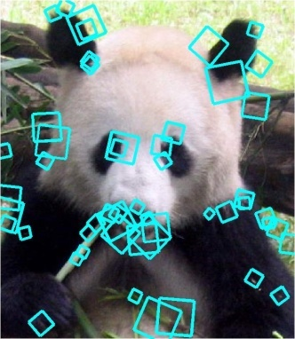
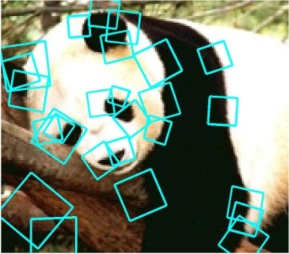
Part-based and local feature models for generic object recognition
Wed, April 20
Kristen Grauman
UT-Austin

Slide 2
Previously
Discriminative classifiers
  Boosting
  Nearest neighbors
  Support vector machines
Useful for object recognition when combined with “window-based” or holistic appearance descriptors

Slide 3
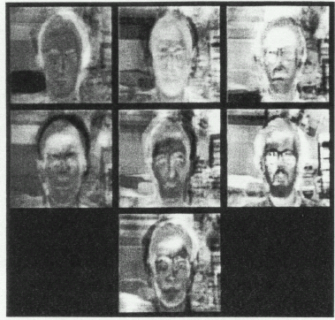
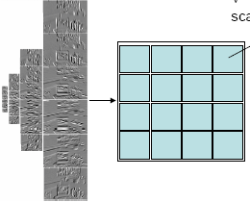
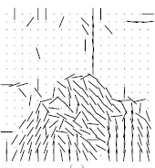
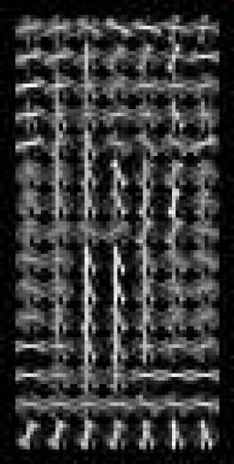
Global window-based appearance representations
eigenfaces
Histograms of oriented gradients
Gist
Map of local orientations
These examples are truly global; each pixel in the window contributes to the representation.
Classifier can account for relative relevance…
When might this not be ideal?
Kristen Grauman

Slide 4
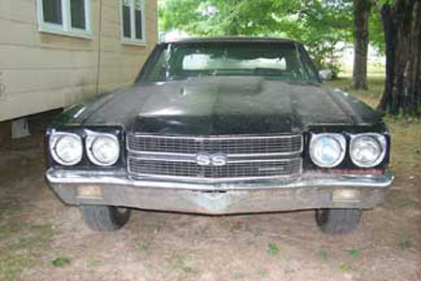
Part-based and local feature models for recognition
Main idea:
Rather than a representation based on holistic appearance, decompose the image into:
local parts or patches, and
their relative spatial relationships
Kristen Grauman

Slide 5
Part-based and local feature models for recognition
We’ll look at three forms:
Bag of words (no geometry)
Implicit shape model (star graph for spatial model)
Constellation model (fully connected graph for spatial model)
Kristen Grauman

Slide 6

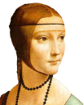
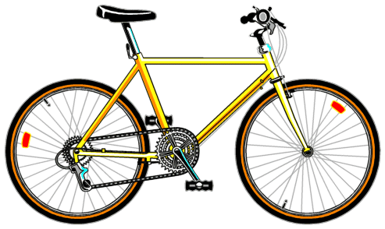
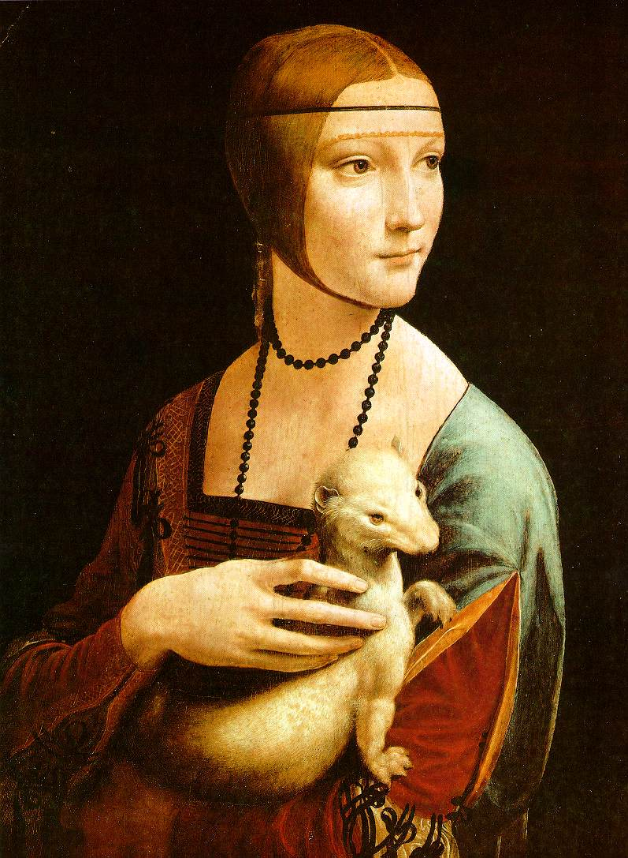

Bag-of-words model
Summarize entire image based on its distribution (histogram) of word occurrences.
  Total freedom on spatial positions, relative geometry.
  Vector representation easily usable by most classifiers.
Kristen Grauman
Notes:
6

Slide 7
Bag-of-words model
Csurka et al. Visual Categorization with Bags of Keypoints, 2004

Slide 8
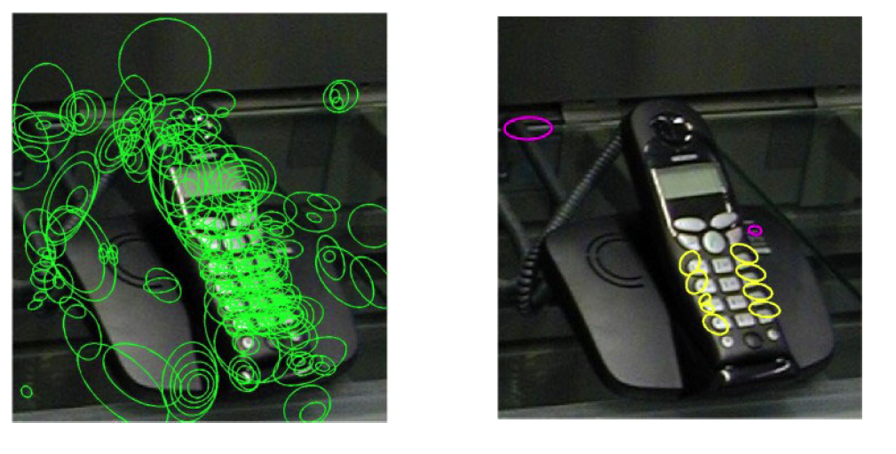
Words as parts
Local features from two selected clusters occurring in this image
All local features
Csurka et al. 2004

Slide 9

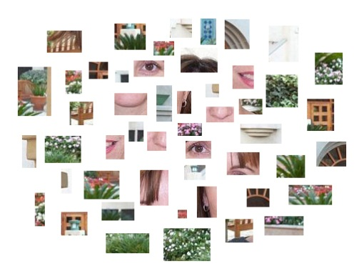

Naïve Bayes model for classification
$$N$$
patches
Object class
decision
Prior prob. of
the object classes
Image likelihood
given the class
What assumptions does the model make, and what are their significance?

Slide 10
Confusion matrix
Example bag of words + Naïve Bayes classification results for generic categorization of objects
Csurka et al. 2004

Slide 11
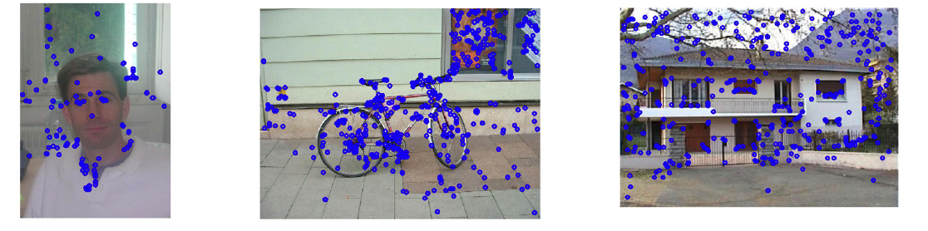
Clutter…or context?
Kristen Grauman

Slide 12
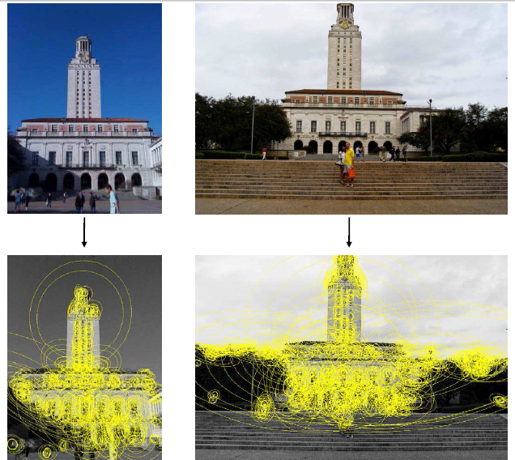
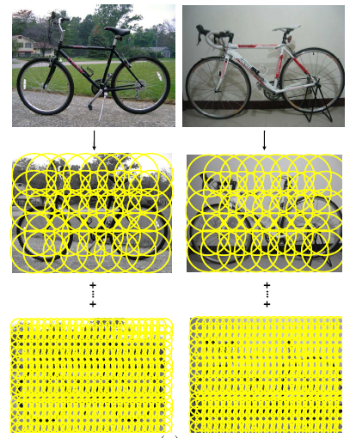
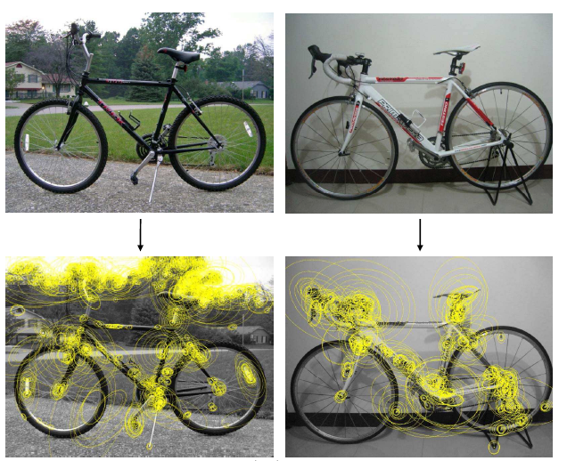
Sampling strategies
Specific object
Category
Kristen Grauman

Slide 13
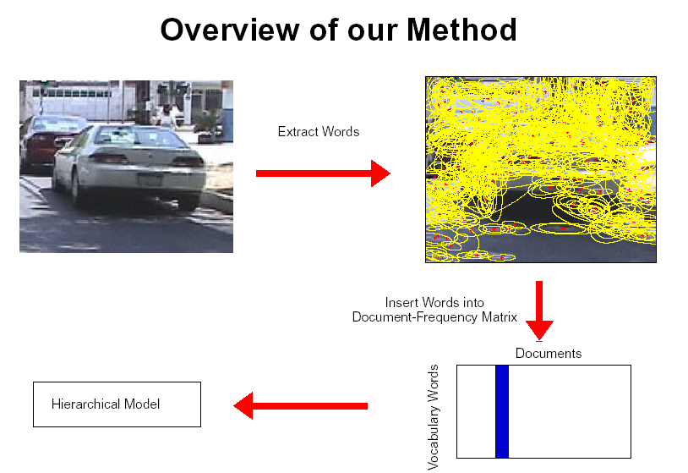
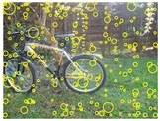
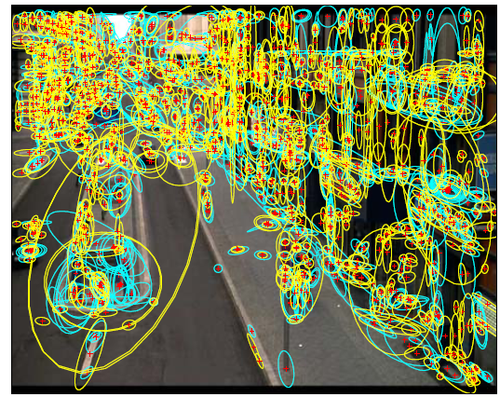
Sampling strategies
Sparse, at interest points
Dense, uniformly
Randomly
To find specific, textured objects, sparse sampling from interest points more reliable.
Multiple complementary interest operators offer more image coverage.
For object categorization, dense sampling offers better coverage.
[See Nowak, Jurie & Triggs, ECCV 2006]
Multiple interest operators
Image credits: F-F. Li, E. Nowak, J. Sivic
Kristen Grauman

Slide 14


Local feature correspondence for generic object categories
Kristen Grauman

Slide 15
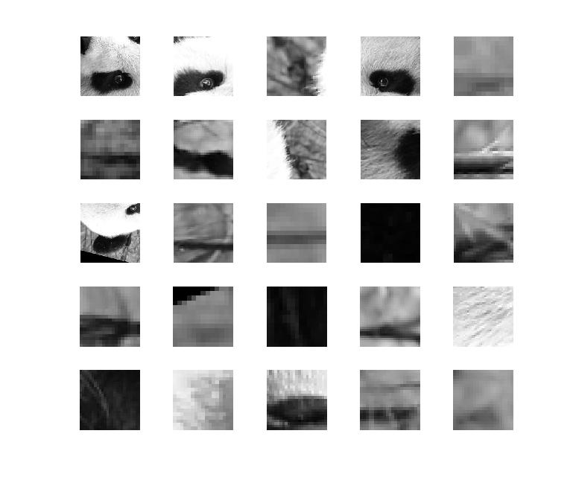
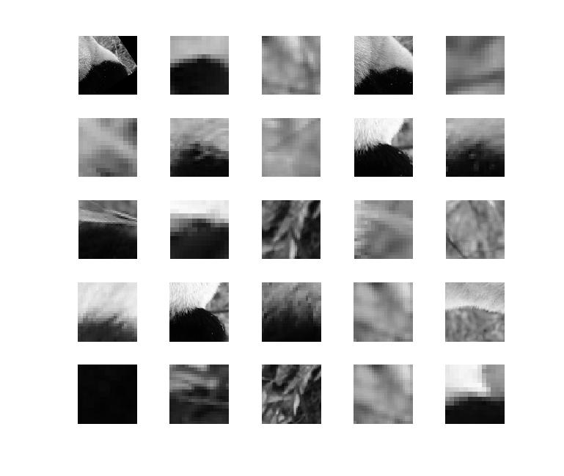
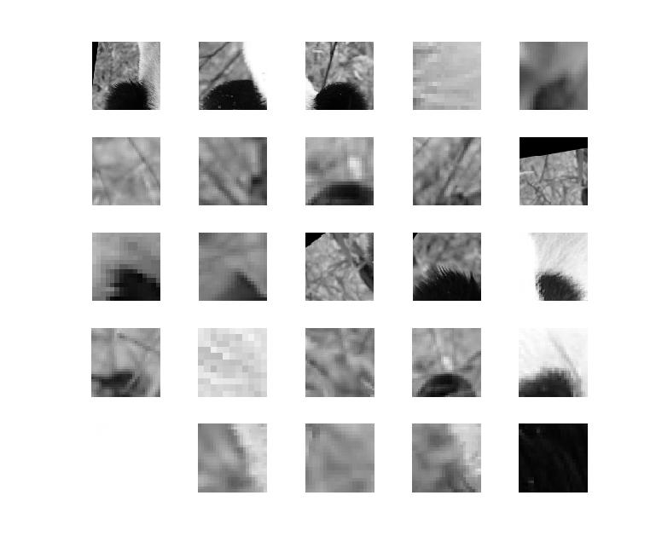
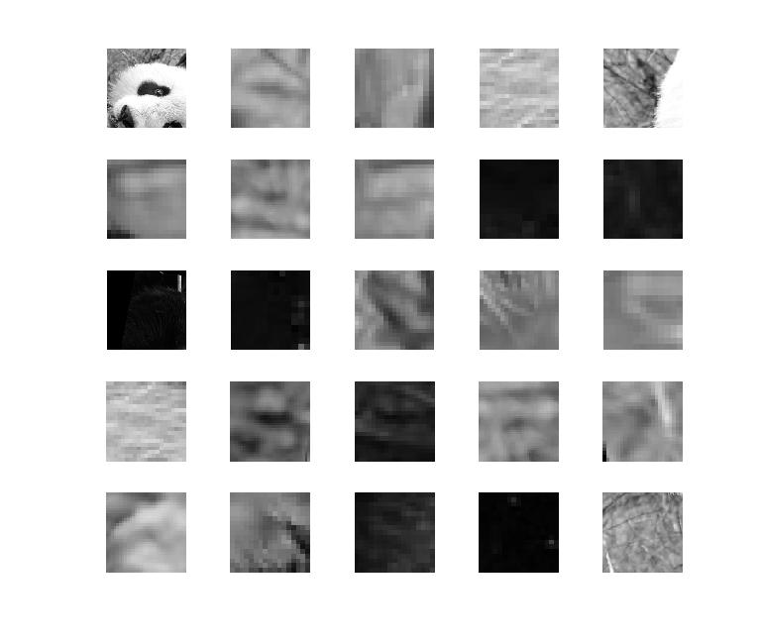
Local feature correspondence for generic object categories
Comparing bags of words histograms coarsely reflects agreement between local “parts” (patches, words).
But choice of quantization directly determines what we consider to be similar…
Kristen Grauman

Slide 16
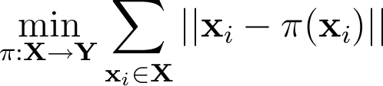
Partially matching sets of features
Optimal match: O(m³)
Greedy match: O(m² log m)
Pyramid match: O(m)
(m=num pts)
We introduce an approximate matching kernel that makes it practical to compare large sets of features based on their partial correspondences.
  [Previous work: Indyk & Thaper, Bartal, Charikar, Agarwal & Varadarajan, …]
Kristen Grauman

Slide 17
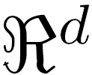
Pyramid match: main idea
Feature space partitions serve to “match” the local descriptors within successively wider regions.
descriptor space
[Grauman & Darrell, ICCV 2005]

Slide 18


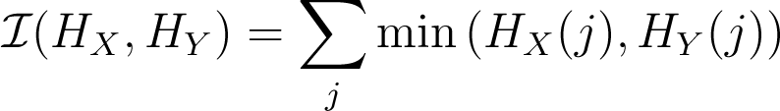

Pyramid match: main idea
Histogram intersection counts number of possible matches at a given partitioning.
[Grauman & Darrell, ICCV 2005]

Slide 19
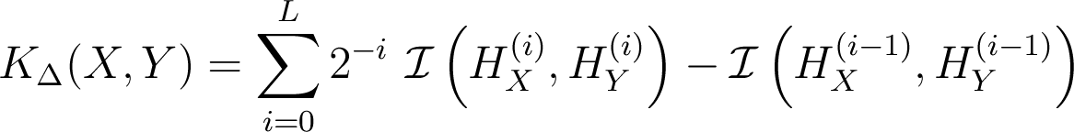
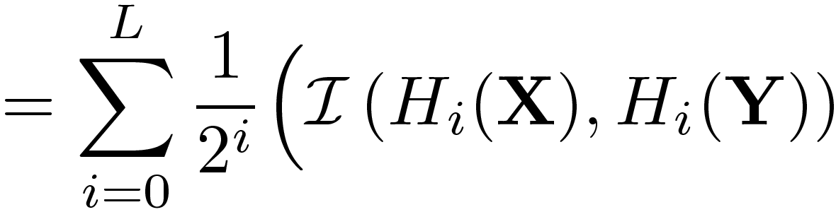
Pyramid match kernel
measures difficulty of a match at level
number of newly matched pairs at level
For similarity, weights inversely proportional to bin size (or may be learned)
Normalize these kernel values to avoid favoring large sets
[Grauman & Darrell, ICCV 2005]

Slide 20
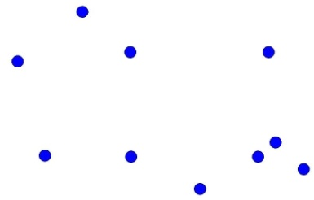






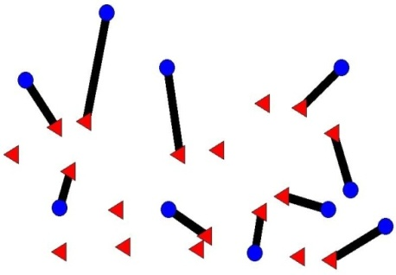

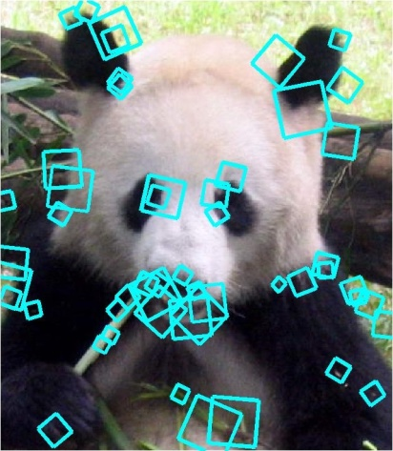
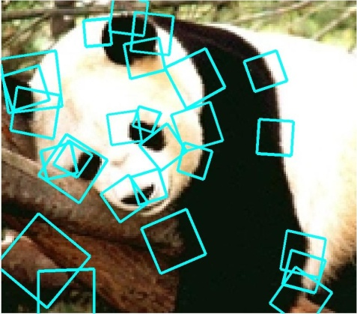


Pyramid match kernel
Optimal match: O(m³)
Pyramid match: O(mL)
optimal partial matching
[Grauman & Darrell, ICCV 2005]

Slide 21
Highlights of the pyramid match
Linear time complexity
Formal bounds on expected error
Mercer kernel
Data-driven partitions allow accurate matches even in high-dim. feature spaces
Strong performance on benchmark object recognition datasets
Kristen Grauman

Slide 22
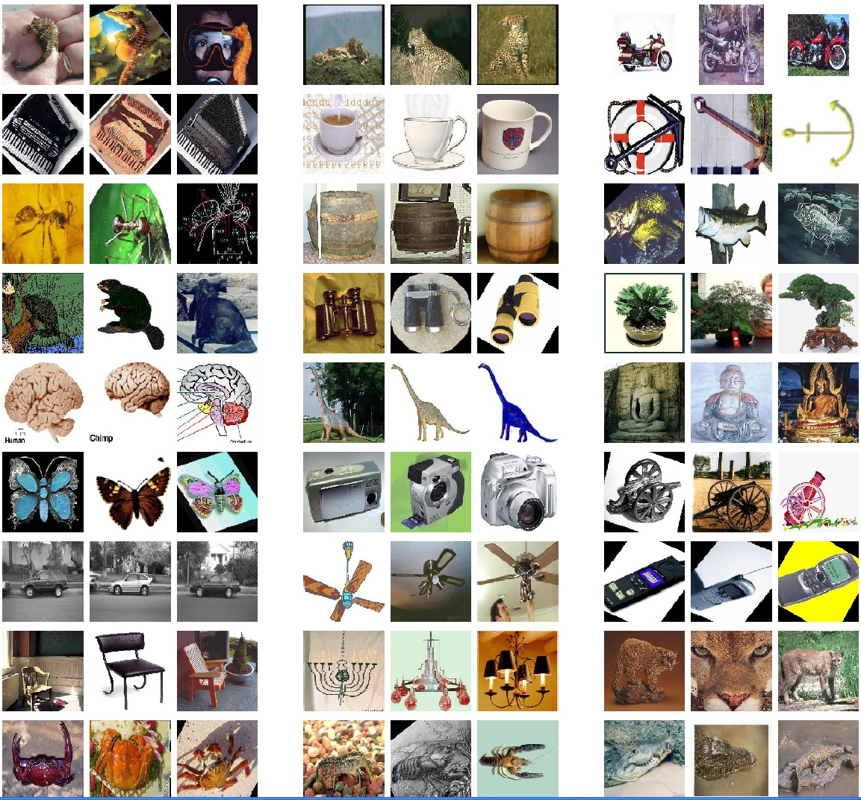
Example recognition results:
Caltech-101 dataset
101 categories 40-800 images per class
Data provided by Fei-Fei, Fergus, and Perona

Slide 23
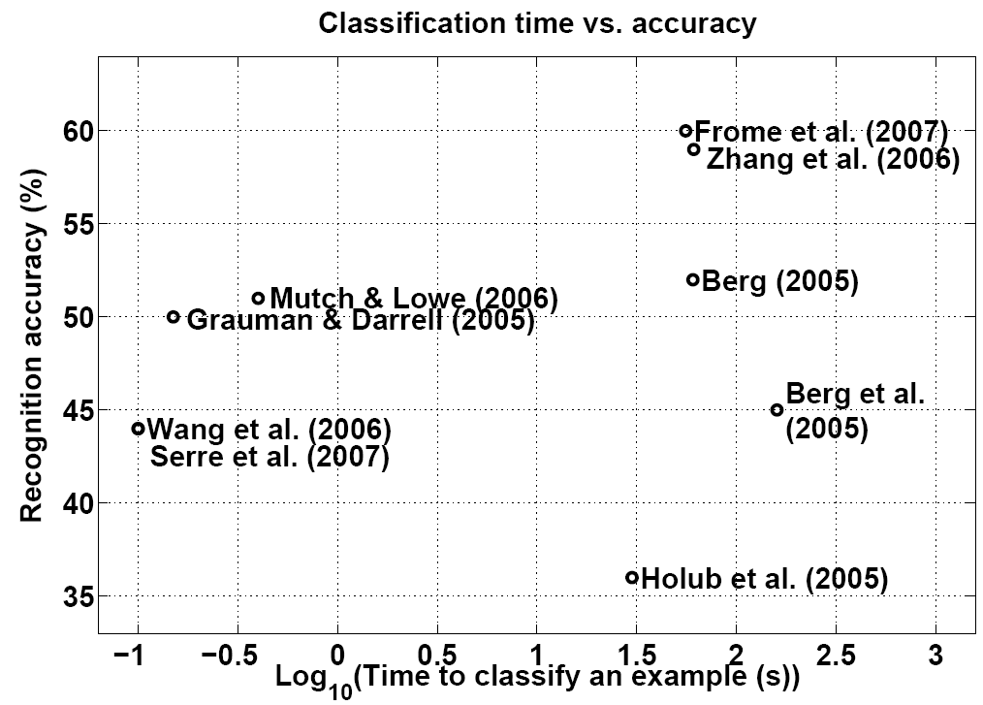
Recognition results:
Caltech-101 dataset
Jain, Huynh, & Grauman (2007)

Slide 24
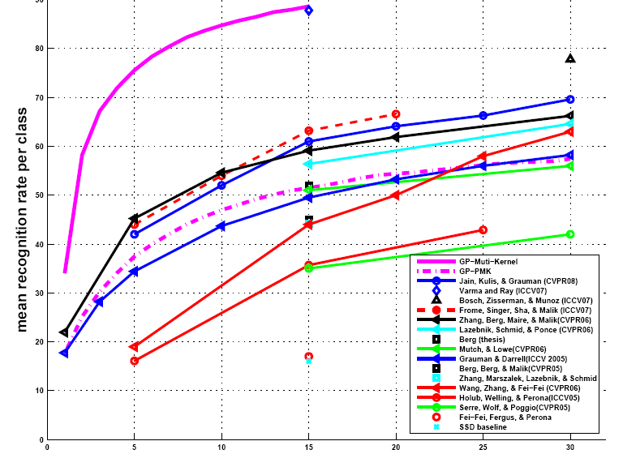
Example recognition results:
Caltech-101 dataset
Combination of pyramid match and correspondence kernels
Accuracy
[Kapoor et al. IJCV 2009]
Number of training examples

Slide 25
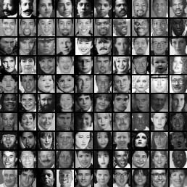
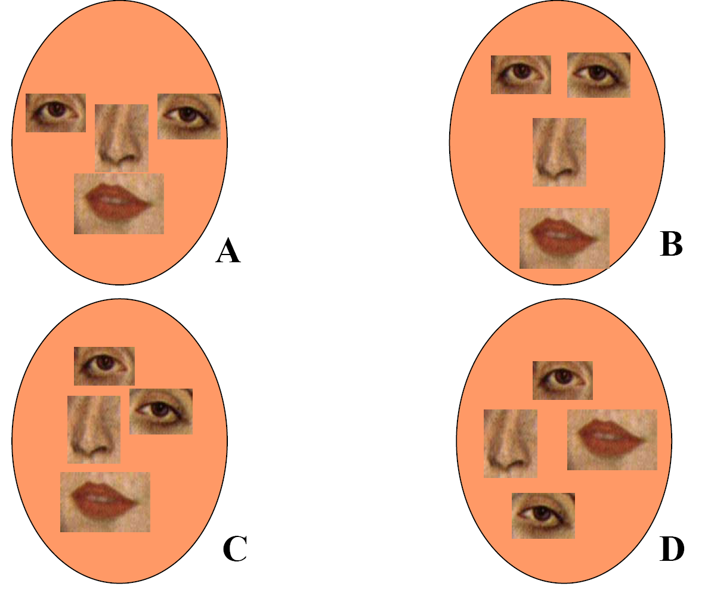
Unordered sets of local features:
No spatial layout preserved!
Too much?
Too little?

Slide 26
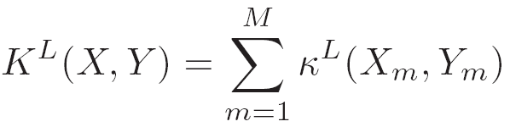
Spatial pyramid match
Make a pyramid of bag-of-words histograms.
Provides some loose (global) spatial layout information
Sum over PMKs computed in image coordinate space, one per word.
[Lazebnik, Schmid & Ponce, CVPR 2006]
Kristen Grauman

Slide 27
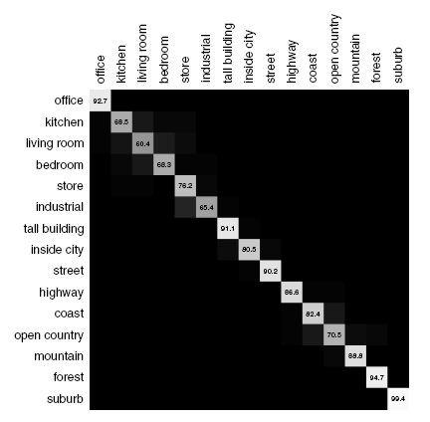
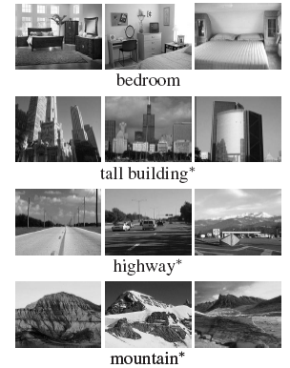
Spatial pyramid match
Captures scene categories well---texture-like patterns but with some variability in the positions of all the local pieces.
Confusion matrix
Kristen Grauman

Slide 28
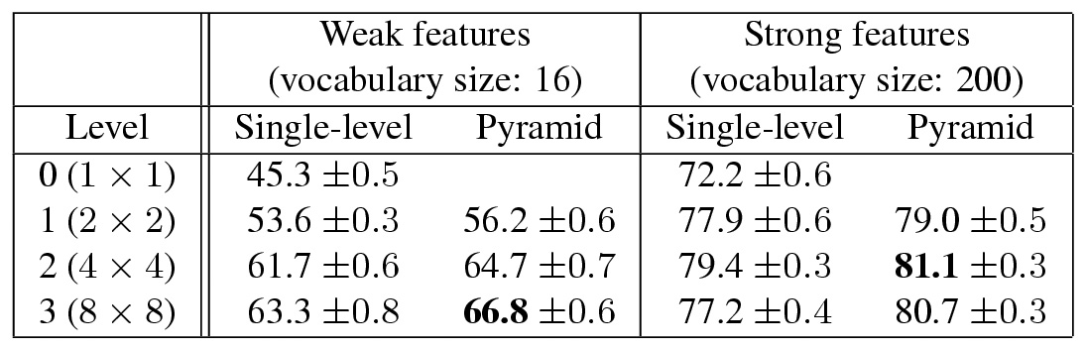
Spatial pyramid match
Captures scene categories well---texture-like patterns but with some variability in the positions of all the local pieces.
Kristen Grauman

Slide 29
Part-based and local feature models for recognition
We’ll look at three forms:
Bag of words (no geometry)
Implicit shape model (star graph for spatial model)
Constellation model (fully connected graph for spatial model)
Kristen Grauman

Slide 30
Shape representation in part-based models
“Star” shape model
x₁
x₆
x₂
x₅
x₃
x₄
e.g. implicit shape model
Parts mutually independent
N image features, P parts in the model

Slide 31

Implicit shape models
Visual vocabulary is used to index votes for object position [a visual word = “part”]
visual codeword with
displacement vectors
training image annotated with object localization info
B. Leibe, A. Leonardis, and B. Schiele, Combined Object Categorization and Segmentation with an Implicit Shape Model, ECCV Workshop on Statistical Learning in Computer Vision 2004

Slide 32
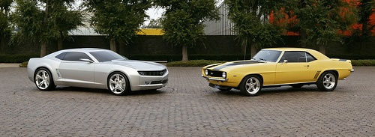
Implicit shape models
Visual vocabulary is used to index votes for object position [a visual word = “part”]
test image
B. Leibe, A. Leonardis, and B. Schiele, Combined Object Categorization and Segmentation with an Implicit Shape Model, ECCV Workshop on Statistical Learning in Computer Vision 2004

Slide 33
Implicit shape models: Training
Build vocabulary of patches around extracted interest points using clustering

Slide 34
Implicit shape models: Training
Build vocabulary of patches around extracted interest points using clustering
Map the patch around each interest point to closest word

Slide 35
Implicit shape models: Training
Build vocabulary of patches around extracted interest points using clustering
Map the patch around each interest point to closest word
For each word, store all positions it was found, relative to object center

Slide 36
Implicit shape models: Testing
Given new test image, extract patches, match to vocabulary words
Cast votes for possible positions of object center
Search for maxima in voting space
(Extract weighted segmentation mask based on stored masks for the codebook occurrences)
What is the dimension of the Hough space?

Slide 37
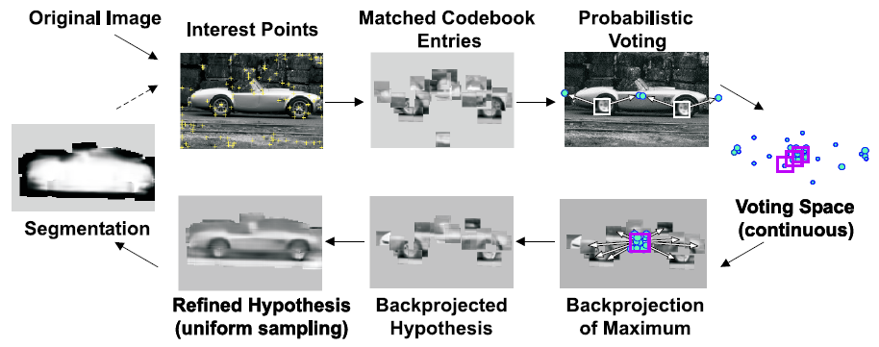
Implicit shape models: Testing

Slide 38
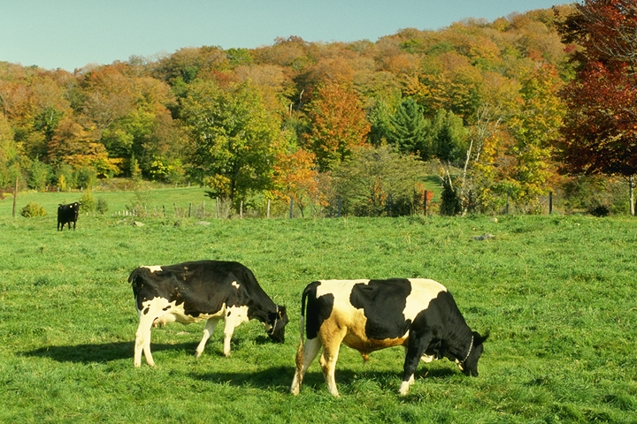
Example: Results on Cows
Original image

Slide 39
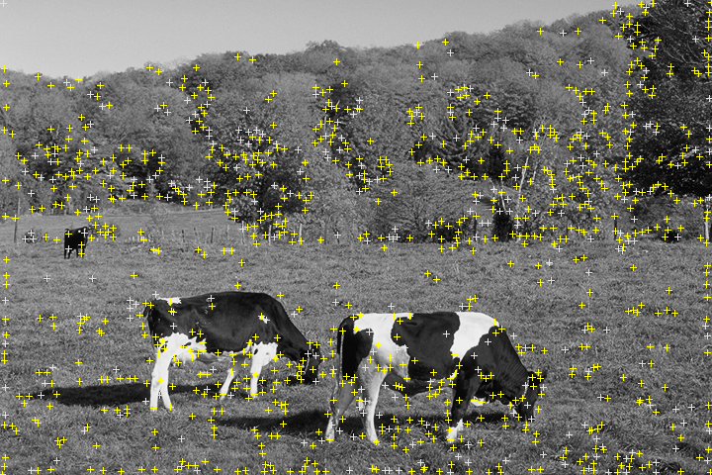
Example: Results on Cows
Original image
Interest points

Slide 40
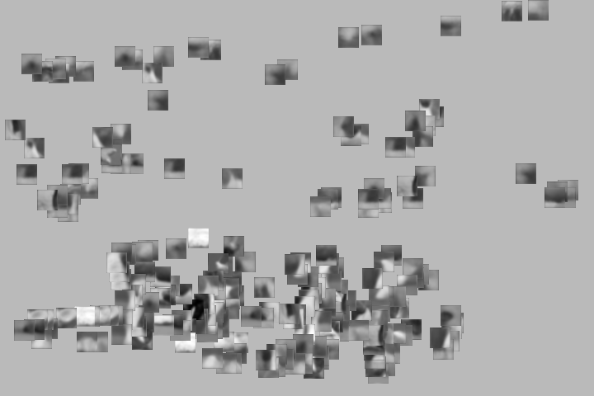
Example: Results on Cows
Original image
Interest points
Matched patches

Slide 41

Example: Results on Cows
Original image
Interest points
Votes
Matched patches

Slide 42
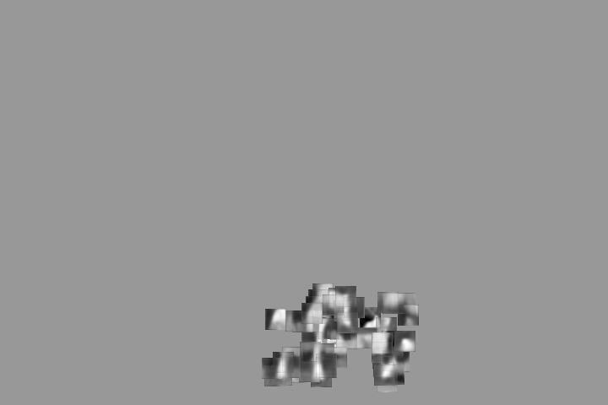
Example: Results on Cows
1st hypothesis

Slide 43
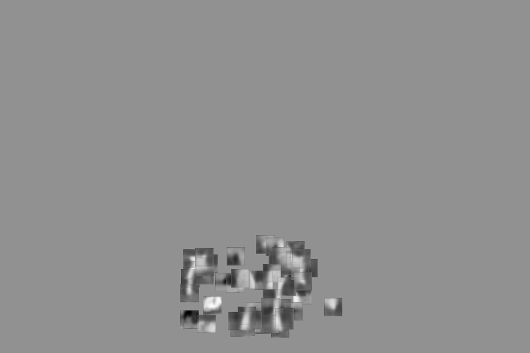
Example: Results on Cows
2nd hypothesis

Slide 44
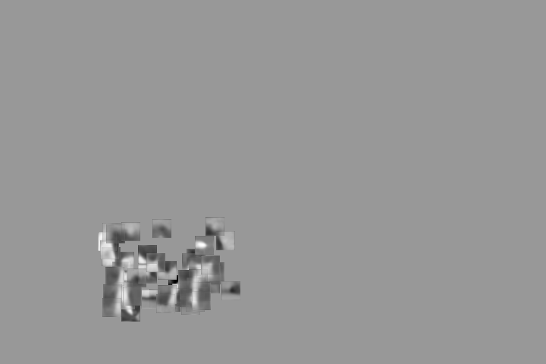
Example: Results on Cows
3rd hypothesis

Slide 45
Detection Results
Qualitative Performance
  Recognizes different kinds of objects
  Robust to clutter, occlusion, noise, low contrast

Slide 46
Shape representation in part-based models
“Star” shape model
Fully connected constellation model
x₁
x₁
x₆
x₂
x₆
x₂
x₅
x₃
x₅
x₃
x₄
x₄
e.g. implicit shape model
Parts mutually independent
e.g. Constellation Model
Parts fully connected
N image features, P parts in the model
Slide credit: Rob Fergus

Slide 47
Probabilistic constellation model
Part
descriptors
Part
locations
h: assignment of features to parts
Candidate parts
Source: Lana Lazebnik

Slide 48
Probabilistic constellation model
h: assignment of features to parts
Part 1
Part 3
Part 2
Source: Lana Lazebnik

Slide 49
Probabilistic constellation model
h: assignment of features to parts
Part 1
Part 3
Part 2
Source: Lana Lazebnik

Slide 50
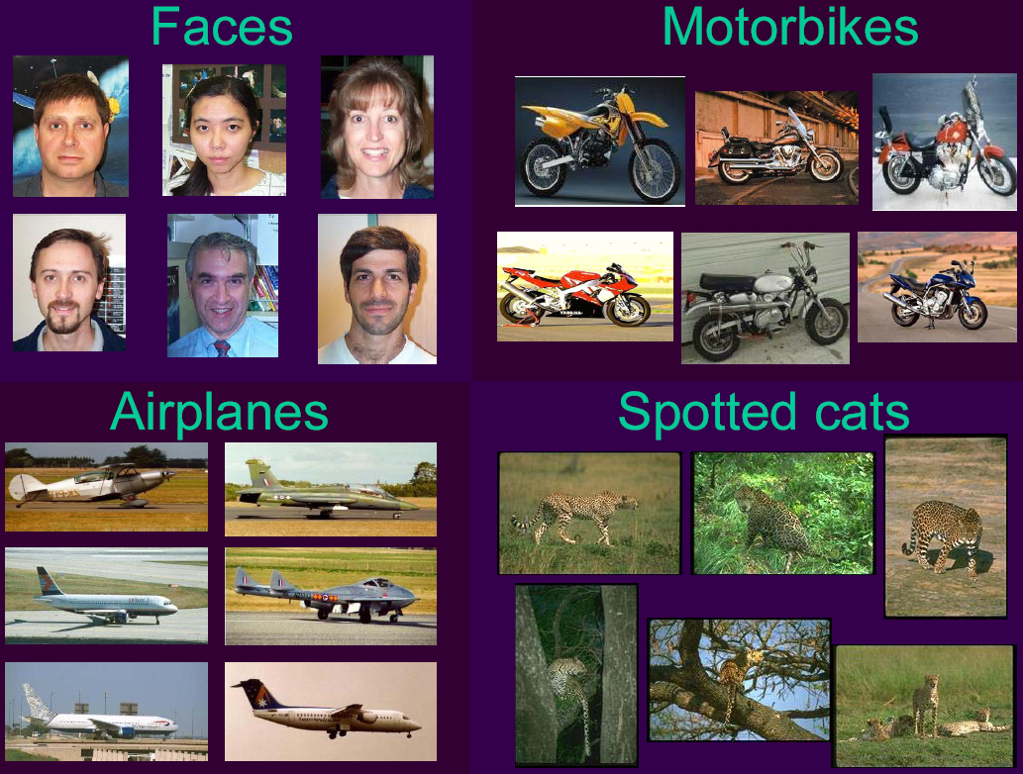
Example results from constellation model: data from four categories
Slide from Li Fei-Fei http://www.vision.caltech.edu/feifeili/Resume.htm

Slide 51


Face model
Appearance: 10 patches closest to mean for each part
Recognition results
Fergus et al. CVPR 2003

Slide 52
Face model
Appearance: 10 patches closest to mean for each part
Recognition results
Test images: size of circles indicates score of hypothesis
Kristen Grauman
Fergus et al. CVPR 2003

Slide 53

Motorbike model
Appearance: 10 patches closest to mean for each part
Recognition results
Kristen Grauman
Fergus et al. CVPR 2003

Slide 54

Spotted cat model
Appearance: 10 patches closest to mean for each part
Recognition results
Kristen Grauman
Fergus et al. CVPR 2003

Slide 55







Comparison
bag of features
bag of features
Part-based model
Source: Lana Lazebnik

Slide 56
Shape representation in part-based models
“Star” shape model
Fully connected constellation model
x₁
x₁
x₆
x₂
x₆
x₂
x₅
x₃
x₅
x₃
x₄
x₄
e.g. implicit shape model
Parts mutually independent
Recognition complexity: O(NP)
Method: Gen. Hough Transform
e.g. Constellation Model
Parts fully connected
Recognition complexity: O(N^{P})
Method: Exhaustive search
N image features, P parts in the model
Slide credit: Rob Fergus

Slide 57
Summary: part-based and local feature models for generic object recognition
Histograms of visual words to capture global or local layout in the bag-of-words framework
  Pyramid match kernels
  Powerful in practice for image recognition
Part-based models encode category’s part appearance together with 2d layout and allow detection within cluttered image
  “implicit shape model”: shape based on layout of all parts relative to a reference part; Generalized Hough for detection
  “constellation model”: explicitly model mutual spatial layout between all pairs of parts; exhaustive search for best fit of features to parts

Slide 58




Recognition models
Instances:
recognition by alignment
Categories:
Holistic appearance models (and sliding window detection)
Categories:
Local feature and part-based models
Kristen Grauman

Slide 59
Coming up
Video processing: motion, tracking, activity

