Slide 1
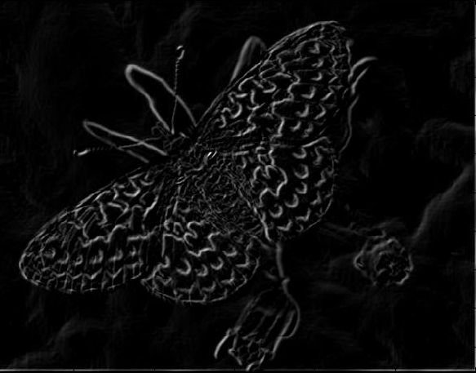
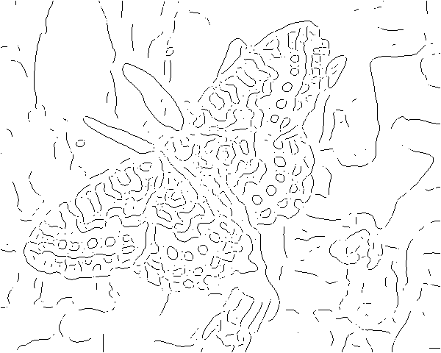
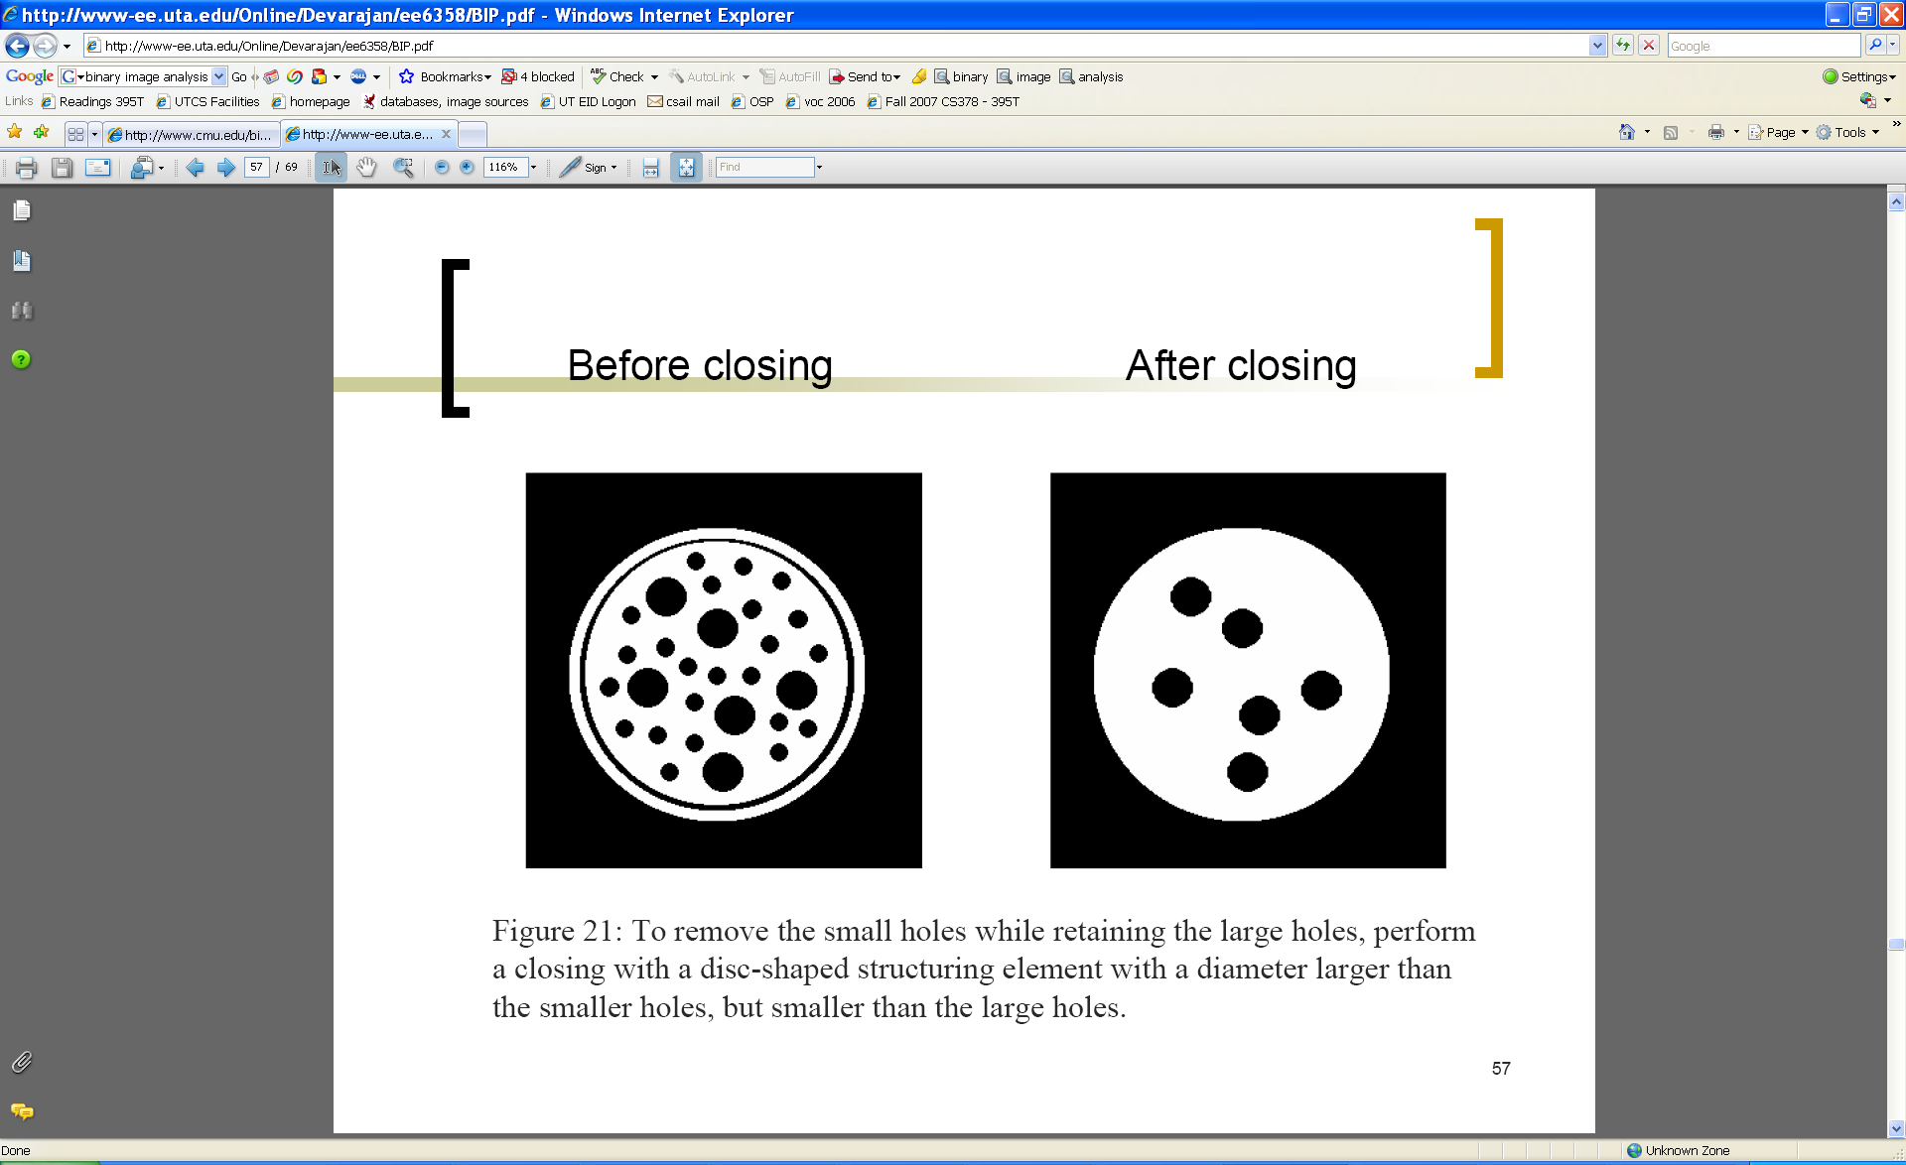
Edges and Binary Image Analysis
Mon, Jan 31
Prof. Kristen Grauman
UT-Austin

Slide 2
Previously
Filters allow local image neighborhood to influence our description and features
  Smoothing to reduce noise
  Derivatives to locate contrast, gradient
Seam carving application:
  use image gradients to measure “interestingness” or “energy”
  remove 8-connected seams so as to preserve image’s energy.

Slide 3
Today
Edge detection and matching
  process the image gradient to find curves/contours
  comparing contours
Binary image analysis
  blobs and regions

Slide 4
Edge detection
Goal: map image from 2d array of pixels to a set of curves or line segments or contours.
Why?
Main idea: look for strong gradients, post-process
Figure from J. Shotton et al., PAMI 2007
Figure from D. Lowe

Slide 5
Gradients -> edges
Primary edge detection steps:
1. Smoothing: suppress noise
2. Edge enhancement: filter for contrast
3. Edge localization
  Determine which local maxima from filter output are actually edges vs. noise
    Threshold, Thin
Kristen Grauman, UT-Austin

Slide 6
Thresholding
Choose a threshold value t
Set any pixels less than t to zero (off)
Set any pixels greater than or equal to t to one (on)

Slide 7
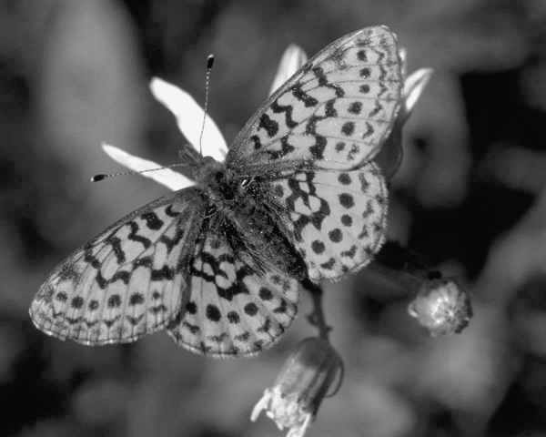
Original image

Slide 8
Gradient magnitude image

Slide 9
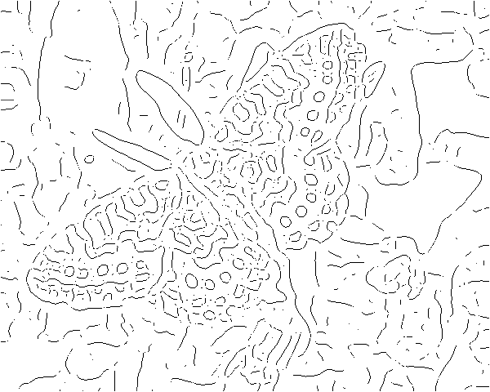
Thresholding gradient with a lower threshold

Slide 10
Thresholding gradient with a higher threshold

Slide 11
Canny edge detector
Filter image with derivative of Gaussian
Find magnitude and orientation of gradient
Non-maximum suppression:
  Thin wide “ridges” down to single pixel width
Linking and thresholding (hysteresis):
  Define two thresholds: low and high
  Use the high threshold to start edge curves and the low threshold to continue them
MATLAB: edge(image, ‘canny’);
>>help edge
Source: D. Lowe, L. Fei-Fei

Slide 12

The Canny edge detector
original image (Lena)
Slide credit: Steve Seitz

Slide 13

The Canny edge detector
norm of the gradient

Slide 14

The Canny edge detector
thresholding

Slide 15

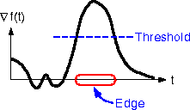
The Canny edge detector
How to turn these thick regions of the gradient into curves?
thresholding

Slide 16

Non-maximum suppression
Check if pixel is local maximum along gradient direction, select single max across width of the edge
  requires checking interpolated pixels p and r

Slide 17

The Canny edge detector
Problem: pixels along this edge didn’t survive the thresholding
thinning
(non-maximum suppression)

Slide 18
Hysteresis thresholding
Use a high threshold to start edge curves, and a low threshold to continue them.
Source: Steve Seitz

Slide 19
Hysteresis thresholding
original image
high threshold
(strong edges)
low threshold
(weak edges)
hysteresis threshold
Source: L. Fei-Fei

Slide 20
Hysteresis thresholding
original image
high threshold
(strong edges)
low threshold
(weak edges)
hysteresis threshold
Source: L. Fei-Fei

Slide 21
Recap: Canny edge detector
Filter image with derivative of Gaussian
Find magnitude and orientation of gradient
Non-maximum suppression:
  Thin wide “ridges” down to single pixel width
Linking and thresholding (hysteresis):
  Define two thresholds: low and high
  Use the high threshold to start edge curves and the low threshold to continue them
MATLAB: edge(image, ‘canny’);
>>help edge
Source: D. Lowe, L. Fei-Fei

Slide 22
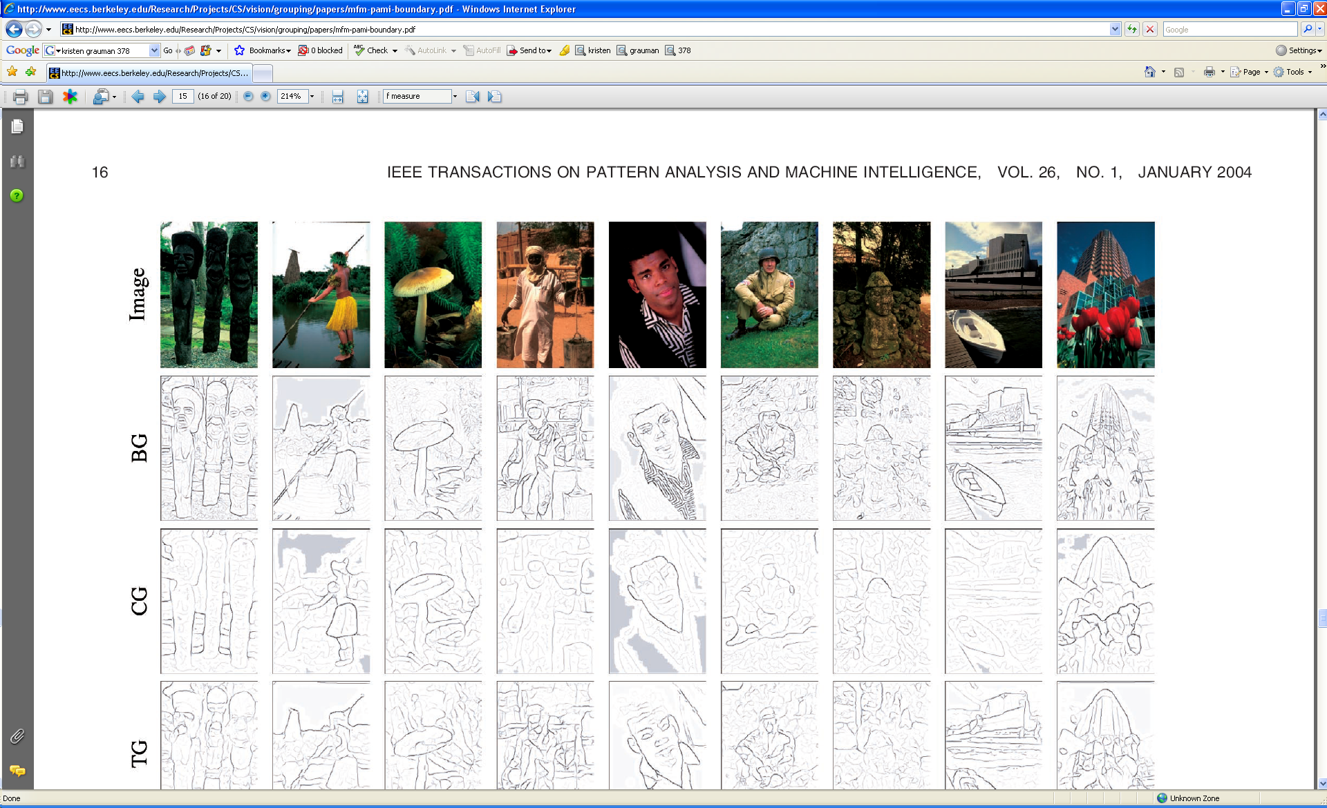
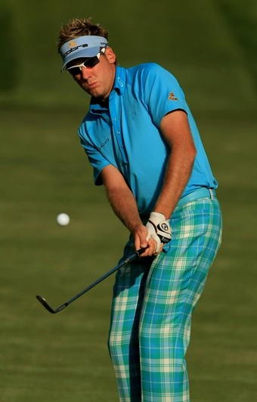
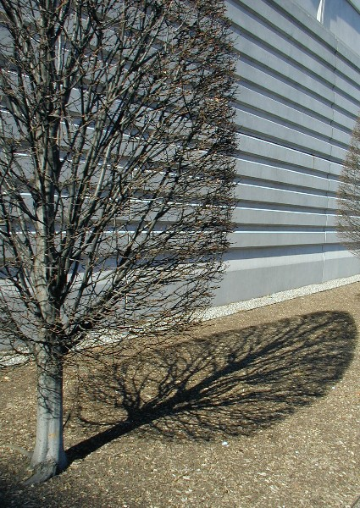

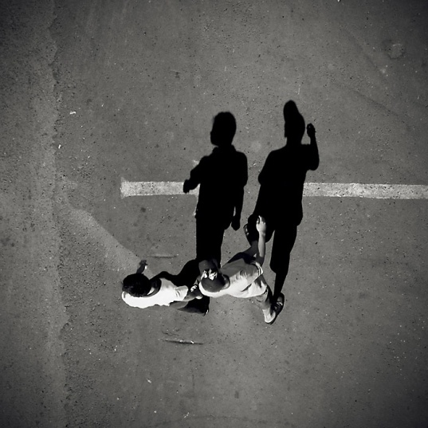
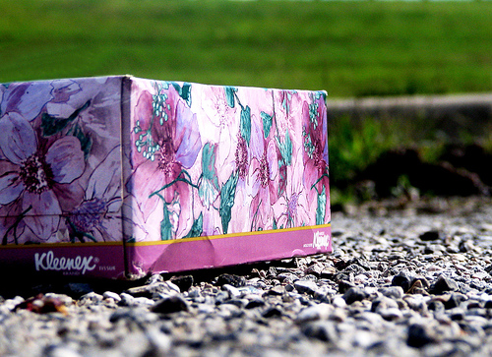
Low-level edges vs. perceived contours
Background
Texture
Shadows
Kristen Grauman, UT-Austin

Slide 23



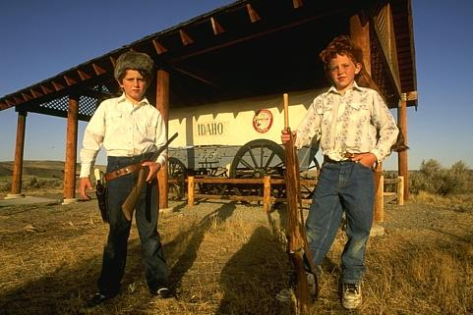


Low-level edges vs. perceived contours
image
human segmentation
gradient magnitude
Berkeley segmentation database:
http://www.eecs.berkeley.edu/Research/Projects/CS/vision/grouping/segbench/
Source: L. Lazebnik

Slide 24
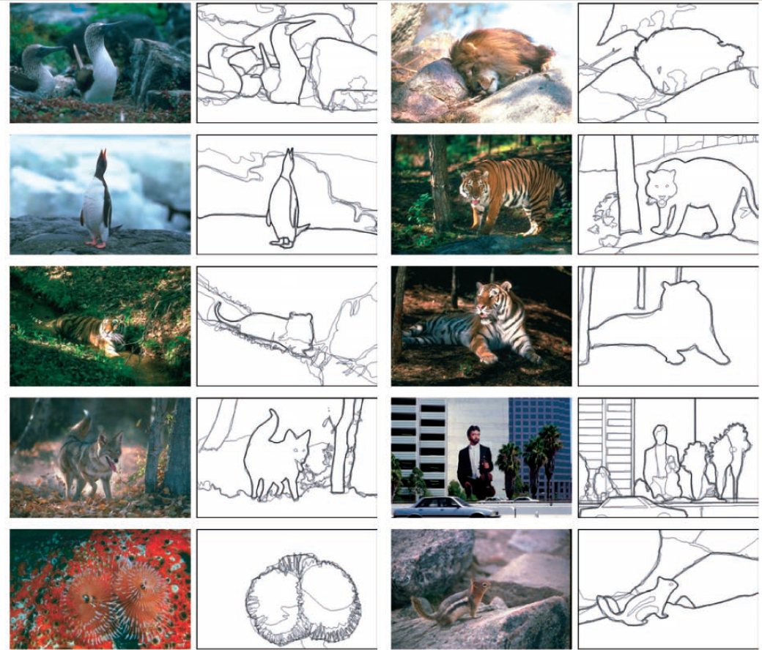
Learn from humans which combination of features is most indicative of a “good” contour?
[D. Martin et al. PAMI 2004]
Human-marked segment boundaries

Slide 25
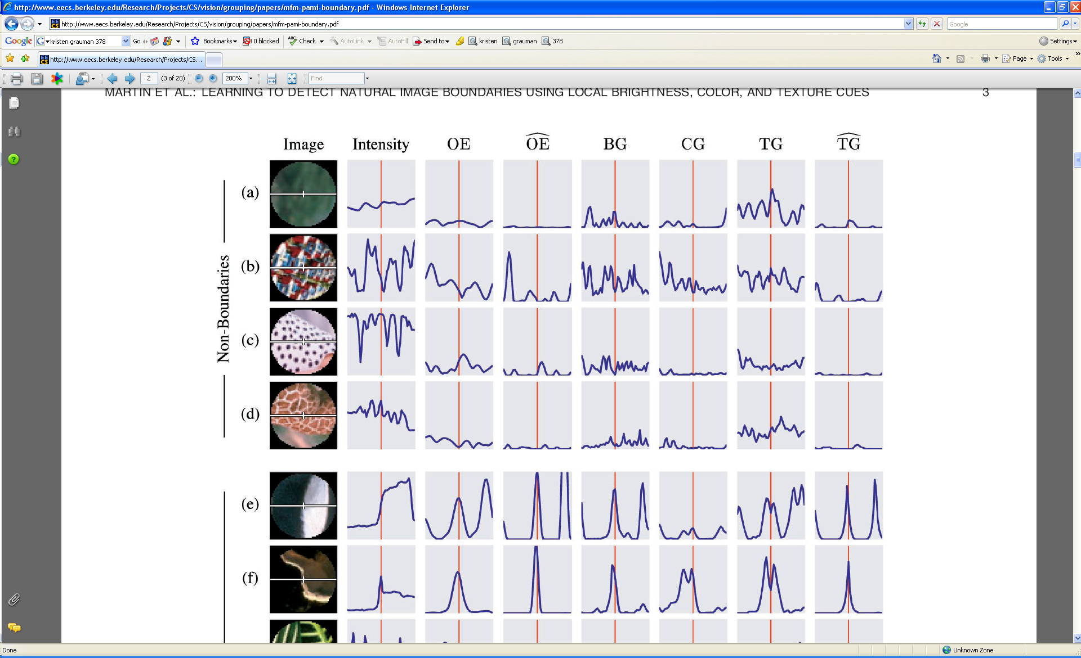
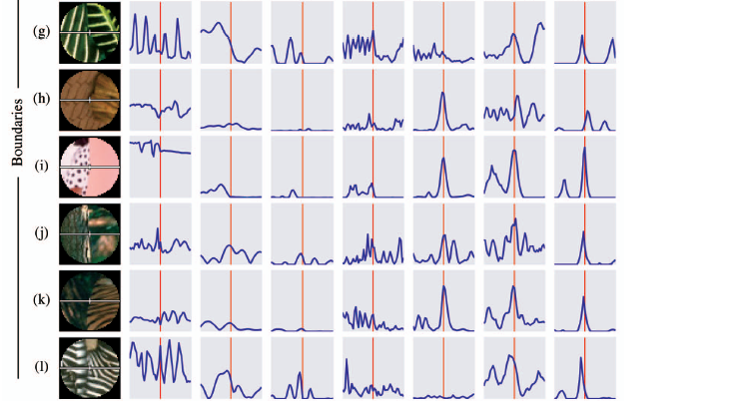
What features are responsible for perceived edges?
Feature profiles (oriented energy, brightness, color, and texture gradients) along the patch’s horizontal diameter
[D. Martin et al. PAMI 2004]
Kristen Grauman, UT-Austin

Slide 26
What features are responsible for perceived edges?
Feature profiles (oriented energy, brightness, color, and texture gradients) along the patch’s horizontal diameter
[D. Martin et al. PAMI 2004]
Kristen Grauman, UT-Austin

Slide 27
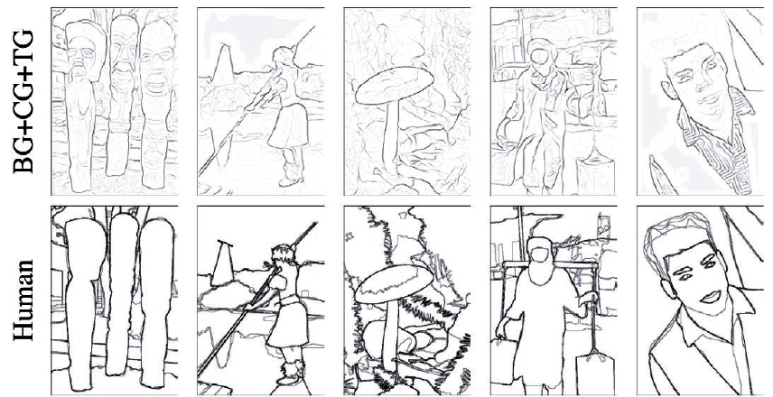
[D. Martin et al. PAMI 2004]
Kristen Grauman, UT-Austin

Slide 28
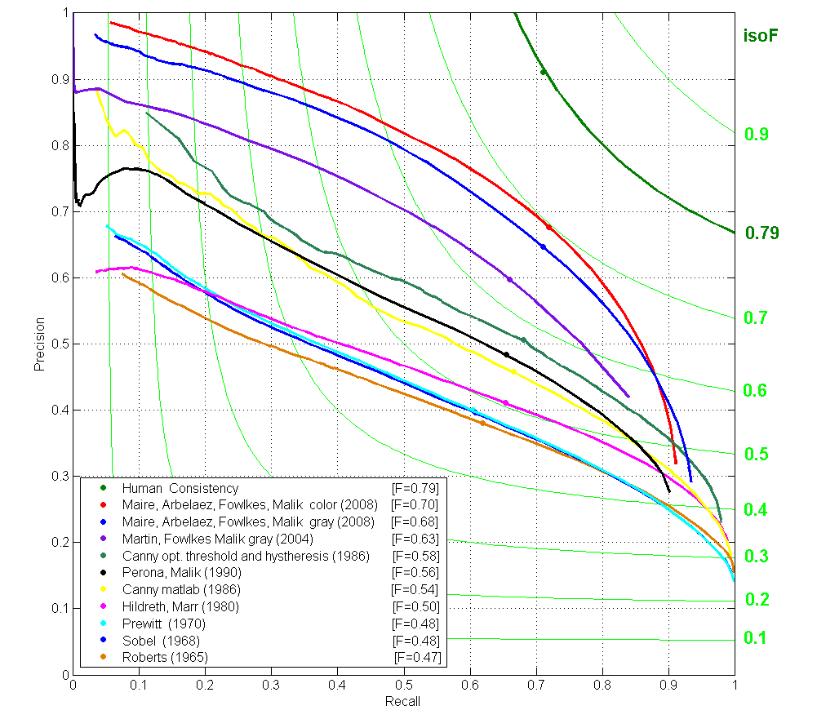
State-of-the-Art in Contour Detection
Canny+opt thresholds
Human agreement
Canny
Prewitt, Sobel, Roberts
Learned with combined features
Source: Jitendra Malik: http://www.cs.berkeley.edu/~malik/malik-talks-ptrs.html

Slide 29
Today
Edge detection and matching
  process the image gradient to find curves/contours
  comparing contours
Binary image analysis
  blobs and regions

Slide 30
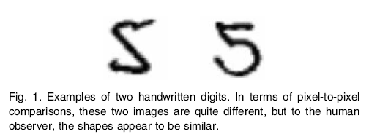
Figure from Belongie et al.

Slide 31
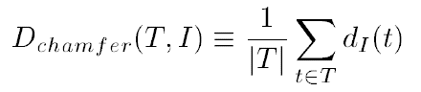
Chamfer distance
Average distance to nearest feature
Set of points in image
Set of points on (shifted) template
Minimum distance between point t and some point in I
Kristen Grauman, UT-Austin

Slide 32
Chamfer distance
Kristen Grauman, UT-Austin

Slide 33
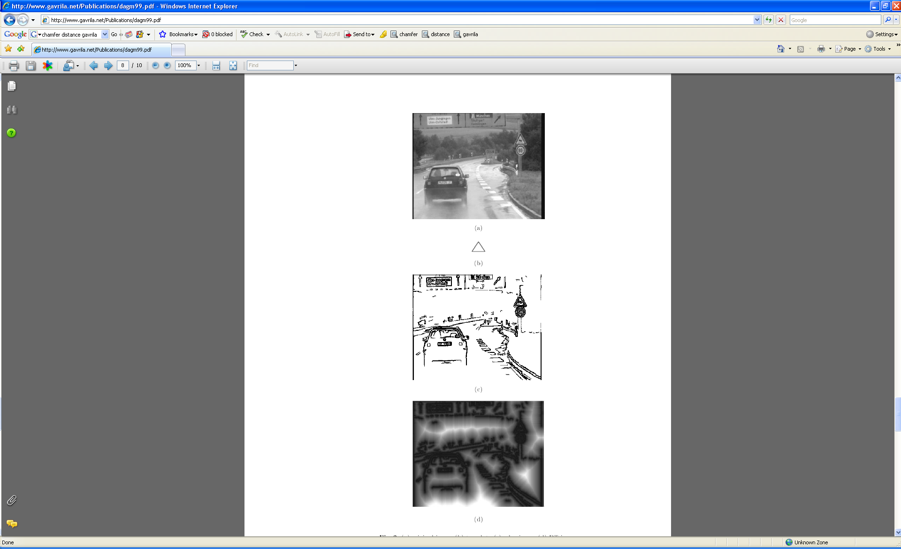
Chamfer distance
Average distance to nearest feature
How is the measure different than just filtering with a mask having the shape points?
How expensive is a naïve implementation?
Edge image
Kristen Grauman, UT-Austin

Slide 34
Distance transform
Image features (2D)
Distance Transform
1
0
1
2
3
4
3
2
1
0
1
2
3
3
2
1
1
0
1
2
3
2
1
0
1
0
0
1
2
1
0
1
2
1
1
2
1
0
1
2
3
2
2
2
1
0
1
2
4
3
3
2
1
0
1
2
5
4
4
3
2
1
0
1
Distance Transform is a function that for each image pixel p assigns a non-negative number corresponding to distance from p to the nearest feature in the image I
Features could be edge points, foreground points,…

Slide 35

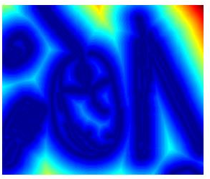

Distance transform
original
edges
distance transform
Value at (x,y) tells how far that position is from the nearest edge point (or other binary mage structure)
>> help bwdist
Kristen Grauman, UT-Austin

Slide 36
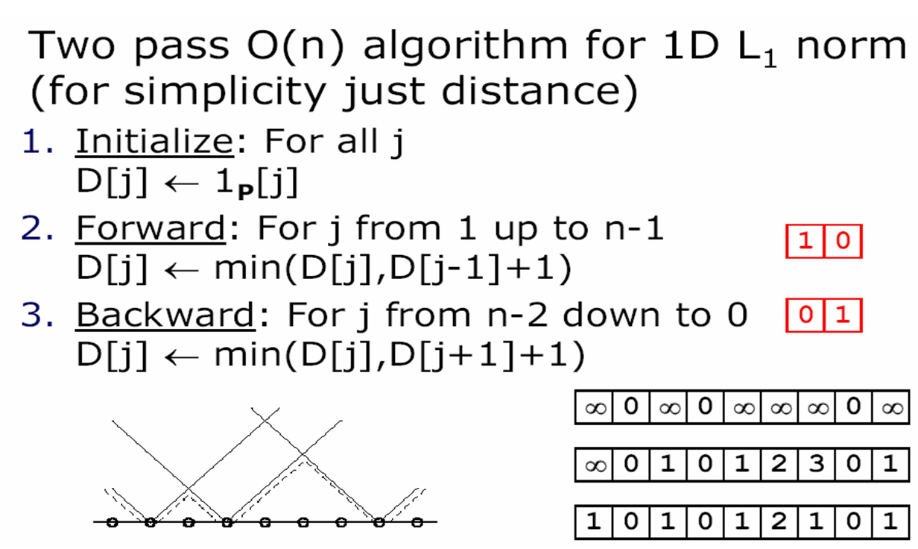
Distance transform (1D)
// 0 if j is in P, infinity otherwise
Adapted from D. Huttenlocher

Slide 37
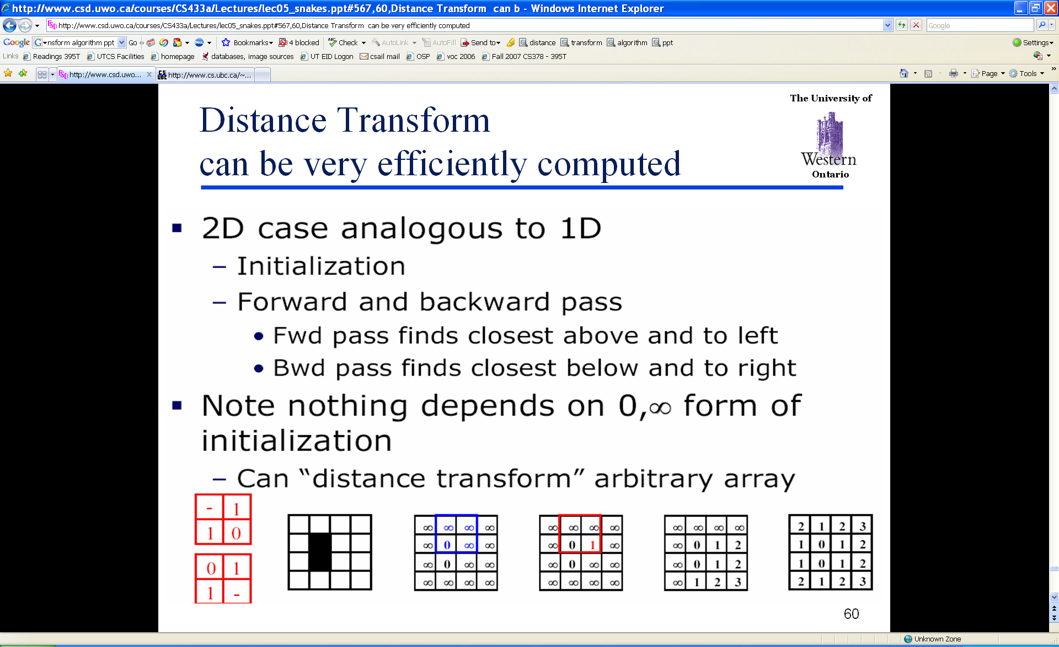
Distance Transform (2D)
Adapted from D. Huttenlocher

Slide 38
Chamfer distance
Average distance to nearest feature
Edge image
Distance transform image
Kristen Grauman, UT-Austin

Slide 39
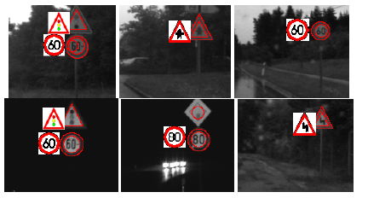
Chamfer distance
Edge image
Distance transform image
Fig from D. Gavrila, DAGM 1999
Kristen Grauman, UT-Austin

Slide 40
Chamfer distance: properties
Sensitive to scale and rotation
Tolerant of small shape changes, clutter
Need large number of template shapes
Inexpensive way to match shapes

Slide 41
Today
Edge detection and matching
  process the image gradient to find curves/contours
  comparing contours
Binary image analysis
  blobs and regions

Slide 42
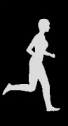
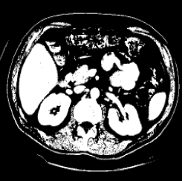
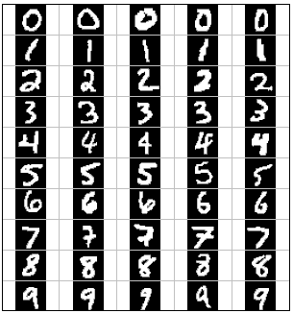
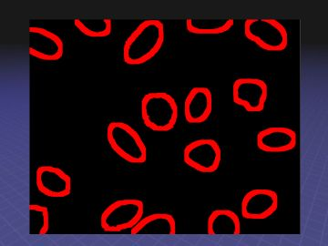
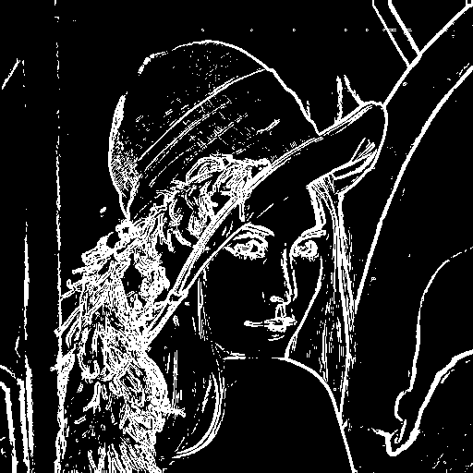
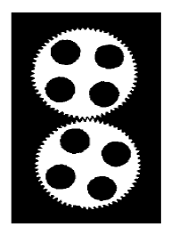
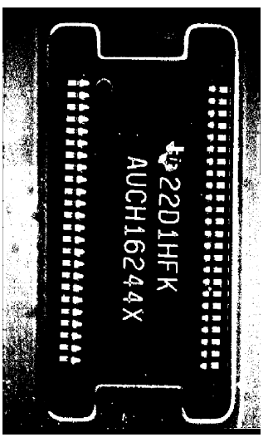
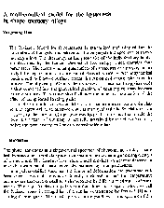
Binary images
Kristen Grauman, UT-Austin

Slide 43
Binary image analysis: basic steps
Convert the image into binary form
  Thresholding
Clean up the thresholded image
  Morphological operators
Extract separate blobs
  Connected components
Describe the blobs with region properties
Kristen Grauman, UT-Austin

Slide 44
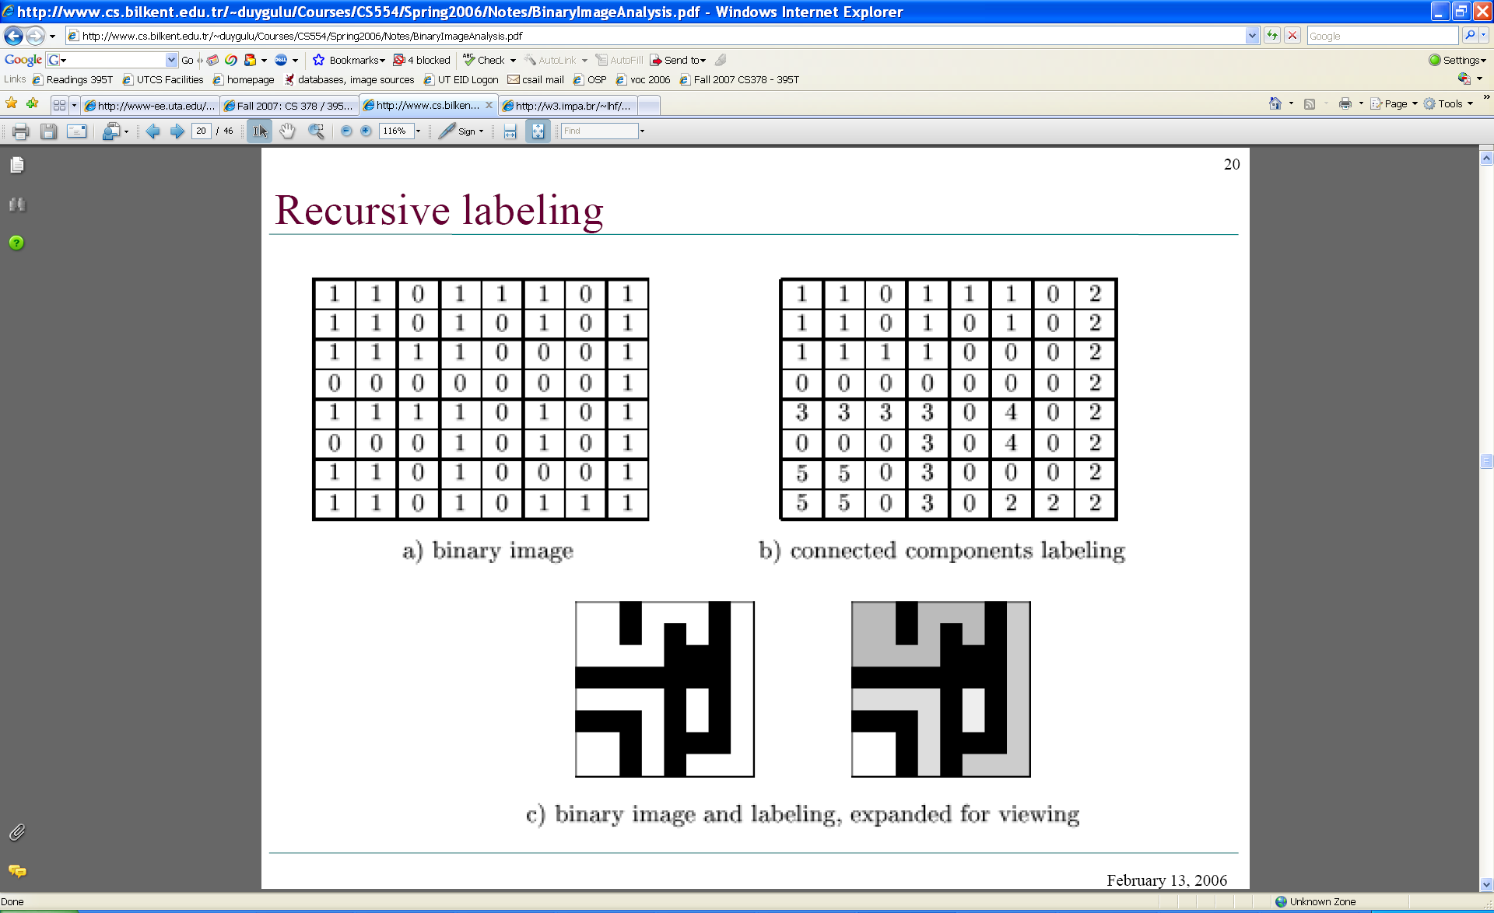
Binary images
Two pixel values
  Foreground and background
  Mark region(s) of interest

Slide 45



Thresholding
Grayscale -> binary mask
Useful if object of interest’s intensity distribution is distinct from background
Example http://homepages.inf.ed.ac.uk/rbf/CVonline/LOCAL_COPIES/FITZGIBBON/simplebinary.html

Slide 46
Thresholding
Given a grayscale image or an intermediate matrix → threshold to create a binary output.
Example: edge detection
Gradient magnitude
fg_pix = find(gradient_mag > t);
Looking for pixels where gradient is strong.
Kristen Grauman, UT-Austin

Slide 47
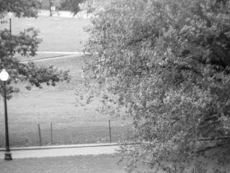
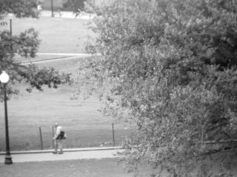
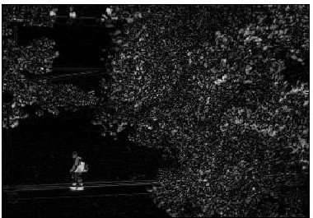
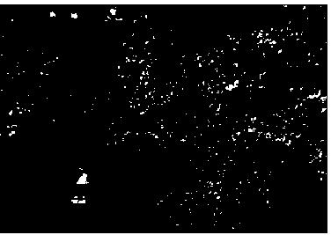
Thresholding
Given a grayscale image or an intermediate matrix → threshold to create a binary output.
Example: background subtraction
-
=
Looking for pixels that differ significantly from the “empty” background.
Kristen Grauman, UT-Austin
fg_pix = find(diff > t);

Slide 48
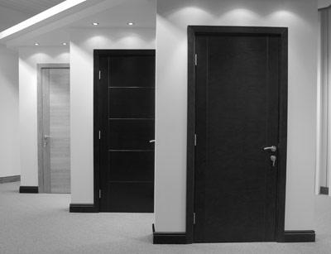
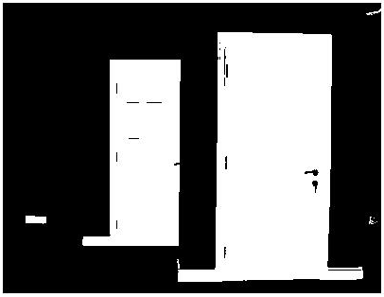
Thresholding
Given a grayscale image or an intermediate matrix → threshold to create a binary output.
Example: intensity-based detection
fg_pix = find(im < 65);
Looking for dark pixels
Kristen Grauman, UT-Austin

Slide 49

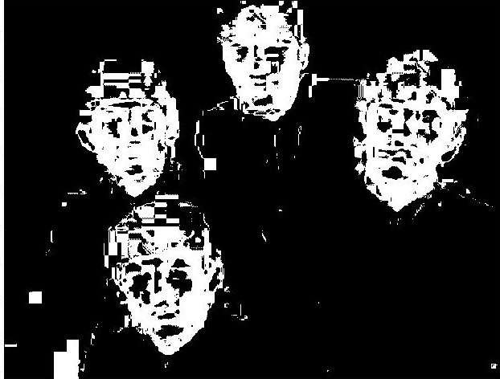
Thresholding
Given a grayscale image or an intermediate matrix → threshold to create a binary output.
Example: color-based detection
fg_pix = find(hue > t1 & hue < t2);
Looking for pixels within a certain hue range.
Kristen Grauman, UT-Austin

Slide 50
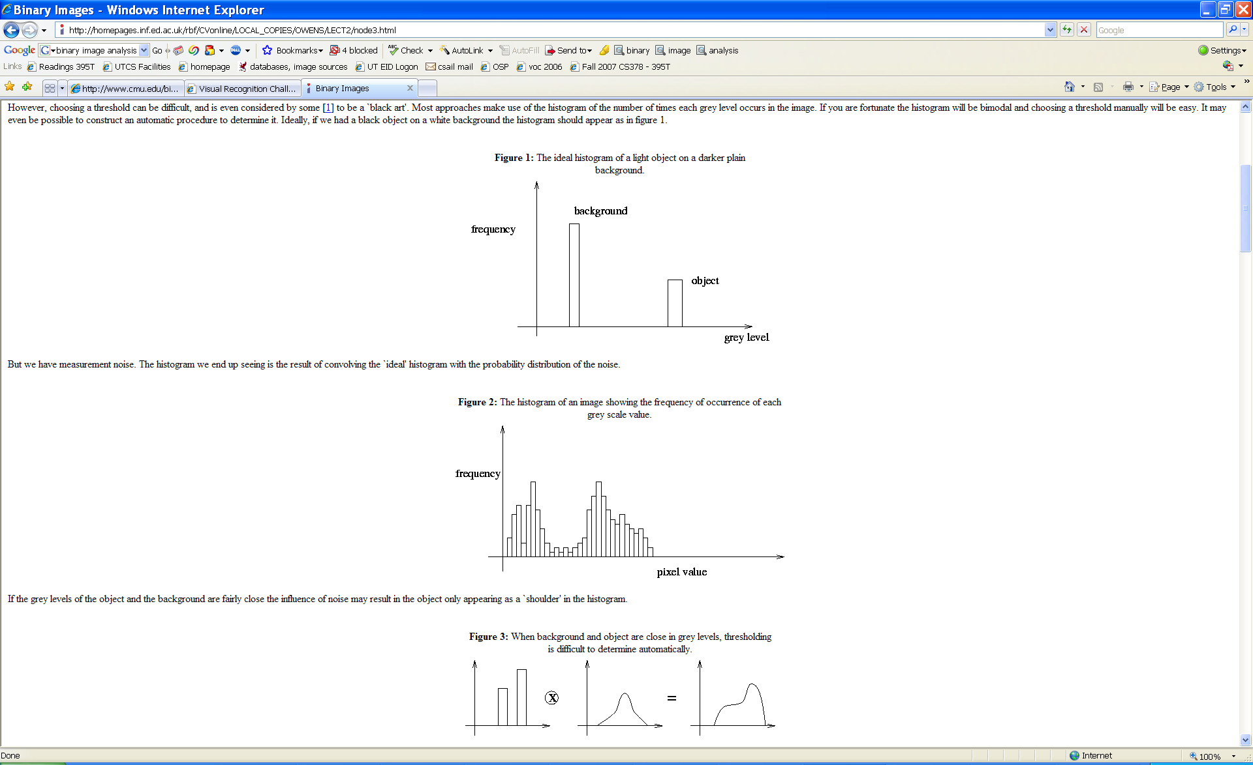
A nice case: bimodal intensity histograms
Ideal histogram, light object on dark background
Actual observed histogram with noise
Images: http://homepages.inf.ed.ac.uk/rbf/CVonline/LOCAL_COPIES/OWENS/LECT2/node3.html

Slide 51
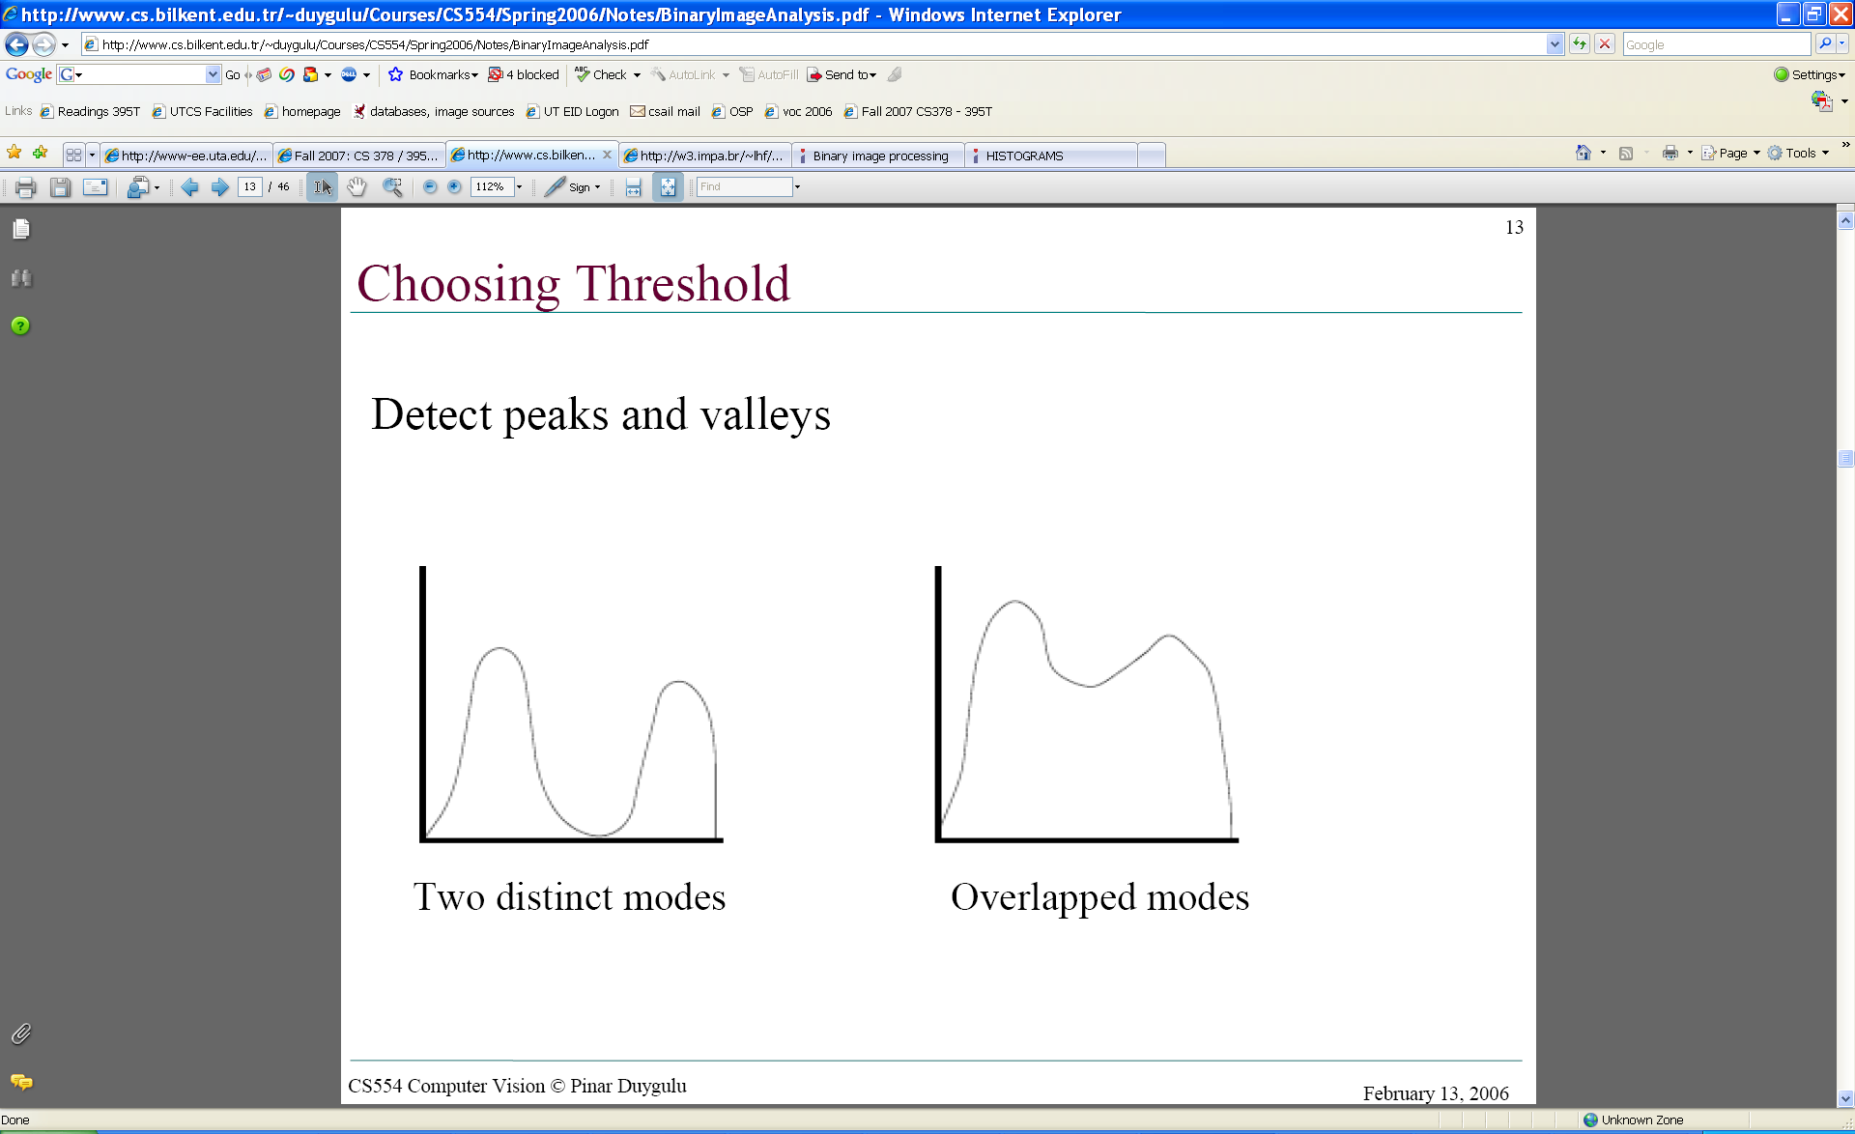
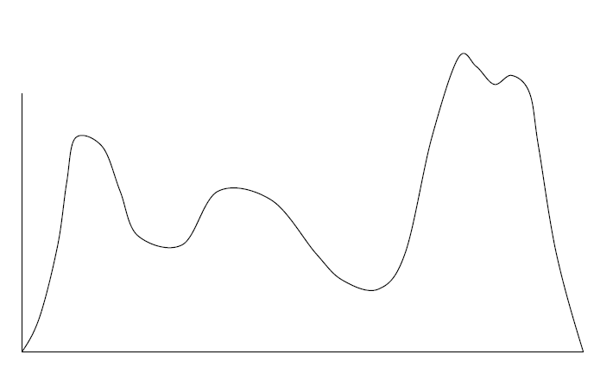
Not so nice cases
Shapiro and Stockman

Slide 52
Issues
What to do with “noisy” binary outputs?
  Holes
  Extra small fragments
How to demarcate multiple regions of interest?
  Count objects
  Compute further features per object
Kristen Grauman, UT-Austin

Slide 53
Morphological operators
Change the shape of the foreground regions via intersection/union operations between a scanning structuring element and binary image.
Useful to clean up result from thresholding
Basic operators are:
  Dilation
  Erosion

Slide 54
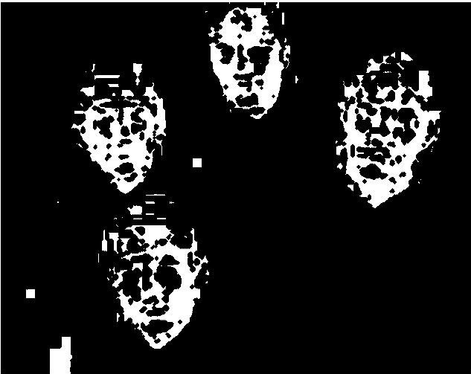
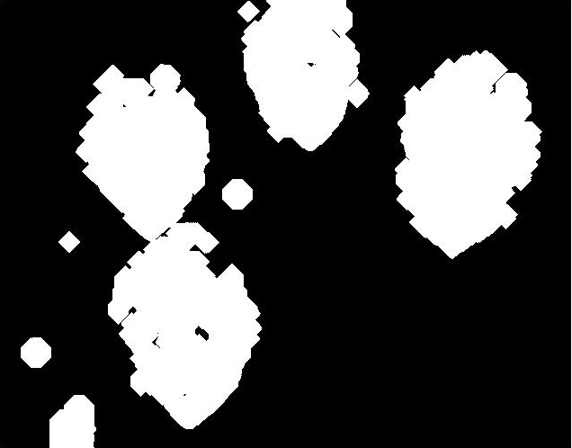
Dilation
Expands connected components
Grow features
Fill holes
Before dilation
After dilation
Kristen Grauman, UT-Austin
Notes:
Disk strel, 5 pixels wide

Slide 55
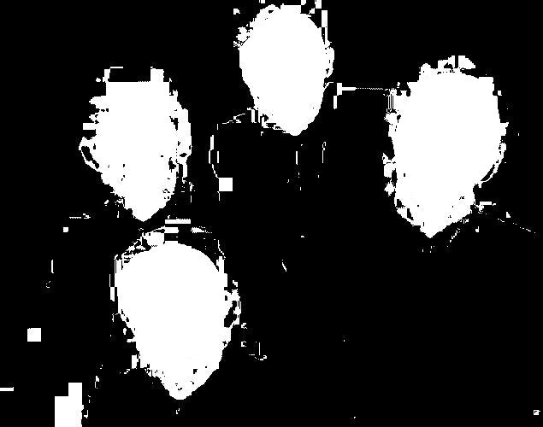
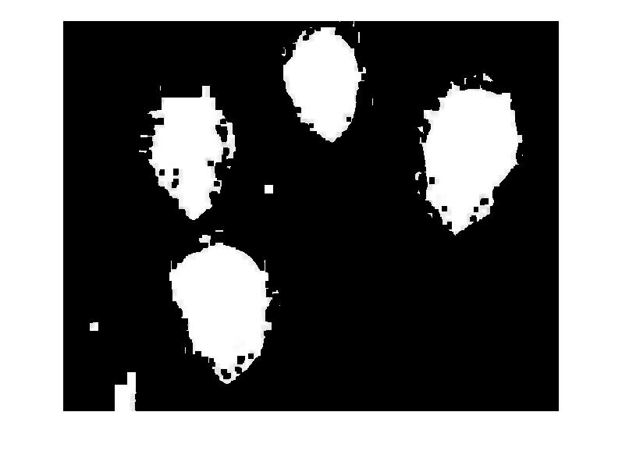
Erosion
Erode connected components
Shrink features
Remove bridges, branches, noise
Before erosion
After erosion
Kristen Grauman, UT-Austin

Slide 56
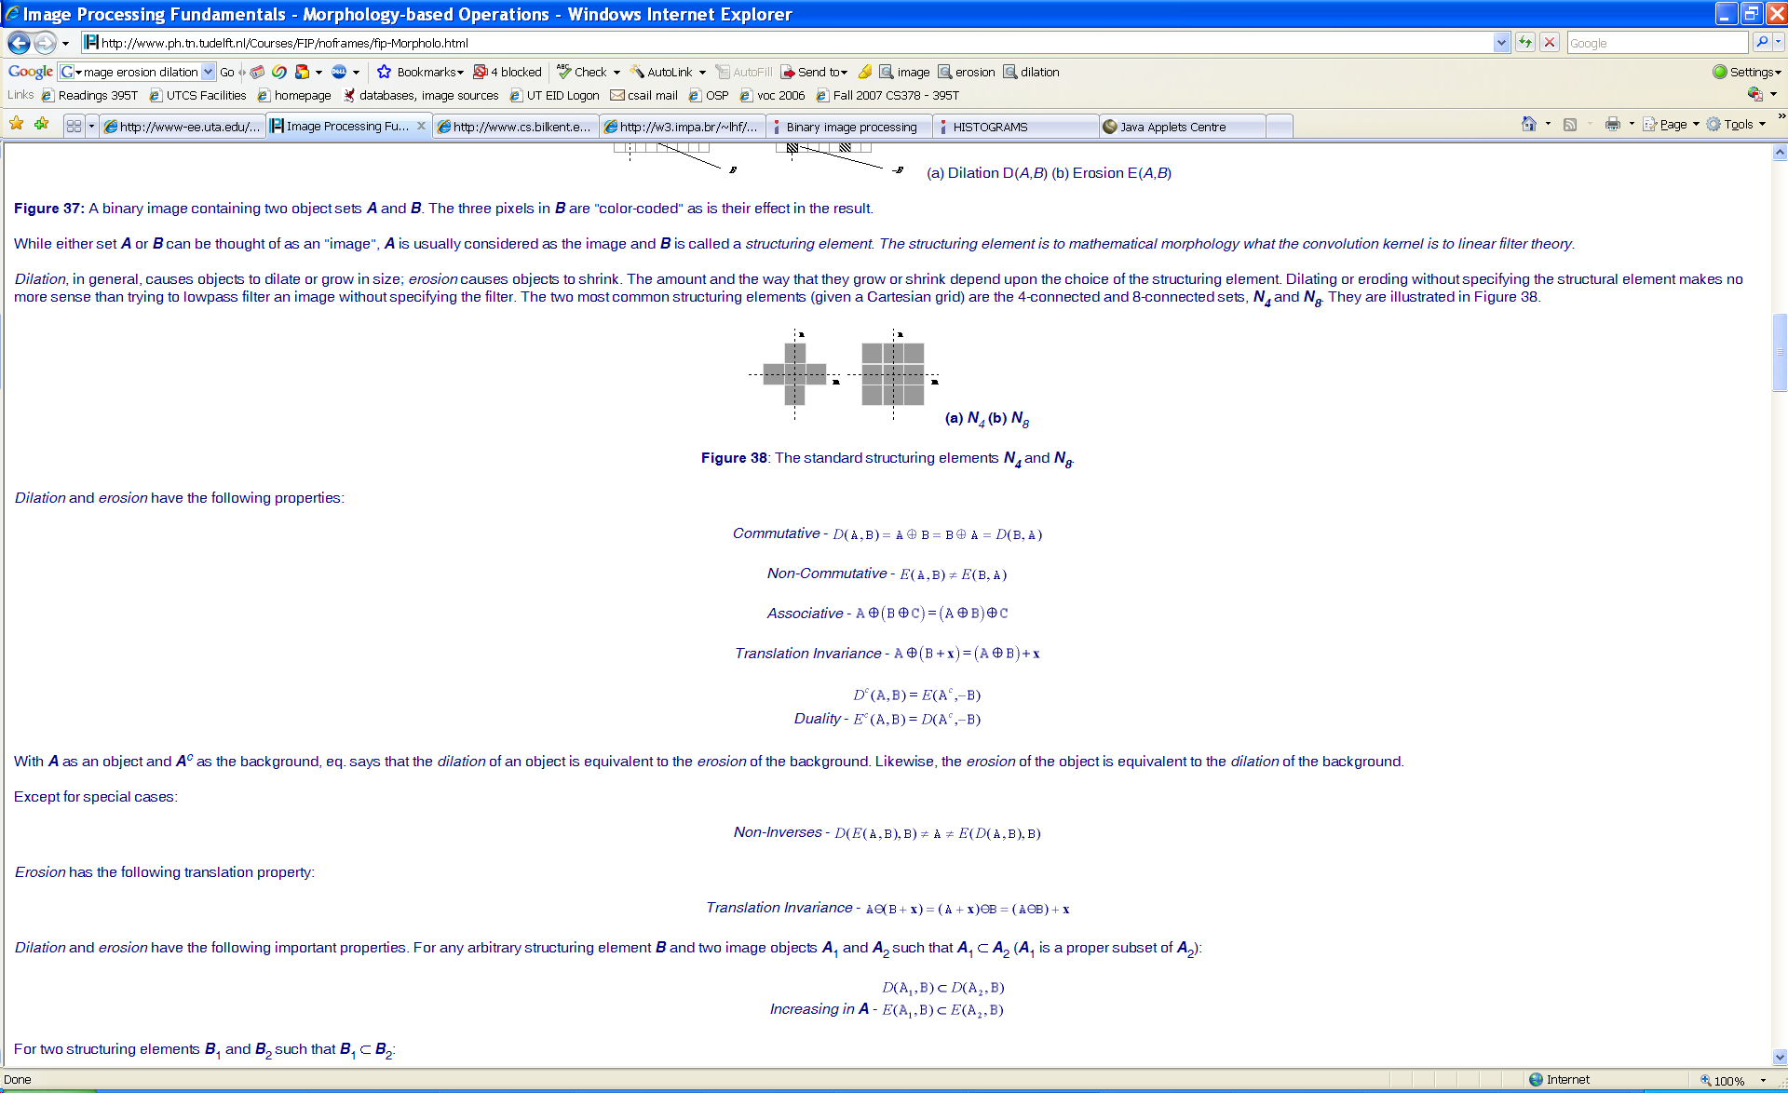
Structuring elements
Masks of varying shapes and sizes used to perform morphology, for example:
Scan mask across foreground pixels to transform the binary image
>> help strel
Kristen Grauman, UT-Austin

Slide 57
Dilation vs. Erosion
At each position:
Dilation: if current pixel is foreground, OR the structuring element with the input image.

Slide 58
Example for Dilation (1D)
Input image
1 | 0 | 0 | 0 | 1 | 1 | 1 | 0 | 1 | 1
1
1
1
Structuring Element
Output Image
1 | 1
Adapted from T. Moeslund

Slide 59
Example for Dilation
Input image
1 | 0 | 0 | 0 | 1 | 1 | 1 | 0 | 1 | 1
Structuring Element
1
1
1
Output Image
1 | 1

Slide 60
Example for Dilation
Input image
1 | 0 | 0 | 0 | 1 | 1 | 1 | 0 | 1 | 1
Structuring Element
1
1
1
Output Image
1 | 1 | 0

Slide 61
Example for Dilation
Input image
1 | 0 | 0 | 0 | 1 | 1 | 1 | 0 | 1 | 1
Structuring Element
1
1
1
Output Image
1 | 1 | 0 | 0

Slide 62
Example for Dilation
Input image
1 | 0 | 0 | 0 | 1 | 1 | 1 | 0 | 1 | 1
Structuring Element
1
1
1
Output Image
1 | 1 | 0 | 1 | 1 | 1

Slide 63
Example for Dilation
Input image
1 | 0 | 0 | 0 | 1 | 1 | 1 | 0 | 1 | 1
Structuring Element
1
1
1
Output Image
1 | 1 | 0 | 1 | 1 | 1 | 1

Slide 64
Example for Dilation
Input image
1 | 0 | 0 | 0 | 1 | 1 | 1 | 0 | 1 | 1
Structuring Element
1
1
1
Output Image
1 | 1 | 0 | 1 | 1 | 1 | 1 | 1

Slide 65
Example for Dilation
Input image
1 | 0 | 0 | 0 | 1 | 1 | 1 | 0 | 1 | 1
Structuring Element
1
1
1
Output Image
1 | 1 | 0 | 1 | 1 | 1 | 1 | 1

Slide 66
Example for Dilation
Input image
1 | 0 | 0 | 0 | 1 | 1 | 1 | 0 | 1 | 1
Structuring Element
1
1
1
Output Image
1 | 1 | 0 | 1 | 1 | 1 | 1 | 1 | 1 | 1
Note that the object gets bigger and holes are filled.
>> help imdilate

Slide 67
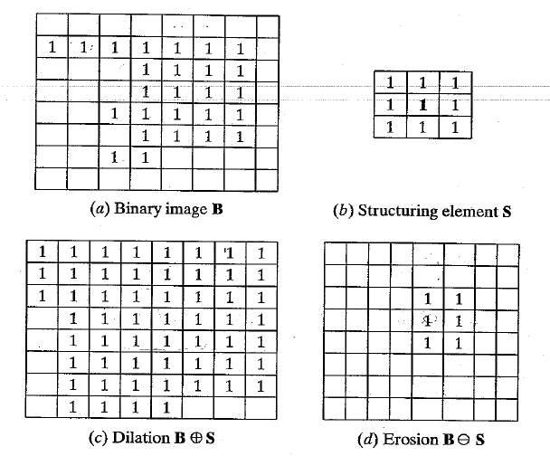
2D example for dilation
Shapiro & Stockman

Slide 68
Dilation vs. Erosion
At each position:
Dilation: if current pixel is foreground, OR the structuring element with the input image.
Erosion: if every pixel under the structuring element’s nonzero entries is foreground, OR the current pixel with S.

Slide 69
Example for Erosion (1D)
Input image
1 | 0 | 0 | 0 | 1 | 1 | 1 | 0 | 1 | 1
1
1
1
Structuring Element
_
Output Image
0

Slide 70
Example for Erosion (1D)
Input image
1 | 0 | 0 | 0 | 1 | 1 | 1 | 0 | 1 | 1
1
1
1
Structuring Element
_
Output Image
0 | 0

Slide 71
Example for Erosion
Input image
1 | 0 | 0 | 0 | 1 | 1 | 1 | 0 | 1 | 1
Structuring Element
1
1
1
Output Image
0 | 0 | 0

Slide 72
Example for Erosion
Input image
1 | 0 | 0 | 0 | 1 | 1 | 1 | 0 | 1 | 1
Structuring Element
1
1
1
Output Image
0 | 0 | 0 | 0

Slide 73
Example for Erosion
Input image
1 | 0 | 0 | 0 | 1 | 1 | 1 | 0 | 1 | 1
Structuring Element
1
1
1
Output Image
0 | 0 | 0 | 0 | 0

Slide 74
Example for Erosion
Input image
1 | 0 | 0 | 0 | 1 | 1 | 1 | 0 | 1 | 1
Structuring Element
1
1
1
Output Image
0 | 0 | 0 | 0 | 0 | 1

Slide 75
Example for Erosion
Input image
1 | 0 | 0 | 0 | 1 | 1 | 1 | 0 | 1 | 1
Structuring Element
1
1
1
Output Image
0 | 0 | 0 | 0 | 0 | 1 | 0

Slide 76
Example for Erosion
Input image
1 | 0 | 0 | 0 | 1 | 1 | 1 | 0 | 1 | 1
Structuring Element
1
1
1
Output Image
0 | 0 | 0 | 0 | 0 | 1 | 0 | 0

Slide 77
Example for Erosion
Input image
1 | 0 | 0 | 0 | 1 | 1 | 1 | 0 | 1 | 1
Structuring Element
1
1
1
Output Image
0 | 0 | 0 | 0 | 0 | 1 | 0 | 0 | 0

Slide 78
Example for Erosion
Input image
1 | 0 | 0 | 0 | 1 | 1 | 1 | 0 | 1 | 1
Structuring Element
1
1
1
Output Image
0 | 0 | 0 | 0 | 0 | 1 | 0 | 0 | 0 | 1
Note that the object gets smaller
>> help imerode

Slide 79
2D example for erosion
Shapiro & Stockman

Slide 80
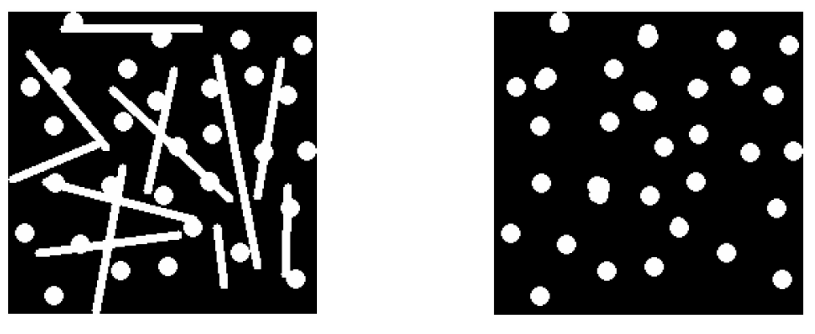
Opening
Erode, then dilate
Remove small objects, keep original shape
Before opening
After opening

Slide 81
Closing
Dilate, then erode
Fill holes, but keep original shape
Before closing
After closing
Applet: http://bigwww.epfl.ch/demo/jmorpho/start.php

Slide 82



Morphology operators on grayscale images
Dilation and erosion typically performed on binary images.
If image is grayscale: for dilation take the neighborhood max, for erosion take the min.
original
dilated
eroded
Kristen Grauman, UT-Austin

Slide 83
Issues
What to do with “noisy” binary outputs?
  Holes
  Extra small fragments
How to demarcate multiple regions of interest?
  Count objects
  Compute further features per object
Kristen Grauman, UT-Austin

Slide 84
Connected components
Various algorithms to compute
  Recursive (in memory)
  Two rows at a time (image not necessarily in memory)
  Parallel propagation strategy

Slide 85
Recursive connected components
Find an unlabeled pixel, assign it a new label
Search to find its neighbors, and recursively repeat to find their neighbors til there are no more
Repeat
Demo http://www.cosc.canterbury.ac.nz/mukundan/covn/Label.html

Slide 86

Connected components
Identify distinct regions of “connected pixels”
Shapiro and Stockman

Slide 87

Connectedness
Defining which pixels are considered neighbors
4-connected
8-connected
Source: Chaitanya Chandra

Slide 88

Connected components
We’ll consider a sequential algorithm that requires only 2 passes over the image.
Input: binary image
Output: “label” image, where pixels are numbered per their component
Note: foreground here is denoted with black pixels.

Slide 89

Sequential connected components
Adapted from J. Neira

Slide 90
Sequential connected components

Slide 91
Sequential connected components

Slide 92
Sequential connected components

Slide 93

Connected components
Slide credit: Pinar Duygulu

Slide 94
Region properties
Given connected components, can compute simple features per blob, such as:
  Area (num pixels in the region)
  Centroid (average x and y position of pixels in the region)
  Bounding box (min and max coordinates)
  Circularity (ratio of mean dist. to centroid over std)
A2=170
A1=200
Kristen Grauman, UT-Austin

Slide 95

Circularity
[Haralick]
Shapiro & Stockman

Slide 96
Binary image analysis: basic steps (recap)
Convert the image into binary form
  Thresholding
Clean up the thresholded image
  Morphological operators
Extract separate blobs
  Connected components
Describe the blobs with region properties

Slide 97
Matlab
N = hist(Y,M)
L = bwlabel (BW,N);
STATS = regionprops(L,PROPERTIES) ;
  'Area'
  'Centroid'
  'BoundingBox'
  'Orientation‘, …
IM2 = imerode(IM,SE);
IM2 = imdilate(IM,SE);
IM2 = imclose(IM, SE);
IM2 = imopen(IM, SE);

Slide 98

Example using binary image analysis: OCR
[Luis von Ahn et al. http://recaptcha.net/learnmore.html]

Slide 99

Example using binary image analysis: segmentation of a liver
Slide credit: Li Shen

Slide 100






Example using binary image analysis:
Bg subtraction + blob detection
…

Slide 101

Example using binary image analysis:
Bg subtraction + blob detection
University of Southern California
http://iris.usc.edu/~icohen/projects/vace/detection.htm

Slide 102
Binary images
Pros
  Can be fast to compute, easy to store
  Simple processing techniques available
  Lead to some useful compact shape descriptors
Cons
  Hard to get “clean” silhouettes
  Noise common in realistic scenarios
  Can be too coarse of a representation
  Not 3d
Kristen Grauman, UT-Austin

Slide 103
Summary
Operations, tools
Features, representations
Derivative filters
Smoothing, morphology
Thresholding
Connected components
Matched filters
Histograms
Edges, gradients
Blobs/regions
Local patterns
Textures (next)
Color distributions

Slide 104

Next
Texture: read 10.5
Pset 1 out tonight, due in 2 weeks

