Slide 1
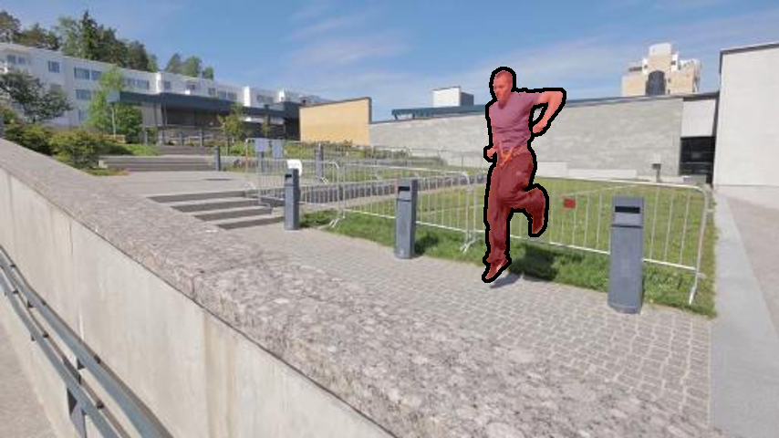
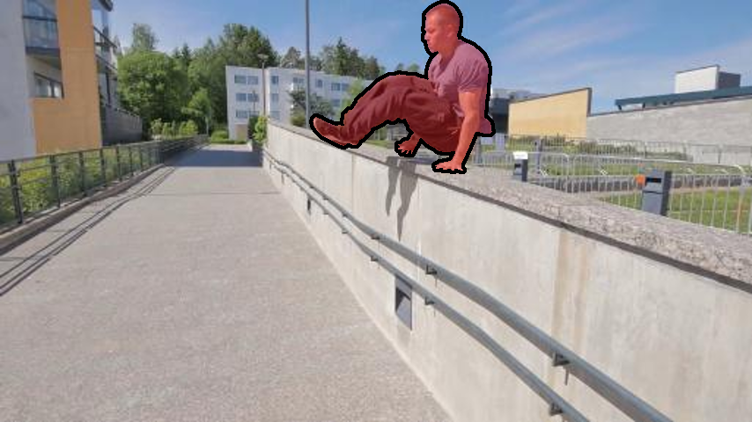
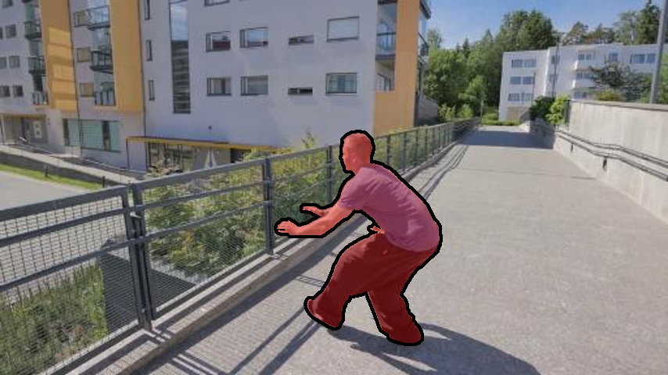
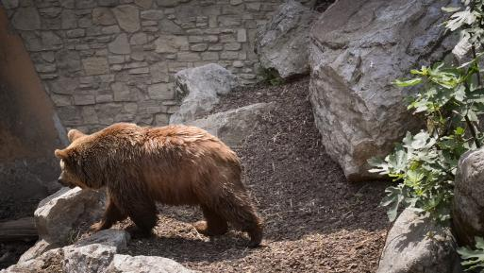
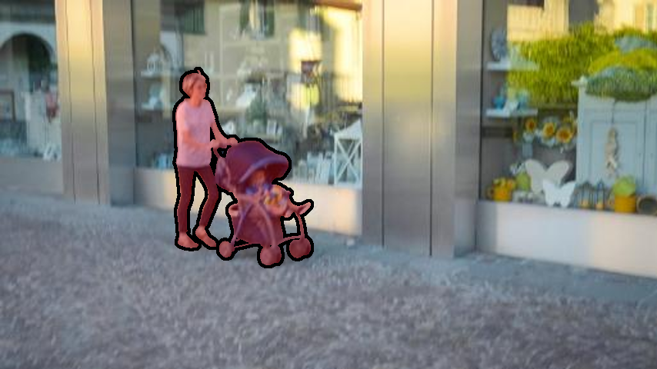
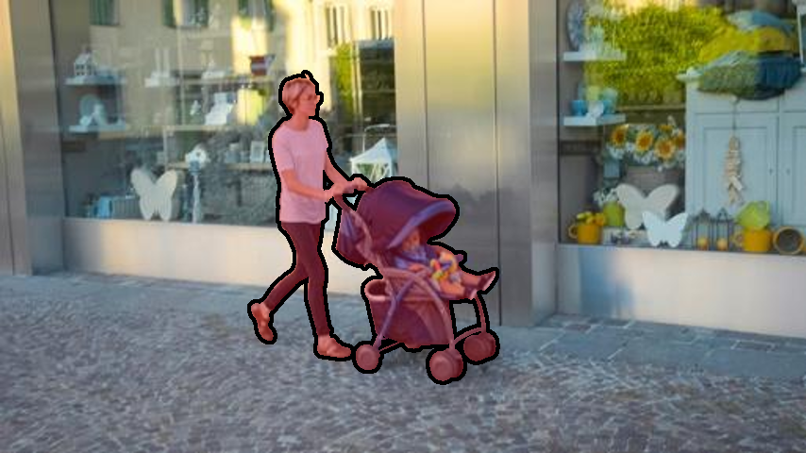
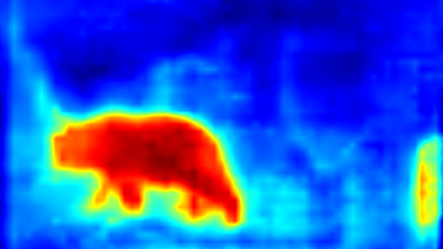
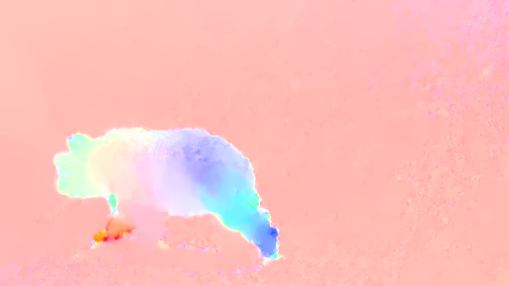
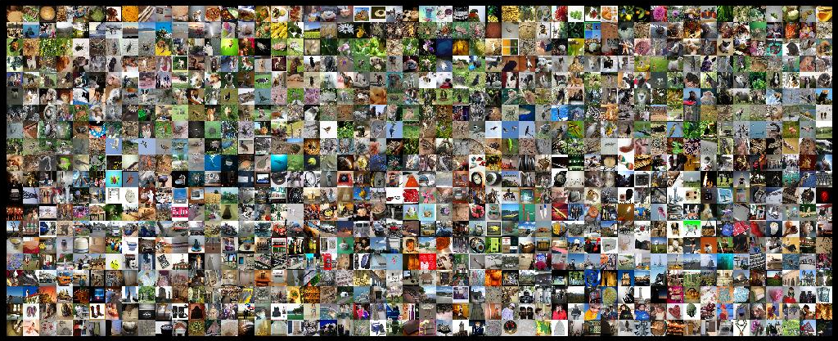
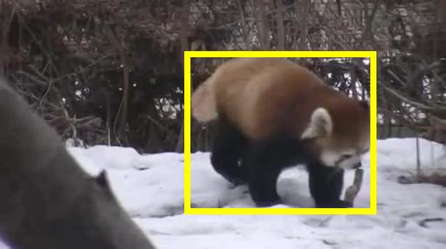
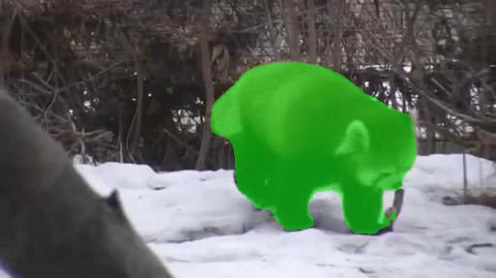
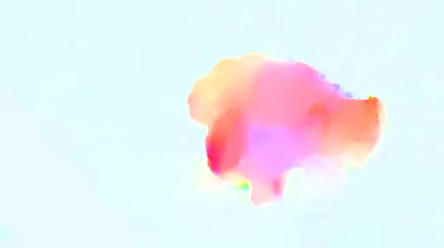
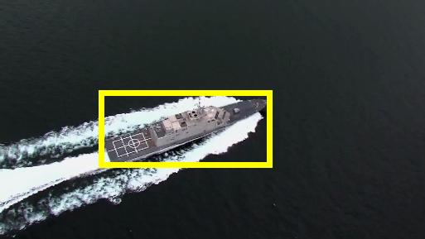
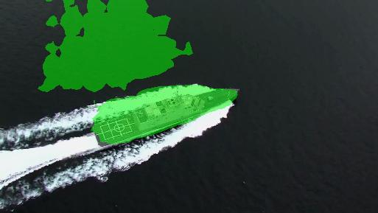
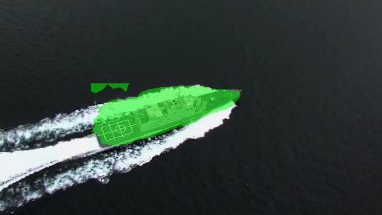
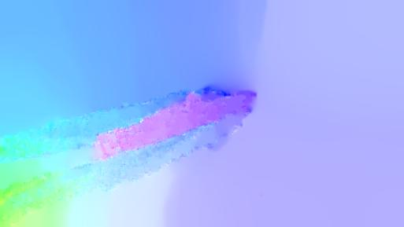
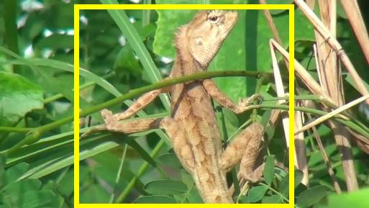
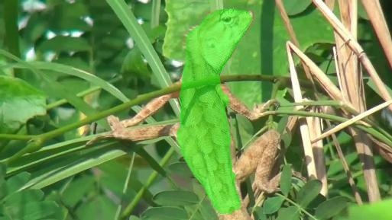
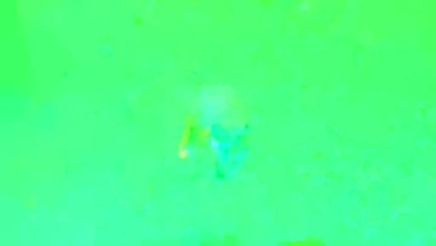
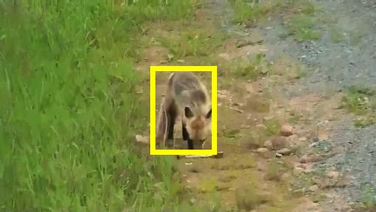
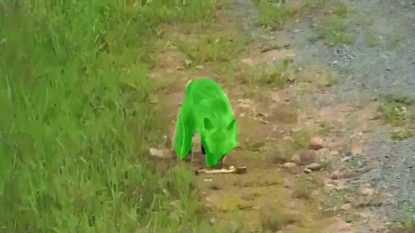
FusionSeg: Learning to Combine Motion and Appearance for Fully Automatic Segmentation of Generic Objects in Videos
Suyog Dutt Jain*, Bo Xiong*, Kristen Grauman
http://vision.cs.utexas.edu/projects/fusionseg/
Introduction
Challenges
Our Solution
Appearance Stream - Generalization
Goal: Automatically segment foreground objects in videos.
Representation: Identifying complex patterns in appearance and motion which indicate objectness.
Generalization: Segmenting foreground objects from large number of object categories (1000s), many unseen.
Lack of data: End-to-end learning without having access to large-scale pixel-level video object annotations.
Two-stream fully-convolutional deep segmentation network
Individual streams encode generic appearance and motion cues. The fusion module learns to combine them in a unified manner.
RGB frame
Appearance Stream
Optical Flow
Motion Stream
Fusion Module
End-to-end framework which learns to combine appearance and motion for segmenting generic objects in videos.
Requires no human input at test time, produces a single hypothesis, and is trained to segment all prominent objects.
State-of-the-art performance for segmenting generic foreground objects using appearance.
Appearance Stream
Motion Stream
Results
Implicit image-level category annotations
Explicit boundary level annotations
Video frames with bounding boxes
Apply appearance stream
Prune segmentation with box
Bounding box overlap test for quality
Optical flow test for motion
Training data for motion stream
Appearance model
+
Motion model
Generalization
Object Boundaries
Pass
Pass
Joint model
Feature map visualization
Pass
Pass
Fail
Optical Flow
Classification Network
Segmentation Network
Classification Network
Segmentation Network
Pass
Fail
Our appearance stream generalizes to segment foreground objects from thousands of object categories.
Independently training motion stream without any appearance signal ensures that it learns to segment objects using motion alone.
Ours vs. Automatic
Ours vs. Semi-supervised
(no human involvement for new videos)
(baselines need human-in-the-loop for new videos)
Network Architecture
Conv 3×3,2
Dilation: 6
RGB frame
Appearance Stream
Conv 3×3,2
Dilation: 12
Fusion Module
Conv
7×7,64
Stride: 2
Max Pool
3×3
Stride: 2
Conv
1×1,64
3×3,64
1×1,256
Conv
1×1,128
3×3,128
1×1,512
Conv
1×1,256
3×3,256
1×1,1024
Dilation: 2
Conv
1×1,512
3×3,512
1×1,2048
Dilation: 4
Sum
Conv 1×1,2
RELU
Conv 3×3,2
Dilation: 18
×3
×4
×23
×3
Conv 3×3,2
Dilation: 24
Conv 1×1,2
RELU
FST
FCP
Conv 3×3,2
Dilation: 6
Conv 1×1,2
RELU
MAX
Optical Flow image
Motion Stream
Conv 3×3,2
Dilation: 12
NLC
BVS
Conv
7×7,64
Stride: 2
Max Pool
3×3
Stride: 2
Conv
1×1,64
3×3,64
1×1,256
Conv
1×1,128
3×3,128
1×1,512
Conv
1×1,256
3×3,256
1×1,1024
Dilation: 2
Conv
1×1,512
3×3,512
1×1,2048
Dilation: 4
Sum
Conv 1×1,2
RELU
Conv 3×3,2
Dilation: 18
Ours
Ours
×3
×4
×23
×3
Conv 3×3,2
Dilation: 24
Element-wise multiplication
Learning to combine motion and appearance together results in state-of-the-art fully automatic object segmentation in videos.

