Slide 1


Learning about fashion from web photos
Kristen Grauman
Facebook AI Research
University of Texas at Austin

Slide 2
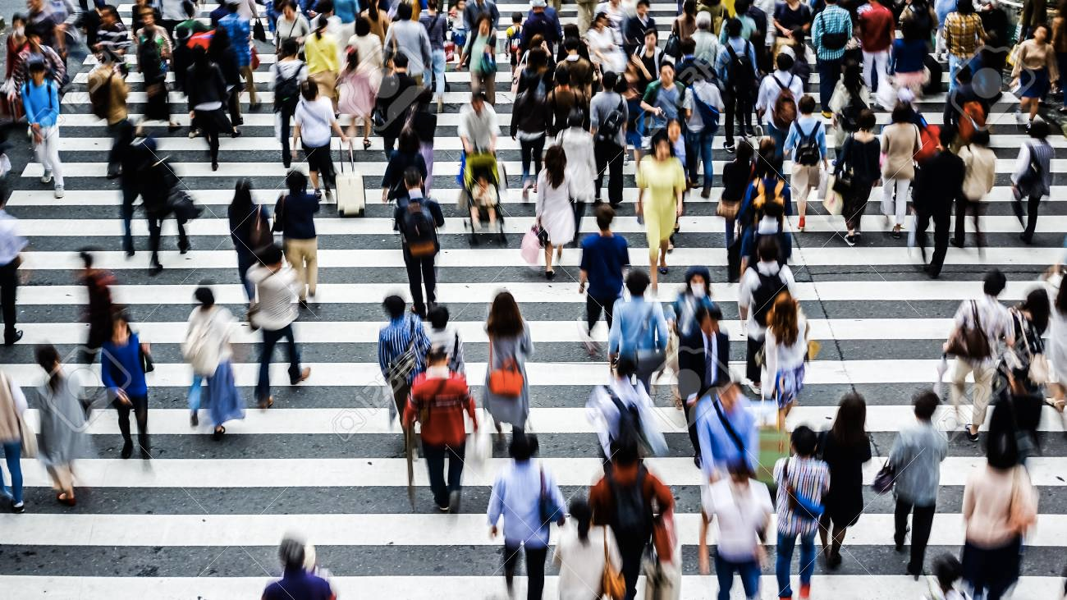
Fashion: what people wear
Kristen Grauman, FAIR & UT Austin

Slide 3
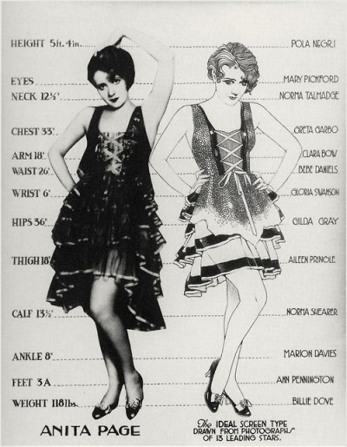
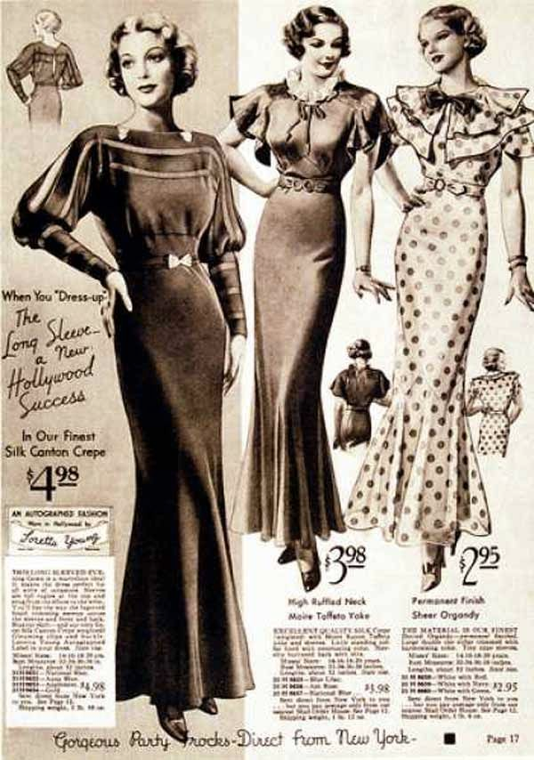
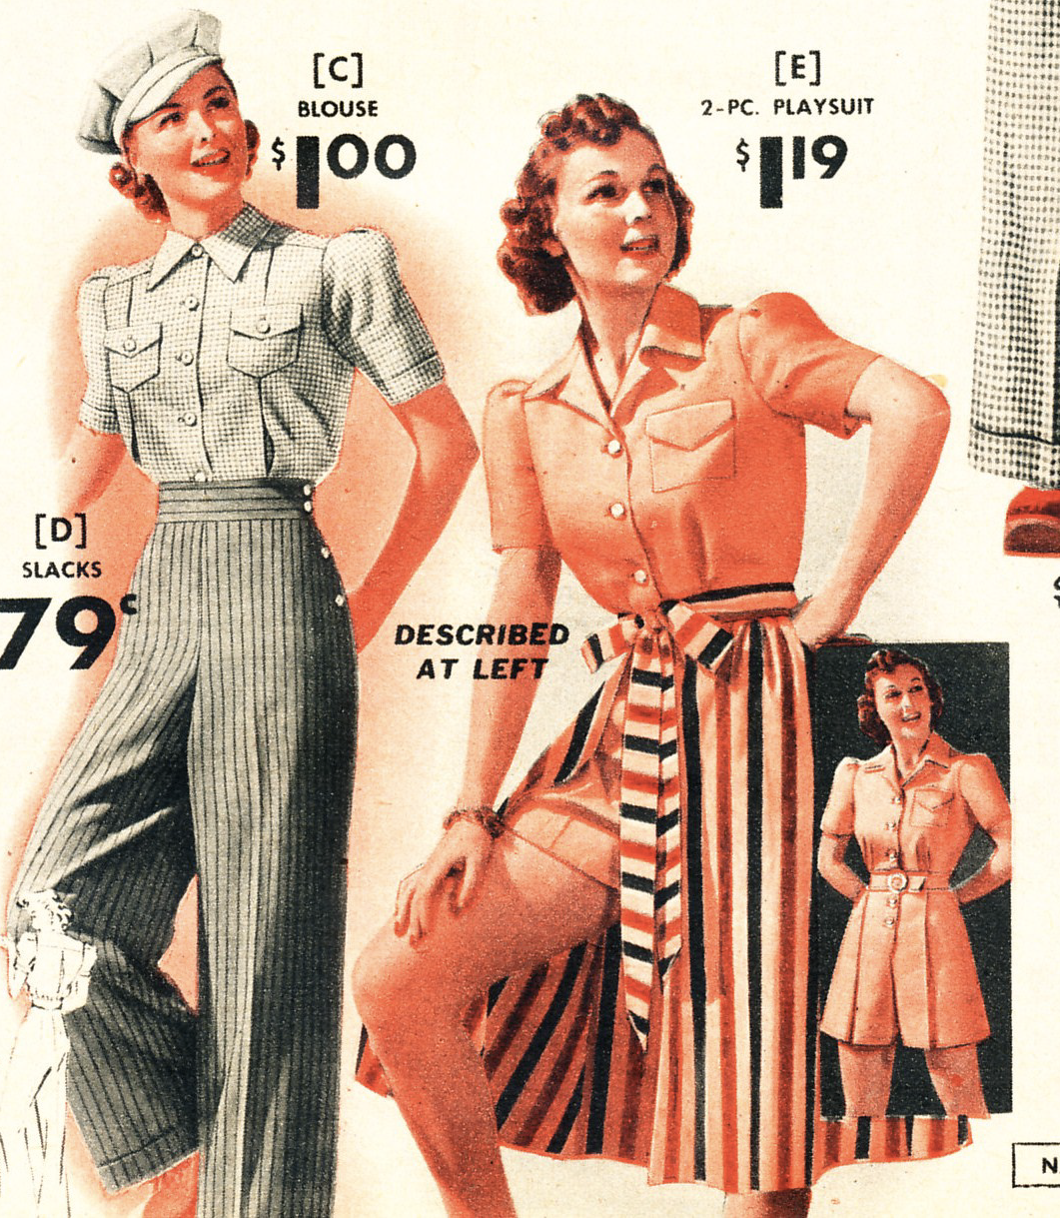
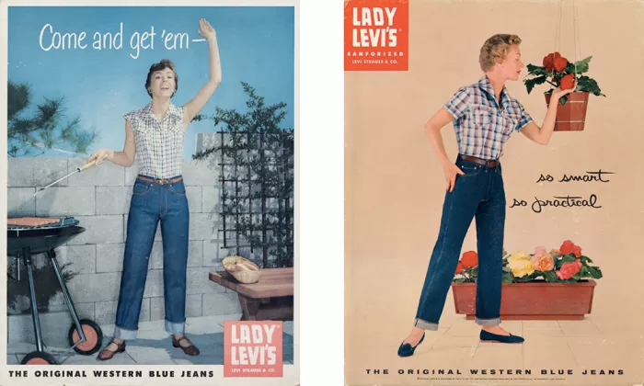
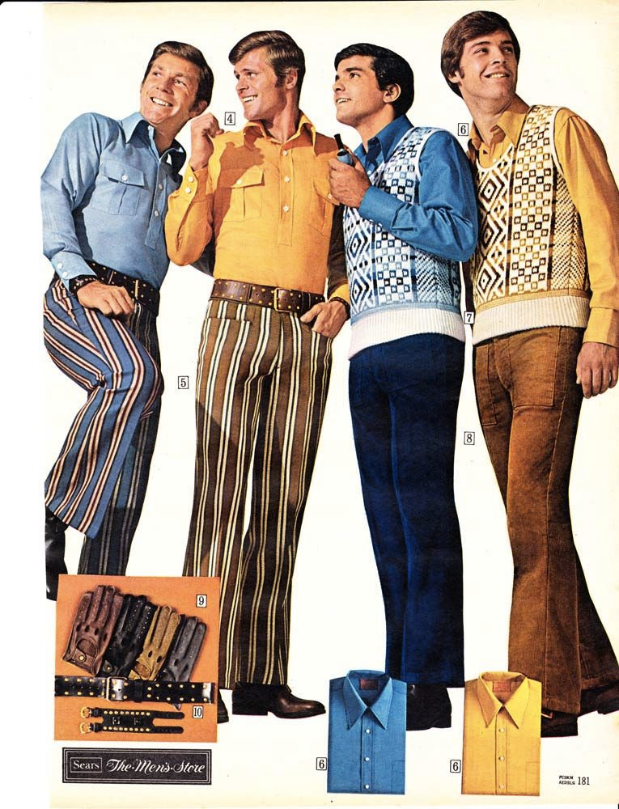
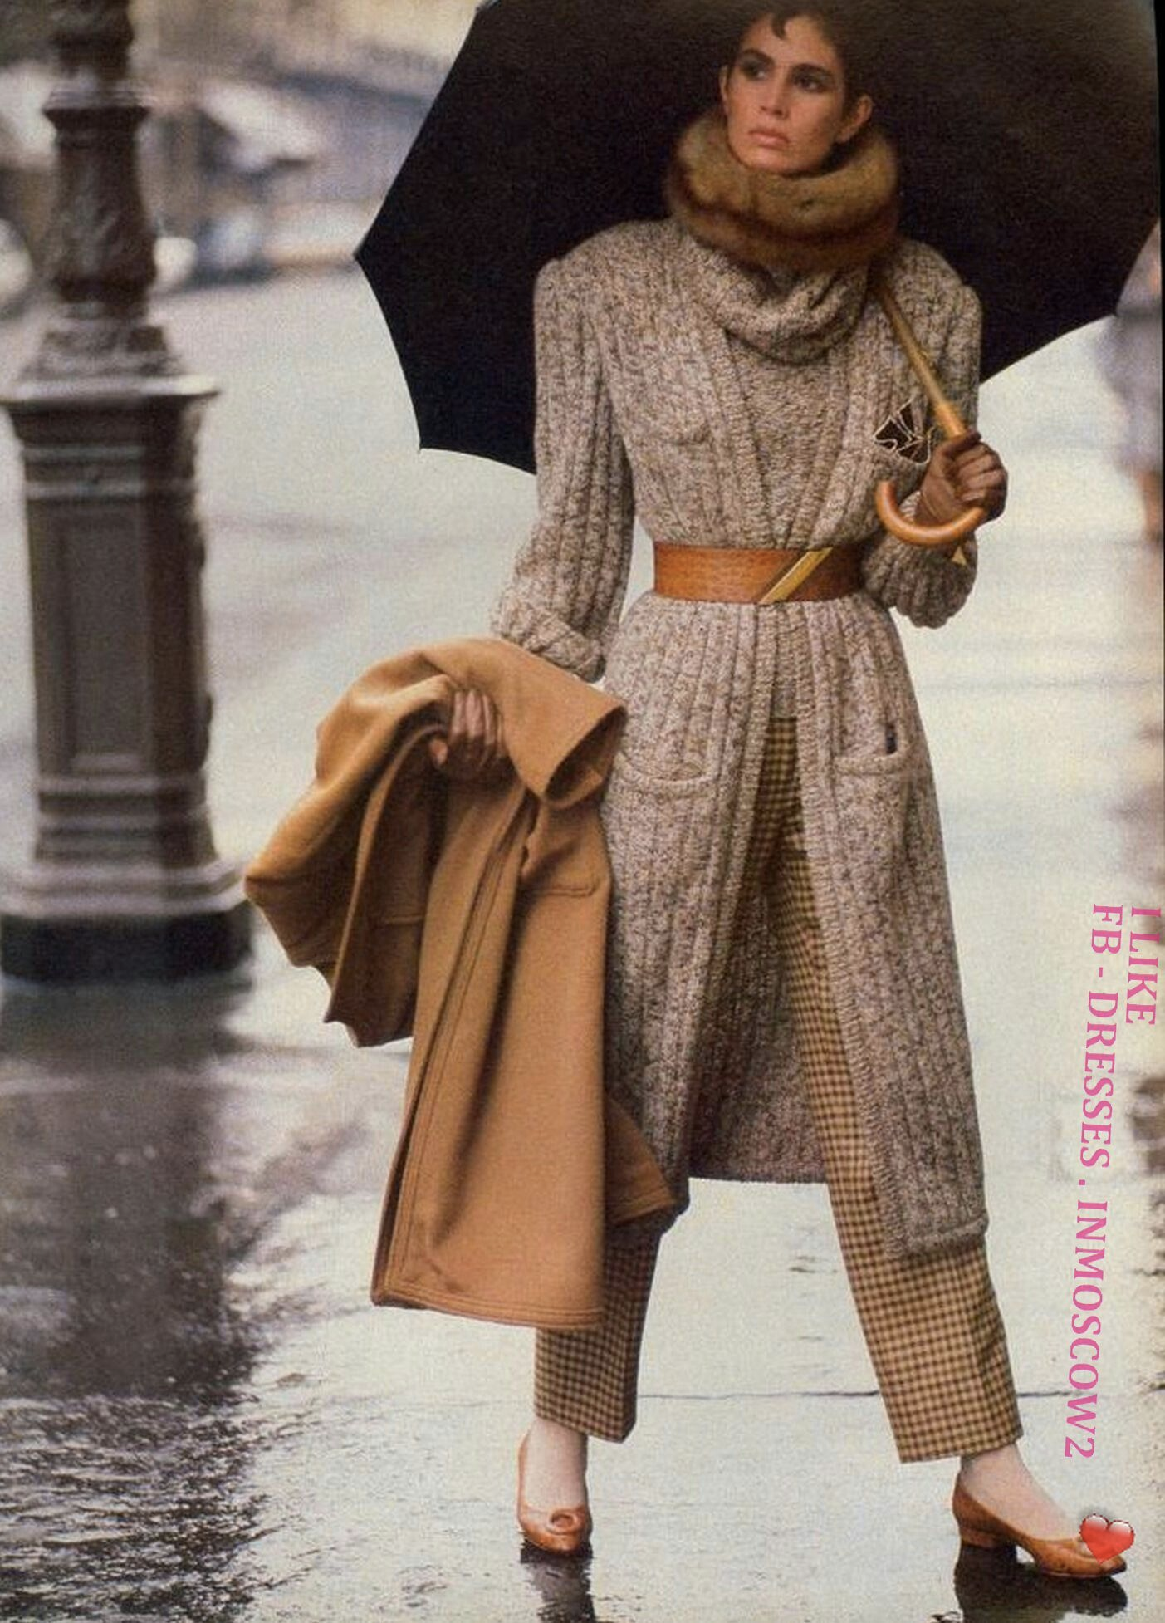
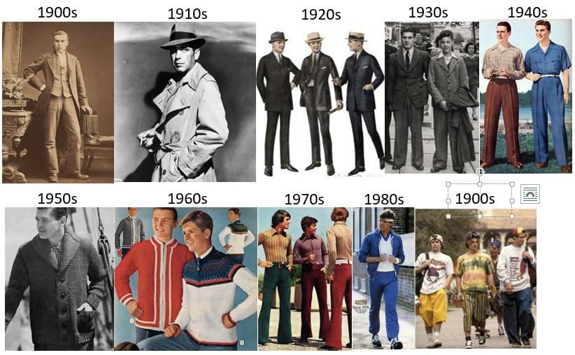
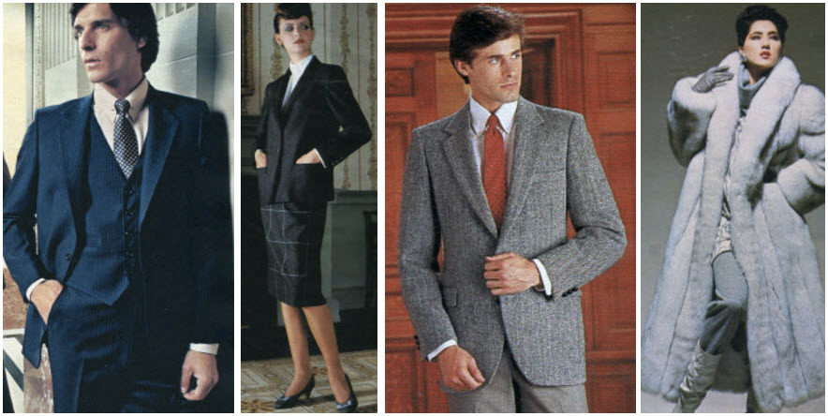
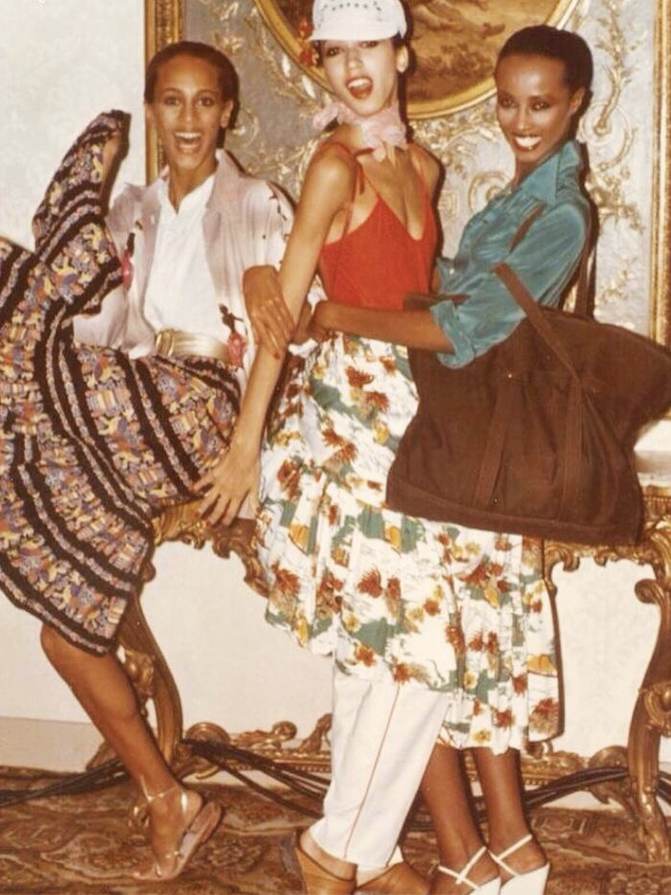
Fashion and culture
Postwar simplicity
Manufacturing fabrics
WWII austerity
Anti-war
Women in the workplace
Feminism
1920
1930
1940
1950
1970
1980
Kristen Grauman, FAIR & UT Austin

Slide 4
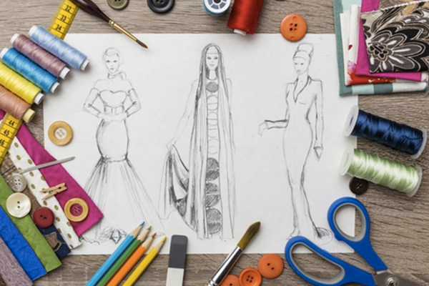






Vision + fashion: influence
Design & creativity
Business
How we shop
Kristen Grauman, FAIR & UT Austin

Slide 5
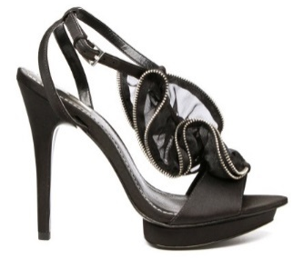
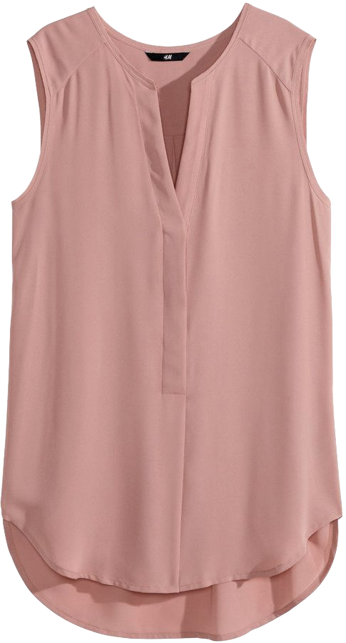
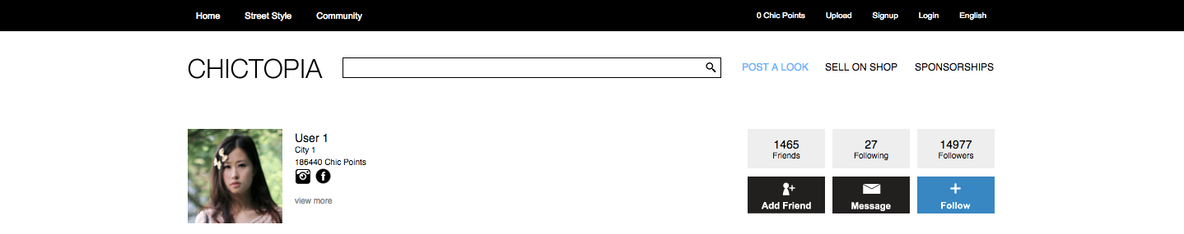
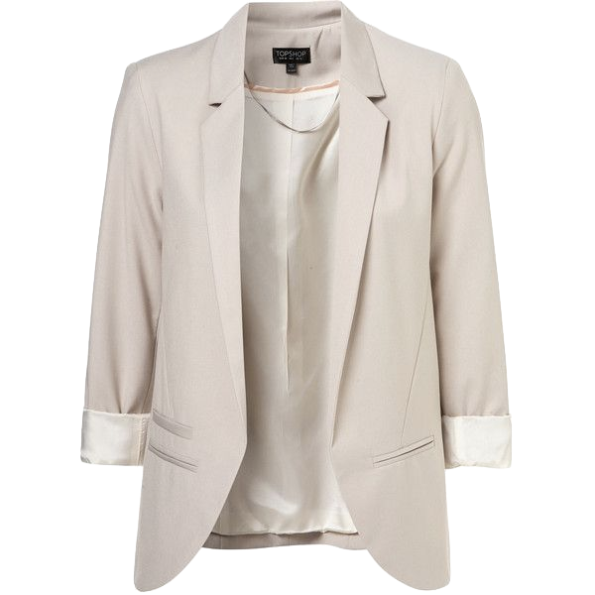
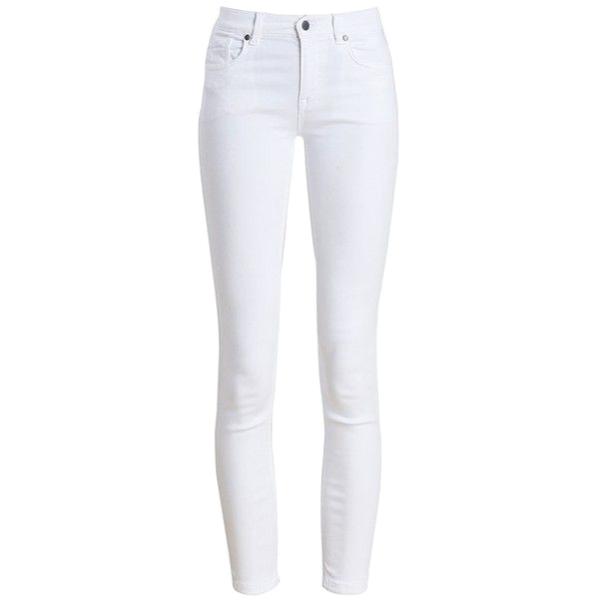
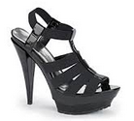
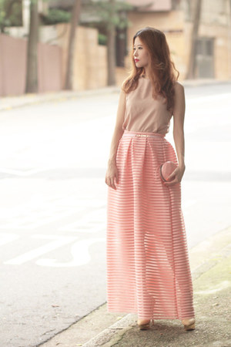
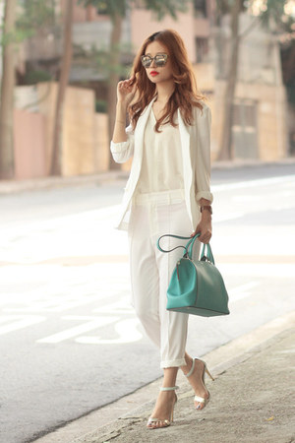
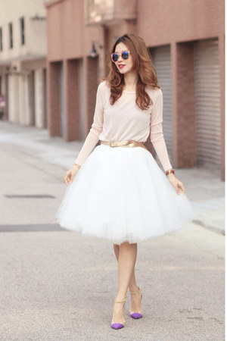
Vision + fashion: problems
Fashion introduces new challenges for high-level vision:
Subtle distinctions
Composition and compatibility
Personalization and taste
Requires computational models for style
Kristen Grauman, FAIR & UT Austin

Slide 6
This talk: fashion & web photos
Assembling fashionable outfits
  What goes with what?
  How to compose a wardrobe?
  How could this outfit look better?
Learning subtle attributes
  How to distinguish slight differences?
Kristen Grauman, FAIR & UT Austin

Slide 7
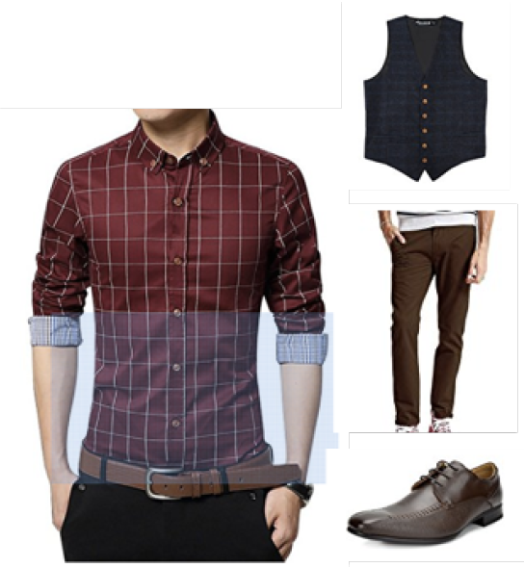
How to learn visual compatibility?
Manual curation
[Li 2017, Song 2017, Han 2017]
Our goal:
Unlabeled in the wild photos
Co-purchase data
[McAuley 2015, Veit 2015, He 2016]
Supervised
Kristen Grauman, FAIR & UT Austin

Slide 8
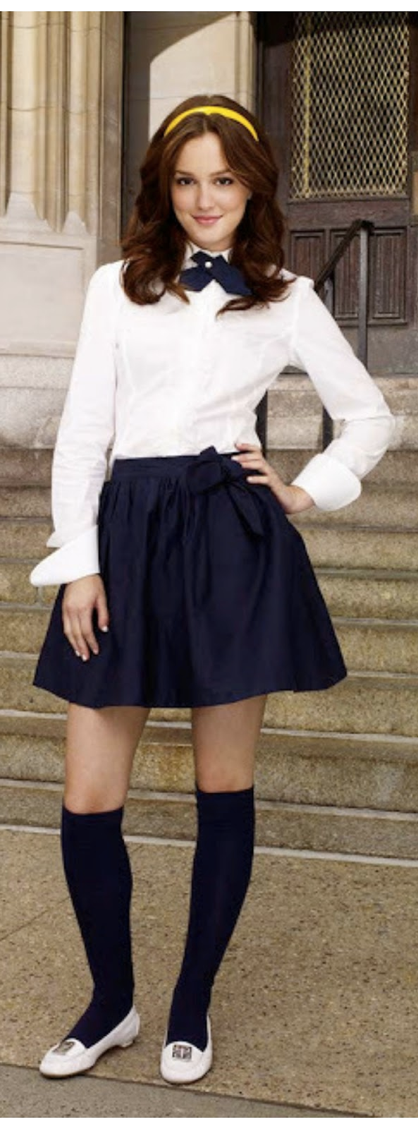
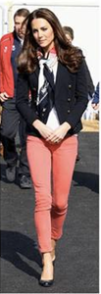
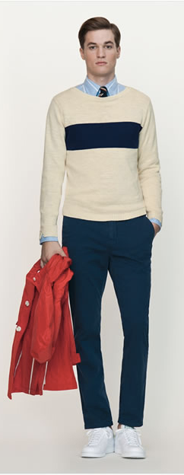
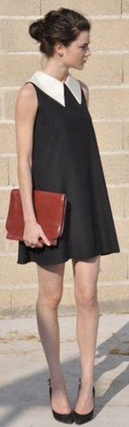
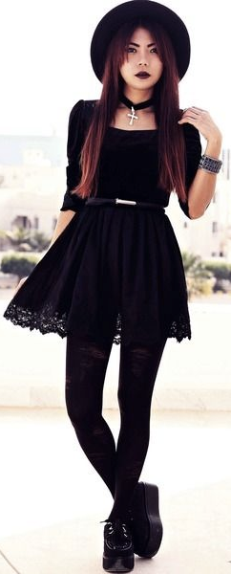
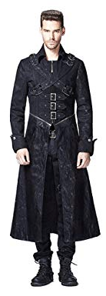
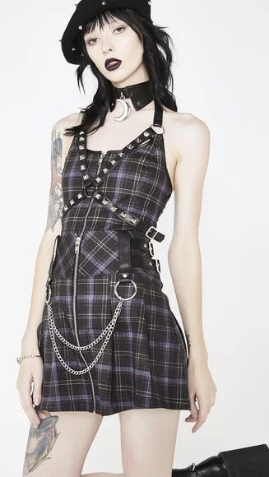
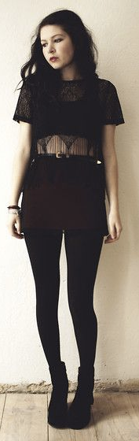
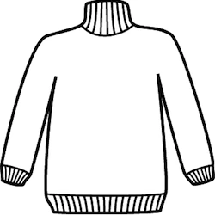

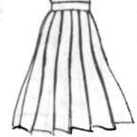



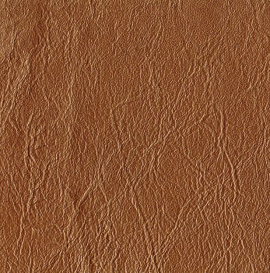
Attributes as style elements
Style: underlying compositions of elements.
Kristen Grauman, FAIR & UT Austin

Slide 9
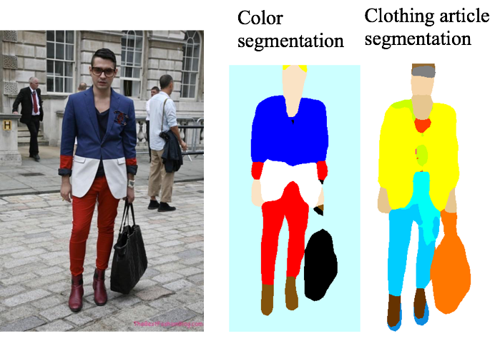
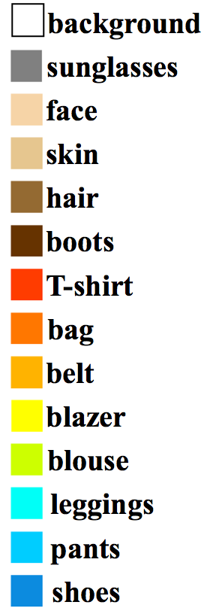
Attributes as style elements
blazer-color-blue
pants-color-red
Material, cut, pattern
  Fine-tune classification on ResNet50
Color, clothing article:
  Segmentation on DeepLab-DenseCRF
Kristen Grauman, FAIR & UT Austin

Slide 10
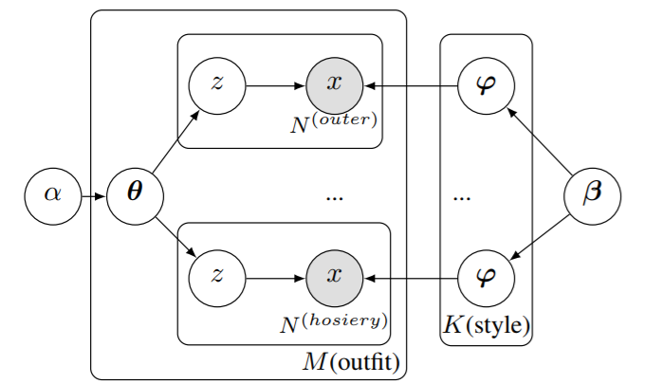
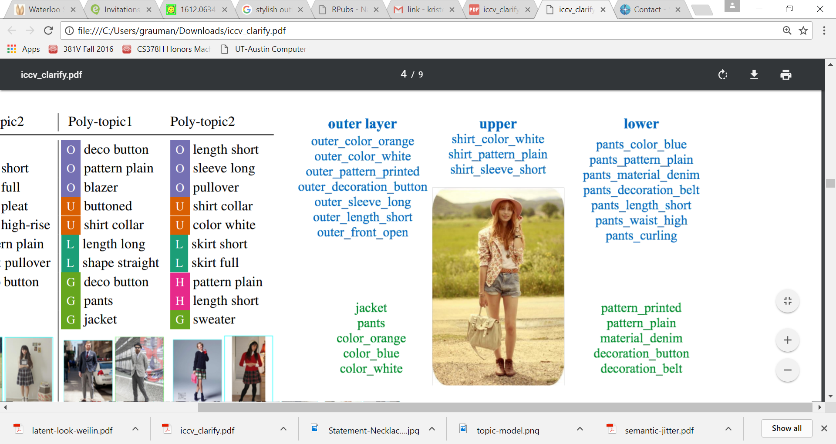
Learning styles from web photos
Unsupervised learning of a “visual style topics” with a polylingual topic model
...
An outfit is a mixture of (latent) styles.
A style is a distribution over attributes.
Mimno et al. "Polylingual topic models." EMNLP 2009.
Hsiao & Grauman, ICCV 2017

Slide 11
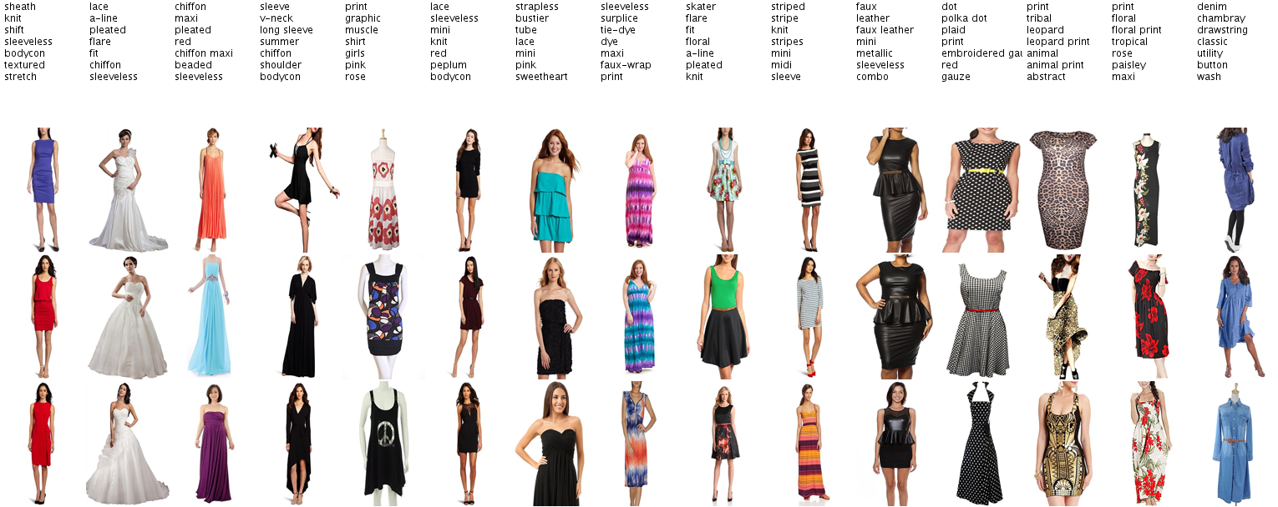
Styles we automatically discover in the Amazon dataset [McAuley et al. 2015]
Example discovered styles (dresses)

Slide 12
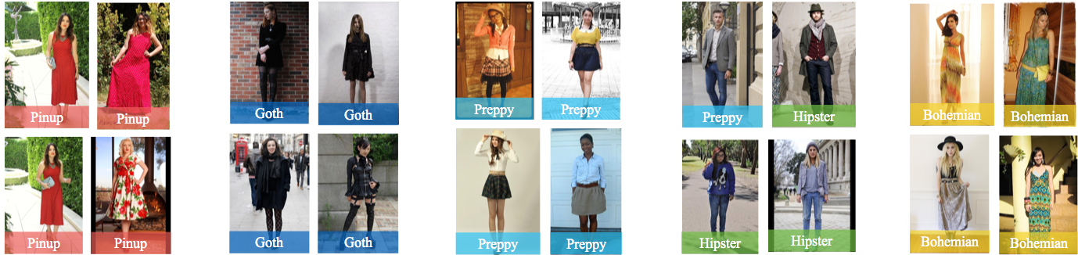
Styles we automatically discover in the HipsterWars dataset [Kiapour et al]
Example discovered styles (full outfit)

Slide 13
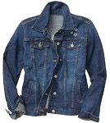
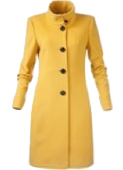

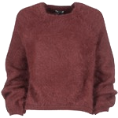
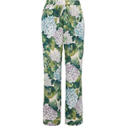
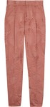
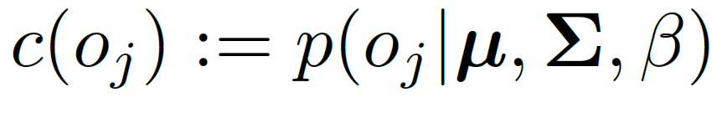
Visual compatibility
Calculate compatibility of garments via likelihood under topic model
An outfit is a mixture of (latent) styles.
A style is a distribution over attributes.
Kristen Grauman, FAIR & UT Austin
Hsiao & Grauman, CVPR 2018

Slide 14
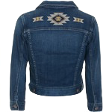
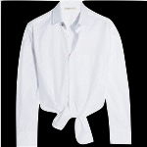
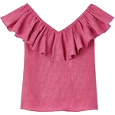
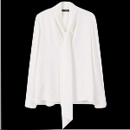
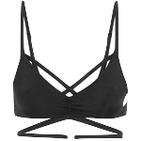
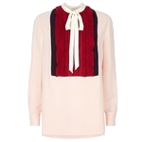






















Visual compatibility results
Most compatible
Kristen Grauman, FAIR & UT Austin

Slide 15






























Visual compatibility results
Least compatible
Kristen Grauman, FAIR & UT Austin

Slide 16

Visual compatibility results
BiLSTM ^{[Han et al. 17]}: unsupervised sequential model trained on Polyvore sets.
Monomer ^{[He et al. 16]}: supervised embedding trained on Amazon products co-purchase info.
Encouraging results for learning compatibility from unlabeled, full-body Web images
Kristen Grauman, FAIR & UT Austin
Hsiao & Grauman, CVPR 2018

Slide 17






Creating a “capsule” wardrobe
Goal: Select minimal set of pieces that mix and match well to create many viable outfits
Capsule pieces
Outfit #1
Outfit #2
Outfit #3
Outfit #4
Outfit #5
Kristen Grauman, FAIR & UT Austin

Slide 18
Creating a “capsule” wardrobe
Pose as subset selection problem
set of garments = argmax compatibility + versatility
Capsule pieces
Outfit #1
Outfit #2
Outfit #3
Outfit #4
Outfit #5
Kristen Grauman, FAIR & UT Austin
Hsiao & Grauman, CVPR 2018

Slide 19








Capsule via subset selection
optimal set of composed outfits
Pose as subset selection problem
set of garments = argmax compatibility + versatility
increase outfit compatibility
cover all styles (or user’s styles)
Capsule pieces
A0T
Outfit #1
Outfit #2
A1T
…..
y
Outfit #3
Outfit #4
A2T
Kristen Grauman, FAIR & UT Austin

Slide 20



















Personalized capsule example
Discover user’s style preferences from album
Personalized capsule
Kristen Grauman, FAIR & UT Austin
Hsiao & Grauman, CVPR 2018

Slide 21























Personalized capsule example
Discover user’s style preferences from album
Personalized capsule
Kristen Grauman, FAIR & UT Austin
Hsiao & Grauman, CVPR 2018

Slide 22
This talk: fashion & web photos
Assembling fashionable outfits
  What goes with what?
  How to compose a wardrobe?
  How could this outfit look better?
Learning subtle attributes
  How to distinguish slight differences?
Kristen Grauman, FAIR & UT Austin

Slide 23








Idea: Minimal edits for outfit improvement
Kristen Grauman, FAIR & UT Austin
[Hsiao et al. Fashion++, arXiv 2019]

Slide 24



Fashion++
Kristen Grauman, FAIR & UT Austin
[Hsiao et al. Fashion++, arXiv 2019]

Slide 25


Fashion++
Try this top!
Kristen Grauman, FAIR & UT Austin
[Hsiao et al. Fashion++, arXiv 2019]

Slide 26





Our approach: Fashion++
Image generation pipeline factorizes shape and texture
u⁺⁺
x^{(q)}
t^{(q)}
t⁺⁺
Region-wise propagate
Et
x⁺⁺
Gt
F⁺⁺
m⁺⁺
m^{(q)}
s^{(q)}
s⁺⁺
Gs
Es
Edit via activation maximization with discriminative fashionability model
Kristen Grauman, FAIR & UT Austin
[Hsiao et al. Fashion++, arXiv 2019]

Slide 27

Learning discriminative fashionability model
positive
…
Represent an outfit as concatenation of its latent codes
Kristen Grauman, FAIR & UT Austin

Slide 28

Learning discriminative fashionability model
positive
negative
…
…
Bootstrap web photos for “negatives” to learn fashionability
Kristen Grauman, FAIR & UT Austin

Slide 29
Computing an outfit edit
c
F⁺⁺
z
P(y|z)
y
Fashionable
…
fc1
fc2
fc3
Unfashionable
Kristen Grauman, FAIR & UT Austin

Slide 30
Computing an outfit edit
c
F⁺⁺
z
P(y|z)
y
Fashionable
…
fc1
fc2
fc3
Unfashionable
  Propagate gradients to iteratively update the target feature (e.g., shape)
Kristen Grauman, FAIR & UT Austin

Slide 31










Fashion++ minimal edits
Visualization of changed garment in new presentation.
Swap to garment from inventory.
Kristen Grauman, FAIR & UT Austin
[Hsiao et al. Fashion++, arXiv 2019]

Slide 32









Fashion++ minimal edits
Blouse shirt out
Blouse shirt out
Change pants fit
Tuck shirt in
Blouse shirt out
Change pants fit
Change pants fit
Change pants length
Tuck shirt in
Change pants length
Tuck shirt in
Change pants length
Kristen Grauman, FAIR & UT Austin
[Hsiao et al. Fashion++, arXiv 2019]

Slide 33

Fashion++ minimal edits
Automatic evaluation
Human subject study
  Fashion++ balances best by improving fashionability while not changing too much.
Kristen Grauman, FAIR & UT Austin
[Hsiao et al. Fashion++, arXiv 2019]

Slide 34

This talk: fashion & web photos
Assembling fashionable outfits
  What goes with what?
  How to compose a wardrobe?
  How could this outfit look better?
Learning subtle attributes
  How to distinguish slight differences?
The limits of web photos!
Kristen Grauman, FAIR & UT Austin

Slide 35


Fine-grained attribute comparisons
Which is more sporty?
Which is more flirty?
vs.
vs.
Goal: Subtle visual comparisons
Challenge: Curating training image pairs
Kristen Grauman, FAIR & UT Austin

Slide 36

Web photos and the streetlight effect
Kristen Grauman, FAIR & UT Austin
https://www.google.com/url?sa=i&source=images&cd=&ved=2ahUKEwiJnt-Uh-3iAhVtRN8KHeXDBOoQjRx6BAgBEAU&url=https%3A%2F%2Ftheethicalskeptic.com%2Fstreetlight-effect%2F&psig=AOvVaw2gKVQbHScfqYTmqzsZXi4k&ust=1560741993159531

Slide 37


Idea: Semantic jitter
Overcome sparsity of available fine-grained image pairs with attribute-conditioned image generation
Images generated by Yan et al. 2016
Attribute2Image CVAE approach
Kristen Grauman, FAIR & UT Austin
Yu & Grauman, ICCV 2017

Slide 38













Idea: Semantic jitter
Overcome sparsity of available fine-grained image pairs with attribute-conditioned image generation
sporty
comfort
open
+
+
vs.
+
-
-
-
Status quo:
Low-level jitter
Our idea:
Semantic jitter
Kristen Grauman, FAIR & UT Austin
Yu & Grauman, ICCV 2017

Slide 39


















Semantic jitter for attribute learning
Train rankers with both real and synthetic image pairs, test on real fine-grained pairs.
Novel Pair
vs.
Faces, Shoes
Real Pairs
Synthetic Pairs
Attribute accuracy
Real
50% Real+synth
Ranking functions trained with deep spatial transformer ranking networks [Singh & Lee 2016] or Local RankSVM [Yu & Grauman 2014]
Yu & Grauman, ICCV 2017

Slide 40






Idea: Active training image creation
Actively generate best image pairs for human labeling
Current Ranker
Ideal Ranker
(open)
Real Image
Real Image (unlabeled)
Generated Image
Kristen Grauman, FAIR & UT Austin
Yu & Grauman, CVPR 2019

Slide 41

Ranking loss
Active training image creation
−Ranking loss
System “imagines” image pairs that would confuse current ranking model
Kristen Grauman, FAIR & UT Austin
Yu & Grauman, CVPR 2019

Slide 42






































Active training image creation
Real Pairs
Active Synthetic Pairs
Casual
Durable
Smiling
Actively curating synthetic training images → more accurate model
Kristen Grauman, FAIR & UT Austin

Slide 43


Summary
Kimberly Hsiao
Learning styles and fashionability from web photos
New ideas and methods for:
  Style and compatibility
  Capsule wardrobe creation
  Incremental outfit improvement
  Subtle visual comparisons
Aron Yu
Kristen Grauman
FAIR & UT Austin

Slide 44
Papers
Creating Capsule Wardrobes from Fashion Images. W-L. Hsiao and K. Grauman. In Proceedings of IEEE Conference on Computer Vision and Pattern Recognition (CVPR), Salt Lake City, June 2018.
Thinking Outside the Pool: Active Training Image Creation for Relative Attributes. A. Yu and K. Grauman. In Proceedings of the IEEE Conference on Computer Vision and Pattern Recognition (CVPR), Long Beach, CA, June 2019.
Semantic Jitter: Dense Supervision for Visual Comparisons via Synthetic Images. A. Yu and K. Grauman. In Proceedings of the International Conference on Computer Vision (ICCV), Venice, Italy, Oct 2017.
Learning the Latent "Look": Unsupervised Discovery of a Style-Coherent Embedding from Fashion Images. W-L. Hsiao and K. Grauman. In Proceedings of the International Conference on Computer Vision (ICCV), Venice, Italy, Oct 2017.
Fashion++: Minimal Edits for Outfit Improvement. Wei-Lin Hsiao, Isay Katsman, Chao-Yuan Wu, Devi Parikh, Kristen Grauman. arXiv:1904.09261v1. April 2019.

Slide 46



BrowseWithMe
Make online shopping more accessible for visually impaired users
Status quo: screen reader
User: shirt color?
System: cherry red
https://www.youtube.com/watch?v=lUH5sWDSGuw&feature=youtu.be
Stangl et al. ASSETS 2018
Notes:
Idnetify colors in garments
Smart magnification
Better than screen readers

