Slide 1
Multi-hop DT
A new routing protocol
Simon S. Lam
The University of Texas at Austin
(Based on joint work with Chen Qian)
Keynote, IEEE ICNP, October 31, 2012

Slide 2
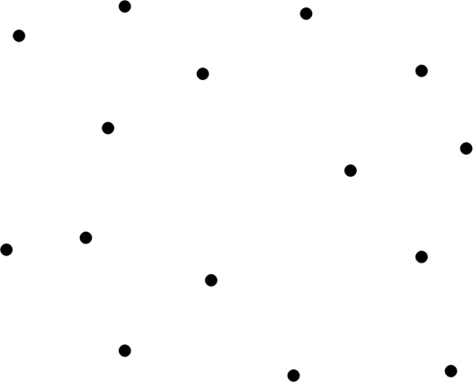
Delaunay triangulation (DT)?
A set of point in 2D

Slide 3
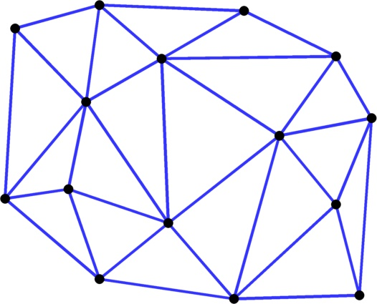
A triangulation of S
Circumcircle of this triangle is not empty

Slide 4
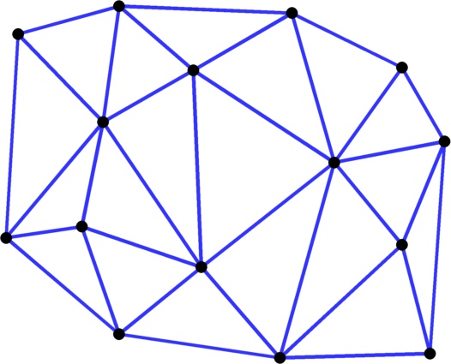
Delaunay triangulation of S
Circumcircle of every triangle is empty

Slide 5
Greedy forwarding in a DT always succeeds to find a destination node
Theorem and proof for nodes in 2D
[Bose & Morin 2004]
Each node is identified by its coordinates in 2D
destination
source
Notes:
Greedy forwarding uses only coordinates of neighbors, the destination, and the node’s own to determine next hop – small routing state at each node

Slide 6
DT in d-dimensional Euclidean space
DT definition generalized from 2D
In any dimension, the DT of S is a graph, denoted by DT(S)
  neighbors in the graph are called DT neighbors
2D | d-dimensional
triangle | simplex
empty circumcircle | empty circum-hypersphere
Notes:
Given a set S of points, there are well-known algorithms to compute the DT graph

Slide 7
Greedy forwarding in a DT always succeeds to find a node closest to a destination location
Theorem and proof for nodes in a d-dimensional Euclidean space, d ≥ 2
[Lee & Lam 2006]
Node coordinates may be arbitrary
location
source
Notes:
Theorem and proof in UTCS TR-06-48, 2006

Slide 8
Distributed system model of DT
A set S of nodes in a d-dimensional Euclidean space
  Each node assigns itself coordinates in the space to be used as the node’s identifier
  “ u knows v ” means “ u knows v’s coordinates ”
Each node is a communicating state machine
  a node’s state is set of nodes it knows
  protocol messages it sends and receives
No need to think about d-dimensional objects except when proving theorems

Slide 9
A distributed DT
C_{u} set of nodes u knows
DT(C_{u} ) local DT computed by u
N_{u} neighbors of u in DT(C_{u} )
The distributed DT is correct iff, for all u ∈ S,
N_{u} = set of u’s neighbors in global DT, DT(S)
No broadcast, N_{u} C_{u} and |C_{u}| << |S|
local info
Notes:
Scoped flooding does not work in general because all DT neighbors of a node may not be found in a pre-specified hop limit; flooding is also inefficient

Slide 10
Node u finds nodes and computes its local DT
g
i
f
How does u search?
e
h
j
l
When does u stop?
a
d
k
b
C_{u}={u, a, b, c, d}
u
c
DT(C_{u})
N_{u}={a, b, c}

Slide 11
Application to Layer 2 routing
Layer 2 network represented by an arbitrary graph of nodes and physical links (connectivity graph)
Minimal assumptions:
  graph is connected
  each physical link is bidirectional
How to make use of distributed DT?
Notes:
Links are wireless or wired
A wireless link may be unidirectional – if so, it is not used

Slide 12
Extension - Multi-hop DT
Connectivity graph – nodes and physical links
DT graph
In a multi-hop DT, neighbors can be
  directly connected
  multiple hops apart and communicate via a virtual link
j
i
h
g
b
a
e
c
f
d
a physical link that is not a DT edge
Notes:
Nodes are located in the space by their coordinates which may not be their locations in physical space

Slide 13
Each node has a forwarding table
Each entry in the forwarding table is a 4-tuple
<source, pred, succ, dest>
for the DT edge a-d, to provide the path a-b-c-d,
each node stores a tuple,
e.g.,
  node b stores <a, a, c, d>
j
i
h
g
b
a
c
e
f
d
The tuple is used by b for forwarding in both directions

Slide 14
In a multi-hop DT, each node u
maintains tuples in its forwarding table F_{u} as soft state
C_{u} = set of destination nodes in tuples of F_{u}
N_{u} = set of neighbors in DT(C_{u})
state of node u
node u’s local DT
Notes:
Each tuple is refreshed whenever there is packet traffic (e.g., application data or keep-alive message) and is deleted when it times out.

Slide 15
A multi-hop DT is correct iff
for all u ∈ S, N_{u} = set of u’s neighbors in DT(S)
for every DT edge (u, v), there exists a unique k-hop path between u and v in the forwarding tables of nodes in S
(the distributed DT is correct)
Notes:
all v ∈ S, N_{v} = set of v’s neighbors in global DT, DT(S)

Slide 16
MDT’s 2-step greedy forwarding
node u receives a packet with destination d
greedy step 1
yes
∃ a physical neighbor v closest to d ? transmit to v
greedy step 2
no
yes
∃ a DT neighbor w closest to d ? forward to w
no
(using a tuple in forwarding table)
node u is closest to d
Notes:
DT neighbor in greedy step 2 is a multi-hop neighbor

Slide 17
MDT’s 2-step greedy - example
destination
k
Source c, dest. k
At node c, physical neighbor closest to k is b
  c transmits msg to b
j
i
h
g
b
a
c
e
source
f
d
MSG

Slide 18
2-step greedy example (cont.)
destination
k
Node b is a local minimum
with multi-hop DT neighbor j closest to k
node b forwards msg to j by transmitting it to e
node e forwards msg to j by transmitting it to h
    does not perform greedy step 1
h transmits msg to j
j finds itself closest to k
j
i
h
g
b
a
MSG
e
c
source
d
f
Notes:
When a node forwards a message m to a relay (with m.relay not null), the node does not use greedy step 1

Slide 19
In a correct multi-hop DT
MDT’s 2-step greedy forwarding provides guaranteed delivery to a node that is closest to the destination location
  Theorem and proof [Lam and Qian 2011]
We next present a join protocol for nodes to construct a correct multi-hop DT
Notes:
all v ∈ S, N_{v} = set of v’s neighbors in global DT, DT(S)

Slide 20
MDT join protocol: initial step
Given: a correct multi-hop DT of S
node a boots up
to join S, a needs to find the closest node in S
  It must be a neighbor of a in the DT of S∪{a}
j
i
h
g
b
a
e
c
f
d
Notes:
A node a boots up, assigns itself coordinates, discovers its physical neighbors and their coordinates, inserts forwarding tuples for them. It then tries to find all of its DT neighbors. To begin its search, it must find at least one neighbor in the new DT.
By a property of DT, the closest node must be a DT neighbor

Slide 21
2-step greedy in existing DT finds node closest to a
a sends JOIN_ req to b with a’s location as destination
It is greedily forwarded to node c which is closest to a
Each node along the path of JOIN_req stores a forwarding tuple for the path
j
i
h
g
JOIN_req
JOIN_req
b
a
e
c
f
d

Slide 22
Closest node c found
c sends JOIN_ rep to a along the reverse path
Node a begins an iterative search
a sends NB_req to c
j
i
h
NB_req
g
b
a
e
c
JOIN_rep
f
d

Slide 23
Finding more DT neighbors
c adds a to its set C_{c}
c recomputes DT(C_{c})
Set of a’s new neighbors in DT(C_{c}) is N_{a}^{c} = { j, d }
c sends NB_rep(N_{a}^{c})
to a
j
i
h
g
b
a
e
c
f
NB_rep
d

Slide 24
Iterative search by node u
for distributed DT [Lee and Lam 2006]
repeat
for all x ∈ N_{u}^{new} do
remove x from N_{u}^{new}
send NB_req to x
receive NB_rep(N_{u}^{x})
C_{u} = C_{u} ∪ {N_{u}^{x}}
compute DT(C_{u}); update N_{u}
update N_{u}^{new}
until N_{u}^{new} is empty (successfully joined)
node x
receive NB_req from u
C_{x} = C_{x} ∪ {u}
compute DT(C_{x}) ; update N_{x}
N_{u}^{x} = u ’s neighbors in DT(C_{x})
send NB_rep (N_{u}^{x}) to u
N_{u}^{new} new neighbors that have not been sent a NB_req
Notes:
Initially, only the closest node c is in the set of new nodes
Stop when the new neighbor set is empty and there is no outstanding NB_req waiting for a reply.
Now we have a search method and a stopping condition

Slide 25
Path to a multi-hop DT neighbor
Node a has learned j from node c
  a sends NB_req
  a-c path has been established
  c-j: the existing multi-hop DT is correct; a forwarding path exists between c and j
The virtual link a-j is set up
j
i
h
g
b
a
e
c
NB_req
NB_req
f
d
25
Notes:
A sends NB-req to j

Slide 26
Physical-link shortcut
j received NB_req and sends NB_rep to a
At any intermediate node along the reverse path j-h-e-c-b-
  if a node (h in this example) finds that dest. a is a physical neighbor, the msg is transmitted directly to a
  h updates its tuple for a and j
NB_rep
j
i
h
g
b
a
e
c
f
d
Tuples for a and j in nodes b, c, and e will time out
Notes:
Tuples are soft states
The forwarding entries in b, c, and e will time out because a and j will not use them nor refresh them

Slide 27
When join protocol terminates the multi-hop DT of S∪{u} is correct
  For a single join
  Theorem and proof [Lam and Qian 2011]
Theorem also holds for concurrent joins that are independent
A correct multi-hop DT can be constructed by nodes joining serially
Notes:
Or concurrent with a node failure that is independent.
It uses correctness proof for the join protocol of a distributed DT in TR-06-48 by Lee and Lam

Slide 28
Concurrent events
Two practical problems
  At network initialization, all nodes join concurrently to construct a correct multi-hop DT
  Dynamic topology changes occurring at a high rate (churn)
      nodes
      Links
MDT solution - Each node runs the iterative search protocol repeatedly and asynchronously (controlled by a timer)
Notes:
An event is any topology change – addition/deletion of a link or a node

Slide 29
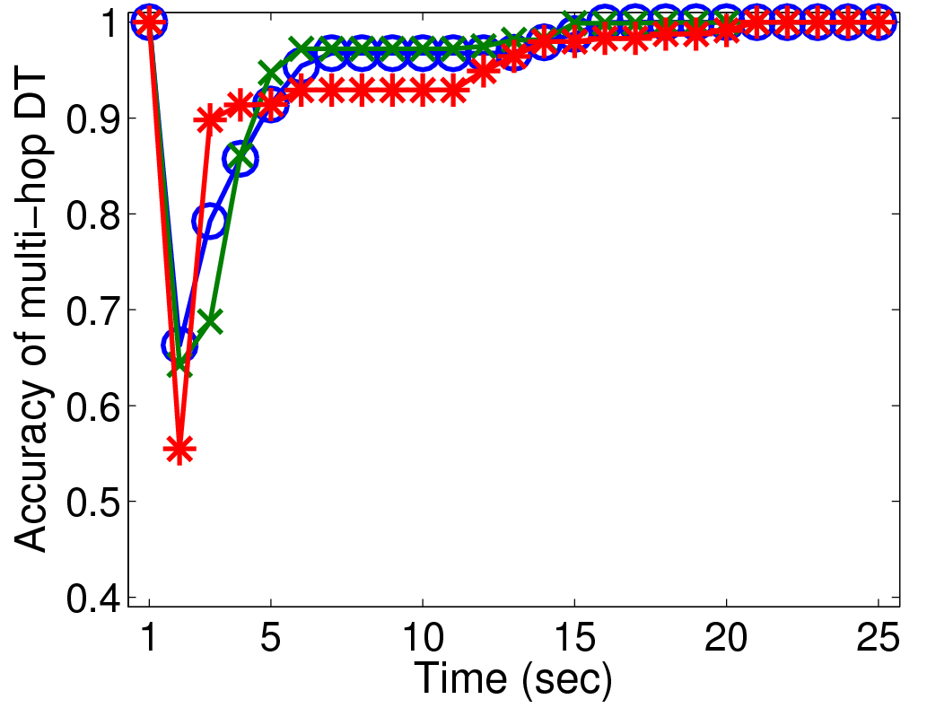
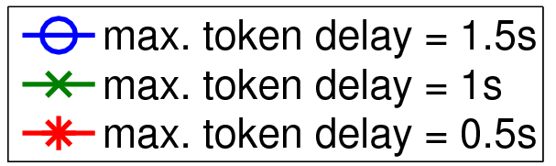
Initialization - Accuracy vs. time
concurrent joins of 300 nodes in 3D, ave. msg delay =15 ms
Each node has run iterative search
2 or 3 times
accuracy=1 ⇔ correct MDT
10 sec TO
Notes:
Maximum token delay is time interval over which start times of nodes are randomized
When a multi-hop DT is correct, every tuple in every forwarding table of every node is correct – a stringent requirement.
Iterative search finishes in a fraction of a second, the timeout value for repeating iterative search can be as short as 1 second
Node density is 13.5 (ave. node degree), low for 3D space. Ave. # of additional nodes in forwarding table = 22 per node (some are not the node’s multi-hop DT neighbors)

Slide 30
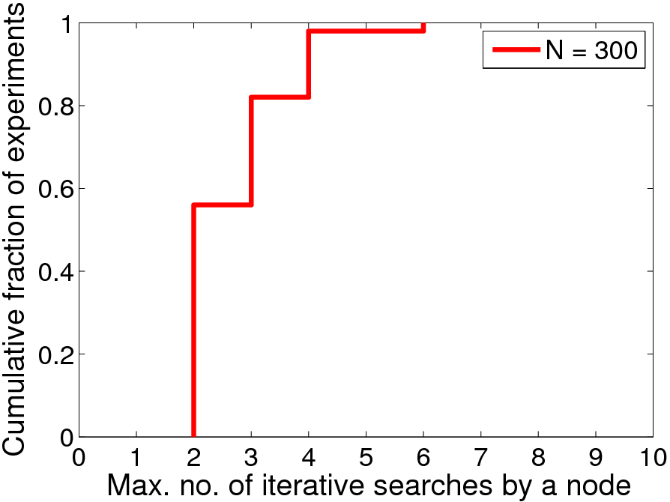
Convergence to a correct multi-hop DT
300 nodes in 3D join concurrently, 50 experiments
max. no. = 6
Notes:
In only in 1 out of 50 experiments, some node required 6 iterative searches
In 49 out of 50 experiments, the max no of iterative searches by a node is 4

Slide 31
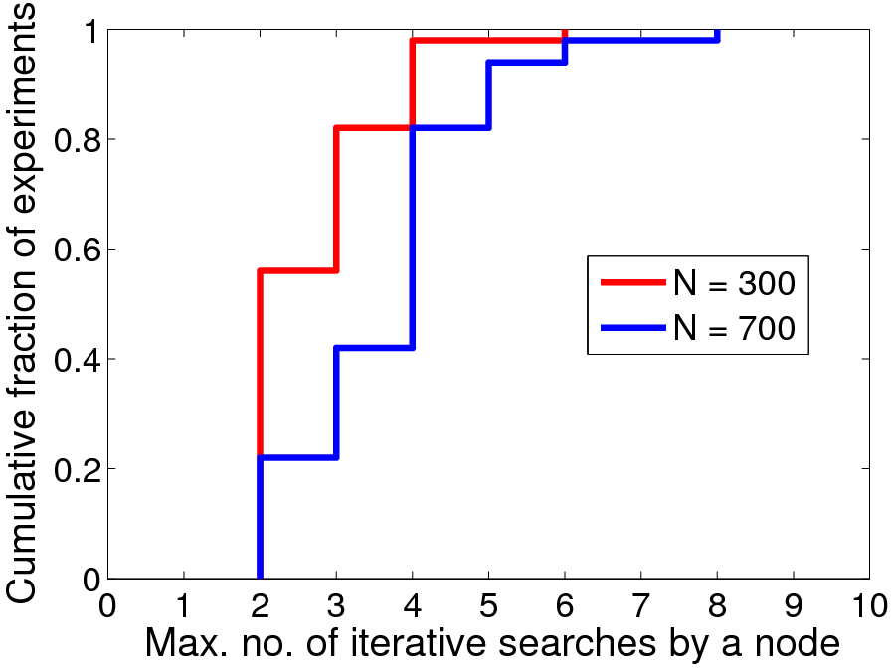
Convergence to a correct multi-hop DT
700 nodes in 3D join concurrently, 50 experiments
max. no. = 8
Notes:
For 700 nodes, again in only one out of 50 experiments , some node required 8 iterative searches
In 49 out of 50 experiments, the max no of iterative searches by a node is 6

Slide 32
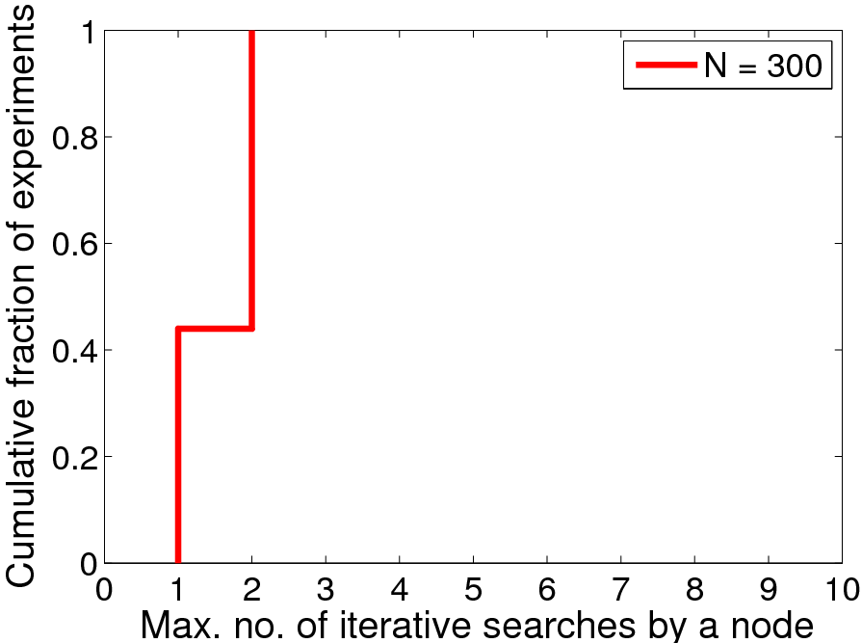
Achieving 100% routing success rate is faster
300 nodes in 3D join concurrently, 50 experiments
Notes:
Max no. is 2 for all 50 experiments

Slide 33
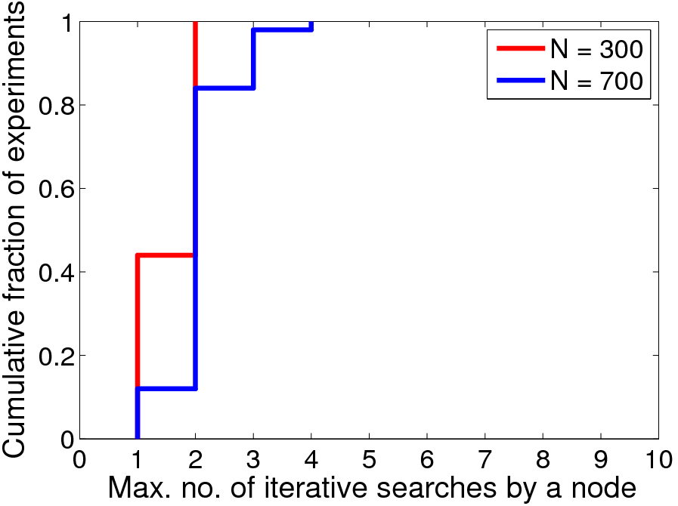
Achieving 100% routing success rate is faster
700 nodes in 3D join concurrently, 50 experiments
max. no. = 4
Notes:
Max. no. of iterative searches is 4 by some node in 1 out of 50 experiments

Slide 34
500 simulation experiments
  300 - 1500 nodes in 3D and 2D, ran on some difficult graphs
  Convergence to a correct multi-hop DT in every experiment
Conjecture. The iterative search protocol when run repeatedly by a set of nodes is self-stabilizing.
  No proof, but no counter example has been found in simulations
  What assumptions are needed?
Notes:
There are some obvious cases that would not work, for example, points in a straight line – a DT does not exist.

Slide 35
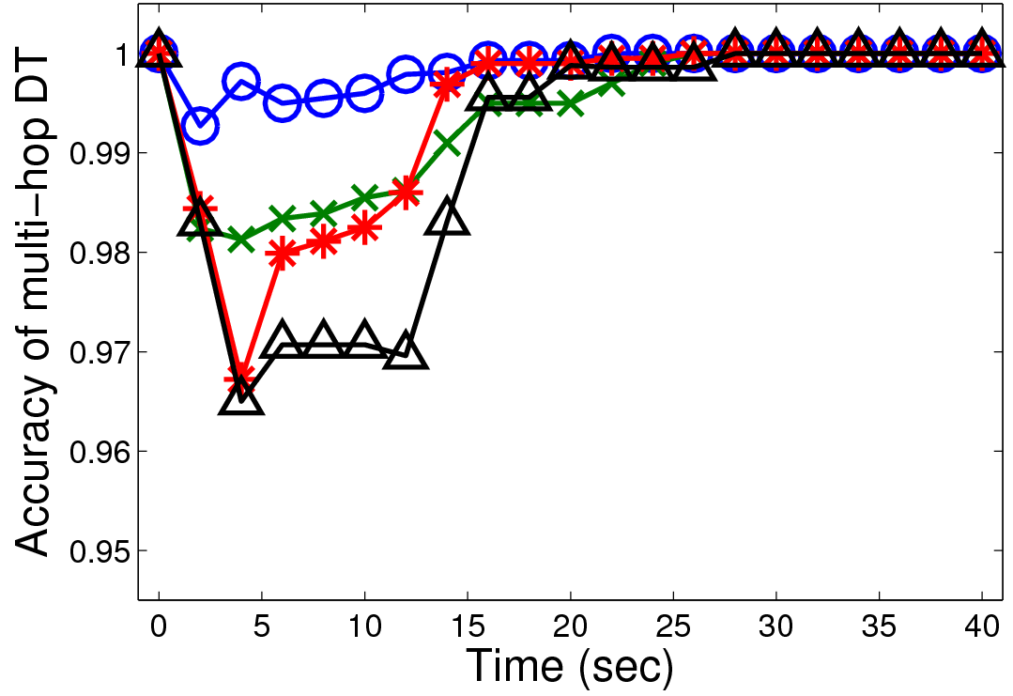
Churn - Accuracy vs. time
300 nodes in 3D, churn rate = 20 nodes/second from time 0 to 5 sec, ave. msg delay = 15 ms
correct multi-hop DT
Each node has run iterative search 2 or 3 times
10 sec TO
churn
stopped
Notes:
Correct multi-hop DT at 28 seconds for all cases
Four graphs ranging from very difficult to not so difficult
Difficulty of a connectivity graph – proportional to the size of the forwarding table - ranging from 25 to 36 distinct nodes in a table on the average
Node density is 13.5 (ave. node degree)

Slide 36
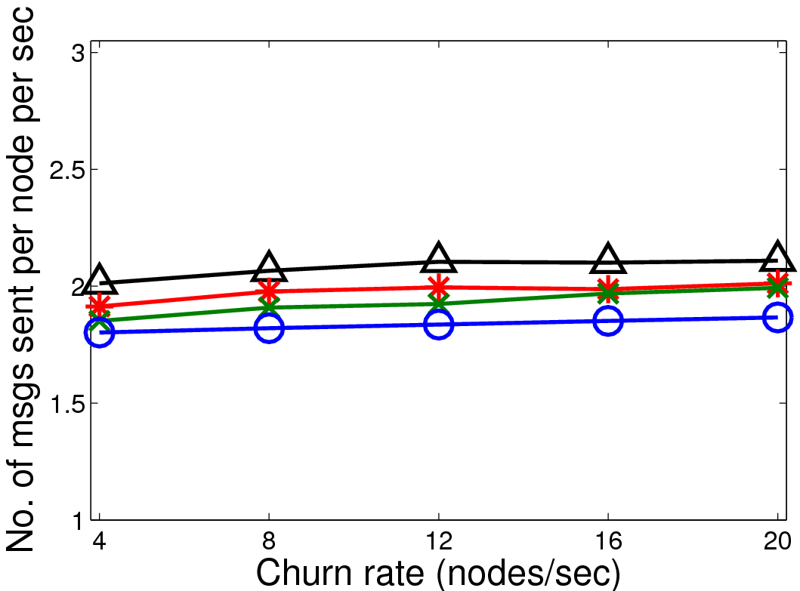
Msg cost/node/sec vs. churn rate
300 nodes in 3D, ave. msg delay =15 ms
This message cost depends more on
TO interval than on churn rate
TO interval should be adaptive
10 sec TO per
iterative search
Notes:
TO interval for iterative search
For 60 sec TO, less than 0.5 msg per node per sec
Node density is 13.5 (ave. node degree)

Slide 37
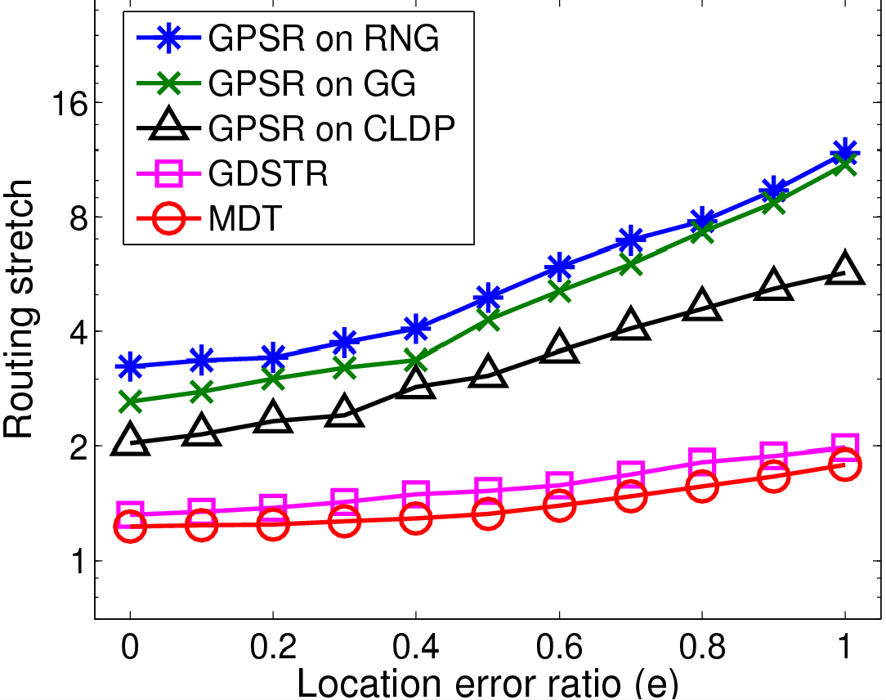
Comparison of 5 protocols in 2D
Routing stretch vs. e
300 nodes with inaccurate coordinates,
static topologies, density = 9.7
log scale
only for packets delivered by GPSR
Notes:
Horizontal axis is location error ratio – when it is equal to 1, the average location error is as large as the average distance between two directly-connected neighbors.
Vertical axis, in log scale, is ave. routing stretch. For each S-D pair, the routing stretch of a protocol is the ratio between the hop count of the protocol’s route and the hop count of the shortest route – averaged over all S-D pairs.
We only compare them for static topologies because CLDP and GDSTR are not designed to handle dynamic topology changes.
The routing stretch is shown for packets actually delivered by GPSR – the routing success rate of GPSR is well below 1
Packets not deliverable by GPSR incur the maximum hop limit

Slide 38
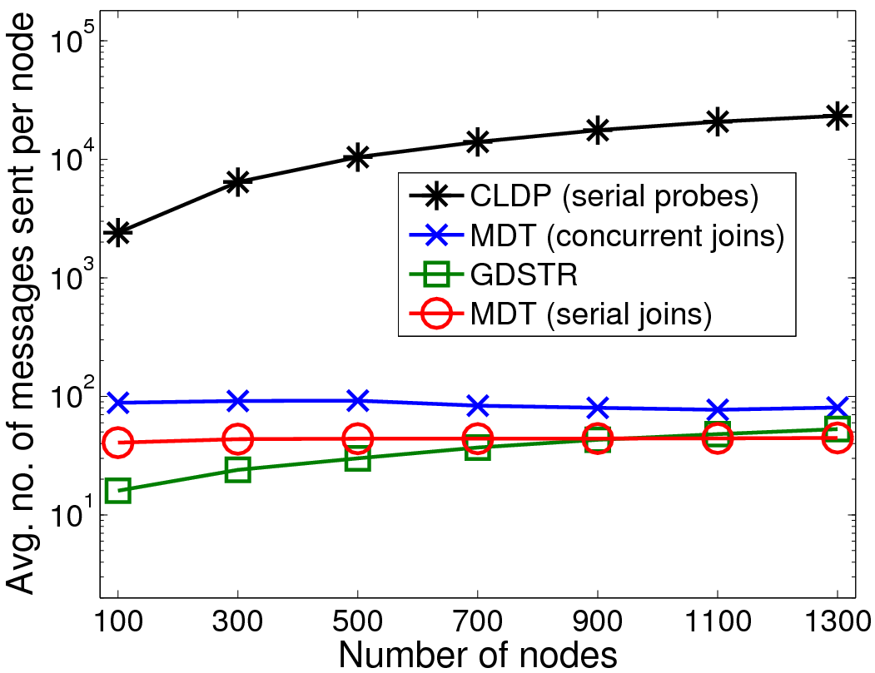
Initialization msg cost vs. N
log scale
node density = 12
MDT costs do not increase with N
Notes:
Large obstacles, p=0.1, e = 1, CLDP’s cost is 2 orders of magnitude larger
GDSTR uses link broadcast to all physical neighbors – each send is only counted only as one message.
MDT messages are unicast

Slide 39
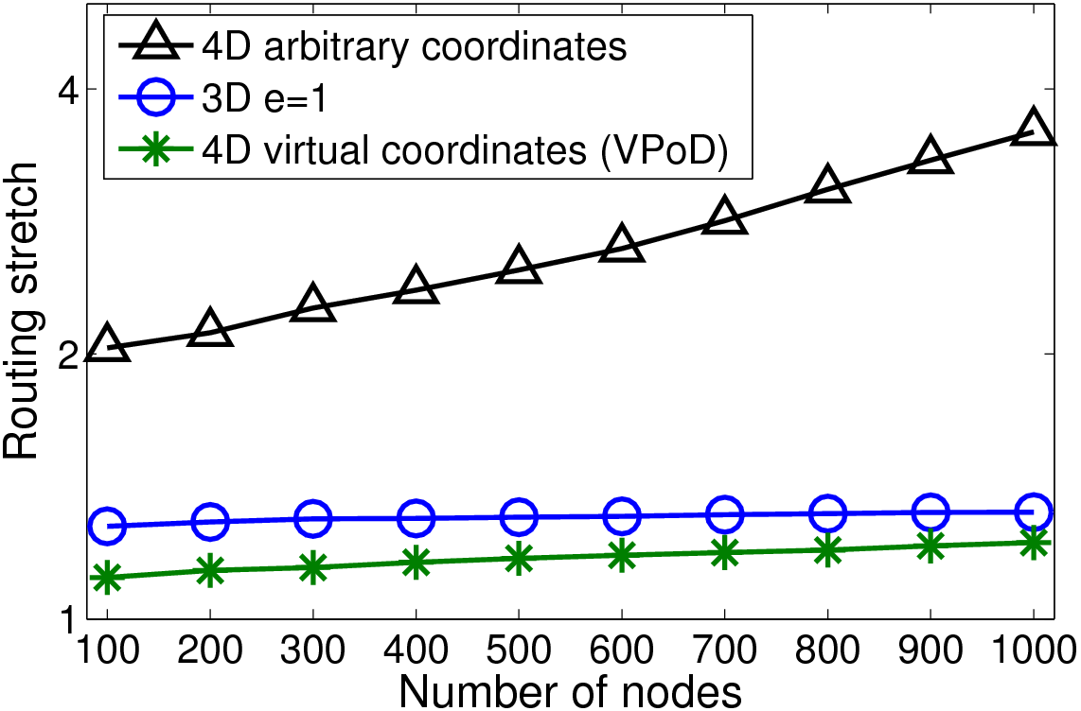
Virtual vs. physical coordinates
log scale
inaccurate physical coordinates
VPoD
Notes:
3D, e=1 case, routing stretch is slightly above 1.1
Using the VPoD protocol, and given link routing costs, each node can communicate with its directly-connected neighbors as well as multi-hop DT neighbors to improve its location in the virtual space.
Note that the curves are almost flat as N increases
Routing success is guaranteed for any static topology

Slide 40
Multi-hop DT - overview
Nodes in a d-dimensional Euclidean space
  Each node assigns itself coordinates in the space
  any connectivity graph, bidirectional links
MDT protocols
  2-step greedy forwarding
  Join protocol – each node runs iterative search once
  Leave and failure protocols for repairing node states after a single leave or failure
  Maintenance protocol – each node runs optimized iterative search periodically to repair node states
  Network initialization by concurrent joins – each node runs iterative search once followed by optimized iterative search repeatedly
Notes:
Node assigns itself coordinates – 1. inaccurate physical coordinates from localization , 2. chosen randomly, or 3. the hash value of a name, or the node’s IP address or MAC address (as in ROME)
For a large network, many concurrent joins, leaves, failures are independent

Slide 41
MDT protocols performance
An efficient and effective search method for nodes to construct and maintain a correct multi-hop DT – fast convergence
2-step greedy forwarding provides guaranteed delivery to a node closest to a given location – basis for a DHT
scalable and highly resilient to dynamic topology changes
every node runs the same protocols – no special nodes
Notes:
Iterative search protocol is very efficient and effective
In MDT, every node is surrounded by its DT neighbors . Efficient because MDT’s iterative search is directional. In the directions where DT neighbors have been found, the search stops. But in any direction where a DT neighbor has not been found, the search keeps going without a hop limit
Compared it to, for example, scoped flooding which has two problems: 1. flooding is inefficient, 2. the search in scoped flooding is limited by a pre-specified number of hops, which may not be enough for a difficult graph

Slide 42
Routing applications in layer 2
Wireless routing for nodes with inaccurate coordinates in 2D or 3D
  Lowest routing stretch compared to other geographic routing protocols
Wired or wireless routing using virtual coordinates
  VPoD and GDV provide end-to-end routing cost close to that of shortest path routing
Finding a node closest to a location in a virtual space
  Delaunay DHT – highly resilient to churn
Notes:
Unlike other geographic routing, any additive routing metric can be used for link costs
Embedding of nodes in virtual space such that the routing cost between two nodes is approximated by the Euclidean distance between them in the virtual space
First-generation DHTs are not at all resilient to churn – Chord, Pastry, Tapestry

Slide 43
References
P. Bose and P. Morin. Online routing in triangulations. SIAM Journal on Computing, 2004.
D.-Y. Lee and S. S. Lam. Protocol design for dynamic Delaunay triangulation. Technical Report TR-06-48, UTCS, December 2006; an abbreviated version in Proceedings IEEE ICDCS, June 2007.
S. S. Lam and C. Qian. Geographic Routing in d-dimensional Spaces with Guaranteed Delivery and Low Stretch. In Proceedings of ACM SIGMETRICS, June 2011; revised version to appear in IEEE/ACM Trans. Networking.
C. Qian and S. S. Lam. Greedy Distance Vector Routing. In Proceedings of IEEE ICDCS, June 2011.
C. Qian and S. S. Lam. ROME: Routing On Metropolitan-scale Ethernet. In Proceedings of IEEE ICNP, 2012.

Slide 44
The end

