Slide 1
Teaching Modeling and Variability in Software Design and its Importance to Science
Don Batory Department of Computer Science University of Texas at Austin Austin, Texas 78712
Notes:
intro up to Cute 11.5
up to Engineers 14.5-15.5 26.0-27.0
still thinking 10.5-11.0 36.5-38.0
but I don’t like math 5.5 42.0-43.5
conclusions 3.0 45.0-46.5

Slide 2
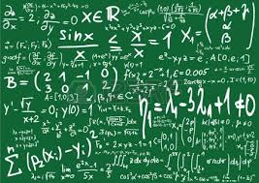

Overture
My work is in automated software design (ASD)
my interests: software product lines (SPLs), model driven engineering (MDE), refactoring
background in systems, not formal methods
flavor of my work is to use mathematics to explain what I have observed and done in practice
from practice
to theory

Slide 3
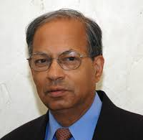
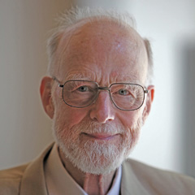
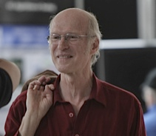
Heard Lectures by
Jay Misra
Tony Hoare
Ric Hehner
Their work is to find algebraic laws of programming (esp. concurrency)
My approach to software automation has this flavor (physics), but is not as formal
geared more toward practicing engineers
does not preclude others with stronger formal backgrounds to follow up

Slide 4
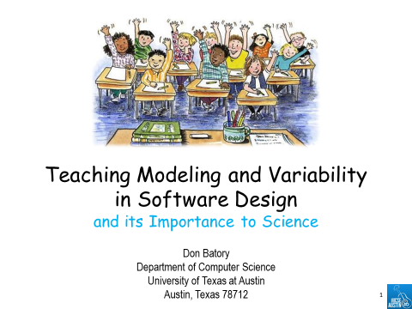
Recent Lectures by
Jay Misra
Tony Hoare
Ric Hehner
Their work is to find algebraic laws of programming
My approach to software automation has this flavor (physics), but is not as formal
geared more to practice and engineering
does not preclude others with stronger formal backgrounds to follow up

Slide 5
Introduction
I teach undergraduate and graduate software design courses
Goal is not JUST to present software design as:
a collection of best practice techniques and tools to create understandable and cost-effective designs, but also
a foundation to explain classical and revolutionary concepts in last 25 years
Model Driven Engineering
Refactorings
Design Patterns
Parallel Architectures
Product Lines

Slide 6
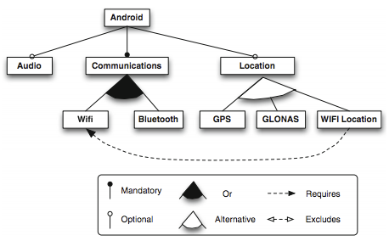


Motivation #1 For This Talk
I attended Software Product Line Conference in Nashville last summer
Listened to a keynote of a founder of that Conference Series
History and motivation behind the creation of SPLC
Software Reuse Conference lacked a focus on practical, cost-effective technology
and “we didn’t have to worry about math”

Slide 7

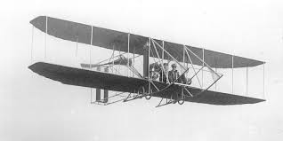
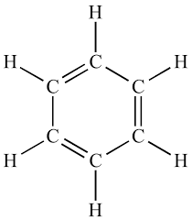
Not Surprising
Historically w.r.t. science, I think Software Design is ~1880s
Practice as an art dominated in chemistry
Against the tide of the history of science
In practice, there is no difference between theory and practice.
In theory, there is.
Notes:
kekule’s work revolutionized pure and applied chemistry

Slide 8
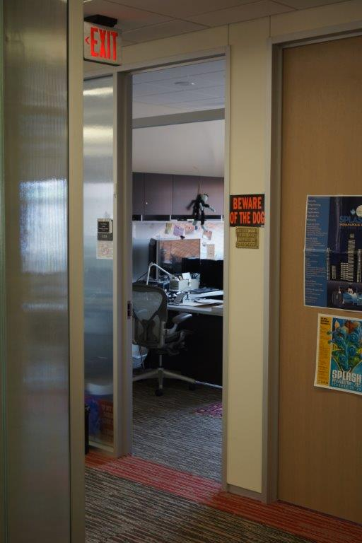
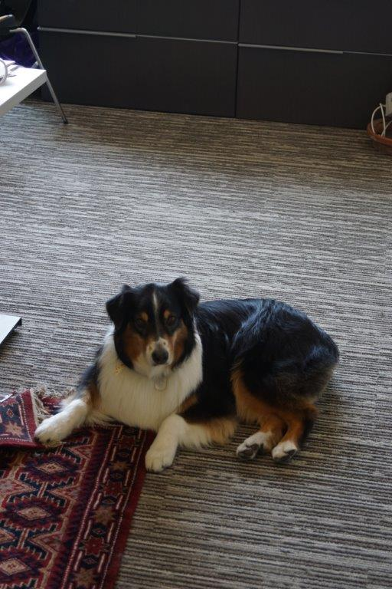
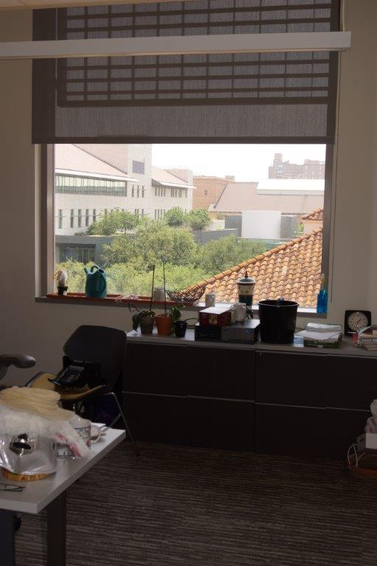
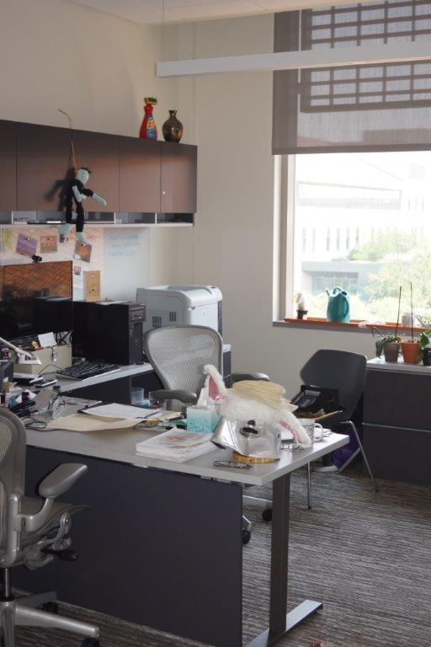
The Difference is Obvious
View Software Design from reductionist and mathematical perspective
Only if you’re in the right place
At the right time
Looking in the right direction
You’ll discover something beautiful

Slide 9

A Starting Point to Teach Modern Software Design

Slide 10




Basic Mathematics
Addition and subtraction of numbers
Some operations (multiplication) distribute over addition
$$R⋅\left(G+H\right)=R⋅G+R⋅H$$
Functions $F:ℝ→ℝ$
identity
$$A+0=A$$
commutativity
$$A+B=B+A$$
associativity
$$A+(B+C)=(A+B)+C$$
not in this
talk…
Notes:
Ok – are integrals higher order functions? YES

Slide 11






Dreaded Homework Assignments
Are these expressions equal?
$$x^{2}+5⋅x +6 = \left(x+3\right)⋅(x+2)$$
Obviously no! They are different
We were taught to apply a series of identities replace equals with equals to prove their semantic equality or not
$$\left(x+3\right)⋅\left(x+2\right)$$
= $\left(x+3\right)⋅x+\left(x+3\right)⋅2$
= $x^{2}+3⋅x+2⋅x+6$
= $x^{2}+5⋅x+6$

Slide 12


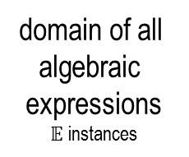


MDE Cosmic View
We have a domain of algebraic expressions defined by metamodel $𝔼$
We have 2 elements: expressions $e_{1}$ and $e_{2}$
Is there a path proof between $e_{1}$ and $e_{2}$using arrows identities that transforms $e_{1}$into $e_{2}$?
metamodel of all
algebraic
expressions
$$𝔼$$
cone of
instances
domain of all algebraic
expressions
$𝔼$ instances
$$e_{2}$$
$$e_{1}$$

Slide 13
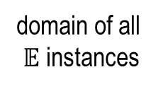
MDE Cosmic View
Of course, there can be many paths derivations
Can derive a large number of semantically equivalent expressions
Yields a subdomain of “equivalent expressions”
A common source of variability in mathematics that we don’t think about
You might say some expressions are better than others. More later…
$$𝔼$$
metamodel of all
expressions
cone of
instances
$$e_{2}$$
domain of all $𝔼$ instances
$$e_{1}$$

Slide 14







Incremental Software Design
Is a classical way to control software complexity
Hallmark of Agile approaches, like XP
Goal of Automated Software Design is to automate all or some the common arrows/transformations of software design
“all” is more likely in domain-specific applications
“some” expected in generic applications, like refactorings
$$P_{0}$$
$$τ_{1}$$
$$P_{1}$$
$$τ_{2}$$
$$P_{2}$$
$$τ_{3}$$
$$P_{3}$$

Slide 15
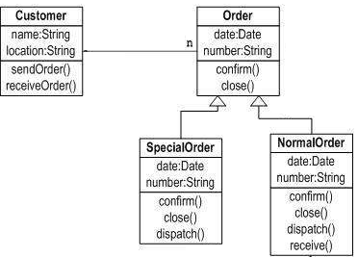
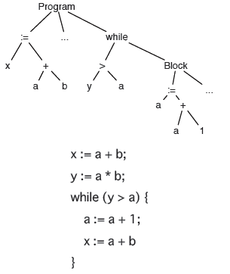
Automated Software Design
Programs are graphs
Class
Diagrams
Data Flow
Parse
Trees
Foundations of Today’s MDE

Slide 16

Automated Software Design
Deals with the addition and subtraction of graphs, not numbers, w. similar properties
Some operations distribute over addition: make graph $R$ed
$$R⋅\left(G+H\right)=R⋅G+R⋅H$$
Functions $F:𝔾→𝔾$
identity
$$A+0=A$$
commutativity
$$A+B=B+A$$
associativity
$$A+(B+C)=(A+B)+C$$
not in this
talk!
Notes:
Ok – are integrals higher order functions? YES

Slide 17




Make This Concrete!
Start with UML class diagrams $δ+γ=ϕ$
$$δ=$$
$$γ=$$
+ is a union-like op that has an identity 0, is commutative and
associative
$$φ=$$
– is a set subtraction
operation

Slide 18
cute
cute But so what?

Slide 19
How Would You Explain
A typical spaghetti class diagram to someone?

Slide 20
Using Graph Addition
Build graph incrementally by adding subgraphs to a simple base graph
Each step is understandable, implementable, and testable!
Explain
Complexity
in a Simple
Way

Slide 21
No Unique Way to Construct Diagram
Consequence of commutativity and associativity of graph addition
Math confirms the intuitive: one can create a design in any number of equivalent ways – more later…

Slide 22
cute
cute But Who Cares?

Slide 23
Graph Identities often presented as Refactorings
Push down association
Refactorings are reversible (equalities)
Lots of these identities – see more later…

Slide 24




MDE Universe
Metamodel $ℂ𝔻$whose domain is class diagrams
Given two class diagrams, $c_{1}$and $c_{2}$, does $c_{1}=c_{2}$?
Can we apply a set of graph identities to prove their equivalence?
Let’s a look at an example
$$ℂ𝔻$$
metamodel of all
class diagrams
cone of
instances
$$c_{2}$$
domain of all class diagrams
$$c_{1}$$

Slide 25
Motivation #2 for this Talk
“Abstraction Challenges” Panel at MODELS 2013
I posed a question: if I give a modeling assignment** to my class…
** create a class diagram to express …
Response caught me off-guard
if panelists said anything it was “but there is only one right answer”
Really??

Slide 26

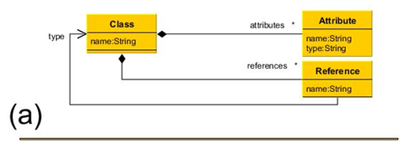
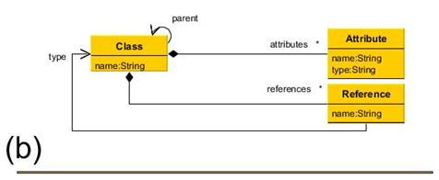

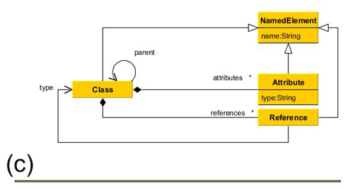
Guess: Common Interpretation
thank you Davide!
Example from Davide Di Ruscio clarified a common interpretation
What is a class diagram of a class diagram?
allows classes to have attributes and directed associations
answer (a) + class hierarchies
answer (b) + pull-up common attributes name

Slide 27
Teaching Databases Mid-1980s
I noticed the same problems
unless you are very specific about what you want students to model, you will get a zoo answers
I graded the same way as Davide…
Decades later, in teaching Software Design, I took a broader perspective, I realized I needed to tighten the problem spec to reduce the zoo of answers

Slide 28
Where I Start Now
What is a class diagram of a class diagram?
Here is my in-class answer:
For MDE purists, this CD is an instance of itself

Slide 29
The Assignment
Given this metamodel, what minimal change do you need to make to generalize it to express inheritance relationships among classes?
And I get all sorts of answers…

Slide 30
Answers #1 and #2
The left answer is my answer + constraint that there are no inheritance cycles not shown
?
let’s hope we agree on cardinality
labeling, as it is non-standard. I use Booch et al. UML convention

Slide 31
Graph Identities Known Beforehand a.k.a. Refactorings
A standard rewrite of database design circa mid-1980s called “normalize” association
And, of course, the rename refactoring which asserts “X” equals “Y”

Slide 32
Graph Identities Known Beforehand a.k.a. Refactorings
A standard rewrite of database design circa mid-1980s called “normalize” association
Special case where A = B

Slide 33
So Let’s Derive their Equivalence
normalize
?
equals
Of course, the right diagram is more verbose than the left, but they are equivalent
They don’t get equivalent grades because the right CD is not minimal

Slide 34
Here’s Another Student Answer
?
Constraint on both diagrams: no box can have multiple super classes, no inheritance cycles, …

Slide 35
Again Use Normalization

Slide 36
Next…

Slide 37
Last Step

Slide 38

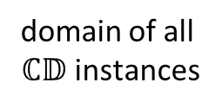


Big Picture
Graph refactorings are Graph identities
We should be teaching is the mathematics of software design – this is the Science of Design
Variations in designs are explained by the application of graph identities
Interesting assignments for students to think about what identities they need to grade each other’s answers
metamodel of all
class diagrams
$$ℂ𝔻$$
Cone of
Instances
$$s$$
$$m$$
domain of all $ℂ𝔻$ instances

Slide 39
cute
cute But engineers don’t need this…
cute

Slide 40

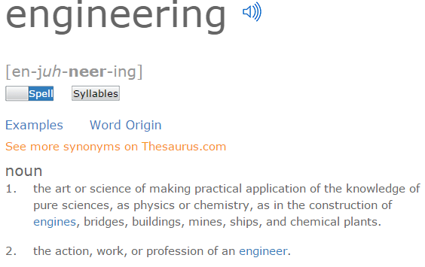

Really???

Slide 41
Really???
Engineering is
Applied Science
whose language is
mathematics

Slide 42
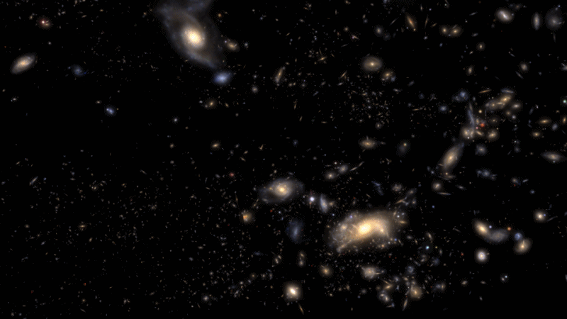
Science is Everything in ASD
It is the cooperation of theory and experiments
experiments give observational data
theory distills seemingly unrelated observations into a system of laws
Go back in time to see the origins of Automated Software Design (ASD)
Nothing to do with being “cute”
1986
2006
1996
2016

Slide 43
In ~1986, Keys to the Future of Software Development
Paradigms of the future must embrace at least:
Compositional Programming
develop software by composing “modules” (not writing code)
Generative Programming
want software development to be automated
Domain-Specific Languages (DSLs)
not C or C++, use domain-specific notations
Automatic Programming
declarative specs → efficient programs
Verification
want our programs to be correct
Need simultaneous advance in all fronts to make a significant impact

Slide 44
Yeh, Right
But … an example of this futuristic paradigm realized 7 years earlier (1979) around time when many AI researchers gave up on automatic programming
IMO – most significant result in ASD and automated construction. Period.
Rarely mentioned in typical texts and research papers in SE, software design,
modularity, product lines, DSLs, MDE, software architectures…
Relational Query Optimization
Relational Query Optimization
Selinger ACM SIGMOD 79

Slide 45
Relational Query Optimization (RQO)
compositional
programming
SQL
select
statement
inefficient relational
algebra
expression
efficient relational
algebra
expression
optimizer
code generator
parser
declarative
domain-specific
language
automatic
programming
generative
programming
efficient
program
correct-by-construction (see this later)

Slide 46

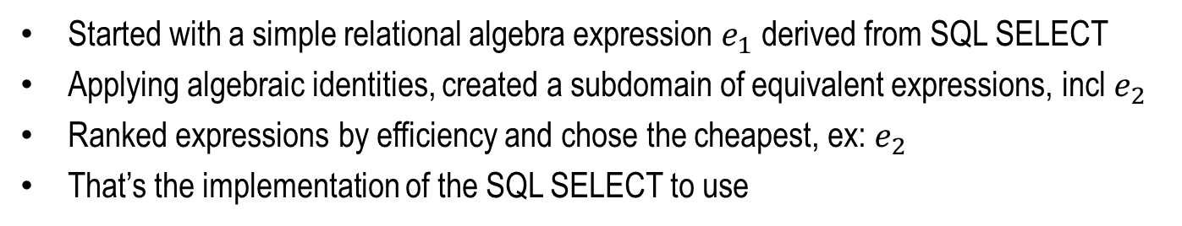


What RQO Did
Started with a simple relational algebra expression $e_{1}$ derived from SQL SELECT
Applying algebraic identities, created a subdomain of equivalent expressions, incl $e_{2}$
Ranked expressions by efficiency and chose the cheapest, ex: $e_{2}$
That’s the implementation of the SQL SELECT to use
metamodel of all relational algebra expressions
$$ℝ𝔼$$
cone of
instances
Elegant!
domain of all relational algebra
expressions
$$e_{2}$$
$$e_{1}$$

Slide 47
Keys to RQO Success
Automated development of query evaluation programs
hard-to-write, hard-to-optimize, hard-to-maintain
revolutionized and simplified database usage
Based on algebra of tables (not numbers)
different table expressions represented different programs
Program designs / expressions can be optimized automatically
key is finding relational algebra identities
Gave me a framework about how to think about ASD

Slide 48
SHOW ME SOMETHING USEFUL
Nice

Slide 49
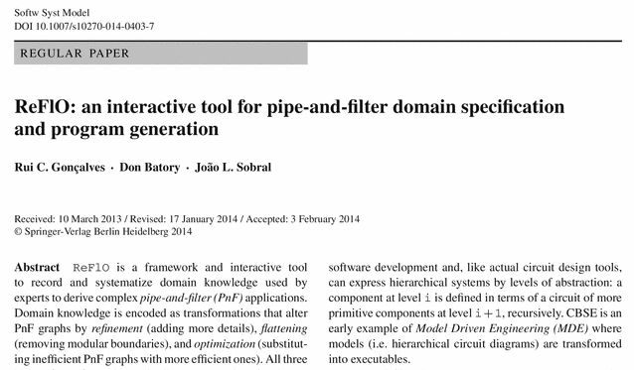
Really??
Revolutionizing database management was not useful?
While you think about an answer, let me show others this example about dataflow applications…

Slide 50
How Do You Explain…
This spaghetti diagram: it is a dataflow graph of a fundamental parallel hash join algorithm, similar to what is used in database machines today
To explain & derive it, you need data flow graph identities
DeWitt, et al. IEEE TKDE 1990
Gamma

Slide 51
Simple Way To Derive Gamma
Need 2 identities that are well-known to database researchers but few others
Bloom filters remove tuples from stream B that provably cannot join with stream A
Parallelize HJOIN operation via map-reduce:
bloom filter
map reduce

Slide 52
Derivation of Gamma
map reduce
bloom
filter

Slide 53
Derivation of Gamma
Gamma
graph rearrangement

Slide 54
Design is Correct By Construction
Initial graph is correct
Rewrites are correct
End result is correct
bloom filter
map reduce
Gamma

Slide 55
Remember!
There are many ways to derive the same graph
simple exploration of this space reveals other fundamental identities
bloom filter
map reduce

Slide 56

Identity Optimizations
Merge tuple streams $A_{1}…A_{n}$ into A and then reconstitute them
Merge bitmaps $M_{1}…M_{n}$ into a single bitmap $M$ and recreate bitmaps $M_{1}…M_{n}$
optimize
optimize

Slide 57
Derivation
This is another
way to discover
graph identities.
Gamma
optimize

Slide 58
Too fancy for me; I prefer my way
Don

Slide 59
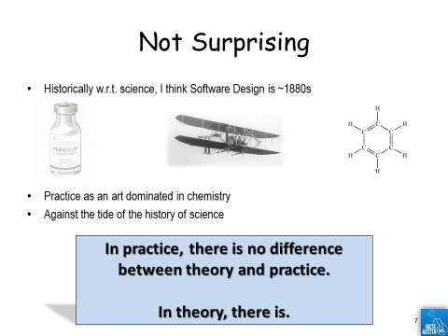
I Understand…
That’s exactly what Chemists said in the 1880s…
but this will change and will take time…
if it were easy, would have been done years ago
Let me show
you a difference
between manual
software development
and automated
design in another
fundamental
area of CS

Slide 60
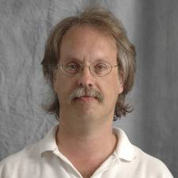
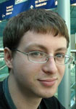
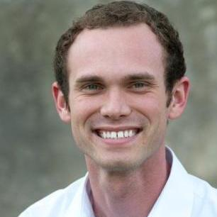
Dense Linear Algebra (DLA)
Robert van de Geijn
last 30 years creating elegant mathematically layered designs of DLA computations
Jack Paulson created Elemental Distributed DLA package
standard BLAS3 matrix-matrix operations
solvers
decomposition functions (Cholesky factorization)
eigenvalue problems
Bryan Marker mechanized the above work as application of dataflow identities
DxTer name of his tool

Slide 61

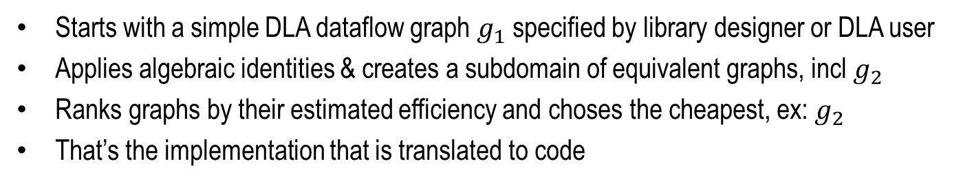


What DxTer Does
Starts with a simple DLA dataflow graph $g_{1}$ specified by library designer or DLA user
Applies algebraic identities & creates a subdomain of equivalent graphs, incl $g_{2}$
Ranks graphs by their estimated efficiency and choses the cheapest, ex: $g_{2}$
That’s the implementation that is translated to code
$$𝔻𝔽$$
metamodel of data flow graphs
cone of
instances
Look Familiar?
$$g_{2}$$
domain of all data flow graphs
$$g_{1}$$

Slide 62
Performance Results
Machine | # of Cores | Peak Performance
Argonne’s BlueGene/P (Intrepid) | 8,192 | 27+ TFLOPS
Texas Advanced Computing Center (Lonestar) | 240 | 3.2 TFLOPS
DxTer automatically generated & optimized Elemental code for BLAS3 and Cholesky operations
Benchmarked with manually-written ScaLAPACK
vendors standard option for distributed memory machines; auto-tuned or manually-tuned
only alternative available for target machines

Slide 63
BLAS3 Performance on Intrepid

Slide 64
BLAS3 Performance on Intrepid
Execution Time = Money
this is Huge

Slide 65
Bryan Found
Error(s) in Elemental Library
Instances where the Domain Expert Jack forgot to apply an optimization
Or used the wrong algorithm (performance error)
DxTer-Generated code is being shipped with
Elemental

Slide 66
What is Really Important…
New hardware architectures are invented every year
DLA algorithms that are optimized for 1 architecture are not optimized for another…
Porting DLA libraries either
runs slower than optimal – which is costly
rewrite much from scratch – which is costly
DxTer is a long-term,
cost-effective, & scalable
way to customize DLA libraries

Slide 67
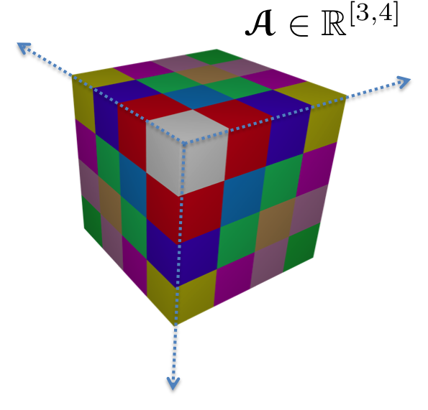

Next Stop – Tensors!
Tensor
n – dimensional array
Tensor Contraction
generalization of matrix multiplication
Tensors = matrices on steroids
Based on ROTE Library of Martin Schatz

Slide 68
Next Stop
Generalized computations to tensor equations in Computational Chemistry
Here are the CCSD coupled cluster single double equations for accurate reproduction of experimental results on electron correlation for molecules
Bryan & Martin created a dataflow graph of these equations and DxTer to optimize their implementation

Slide 69

Next Step
Generalized computations to tensor equations in Computational Chemistry
Here are the CCSD coupled cluster single double equations for accurate reproduction of experimental results on electron correlation for molecules
Marker created a dataflow graph of these equations and DxTer to optimize their implementation
Nontrivial Space O($10^{22}$)
Searched in ~11sec

Slide 70
State of the Art
Contestant: CTF – Cyclops Tensor Framework
state-of-the art distributed library for tensor computations
performs one contraction (tensor multiply) at a time
chooses among different algorithms
Machine: Benchmark on BlueGene/Q
16 shared-memory cores of IBM’s 64-bit Power A2 architecture @ 1600MHz
each node has 16 GB of memory
ran CCSD on 256 of these nodes, for a total of 4096 cores

Slide 71
Performance of Full CCSD on 4096 cores, ¼ peak on top
approx 1.3x larger problems
approx 1.4x faster
This is good!

Slide 72
Performance of Full CCSD on 4096 cores, ¼ peak on top
Take-away:
DxTer was essential in
guiding the development of ROTE & its Infrastructure
approx 1.3x larger problems
approx 1.4x faster
This I
is good!

Slide 73
There is much, much more to say… but enough for today

Slide 74
Don, I don’t want to worry about math
Don,
☺
Notes:
What do you expect? You’re a dog?

Slide 75
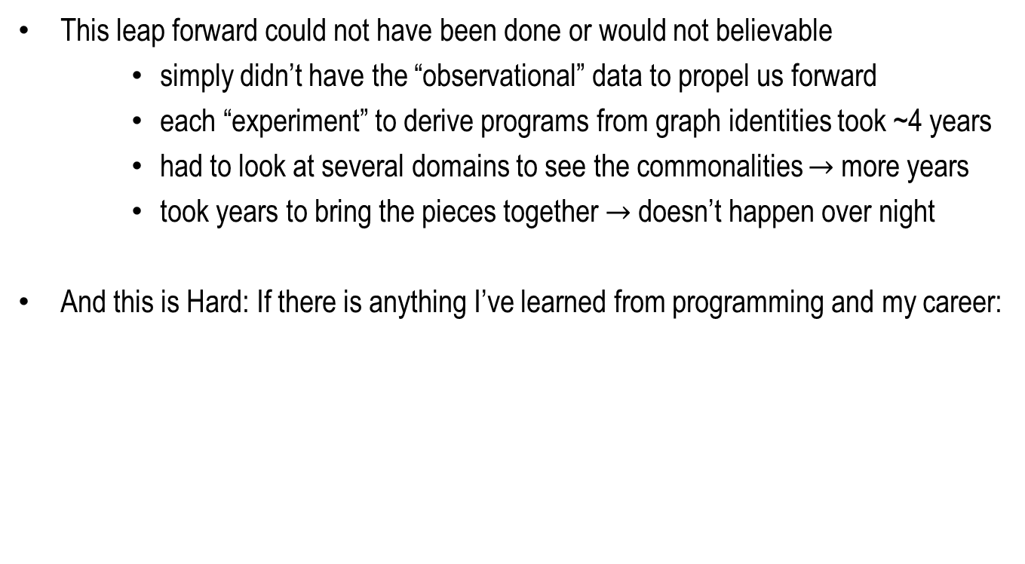
30 Years Ago
This leap forward could not have been done or would not believable
simply didn’t have the “observational” data to propel us forward
each “experiment” to derive programs from graph identities took ~4 years
had to look at several domains to see the commonalities $→$more years
took years to bring the pieces together $→$doesn’t happen over night
And this is Hard: If there is anything I’ve learned from programming and my career:
We are geniuses at making the simplest things complicated; Finding the simplicity and elegance behind what we do is hard

Slide 76
And If You Do It Right…
You will know you are successful when people ask…
Here, in summary, are my take-away ideas…
So what was the problem? What is so hard about this?

Slide 77
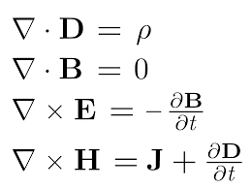
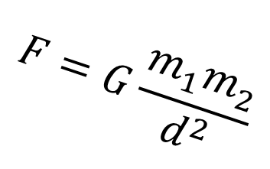
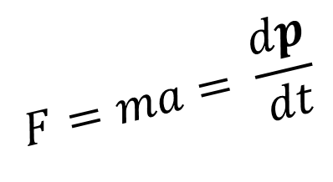
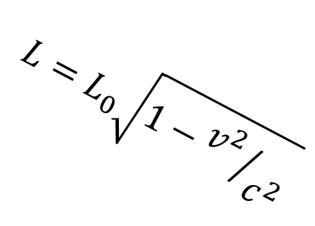
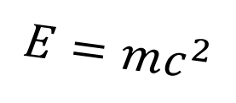
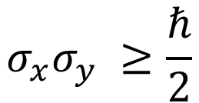
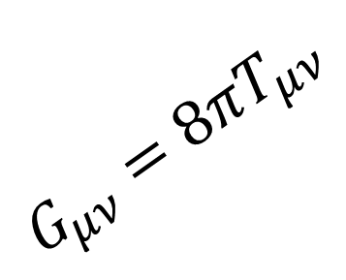
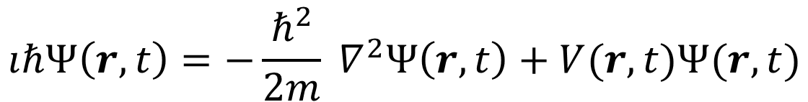
Finding Domain-Specific Identities
Is a fundamental activity in Science, like Physics
$$G_{μν}=8πT_{μν}$$
$$L=L_{0}\sqrt{1−{v^{2}}/{c^{2}}}$$
$$E=mc^{2}$$
$$σ_{x}σ_{y} ≥\frac{ℏ}{2}$$
$$F=ma= \frac{dp}{dt}$$
$$F=G\frac{m_{1}m_{2}}{d^{2}}$$
$$ıℏΨ\left(r,t\right)=−\frac{ℏ^{2}}{2m} ∇^{2}Ψ\left(r,t\right)+V(r,t)Ψ(r,t)$$
Notes:
Maxwell’s equations
Lorenz contraction
Newtons’ laws of force and gravity
Schroedinger’s equation
Einstein’s laws of special and general relativity
Heisenberg’s uncertainty inequality

Slide 78
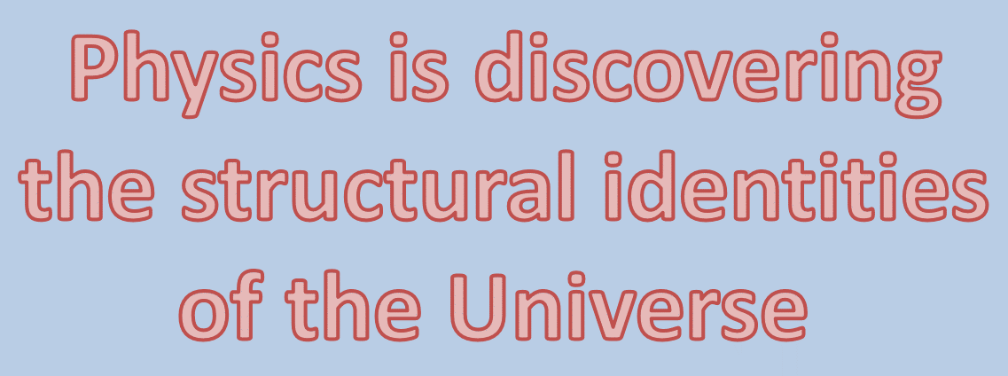
Finding Domain-Specific Identities
Is a fundamental activity in Science, like Physics
$$G_{μν}=8πT_{μν}$$
$$L=L_{0}\sqrt{1−{v^{2}}/{c^{2}}}$$
$$E=mc^{2}$$
$$σ_{x}σ_{y} ≥\frac{ℏ}{2}$$
$$F=ma= \frac{dp}{dt}$$
$$F=G\frac{m_{1}m_{2}}{d^{2}}$$
$$ıℏΨ\left(r,t\right)=−\frac{ℏ^{2}}{2m} ∇^{2}Ψ\left(r,t\right)+V(r,t)Ψ(r,t)$$
Notes:
Maxwell’s equations
Lorenz contraction
Newtons’ laws of force and gravity
Schroedinger’s equation
Einstein’s laws of special and general relativity
Heisenberg’s uncertainty inequality

Slide 79




Finding Domain-Specific Identities
Is also a fundamental activity in Automated Software Design

Slide 80

Finding Domain-Specific Identities
Is also a fundamental activity in Automated Software Design

Slide 81
Teaching Math in Software Design is Important
Foundation of Science
Shows algebraic foundations of advances in last 25 years in Software Design:
Model Driven Engineering
Refactorings
Design Patterns
Parallel Architectures
Product Lines

Slide 82

Remember History of Science
Greatest technical advances in last century were via science
It will be no difference for software design
It is now time to prepare our students for the future, not to continue the past
Even if you
are a dog…
☺
Thank You!

