Slide 1
Cybersecurity

Slide 2
The Scale of the Issue
2.75 billion Internet users
294 billion emails/day (2010) (about 90% spam)
58 million tweets/day
Facebook has over 1.23 billion users (making it the 3rd largest country in the world).
http://www.allaboutmarketresearch.com/internet.htm
Notes:
Facebook number: http://expandedramblings.com/index.php/resource-how-many-people-use-the-top-social-media/3/#.U0vr36Ka_ZQ
Tweets: http://www.statisticbrain.com/twitter-statistics/
http://www.internetworldstats.com/stats.htm for the first number. The rest from Fred Chang.

Slide 3
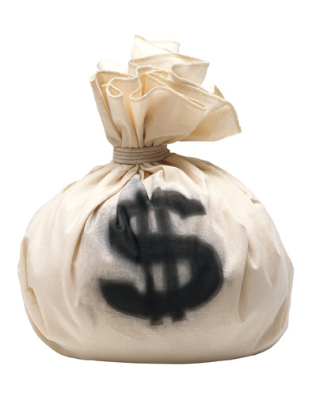
The Scale of the Issue
$114 billion
Cybercrime’s toll on consumers worldwide, according to a September 2011 study by Symantec.
Notes:
Claim: http://www.nytimes.com/2012/01/17/technology/koobface-gang-uses-facebook-to-spread-powerful-worm.html?_r=1&hp
Money bag image: http://prospect.rsc.org/blogs/cw/2010/05/28/chemistry-worlds-round-up-of-money-and-molecules-5/

Slide 4
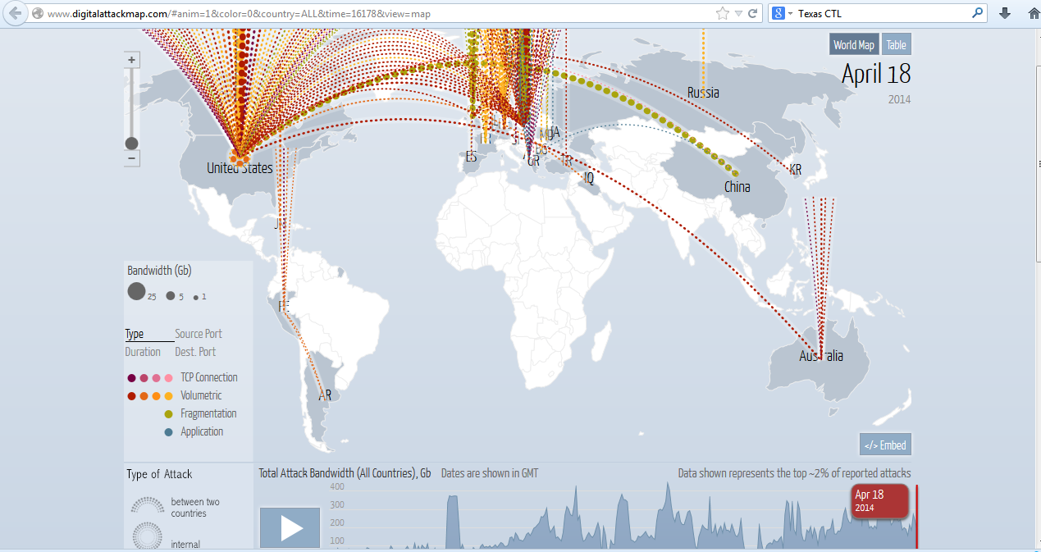
Where Do Attacks Come From?
http://www.digitalattackmap.com/#anim=1&color=0&country=ALL&time=16178&view=map

Slide 5
Scary Stuff
Viruses and worms
Stealing information
Personal information
Government/commercial secrets
Information = Money
Cyberstalking
Compromising national security

Slide 6
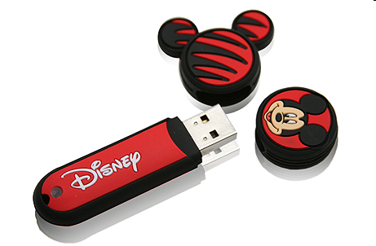
How Easy it is to Infiltrate
http://www.washingtonpost.com/wp-dyn/content/article/2010/08/24/AR2010082406154.html?nav=rss_email/components
Notes:
The article is about rogue software that, via a flash drive, got on to a single U.S. military laptop on a post in the Middle East in 2008. Then it spread on the military’s network. More generally, anyone can give away “free” flashdrives with anything on them they want.

Slide 7
Another Way to Infiltrate
The 25 most popular passwords of 2012
http://games.yahoo.com/blogs/plugged-in/25-most-popular-passwords-2012-164015152.html

Slide 8
Another Way to Infiltrate
The 25 most popular passwords of 2012
1. password (Unchanged) 2, 123456 (Unchanged) 3. 12345678 (Unchanged) 4. abc123 (Up 1) 5. qwerty (Down 1) 6. monkey (Unchanged) 7. letmein (Up 1) 8. dragon (Up 2) 9. 111111 (Up 3) 10. baseball (Up 1) 11. iloveyou (Up 2) 12. trustno1 (Down 3) 13. 1234567 (Down 6)
14. sunshine (Up 1) 15. master (Down 1) 16. 123123 (Up 4) 17. welcome (New) 18. shadow (Up 1) 19. ashley (Down 3) 20. football (Up 5) 21. jesus (New) 22. michael (Up 2) 23. ninja (New) 24. mustang (New) 25. password1 (New)
http://games.yahoo.com/blogs/plugged-in/25-most-popular-passwords-2012-164015152.html

Slide 9
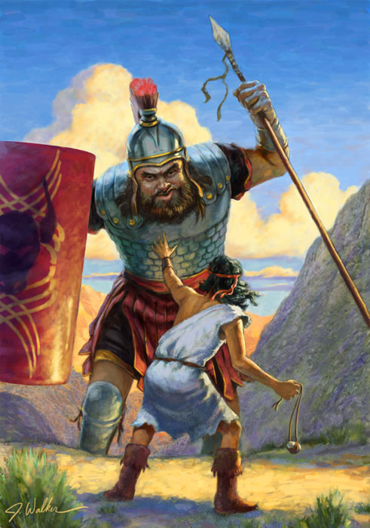
More Generally …
Notes:
David and Goliath: In the physical space, one little guy can rarely successfully attack a big guy. But not so in cyberspace. Even big powerful corps and governments can get hacked by a single kid in a garage.
http://www.yeujesus.com/links/Movies/page.html

Slide 10
Why?
Anonymity

Slide 11
Why?
Anonymity
Trust
Notes:
In the beginning, it was small and for science. So it was designed to be open. Hackers exploit this.

Slide 12
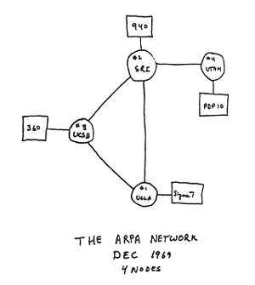
Why?
Anonymity
Trust
Notes:
In the beginning, it was small and for science. So it was designed to be open.
http://www.maconstateit.net/Tutorials/XHTML/XHTML01/xhtml01-01.php

Slide 13
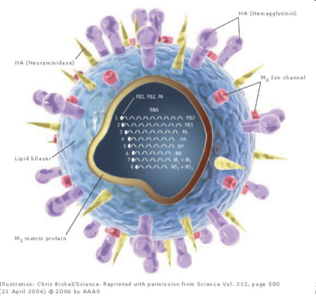
Malware
Viruses
Notes:
P is infected. User runs P, which runs V. Among other things, V finds another program Q. It creates a new version of Q that is infected. Can do this as many times as it likes. Then probably passes control back to P.
http://www.ifpma.org/Influenza/content/images/diagram_virus.jpg

Slide 14
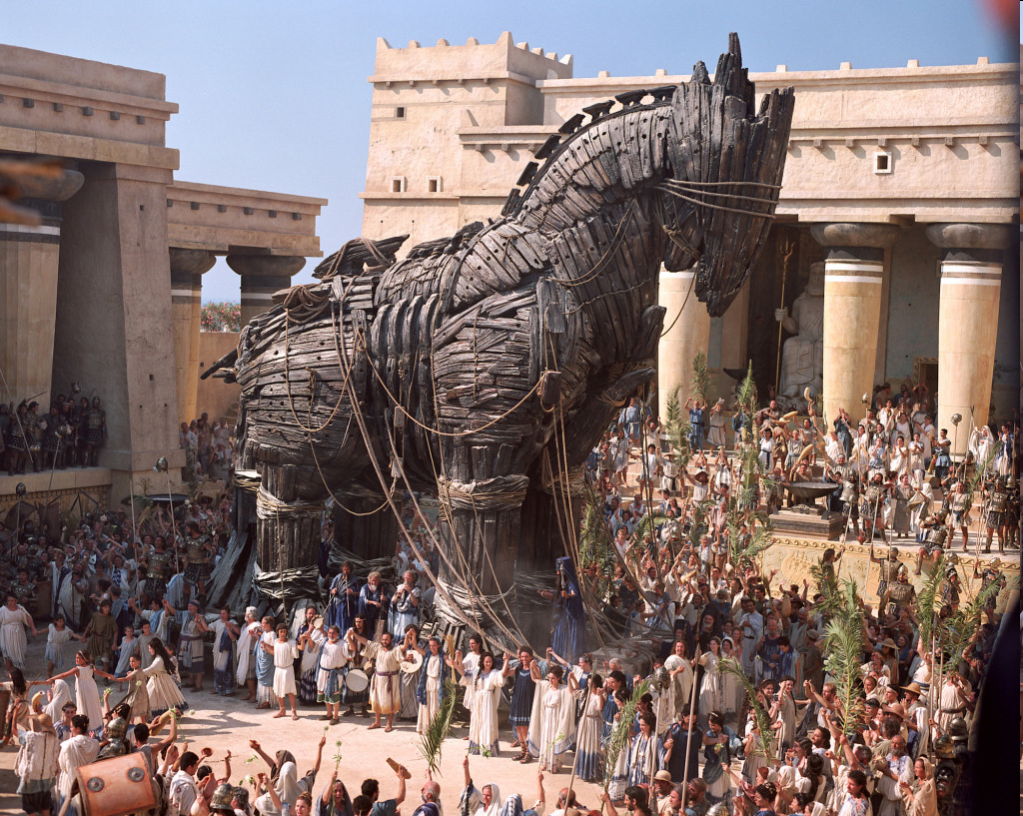
Malware
Viruses
Trojan horses
Notes:
Just a bad program that you choose to run. No way to replicate automatically.
http://markelikalderon.com/2008/06/22/applescript-trojan-horse/

Slide 15
Malware
Viruses
Trojan horses
Worms
Notes:
http://www.faqs.org/photo-dict/photofiles/list/3144/4192velvet_worm.jpg

Slide 16
Why Are They So Hard to Filter?
They mutate.
Undecidability of equivalence.
The bad guys are clever. They can launch “zero-day” attacks and get in before anyone knows to check from them.

Slide 17
Operation Aurora
Google and others were attacked in December, 2009.
What happened?
Attackers chose their targets.
Used social network sites to find their friends.
Zero-day attack: Faked emails from “trusted” friends, which the targets opened (along with links).
Code exploited an error in Internet Explorer to install a beachhead.
More code installed. Now the infected machine communicated with the hackers.
Notes:
Targets chosen: people/systems that would give the attackers the privileges they wanted.
http://blogs.mcafee.com/corporate/cto/operation-%E2%80%9Caurora%E2%80%9D-hit-google-others

Slide 18
Operation Aurora
Who did it?
Probably the Chinese government.
Notes:
Targets chosen: people/systems that would give the attackers the privileges they wanted.
http://blogs.mcafee.com/corporate/cto/operation-%E2%80%9Caurora%E2%80%9D-hit-google-others

Slide 19
Operation Aurora
Who did it?
Probably the Chinese government.
Why?
To spy on Chinese dissidents?
To learn how Google works?
To censor Google?
Notes:
Targets chosen: people/systems that would give the attackers the privileges they wanted.
http://blogs.mcafee.com/corporate/cto/operation-%E2%80%9Caurora%E2%80%9D-hit-google-others

Slide 20
Operation Aurora
Lessons:
No one is safe. There will always be:
Vulnerabilities
Zero-days.
Notes:
Targets chosen: people/systems that would give the attackers the privileges they wanted.
http://blogs.mcafee.com/corporate/cto/operation-%E2%80%9Caurora%E2%80%9D-hit-google-others
http://blogs.mcafee.com/corporate/cto/operation-%E2%80%9Caurora%E2%80%9D-hit-google-others

Slide 21
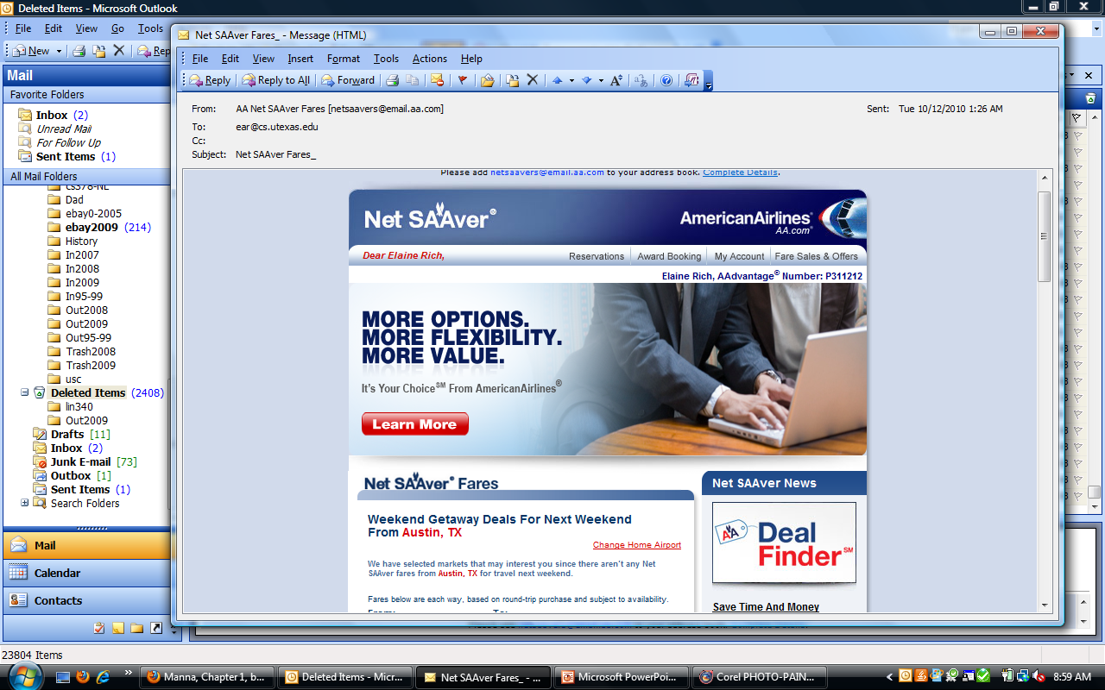
Email
Can bad things happen when you open an email?
Tell a spammer that you exist?
Notes:
When your email client reads the html, it sends a request to mybadstuff.com to fetch the image. You can’t see the image, but the site knows that your ip address exists.

Slide 22
Email
Can bad things happen when you open an email?
Tell a spammer that you exist
<html> <body>
Real text
<img src = http://mybadstuff.com/onewhitepixel.gif>
</body>
</html>
You can protect against this by telling your browser not to display images or not to display images except from senders you trust.
Notes:
When your email client reads the html, it sends a request to mybadstuff.com to fetch the image. You can’t see the image, but the site knows that your ip address exists.

Slide 23
Email
Can bad things happen when you open an email?
Tell a spammer that you exist?
Infect you with a virus just by opening it?

Slide 24
Email
Can bad things happen when you open an email?
Tell a spammer that you exist?
Infect you with a virus just by opening it?
Old days yes, if an html message allowed Javascript and if your mail client executed it.
Now: most mail clients don’t run Javascript when you open a message.

Slide 25
Email
Can bad things happen when you open an email?
Tell a spammer that you exist?
Infect you with a virus?
Attachments
Links
Notes:
Word – macros
Once you click on a link, you don’t know what will happen on the website you go to.

Slide 26
Email Viruses - Attachments
Notes:
You open the attachment. The virus runs. It finds your address book. It passes on the message.

Slide 27
Email Viruses
What if the attachment is a .jpeg?
Notes:
Okay to allow it to open automatically.

Slide 28
Clicking on Links
Notes:
You don’t know what will run if you click. This is a random message from my spam box.

Slide 29
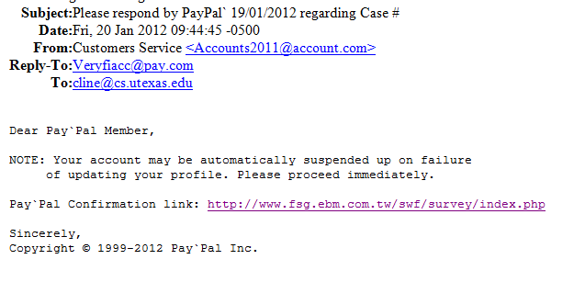
Phishing
Notes:
Here there’s a direct attempt to get you to volunteer sensitive information.

Slide 30
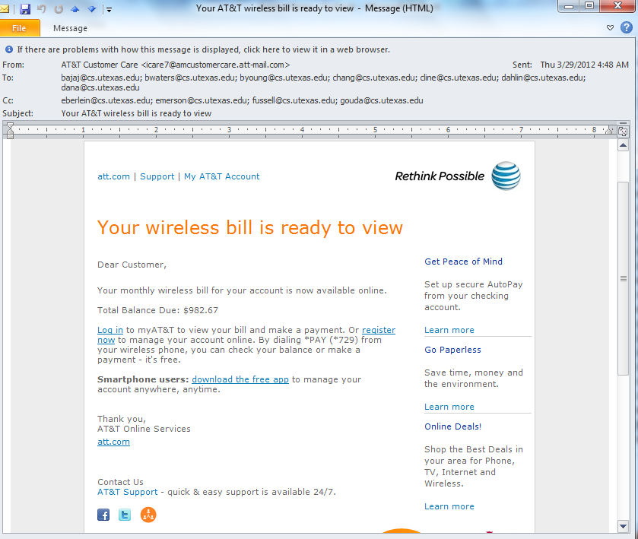

Slide 31
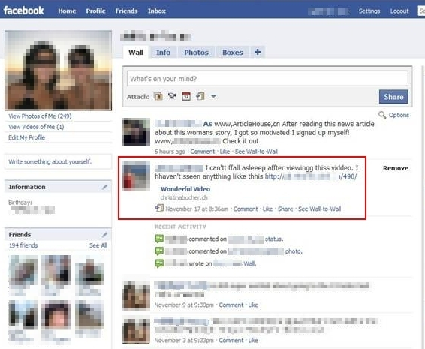
Koobface
Notes:
Often called a worm, but really a trojan. Spreads through social networks. You see this. You click on it. Up pops a window that tells you that you need an updated flash player. You click to install. You’ve just installed the malware.
http://securitylabs.websense.com/content/Alerts/3505.aspx

Slide 32
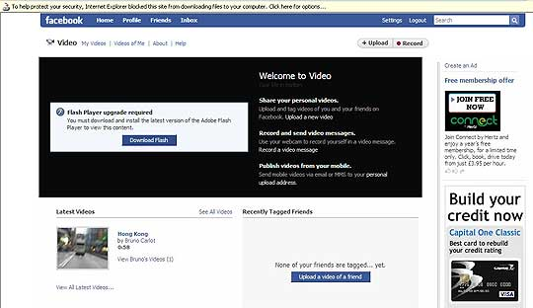
Koobface
Notes:
Once, you download it, you’ve installed the malware. Then they make you pay to get rid of it.
http://labs.m86security.com/tag/koobface/

Slide 33
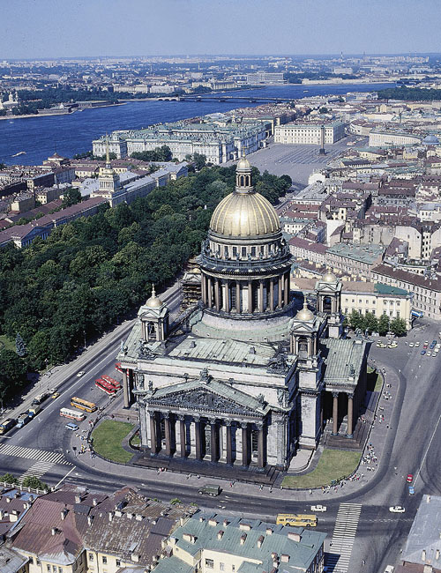
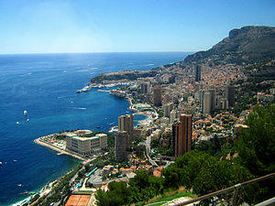
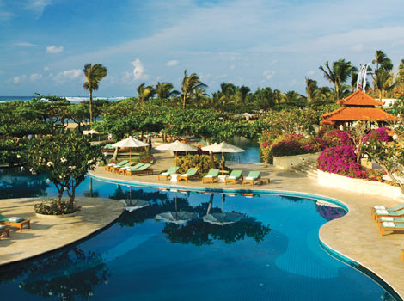
The Koobface Gang
Monte Carlo
St. Petersburg
Bali
Notes:
The Koobface gang is living well and openly in St. Petersburg and vacationing in these places.
http://www.nytimes.com/2012/01/17/technology/koobface-gang-uses-facebook-to-spread-powerful-worm.html?_r=1&hp
http://www.metrolic.com/travel-guides-russia-159376/
http://en.wikipedia.org/wiki/Monte_Carlo
http://www.smarttravelasia.com/TopHotels/GrandHyattBali.htm

Slide 34
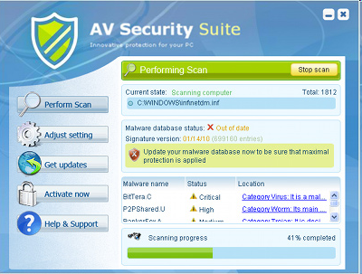
Another Ransomware via Spyware Example
Notes:
Image from: http://www.spywares-remove.com/remove-av-security-suite-av-security-suite-removal-tutorial
Tries to get you to pay to remove it. But then it completely takes over. And it has your credit card.

Slide 35
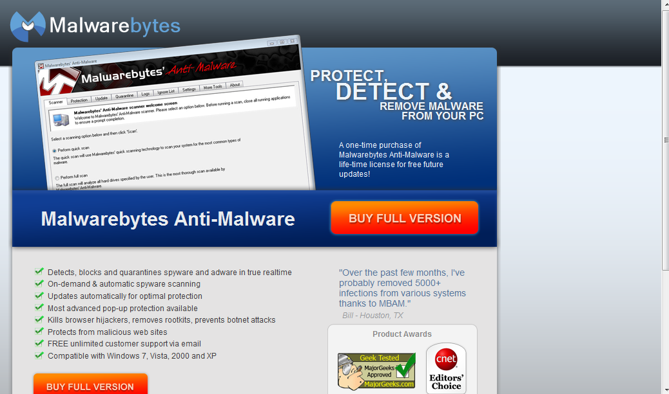
Protecting Your Machine
http://www.malwarebytes.org/

Slide 36
Cybercrime and Identity Theft
Between Jan. 1, 2005 and March 22, 2011:
516,975,878 data records
of US residents have been exposed due to security breaches.
Between Jan. 1, 2005 and October 19, 2012:
563,877,193 data records
of US residents have been exposed due to security breaches.
Notes:
http://www.privacyrights.org/data-breach#Total 563,877,193

Slide 37
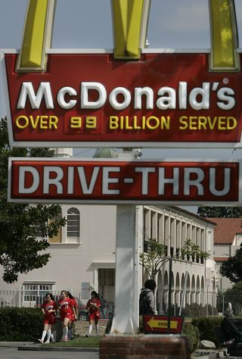
Stolen Databases
On December 16, 2010, McDonald’s released a statement:
“Recently McDonald’s was informed by one of its partners that limited customer information collected in connection with our promotions or websites was improperly accessed by a third party," McDonald's said. "Limited customer information such as name, address, phone number, birth date and gender was included in the information that was accessed."
Notes:
Article about the incident plus this image: http://latimesblogs.latimes.com/technology/2010/12/mcdonalds-databases-hacked-customer-data-stolen.html

Slide 38
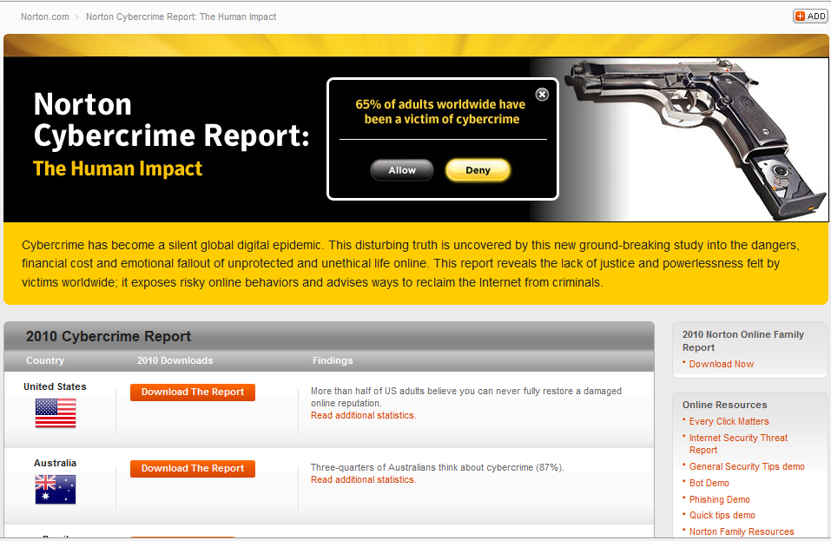
http://us.norton.com/theme.jsp?themeid=cybercrime_report
Notes:
This report is the source of the numbers on the next slide.

Slide 39
How Safe Do You Feel?
65% of people worldwide have been victims of cybercrime.
83% in China
76% in Brazil and India
73% in the US
9% of people feel very safe online
3% of people think cybercrime won’t happen to them
79% do not believe cybercriminals will be brought to justice.
Notes:
From the Norton Cybercrime report shown on the previous slide.

Slide 40
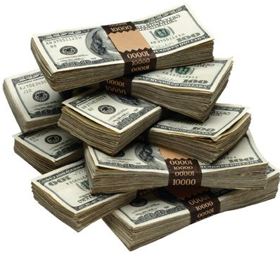
How Much Does it Cost?
In the US:
According to Forbes, identity theft and related fraud were up considerably in 2009 with 11.2 million victims for an estimated cost of $54 billion U.S. dollars. In 2008, just under 10 million people were ripped off as a result of identify theft, for an estimated cost of $48 billion. Interestingly, the cost to individuals as a result of data breaches has declined from $498 in 2008 to only $373 in 2009. Who, then, is picking up the tab for identity theft incidents? Increasingly it’s the financial institutions with whom we entrust our money.
Notes:
http://www.crunchgear.com/2010/02/10/identity-theft-costs-rise-overall-while-costs-per-victim-decline/

Slide 41
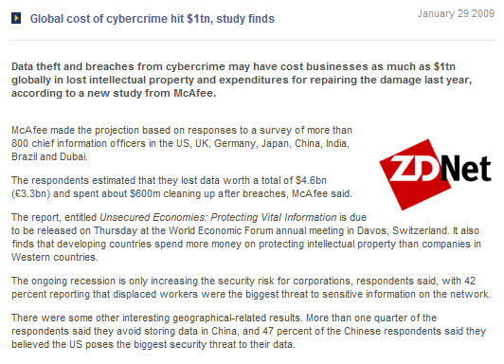
How Much Does it Cost?
Notes:
http://www.gss.co.uk/news/article/5892/go/

Slide 42
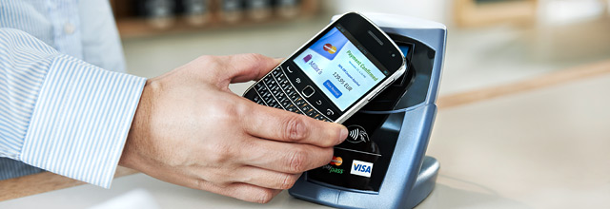
The Newest Threat: Smartphones
NFC (Near Field Communication) payments
http://money.cnn.com/2012/09/17/technology/smartphone-cyberattack/index.html
Notes:
Watch the video about risks. Point out that hackers aren’t really focusing on smartphones yet because there’s still low hanging fruit on PCs and too much diversity in smart phones. See this article:
http://www.cnn.com/2012/09/19/travel/mobile-airport-travel-apps/index.html?utm_source=feedburner&utm_medium=feed&utm_campaign=Feed%3A+rss%2Fcnn_topstories+%28RSS%3A+Top+Stories%29&utm_content=My+Yahoo
Image: http://www.infineon.com/cms/en/product/applications/chip-card-and-security/nfc/index.html
NFC: Near field communication

Slide 43
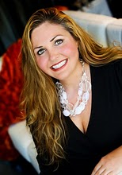
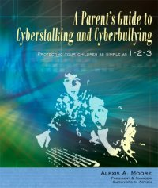
Cyberstalking
Alexis Moore
Notes:
In 2004, her ex-boyfriend hacked in to her online accounts, shut off her utilities and cellphone, then emptied her bank account. It took three years to fix everything. Now she is an advocate for victims.
http://www.blogger.com/profile/14859879458236978817

Slide 44
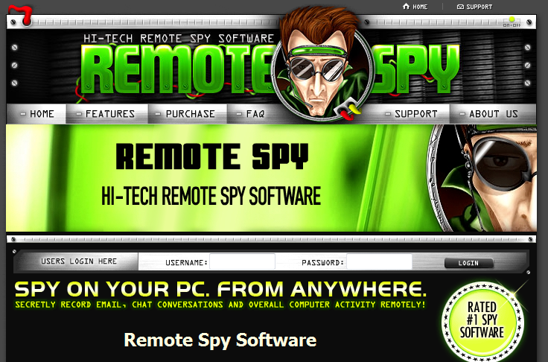
Cyberstalking
http://www.remotespy.com/
FTC settlement: http://www.lavasoft.com/mylavasoft/company/blog/ftc-spyware-settlement-remotespy
Notes:
Go to the site to see what they claim, including undetectability.
Is the FTC settlement enough? It requires owner’s consent. But my roommate just acts like the owner and gives consent.

Slide 45
Cyberbullying
http://www.stopcyberbullying.org/index2.html
http://www.statesman.com/news/local/austin-parents-students-community-leaders-talk-about-cyberbullying-1302625.html?cxtype=rss_ece_frontpage
Notes:
Article about local concerns and Mark Strama’s bill in the legislature that would allow schools to punish cyberbulliers. Unfortunately, the bill died in committee in 2011.

Slide 46
What About the Security of Critical Things?

Slide 47
Cyberwarfare
Jus ad bellum:
Article 2(4) of the UN Charter prohibits every nation from using “the threat or use of force against the territorial integrity or political independence of any state, or in any other manner inconsistent with the Purposes of the United Nations.” .
Conceptual muddle: What constitutes use of force:
Launching a Trojan horse that disrupts military communication?
Hacking a billboard to display porn to disrupt traffic?
Hacking a C&C center so it attacks its own population?
Notes:
Hide these 4 Cybersecurity slides for 349/329E since they’re also in the ethics part.
Most of this from: http://www.nap.edu/catalog.php?record_id=12651
Jus ad bellum: just cause for going to war
Jus in bello: just way to wage war

Slide 48
Cyberwarfare
Jus in bello:
Military necessity
Minimize collateral damage
Perfidy
Distinction
Neutrality
Conceptual muddle: What constitutes distinction:
If we launch a Trojan horse against an ememy, must it contain something like “This code brought to you compliments of the U.S. government”?
Notes:
Jus ad bellum: just cause for going to war
Jus in bello: just way to wage war
Perfidy: you can’t pretend to be an ambulance
Distinction: you have to mark military objects clearly

Slide 49
Cyberwarfare
Jus in bello:
Military necessity
Minimize collateral damage
Perfidy
Distinction
Neutrality
Conceptual muddle: What constitutes neutrality:
If A allows B to drive tanks through its territory on their way to attack C, A is no longer neutral.
If A allows network traffic to pass through its routers on the way from B to C and an attack is launched, has A given up neutrality?
Notes:
Jus ad bellum: just cause for going to war
Jus in bello: just way to wage war
Perfidy: you can’t pretend to be an ambulance
Distinction: you have to mark military objects clearly

Slide 50
Cyberwarfare
http://www.nap.edu/catalog.php?record_id=12651#toc

Slide 51
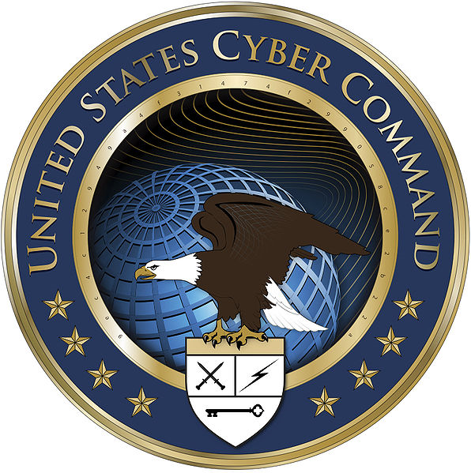
U.S. Cyber Command
Established in 2010
"USCYBERCOM plans, coordinates, integrates, synchronizes and conducts activities to: direct the operations and defense of specified Department of Defense information networks and; prepare to, and when directed, conduct full spectrum military cyberspace operations in order to enable actions in all domains, ensure US/Allied freedom of action in cyberspace and deny the same to our adversaries."
Notes:
Logo from: http://en.wikipedia.org/wiki/United_States_Cyber_Command

Slide 52
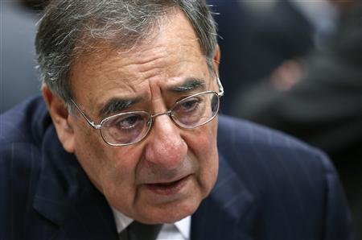
How Real Is the Threat?
October, 2012 U.S. Secretary of Defense Leon Panetta calls cyberspace the battlefield of the future.
http://news.yahoo.com/defense-chief-calls-cyberspace-battlefront-future-001539365.html

Slide 53
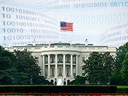
The Nation’s Cybersecurity
Should the President have the authority to shut down the Internet?
Protecting Cyberspace as a National Asset Act
http://news.cnet.com/8301-1009_3-20020901-83.html
Notes:
Image from: http://news.cnet.com/8301-1009_3-20020901-83.html

Slide 54
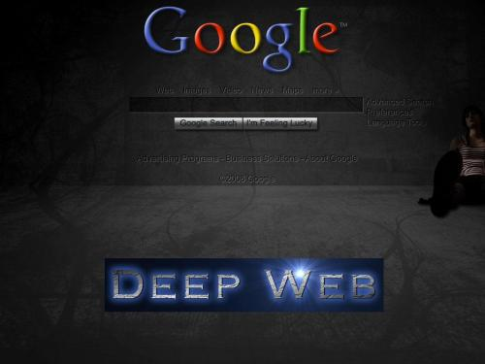
Where Is All This Bad Stuff Coming From?
Dark web or deep web: pages that do not have names that are registered in any DNS. Search engines cannot find them.
http://freenetproject.org/
Notes:
The deep web can be used to hide malicious activity or to get around government censorship.
http://witnessthis.wordpress.com/2009/12/14/the-dark-web-explained-2/

Slide 55
What About the Stuff that Comes from Us?
Snowden’s documents describe cyberattacks by US government.
http://www.nytimes.com/2013/09/01/world/americas/documents-detail-cyberoperations-by-us.html?_r=1&

Slide 56
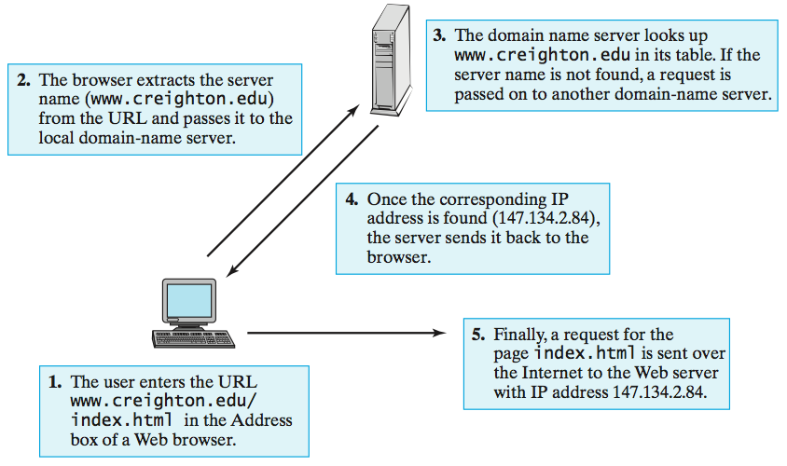
Recall: Domain Name Servers
Notes:
David Reed, A Balanced Introduction to Computer Science

Slide 57
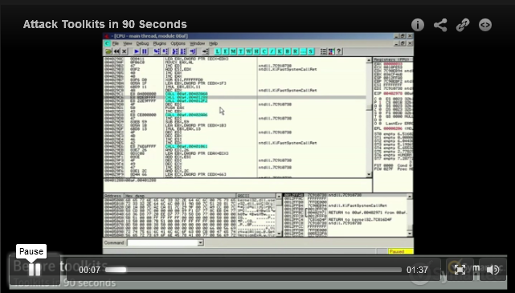
Attack Toolkits
http://www.symantec.com/tv/news/details.jsp?vid=750972922001
Notes:
Click to watch the video

Slide 58
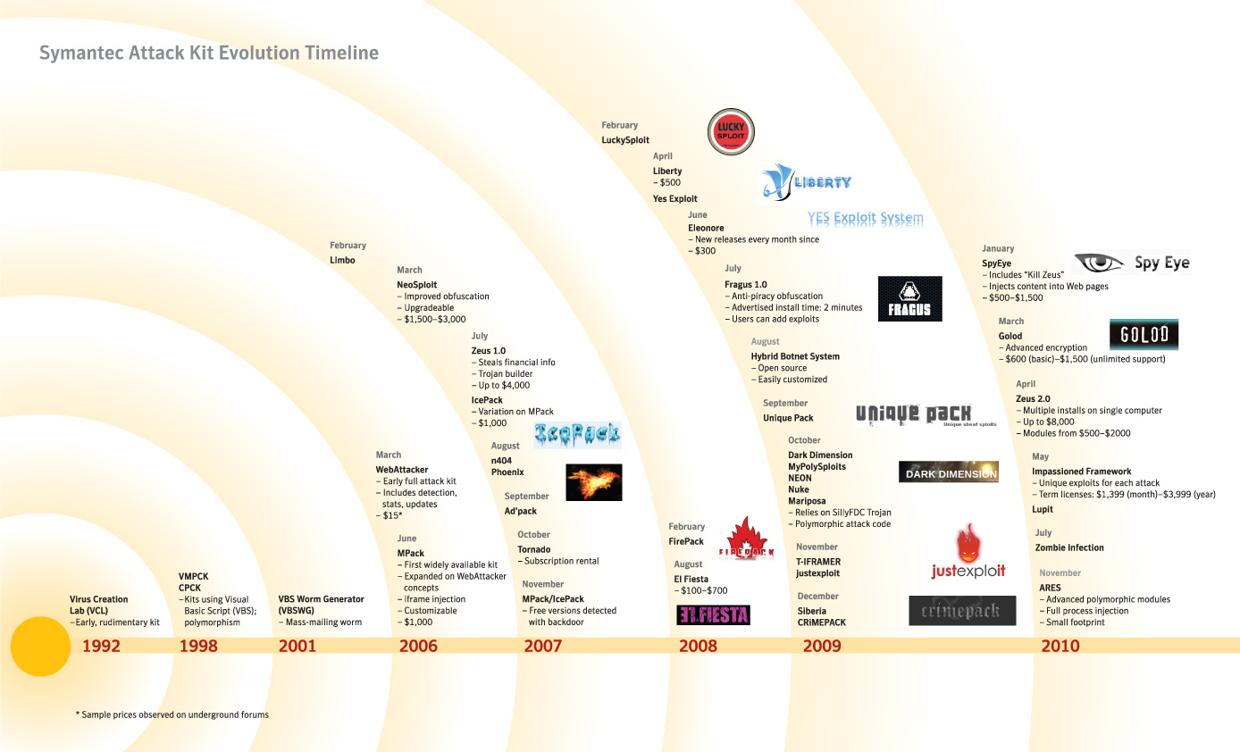
http://www.symantec.com/business/popup.jsp?popupid=attack_kit_evolution_timeline
Notes:
Go there to see it bigger but you have to scroll. I tried this on 10/19/12 and the image didn’t appear.

Slide 59
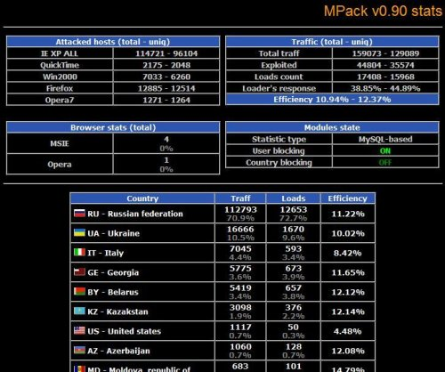
MPack
A malware bundle that was created by Russian hackers in 2006. It’s marketed to criminals as a commercial package that costs between $500 and $1,000. Frequent updates keep it one step ahead of antivirus software. MPack even comes with a management console that allows the botnet owner to keep track of how many computers have been infected, which browsers their owners were using at the time and which countries they’re in.
Notes:
http://pcplus.techradar.com/node/3066

Slide 60
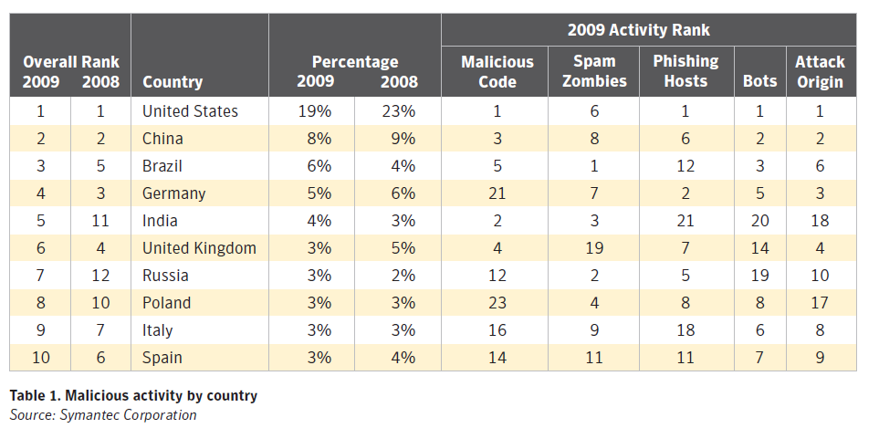
Where Are the Bad Guys?
Symantec Internet Security Threat Report , Volume XV, April, 2010
Notes:
http://eval.symantec.com/mktginfo/enterprise/white_papers/b-whitepaper_internet_security_threat_report_xv_04-2010.en-us.pdf

Slide 61
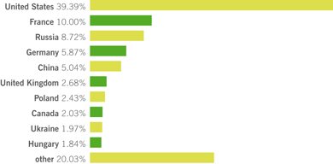
Where Are the Bad Guys?
Sophos Security Threat Report 2011
Notes:
http://www.sophos.com/security/topic/security-threat-report-2011.html?utm_source=Non-campaign&utm_medium=AdWords&utm_campaign=NA-AW-SecurityThreatReport-NL

