Slide 1
Ethics and Morality

Slide 2
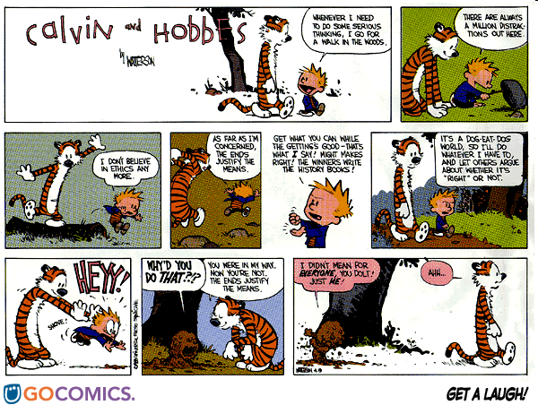
Notes:
http://imgsrv.gocomics.com/dim/?fh=4ca736f1644fcdc780d7f238db2280e1

Slide 3
The Words
Morality, from Latin moralis (custom). Actions are moral if they are “good” or worthy of praise.
Ethics, from Greek ήθος (custom). The formal study of moral standards and conduct.
    Goal: construct a general basis for deciding what is moral.

Slide 4
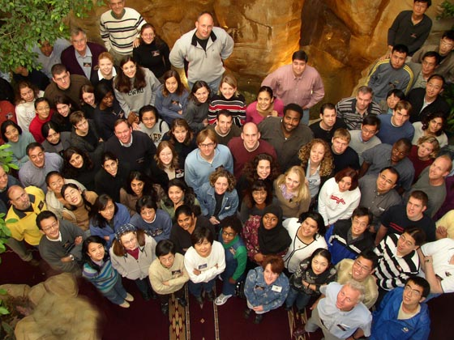
Which Can be Moral or Immoral?
Notes:
Normal people? Now what if I tell you that these are all people with serious mental illness?

Slide 5
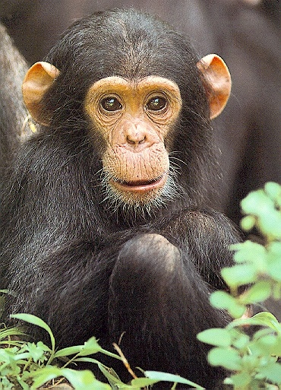
Which Can be Moral or Immoral?
Notes:
Chimpanzee

Slide 6
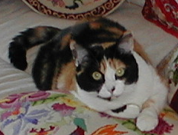
Which Can be Moral or Immoral?

Slide 7
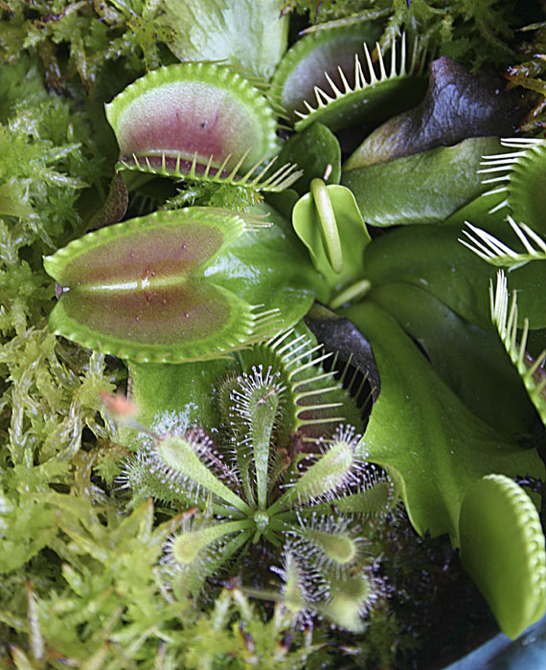
Which Can be Moral or Immoral?

Slide 8
Prerequisites for Morality
It must be possible to choose actions and to plan. What abilities enable us to do that?
Notes:
Memory, Language, Reason

Slide 9
What Else Has These Capabilities?

Slide 10
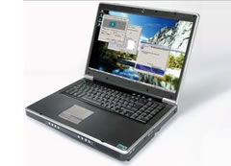
What Else Has These Capabilities?
So we must worry about : machine ethics
Notes:
Recall mention of this in Intro: Algorithm Bias and Driverless Car.

Slide 11
Ethics is About Choosing Actions
Virtue ethics: Chose actions that are inherently “good” rather than ones that are inherently “bad”.
Deontological (duty based) ethics: Choose actions that follow an accepted set of rules.
Consequentialist ethics: Choose actions that lead to desirable outcomes.

Slide 12
Problems
Virtue and duty-based ethics:
Notes:
Which ones? Who gets to decide?

Slide 13
Problems
Consequentialist ethics: Choose actions that lead to desirable outcomes.
The process:
  Choose goal(s).
  Reason about a plan to get as close as possible to the goal(s),
  Subject to some set of constraints.
Which?
How?
Which?
Notes:
1 and 3 require value judgements. People could disagree. 2 requires a lot of data and a lot of processing capability if we are going to do a good job at predicting what the outcomes of the various actions will be.

Slide 14
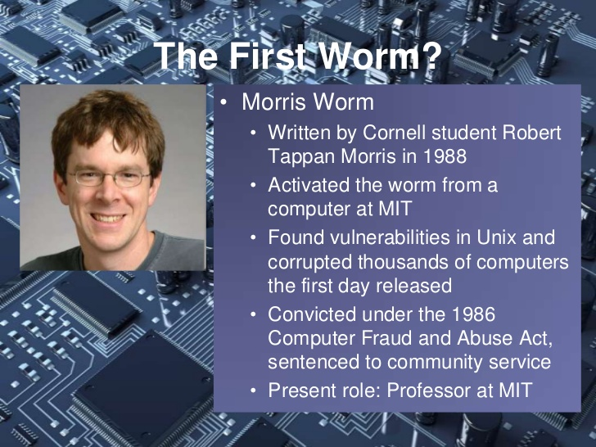
How Do People Actually Decide?
It feels right.
You notice an internet vulnerability and see how you can exploit it for a project.
Notes:
Stacey Edgar, Morality and Machines, p. 17
http://www.slideshare.net/mkgspsu/computer-viruses-14034411
He wanted to guage the size of the internet. He ended up being the first person convicted under the CFAA. (Robert Morris, Jr., at Cornell in 1988. Cost of worm: $100,000–100,000,000

Slide 15
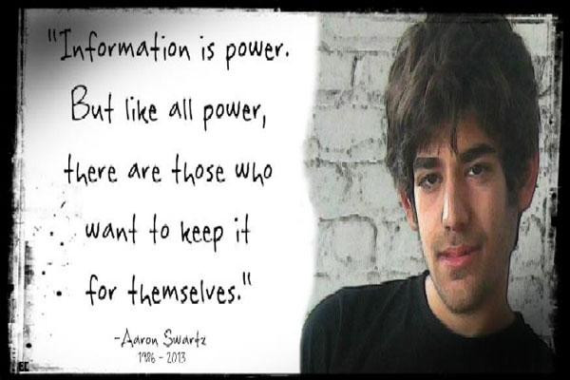

How Do People Actually Decide?
It feels right.
You think that information should be free so you download all of JSTOR.
Notes:
https://www.henrymakow.com/upload_images/Who-Killed-Aaron-Swartz.jpg

Slide 16
How Do People Actually Decide?
Listen to your conscience.
Notes:
The terrorists who planned the Sept. 11 attacks. Conscience is too personal and subjective.

Slide 17
How Do People Actually Decide?
Avoid making a mistake by doing nothing.
Examples:
Notes:
You look at a co-worker’s code and it seems really sloppy. You’re not sure they’re not planning to fix it. So you don’t say anything. We’ll talk more later about avoiding self driving cars because they might screw up, when, in fact, they will screw up far less often than people do.

Slide 18
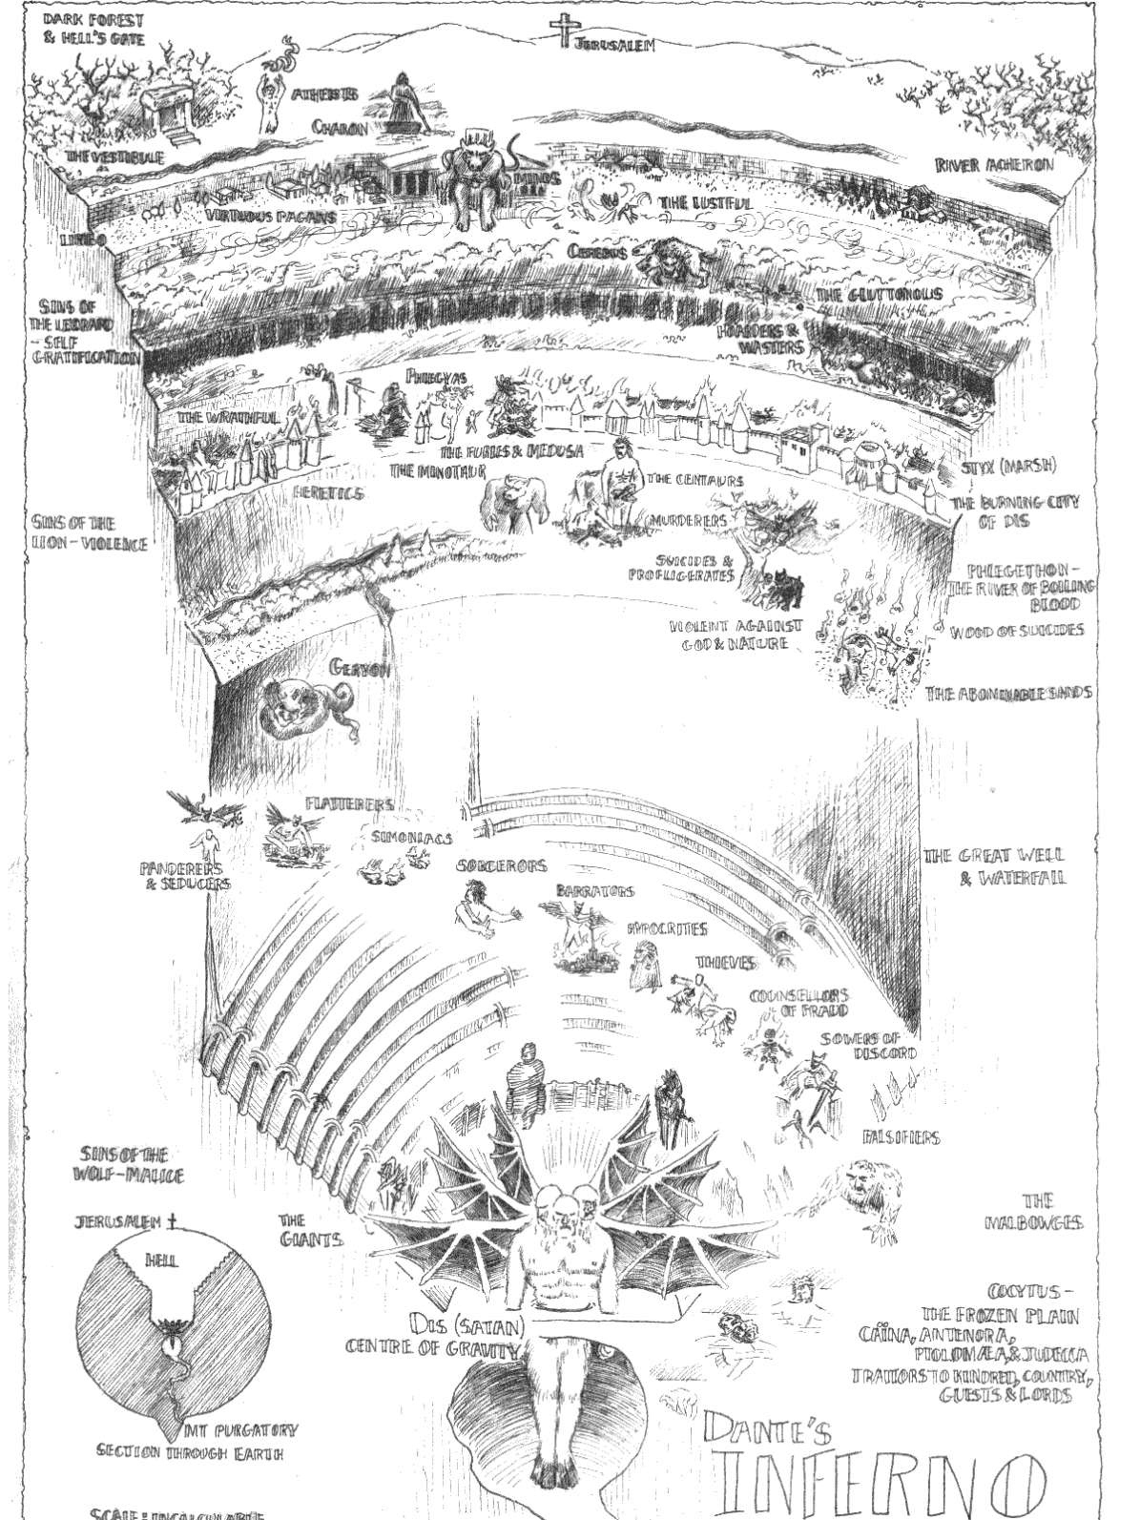
Where Dante (1265 – 1321)
Put the Undecided
Notes:
Running around forever in the vestibule. Image from: http://www.tabula-rasa.info/Horror/Inferno.html. Claim that this is in Canto III in Stacey Edgar, Morality and Machines, p. 17. Written between 1308 and his death in 1321

Slide 19
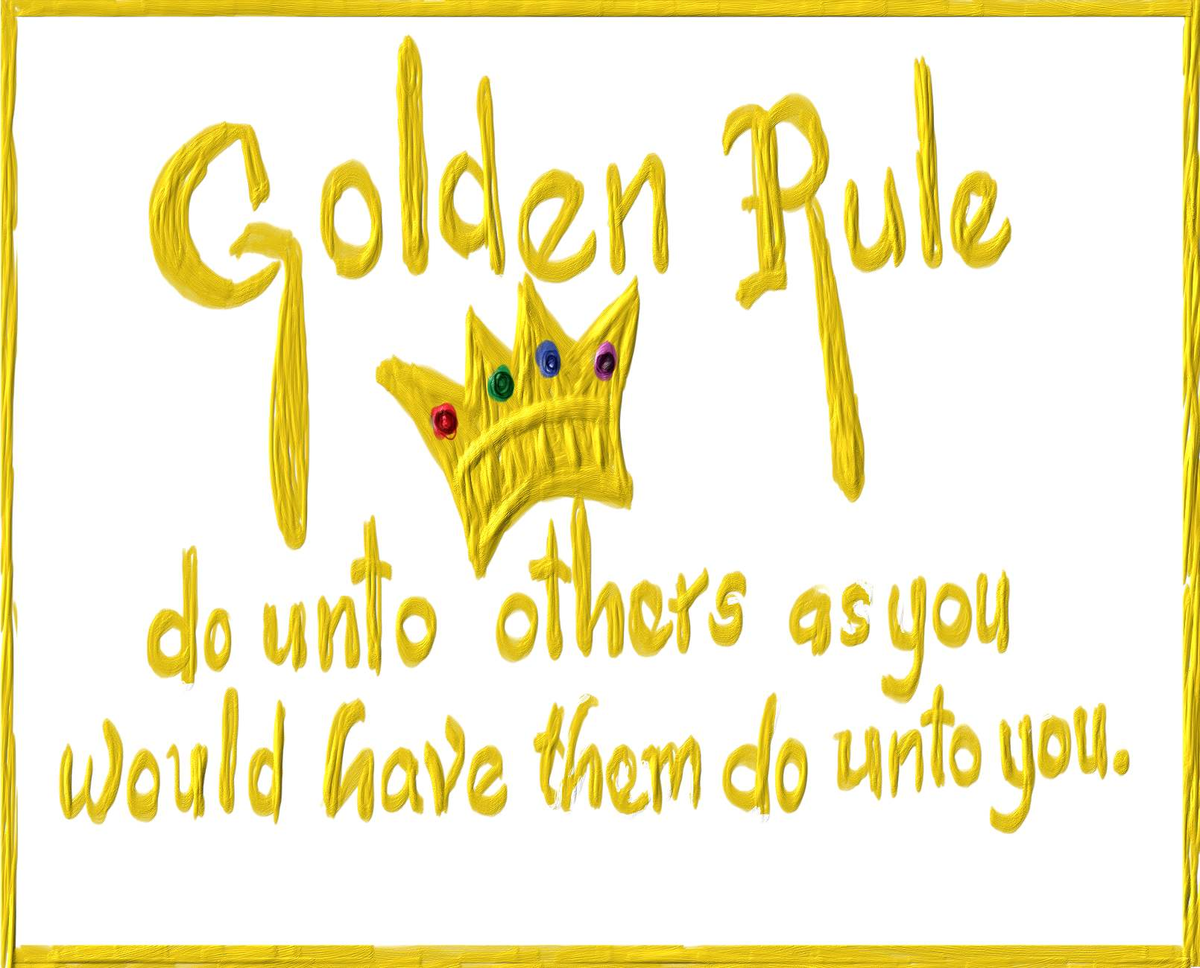
How Do People Actually Decide?
Hope that a simple rule works.
Notes:
But what if not everyone wants what you want. Suppose you are happy to give your software away free. Does this mean you can steal someone else’s? (Tavani, p 48)
Or this: Someone on your engineering team is grossly incompetent and is putting the whole project at risk. You consider reporting him. But you don’t because, if you were incompetent, you wouldn’t want to be reported.
Or consider what happens if people are in different roles. I don’t need anyone to bring me food. So does that mean I have no responsibility to bring food to anyone else, even my children?
https://marquetteeducator.files.wordpress.com/2013/12/golden-rule.jpg

Slide 20
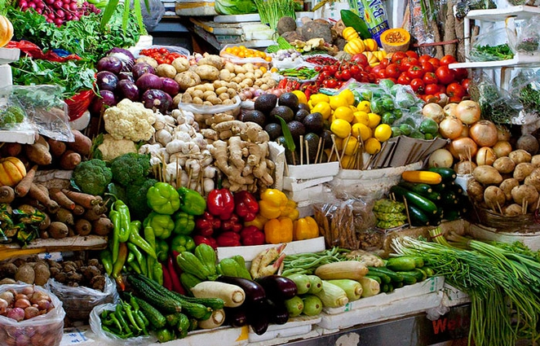
The Golden Rule
Christianity All things whatsoever ye would that men should do to you, do ye so to them; for this is the
law and the prophets. Matthew 7:1
Confucianism Do not do to others what you would not like yourself. Then there will be no
resentment against you, either in the family or in the state. Analects 12:2
Buddhism Hurt not others in ways that you yourself would find hurtful. Udana-Varga 5,1
Hinduism This is the sum of duty; do naught onto others what you would not have them do unto you.
Mahabharata 5,1517
Islam No one of you is a believer until he desires for his brother that which he desires for himself.
Sunnah
Judaism What is hateful to you, do not do to your fellowman. This is the entire Law; all the rest is
commentary. Talmud, Shabbat 3id
Taoism Regard your neighbor’s gain as your gain, and your neighbor’s loss as your own loss. Shang Kan Yin P’ien
Zoroastrianism That nature alone is good which refrains from doing another whatsoever is not good for
itself. Dadisten-I-dinik, 94,5
Now Hiring
Must Have a Clue
Free software?
Notes:
But what happens if people are in different roles. I don’t need anyone to bring me food. So does that mean I have no responsibility to bring food to anyone else, even my children?
What if not everyone wants what you want. Suppose you are happy to give your software away free. Does this mean you can steal someone else’s? (Tavani, p 48)
Or this: Someone on your engineering team is grossly incompetent and is putting the whole project at risk. You consider reporting him. But you don’t because, if you were incompetent, you wouldn’t want to be reported.
https://f69aa27b9b6c6702e27b-ffbfdeddb5f7166a1729dfea28599a63.ssl.cf3.rackcdn.com/raw_21921_d276d92790a041f5a098fed693a118c6_pile-vegetables.jpg

Slide 21
How Do People Actually Decide?
Appeal to authority (or “pass the buck”).
A religious tome.

Slide 22
How Do People Actually Decide?
Appeal to authority (or “pass the buck”).
A religious tome.
Leviticus 25: 45-46: “Moreover of the children of the strangers that do sojourn among you, of them shall ye buy, and of their families that are with you, which they begat in your land: and they shall be your possession. And ye shall take them as an inheritance for your children after you, to inherit them for a possession; they shall be your bondmen for ever: but over your brethren the children of Israel, ye shall not rule one over another with rigour.”

Slide 23
How Do People Actually Decide?
Appeal to authority.
A religious tome.
1 Timothy 6:1-2 : " Christians who are slaves should give their masters full respect so that the name of God and his teaching will not be shamed. If your master is a Christian, that is no excuse for being disrespectful. "

Slide 24
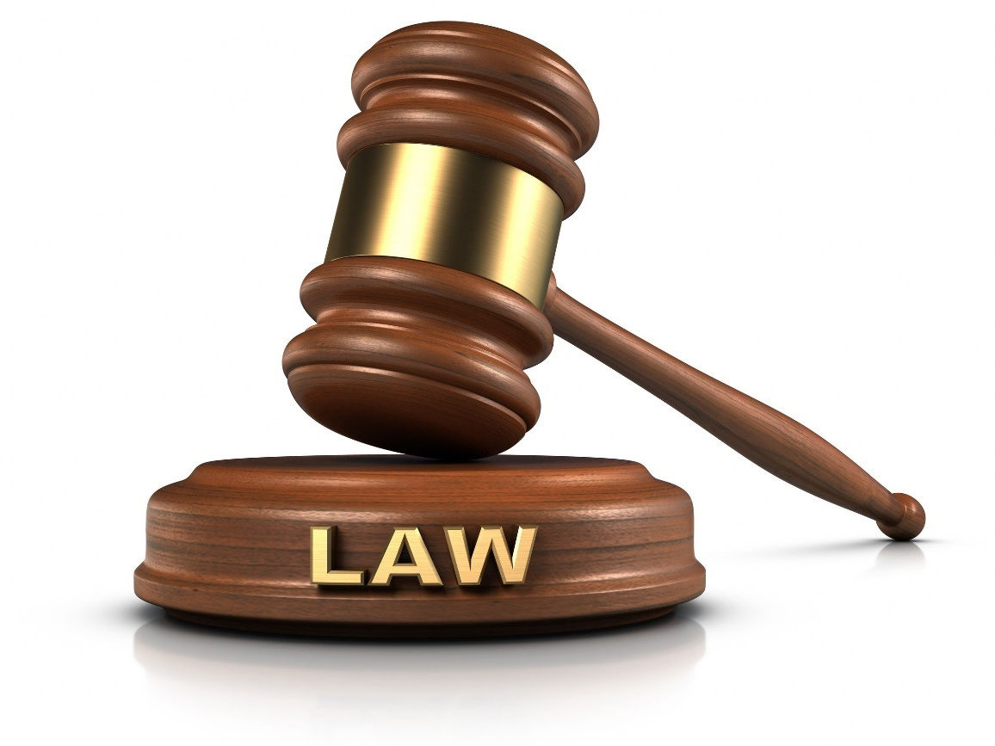
How Do People Actually Decide?
Appeal to authority.
A religious tome.
The law.
Notes:
http://www.slideshare.net/mkgspsu/computer-viruses-14034411
https://www.henrymakow.com/upload_images/Who-Killed-Aaron-Swartz.jpg

Slide 25
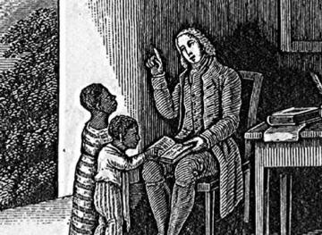
The Law
After the Nat Turner rebellion (1831), in most southern states it became illegal to teach slaves (and sometimes all black people) to read and write.
Jim Crow laws
Anti-miscegenation laws
U.S. Copyright law on statutory damages
Notes:
So we can’t always count on the law.
http://abolition.e2bn.org/library/0711/0000/0011/BEBE2_360.jpg

Slide 26
How Do People Actually Decide?
Appeal to authority.
A religious tome.
The law.
The boss.

Slide 27
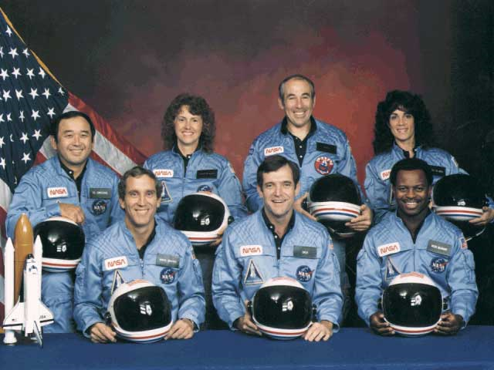
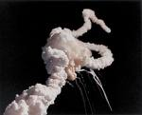
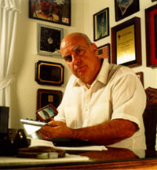
How Do People Actually Decide?
Appeal to authority.
A religious tome.
The law.
The boss.
The Challenger disaster (Jan 28, 1986)
http://www.onlineethics.org/cms/7123.aspx
Notes:
http://www.aerospaceguide.net/spaceshuttle/challenger_disaster.html

Slide 28
How Do People Actually Decide?
Appeal to authority.
A religious tome.
The law.
The boss.
A recognized smart person.

Slide 29
How Do People Actually Decide?
Appeal to authority.
A religious tome.
The law.
The boss.
A recognized smart/successful person.
Cecil Rhodes
Henry Ford
Notes:
Said

Slide 30

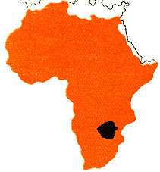
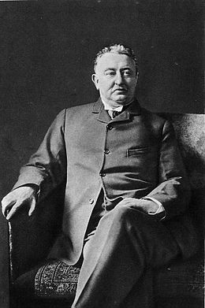

Cecil Rhodes
De Beers
Rhodesia
1853 -1902
Notes:
Businessman, Statesman, Philanthropist
Founded deBeers, Rhodesia (became Zambia and Zimbabwe)
http://en.wikipedia.org/wiki/Cecil_Rhodes
http://www.wikipedy.com/history_of_rhodesia_facts.htm
Diamond picture: http://www.personal.psu.edu/afr3/blogs/SIOW/2011/09/diamonds-are-a-planets-best-friend.html

Slide 31
Cecil Rhodes
De Beers
Rhodesia
"I contend that we are the first race in the world, and that the more of the world we inhabit the better it is for the human race...If there be a God, I think that what he would like me to do is paint as much of the map of Africa British Red as possible..."
1853 -1902
Notes:
Businessman, Statesman, Philanthropist
Founded deBeers, Rhodesia (became Zambia and Zimbabwe)
http://en.wikipedia.org/wiki/Cecil_Rhodes
http://www.wikipedy.com/history_of_rhodesia_facts.htm
Diamond picture: http://www.personal.psu.edu/afr3/blogs/SIOW/2011/09/diamonds-are-a-planets-best-friend.html

Slide 32
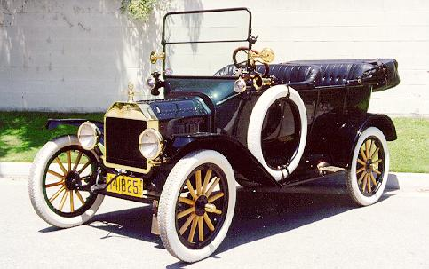
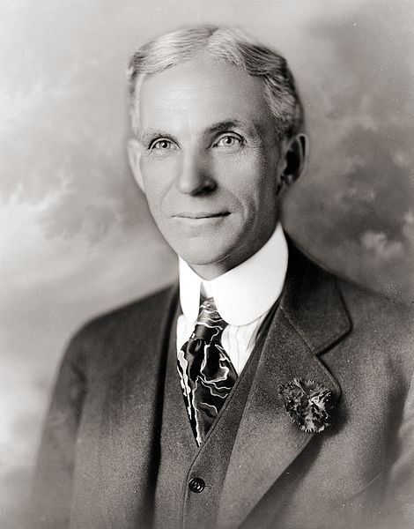
Henry Ford
In 1999, he was among 18 included in Gallup's List of Widely Admired People of the 20th Century, from a poll conducted of the American people.
1863 - 1947
Notes:
http://en.wikipedia.org/wiki/Henry_Ford
http://www.musclecarclub.com/other-cars/classic/ford-model-t/ford-model-t.shtml

Slide 33
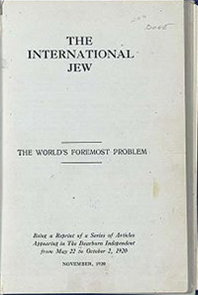
Henry Ford
In 1999, he was among 18 included in Gallup's List of Widely Admired People of the 20th Century, from a poll conducted of the American people.
1863 - 1947
“If fans wish to know the trouble with American baseball they have it in three words—too much Jew.”
Notes:
http://en.wikipedia.org/wiki/Henry_Ford
http://www.musclecarclub.com/other-cars/classic/ford-model-t/ford-model-t.shtml

Slide 34
Moral Dilemmas
Truth vs. loyalty
Individual vs. community
Short term vs. long term
Justice vs. mercy
From Rushworth Kidder, Moral Courage, p. 89
Notes:
Also discussed in Giving Voice to Values, p. 176

Slide 35
Why Do People Act Morally?
Notes:
Fear of getting caught
Guilty conscience

Slide 36
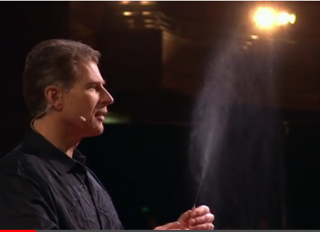
Here’s Another Idea
Paul Zak on Oxytocin
http://www.ted.com/talks/paul_zak_trust_morality_and_oxytocin.html?quote=1148
Notes:
Zak coined the term “neuroeconomics”. Can this be the whole answer? Probably not. But through research like this, might we eventually understand why most people are moral? Maybe.
Commentary by Zak: http://www.cnn.com/2011/12/27/opinion/zak-moral-molecule/

Slide 37

Why Don’t People Act Morally?
Dan Ariely on our buggy moral code
http://www.ted.com/talks/dan_ariely_on_our_buggy_moral_code.html

Slide 38
Why Don’t People Act Morally?
Rationalization:
Everyone does it. It’s standard practice.
It doesn’t really hurt anyone.
This is not my responsibility. I shouldn’t stick my nose in.
If I make a stink, I won’t be effective but I’ll get a reputation as a complainer.
If I stood up for what I believe, they’d just fire me and get someone else to do what they want.
Notes:
Much of this taken from Giving Voice to Values, p. 179

Slide 39
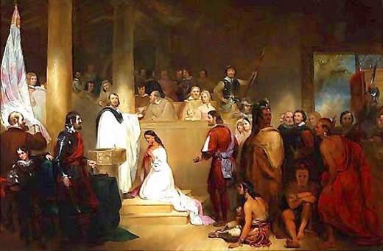
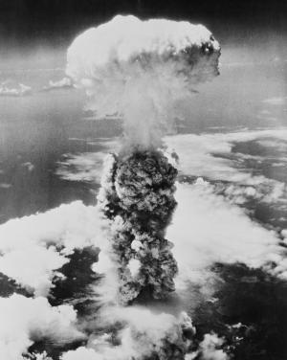
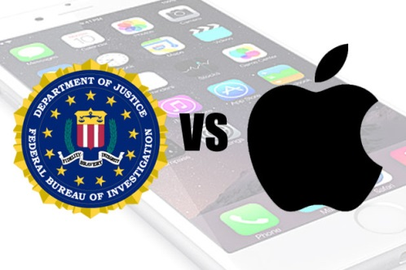
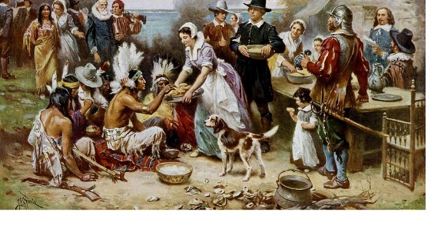
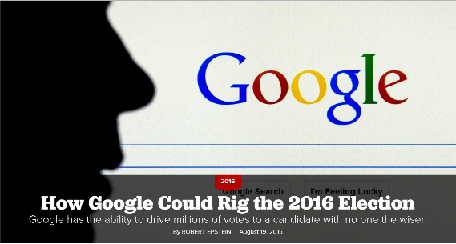
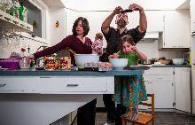
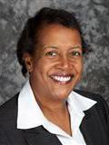
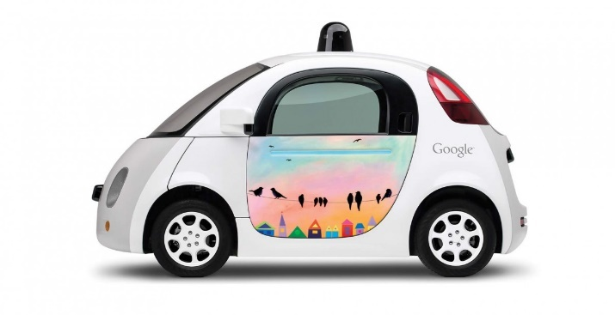
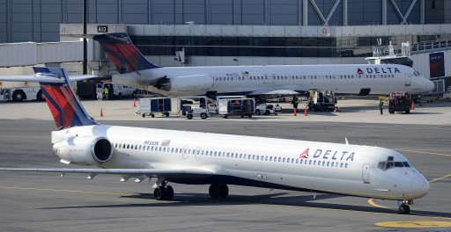
So, What Should We Do?
Responsibility for the big picture
“Latisha Smith Truth...
Check Latisha Smith's Arrests.”
Notes:
You folks have to worry about ethics in two important ways: Because you build important things, you must think about the big picture.
https://www.aoc.gov/art/historic-rotunda-paintings/baptism-pocahontas
http://history1900s.about.com/od/worldwarii/a/hiroshima.htm
http://www.vosizneias.com/160026/2014/03/30/atlanat-delta-virgin-takes-up-battle-for-new-york-london-fliers/
http://mobile.nytimes.com/2012/11/22/technology/when-phones-come-out-long-before-the-turkey.xml
Jamestown image: http://bigthink.com/think-tank/the-first-thanksgiving-reclaiming-jamestown-from-the-dustbin-of-history?page=all
http://www.politico.com/magazine/story/2015/08/how-google-could-rig-the-2016-election-121548.html?ml=po#.VdzO3_lVikq
http://www.thewrap.com/fbi-admits-it-reset-san-bernardino-shooters-iphone-password/
http://articles.chicagotribune.com/2012-11-25/business/sns-rt-usa-internetprofilingl1e8me8dx-20121124_1_internet-ad-personal-data-ad-text
http://www.forbes.com/sites/brookecrothers/2015/11/12/google-is-leader-in-revolutionary-self-driving-cars-says-ihs/#1fc314e3e6b1

Slide 40
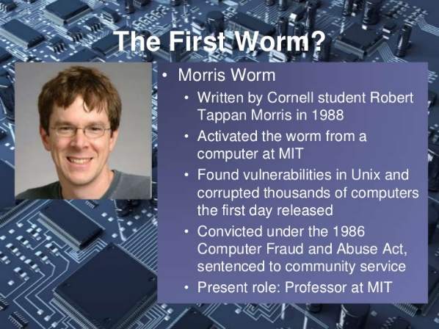
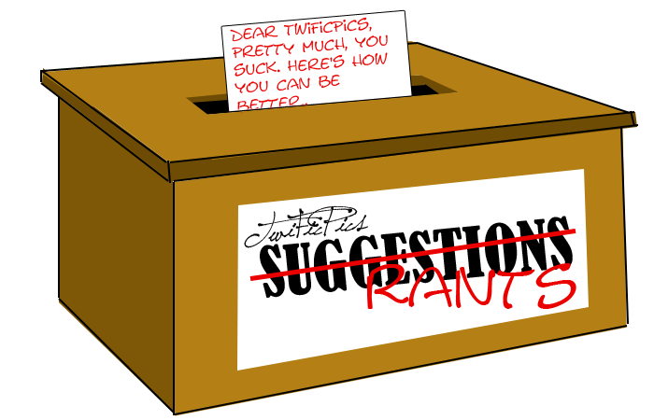
So, What Should We Do?
Responsibility for our individual decisions
Notes:
You must also make personal decisions, both in your private life and at work, as these examples have shown.
You notice an internet security vulnerability. Is it okay to use it because it lets you do what you want? (i.e., find out the size of the internet)?
You believe that everyone has the right to knowledge. Should you download the contents of JSTOR and post them on the web?
You know that there’s something wrong in your organization. Should you whistleblow?
Your boss asks you to de-anonymize the suggestion box. Should you do it?
http://www.slideshare.net/mkgspsu/computer-viruses-14034411
http://www.nytimes.com/2013/01/13/technology/aaron-swartz-internet-activist-dies-at-26.html?ref=us
http://www.aerospaceguide.net/spaceshuttle/challenger_disaster.html
http://yourforum.gr/InvisionBoard/index.php?showtopic=392745

Slide 41
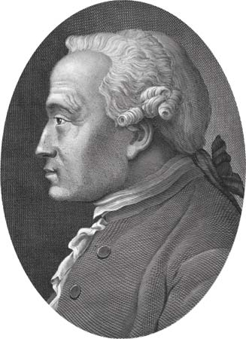
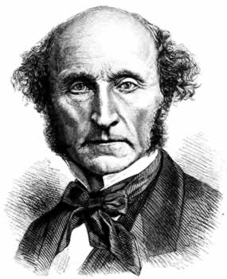
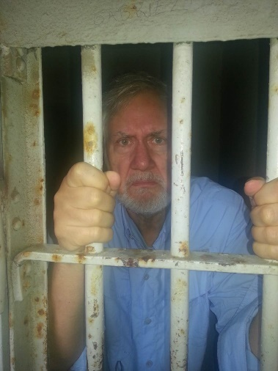
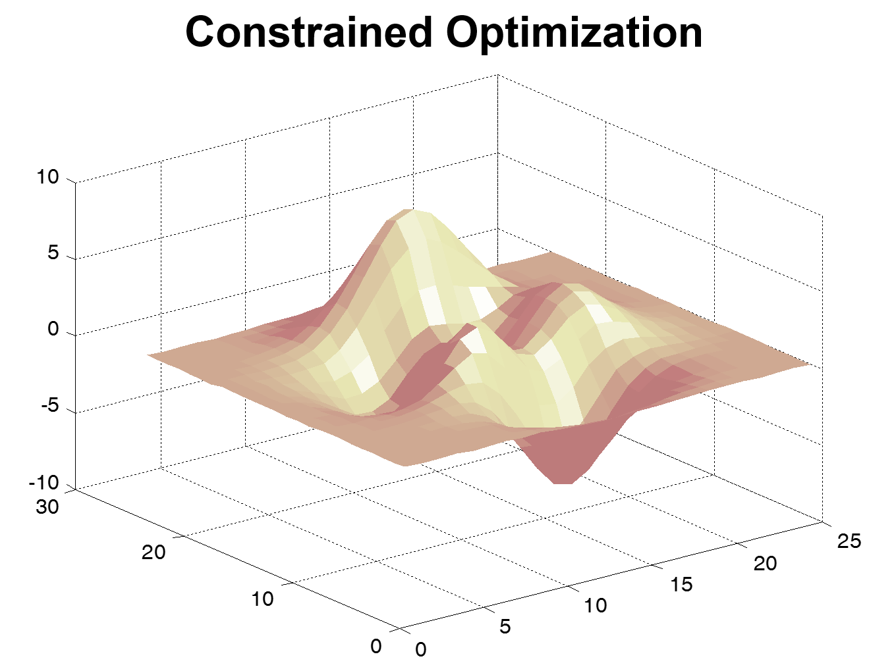
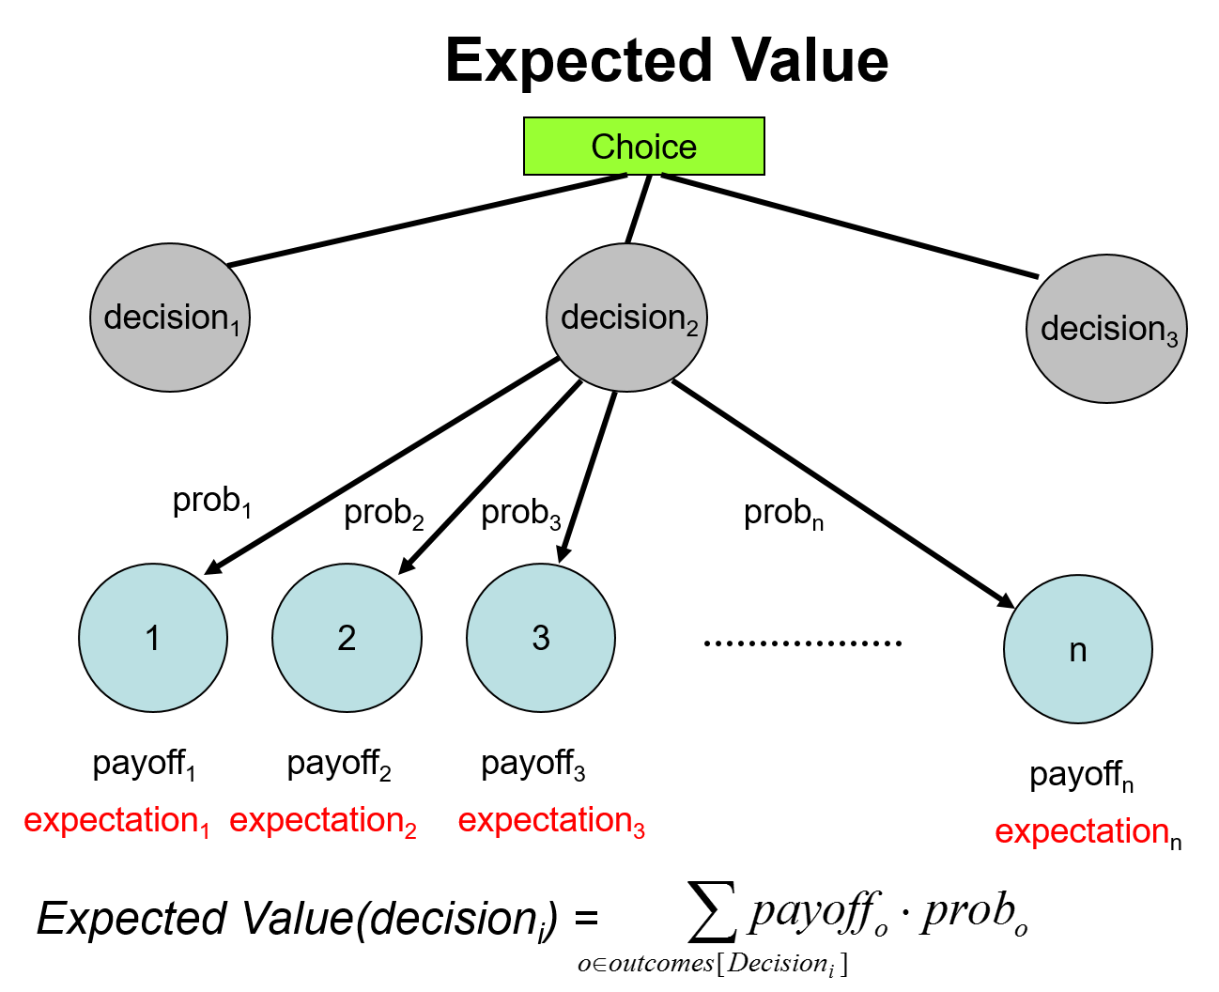
Ethical Frameworks Help Us Find Answers
and Mathematics
Kant and Deontology
Utilitarianism
Prisoner’s Dilemma
Notes:
We present philosophical approaches. But we can also make use of theories that are not generally considered by philosophers.
Mill (hair sticking out): http://www.utilitarian.net/jsmill/
Kant: http://media-2.web.britannica.com/eb-media/69/99069-004-1D777F95.jpg
Utilitarianism is outcome based. How to compute outcomes?
Utilitarianism is optimization based. Deontological approaches impose constraints. So how does constrained optimization work?
How to behave in a world where other agents are rational? Prisoner’s dilemma.

Slide 42
Ethical Frameworks Help Us Find Answers
Kant and Deontology
Utilitarianism
Actions are good or bad.
What matters is outcome.
Notes:
We present philosophical approaches.
Mill (hair sticking out): http://www.utilitarian.net/jsmill/
Kant: http://media-2.web.britannica.com/eb-media/69/99069-004-1D777F95.jpg
Utilitarianism is outcome based. How to compute outcomes?
Utilitarianism is optimization based. Deontological approaches impose constraints. So how does constrained optimization work?
How to behave in a world where other agents are rational? Prisoner’s dilemma.

Slide 43
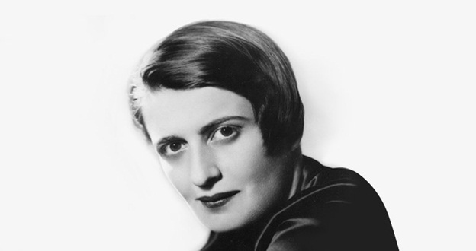
Ethical Egoism
“The achievement of his own happiness is man’s highest moral purpose.”
- Ayn Rand, The Virtue of Selfishness (1961)
Notes:
One quick slide on this approach.
http://www.signature-reads.com/2014/12/hidden-ayn-rand-novel-published-for-first-time-80-years/

Slide 44
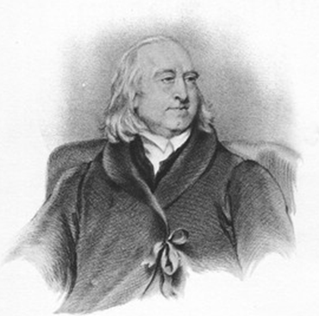
Utilitarianism
Jeremy Bentham
1748-1832
John Stuart Mill
1806-1873
Notes:
Mill: http://www.utilitarian.net/jsmill/
Bentham: http://www.iep.utm.edu/bentham/

Slide 45
Utilitarianism
Choose the action that results in the greatest total
To do this, we need to:
  Define what’s good.
  Find a way to measure it.
good.
utility.

Slide 46
Intrinsic Good
We could argue that happiness is an intrinsic good that is desired for its own sake.
But we’re still stuck:
  Other things are good if they are a means to
  the end of happiness.
  And what makes you happy, anyway?
Notes:
How do define “good”?

Slide 47
“Higher” Pleasures
“It is better to be a human being dissatisfied than a pig satisfied; better to be Socrates dissatisfied than a fool satisfied.”
- John Stuart Mill, Utilitarianism

Slide 48
Preference Utilitarianism
Choose actions that allow all individuals to maximize good to them.
Notes:
Worth mentioning preference utilitarianism here because modern technology makes it possible in a way it never was before.
We don’t all have to read the same news or watch the same tv.

Slide 49
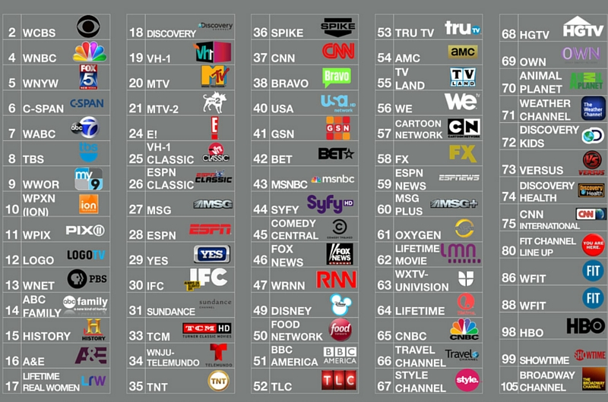
Preference Utilitarianism
Choose actions that allow all individuals to maximize good to them.
A: CNN
B: Fox
C: MSNBC
D: NPR
E: BBC
Notes:
Examples of ways technology is good from a preference utilitarian’s perspective:
We don’t all have to read the same news or watch the same tv. Or have the same privacy settings on Facebook.
http://it.fitnyc.edu/2014/08/05/tv-channel-guide/

Slide 50
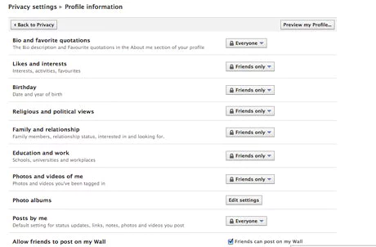
Preference Utilitarianism
Choose actions that allow all individuals to maximize good to them.
A: No Facebook
B: Only friends
C: In between
D: It’s all out there.
Notes:
Examples of ways technology is good from a preference utilitarian’s perspective:
We don’t all have to read the same news or watch the same tv. Or have the same privacy settings on Facebook.
https://www.theguardian.com/technology/2010/may/27/how-new-facebook-privacy-settings-work

Slide 51

Preference Utilitarianism
Choose actions that allow all individuals to maximize good to them.
A: None
B: Maybe one
C: In between
D: All I can find
Notes:
Examples of ways technology is good from a preference utilitarian’s perspective:
We don’t all have to make the same tradeoff between protecting privacy and getting good deals.
http://kinsmenlutheran.org/donation-programs/

Slide 52
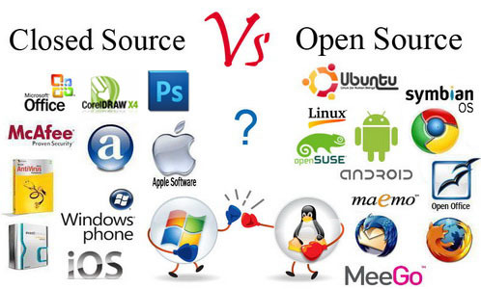
Preference Utilitarianism
Choose actions that allow all individuals to maximize good to them.
Notes:
Examples of ways technology is good from a preference utilitarian’s perspective:
IP law protects your work if you want it too. But you don’t have to use it.
http://ianthro.com/microsoft-vs-open-source-software

Slide 53
Act Utilitarianism
On every individual move:
choose the action with the highest utility.

Slide 54
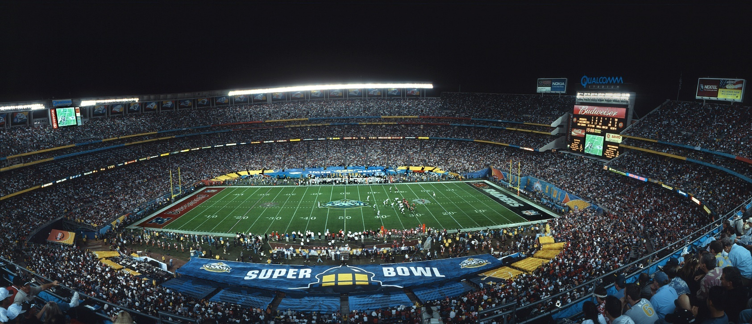
Problems with Act Utilitarianism
Teams A and B are playing in the Super Bowl.
Team A has twice as many die-hard fans as Team B.
You play for Team B.
Should you try to lose in order maximize the happiness of fans?
Notes:
Maximizing happiness conflicts with the commitment you made when you joined Team B.
Also, long term, if people find out that games are rigged, will they get less enjoyment from the game?
http://scooperinc.com/can-the-super-bowl-help-the-nfl-get-over-its-millennial-problem/

Slide 55

Problems with Act Utilitarianism
It’s Saturday morning:
  You can hang out and watch a game.
  Or you can volunteer with Habitat.
Are you required to volunteer?
Notes:
Surely everyone is entitled to some time off.
http://bbjtoday.com/wp-content/woo_custom/1692-habitat-for-humanity-web.jpg

Slide 56
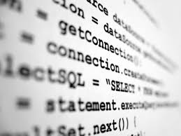
Problems with Act Utilitarianism
You’re up against a deadline and you’ve got some tricky code to write. You still have the files from your old company and you remember someone on the team solving this problem.
  You can go grab the old code and reuse it.
  Or you can rewrite the code.
Do you ask yourself questions like,
  “How long will it take to write the code?” or
  “How likely is it that someone will find out?”
Notes:
Or do you just apply a rule that says no cheating.
http://uoacomputerscience.blogspot.com/2012/04/is-computer-code-property.html

Slide 57


Rule Utilitarianism
On every move, choose the action that accords with general rules that lead to the highest utility.
The Super Bowl problem.
The Saturday morning problem.
The code sharing problem.

Slide 58
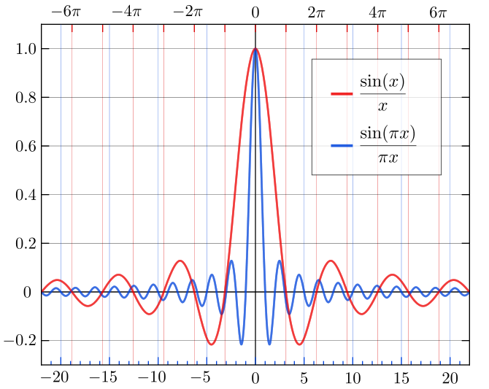
Implementing Utilitarianism
ACT:
RULE:
Notes:
Explain arg max. Not everyone has seen it before.

Slide 59
Optimality?
Optimal behavior (in some sense): Explore all paths and choose the best.
Notes:
http://www.godowntownraleigh.com/go/cabarrus-street-parking-lot

Slide 60
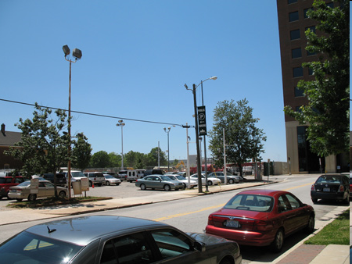
Bounded Rationality
Optimal behavior (in some sense): Explore all paths and choose the best.
Notes:
http://www.godowntownraleigh.com/go/cabarrus-street-parking-lot
The question. Do you take this space that is a block away from your goal, or do you keep going, in search of the “optimal” parking space?

Slide 61
Bounded Rationality
Optimal behavior (in some sense): Explore all paths and choose the best.
Bounded rationality: Stop and choose the first path that results in a state whose value is above threshold.
Satisfice
Recall where Dante put the folks who can’t make up their minds.
Notes:
In other words, “good enough”. There is a fancy word for “good enough”

Slide 62
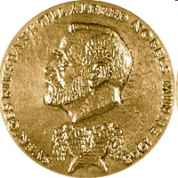
Bounded Rationality
Optimal behavior (in some sense): Explore all paths and choose the best.
Bounded rationality: Stop and choose the first path that results in a state whose value is above threshold.
The Sveriges Riksbank Prize in Economic Sciences in Memory of Alfred Nobel 1978, awarded to Herbert Simon:
"for his pioneering research into the decision-making process within economic organizations"

Slide 63
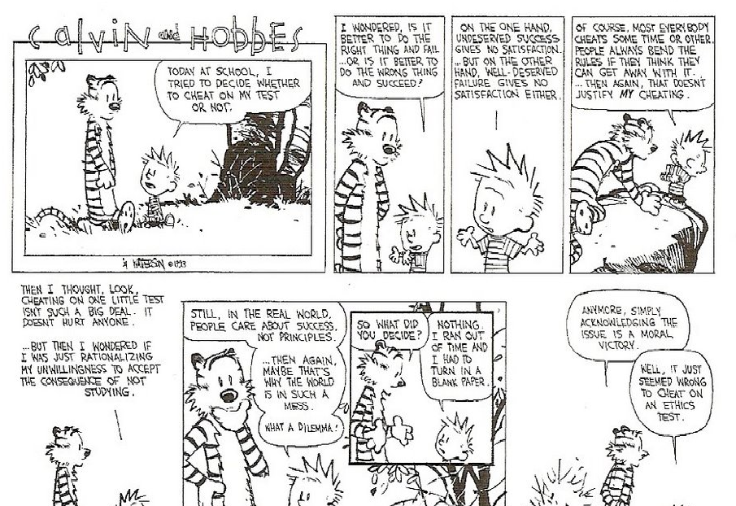
Notes:
http://radiganneuhalfen.blogspot.com/2009/07/ethics-with-calvin-and-hobbes.html

Slide 64
Implementing Utilitarianism
Determine the audience (the beings who may be affected).
Determine the positive and negative effects of the alternative actions or policies.
Construct a utility function that weights those affects appropriately.
Compute the value of the utility function for each alternative.
Choose the alternative with the highest utility.
Notes:
Note use of “beings” rather than “people”. Bentham made a big deal about this and concluded that not only all people but other sentient creatures should be included.

Slide 65
Implementing Utilitarianism
Determine the audience (the beings who may be affected).
Determine the positive and negative effects of the alternative actions or policies.
Construct a utility function that weights those affects appropriately.
Compute the value of the utility function for each alternative.
Choose the alternative with the highest utility.
Notes:
What happens when we can’t predict outcomes with certainty? How can we do step 2?

Slide 66

Implementing Utilitarianism
Determine the audience (the beings who may be affected).
Determine the positive and negative effects of the alternative actions or policies.
Notes:
How, in a complex world? Just to pick one. Do we know whether a back door would make the phone more vulnerable to bad guys? Do we know what effect doing this would have on our customers? Do we even know whether, with a back door, it will be possible for Law Enforcement to find something useful? So how do we do step 2?

Slide 67
Your First Job
Your first job after graduation is system administrator for a 200 person
privately held manufacturing company.
The president/owner sends this message to the employees:
  “I want to encourage each of you to make comments to me about any facet of our operation you care to. Your response should be made through our anonymizer program so that your identity will not be disclosed”
The president/owner finds one response saying:
  “This company sucks. The only way I find to retaliate for the way I have been treated is sabotage. Every tenth part I turn out is defective.”
The president/owner insists that you examine the computer usage records to determine the identity of the alleged saboteur.
What should you do?
… and they do make pacemakers in a small town. The company is “Beat Beat Pump Pump ® Pacemakers”.
Notes:
Back to this one. We need more information.

Slide 68
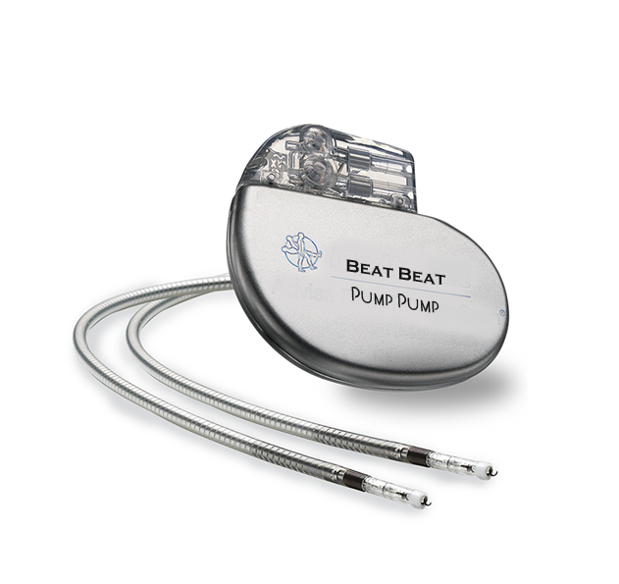

Slide 69

What should you do?
D₁. Identify the sender and inform boss
D₂. Identify the Sender and secretly meet him/her
D₃. Publicize the boss’s request to everyone
D₄. Claim you can’t identify the sender
…
D_{n}. Quit

Slide 70
You control that decision
… but what happens next you do not control.
Someone else or “fate” (i.e., no person) controls the outcome.
Since you cannot guarantee the outcome, we might model that as a random event with probabilities attached to the possibilities.
Remember: In Utilitarianism, we care about outcomes.

Slide 71
Let’s consider your situation at Beat Beat Pump Pump ®
One possible decision was:
“Identify the sender and inform boss”
You could decide to do that and then:
The boss rewards you and no other consequences.
The boss rewards you but word gets out that you ratted on someone.
Your best friend (who sent the message as a joke) is fired.
The saboteur is fired and the company (and thus the community) becomes quite successful for making the most reliable pacemakers.
…

Slide 72
The boss rewards you and no other consequences.
The boss rewards you but word gets out that you ratted on someone.
Your best friend (who sent the message as a joke) is fired.
The saboteur is fired and the company (and thus the community) becomes quite successful for making the most reliable pacemakers.
…
To employ this method of “rational” decision making, you would next assign probabilities and costs/payoffs/utility to each of these outcomes.

Slide 73
Expected Value
Choice
decision₁
decision₂
decision_{n}
prob₁
prob₂
prob₃
prob_{k}
1
2
3
k
payoff₁
payoff₂
payoff₃
payoff_{k}
expectation₁
= payoff₁·prob₁
expectation₂
expectation₃
expectation_{k}
= payoff_{k}·prob_{k}
Expected Value(decision_{i}) =

Slide 74
Rational Choice

Slide 75
Implementing Utilitarianism
ACT:
Notes:
Plugging expected value into our implementation of utilitarianism, we get this.
But the problem here is that no way will you ever have all the required numbers. So what do you do?

Slide 76

What Would You Do?
Notes:
You actually do use expected value. You just estimate.
What’s the probability that this is a phish? Very high. And price to be paid if phish? Very high.

Slide 77
What Would You Do?
iClicker Moment:
Ignore this
Respond

Slide 78
Rational Choice
Choice
ignore
respond
.0001
.9999
.9999999
.0000001
Lose Email
Nothing
Phish City
Save Email
-$10,000
$0
-$50,000
-$1
Expected Value(ignore) = -$10,000 * .0001 + $0 *.9999
= - $1
Expected Value(respond) = -$50,000 * .9999999 + -$1 *.0000001
= -$49,999.995….
What decision might a non-computer professional make?
What decision might the bad guys make?

Slide 79
Do you not often make decisions consciously or unconsciously based upon maximizing expected value?
Should I illegally download music?
Should I inform on a cheating coworker?
Should I have my children vaccinated?
Should I run this red light?
But what did Dan Ariely say about his experimental subjects applying this approach to make decisions about cheating?

Slide 80
Technology and Rights Tradeoffs
Privacy vs Security
Notes:
Often the issue is trading off rights in new ways. Can we compute the expected value of outcome for each choice?
http://www.thewrap.com/fbi-admits-it-reset-san-bernardino-shooters-iphone-password/

Slide 81
But People Don’t Do It Quite This Way
Imagine that the U.S. is preparing for the outbreak of an unusual Asian disease, which is expected to kill 600 people. Two alternative programs to combat the disease have been proposed.
Notes:
Much research (e.g., Kahneman and Tversky) shows that people are not completely rational in these circumstances. Particularly in the way they evaluate risk.
Show this slide. Then ask half the people to leave the room.

Slide 82
But People Don’t Do It Quite This Way
Problem 1: Imagine that the U.S. is preparing for the outbreak of an unusual Asian disease, which is expected to kill 600 people. Two alternative programs to combat the disease have been proposed. Assume that the exact scientific estimate of the con- sequences of the programs are as follows:
If Program A is adopted, 200 people will be saved.
If Program B is adopted, there is 1/3 probability that 600 people will be saved, and 2/3 probability that no people will be saved.
Which of the two programs would you favor?
From Amos Tversky and Daniel Kahneman, “The Framing of Decisions and the Pyschology of Choice”, Science, Vol. 211, No. 4481 (Jan. 30, 1981), pp.453-458.
Notes:
Show this version and ask people to click. Write down the percentages for the two answers. Then click to the next slide (which is the same as the previous one). With it up, send these people out of the room and bring the others back in.

Slide 83
But People Don’t Do It Quite This Way
Imagine that the U.S. is preparing for the outbreak of an unusual Asian disease, which is expected to kill 600 people. Two alternative programs to combat the disease have been proposed.
Notes:
Once other half is in room, click next.

Slide 84
But People Don’t Do It Quite This Way
Problem 2 Imagine that the U.S. is preparing for the outbreak of an unusual Asian disease, which is expected to kill 600 people. Two alternative programs to combat the disease have been proposed. Assume that the exact scientific estimate of the con- sequences of the programs are as follows:
If Program C is adopted, 400 people will die.
If Program D is adopted, there is 1/3 probability that nobody will die, and 2/3 probability that 600 people will die.
Which of the two programs would you favor?
From Amos Tversky and Daniel Kahneman, “The Framing of Decisions and the Pyschology of Choice”, Science, Vol. 211, No. 4481 (Jan. 30, 1981), pp.453-458.
Notes:
Notice difference in how the problem is framed. Again, ask students and write the percentages of each response on the board. When done, click next.

Slide 85
But People Don’t Do It Quite This Way
Imagine that the U.S. is preparing for the outbreak of an unusual Asian disease, which is expected to kill 600 people. Two alternative programs to combat the disease have been proposed.
Notes:
This is up again while people are milling around. When settled, click next.

Slide 86
But People Don’t Do It Quite This Way
How a problem is framed matters.
Problem 1 [N = 152]: Imagine that the U.S. is preparing for the outbreak of an unusual Asian disease, which is expected to kill 600 people. Two alternative programs to combat the disease have been proposed. Assume that the exact scientific estimate of the con- sequences of the programs are as follows:
If Program A is adopted, 200 people will be saved. [72 percent]
If Program B is adopted, there is 1/3 probability that 600 people will be saved, and 2/3 probability that no people will be saved. [28 percent]
Which of the two programs would you favor?
From Amos Tversky and Daniel Kahneman, “The Framing of Decisions and the Pyschology of Choice”, Science, Vol. 211, No. 4481 (Jan. 30, 1981), pp.453-458.
Notes:
This is the first question. Numbers in red correspond to responses from a group of Stanford students when Tversky and Kahneman did this experiment. Compare numbers you got.

Slide 87
But People Don’t Do It Quite This Way
How a problem is framed matters.
Problem 2 [N = 155]: Imagine that the U.S. is preparing for the outbreak of an unusual Asian disease, which is expected to kill 600 people. Two alternative programs to combat the disease have been proposed. Assume that the exact scientific estimate of the con- sequences of the programs are as follows:
If Program C is adopted, 400 people will die. [22 percent]
If Program D is adopted, there is 1/3 probability that nobody will die, and 2/3 probability that 600 people will die. [78 percent]
Which of the two programs would you favor?
From Amos Tversky and Daniel Kahneman, “The Framing of Decisions and the Pyschology of Choice”, Science, Vol. 211, No. 4481 (Jan. 30, 1981), pp.453-458.
Notes:
And the second version.

Slide 88
Risk
Choices involving gains are often risk-averse.
  Go for the sure win.
Choices involving losses are often risk-taking.
Avoid the sure loss.

Slide 89

Prospect Theory
Instead of computing, for each outcome:
We compute:
A typical v:
Notes:
The theory due to Tversky and Kahneman Also pi handles the fact that people tend to overweight low probabilities.
Picture from: http://en.wikipedia.org/wiki/Image:Valuefun.jpg
Weights applied to true values (along the x axis) to compute perceived values.

Slide 90

Implementing Utilitarianism
Can we implement step 2 (determine effects)?
What about unintended consequences?

Slide 91
Collingridge’s Argument
To avoid undesired consequences:
"It must be known that a technology has, or will have, harmful effects, and
it must be possible to change the technology in some way to avoid the effects."
At early stage the problem is:
At late stage the problem is:
Notes:
David Collingridge starting in 1980
Early stage, like AI, we simply don’t know what will happen.
At late stage, like cars today, we know, but the system is too entrenched to make change possible.

Slide 92
Implementing Utilitarianism
Determine the audience (the beings who may be affected).
Determine the positive and negative effects of the alternative actions or policies.
Construct a utility function that weights those affects appropriately.
Compute the value of the utility function for each alternative.
Choose the alternative with the highest utility.

Slide 93
Implementing Utilitarianism
Can we implement step 3 (weight the factors)?
What about tradeoffs?
How shall we weigh privacy vs security?
Notes:
Can we weight things like the life of a child?
http://www.thewrap.com/fbi-admits-it-reset-san-bernardino-shooters-iphone-password/

Slide 94
Implementing Utilitarianism
Can we implement step 3 (weight the factors)?
What about tradeoffs?
How shall we weigh privacy vs security?
Weighted utility functions
Example:
value = .7 ∗ privacy + .3 ∗ security
Notes:
Can we weight things like the life of a child?
http://www.thewrap.com/fbi-admits-it-reset-san-bernardino-shooters-iphone-password/

Slide 95

The Risk of Doing Nothing
Self-driving Tesla in accident: 1 person killed
Notes:
http://www.nytimes.com/2016/07/01/business/self-driving-tesla-fatal-crash-investigation.html?_r=0
We mentioned this in intro. But now we know how to do expected value computations.

Slide 96

The Risk of Doing Nothing
Human driven cars: people killed per year
Notes:
https://en.wikipedia.org/wiki/List_of_motor_vehicle_deaths_in_U.S._by_year
Why the decline even as passenger miles have increased? http://www.cnn.com/2011/US/04/01/traffic.fatalities/
Experts attribute the change to a variety of reasons, including changes to cars -- such as vehicle rollover protection -- and programs to change driver behavior -- such as campaigns addressing drunk driving, distracted driving and seat belt use. Laws aimed at young people also likely have had an impact, notably older minimum drinking ages and graduated drivers' licenses.

Slide 97
How to Compare?
Choice
people
hybrid
auto
payoff = c₁ ∗ deaths + c₂ ∗ …..
Notes:
Walk through an expected value calculation. What data do we need? We need a weighted utility function. Other factors like independence of older/disabled people, improved traffic, less space needed for parking. What else?
Can’t really do a real one since there has been only one fatality. Small sample size. In 2014 for cars with drivers, 1.08 fatality per 100million Vehicle Miles Travelled.
As of March 2016, Google had test driven their fleet of vehicles, in autonomous mode, a total of 1,498,214 mi (Wikipedia) with no fatalities. Tesla said this was the first known death in over 130 million miles of Autopilot operation. Citation: http://www.pbs.org/newshour/rundown/driver-killed-in-self-driving-car-accident-for-first-time/

Slide 98

The Risk of Doing Nothing – An Ethical Issue?
Notes:
Yes. Doing nothing, when something is possible, is no different from killing all those people.
https://en.wikipedia.org/wiki/List_of_motor_vehicle_deaths_in_U.S._by_year
https://assets.wired.com/photos/w_1025/wp-content/uploads/2014/06/traffic-jam-getty.jpg
http://www.forbes.com/sites/brookecrothers/2015/11/12/google-is-leader-in-revolutionary-self-driving-cars-says-ihs/#1fc314e3e6b1

Slide 99

Implementing Utilitarianism
You’ve got $100 to spend on food.
  You can feed your two children.
  Or you can feed 50 children in some developing country.
May you feed your children?
Notes:
Greatest good for greatest number means feeding 50 children. But do we need to bias so that everyone worries about people closest to them first?
http://www.occupy.com/article/face-harsh-austerity-britains-hunger-crisis-sparks-first-student-led-food-bank#sthash.PfNUBKU2.dpbs

Slide 100
Changing the Utility Function
Greatest good for greatest number: simple algorithm:
Greatest good for greatest number: weighted algorithm:
Notes:
At the extreme, where only you count, you get egoism.

Slide 101


Implementing Utilitarianism
Can we trade off:
  the good of the many
for
  the suffering of a few?
Notes:
We can implement a new technology that makes great stuff cheap for everyone but puts 10% of the population out of work?
Coors bottling plant – no workers visible. Keeps cost of beer down.
http://visitgolden.com/wp-content/uploads/2016/03/CoorsCompany.jpg
But people out of work.
http://media.mlive.com/businessreview/western_impact/photo/unemployment-line-0febebd9276aed6b.jpg

Slide 102

Foxconn in Shenzhen
Foxconn's largest factory worldwide is in Longhua, Shenzhen, where hundreds of thousands of workers (varying counts include 230,000, 300,000, and 450,000]) are employed in a walled campus sometimes referred to as "iPod City“, that covers about 1.16 square miles. A quarter of the employees live in the dormitories, and many of them work up to 12 hours a day for 6 days each week.^{[16]}
On 25 May 2016, the BBC reported that Foxconn fired 60,000 employees because it had automated "many of the manufacturing tasks associated with our operations". Foxconn confirmed those claims.
Notes:
These quotes are from Wikipedia. CNN follow up in August, 2013: http://www.cbsnews.com/8301-505124_162-57597168/what-happened-after-the-foxconn-suicides/
Note that CNN article picks up on two themes: Foxconn threatens robots. And profits from increased productivity going not to workers but to the likes of Apple and their shareholders.
Source of text: http://en.wikipedia.org/wiki/Foxconn
Source of image: http://asia.cnet.com/blogs/leaked-report-threatens-new-storm-over-working-conditions-at-iphone-makers-foxconn-62115981.htm

Slide 103

A Closer to Home Example of the Tradeoff
X has written a hit song.
You can put the song up on the web and distribute it to all the fans.
  Millions of people win.
  One person loses.
Notes:
http://www.freevector.com/music-piracy

Slide 104
Deontological Theories
Duty based
Respect for persons (RP) as rational agents
  So it is unacceptable to treat humans as a means to an end.

Slide 105
Kant’s Categorical Imperative:
Rule Deontology
Act always on the principle that ensures that all individuals will be treated as ends in themselves and never as merely a means to an end.
Act always on the principle that you would be willing to have be universally binding, without exception, on everyone.

Slide 106

http://www.youtube.com/watch?v=xwOCmJevigw

Slide 107

Is “Means to an End” Obsolete?
When powerful people depended on the labor of others.
Notes:
Does it make sense to talk about people as means to an end anymore? Sure, we exploit workers in China today. But if automation becomes more complete, maybe the problem becomes not that we exploit people but that we marginalize them. Surely it is okay to treat computers as a means to an end. But is it, if they become smart enough?
Virginia plantation slaves and tobacco: https://virginiaplantation.wordpress.com/2012/09/10/slavery-in-virginia-and-belle-grove/

Slide 108

Is “Means to an End” Obsolete?
When powerful people depended on the labor of others.
Notes:
Does it make sense to talk about people as means to an end anymore? Sure, we exploit workers in China today. But if automation becomes more complete, maybe the problem becomes not that we exploit people but that we marginalize them. Surely it is okay to treat computers as a means to an end. But is it, if they become smart enough?
Foxconn workers on iPhones: http://www.hangthebankers.com/islave-foxconn-workers-strike-over-iphone-5-demands/

Slide 109

Is “Means to an End” Obsolete?
When powerful people depended on the labor of others.
When computers can do the work.
Notes:
Does it make sense to talk about people as means to an end anymore? Sure, we exploit workers in China today. But if automation becomes more complete, maybe the problem becomes not that we exploit people but that we marginalize them. Surely it is okay to treat computers as a means to an end. But is it, if they become smart enough?
Tesla factory: http://www.nytimes.com/2012/08/19/business/new-wave-of-adept-robots-is-changing-global-industry.html?_r=0

Slide 110

Problems with the Categorical Imperative
Must I reason as follows:
I shouldn’t have any children because overpopulation is a threat to the planet.
Notes:
Of course it depends on how specific the rules are, but maybe what we need is precisely that we don’t all do the same thing.
http://www.evidenceunseen.com/articles/prophecy/overpopulation/

Slide 111

Problems with the Categorical Imperative
Or how about:
I should go to work for a nonprofit rather than a profit-oriented business like Apple.
Notes:
http://thednetworks.com/2012/11/27/apple-profits-greater-facebook-google-microsoft-amazon-ebay-combined/

Slide 112

Problems with the Categorical Imperative
Is this a moral rule:
We will cut off one arm of every baby who is born.
Notes:
Here the problem is that consequences really do matter. The same for everyone could mean bad for everyone.
http://www.medicaldaily.com/can-babies-be-racist-infants-show-racial-bias-over-fairness-when-choosing-playmates-277196

Slide 113

Problems with the Categorical Imperative
If rules are absolute, what happens when they conflict?
Notes:
Two rules: Keep your promises, don’t lie. Is a fix that one shouldn’t make promises of this sort?
From Ethical, Legal and Professional Issues in Computing, 2008, p. 9,

Slide 114
Problems with the Categorical Imperative
Suppose we have these two rules:
  Tell the truth.
  Keep your promises.
You are part of the marketing department of a cool tech company. You have signed an employment agreement to protect your company’s trade secrets. The organizer of a trade show invites you to be on a panel showcasing upcoming products. Companies typically fall all over each other to get such invitations. Yet you know that your new product has a critical flaw, known only to company insiders. Should you:
Accept the invitation and tell the truth about your product.
Accept the invitation and misrepresent the quality of your product.
Tell the organizer that you don’t feel comfortable talking about your product.

Slide 115
Prudential Rights
Rights that rational agents would agree to give to everyone in society because they benefit society.
Examples:
Notes:
Life, liberty, the pursuit of happiness, privacy … We’ll come back to this soon to talk about right to the internet.

Slide 116
Doctrine of Rights
Rights may not be sacrificed for greater overall utility.
One group’s rights may be sacrificed to protect a more basic right of another group.
So we need a hierarchy of rights.

Slide 117
Gewirth’s Hierarchy of Rights
Increase fulfillment:
property,
respect,
Maintain fulfillment: Not to be:
deceived, cheated, stolen from,
have promises reneged on.
Required to exist: Life, Health
Notes:
Where to put: privacy on facebook, security of credit card, access to internet?
Philosopher Alan Gewirth has proposed a three-tiered hierarchy of rights. The first tier includes the most basic rights, the essential preconditions of action: life, physical integrity, and mental health. The second tier includes rights to maintaining the level of purpose-fulfillment an individual has already achieved. This tier includes the right not to be deceived or cheated, to have one's possessions stolen, to be defamed, or to suffer broken promises. The third tier includes those rights necessary to increase one's level of purpose-fulfillment. It includes the right to such things as property, self-respect, and nondiscrimination. http://ethics.tamu.edu/ethics/essays/moral.htm

Slide 118
Positive and Negative Rights
Negative rights: I have the right for you not to interfere with me:
  Life, liberty, the pursuit of happiness
  Privacy
  Free speech
  The ability to make and keep money

Slide 119
Positive and Negative Rights
Negative rights: I have the right for you not to interfere with me:
  Life, liberty, the pursuit of happiness
  Privacy
  Free speech
  The ability to make and keep money
Positive rights: You must give me:

Slide 120
Positive and Negative Rights
Negative rights: I have the right for you not to interfere with me:
  Life, liberty, the pursuit of happiness
  Privacy
  Free speech
  The ability to make and keep money
Positive rights: You must give me:
  Education

Slide 121
Positive and Negative Rights
Negative rights: I have the right for you not to interfere with me:
  Life, liberty, the pursuit of happiness
  Privacy
  Free speech
  The ability to make and keep money
Positive rights: You must give me:
  Education
  Healthcare

Slide 122
Positive and Negative Rights
Negative rights: I have the right for you not to interfere with me:
  Life, liberty, the pursuit of happiness
  Privacy
  Free speech
  The ability to make and keep money
Positive rights: You must give me:
  Education
  Healthcare
  Access to the Internet
Notes:
The role of technology in all of this. It totally affects privacy. Other negative rights too. And of course our ability to deliver positive rights.

Slide 123

What about Access to the Internet?
A 2013 Pew survey estimates, of American households, how many have broadband:
84% making more than $54,000
54% making under $30,000
Notes:
http://fortune.com/2016/03/08/fcc-poor-people-deserve-broadband-too/
http://www.esudo.com/it-services/internet-broadband-services/

Slide 124


What about Access to the Internet?
      http://www.bbc.co.uk/news/technology-11309902
http://thehill.com/policy/technology/274835-fcc-approves-internet-subsidies-for-poor
Notes:
https://www.fcc.gov/consumers/guides/lifeline-support-affordable-communications
Berners-Lee spoke about this in 2010 when about 20% of the world’s population had access to the internet. In 2016, about 45% does.
Lifeline: $9.25/mo can be used for phone or internet.

Slide 125
What about Access to the Internet?
Internet access is a prudential right for:
A: Everyone.
B: Everyone in rich countries.
C: Some people, e.g., students.
D: No one.
E: It’s more complicated.

Slide 126
Social Contract Theory
Choose the action that accords with a set of rules that govern how people are to treat each other.
Rational people will agree to accept these rules, for their mutual benefit, as long as everyone else agrees also to follow them.
Notes:
From Quinn, Ethics for the Information Age, p. 83

Slide 127
Social Contract Theory
Choose the action that accords with a set of rules that govern how people are to treat each other.
Rational people will agree to accept these rules, for their mutual benefit, as long as everyone else agrees also to follow them.
Notes:
From Quinn, Ethics for the Information Age, p. 83

Slide 128

The Prisoner’s Dilemma

Slide 129

The Prisoner’s Dilemma

Slide 130
The Prisoner’s Dilemma
 | B cooperates | B defects (rats)
A cooperates | A: six months B: six months | A: 10 years B: goes free
A defects (rats) | A: goes free B: 10 years | A: 5 years B: 5 years

Slide 131
The Prisoner’s Dilemma
 | B cooperates | B defects (rats)
A cooperates | A: six months | A: 10 years
A defects (rats) | A: goes free | A: 5 years
Notes:
Simplifying by looking at just from A’s point of view. Identical situation for B.
Whichever B chooses, A comes out ahead by ratting. Same for B. So they both rat. Yet, if they both cooperated, they’d both be better off. The problem is that neither can make that choice without being able to trust the other.

Slide 132
The Theory of Games
Zero-sum games
Nonzero-sum games
  Prisoner’s Dilemma

Slide 133
The Theory of Games
Zero-sum games
  Chess
  The fight for page rank
Nonzero-sum games
  Prisoner’s Dilemma

Slide 134
The Prisoner’s Dilemma
Defect dominates cooperate.
A single Nash equilibrium (defect/defect)
  (No one can unilaterally improve his position)
 | B cooperates | B defects (rats)
A cooperates | A: six months B: six months | A: 10 years B: goes free
A defects (rats) | A: goes free B: 10 years | A: 5 years B: 5 years
Notes:
From wikipedia: The Prisoner's Dilemma was originally framed by Merrill Flood and Melvin Dresher working at RAND in 1950. Albert W. Tucker formalized the game with prison sentence payoffs and gave it the "Prisoner's Dilemma" name (Poundstone, 1992).
By the way, there can be multiple Nash equilibria. Should we drive on the right or left side of the street. Same payoff in either case in which both do the same thing (good) or one does one thing and one does the other (bad). Usually solved by social convention.
Social optimum: Maximize sum of outcomes. The utilitarian choice.

Slide 135
The Prisoner’s Dilemma
Defect dominates cooperate.
A single Nash equilibrium (defect/defect)
  (No one can unilaterally improve his position)
Pareto optima
  (There exists no alternative that is better for at least one player and not worse for anyone.)
 | B cooperates | B defects (rats)
A cooperates | A: six months B: six months | A: 10 years B: goes free
A defects (rats) | A: goes free B: 10 years | A: 5 years B: 5 years
The Nash equilibrium is not Pareto optimal.
Notes:
From wikipedia: The Prisoner's Dilemma was originally framed by Merrill Flood and Melvin Dresher working at RAND in 1950. Albert W. Tucker formalized the game with prison sentence payoffs and gave it the "Prisoner's Dilemma" name (Poundstone, 1992).
By the way, there can be multiple Nash equilibria. Should we drive on the right or left side of the street. Same payoff in either case in which both do the same thing (good) or one does one thing and one does the other (bad). Usually solved by social convention.
Social optimum: Maximize sum of outcomes. The utilitarian choice.

Slide 136
The Prisoner’s Dilemma
Defect dominates cooperate.
A single Nash equilibrium (defect/defect)
  (No one can unilaterally improve his position)
Pareto optima
  (There exists no alternative that is better for at least one player and not worse for anyone.)
Social optimum
 | B cooperates | B defects (rats)
A cooperates | A: six months B: six months | A: 10 years B: goes free
A defects (rats) | A: goes free B: 10 years | A: 5 years B: 5 years
The utilitarian solution. Maximize the sum of the payoffs.
Notes:
From wikipedia: The Prisoner's Dilemma was originally framed by Merrill Flood and Melvin Dresher working at RAND in 1950. Albert W. Tucker formalized the game with prison sentence payoffs and gave it the "Prisoner's Dilemma" name (Poundstone, 1992).
By the way, there can be multiple Nash equilibria. Should we drive on the right or left side of the street. Same payoff in either case in which both do the same thing (good) or one does one thing and one does the other (bad). Usually solved by social convention.
Social optimum: http://homepages.cwi.nl/~apt/stra/nash11-sli.pdf
Social optimum: Maximize sum of outcomes. The utilitarian choice.

Slide 137
Nuclear Disarmament
 | B Disarms | B Arms
A Disarms | A: safer and less expense | A: at risk from B
A Arms | A: major expense | A: major expense and riskier world

Slide 138
Sports Doping
 | B is clean | B dopes
A is clean | A: clean and honest competition | A: at competitive disadvatage to B
A dopes | A: at competitive advantage over B | A: dishonest (but balanced) competition

Slide 139
Externalities
 | B is clean | B pollutes
A is clean | A: Small expense; Clean environment; No competitive advantage | A: Small expense; Competitive disadvantage to B
A pollutes | A: No expense; Competitive advantage over B | A: No expense; No competitive disadvantage. Horrible environment; Cost of disasters high.
Notes:
Lights in the Tunnel points out that free market doesn’t do a good job of dealing with externalities. Something “external”, like the government, is required.

Slide 140
Jobs
 | B keeps jobs | B nukes jobs
A keeps jobs | A: Payroll expense No competitive advantage Plenty of customers | A: Payroll expense At competitive disadvantage to B Some customers
A nukes jobs with technology | A: Lower payroll expense At competitive advantage over B Some customers | A: Lowest payroll expense No competitive advantage No customers
Notes:
What to do here to prevent us landing in nukes/nukes, where no one can make any money because there are no customers?

Slide 141
More Examples
Corporate advertising
Climate and environmental protection
Intercollegiate athletics
Cheating on tests
Immediate vs. long term goals
Stealing software
http://www.nytimes.com/1986/06/17/science/prisoner-s-dilemma-has-unexpected-applications.html

Slide 142
Should Your Code Be Open Source?
Open source code:
Allows the industry to make rapid progress because new code can easily be built on top of existing code.
Is higher quality.
A 2011 report analyzed more than 37 million lines of open source software code and more than 300 million lines of proprietary software code from a sample of anonymous Coverity users. For open source projects, which have an average project size of 832,000 lines of code, the average number of defects per thousand lines of code was .45. For example, Linux 2.6, PHP 5.3, and PostgreSQL 9.1 had defect densities of .62, .20, and .21, respectively. But in propriety codebases, which averaged 7.5 million lines of code, the average defect density was .64.
But where’s the competitive advantage?
Notes:
The point here is that the pareto optimum is all open source. And it’s certainly best from a utilitarian point of view (assuming that anyone can make enough money to stay in business and thus write any code at all). But closed/closed is a Nash equilibrium.
2011 Scan Open Source Integrity Report from the U.S. Department of Homeland Security and Coverit
http://www.nytimes.com/2012/02/27/technology/opt-out-provision-would-halt-some-but-not-all-web-tracking.html?_r=1

Slide 143
Should Your Code Be Open Source?
 | B: open source | B: proprietary
A: open source | A:  B:  | A:  B: 
A: proprietary | A:  B:  | A:  B: 

Slide 144
Should Your Code Be Open Source?
 | B: open source | B: proprietary
A: open source | A:  B:  | A:  B: 
A: proprietary | A:  B:  | A:  B: 

Slide 145


Cyber Shilling
http://consumerist.com/2011/12/13/growing-number-of-cyber-shills-invade-online-reviews/
http://consciouslifenews.com/paid-internet-shill-shadowy-groups-manipulate-internet-opinion-debate/1147073/
Notes:
The links are to articles. The first one is about paying pennies for “likes” and good reviews.
The second is about paying for substantive opinion pieces on political issues.
Twitter: http://activerain.com/blogsview/3633443/marketing-luxury-real-estate-cyber-shill-marketing-part-2
Ebay: http://www.onceoverlightly.com/2011/10/how-to-shop-on-ebay.html

Slide 146
Cyber Shilling
Utilitarianism
Categorical Imperative
Rights of Persons
Notes:
Is it moral from the point of our various theories?

Slide 147
Cyber Shilling
 | B is honest | B shills
A is honest | A:  B:  | A: B: 
A shills | A:  B: | A: B:
Notes:
Shilling is a Nash equilibrium (no player can unilaterally improve his position) that is not pareto optimal (because there is a situation that is better for both) Both honest is a social maximum.

Slide 148
A Typical Solution
Laws enforce the contract.
But note that not all laws are justified by social contract theory.
Notes:
Segregation laws, for example. The theory requires that everyone have equal rights.

Slide 149
Virtue Ethics
You chop down a tree in your front yard because:
Your grass is dying and your children need a place to play.

Slide 150
Virtue Ethics
You chop down a tree in your front yard because:
You want to spite your neighbor.
Notes:
In one case you’re a bad person. But can we evaluate the morality of the action independently of motive? In utilitarianism, do we give points for the joy you get from spite?

Slide 151
Virtue Ethics
You write code with an important bug because:
You want to stick it to your company.

Slide 152
Virtue Ethics
You write code with an important bug because:
You simply messed up.
Notes:
In this case, there’s a bad effect, but it’s probably amoral unless you didn’t try very hard or something like that.

Slide 153
Can Science Answer the Questions?
Two key questions:
What are we trying to achieve (what is “good”)?
How can we achieve it (what actions are moral)?

Slide 154
Can Science Answer the Questions?
Two key questions:
What are we trying to achieve (what is “good”)?
How can we achieve it (what actions are moral)?
  Collect data.
  Compute expected value
  Constrained optimization

Slide 155
Can Science Answer the Questions?
Two key questions:
What are we trying to achieve (what is “good”)?
  Generally thought of as outside the purview of science.
  But could modern neuroscience answer the question:
  What is human well-being?
      Sam Harris, The Moral Landscape
How can we achieve it (what actions are moral)?
  Collect data.
  Compute expected value
  Constrained optimization

Slide 156


How can we behave ethically?
How shall we program machines to do so?
Notes:
Mill: http://www.utilitarian.net/jsmill/
Kant: http://media-2.web.britannica.com/eb-media/69/99069-004-1D777F95.jpg

Slide 157


Machine Ethics
Notes:
http://www.nytimes.com/2016/08/17/business/ford-promises-fleets-of-driverless-cars-within-five-years.html
http://www.electronicsweekly.com/news/business/ford-targets-driverless-taxis-2021-2016-08/
Ford is aiming particularly for autonomous taxis that would work in cities that have been well mapped.

Slide 158

Machine Ethics
https://youtu.be/nBkQQ6czRJI
Notes:
http://www.huffingtonpost.com/entry/driverless-cars-moral-dilemma_us_576c1bd0e4b0aa4dc3d4b557
Also, remind that, whenever we think about the risks of driverless cars, we must balance them against the risks of drivers. Expected value.

Slide 159



What Should the Car Do?
A: Save the passengers.
B: Save others.
C: The only thing that matters is how many people.
D: Something else.
Which car would you buy?
Notes:
http://www.smbc-comics.com/comic/self-driving-car-ethics

Slide 160

Machine Ethics
http://www.smbc-comics.com/comic/self-driving-car-ethics

Slide 161






Algorithm Bias
Notes:
https://www.technologyreview.com/s/608248/biased-algorithms-are-everywhere-and-no-one-seems-to-care/
Algorithmic hiring: http://fortune.com/2017/05/19/ai-changing-jobs-hiring-recruiting/ including NL to analyze what they say
Algorithmic hiring in health care: https://www.arena.io/
EAR
Digital lending: http://www.npr.org/sections/alltechconsidered/2017/03/31/521946210/will-using-artificial-intelligence-to-make-loans-trade-one-kind-of-bias-for-anot

Slide 162

Algorithmic Bias
Latisha Smith, M.D.
Latanya Sweeney
Professor
Harvard
Instantcheckmate.com ads:
“Latisha Smith Truth... Check Latisha Smith's Arrests.”
“Latisha Smith Truth... Check Latisha Smith's Arrests.”
“We found Emily Jefferson.”
Notes:
Did this one back in Intro.
Black sounding names more likely to come up with arrests than white sounding ones.
If you search for Dr. Smith, an expert in undersea medicine, this is what you get.
http://so-treu.tumblr.com/post/36514648382/professor-finds-racial-profiling-in-ads-for-personal

Slide 163

Algorithmic Bias – How Would We Know?
A: Ethical
B: not Ethical
Notes:
Clicker question: Would it be ethical for Facebook to intentionally bias news in an attempt to influence an election? Ask students whether/how Facebook is different from MSNBC or Fox.
http://www.nytimes.com/2016/05/12/technology/facebooks-bias-is-built-in-and-bears-watching.html?_r=0
http://blog.storyful.com/2016/04/12/five-tips-for-improving-facebook-discovery/#.V9n575grI2w
http://www.youtube.com/watch?v=B8ofWFx525s
http://lonelybrand.com/blog/facebook-newsfeed-new-dimensions/

Slide 164

Algorithmic Bias
Notes:
http://www.nytimes.com/2016/06/26/opinion/sunday/artificial-intelligences-white-guy-problem.html?_r=0
http://www.usatoday.com/story/tech/2015/07/01/google-apologizes-after-photos-identify-black-people-as-gorillas/29567465/

Slide 165
Misfortune Teller
Increasingly accurate statistical models can predict who is likely to reoffend.
http://www.theatlantic.com/magazine/archive/2012/01/misfortune-teller/8846/
Should we use them to make sentencing and parole decisions?
Notes:
Utilitarian view: This is good. But does it violate individual rights?
Atlantic Article: http://www.theatlantic.com/magazine/archive/2012/01/misfortune-teller/8846/
One important issue is that if you use data like juvenile record, you are effectively using race.

Slide 166
Algorithmic Bias
Shoplifted $86.35 worth of tools from Home Depot.
Stole a child’s bike and scooter. Value $80. Dropped them and ran.
Convicted of armed robbery and attempted armed robbery, for which he served five years in prison, in addition to another armed robbery charge.
Misdemeanors committed while a juvenile.
Got it backward.
Notes:
http://www.nytimes.com/2016/06/26/opinion/sunday/artificial-intelligences-white-guy-problem.html?_r=0
https://www.propublica.org/article/machine-bias-risk-assessments-in-criminal-sentencing Yet Prater was the more seasoned criminal. And Borden did not reoffend. Prater did. EAR

Slide 167

Algorithmic Bias
https://www.google.com/settings/u/0/ads/authenticated
Notes:
http://www.nytimes.com/2016/06/26/opinion/sunday/artificial-intelligences-white-guy-problem.html?_r=0
https://www.google.com/settings/u/0/ads/authenticated See how you can tell Google about yourself.
http://www.cmu.edu/news/stories/archives/2015/july/online-ads-research.html Now see how they use the info.

Slide 168
Algorithmic Bias
Notes:
http://www.nytimes.com/2016/06/26/opinion/sunday/artificial-intelligences-white-guy-problem.html?_r=0
http://www.cmu.edu/news/stories/archives/2015/july/online-ads-research.html

Slide 169



The Facebook News Feed Algorithm
Goal: Maximize engagement.
Joe Expert
Yesterday
Joe Cool Dude
Yesterday
The many differences between our coastal states and the central part of the country are complex in origin. Thus we shouldn’t be surprised that effective ways of bringing our country back together again will also be complex. We need to look carefully at economics, the formation …
We can always hope that California will simply fall into the ocean.
Notes:
I made up the text. But which of these is more likely to get liked and reposted? Which candidate will get more “feed time”?
https://www.theatlantic.com/technology/archive/2017/09/the-false-dream-of-a-neutral-facebook/541404/?google_editors_picks=true
https://www.iconfinder.com/icons/1321472/avatar_businessman_circle_human_male_person_user_icon
https://www.iconfinder.com/icons/1321470/avatar_circle_face_human_male_person_user_icon

Slide 170
Many Voices
Listing some key voices
See what you think

Slide 171
The Voices May Differ
Is it “right” to share music files on the Internet?
The Utilitarian voice: Sure. Greatest good for greatest number.
The RP voice: No. The rights of the owners must be protected.
Other voices:
Notes:
But utilitarian view is too simplistic: If no one can make a living as an artist, there won’t be any music.

Slide 172

The Voices May Differ
Is it “right” to use ad blockers?
Let’s be utilitarians.
A: Yes, it’s my screen.
B: It depends on how intrusive the ads are.
C: No, web sites have a right to control their user experience.
Notes:
But utilitarian view is too simplistic: If websites can’t make money, they won’t exist.
https://techcrunch.com/2016/08/11/facebooks-blocker-blocking-ads-blocked-by-blockers/
Image: http://www.wsj.com/articles/ad-blockers-internet-advertisers-play-cat-and-mouse-1437046675

Slide 173
The Voices May Differ
Is it “right” to use ad blockers?
Let’s be Kantians.
A: Yes, it’s my screen.
B: It depends on how intrusive the ads are.
C: No, web sites have a right to control their user experience.
Notes:
But utilitarian view is too simplistic: If websites can’t make money, they won’t exist.
https://techcrunch.com/2016/08/11/facebooks-blocker-blocking-ads-blocked-by-blockers/
Image: http://www.wsj.com/articles/ad-blockers-internet-advertisers-play-cat-and-mouse-1437046675

Slide 174
Combining Approaches:
Just Consequentialism
Choosing the “right” action is a problem in constrained optimization:
  Utilitarianism asks to maximize good.
  RP provides constraints on that process.
Notes:
Just consequentialism James Moor “just” means “fair”, not “only”

Slide 175
Constrained Optimization

Slide 176
Where’s the highest point within the marked region?

Slide 177
Now, where’s it the highest point within the marked region?

Slide 178

A Typical Professional Dilemma
Jonathan is an engineering manager at a computer systems company that sells machines with reconditioned parts.
He has heard that the firm’s hard drive wiping process fails 5% of the time.
He and his colleagues estimate that it would cost $5 million to develop a better process.
Should Jonathan speak up about this so far unreported problem?
Notes:
Giving Voice to Values, p.188 ff Talk about what is right? Talk about rationalizations for doing nothing.

Slide 179

A Typical Professional Dilemma
Jonathan is an engineering manager at a computer systems company that sells machines with reconditioned parts.
He has heard that the firm’s hard drive wiping process fails 5% of the time.
He and his colleagues estimate that it would cost $5 million to develop a better process.
Should Jonathan speak up about this so far unreported problem?
Giving Voice to Values
Notes:
Giving Voice to Values, p.188 ff Talk about what is right? Talk about rationalizations for doing nothing.

Slide 180
Ethics for Our Time
The notion of “right” has changed over time as society has changed.
Computers are changing society more than probably any other invention since writing.
So, to consider “computer ethics”, we must:
  Decide what is “right” today, and
  Think about how our computing systems may change society and what will be right then.

Slide 181
Ethics for Our Time
The notion of “right” is different in different societies around the world.
Computers are forcing us into one global society.
So, to consider “computer ethics”, we must:
  Decide what is “right” today, and
  Think about how our computing systems may change society and what will be right then, and
  Find an ethical system that can be agreed to throughout the world.
Notes:
Contrasting with earlier systems we’ve mentioned, all of which have a very Western feel. Example: Muslim view of usury.

Slide 182

The First Modern Cyberethics
Where does “cyber” come from?
The Greek Κυβερνήτης (kybernetes, steersman, governor, pilot, or rudder — the same root as government).
Notes:
Image from: http://mmtaylor.net/Holiday2000/Legends/fresco.html Akrotiri Marine fresco Santorini probably about 1500 BC

Slide 183

The First Modern Cyberethics
“cyber” first used in a technical sense as a title:
Norbert Wiener (1948), Cybernetics or Control and Communication in the Animal and the Machine, Paris, Hermann et Cie - MIT Press, Cambridge, MA.
Notes:
Source: http://www.manhattanrarebooks-science.com/maxwell.htm
the first formulation of the theory of feedback, the foundation of cybernetics:
James Clerk Maxwell's "On Governors"
1868 first printing in scarce original wrappers

Slide 184
The Human Use of Human Beings
“It is the thesis of this book that society can only be understood through a study of the messages and the communication facilities which belong to it; and that in the future development of these messages and communication facilities, messages between man and machines, between machines and man, and between machine and machine, are destined to play an ever-increasing part.”
Chapter 1.
Notes:
Weiner, Norbert, The Human Use of Human Beings, 1950

Slide 185
The Human Use of Human Beings
“To live effectively is to live with adequate information. Thus, communication and control belong to the essence of man’s inner life, even as they belong to his life in society.”
Chapter 1.
Notes:
p. 27 in my paperback edition

Slide 186
The Human Use of Human Beings
“Information is more a matter of process than of storage. That country will have the greatest security whose informational and scientific situation is adequate to meet the demands that may be put on it – the country in which it is fully realized that information is important as a stage in the continuous process by which we observe the outer world, and act effectively upon it. In other words, no amount of scientific research, carefully recorded in books and papers, and then put into our libraries with labels of secrecy, will be adequate to protect us for any length of time in a world where the effective level of information is perpetually advancing. There is no Maginot Line of the brain.”
- Weiner, Norbert, The Human Use of Human Beings, 1950, chapter 7.
Notes:
p. 27 in my paperback edition

Slide 187
Wiener’s Principles
The Principle of Freedom: Justice requires the liberty of each human being to develop in his freedom the full measure of the human possibilities embodied in him.
The Principle of Equality: Justice requires the equality by which what is just for A and B remains just when the positions of A and B are interchanged.
The Principle of Benevolence: Justice requires a good will between man and man that knows no limits short of those of humanity itself.
The Principle of Minimum Infringement of Freedom: What compulsion the very existence of the community and the state may demand must be exercised in such a way as to produce no unnecessary infringement of freedom.
Notes:
From Bynum’s Essay: http://www.southernct.edu/organizations/rccs/resources/research/introduction/bynum_wiener.html

Slide 188
Computer Ethics
The analysis of the nature and the social impact of computer technology and the corresponding formulation and justification of policies for the ethical use of such technology.
James Moor, 1985

Slide 189
Computer Ethics
Why are computers special?
Logical malleability
Impact on society
Invisibility factor
Invisible abuse
Invisible programming values
Invisible complex calculation
Notes:
Moor’s argument, described in Duquenoy, Jones and Blundell
Invisible abuse: programmer of bank system instructs system to round and to deposit what is left in his account.
Invisible values: programmer decides how to weight the various factors in making a decision. No one can see those decisions.
Computer may make calculation on something important, like when to launch a missle. But no one can check the calculations. Or example of VW emissions cheating.

Slide 190
Moor’s View of Computer Ethics
Identify policy vacuums.
Clarify conceptual muddles.
Formulate policies for the use of computer technology.
Provide an ethical justification for those policies.

Slide 191
Vacuums and Muddles
Computer programs become economically significant assets.
  Policy vacuum: How should this intellectual property be protected?
  Conceptual muddle: What is a program?
    Is it text?
    Is it an invention?
    Is it mathematics?
Notes:
We already did this one in the intro, so just review.
Answer: Software can be copyrighted and patented.

Slide 192
Vacuums and Muddles
Email
  Policy vacuum: Should the privacy of email communication be protected?
  Conceptual muddle: What is email? Is it more like a:
    letter, or a
    postcard?
Notes:
We already did this one in the intro, so just review.

Slide 193
Policy Vacuums and
Conceptual Muddles
Wireless networks have just appeared.
  Policy vacuum: Is it ethical/legal to access someone’s network by parking outside their house?
  Conceptual muddle: Is this trespassing?
Notes:
Is this a form of “trespassing”?

Slide 194


Vacuums and Muddles
Are ISPs common carriers?
Provide equal service to everyone.
Are not responsible for content.
2015: ISPs are common carriers
Notes:
Policy implication: net neutrality.
The FCC classified Internet Service Providers as common carriers, effective June 12, 2015, for the purpose of enforcing net neutrality
(Wikipedia) But this could always change.
https://transition.fcc.gov/files/logos/fcc-seal_black-large.png
http://www.bandwidthplace.com/comparing-different-types-of-internet-service-providers-article/

Slide 195

Vacuums and Muddles
Are Google and Facebook public utilities?
Are they responsible for content?
Notes:
The Stop Enabling Sex Traffickers Act of 2017
https://i.ytimg.com/vi/7xOBwJX_5UA/maxresdefault.jpg

Slide 196
Vacuums and Muddles
Exist independently of computer and communication technology.
Should abortion be allowed?
Notes:
Is abortion murder?

Slide 197
Vacuums and Muddles
But they are often created by computer and communication technology.
Notes:
What is software?
Is copying digital music stealing?

Slide 198
Vacuums and Muddles
Cyberbullying and the Megan Meier case.
  Policy vacuum: No law adequate to throw Lori Drew in prison.
  Conceptual muddle: What Lori Drew did:
    Is it stalking?
    Is it sexual harrasment?
    Is it child abuse?

Slide 199
Vacuums and Muddles
The police confiscate your laptop, hoping to find incriminating evidence. But you’ve encrypted it.
  Policy vacuum: Can the police force you to decrypt it?
  Conceptual muddle:
    Does the 5th Amendment protect you from being forced to “incriminate yourself”?
    Or is this the same as the requirement that, if the police show up at your house with a warrant, you must unlock the door?
Notes:
http://www.wired.com/threatlevel/2012/01/judge-orders-laptop-decryption/
In Feb, 2012, the 10th U.S. Circuit Court of Appeals, upheld the January decision that a woman accused of mortgage fraud must decrypt her laptop.

Slide 200
Key Disclosure Laws
Australia - Cybercrime Act grants police with a magistrate's order the wide-ranging power to require "a specified person to provide any information or assistance that is reasonable and necessary to allow the officer to" access computer data that is "evidential material"; this is understood to include mandatory decryption. Failing to comply carries a penalty of 6 months imprisonment.
Belgium – police can force disclosure only from nonsuspects.
Notes:
Australia text from Wikipedia
Belgium worry about self-incrimination
This means laws requiring you to give up your encryption key.

Slide 201


Your Encrypted Hard Drive
January 23, 2012: a Colorado U.S. District Judge, in a case against a woman accused of bank fraud, that the woman must decrypt her laptop. That decision was upheld by the 10th US Circuit Court of Appeals on February 22, 2012.
February 23, 2012: the 11th US Circuit Court of Appeals, in a case against a man accused of child pornography, ruled that forcing the man to decrypt his computer would be a breach of the Fifth Amendment.
Notes:
http://www.wired.com/threatlevel/2012/01/judge-orders-laptop-decryption/
http://www.wired.com/threatlevel/2012/02/laptop-decryption-unconstitutional/
Disk image: http://www.zdnet.com/blog/doc/what-about-the-hard-drive-in-your-printer/1551
Picture to illustrate “back and forth”: http://www.acclaimclipart.com/free_clipart_images/boys_throwing_a_ball_back_and_forth_0515-1001-0204-0410.html

Slide 202
Your Encrypted Hard Drive
June 25, 2014: Massachusetts Supreme Judicial Court ruled that lawyer accused of mortgage fraud had to decrypt his computer.
Notes:
http://arstechnica.com/tech-policy/2014/06/massachusetts-high-court-orders-suspect-to-decrypt-his-computers/
Legalities are complex. One issue is whether, in boasting to police, suspect had already said enough about what was on the computers that decrypting them would not be incriminating himself. This precedent only applies in MA.

Slide 203

Warfare
Notes:
http://www.theatlantic.com/technology/archive/2013/01/could-human-enhancement-turn-soldiers-into-weapons-that-violate-international-law-yes/266732/

Slide 204
Warfare
New weapons must conform to International Humanitarian Law:
Article 36 of the Geneva Conventions, Additional Protocol I of 1977, specifies:
  In the study, development, acquisition or adoption of a new weapon, means or method of warfare, a High Contracting Party is under an obligation to determine whether its employment would, in some or all circumstances, be prohibited by this Protocol or by any other rule of international law applicable to the High Contracting Party.
Notes:
High contracting party is a term in international law for the parties to an international agreement.
http://www.theatlantic.com/technology/archive/2013/01/could-human-enhancement-turn-soldiers-into-weapons-that-violate-international-law-yes/266732/

Slide 205
Warfare
Conventional (human) soldiers are not generally regarded as weapons.
But, do we agree that a sophisticated robotic soldier is a weapon?
What about a cyborg?
Notes:
If we just use lasik on a human, probably not a weapon. But how much would have to be enhanced/replaced before we would have a weapon?
http://www.theatlantic.com/technology/archive/2013/01/could-human-enhancement-turn-soldiers-into-weapons-that-violate-international-law-yes/266732/

Slide 206
Cyberwarfare
Jus ad bellum:
  Article 2(4) of the UN Charter prohibits every nation from using “the threat or use of force against the territorial integrity or political independence of any state, or in any other manner inconsistent with the Purposes of the United Nations.” .
  Conceptual muddle: What constitutes use of force:
    Launching a Trojan horse that disrupts military communication?
    Hacking a billboard to display porn to disrupt traffic?
    Hacking a C&C center so it attacks its own population?
Notes:
Most of this from: http://www.nap.edu/catalog.php?record_id=12651
Jus ad bellum: just cause for going to war
Jus in bello: just way to wage war

Slide 207
Cyberwarfare
Jus in bello:
  Military necessity
  Minimize collateral damage
  Perfidy
  Distinction
  Neutrality
  Conceptual muddle: What constitutes distinction:
    If we launch a Trojan horse against an ememy, must it contain something like “This code brought to you compliments of the U.S. government”?
Notes:
Jus ad bellum: just cause for going to war
Jus in bello: just way to wage war
Perfidy: you can’t pretend to be an ambulance
Distinction: you have to mark military objects clearly

Slide 208
Cyberwarfare
Jus in bello:
  Military necessity
  Minimize collateral damage
  Perfidy
  Distinction
  Neutrality
  Conceptual muddle: What constitutes neutrality:
    If A allows B to drive tanks through its territory on their way to attack C, A is no longer neutral.
    If A allows network traffic to pass through its routers on the way from B to C and an attack is launched, has A given up neutrality?
Notes:
Jus ad bellum: just cause for going to war
Jus in bello: just way to wage war
Perfidy: you can’t pretend to be an ambulance
Distinction: you have to mark military objects clearly

Slide 209

Cyberwarfare
http://www.nap.edu/catalog.php?record_id=12651#toc

Slide 210
Vacuums and Muddles
Access to the Internet
  Policy vacuum: Do all citizens have the right to equal access to the Internet?
  Conceptual muddle: What is the Internet? Is it like a:
    phone, or
    iPod?
http://www.bbc.co.uk/news/technology-11309902

Slide 211
Vacuums and Muddles
Privacy
  Policy vacuum: Is it illegal to use listening devices and infrared cameras to peer inside your house?
  Conceptual muddle: What does “peeping” mean?

Slide 212
Vacuums and Muddles
Free Speech
  Policy vacuum: Does a high school student have the right to blast a teacher/principal on her/his Facebook/mySpace page?
  Conceptual muddle: Is Facebook/mySpace:
    personal communication, or
    broadcast medium?
  Evans v Bayer:
    http://blog.wired.com/27bstroke6/2008/12/us-student-inte.html
    http://www.nytimes.com/2010/02/16/education/16student.html?partner=rss&emc=rss
    http://howappealing.law.com/EvansVsBayerSDFla.pdf (ruling on motion to dismiss)
    http://legalclips.nsba.org/?p=3880 (They settled)
  Trosch v Layshock:
    (http://www.citmedialaw.org/threats/trosch-v-layshock#description )
    (http://caselaw.findlaw.com/us-3rd-circuit/1506485.html )
    http://www.ca3.uscourts.gov/opinarch/074465p1.pdf (feb. 2010 decision – 1st Amendment wins)

Slide 213
Professional Ethics
ACM Code of Ethics and Professional Conduct

Slide 214
Are Science and Technology Morally Neutral?
The Federation of American Scientists

