Slide 1
The Future of Technology and Our Economy

Slide 2
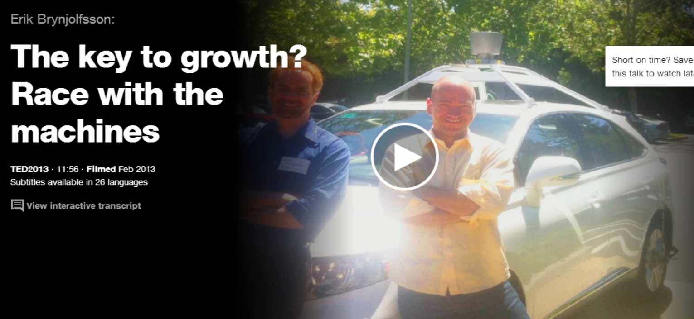
Erik Brynjolfsson
http://www.ted.com/talks/erik_brynjolfsson_the_key_to_growth_race_em_with_em_the_machines#t-414811

Slide 3
Technology creates possibilities and potential, but ultimately, the future we get will depend on the choices we make. We can reap unprecedented bounty and freedom, or greater disaster than humanity has ever seen before.
The Second Machine Age, p. 256
Notes:
Andrew McAfee and Erik Brynjolfsson

Slide 4
The Human Use of Human Beings
“When I say that the machine’s danger to society is not from the machine itself but from what man makes of it, I am really underlining the warning of Samuel Butler [1835 – 1902].”
- Weiner, Norbert, The Human Use of Human Beings, 1950, chapter 10.
Notes:
He estimated 10 to 20 years, or less time if big war.

Slide 5
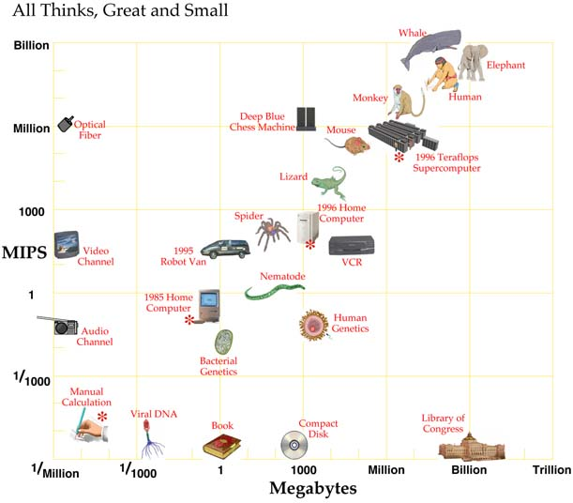
How Much Compute Power Does it Take?
•
Watson
From Hans Moravec, Robot Mere Machine to Transcendent Mind 1998.
Notes:
We showed these at the end of robotics, but repeat here.
Info on Watson: http://gcn.com/articles/2011/02/10/watson-vs-human-brain-tale-of-the-tape.aspx
Its memory:1.5 * 10^ megabytes. Its processing power: 8*10^7 MIPS

Slide 6
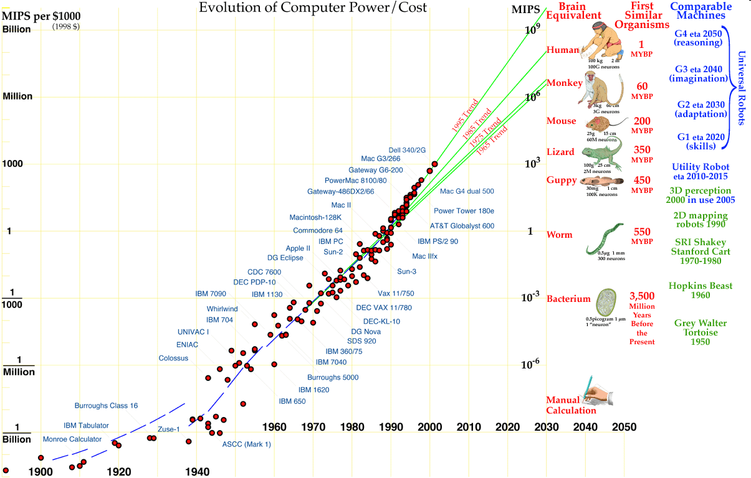
How Much Compute Power is There?
Hans Moravec: http://www.frc.ri.cmu.edu/~hpm/talks/revo.slides/power.aug.curve/power.aug.gif

Slide 7
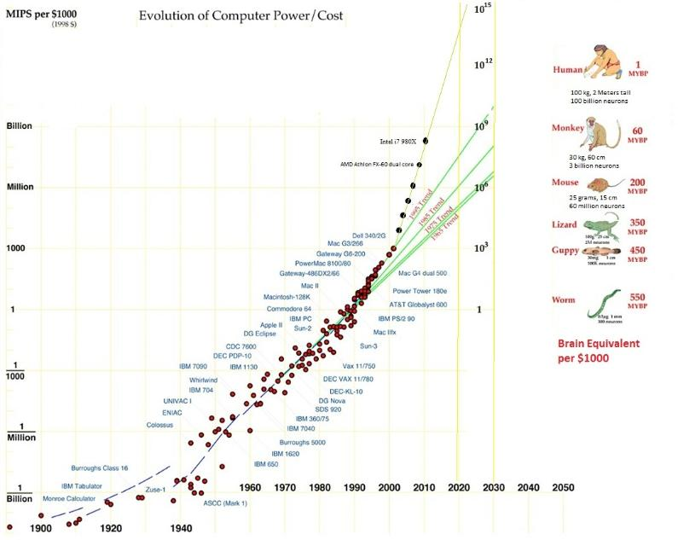
How Much Compute Power Is There?
Notes:
A newer one from: http://www.donbot.com/Futurebot/NewTech/NT01370MoravecsGraphUpdated2020.html
Note that it puts people at 1000 times more compute power than Moravec, yet still projects matching them before 2020.

Slide 8
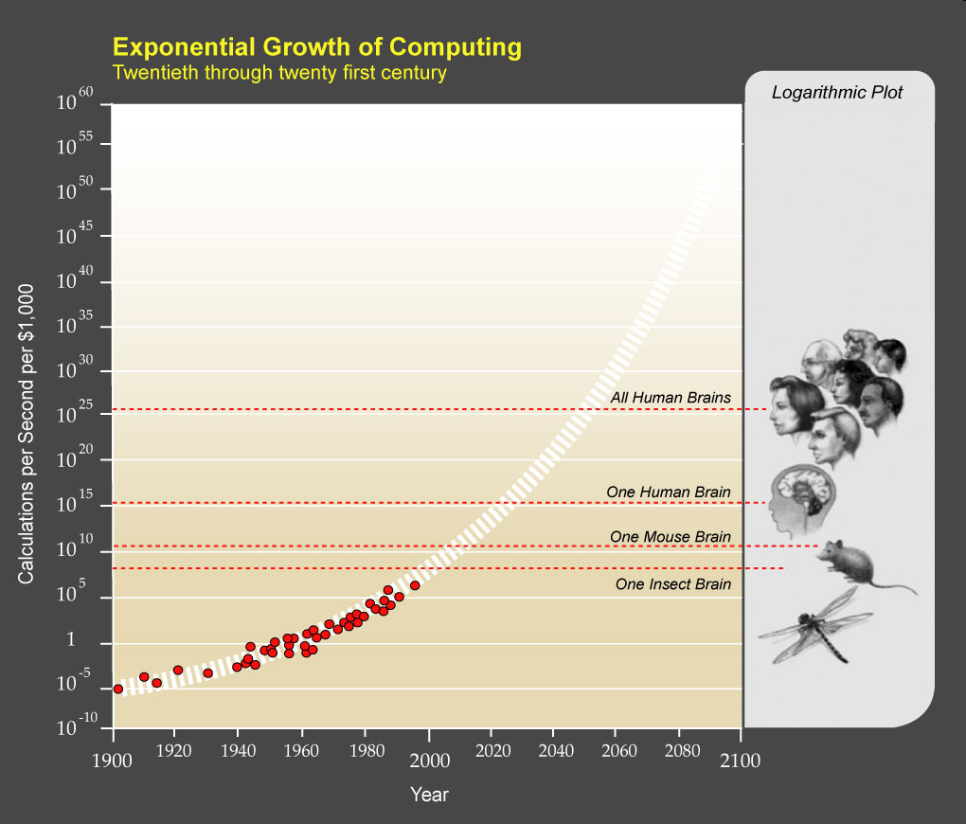
The Law of Accelerating Returns
Notes:
Image from: http://brent.kearneys.ca/2009/02/14/the-singularity-summit-2008/

Slide 9
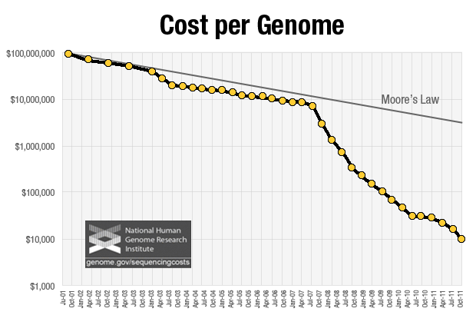
Law of Accelerating Returns Another Example
Notes:
One more example: http://www.caseyresearch.com/cm/the-one-cancer-fighting-stock-you-must-own?ppref=CDD453XX0812A

Slide 10
The Singularity
Stanislaw Ulam, in 1958 wrote of a conversation with John von Neuman concerning the "ever accelerating progress of technology and changes in the mode of human life, which gives the appearance of approaching some essential singularity in the history of the race beyond which human affairs, as we know them, could not continue."
Now often used to mean the hypothetical future emergence of greater-than-human superintelligence through technological means.
Notes:
http://en.wikipedia.org/wiki/Technological_singularity

Slide 11
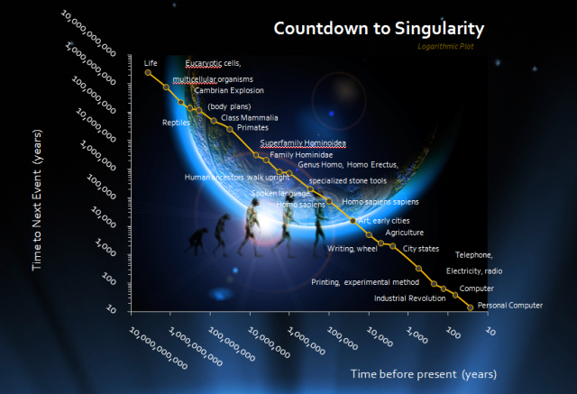
Countdown to Singularity
Notes:
Note log log plot : http://my.opera.com/Flavio58/blog/the-law-of-accelerating-returns (Kurzweil)

Slide 12
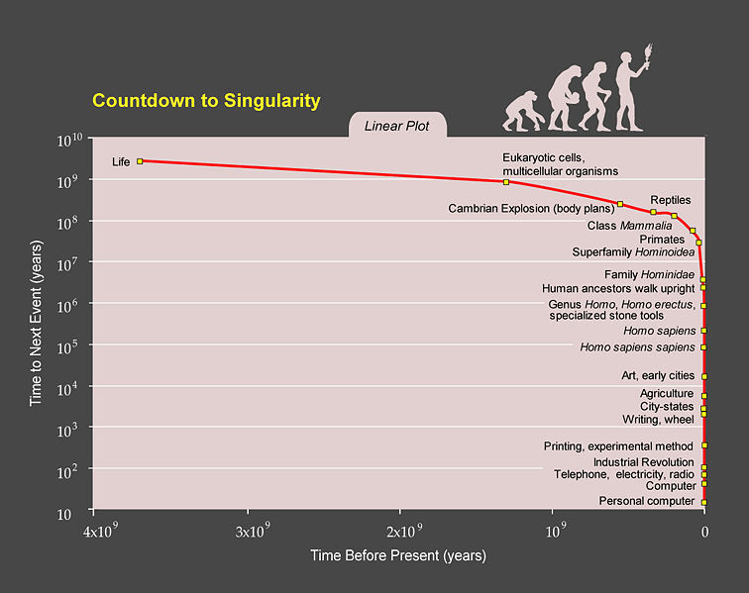
Notes:
http://en.wikipedia.org/wiki/Transhumanism, bottom of page This one maybe more dramatic because semi log plot

Slide 13
Why Would the Singularity Be Important?
It would be an event horizon, beyond which we’re not now able to predict.
It won’t stop just when the robots get as smart as we are.
The Singularity Institute for Artificial Intelligence
Notes:
http://en.wikipedia.org/wiki/Technological_singularity

Slide 14
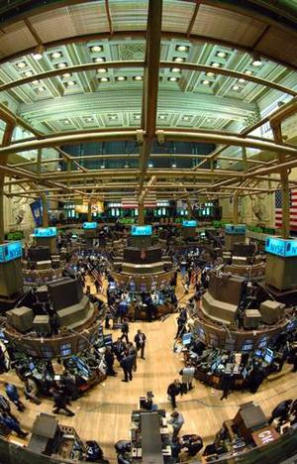
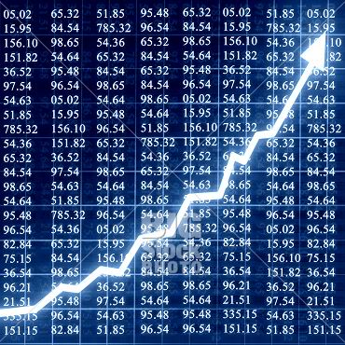
Past the Singularity – An Example
Automated stock traders drive out humans
Notes:
Stock exchange: http://www.stockmarketinvesting.com/stock-market-tips/
Graph: http://www.geekesfera.com/tag/stock-market

Slide 15
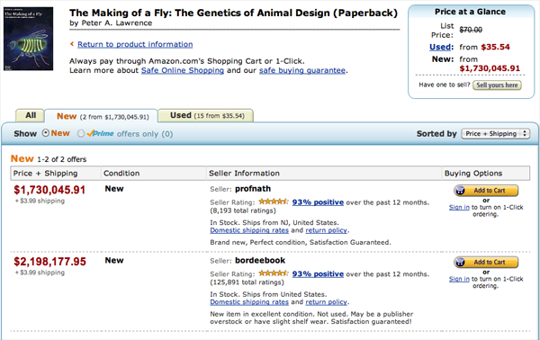
Or When We’re Not Quite There Yet
http://www.michaeleisen.org/blog/?p=358
Notes:
Article talks about how profnath keeps setting it’s price to just less than bordeebook, who keeps setting theirs to just more than profnath, but the product of their factors is greater than 1.

Slide 16
If You Can’t Lick ′em, Join ′em
Physical augmentation
Collaboration
Us in the machine

Slide 17
Transhumanism
An illustration by Michael Gibbs for The Chronicle of Higher Education's look at how biotechnology will change the human experience.

Slide 18
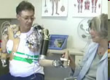
It’s Not Simply Us vs Them: Augmentation
http://www.cbsnews.com/video/watch/?id=4937720n&tag=related;photovideo
http://www.jhuapl.edu/prosthetics/program/multimedia.asp

Slide 19
Landis, Admitting Doping, Accuses Top U.S. Cyclists
Floyd Landis, left, accused his former teammates, including Lance Armstrong, riding in the 2004 Tour de France, of doping.
http://www.nytimes.com/2010/05/21/sports/cycling/21landis.html?emc=eta1
Notes:
Why am I showing this? The idea is that we’re already at the point in some sports where an “unaugmented” person can’t effectively compete. What will happen when a person with an unaugmented brain won’t be able to compete in society?

Slide 20
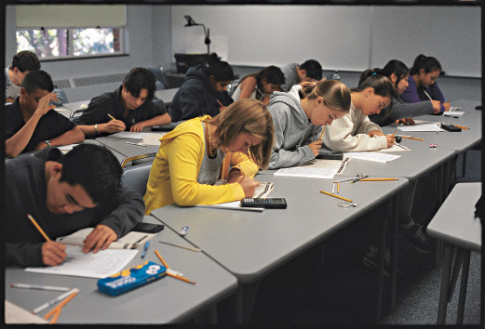
Closer to Home
Risky rise of good grade pill
Notes:
Students at high pressure high schools take stimulants, like ADHD drugs, so they can study and focus while taking tests like SAT. If some people do this, does everyone have to? Prisoner’s Dilemma?
http://www.nytimes.com/2012/06/10/education/seeking-academic-edge-teenagers-abuse-stimulants.html?pagewanted=all
Source of image: http://www.highereducation.org/crosstalk/ct1001/news1001-satsummercamp.shtml

Slide 21
What About This?
Notes:
Ask a clicker question: Next week, we will bring to class chips that can be embedded in your brain, giving you all the mathematics capability of Matlab and all the knowledge of Wikipedia. Would you take one? Yes, maybe, no way.
http://www.21stcentech.com/wp-content/uploads/2013/12/ibm-brain-chip-02-neuromorphic-chips.jpg

Slide 22
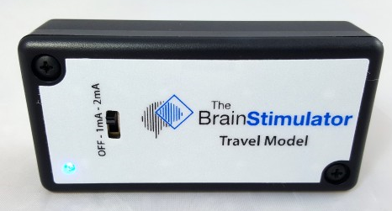
Much Higher Tech
A Brief Chronicle of Cognitive Enhancement
500 b.c.: Ancient Greek scholars wear rosemary in their hair, believing it to boost memory.
1886: Original Coca-Cola, with cocaine and caffeine. It’s advertised as a “brain tonic.”
1955: The FDA licenses Ritalin.
1997: Baby Einstein products claim to “facilitate the development of the brain in infants.”
2005: Lumosity, devoted to online “brain training,” is founded.
2020: A tDCS company starts an SAT-prep service for high-school students.
http://www.theatlantic.com/magazine/archive/2014/09/prepare-to-be-shocked/375072/
Notes:
Use of electrical brain stimulation to increase learning and other cognitive function.tDCS = transcranial direct-current stimulation.
Last one is a prediction. tDCS seems to be snake oil. But is this not a common risk for some new technology that makes awesome claims?

Slide 23
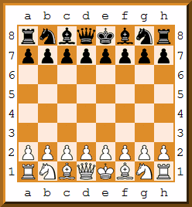
It’s Not Simply Us vs Them: Collaboration
Freestyle chess
Notes:
People/machine combinations can beat either computers alone or people alone.

Slide 24
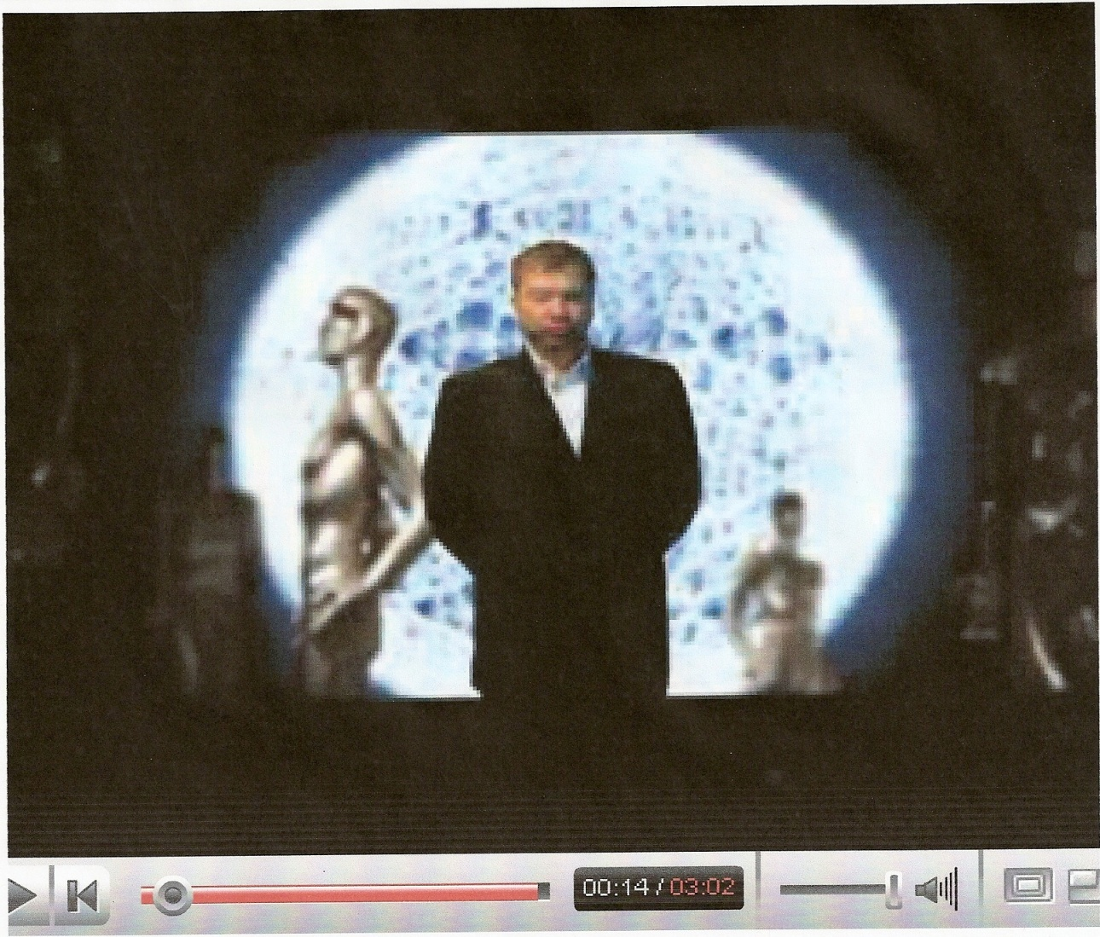
I am the Very Model
I am the Very Model of a Singularitarian
Notes:
Words: http://www.kurzweilai.net/articles/art0626.html?printable=1

Slide 25
Collaboration
Zara
Notes:
The Second Machine Age p. 193 Use people to look at customers and talk to them to predict what to order for their particular store. But exploit high tech just in time manufacturing and communication to make small batches and them to the stores right away.
Image from: http://www.destinationcentreville.com/en/shopping/zara

Slide 26
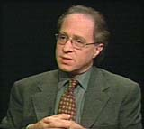
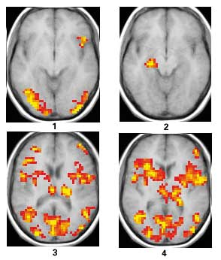
We'll be able to send scanners inside the brain, tiny little scanners that are the size of blood cells, that will travel through the brain, through our capillaries, and actually scan the human brain from inside and build up a database that describes everything going on in the human brain. And that's a scenario that will be feasible within 25 years. (1999)
Notes:
Below are four fMRI (functional magnetic resonance imaging) brain scans obtained during a visual memory task. The results of the experiment were reported in November 2000 by Mark D'Esposito and Charan Ranganath of the University of California, Berkeley, at the annual meeting of the Society for Neuroscience.
n scan 1, a subject is asked to remember a face. Areas at the rear of the brain that process visual information are active during this task, as is an area in the frontal lobe. In scan 2, the subject is asked to "think about this face." Surprisingly, the hippocampus is activated - the first time this has been documented. The hippocampus was already known to be important for memory, but these results show that this part of the brain is specifically active during the time when we are remembering new information.
In scans 3 and 4, the subject was asked to compare another face to the remembered face. Some of the same visual areas are activated as during the initial memory task, but other areas, such as part of the frontal lobe, are involved in making a decision about the memory.
http://www.berkeley.edu/news/media/releases/2000/11/20_mri.html

Slide 27
Should We Do It?
Does it make sense to ask?
What does history tell us?
Do we good job of predicting the future?

Slide 28
Is This Even A Question It Makes Sense to Ask?
Notes:
http://www.bristolstories.org/site_images/big_world_map.jpg
Guns Germs and Steel argument: Eurasia won because of geography. Europe won because China lost lost because they burned the boats and the Europeans didn’t. Can one group ever effectively decide against technology?

Slide 29
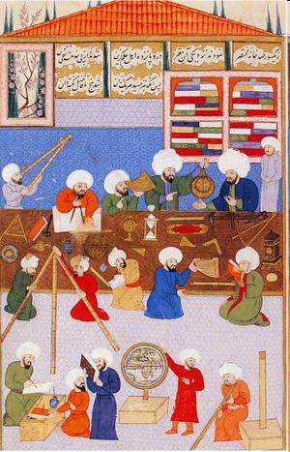
Islamic Science in the Golden Age
c 750 - 1250
https://www.youtube.com/watch?v=WZCuF733p88
Notes:
Point here: you can be on top. But then if you decide to stop doing science/technology, someone else will just take over. You can’t make it stop everywhere.
Image from: http://musham.wordpress.com/2008/09/19/islamic-science-and-development-historyin-quran-view/
The link is to a YouTube video of Neil de Grasse Tyson

Slide 30
Oppenheimer Quote
“When you see something that is technically sweet you go ahead and do it.”
Notes:
Quoted on p. 210 of The Luddites

Slide 31
Collingridge’s Argument
To avoid undesired consequences:
"It must be known that a technology has, or will have, harmful effects, and
it must be possible to change the technology in some way to avoid the effects."
At early stage the problem is:
At late stage the problem is:
Notes:
David Collingridge starting in 1980
Early stage, like AI, we simply don’t know what will happen.
At late stage, like cars today, we know, but the system is too entrenched to make change possible.

Slide 32
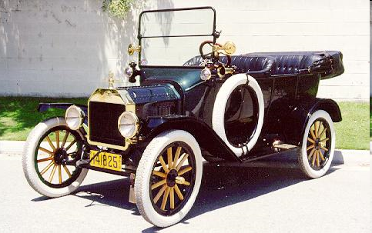
Can We Predict the Impact of New Technology?
Notes:
Image from: http://www.musclecarclub.com/other-cars/classic/ford-model-t/ford-model-t.shtml
Some impacts no one foresaw: pollution, urban sprawl, people getting fat

Slide 33
Can We Predict?
http://www.youtube.com/watch?v=EAHdX2I4fuE
Notes:
Watch the video. Sergi Brin and then Jerry Brown telling us why the selfdriving car will solve all our problems.

Slide 34
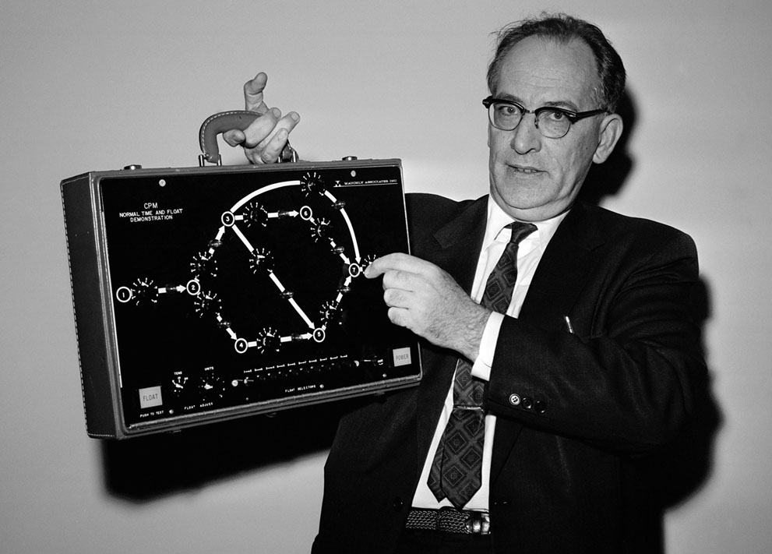
Can We Predict?
John Mauchley, 1962: predicted everyone will be walking around with his own personalized computer within a decade.
Notes:
Dr. John W. Mauchly, inventor of some of the original room-size electronic computers, poses in Washington, DC, on November 2, 1962 with one the size of a suitcase after addressing a meeting of the American Institute of Industrial Engineers. He now is working on a pocket variety which, he says, may eliminate the housewife's weekly shopping list and the chore of filling it by hand. He predicted everyone will be walking around with his own personalized computer within a decade. (AP Photo/Byron Rollins) #
http://www.theatlantic.com/infocus/2012/05/50-years-ago-the-world-in-1962/100296/

Slide 35
Our Inability to Predict Impact
Future predictions
More hopelessly wrong predictions
Can we predict the impact of:
The Internet?
Household and factory robots?
Human-level AI?
Human genome sequencing

Slide 36
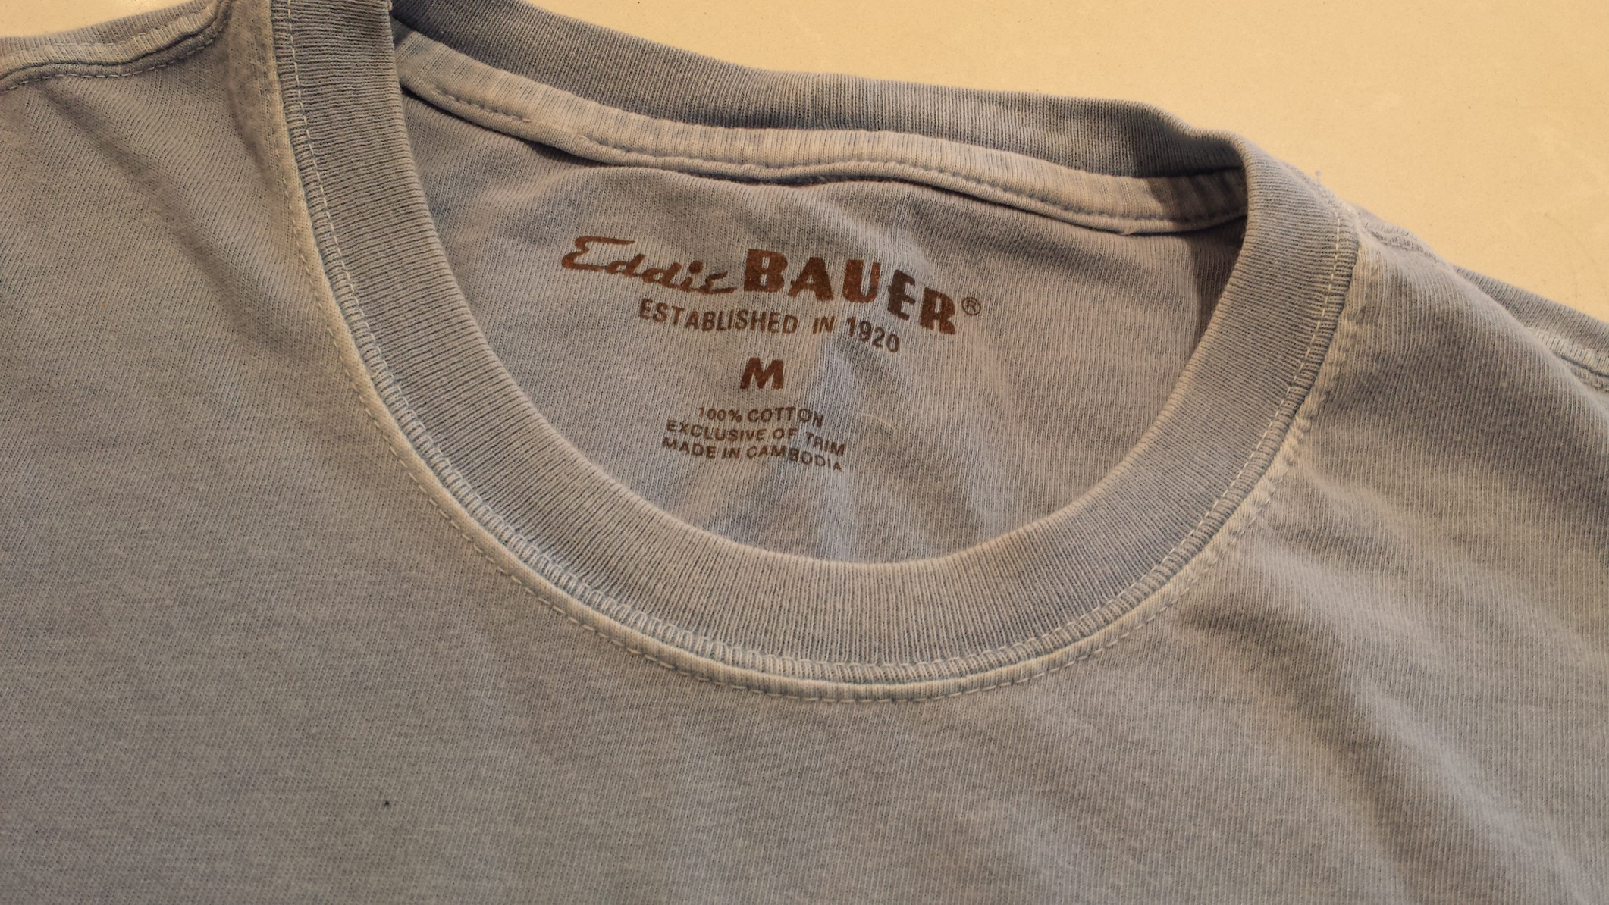
Unintended Consequences
Proposal for ethical outsourcing of manufacturing:
New law: It shall be illegal to import manufactured goods unless the manufacturer can show that its workers were paid a living wage.
Economic?
Technological?
Ethical?
Consequences?
Notes:
Ethical argument: Does this feel “right”?
Economic argument: If the demand for tee shirts is elastic, will higher prices mean fewer tee shirts? Less for consumers. And fewer foreign workers have jobs.
Technological argument: Will this just accelerate the introduction of manufacturing machines and drive human labor out all together?

Slide 37
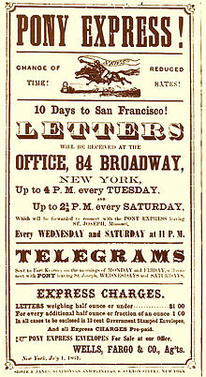
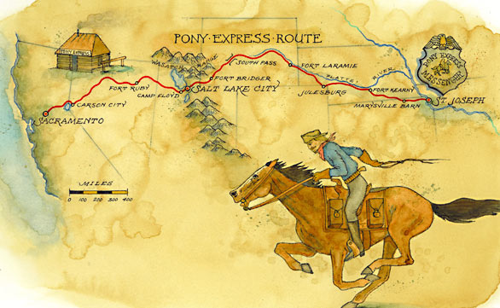
How Fast Things Can Change
April 3, 1860 – October, 1861
Notes:
Bob Greene: Why Twitter Should Watch Its Back: http://www.cnn.com/2014/01/26/opinion/greene-pony-express/
Lasted 18 months from April 3, 1860, to October 1861.
http://en.wikipedia.org/wiki/Pony_Express
http://articles.latimes.com/2010/may/16/travel/la-tr-ponyexpress-20100516

Slide 38
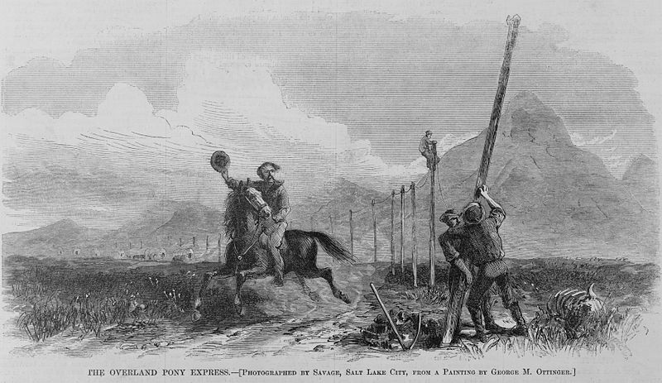
How Fast Things Can Change
Notes:
The transcontinental telegraph being built.
http://en.wikipedia.org/wiki/File:The_Overland_Pony_Express.jpg

Slide 39
"The industrial revolution and its consequences have been a disaster for the human race.
They:
have greatly increased the life-expectancy of those of us who live in 'advanced' countries,
but they:
have destabilized society,
have made life unfulfilled,
have subjected human beings to indignities,
have led to psychological suffering (in the Third World to physical suffering as well) and
have inflicted severe damage on the natural world."
Theodore Kaczynski, Industrial Society and Its Future (1995)

Slide 40
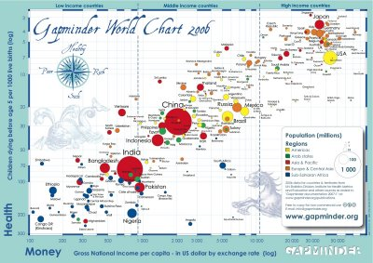
Since the Industrial Revolution
Has technology benefited people?
http://www.youtube.com/watch?feature=youtube_gdata_player&v=jbkSRLYSojo
Notes:
http://4.bp.blogspot.com/_JkY44588yyw/SVpfRobpWxI/AAAAAAAAAGo/0V7a4EoDv9Y/s400/gapminder_world_chart_2006.jpg

Slide 41
But Nearly Everyone Else Agrees That …
Technology has improved our lives.

Slide 42
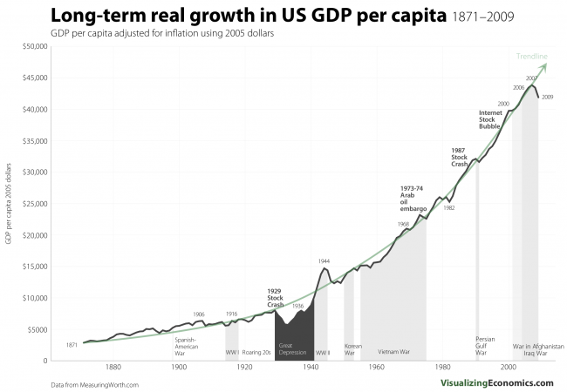
GDP Growth
Notes:
Our standard of living keeps going up because of technology.
http://visualizingeconomics.com/2011/03/08/long-term-real-growth-in-us-gdp-per-capita-1871-2009/

Slide 43
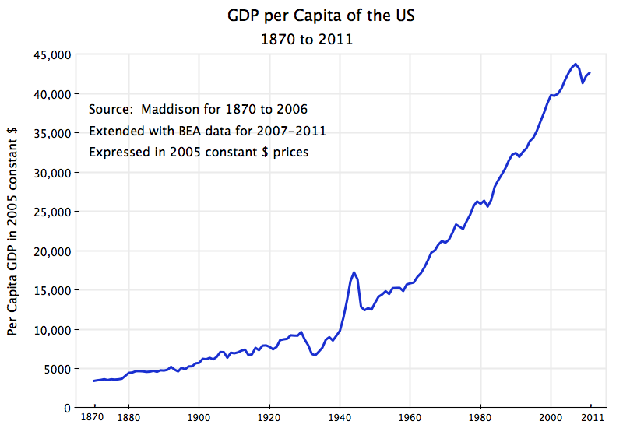
GDP Growth
Notes:
This one goes out farther.
http://aneconomicsense.com/2012/07/20/the-shift-from-equitable-to-inequitable-growth-after-1980-helping-the-rich-has-not-helped-the-not-so-rich/

Slide 44
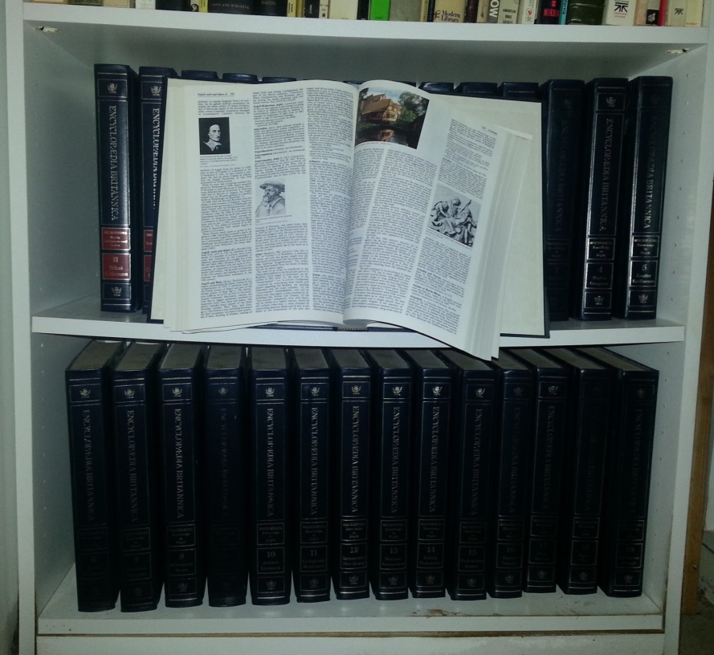
And GDP Isn’t the Whole Story
GDP doesn’t measure free or almost free.
$1,395.00
Notes:
We have a lot more “product” but how can we measure it? In fact, if Encyclopedia Britannica isn’t selling these sets anymore, it looks like there’s less product. March, 2012 – Encyclopedia Britannica announced the end of the print edition after 244 years.

Slide 45
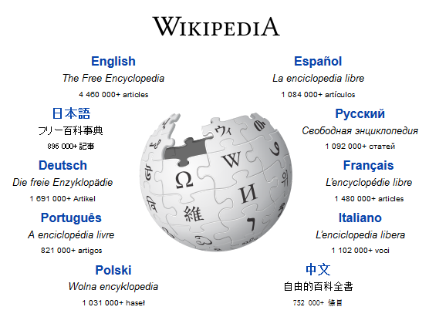
And GDP Isn’t the Whole Story
GDP doesn’t measure free or almost free.
$1,395.00
Notes:
We have a lot more “product” but how can we measure it? In fact, if Encyclopedia Britannica isn’t selling these sets anymore, it looks like there’s less product. March, 2012 – Encyclopedia Britannica announced the end of the print edition after 244 years.

Slide 46
And GDP Isn’t the Whole Story
GDP doesn’t measure free or almost free.
$1,395.00
GDP Growth ≠ Economic Growth
Notes:
We have a lot more “product” but how can we measure it? In fact, if Encyclopedia Britannica isn’t selling these sets anymore, it looks like there’s less product. March, 2012 – Encyclopedia Britannica announced the end of the print edition after 244 years.

Slide 47
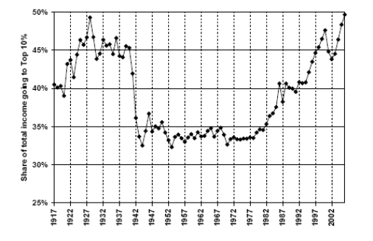
Income Disparity
Notes:
But things may no longer be continuing to get better in the same way. A rich person doesn’t buy 100 times as many cars or iPhones as 100 regular people. So this trend is very scary.
http://animalspiritspage.blogspot.com/2009/05/income-inequality-debt-crisis-and.html

Slide 48
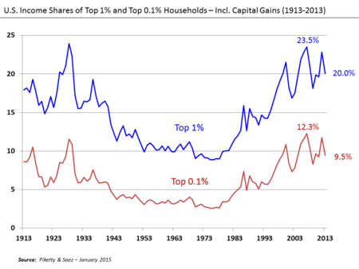
Income Disparity
Notes:
https://en.wikipedia.org/wiki/Income_inequality_in_the_United_States
Bad when a small group controlled the means of production. Got better when labor got power. Now getting worse as labor is less necessary.
But things may no longer be continuing to get better in the same way. A rich person doesn’t buy 100 times as many cars or iPhones as 100 regular people. So this trend is very scary.
http://animalspiritspage.blogspot.com/2009/05/income-inequality-debt-crisis-and.html

Slide 49
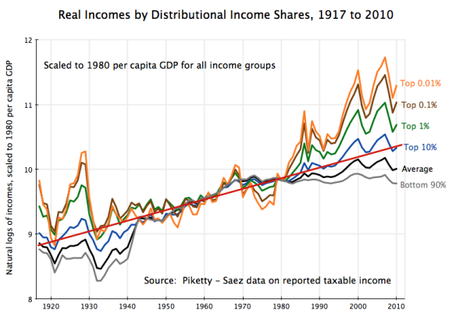
Income Disparity
Notes:
Another view. Note logarithmic scale, so a constant rate of growth would be a straight line.
http://aneconomicsense.com/2012/07/20/the-shift-from-equitable-to-inequitable-growth-after-1980-helping-the-rich-has-not-helped-the-not-so-rich/

Slide 50
Technology and Our Jobs
Technology eliminates jobs.
Of course, technology also creates jobs.
OURS
What is the balance?
And maybe we need jobs to go away (at least in some places).
Notes:
Do elderly support ratio next. It’s short. Then move on the jobs issue.

Slide 51
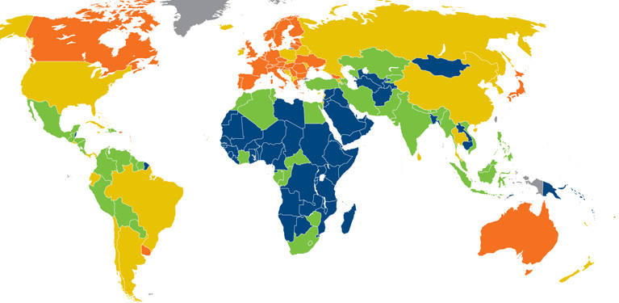
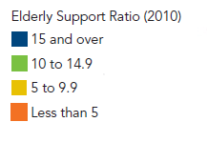
Elderly Support Ratio
Notes:
But maybe we desperately need more workers who can’t get old and need to be taken care of.
http://www.prb.org/pdf10/10wpds_eng.pdf

Slide 52
Elderly Support Ratio 2050
Country | Ratio
Niger | 19
Uganda | 16
Guatamala | 7
Pakistan | 7
Egypt | 5
India | 5
Morocco | 4
United States | 3
Mexico | 3
China | 3
France | 2
Japan | 1
Notes:
http://www.prb.org/pdf10/10wpds_eng.pdf

Slide 53
How Does Technology Destroy Jobs?
Technology replaces human labor.
Winner takes all.

Slide 54
How Does Technology Destroy Jobs?
Technology replaces human labor.
Winner takes all.

Slide 55
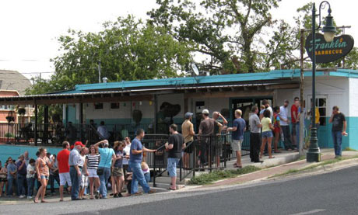
Winner Doesn’t Take All
Notes:
Do this one first because it’s shorter. Franklin’s bbq. People in line. If line gets too long, people will go to second best bbq.
http://www.theguardian.com/travel/2012/oct/17/10-best-local-food-diners-austin

Slide 56
Winner Takes All
When it’s digital, no one needs second best:
No lines.
No geography issues.

Slide 57
Software
Notes:
Sometimes there might be two, at least for a while. There’s always the taste issue. But not lots.

Slide 58
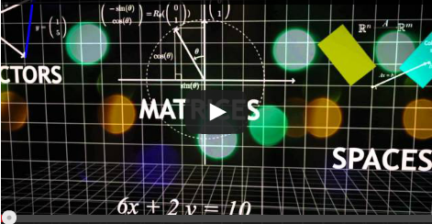
Education
Notes:
Rvdg’s MOOC
Remind – these examples aren’t about machines replacing human labor (very much). They are about technology enabling a small number of people to get all the customers in some businesses. And to do it without having to hire a lot of employees.
Note that, in some arenas, there is still a long tail. Musicians, for example, because of variations in taste.

Slide 59
How Does Technology Destroy Jobs?
Technology replaces human labor.
Winner takes all.

Slide 60
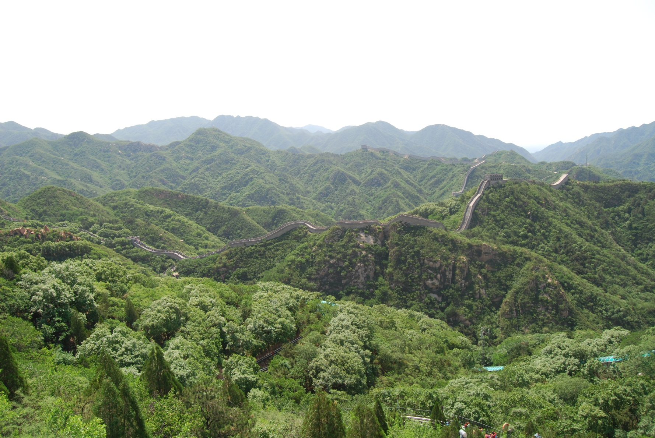
A Quick Look at Cheap Human Labor

Slide 61
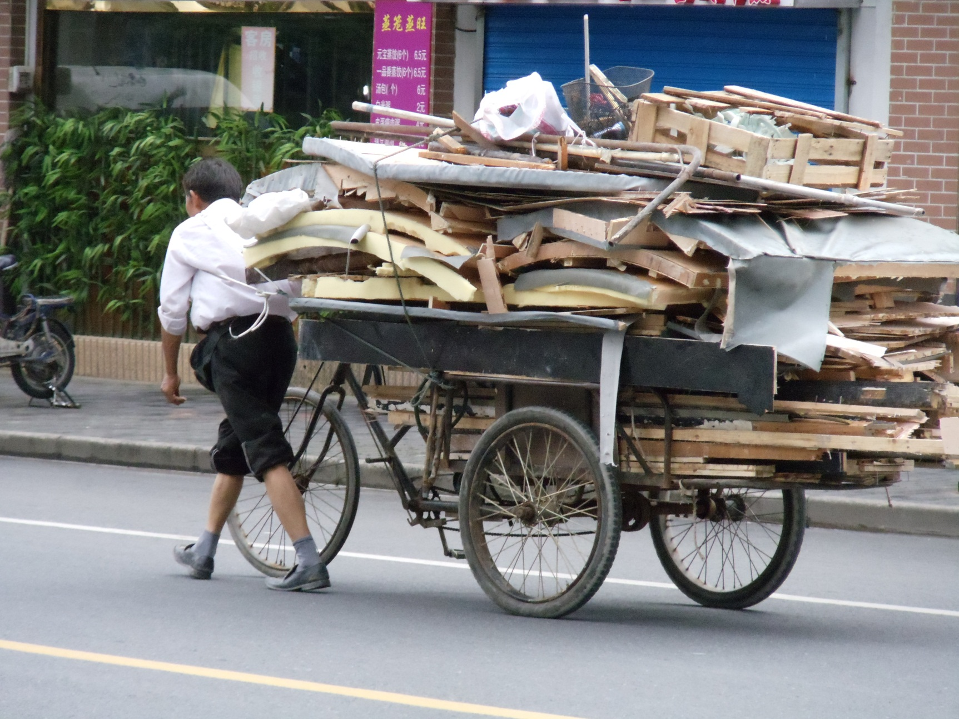
Transportation

Slide 62
Transportation

Slide 63
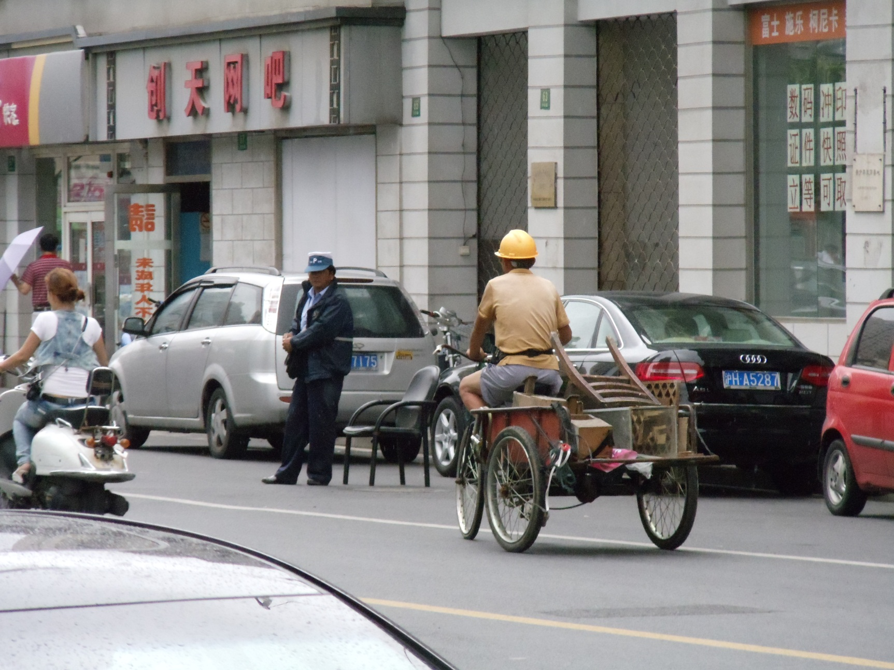
Transportation

Slide 64
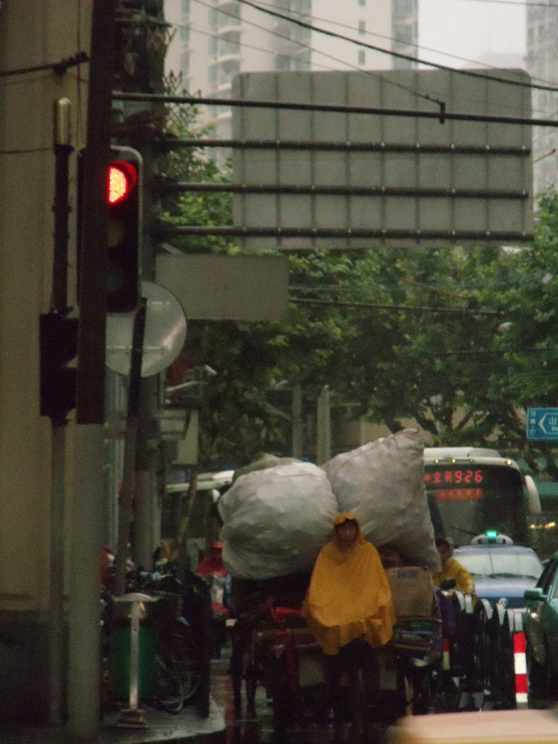
Transportation

Slide 65
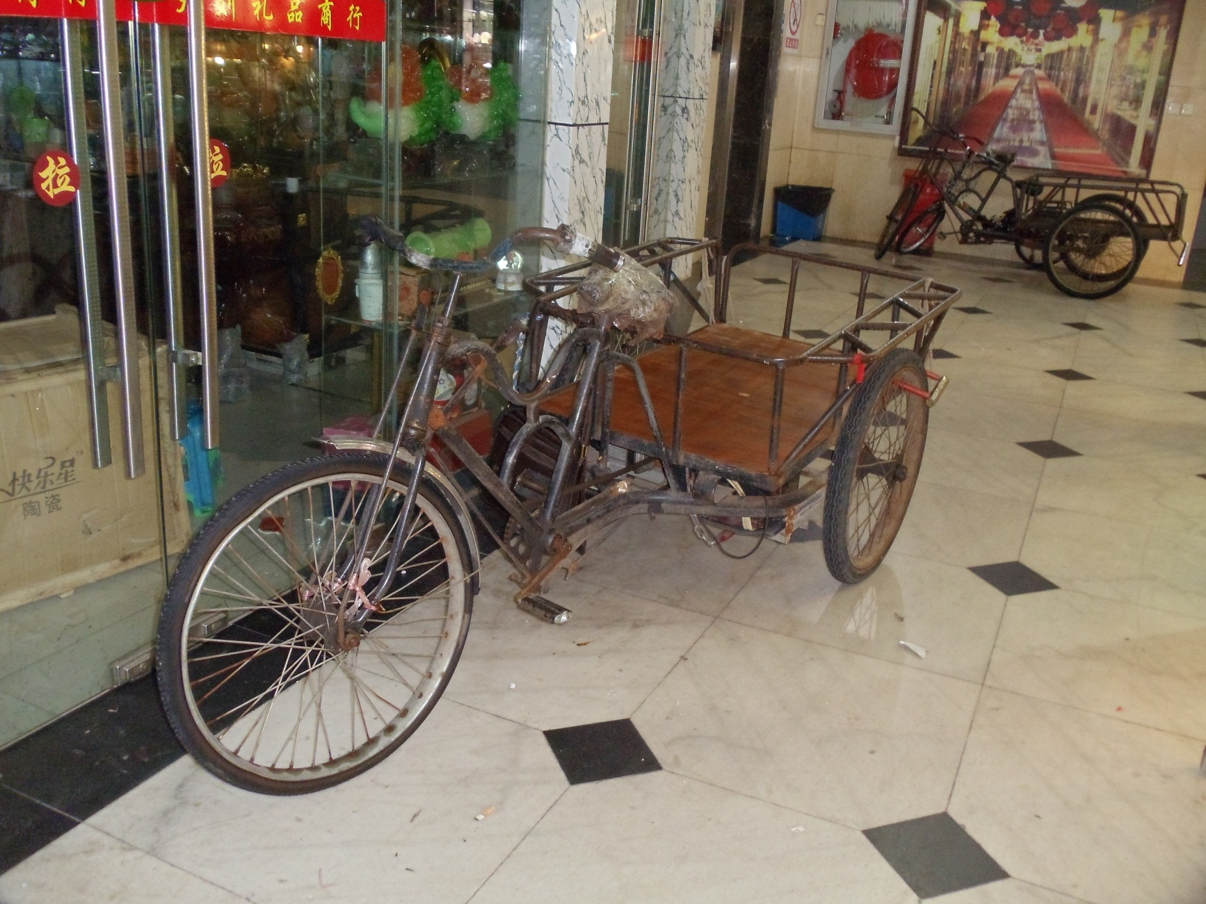
Transportation

Slide 66
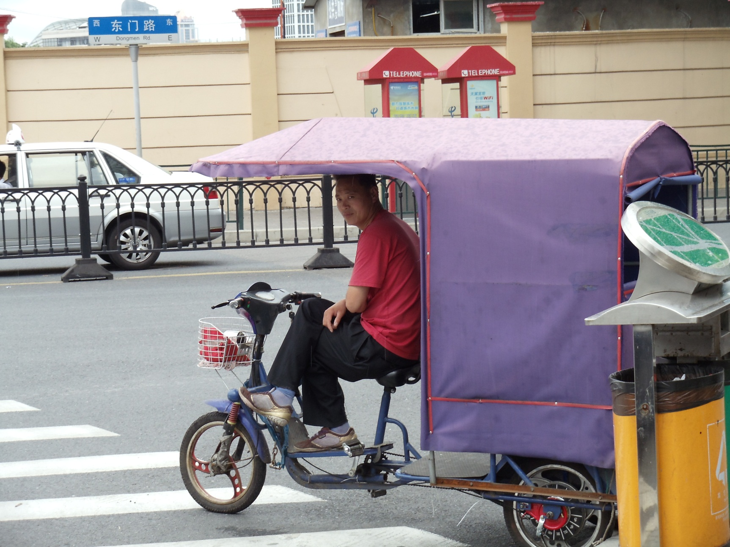
Transportation
Notes:
Transporting people

Slide 67
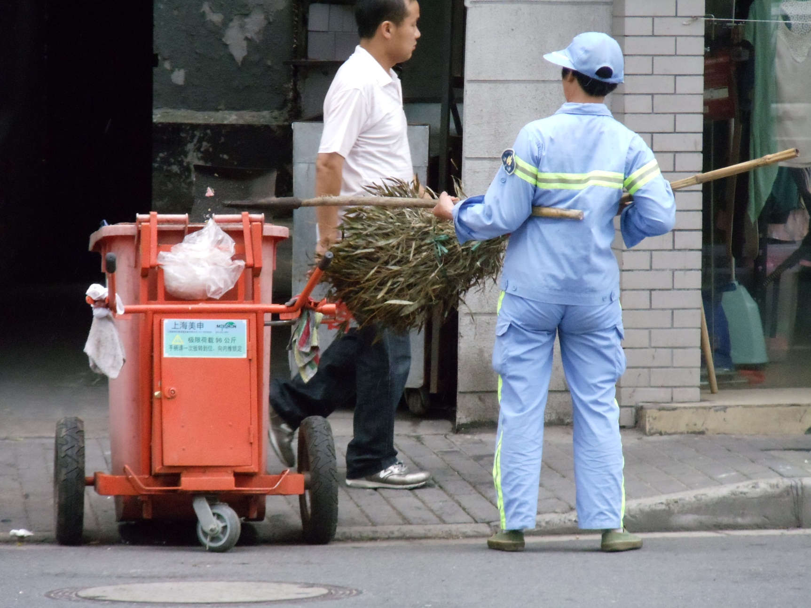
Street Cleaning

Slide 68
Retail

Slide 69
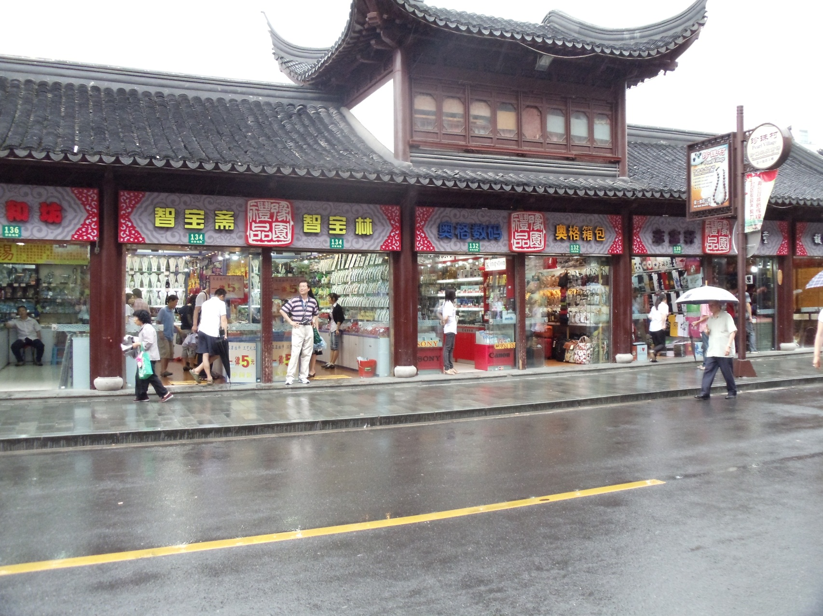
Retail

Slide 70
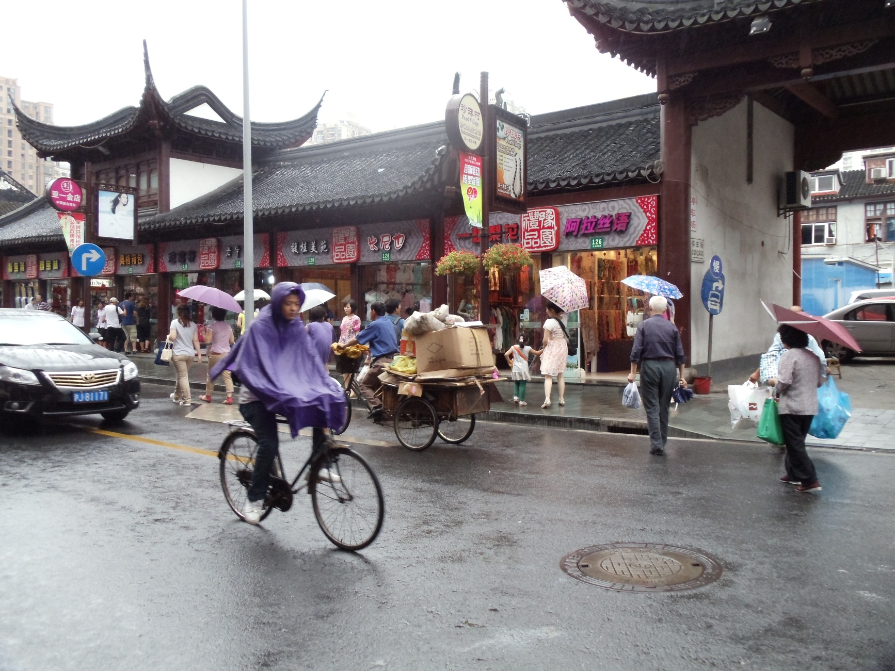
Retail (and Transportation)

Slide 71
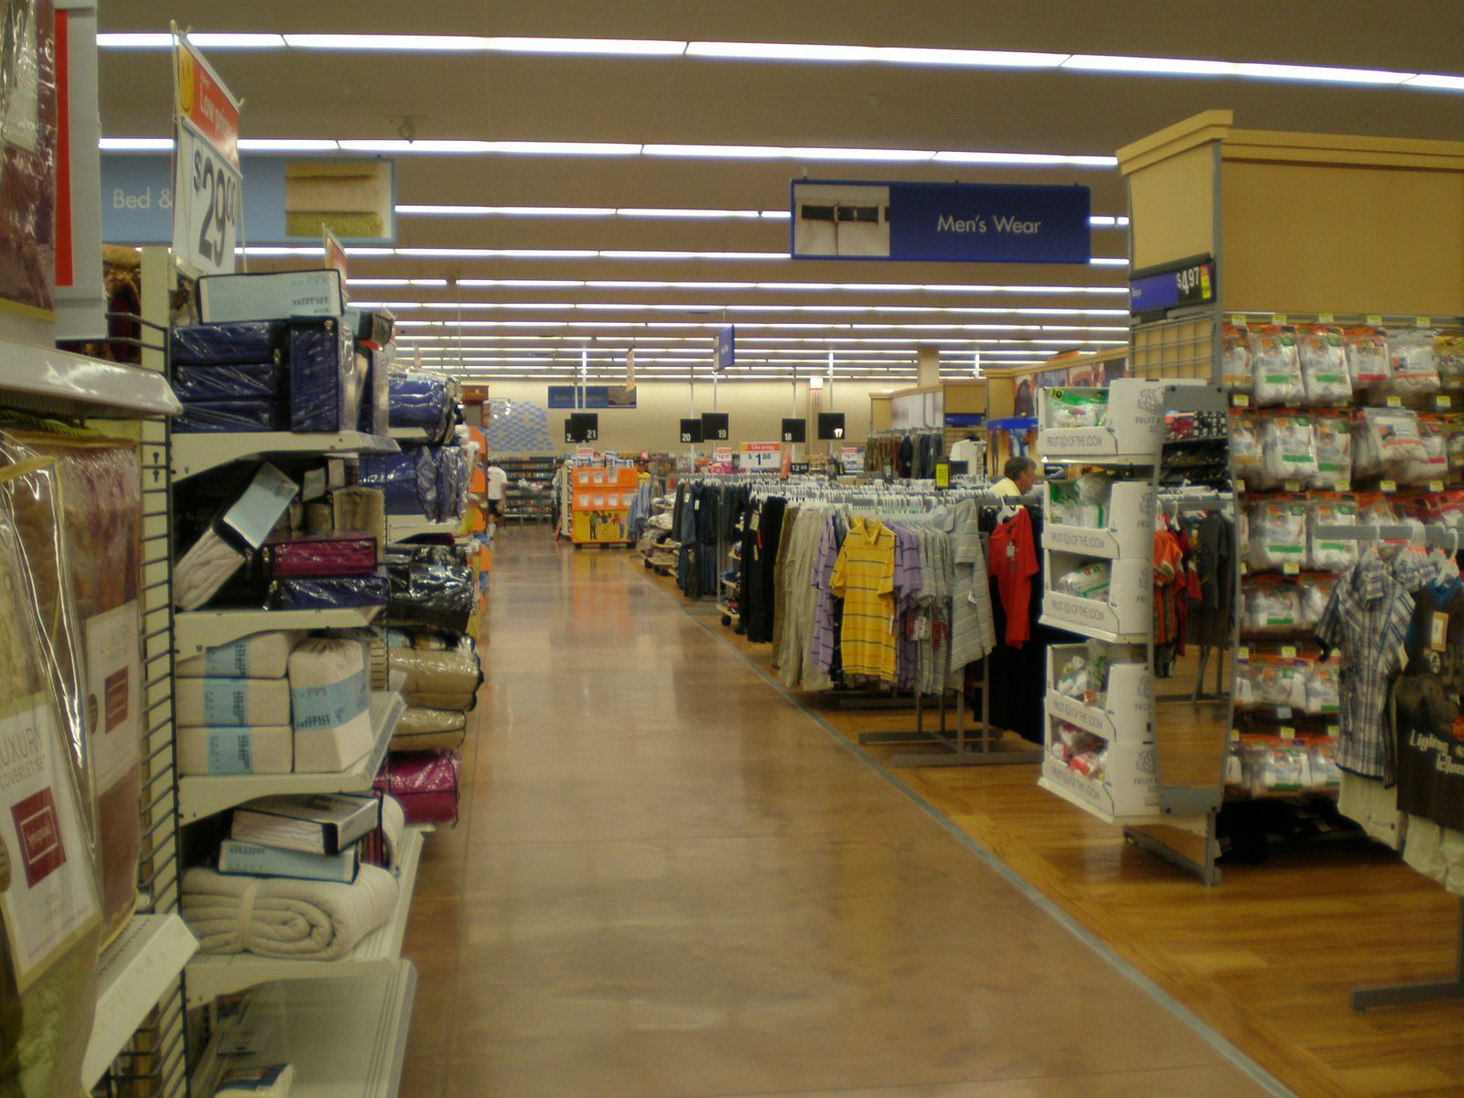
Retail – Different Way
Notes:
http://picasaweb.google.com/lh/photo/wA6qK1fAwUU7uHwcOLjKHQ Inside a Walmart Note no employees visible.

Slide 72
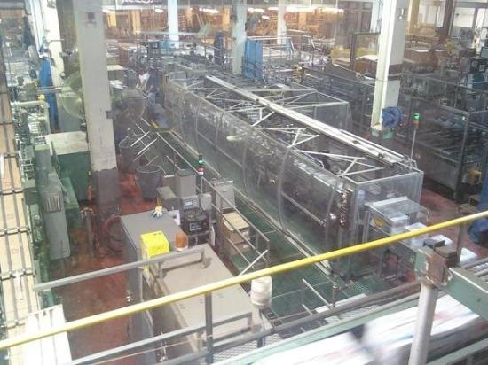
Manufacturing
Notes:
https://www.tripadvisor.com/LocationPhotoDirectLink-g33388-i23828601-Denver_Colorado.html#23828601
Note: No people. Actually, when we were there, exactly one person.

Slide 73
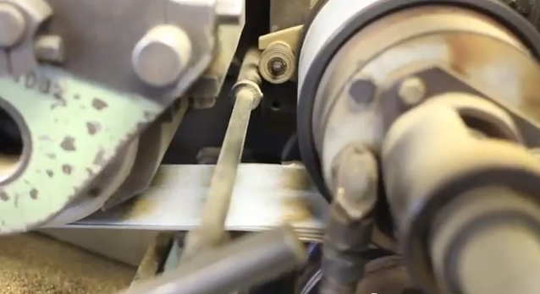
Celestial Seasonings
http://www.youtube.com/watch?v=ZR0gc8tvomk (Skip to 1:00)
Notes:
Copied from AI and Robotics. Watch this video. Way cool how the bags are made.
Note that these machines don’t look at all like people. They just do the work that people used to do.

Slide 74
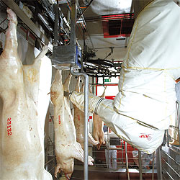
An Unpleasant Task
http://www.kuka.com/usa/en/solutions/solutions_search/L_R232_Robot_optimizes_cutting_of_pork_sides.htm
Notes:
Copied form AI and Robotics. Harder than making cars since each pig is different. Just an article – no video.

Slide 75
Do We Care Who Does the Work?

Slide 76
Coping with Change
Notes:
Fast change affects many aspects of society. Let’s look at one: jobs.
Watson
Robotic pharmacist: https://www.youtube.com/watch?v=EQGSk3Lt9X0
Coors factory: Note no people. https://www.tripadvisor.com/LocationPhotoDirectLink-g33388-i23828601-Denver_Colorado.html
Google car: https://youtu.be/nBkQQ6czRJI

Slide 77
A Much Trickier Task
https://www.youtube.com/watch?v=kcQro2KwBCk
Notes:
For grins. Copied from AI and Robotics. CMU robot named HERB. The idea is to help disabled people with lots of tasks.

Slide 78
The Luddites
The Luddites, 1812
Notes:
But here’s the other side.

Slide 79
The Luddites
Notes:
http://www.spartacus.schoolnet.co.uk/PRluddites1.JPG

Slide 80
It Was Personal
Watch Queenie
Notes:
Larkrise to Candleford Season 4 Episode 2 part 2 (called 2-2) :
http://www.youtube.com/watch?v=9sMatUNCQHA start at 2:09
This is where Queenie tries to sell her lace to the Misses Pratt.
But this picture is from part 3, 6:14:
http://www.youtube.com/watch?v=Jg_69ZKe-3U&feature=relmfu

Slide 81
Bobbin Lace

Slide 82
Bobbin Lace

Slide 83
One Futuristic Vision
Rosie, the
Jetsons’ maid
~1962
Watch Rosie: http://www.cs.utexas.edu/~ear/cs349/VideosInSlides/JetsonsRosie.mp4
Notes:
I have made a copy of this video. It is in Ear\Cswork\CS349\TheJetsonsStartAt3-10.
The idea is a humanoid that simply does things the way people did before.
http://heightofhappiness.files.wordpress.com/2010/04/rosie-cleaning-jetsons3.jpg
http://www.youtube.com/watch?feature=player_detailpage&v=4MTHGWPqd14#t=190s 3:10

Slide 84
How Does Technology Replace Human Workers?
Notes:
But it hasn’t worked that way. We haven’t created robots that bring in wood (or coal), lay fires, monitor them, and clean up all the dust they make in the house. We’ve created a totally different way to cook food and heat houses. Similarly, the Luddites weren’t upset about weaving robots. They were upset about machines that simply did the task differently. Maybe some tasks will require humanoid robots, but many haven’t/won’t.
Maid image: http://3.bp.blogspot.com/_8Mva9I-cdIU/Rc99Aaf0FxI/AAAAAAAAAN0/wAxJVjkO5oQ/s320/maid.jpg

Slide 85
How It Has Actually Happened – Roomba
2001 A robot vacuum cleaner

Slide 86
Celestial Seasonings Factory
http://www.youtube.com/watch?v=ZR0gc8tvomk (Skip to 1:00)
Notes:
Already saw this in the Robots presentations. Way cool how the bags are made.
Note that these machines don’t look at all like people. They just do the work that people used to do.

Slide 87
Pendelton Woolen Mills
c. 1909
Notes:
http://syndicate.details.com/post/featured-gift-find-pendleton-national-park-blankets-a-tour-of-their-mill

Slide 88
Pendelton Woolen Mills
Today
Notes:
http://syndicate.details.com/post/featured-gift-find-pendleton-national-park-blankets-a-tour-of-their-mill

Slide 89
Another Example – Parking the Car
http://www.cnn.com/video/standard.html?/video/us/2013/05/30/erin-tapper-robot-garage.cnn
Notes:
This isn’t a biggie, but we keep chipping away at the jobs.

Slide 90
From Cheap Labor to Robotic Labor
iPhone manufacturer Foxconn is replacing 60,000 workers with robots
Notes:
http://qz.com/692389/iphone-manufacturer-foxconn-is-replacing-60000-workers-with-robots/ May 25, 2016

Slide 91
Transportation
Notes:
https://tctechcrunch2011.files.wordpress.com/2015/06/google-car.gif
https://medium.com/basic-income/self-driving-trucks-are-going-to-hit-us-like-a-human-driven-truck-b8507d9c5961#.37tf39hcp May, 2015

Slide 92
Transportation
3.5 million professional truck drivers (May, 2015)
Notes:
https://medium.com/basic-income/self-driving-trucks-are-going-to-hit-us-like-a-human-driven-truck-b8507d9c5961#.37tf39hcp May, 2015 But keep in mind that without drivers no need for truck stops. And drivers make perhaps 40K/year. Hard to find something else that pays that well.

Slide 93
Can We Always Imagine How?
Notes:
Taken with permission at Torchy’s Tacos, May 1, 2012. Can we imagine how to get the tables cleaned without a robot that mimics a person?

Slide 94
Can We Always Imagine How?
Customers return about 23% of their purchases both in-store and online, costing retailers $643 billion per year. Can artificial intelligence eliminate returns through virtual 3D try-on?
What can artificial intelligence do for retail?

Slide 95
Where Are the Jobs?
U.S. Jobs by Industry. 2000 Census. From Marshall Brain, Robotic Nation.
Notes:
Hidden because the students will read this.

Slide 96
From Robotic Nation
There will be huge job losses by 2040 or 2050 as robots move into the workplace. For example:
Nearly every construction job: ~6 million jobs.
Nearly every manufacturing job: ~16 million jobs lost.
Nearly every transportation job: ~3 million jobs lost.
Many wholesale and retail jobs: at least 15 million lost jobs.
Nearly every hotel and restaurant job: ~10 million jobs lost.
If you add that all up, it's over 50 million jobs lost to robots. That is a conservative estimate. By 2050 or so, it is very likely that over half the jobs in the United States will be held by robots.

Slide 97
Contrast with the Previous 50 Years
If you walked into a restaurant, hotel or store in 1950, it would be nearly identical to a restaurant, hotel or store today. People do everything in both cases -- people stock the shelves, prepare the food, serve the food, help customers, man the cash registers and sweep the floors just like they did in 1950.
It's the same on any construction site. In 1950, guys with circular saws and hammers built houses. Today it is guys with circular saws and nail guns. No big difference.
An airport in 1950 and an airport today are nearly identical. People take your tickets, handle the baggage, maintain the planes and pilot them in both cases.
Notes:
More from Robotic Nation.

Slide 98
Contrast with the Previous 50 Years
Coney island in 1950 looks like any amusement park today, with people operating the rides, selling the concessions and keeping the park clean.
Notes:
http://www.anguilla-beaches.com/corny-coney-island.html

Slide 99
Gone Already
Gone:
Automobile assembly (much of it)
Gas station attendant
Switchboard operator
Typist
Mail sorter
Notes:
Source: http://www.nytimes.com/2011/10/24/technology/economists-see-more-jobs-for-machines-not-people.html
Switchboard: http://kressmark.blogspot.com/2011/05/lync-operator-solutions.html
Gas station: http://www.superstock.com/stock-photos-images/255-18980
Typing pool: http://david-toms.blogspot.com/2011/05/tuesday-morning-at-office.html

Slide 100
On the Way Out
On the way out:
bank teller
cashier
home security guards
baby sitter
language translator
librarian
file clerk
taxi driver
Notes:
Source: http://www.nytimes.com/2011/10/24/technology/economists-see-more-jobs-for-machines-not-people.html
Bank teller: http://www.moneyandrisk.com/hot-dates/deadlines/small-businesses-will-be-required-to-make-tax-payments-electronically/
Self checkout: http://www.cracked.com/funny-6085-self-checkout-machines/
File clerk: http://www.ohs.org/education/focus/internet-links-womens-history.cfm

Slide 101
It’s Faster and More Pervasive Than Before
Notes:
http://www.hrcapitalist.com/2014/01/probability-hr-jobs-will-be-lost-to-robots-in-the-next-20-years.html Jan, 2014.
There are lots of other projections like this. Differ in details.

Slide 102
Yet:
What about New Jobs?
http://www.bls.gov/ooh/fastest-growing.htm
http://www.bls.gov/ooh/most-new-jobs.htm
Notes:
Get students to talk about new and growing jobs. Then click on link. This screen shot taken 10/2016 with data from 12/2015.

Slide 103
A Secure Job
Notes:
http://www2.bccr.edu/pages/ppc4.php?gclid=CJj4o-augbMCFemiPAod5k4Arw

Slide 104
Or Is It?
March, 2012 Art of court stenographer faces the final sentence: Last stenographers leave the Old Bailey.
http://www.independent.co.uk/news/uk/home-news/art-of-court-stenographer-faces-the-final-sentence-7584129.html
Notes:
http://www.independent.co.uk/news/uk/home-news/art-of-court-stenographer-faces-the-final-sentence-7584129.html
More info: http://www.bbc.co.uk/news/magazine-13035979

Slide 105
An Interesting Experiment
March 2012 Marketplace’s David Brancaccio tested whether he could drive from New Jersey to California without ever having to interact with another human (he took along a robot dog for company on his road trip). He:
bought gas at self-serve gas,
stayed at hotels where robot attendants check you in and dispense key cards to a room,
bought groceries at stores with self-checkout stations,
drove toll roads with EZ-Pass technology,
used GPS to navigate,
listened to music picked by Pandora.
Notes:
http://www.theboxcarkids.net/wordpress/tag/jobs-lost-to-automation/

Slide 106
Is it Already Happening?
Notes:
From the Atlantic article: http://www.theatlantic.com/magazine/archive/2011/09/can-the-middle-class-be-saved/8600/?single_page=true
Article argues that there are fixes, like more education. But, given what we know about the progression of technology, are there really any fixes?

Slide 107
Is it Already Happening?
Notes:
http://theeconomiccollapseblog.com/archives/not-everyone-is-hurting-the-rich-get-richer-as-the-income-inequality-gap-explodes

Slide 108
Some Newer Data
Notes:
http://economix.blogs.nytimes.com/2013/09/10/the-rich-get-richer-through-the-recovery/?_r=0

Slide 109
Some Newer Data
Notes:
Now did down to the top 1%
https://en.wikipedia.org/wiki/Income_inequality_in_the_United_States

Slide 110
Is it Already Happening?
“Almost one of every 12 white-collar jobs in sales, administrative support, and nonmanagerial office work vanished in the first two years of the recession; one of every six blue-collar jobs in production, craft, repair, and machine operation did the same.”
Notes:
From the Atlantic article: http://www.theatlantic.com/magazine/archive/2011/09/can-the-middle-class-be-saved/8600/?single_page=true
Argues that there are jobs at the top and very menial jobs at the bottom. But the solid middle class jobs in the middle, like unionized manufacturing jobs are gone and aren’t coming back.

Slide 111
Is it Already Happening?
Notes:
http://www.stateofworkingamerica.org/articles/view/18 Of course, this may just be a bad recession and maybe the jobs will come back. But there’s a good argument that technology will mean that they won’t.

Slide 112
Is it Already Happening?
Notes:
And just counting jobs masks the issue of what sort of job.
https://www.washingtonpost.com/news/wonk/wp/2013/02/28/how-the-recession-turned-middle-class-jobs-into-low-wage-jobs/

Slide 113
Maddie’s Job
Common practice:
Invest in a machine if you can earn back its cost in 2 years.
In the past decade, the flow of goods emerging from U.S. factories has risen by about a third.
Factory employment has fallen by roughly the same fraction.
Notes:
http://www.theatlantic.com/magazine/archive/2012/01/making-it-in-america/8844/ Standard is name of factory. AKC
Maddie is cheaper than a machine. It would be easy to buy a robotic arm that could take injector bodies and caps from a tray and place them precisely in a laser welder. Yet Standard would have to invest about $100,000 on the arm and a conveyance machine to bring parts to the welder and send them on to the next station. As is common in factories, Standard invests only in machinery that will earn back its cost within two years.
Interesting thing: If demand for product goes up and the factory can run more shifts, then, in fact, jobs for humans will disappear.

Slide 114
Making It in America
In the past decade, the flow of goods emerging from U.S. factories has risen by about a third.
Factory employment has fallen by roughly the same fraction.
Notes:
http://www.theatlantic.com/magazine/archive/2012/01/making-it-in-america/8844/ Picture of Maddie, worker at Standard Motor Products

Slide 115
Making It in America
“Maddie is cheaper than a machine. It would be easy to buy a robotic arm that could take injector bodies and caps from a tray and place them precisely in a laser welder. Yet Standard would have to invest about $100,000 on the arm and a conveyance machine to bring parts to the welder and send them on to the next station. As is common in factories, Standard invests only in machinery that will earn back its cost within two years. For Tony, it’s simple: Maddie makes less in two years than the machine would cost, so her job is safe—for now. If the robotic machines become a little cheaper, or if demand for fuel injectors goes up and Standard starts running three shifts, then investing in those robots might make sense.”
Notes:
http://www.theatlantic.com/magazine/archive/2012/01/making-it-in-america/8844/ Strange thing: if demand goes up, jobs go down.

Slide 116
Making It in America
“What worries people in factories is electronics, robots,” she tells me. “If you don’t know jack about computers and electronics, then you don’t have anything in this life anymore. One day, they’re not going to need people; the machines will take over. People like me, we’re not going to be around forever.”
Notes:
http://www.theatlantic.com/magazine/archive/2012/01/making-it-in-america/8844/

Slide 117
Another Industry - Textiles
Take Parkdale: The mill here produces 2.5 million pounds of yarn a week with about 140 workers. In 1980, that production level would have required more than 2,000 people.
http://mobile.nytimes.com/2013/09/20/business/us-textile-factories-return.html?s=dZeu8lDaSmr&_p=p1&
Notes:
Watch the video if there’s time.

Slide 118
Another Industry - Photos
At its prime in 1988, Kodak had 145,000 employees.
In 2012, Kodak filed for bankruptcy.
Notes:
http://www.rawstory.com/2015/03/robert-reich-in-our-horrifying-future-very-few-people-will-have-work-or-make-money/
Students saw this in the Robert Reich article. Another example of how GDP doesn’t even measure value. I now take pictures and pay nothing. I don’t even need a camera.
https://upload.wikimedia.org/wikipedia/commons/thumb/9/95/Kodak_Camera_Center,_Gatlinburg,_Tenn,_Highway_71.jpg/220px-Kodak_Camera_Center,_Gatlinburg,_Tenn,_Highway_71.jpg
https://www.bhphotovideo.com/images/images2500x2500/Kodak_GB_135_24_Gold_200_27710.jpg
http://petapixel.com/assets/uploads/2013/01/filmdeveloping-3.jpg

Slide 119
Another Industry - Photos
The same year Kodak went under, Instagram had 13 employees serving 30,000,000 customers.
Notes:
Students saw this in the Robert Reich article. Another example of how GDP doesn’t even measure value. I now take pictures and pay nothing. I don’t even need a camera.
http://www.mobyaffiliates.com/wp-content/uploads/2015/08/instagram.png

Slide 120
Software reads mammograms with 99% accuracy and fewer false positives than humans.
Notes:
It’s not just blue collar jobs.
https://futurism.com/artificial-intelligence-reads-mammograms-with-99-accuracy/

Slide 121
Robotic Pharmacy at UCSF
Notes:
https://ww2.kqed.org/futureofyou/2016/04/28/when-a-robot-counts-out-your-pills-what-will-your-pharmacist-do/
And it’s not just dispensing pills. AI can check for drug interactions.

Slide 122
Notes:
https://www.topbots.com/automating-the-law-a-landscape-of-legal-a-i-solutions/

Slide 123
What About in China?
At a Foxconn factory
Feb., 2012: A typical Foxconn worker earns about $360/mo for full time plus 36 hours of overtime (at time and a half).
Notes:
Foxconn to replace Chinese workers with robots: http://www.guardian.co.uk/world/2011/aug/01/foxconn-robots-replace-chinese-workers
http://economix.blogs.nytimes.com/2012/02/24/the-ieconomy-how-much-do-foxconn-workers-make/ Read this – good numbers.

Slide 124
What About in China?
$368
2015
Notes:
http://www.marketwatch.com/story/it-would-take-25-years-of-foxconn-wages-to-afford-10000-apple-watch-2015-03-10

Slide 125
What About in China?
At a Foxconn factory
Feb., 2012: A typical Foxconn worker earns about $360/mo for full time plus 36 hours of overtime (at time and a half).
If Foxconn raises salaries and improves working conditions, what happens to the tipping point where it makes sense to buy robots instead?
http://www.bbc.com/news/technology-36376966
Notes:
http://www.bbc.com/news/technology-36376966 Foxconn to replace Chinese workers with robots: http://www.guardian.co.uk/world/2011/aug/01/foxconn-robots-replace-chinese-workers
http://economix.blogs.nytimes.com/2012/02/24/the-ieconomy-how-much-do-foxconn-workers-make/ Read this – good numbers.

Slide 126
http://www.theonion.com/articles/chinese-factory-workers-fear-they-may-never-be-rep,35566/

Slide 127
Knowledge Worker Jobs
Not only is AI software much cheaper than mechanical automation to install and operate, there is a far greater incentive to adopt it—given the significantly higher cost of knowledge workers compared with their blue-collar brothers and sisters in the workshop, on the production line, at the check-out and in the field.
Notes:
http://www.economist.com/blogs/babbage/2011/11/artificial-intelligence

Slide 128
Making It in America
U.S. Population in 1940: 142,164,569
U.S. Population in 2010: 308,282,000
Notes:
http://bonddad.blogspot.com/2009/10/notes-on-job-losses-during-great.html Also consider there are many more women in the workforce.

Slide 129
What is Productivity?
Labor productivity: amount of real GDP produced by an hour of labor.
To compute it: Divide real GDP by number of labor hours.
Example: Suppose the real GDP of an economy is $10 trillion and the aggregate hours of labor in the country was 300 billion. The labor productivity would be $10 trillion divided by 300 billion, or about $33 per labor hour.
Notes:
http://www.investopedia.com/terms/l/labor-productivity.asp#axzz2HstZ1WhN

Slide 130
Are We Being Alarmist?
US Productivity Growth Has Slowed
Notes:
https://www.theatlas.com/charts/Bkt_j-sng
Why is this if technology is taking over?

Slide 131
Where Are the New Jobs?
Notes:
http://www.bls.gov/ooh/About/Projections-Overview.htm#laborforce
One reason: as machine productivity increases, people are left doing many less productive jobs where there is less incentive to automate.

Slide 132
Some Technologies Are on the Brink of Major Change but Aren’t There Yet
Notes:
http://www.businessinsider.com/momentum-machines-is-hiring-2016-6

Slide 133
And GDP Isn’t the Whole Story
GDP doesn’t measure free or almost free.
$1,395.00
GDP Growth ≠ Economic Growth
Notes:
And recall this issue: We have a lot more “product” but how can we measure it? In fact, if Encyclopedia Britannica isn’t selling these sets anymore, it looks like there’s less product. March, 2012 – Encyclopedia Britannica announced the end of the print edition after 244 years.

Slide 134
Productivity vs Wages
Notes:
http://www.nytimes.com/2013/01/13/sunday-review/americas-productivity-climbs-but-wages-stagnate.html
We’re producing more but the benefits aren’t being spread across the economy. One reason: less labor is needed so labor doesn’t much leverage.

Slide 135
Productivity vs Wages
Notes:
http://www.nytimes.com/2013/01/13/sunday-review/americas-productivity-climbs-but-wages-stagnate.html
We’re producing more but the benefits aren’t being spread across the economy. One reason: less labor is needed so labor doesn’t much leverage.

Slide 136
Were the Luddites Right?
Will technology destroy some people’s lives as they know them?
If so, is it worth the price for the greater good?
Can side effects be mitigated?

Slide 137
Is This the Future?
1567
Notes:
http://www.theatlantic.com/business/archive/2016/06/would-a-world-without-work-be-so-bad/488711/
A 1567 painting by Pieter Bruegel the Elder depicts a mythical land of plenty, where people grow idle in the absence of work.

Slide 138
Boredom
We get bored. Why?
Notes:
Is there an evolutionary explanation. People who tended to get bored got off their duffs more and did more things. That lead to greater success, thus more food, more mating opportunities, etc.

Slide 139
Is It Better than This?
http://www.msmagazine.com/spring2006/paradise_full.asp
Notes:
In Saipan, Northern Mariana Islands

Slide 140
Or This?
http://www.nytimes.com/2013/03/31/us/osha-emphasizes-safety-health-risks-fester.html?emc=eta1
Notes:
Royale Comfort Seating, N.C. (not China) – people blow glue onto foam and sustain significant neurological damage.

Slide 141
Humanizing or Dehumanizing?
Is this right?
No boring jobs left
Human dignity
Repetitive assembly line jobs
Time

Slide 142
The Luddites
The Luddites, 1812
Notes:
Let’s return to this idea. Is technology destroying people’s livelihoods? Even if new jobs get created, are they as good as the old ones?

Slide 143
The Luddites
The Trumpites, 2016
Notes:
Of course, technology has been replacing jobs for a long time. AKC

Slide 144
The Luddite Fallacy
The Luddite view:
Automation will eliminate the need for human labor.
Is a fallacy because:
Automation reduced cost and this increased demand. We all just have more stuff.
Notes:
http://az616578.vo.msecnd.net/files/2016/08/05/636059598405059380-634356351_clothes_13.jpg

Slide 145
The Luddite Fallacy
The Luddite view:
Automation will eliminate the need for human labor.
Is a fallacy because:
Workers were not up against any hard productivity limit. Most workers have been smart enough to become more productive with the new technology.
Notes:
http://blog.xyleme.com/sites/default/files/blog2/posts/xyleme-knowledge-workers.png

Slide 146
The Luddite Fallacy
Fallacy
The Luddite view:
Automation will eliminate the need for human labor.
May not be a fallacy because:
Too much stuff already.
Can’t get any smarter.
Notes:
http://az616578.vo.msecnd.net/files/2016/08/05/636059598405059380-634356351_clothes_13.jpg

Slide 147
The Kelly Article
1. A robot/computer cannot possibly do the tasks I do.
[Later.]
2. OK, it can do a lot of them, but it can’t do everything I do.
[Later.]
3. OK, it can do everything I do, except it needs me when it breaks down, which is often.
[Later.]
4. OK, it operates flawlessly on routine stuff, but I need to train it for new tasks.
[Later.]
5. OK, it can have my old boring job, because it’s obvious that was not a job that humans were meant to do.
[Later.]
6. Wow, now that robots are doing my old job, my new job is much more fun and pays more!
[Later.]
7. I am so glad a robot/computer cannot possibly do what I do now.
Notes:
Ask students to talk about their notecards.

Slide 148
Labor Productivity and Jobs
Notes:
The Second Machine Age (p. 179) says that these two have gone together since the industrial revolution until the end of the 20th century.
Image: http://www.nytimes.com/2012/12/12/opinion/global/jobs-productivity-and-the-great-decoupling.html

Slide 149
Where Are the New Jobs?
Notes:
http://www.bls.gov/ooh/About/Projections-Overview.htm#laborforce

Slide 150
The Luddite Fallacy Fallacy
The Luddite view: automation will eliminate the need for human labor.
The fallacy view may now be wrong because:
We are about at the limit of the amount of stuff we can exploit.
Workers are up against a hard productivity limit. Most workers will not be smart enough to become more productive with the new technology. Even some very smart, skilled workers will be eclipsed by machines.
Notes:
A good discussion of this: http://www.angrybearblog.com/2012/08/the-luddite-fallacy-fallacy.html Note, in the last point, that two things are happening: Less talented people are getting left behind. But also some very smart people, like (Ford’s example) radiologists.

Slide 151
Technological Unemployment
What if:
Amount of time required to retrain workers
(if even possible)
=
Amount of time before technology changes yet again?
Notes:
The Second Machine Age p. 178

Slide 152
In a Free Market
Price
Horse power
Decrease in demand

Slide 153
In a Free Market
Price
Whale oil
Decrease in demand

Slide 154
In a Free Market
Price
Wages
Decrease in demand

Slide 155
The Human Use of Human Beings
“It is fair to say, however, that except for a considerable number of isolated examples, the industrial revolution up to the present has displaced man and the beast as a source of power, without making any great impression on other human functions. …
Let us now go on to a picture of a more completely automatic age. Let us consider what for example the automobile factory of the future will be like …
In other words, the machine plays no favorites between manual labor and white-collar labor. …

Slide 156
The Human Use of Human Beings
What can we expect of its economic and social consequences? In the first place, we can expect an abrupt and final cessation of the demand for the type of factory labor performing purely repetitive tasks. In the long run, the deadly uninteresting nature of the repetitive task may make this a good thing and the source of leisure necessary for a man’s full cultural development. It may also produce cultural results as trivial and wasteful as the greater part of those so far obtained from the radio and the movies. …

Slide 157
The Human Use of Human Beings
Be that as it may, the intermediate period of the introduction of the new means, especially if it comes in the fulminating manner to be expected from a new war, will lead to an immediate transitional period of disastrous confusion. …
Under these circumstances, industry will be flooded with the new tools to the extent that they appear to yield immediate profits, irrespective of what long-time damage they can do.

Slide 158
The Human Use of Human Beings
“Let us remember that the automatic machine, whatever we think of any feelings it may have or may not have, is the precise economic equivalent of slave labor. Any labor which competes with slave labor must accept the economic conditions of slave labor. It is perfectly clear that this will produce an unemployment situation, in comparison with which the present recession and even the depression of the thirties will seem a pleasant joke. …
Thus the new industrial revolution is a two-edged sword. It may be used for the benefit of humanity, but only if humanity survives long enough to enter a period in which such a benefit is possible. It may also be used to destroy humanity, and if it is not used intelligently it can go very far in that direction.”
- Weiner, Norbert, The Human Use of Human Beings, 1950, chapter 9.
Notes:
He estimated 10 to 20 years, or less time if big war.

Slide 159
Slave Revolts
Spartacus
73 – 71 BCE
Notes:
Returning to the idea of revolts: Suppose we don’t do Australia --- http://en.wikipedia.org/wiki/Image:Spartacus_II.JPG

Slide 160
Dominican Revolt
1791 - 1801
Toussaint Louverture

Slide 161
Nat Turner
1831
Notes:
http://en.wikipedia.org/wiki/File:Nat_Turner_woodcut.jpg

Slide 162
Will Displaced People Revolt?

Slide 163
Rossum’s Universal Robots
Will Robot Slaves Revolt?
R. U. R.
A play by Karel Čapek, 1920

Slide 164
Will Robot Slaves Revolt?
R. U. R.
Notes:
An aside: It happens in movies. If robots are smart enough to do everything, they will be smart enough to revolt.

Slide 165
Back to Income Disparity
Notes:
http://animalspiritspage.blogspot.com/2009/05/income-inequality-debt-crisis-and.html

Slide 166
The Rich Get Richer …
Notes:
We saw these in the intro. Now again. As long as there are some customers, the business owner class can keep cutting costs and increasing profits.
http://www.nytimes.com/2008/02/09/business/09idol.html?_r=1

Slide 167
The Rich Get Richer … Until …
Notes:
As long as there are some customers, the business owner class can keep cutting costs and increasing profits. Here, almost no employees in sight.
I edited this picture: http://sixthseal.com/category/fast-food-inc/

Slide 168
… Until All the Customers Have No Money
Notes:
As long as there are some customers, the business owner class can keep cutting costs and increasing profits. Here, no employees in sight.
http://www.designboom.com/weblog/cat/10/view/13925/superflex-flooded-mcdonalds.html

Slide 169
Is This Possible?
Our device saves the average restaurant $135,000 per year in wages and overhead.
http://momentummachines.com/

Slide 170
Is This Possible?
http://www.pocket-lint.com/news/48601/bugeon-hamburger-making-robot-fast-food

Slide 171
How It Works
Notes:
http://www.zerohedge.com/news/2014-01-12/meet-smart-restaurant-minimum-wage-crushing-burger-flipping-robot

Slide 172
A New Kind of Restaurant
https://jobs.lever.co/momentummachines/5c7348d0-1287-40a4-94f1-c9e39c01374d
Notes:
http://www.techinsider.io/momentum-machines-is-hiring-2016-6
http://www.dailymail.co.uk/sciencetech/article-3670321/Rise-burger-flipping-machines-Robots-churn-400-burgers-hour-set-work-grill-new-restaurant.html

Slide 173
What It Isn’t
Notes:
http://singularityhub.com/2014/08/10/burger-robot-poised-to-disrupt-fast-food-industry/
Note that it isn’t a robot that looks like a person.

Slide 174
The Burgeon
“The Burgeon can crank out a burger every 16 seconds. It grinds the meat, stamps out the patty, sends it along a conveyor-belt grill, toasts the buns, squirts on the condiments, slices and drops in pickles and tomatoes and lettuce, then pops the finished burger into a bag, all in under five minutes.
And, says <its creator>, "we're trying to bring it down to a completed burger every 10 seconds."
“Our device isn’t meant to make employees more efficient,” said co-founder Alexandros Vardakostas. “It’s meant to completely obviate them.”
Notes:
Sept 2012: http://www.siliconvalley.com/ci_21602139
Red quote: http://www.xconomy.com/san-francisco/2012/06/12/hamburgers-coffee-guitars-and-cars-a-report-from-lemnos-labs/

Slide 175
And on to Burritos
Notes:
But I think that the burritos are actually made elsewhere and delivered to the machine.
http://www.dailycamera.com/boulder-business/ci_24921160/buzz-getting-burrito-box-vends-evol-foods-handheld

Slide 176
And then Pizza
Let's Pizza is the only machine able to create pizza by kneading it on the spot and adding only fresh ingredients; water, flour, tomatoes, mozzarella and various toppings. The aroma and the taste of an Italian pizza made with only the best Italian products at any time of the day or night in a practical takeaway cardboard box is ready for you. From lunch to a snack, alone or in company, we assure quality and convenience to anyone at any time.
Video: https://www.youtube.com/watch?v=j7_lxiU8eLM
Notes:
http://www.letspizza.it/index-en.html

Slide 177
So What Do We Do?
Halt technological progress.
Change other things.

Slide 178
Now
Notes:
Now: you get the big bucks and you spend them on things you want. That money pays other people to produce those things. You don’t think of it as you giving charity to those workers.
Programmer: http://thesubwaydevcorp.wordpress.com/2011/02/
Car: http://www.rentexoticcars.com/dallas.html
Tropical vacation: http://jamaicabeachresorts.net/your-dream-tropical-vacation-within-the-budget/
Shirts: http://gearjunkie.com/preppy-cycling-gear
Burger and fries: http://www.dogwoodcafe.com/burgers-sandwiches.html
French fry cooker: http://www.anarkismo.net/article/5169
Garment workers: http://drpinna.com/economic-rip-tide-chapter-two-2-4113
Hotel worker: http://positivepsychologynews.com/news/senia-maymin/20070525259
Car factory worker: http://www.businessinsider.com/company-is-dying-to-hire-unemployed-americans-with-the-right-skills-cant-find-any-2010-7
Money: http://paraibaparadise.com/index.php/Joao-Pessoa/2009/10/11/brazil-may-use-sovereign-fund-to-buy-u-s-dollars-estado-says/

Slide 179
Now
Notes:
But you may feel grumpy about having your money go to support folks who are “lazy” or just not trying to contribute. But what if we simply don’t need everyone to work?
Programmer: http://thesubwaydevcorp.wordpress.com/2011/02/
Car: http://www.rentexoticcars.com/dallas.html
Tropical vacation: http://jamaicabeachresorts.net/your-dream-tropical-vacation-within-the-budget/
Shirts: http://gearjunkie.com/preppy-cycling-gear
Burger and fries: http://www.dogwoodcafe.com/burgers-sandwiches.html
Welfare poster: http://chicksontheright.com/2011/01/28/welfare-recipients-in-washington-are-about-to-be-cut-off/
Gang picture: http://txt3.tv/crips-bloods-ms-13-and-the-church/
WIC coupon: http://www.dailykos.com/story/2011/04/14/966873/-WIC-cutsthe-real-story
Section 8 housing: http://www.surveymagnet.com/2010/04/section-8-homes/

Slide 180
Then
Notes:
Then: No need for the workers any more. You get what you want for a lot less money. What happens to the rest of your money? What happens to the people who are now unemployed? Would you be “willing” to support them with your extra money?
Programmer: http://thesubwaydevcorp.wordpress.com/2011/02/
Car: http://www.rentexoticcars.com/dallas.html
Tropical vacation: http://jamaicabeachresorts.net/your-dream-tropical-vacation-within-the-budget/
Shirts: http://gearjunkie.com/preppy-cycling-gear
Burger and fries: http://www.dogwoodcafe.com/burgers-sandwiches.html
Money: http://paraibaparadise.com/index.php/Joao-Pessoa/2009/10/11/brazil-may-use-sovereign-fund-to-buy-u-s-dollars-estado-says/
Army of robots: http://www.sodahead.com/fun/my-problem-with-peace/blog-37972/?page=10&link=ibaf&imgurl=http://www.istockphoto.com/file_thumbview_approve/1716577/2/istockphoto_1716577_robot_army.jpg&q=army%2Bof%2Brobots
Question mark: http://gyantunplugged.com/sound-off/sound-off-artists-managers-needs-to-read-this/attachment/question-mark/

Slide 181
Then
Notes:
Then: No need for the workers any more. You get what you want for a lot less money. What happens to the rest of your money? What happens to the people who are now unemployed? Would you be “willing” to support them with your extra money?
Homeless guy: http://stuffunemployedpeoplelike.com/page/2/
Programmer: http://thesubwaydevcorp.wordpress.com/2011/02/
Car: http://www.rentexoticcars.com/dallas.html
Tropical vacation: http://jamaicabeachresorts.net/your-dream-tropical-vacation-within-the-budget/
Shirts: http://gearjunkie.com/preppy-cycling-gear
Burger and fries: http://www.dogwoodcafe.com/burgers-sandwiches.html
Money: http://paraibaparadise.com/index.php/Joao-Pessoa/2009/10/11/brazil-may-use-sovereign-fund-to-buy-u-s-dollars-estado-says/
Army of robots: http://www.sodahead.com/fun/my-problem-with-peace/blog-37972/?page=10&link=ibaf&imgurl=http://www.istockphoto.com/file_thumbview_approve/1716577/2/istockphoto_1716577_robot_army.jpg&q=army%2Bof%2Brobots
Breadline: http://www.walletpop.com/tag/bureau+of+labor+statistics/

Slide 182
Then
Notes:
More modern version.
Then: No need for the workers any more. You get what you want for a lot less money. What happens to the rest of your money? What happens to the people who are now unemployed? Would you be “willing” to support them with your extra money?
Homeless guy: http://stuffunemployedpeoplelike.com/page/2/
Programmer: http://thesubwaydevcorp.wordpress.com/2011/02/
Car: http://www.rentexoticcars.com/dallas.html
Tropical vacation: http://jamaicabeachresorts.net/your-dream-tropical-vacation-within-the-budget/
Shirts: http://gearjunkie.com/preppy-cycling-gear
Burger and fries: http://www.dogwoodcafe.com/burgers-sandwiches.html
Money: http://paraibaparadise.com/index.php/Joao-Pessoa/2009/10/11/brazil-may-use-sovereign-fund-to-buy-u-s-dollars-estado-says/
Army of robots: http://www.sodahead.com/fun/my-problem-with-peace/blog-37972/?page=10&link=ibaf&imgurl=http://www.istockphoto.com/file_thumbview_approve/1716577/2/istockphoto_1716577_robot_army.jpg&q=army%2Bof%2Brobots

Slide 183
What to Do? More Good Stuff
Improve education.
Invest in more fundamental research and infrastructure development.
Notes:
Why education? Make more regular people employable. Also generate more geniuses who create whole new things that generate new jobs.
But for that first thing: can that be any more than a temporary patch?
Why research and infrastructure? Again so that we create whole new things and continue to raise productivity. Again, anything more than a patch?

Slide 184
What to Do? Reexamine the Labor-Based Economy Model
Not so radical ideas:
Increase taxes on undesirable externalities.
Reduce payroll taxes.
V. A. T.
Notes:
Payroll taxes made sense when there was no alternative to human labor. But now there is. But government still needs money, so raise the other ones.

Slide 185
What to Do? Reexamine the Labor-Based Economy Model
More radical ideas:
A basic income
Swiss proposal to guarantee $33,000 per person
Australia Project
Lights in the Tunnel

Slide 186
Two Paths
Notes:
One path: ignore the problem until more and more people are “warehoused” and marginalized. Another path: something like the Australia Project.
Queensbridge Houses, public housing, Queens: http://www.answers.com/topic/queensbridge-queens?cat=travel
Australia: http://www.connections.travel/content.asp?Document_ID=52578

Slide 187
The Australia Project
Marshall Brain, Manna, Chapter 5
Notes:
Australia: http://www.connections.travel/content.asp?Document_ID=52578

Slide 188
The Lights in the Tunnel
http://www.thelightsinthetunnel.com/
http://econfuture.wordpress.com/
Notes:
Image from: http://favim.com/image/248973/
http://singularityhub.com/

Slide 189
The River Analogy
Traditional View:
Consuming without producing = mooching
Notes:
The Lights in the Tunnel p. 139
View from Eifel Tower: http://www.visitingdc.com/paris/eiffel-tower-view.asp
Think of the market as a river. A business pumps water out when it sells something. It pumps water in when it buys goods or pays workers.
A business that pumps water out but pumps none back in is a free rider.
With many free riders, the river will run dry.

Slide 190
The River Analogy
Revised View:
Producing without consuming = mooching
Notes:
The Lights in the Tunnel p. 139
View from Eifel Tower: http://www.visitingdc.com/paris/eiffel-tower-view.asp
Think of the market as a river. A business pumps water out when it sells something. It pumps water in when it buys goods or pays workers.
A business that pumps water out but pumps none back in is a free rider.
With many free riders, the river will run dry.

Slide 191
Recall Income Disparity
Notes:
A rich person doesn’t buy 100 times as many cars or iPhones as 100 regular people. So this trend is very scary.
http://animalspiritspage.blogspot.com/2009/05/income-inequality-debt-crisis-and.html

Slide 192
Worrying about This?
Notes:
From The Lights in the Tunnel p. 94. If all we do is to extrapolate from historical data, we will be completely caught off guard by exponential growth when we hit the elbow of the curve.

Slide 193
Maintaining a Robust Market
Martin Ford’s “radical” idea:
In a future, largely automated economy, the preservation of robust market demand by providing an income stream to consumers will also have to become a core function of government.
Notes:
The Lights in the Tunnel, p. 161.

Slide 194
Maintaining a Robust Market
Who should win when automation replaces jobs:
The business and its owners get higher profits.
The customers get lower prices.
Wage recapture: the government takes a share that it can use to maintain the market.
Notes:
The Lights in the Tunnel p. 162

Slide 195
Maintaining a Robust Market
Individual income depends on incentives that benefit everyone:
Education.
Community and civic activities.
Journalism.
The environment and other externalities.
Population.
Notes:
The Lights in the Tunnel p. 162 I have added the fifth one. If people have more free time, we must assure that they don’t decide to spend it by having a lot more kids.

Slide 196
What Will People Do?
What will people choose to do if they have more free time?
What work will still need to be done to make [1] possible?

Slide 197
One Small Example
Notes:
Houston Quilt Show 2012 Some people will choose to spend their time going to the show. But they can only do that if other people create new ideas, set up the booths, etc. So we need incentives for that work.

Slide 198
Who Decides and How?
Notes:
Homeless guy: http://stuffunemployedpeoplelike.com/page/2/
http://www.answers.com/topic/question-mark-large-image

Slide 199
Where Is the Political Clout?
The Luddites had no political clout. What about now:
Who has the political clout to affect the outcome?
Does it include the people who are most impacted?

Slide 200
Today’s Technology – Tomorrow’s Jobs
Notes:
Ask students to discuss notecards.

Slide 201
Who Has the Rights?
Scenario: Increasingly sophisticated and human-like robots are being created.
At what point do the robots acquire human-like rights?
Never. They are machines.
When there is conclusive evidence that they are as self-aware as a normal adult.
When they are as self-aware as a child.
When there’s any evidence of perception of anything like physical or emotional pain.

Slide 202
Where Is the Responsibility?
Scenario: Sophisticated household robots are widely available.
The robot drops and seriously injures a baby.
Should the parents win if they sue the robot company?
No.
No, as long as the risk with the robot is not greater than the risk with a human caregiver.
Probably not unless there is evidence that the company knew of flaws and ignored them.
Yes. The company will always be responsible.

Slide 203
Where Is the Responsibility?
Scenario: Sophisticated household robots are widely available.
The robot drops and seriously injures a baby.
Should CPS go after the parents?
No.
No as long as the risk with the robot is not greater than the risk with a human caregiver.
Probably not unless they knew of flaws and ignored them.
Yes. The parents will always be responsible.

Slide 204
Where Is the Responsibility?
Scenario: Sophisticated household robots are widely available.
The robot spills coffee on a guest who is badly burned.
Should the guest win if he sues the owners of the robot?
No.
No as long as the risk with the robot is not greater than the risk with a human caregiver.
Probably not unless there is evidence that they knew of flaws and ignored them.
Yes. Just like now, you’re responsible for whatever happens in your house.

Slide 205
Where Is the Responsibility?
Scenario: Two cars crash in the intersection.
Should the people in the car win if they sue whoever is responsible for controlling the intersection?
No.
Probably not unless there is evidence that the company knew of flaws and ignored them.
Yes. The city/contractors will always be responsible.
Does your answer depend on how the autonomous vehicle failure rate compares with the failure rate of human drivers?

Slide 206
Summary
What can we/will we be able to do?
What effects can we predict?
Are these outcomes that we want?
What should we be doing to prepare?

Slide 207
The Pros and Cons
Pros Cons
Digital You
Information all the time
Interactive entertainment
eCommerce
3D printing
AI and robotics

Slide 208
Can Ethical Frameworks Help Us Find Answers?
and Mathematics
Kant and Deontology
Utilitarianism
Prisoner’s Dilemma
Notes:
We present philosophical approaches.
Mill (hair sticking out): http://www.utilitarian.net/jsmill/
Kant: http://media-2.web.britannica.com/eb-media/69/99069-004-1D777F95.jpg
Utilitarianism is outcome based. How to compute outcomes?
Utilitarianism is optimization based. Deontological approaches impose constraints. So how does constrained optimization work?
How to behave in a world where other agents are rational? Prisoner’s dilemma.

