Slide 1
Privacy

Slide 2
Who Are We Protecting Against?
The government
The medical establishment
Corporations
Society in general

Slide 3
The Founding of America
“When the American Republic was founded, the framers established a libertarian equilibrium among the competing values of privacy, disclosure, and surveillance. This balance was based on technological realities of eighteenth-century life. Since torture and inquisition were the only known means of penetrating the mind, all such measures by government were forbidden by law. Physical entry and eavesdropping were the only means of penetrating private homes and meeting rooms; the framers therefore made eavesdropping by private persons a crime and allowed government to enter private premises only for reasonable searches, under strict warrant controls. Since registration procedures and police dossiers were the means used to control the free movement of “controversial” persons, this European police practice was precluded by American governmental practice and the realities of mobile frontier life.”
From: Alan F. Westin, Privacy and Freedom
Notes:
From Alan F. Westin, Privacy and Freedom, quoted in Gift of Fire, 3rd Edition, p.57.

Slide 4
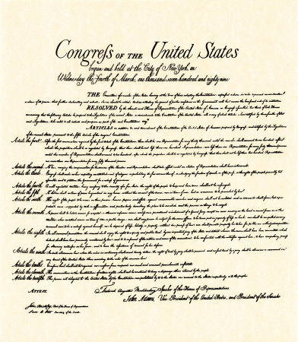
What the Government Cannot Do
The Bill of Rights
Notes:
Note 5: the ultimate privacy: You don’t have to give out the contents of your head.
Fourth amendment. The stuff isn’t in our homes. Further, it isn’t any longer necessary to enter homes to get what’s there.

Slide 5
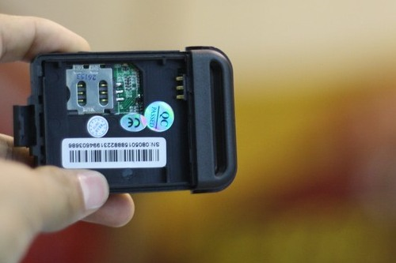
Recall: Tracking Your Car
Notes:
We discussed this in Privacy I. It is illegal for citizens to secretly track each other. But in summer, 2010 U.S. Court of Appeals for the Ninth Circuit ruled that law enforcement agencies have the right to attach GPS tracker to your vehicle without a warrant, even in your driveway. But overturned by US v Jones 2012
http://www.shopkami.com/shop.html?page=shop.product_details&flypage=flypage-ask.tpl&product_id=2695&category_id=11

Slide 6


Recall: Your Encrypted Hard Drive
January 23, 2012: a Colorado U.S. District Judge, in a case against a woman accused of bank fraud, that the woman must decrypt her laptop. That decision was upheld by the 10th US Circuit Court of Appeals on February 22, 2012.
February 23, 2012: the 11th US Circuit Court of Appeals, in a case against a man accused of child pornography, ruled that forcing the man to decrypt his computer would be a breach of the Fifth Amendment.
Notes:
We discussed this in Ethics and Morality as an example of a muddle.
http://www.wired.com/threatlevel/2012/01/judge-orders-laptop-decryption/
http://www.wired.com/threatlevel/2012/02/laptop-decryption-unconstitutional/
Disk image: http://www.zdnet.com/blog/doc/what-about-the-hard-drive-in-your-printer/1551
Picture to illustrate “back and forth”: http://www.acclaimclipart.com/free_clipart_images/boys_throwing_a_ball_back_and_forth_0515-1001-0204-0410.html

Slide 7
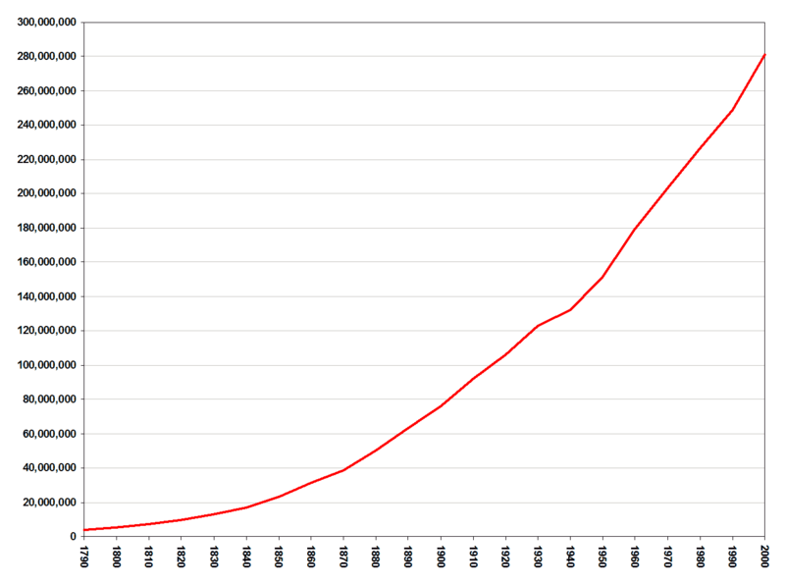
Census Records

Slide 8
Data of the 1790 US Census
Name of head of family
Number of free white males 16 & up including heads of families
Number of free white males under 16
Number of free white females including heads of families
Number of all other free persons except Indians not taxed
Number of slaves

Slide 9
Data of the 1800 US Census
Name of the head of family
# of free white males under age 10
# of free white males age 10-16
# of free white males age 16-26
# of free white males age 26-45
# of free white males over age 45
# of free white females under age 10
# of free white females age 10-16
# of free white females age 16-26
# of free white females age 26-45
# of free white females over age 45
# of all other free persons
# of slaves

Slide 10
Data of the 1820 US Census
1. Name of the head of family
2. # of free white males under age 10
3. # of free white males age 10-16
4. # of free white males age 16-18
5. # of free white males age 16-26
6. # of free white males age 26-45
7. # of free white males age 45 and up
8. # of free white females under age 10
9. # of free white females age 10-16
10. # of free white females age 16-26
11. # of free white females age 26-45
12. # of free white females age 45 and up
13. # of foreigners not naturalized
14. # of persons engaged in agriculture
15. # of persons engaged in commerce
16. # of persons engaged in manufacture
17. # of male slaves under 14
18. # of male slaves age 14-26
19. # of male slaves age 26-45
20. # of male slaves age 45 and up
21. # of female slaves under 14
22. # of female slaves age 14-26
23. # of female slaves age 26-45
24. # of female slaves age 45 and up
25. # of free male colored persons under 14
26. # of free male colored persons age 14-26
27. # of free male colored persons age 26-45
28. # of free male colored persons age 45 and up
29. # of free female colored persons under 14
30. # of free female colored persons age 14-26
31. # of free female colored persons age 26-45
32. # of free female colored persons age 45 and up
33. # of all other persons except Indians not taxed

Slide 11
Data of the 1930 US Census
Street, avenue, road, etc.
House number
Number of dwelling house in order of visitation
Number of family in order of visitation
Name
Relationship of this person to the head of the family
Home owned or rented
Value of home, if owned, or monthly rental, if rented*
Radio set*
Does this family own a farm?
Sex
Color or race
Age at last birthday
Marital condition
Age at first marriage*
Attended school or college any time since Sept. 1, 1929
Whether able to read or write
Place of birth__person
Place of birth__father
Place of birth__mother
Language spoken in home before coming to the United States
Year of immigration into the United States
Naturalization
Whether able to speak English
Trade, profession, or particular kind of work done
Occupation industry or business
Class of worker
Employment
Veteran*

Slide 12
Data of the 1930 US Census
Street, avenue, road, etc.
House number
Number of dwelling house in order of visitation
Number of family in order of visitation
Name
Relationship of this person to the head of the family
Home owned or rented
Value of home, if owned, or monthly rental, if rented*
Radio set*
Does this family own a farm?
Sex
Color or race
Age at last birthday
Marital condition
Age at first marriage*
Attended school or college any time since Sept. 1, 1929
Whether able to read or write
Place of birth__person
Place of birth__father
Place of birth__mother
Language spoken in home before coming to the United States
Year of immigration into the United States
Naturalization
Whether able to speak English
Trade, profession, or particular kind of work done
Occupation industry or business
Class of worker
Employment
Veteran*
2,668 reels of microfilm
1,591 reels of soundex

Slide 13
Data of the 2010 Census

Slide 14
1880 US Census
Required 8 years of processing

Slide 15
1880 US Census
Required 8 years of processing
1890 US Census
Required 1 year of processing

Slide 16
1880 US Census
Required 8 years of processing
1890 US Census
Required 1 year of processing
?

Slide 17
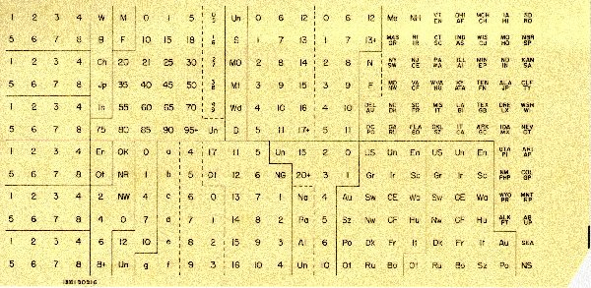
The Hollerith Card
Notes:
http://www.oz.net/~markhow/writing/holl.htm

Slide 18
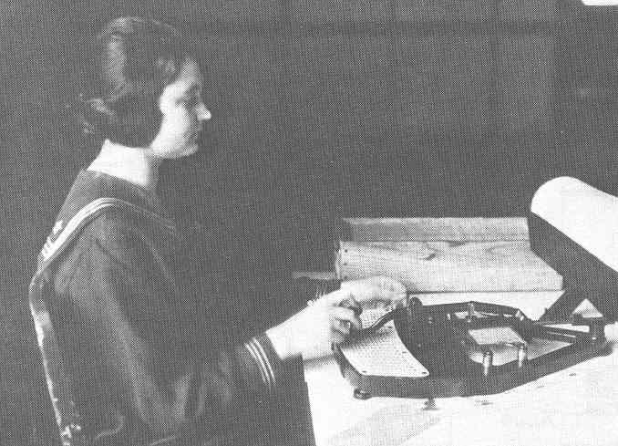
Punching the Cards

Slide 19
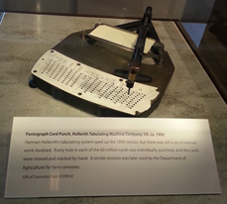
Punching the Cards
Notes:
Taken at CA Computer Museum

Slide 20
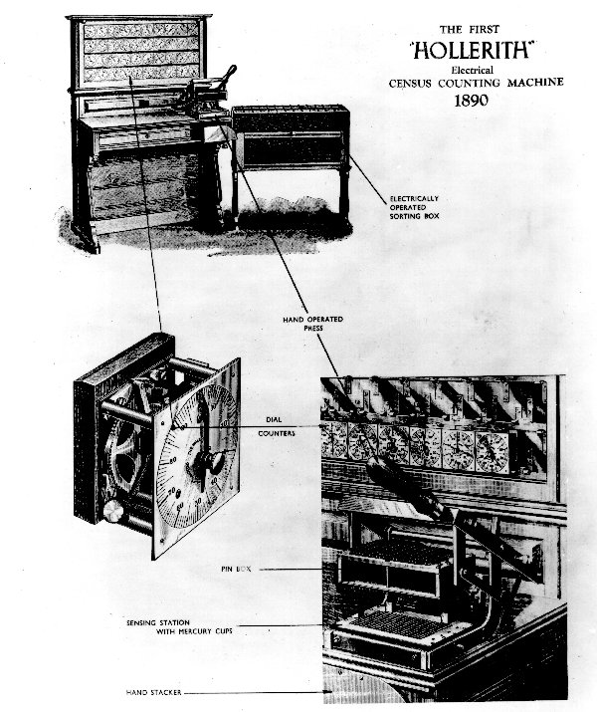
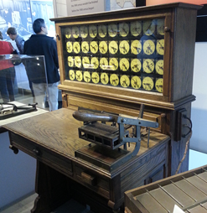
Tabulating the Cards
Notes:
http://www.oz.net/~markhow/writing/holl.htm
Color picture taken at CA Computer Museum.

Slide 21
World War II
Census data used to collect Japanese-Americans to be taken to “relocation camps”.

Slide 22
World War II
Census data used to collect Japanese-Americans to be taken to “relocation camps”.
Post 9/11
Census data used to identify neighborhoods of Arab-Americans

Slide 23


Current Census Data
http://factfinder2.census.gov/faces/nav/jsf/pages/index.xhtml

Slide 24
Remember Latanya Sweeney’s Result
Data from the 1990 US Census show that 87% (216 million out of 248 million) of the United States population provided data that likely make them unique based on only the three attributes of zip code, date of birth, and gender.
Latanya Sweeney, k-Anonymity: A Model for Protecting Privacy

Slide 25
Total Information Awareness
Proposed in 2002.
Would use data mining over databases of financial, medication, travel, communication, biometric information.
Some researchers get sucked in.
ACM letter sent to the Senate, January, 2003.
Funding for domestic surveillance portion suspended in February, 2003.
Name changed to Terrorist Information Awareness.

Slide 26
Is TIA “Right”?
Or, since we’re really concerned with costs:

Slide 27

The Government and Your Facebook Page
http://www.eff.org/deeplinks/2010/08/government-finds-uses-social-networking-sites
Notes:
EFF files suit to get information on how the government uses social networking sites for security clearances.
Image from: http://www.buzzle.com/img/articleImages/298991-18122-9.jpg

Slide 28
The Government
When technical problems tell them too much:
http://www.nytimes.com/2008/02/17/washington/17fisa.html?ex=1360904400&en=d32fbd564f65660c&ei=5089&partner=rssyahoo&emc=rss

Slide 29
The REAL ID Act
The REAL ID Act passed in 2005.
Implementation continues to be delayed.

Slide 30
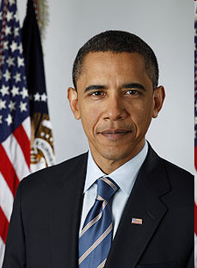
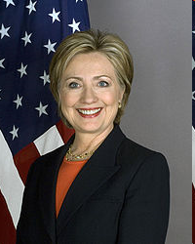
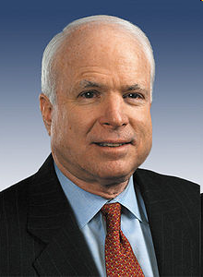
Dirty Tricks
Passport files of presidential candidates
Notes:
Obama photo from http://en.wikipedia.org/wiki/Barack_Obama
Clinton photo from http://en.wikipedia.org/wiki/Hillary_Clinton
McCain photo from http://en.wikipedia.org/wiki/John_McCain

Slide 31
Quis Custodiet
“… quis custodiet ipsos custodes? …”
Juvenal, (Satire 6.346–348)
But earlier, in the Republic. The answer:
"They will guard themselves against themselves. We must tell the guardians a noble lie. The noble lie will inform them that they are better than those they serve and it is therefore their responsibility to guard and protect those lesser than themselves. We will instill in them a distaste for power or privilege, they will rule because they believe it right, not because they desire it."
Notes:
From Wikipedia. Juvenal: late 1st and early 2nd century CE
But note that the Juvenal quote is in the context of locking up the women and then having guards for them while the men are away.

Slide 32


Quis Custodiet
“If you’re the police, who will police the police?"
Notes:
Example from: http://en.wikipedia.org/wiki/Quis_custodiet_ipsos_custodes%3F Simpsons episode 1F09, "Homer the Vigilante", Homer has messed up as a vigilante.
http://www.simpsoncrazy.com/pictures/lisa
http://www.simpsoncrazy.com/pictures/homer

Slide 33
Quis Custodiet
I don’t know. Coast Guard?
“If you’re the police, who will police the police?"
Notes:
From Wikipedia. Juvenal: late 1st and early 2nd century CE
But note that the Juvenal quote is in the context of locking up the women and then having guards for them while the men are away.
Example from: http://en.wikipedia.org/wiki/Quis_custodiet_ipsos_custodes%3F Simpsons episode 1F09, "Homer the Vigilante", Homer has messed up as a vigilante.
http://www.simpsoncrazy.com/pictures/lisa
http://www.simpsoncrazy.com/pictures/homer

Slide 34
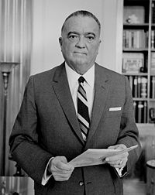
Quis Custodiet
Who is this guy?
Notes:
Picture from wikipedia

Slide 35
Quis Custodiet
J. Edgar Hoover
Director, FBI
May 10, 1924 – May 2, 1972
“…we want no Gestapo or secret police. The FBI is tending in that direction. They are dabbling in sex-life scandals and plain blackmail. J. Edgar Hoover would give his right eye to take over, and all congressmen and senators are afraid of him.”
President Harry S. Truman
Notes:
Picture from wikipedia

Slide 36
Quis Custodiet
In one case, a Maryland banker who sat on the state's public health commission used his access to medical records to cross-check people with cancer who he'd given loans to and then called in their loans. (He was never even punished in the incident.)
Notes:
http://64.236.22.112/TECH/9709/03/netly.news/

Slide 37
Medical Information
An implanted RFID chip would give doctors information even if you’re unconscious.

Slide 38
Stealing Medical Information Isn’t New
Daniel Ellsberg and the Plumbers
But getting at electronic information may be a lot easier.

Slide 39
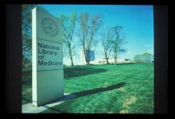
One Easy Way
http://www.washingtonpost.com/wp-dyn/content/article/2008/03/23/AR2008032301753.html?nav=rss_email/components

Slide 40
Corporations

Slide 41
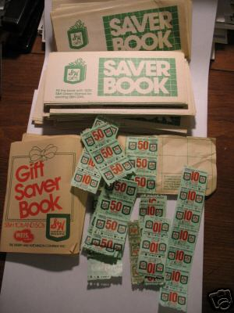
Rebates: the Old Way

Slide 42


Rebates:
Today
http://www.greenpoints.com/account/act_default.asp

Slide 43
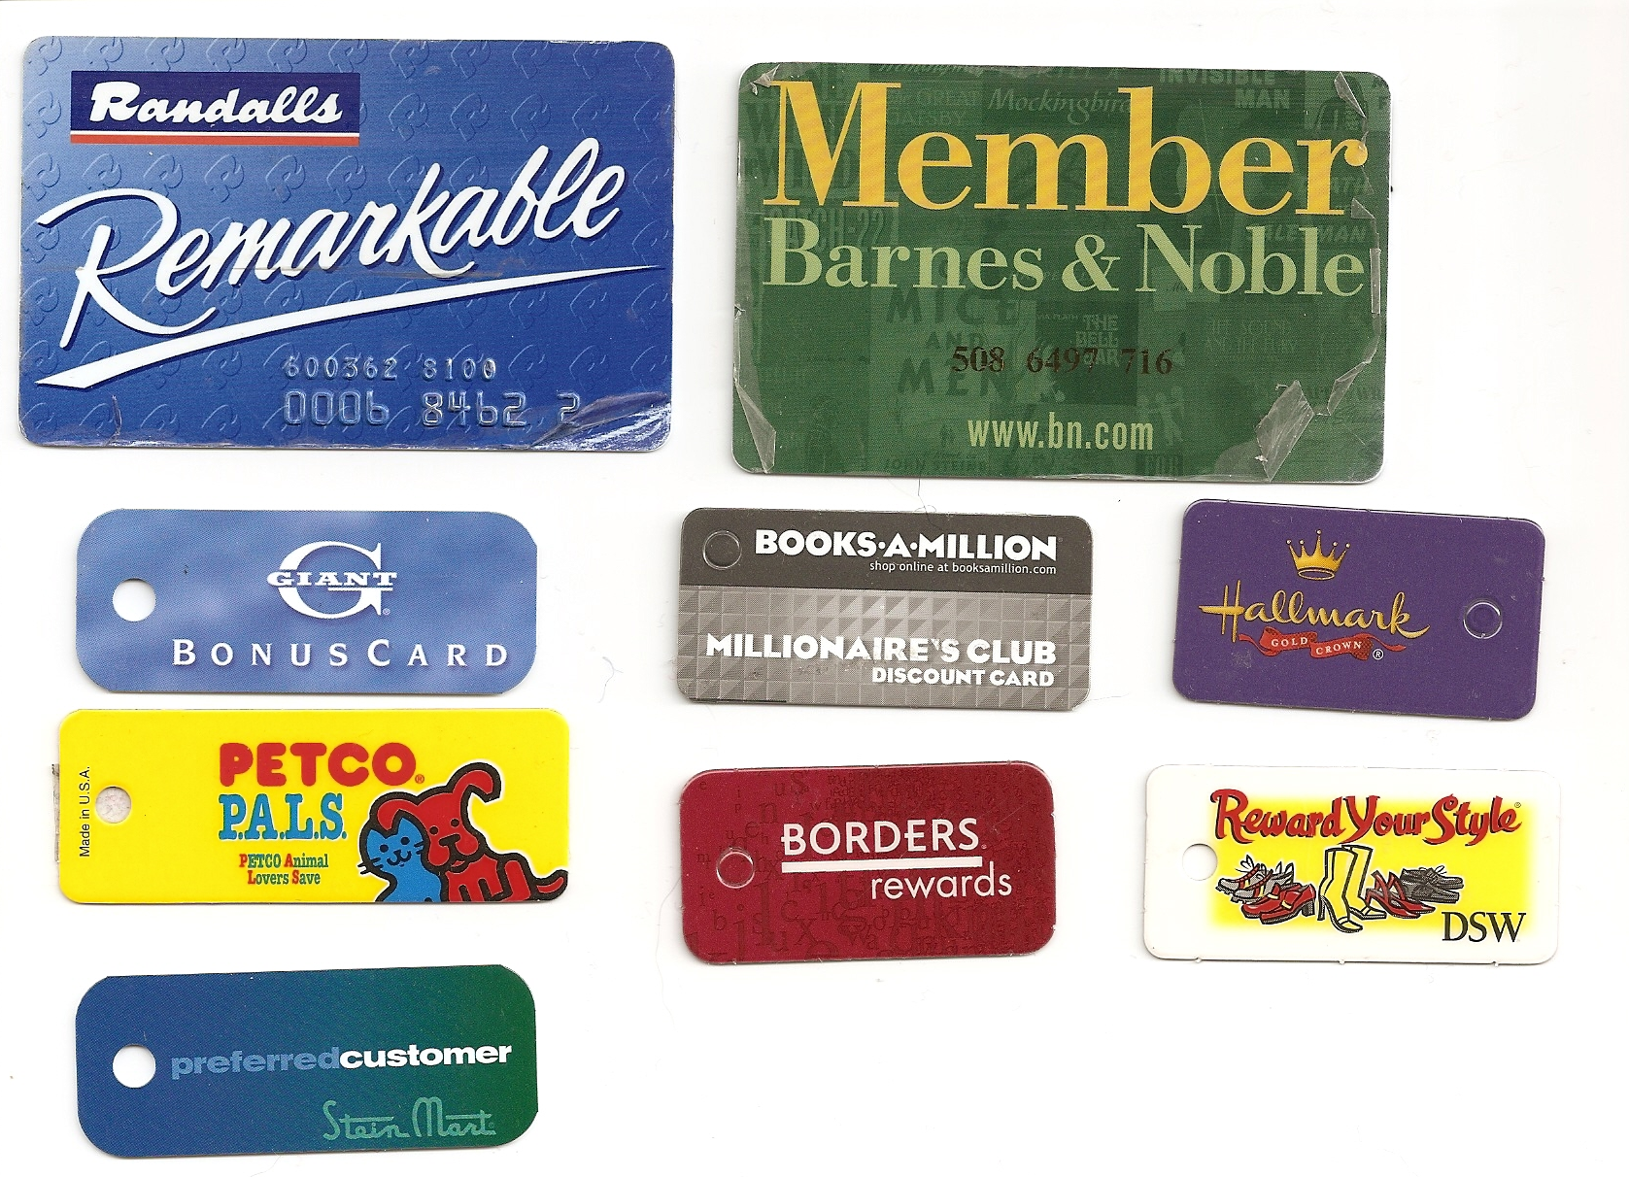
Rebates: Today

Slide 44
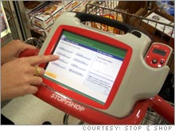
Rebates:
Tomorrow?
View from 2005
The Shopping Buddy
Notes:
http://money.cnn.com/2005/04/28/news/fortune500/supermarket_showdown/

Slide 45
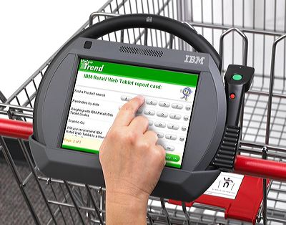
Rebates Tomorrow?
View from 2005
Personal Shopping Assistant

Slide 46
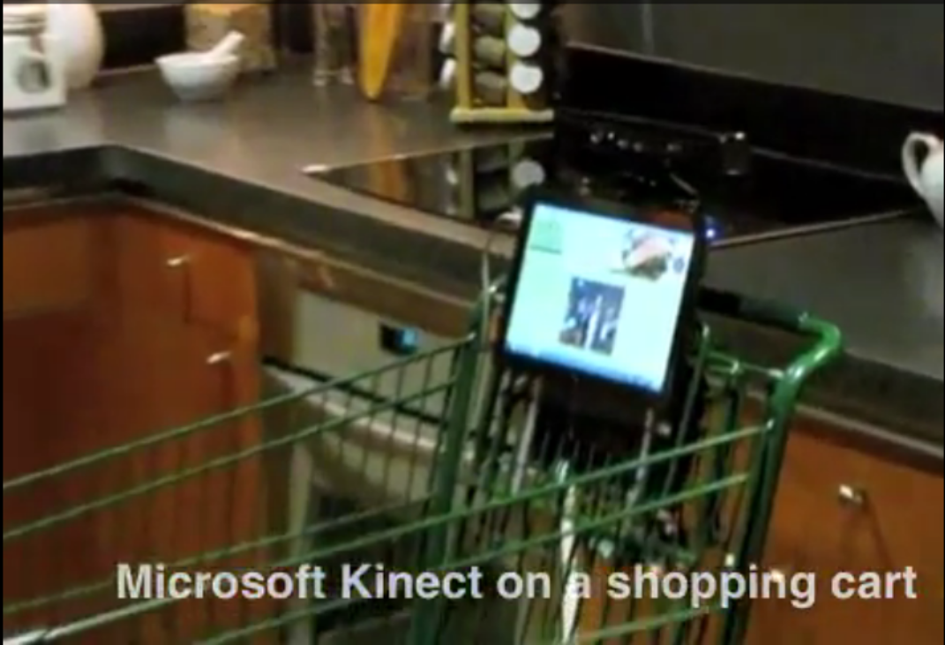
Rebates:
Tomorrow?
View from 2012
Microsoft Kinect Shopping Cart at Whole Foods
Notes:
Go to article and scroll down for video.

Slide 47
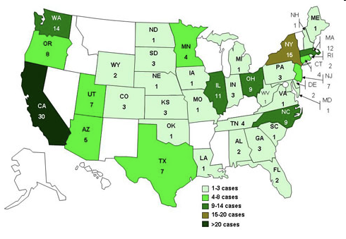
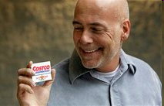
More Than Just Rebates
CDC uses shopper-card data to trace salmonella
2009: 272 people in 44 states sick – black pepper, found from Costco data.
2011: 42 people in 5 states sick – pine nuts, found from Wegman’s data.
2010: E. coli sickened 33 people: Gouda cheese, found from Costco data.
http://www.msnbc.msn.com/id/35800591/ns/health-food_safety/
Notes:
Outbreak started summer 2009. They only used data after asking the sick people. But what if they hadn’t asked? The guy in the picture is one of the sick people who gave his permission.

Slide 48
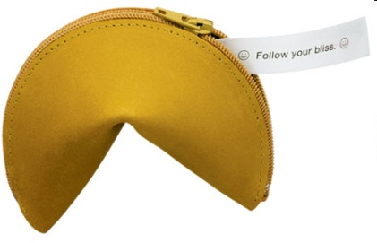
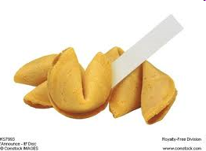
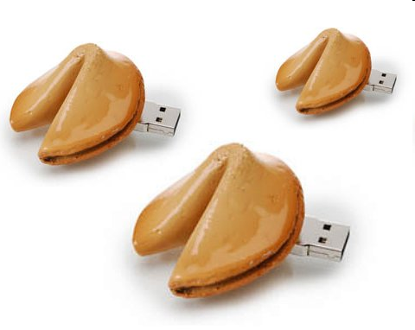

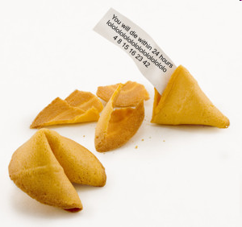
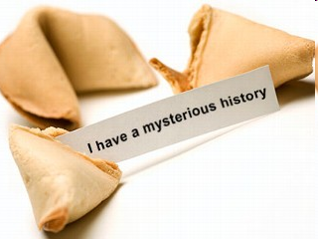
Cookies
Notes:
Usb cookies: http://technabob.com/blog/2007/11/27/fortune-cookie-usb-drives-save-memories-in-bed/
http://www.forums.editingarchive.com/images/archiveitems/4fortune-big.jpg
http://www.sodahead.com/united-states/so-do-you-think-obamas-presidentcy-is-doomed-regardlesss-is-health-care-passes-or-fails/question-827417/?link=ibaf&imgurl=http://a.abcnews.com/images/GMA/fortune_cookie_080808_mn.jpg&q=fortune%2Bcookie
Zippered one: http://www.puppiesandflowers.com/blogimages/09/02/fortuneCookieCoinPurse2.jpg

Slide 49
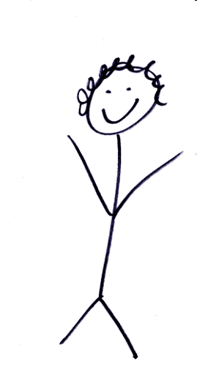
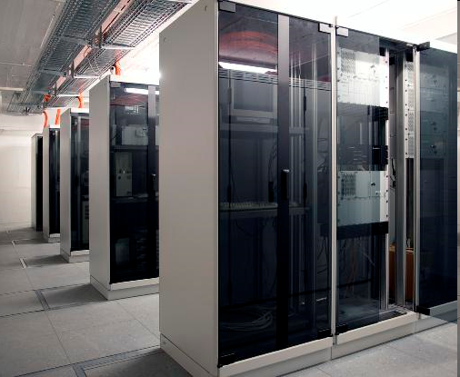
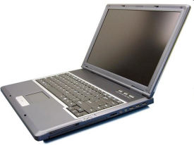

Cookies
GET /index.html HTTP/1.1
Host: www.example.org
HTTP/1.1 200 OK
Content-type: text/html
Set-Cookie: name=value
(content of page)
GET /spec.html HTTP/1.1
Host: www.example.org
Cookie: name=value
Accept: */*
Notes:
Example from: http://en.wikipedia.org/wiki/HTTP_cookie
Images same as later slide on preferences

Slide 50
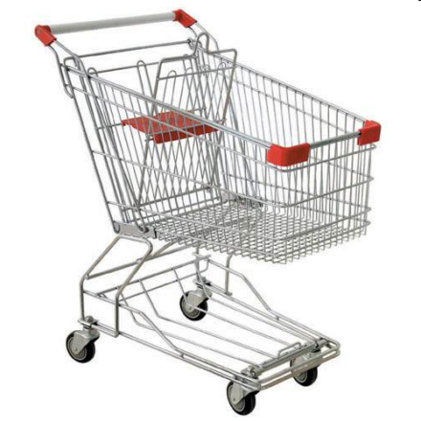
Cookies
Check whether this is a new or returning user
Shopping cart
First generation:
Cookie:
Little Red Book
How to Make a Bomb
Notes:
Shopping cart: http://sellfiles.org/wp-content/uploads/2010/09/shopping-cart.jpg

Slide 51
Cookies
Check whether this is a new or returning user
Shopping cart
Second generation:
Cookie:
Session id: 754623598761
Backend DB: id = 754623598761
order = Little Red Book
How to Make a Bomb

Slide 52
Cookies
Check whether this is a new or returning user
Shopping cart
Remember user name/password

Slide 53
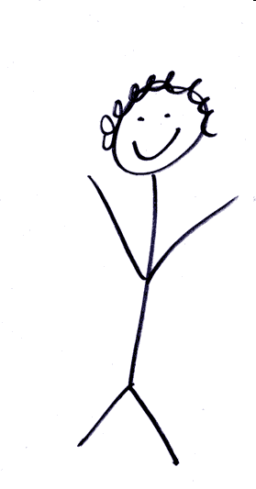
Cookies
Check whether this is a new or returning user
Shopping cart
Remember user name/password
Preferences
webpage
clicks
Notes:
Stick figure: http://www.megansteidl.com/images/stick_figure.gif
Laptop: http://chaselaw.nku.edu/images/admissions/laptop.jpg
Server: http://www.uni-muenster.de/ZIV/inforum/jubilaeum-2004/a23.html

Slide 54
Cookies
Check whether this is a new or returning user
Shopping cart
Remember user name/password
Preferences
Tracking
id
request, id
id, url, date/time, ???
Id, url, date/time, ???
………
Notes:
Stick figure: http://www.megansteidl.com/images/stick_figure.gif
Laptop: http://chaselaw.nku.edu/images/admissions/laptop.jpg
Server: http://www.uni-muenster.de/ZIV/inforum/jubilaeum-2004/a23.html

Slide 55
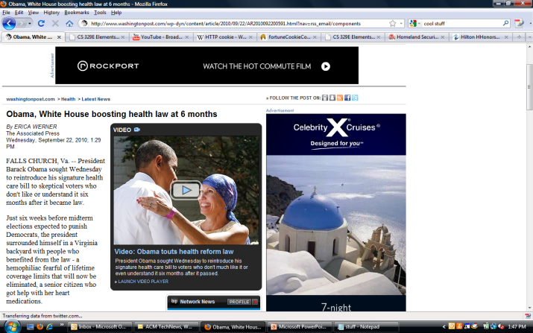
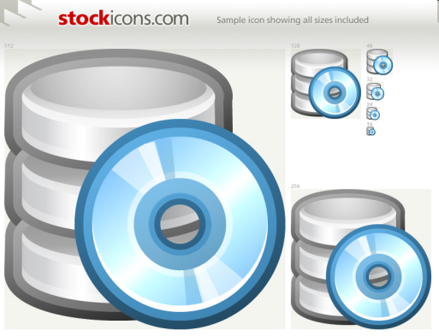

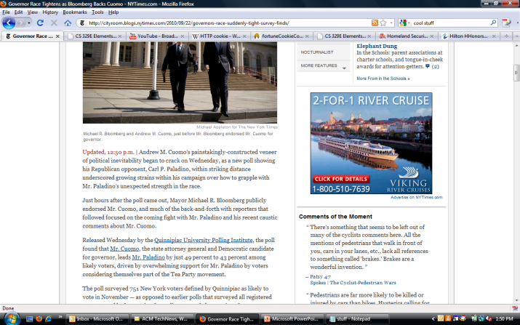
Third-Party Cookies
Today:
MegaId#, ad
www.site1.com
Tomorrow:
#77654, site1
#77654, site2
ad
MegaId#
www.site2.com
Notes:
SoMegaAd Corp now knows that the same person who visited site1 (and maybe looked for a particular thing) also visited site 2.
Dollar sign building: http://www.corbisimages.com/images/67/D3D6B439-D962-44F7-A76D-4FE87D1002FD/42-19826901.jpg

Slide 56
Cookies
Cookies can have other attributes:
Can cookies infect your computer with viruses?
Set-Cookie: RMID=732423sdfs73242;
expires=Fri, 31-Dec-2010 23:59:59 GMT;
path=/; domain=.example.net
Notes:
Continues example from http://en.wikipedia.org/wiki/HTTP_cookie

Slide 57
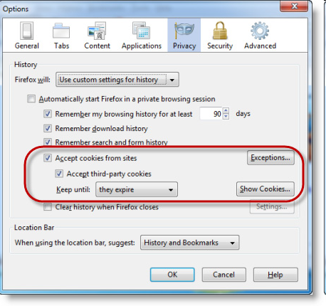
Disabling Cookies
Let’s try it: http://www.washingtonpost.com
Mozilla help: http://support.mozilla.com/en-US/kb/Enabling+and+disabling+cookies?s=cookies&as=s

Slide 58
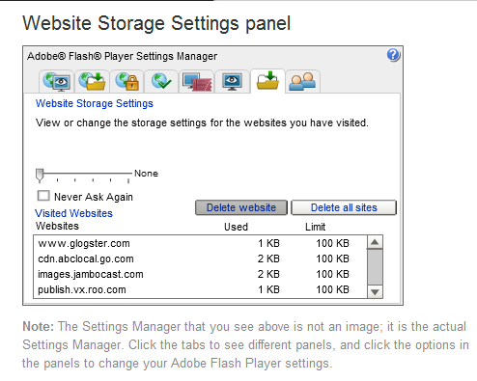
Flash Cookies
Let’s try it:
http://www.macromedia.com/support/documentation/en/flashplayer/help/settings_manager07.html
Notes:
Lawsuits now. Most users don’t know about this and what they can do about it.

Slide 59
Collaborative Filtering
User-based approach
    Look for users with the same pattern.
    Check ratings from those users.
Item-based approach
    Build an item-item matrix.
    Use data from the current user to select from the matrix
An item-based approach using binary data
An Amazon example

Slide 60
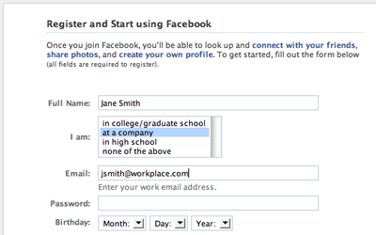
Choosing to Go Public
Get Started On Facebook
Facebook isn't just one big site; it's made up of lots of separate networks based around things like schools, companies, and regions.
Anyone can sign up for Facebook
If you want to see the profiles of your classmates or coworkers on the site, be sure to use your school or work email to register. You can search for anyone on Facebook, but you can only see profiles of your friends and people in your networks.

Slide 61
Privacy Policies
Does anyone read them?
  Facebook

Slide 62

Changing Your Mind
http://www.nytimes.com/2008/02/11/technology/11facebook.html?em&ex=1203051600&en=5f33ac07f19d21f5&ei=5087%0A
Notes:
Image from: http://blogs.zdnet.com/social/?p=392

Slide 63
What’s in it for Them?
[Facebook] is still trying to find a way to monetize its popularity, mostly by allowing marketers access to its wealth of demographic and behavioral information. The retention of old accounts on Facebook’s servers seems like another effort to hold onto — and provide its ad partners with — as much demographic information as possible. NYT, Feb. 11, 2008

Slide 64
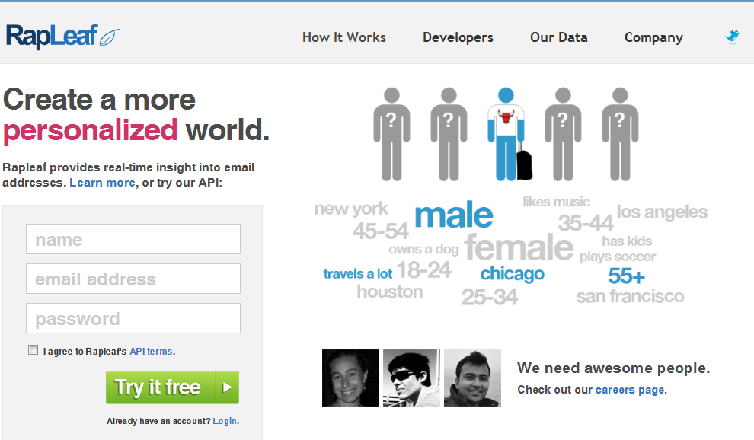
Rapleaf
http://en.wikipedia.org/wiki/Rapleaf
Notes:
Go to this story to see the history of what they’ve done.

Slide 65
Monitoring Your Information
Credit Reports
Equifax
Experian
Trans Union
The Fair and Accurate Credit Transactions Act of 2004 says you can get one free report per year.

Slide 66

Tracking the flu: http://www.google.org/flutrends/
Tracking you and filtering your searches
Notes:
We talked about both of these things back in Intro. We have the clearly good and the possibly scary.

Slide 67
http://www.youtube.com/watch?v=xwq7le9zSv0
Notes:
Google, Privacy, and the Government - Schmidt and Maddow interview

Slide 68
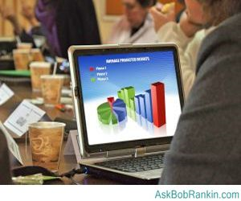
Everybody Else
Notes:
So here you are, surfing at your favorite coffee shop on their wifi network.
Good article, plus source of picture: http://askbobrankin.com/wifi_sidejacking.html

Slide 69
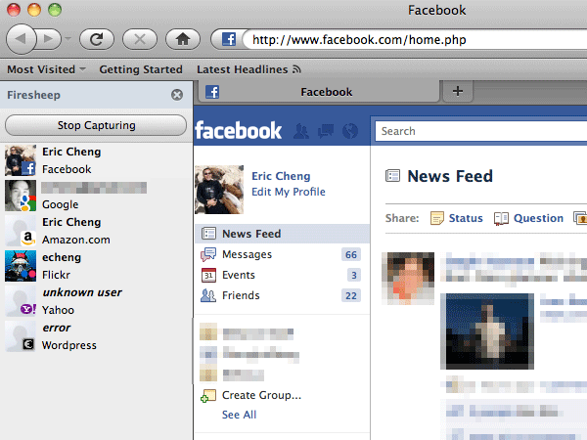
Sidejacking
Notes:
Firesheep is a free addon to Mozilla.
Click on ebay icon to go to ebay. Go to myebay. When you log in, you’ve got https. But the very next page, you don’t any longer. Firesheep grabs cookie with session id and can now be you for the entire session.

Slide 70
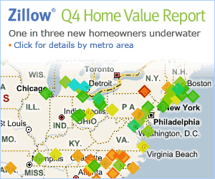
Everybody Else
http://www.zillow.com/search/RealEstateSearch.htm?dg=dg2&addrstrthood=5002+Lea+Cove&citystatezip=Austin%2C+TX

Slide 71
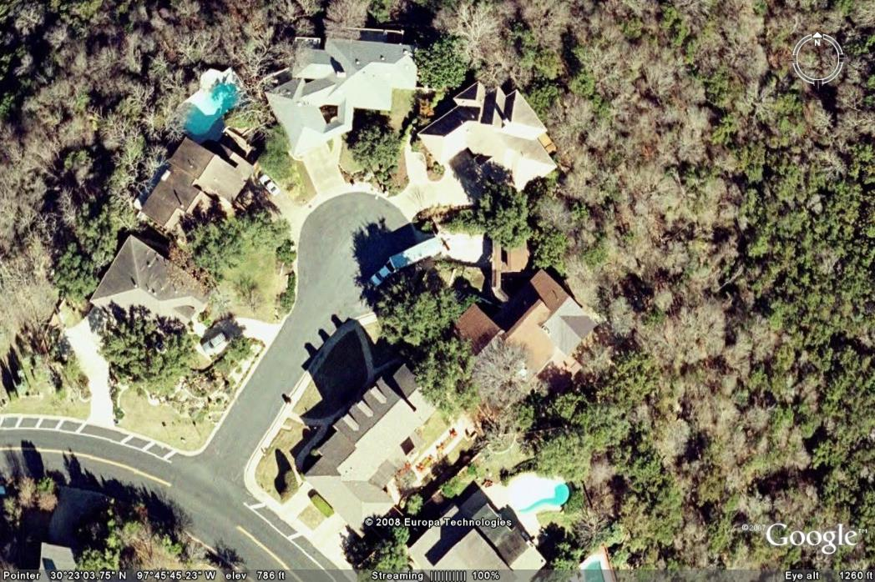
Google Earth

Slide 72
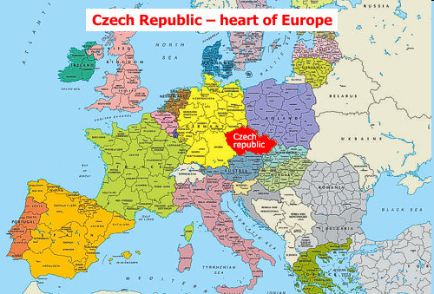
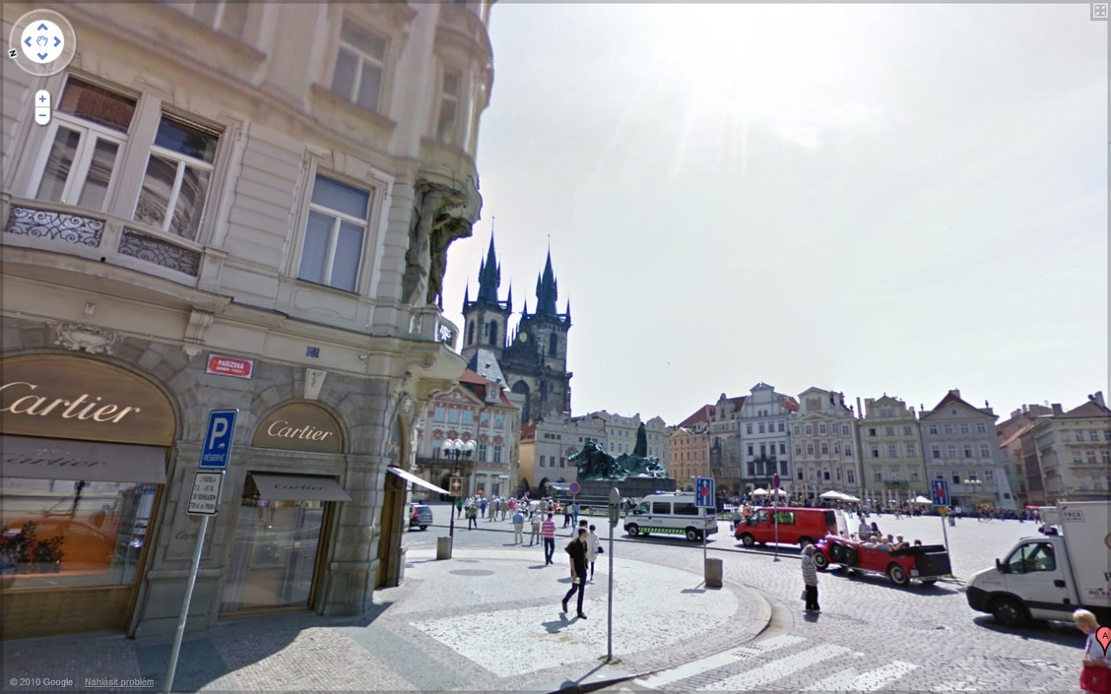
Google Street View
http://news.yahoo.com/s/ap/20100914/ap_on_hi_te/eu_czech_google_street_view
http://maps.google.com/help/maps/streetview/
Notes:
Lots of reasonable people maintain blogs. But who generally writes comments, say on newspaper stories. This story has some sheer drivel.
Czech map: http://www.bbc.co.uk/worldservice/learningenglish/communicate/blog/student//images/map_czech_republic.jpg

Slide 73
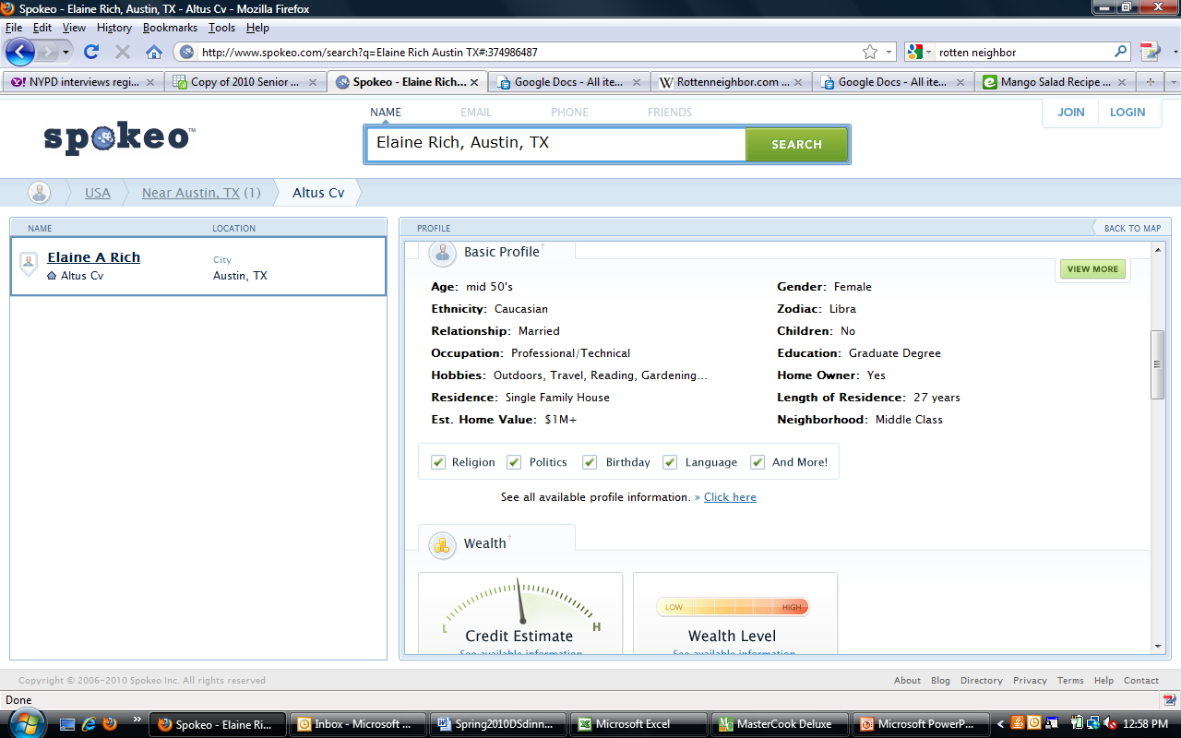
Spokeo
http://www.spokeo.com/

Slide 74
How Safe are You?
Consider someone using these sites:
  Were will the police NOT be?
  Crimestoppers
  Where might there be valuables?
  Zillow
  Is there easy access and departure?
  GoogleEarth
  What will the place look like when I arrive?
  StreetView

Slide 75
Sites Positive?
Yet each one of those sites have very positive uses:
  What’s a safe neighborhood?
  Crimestoppers
  What houses are in my price range?
  Zillow
  How do I get to that address?
  GoogleEarth
  What will the place look like when I arrive?
  StreetView

Slide 76
How Safe are You?
A traffic camera might be very useful as you plan your daily commute:
  Connecticut Avenue at Macomb in Washington, DC - refreshed every two seconds
Could it be a bit scary?
  Same intersection last night

Slide 77
Protections?
Does Google Street View really blur all license plates and faces?
  24th and Speedway – View 1
  24th and Speedway – View 2
  24th and Speedway – View 3

Slide 78


http://www.privacyrights.org/

