Slide 1
Risks (and Rewards)

Slide 2
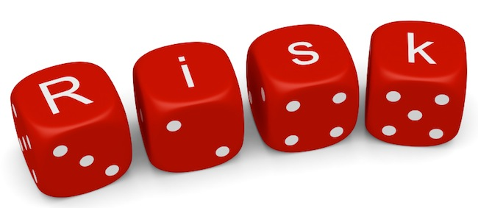
Risk and Reward
Complex systems: bugs and imperfections
Hackers and cybercriminals
Complex systems: bias
Notes:
http://www.melvintjonakon.com/wp-content/uploads/2017/09/risk.jpg AKC

Slide 3
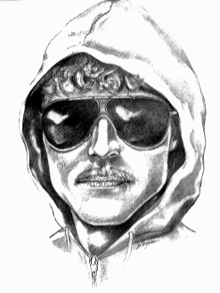
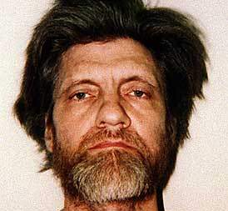
Is Technology Necessary?
The Industrial Revolution and its consequences have been a disaster for the human race. - Theodore Kaczynski

Slide 4
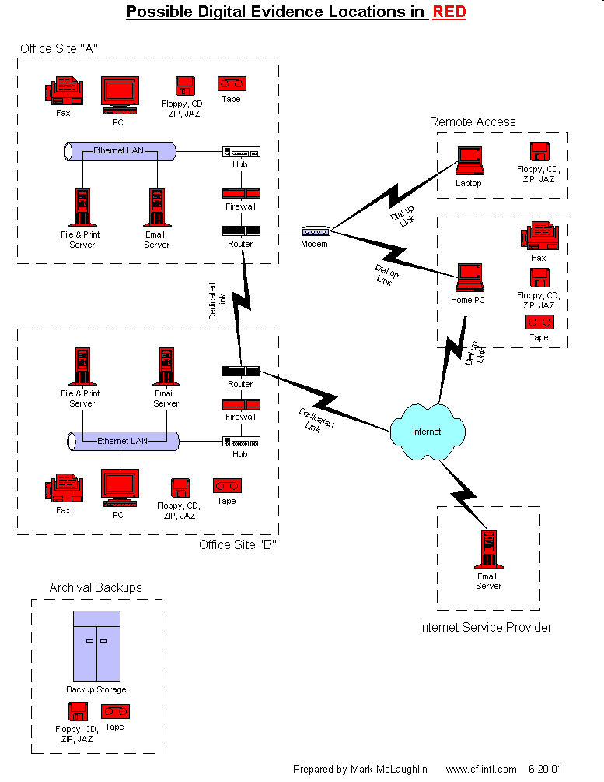
Digital Forensic Tools
http://en.community.dell.com/blogs/direct2dell/archive/2009/07/06/dell-unveils-its-digital-forensics-solution.aspx
Notes:
What could go wrong here?
But can go wrong if we don’t have these tools?

Slide 5
Risks – Who Cares?
Peter Neumann: Computer-Related Risks, Addison-Wesley/ACM Press. 1995
ACM Risks Forum: http://www.risks.org

Slide 6
20 Mishaps That Might Have Started Accidental Nuclear War
From The Limits of Safety by Scott D. Sagan as quoted by Alan F. Philips, M.D.
1) November 5, 1956: Suez Crisis Coincidence
2) November 24, 1961: BMEWS Communication Failure
3) August 23, 1962: B-52 Navigation Error
4) August-October, 1962: U2 Flights into Soviet Airspace
5) October 24, 1962- Cuban Missile Crisis: A Soviet Satellite Explodes
6) October 25, 1962- Cuban Missile Crisis: Intruder in Duluth
7) October 26, 1962- Cuban Missile Crisis: ICBM Test Launch
8) October 26, 1962- Cuban Missile Crisis: Unannounced Titan Missile Launch
9) October 26, 1962- Cuban Missile Crisis: Malstrom Air Force Base
10) October, 1962- Cuban Missile Crisis: NATO Readiness
11) October, 1962- Cuban Missile Crisis: British Alerts
12) October 28, 1962- Cuban Missile Crisis: Moorestown False Alarm
13) October 28, 1962- Cuban Missile Crisis: False Warning Due to Satellite
14) November 2, 1962: The Penkovsky False Warning
15) November, 1965: Power Failure and Faulty Bomb Alarms
16) January 21, 1968: B-52 Crash near Thule
17) October 24-25, 1973: False Alarm During Middle East Crisis
18) November 9, 1979: Computer Exercise Tape
19) June , 1980: Faulty Computer Chip
20) January, 1995: Russian False Alarm
http://www.nuclearfiles.org/menu/key-issues/nuclear-weapons/issues/accidents/20-mishaps-maybe-caused-nuclear-war.htm

Slide 7
Odds of Dying in One Year from Leading Causes
Odds | Cause
1756 | All Causes
4591 | Nontransport Unintentional (Accidental) Injuries
6197 | Transport Accidents
6535 | Motor-Vehicle Accidents
14017 | Accidental poisoning by and exposure to noxious substances
15614 | Falls
17532 | Intentional self-harm by firearm
18953 | Other and unspecified land transport accidents
19216 | Car occupant
25263 | Assault by firearm
29971 | Accidental poisoning by narcotics and psychodysleptics [hallucinogens]
40030 | Intentional self-harm by hanging, strangulation, and suffocation
49139 | Pedestrian
National Safety Council – 2004 Data

Slide 8
Cause of Death – Lifetime Odds in US
Cause | Chance of Dying | Cause | Chance of Dying
Heart Disease | 1-in-5 | Drowning | 1-in-8,942
Cancer | 1-in-7 | Air Travel Accident | 1-in-20,000
Stroke | 1-in-23 | Flood (included also in Natural Forces) | 1-in-30,000
Accidental Injury | 1-in-36 | Legal Execution | 1-in-58,618
Motor Vehicle Accident | 1-in-100 | Tornado (incl also in Natural Forces) | 1-in-60,000
Intentional Self-harm (suicide) | 1-in-121 | Snake, Bee or other Venomous Bite or Sting | 1-in-100,000
Falling Down | 1-in-246 | Earthquake (incl also in Natural Forces) | 1-in-131,890
Assault by Firearm | 1-in-325 | Dog Attack | 1-in-147,717
Fire or Smoke | 1-in-1,116 | Asteroid Impact | 1-in-200,000**
Natural Forces (heat, cold, storms, quakes) | 1-in-3,357 | Tsunami | 1-in-500,000
Electrocution | 1-in-5,000 | Fireworks Discharge | 1-in-615,488
** Perhaps 1-in-500,000
Source: National Center for Health Statistics
Notes:
The idea here: There is no such thing as risk-free life.
http://www.flatrock.org.nz/topics/environment/tornado_season_underway.htm

Slide 9
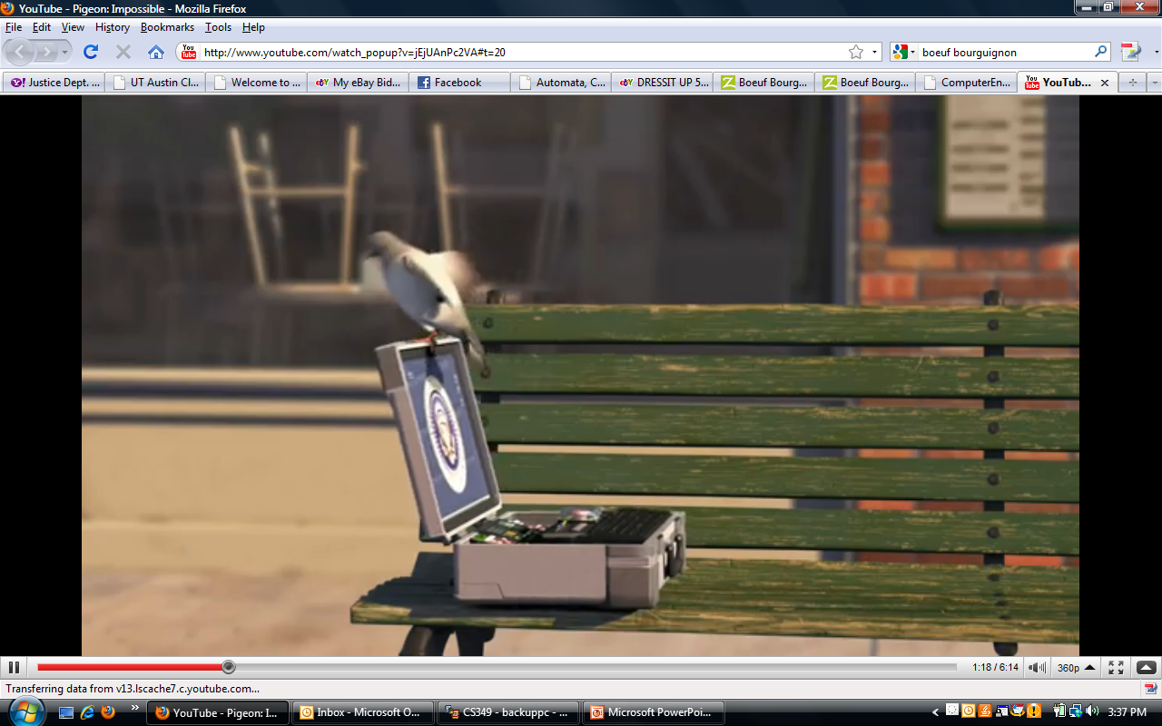
Fanciful, But You Get the Idea
http://www.youtube.com/watch_popup?v=jEjUAnPc2VA#t=20

Slide 10
Why is Software Risky?
 | Lines of Code | Developers
OpenOffice | 9 million
Android OS | http://www.gubatron.com/blog/2010/05/23/how-many-lines-of-code-does-it-take-to-create-the-android-os/
GNU/Linux | 30 million
Windows Vista | 50 million | 2000
Mac OS X 10.4 | 86 million
Lucent 5ESS Switch | 100 million | 5000
Notes:
Windows XP : http://en.wikipedia.org/wiki/Source_lines_of_code
OpenOffice:http://www.openoffice.org/FAQs/build_faq.html#source
GNU/Linux: http://www.dwheeler.com/sloc/
Lucent switch and Windows Vista: http://brianmackay.name/post/2009/01/14/The-Worlds-Largest-Software-Project.aspx
MAC OS X http://en.wikipedia.org/wiki/Source_lines_of_code

Slide 11
Risk of Failure
Why might a complex system fail?
Software error
Hardware error
Interaction between software design and hardware failure
User error
  User interface design
  Training the user

Slide 12
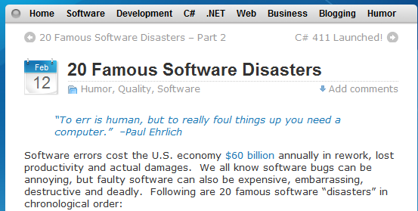
20 Famous Software Disasters
http://www.devtopics.com/20-famous-software-disasters/

Slide 13
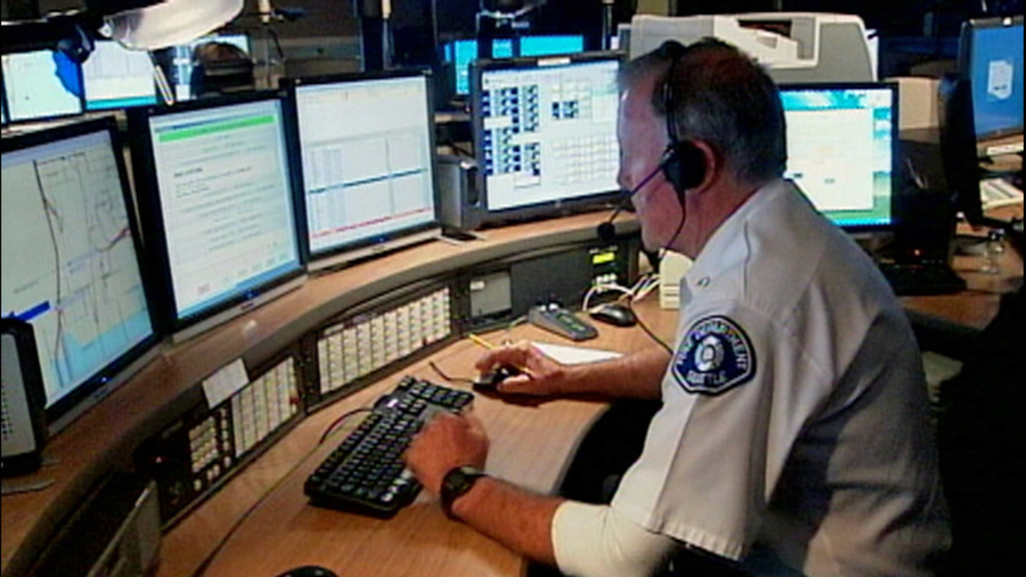
One Number – and 911
Notes:
https://www.theatlantic.com/technology/archive/2017/09/saving-the-world-from-code/540393/?google_editors_picks=true
https://www.washingtonpost.com/news/the-switch/wp/2014/10/20/how-a-dumb-software-glitch-kept-6600-calls-from-getting-to-911/?utm_term=.b1a3907d33db
Image from: https://mediaweb.kirotv.com/photo/2014/04/10/630PreshowA-911_Outage.tran_1667572_ver1.0_1280_720.jpg

Slide 14
Some Other Famous Bugs
http://en.wikipedia.org/wiki/List_of_software_bugs
Notes:
14
4

Slide 15
The Failure of the Software in the Patriot Missile System
What Really was the Bug?
1. The incident of February 23, 1991
2. Getting the information - the background of Patriot
3. The official explanation
4. Contradictions in the official explanation
5. A broader view of the development process

Slide 16
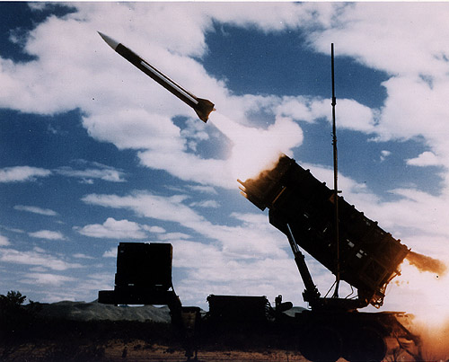

Slide 17
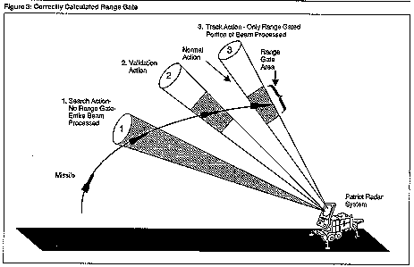

Slide 18
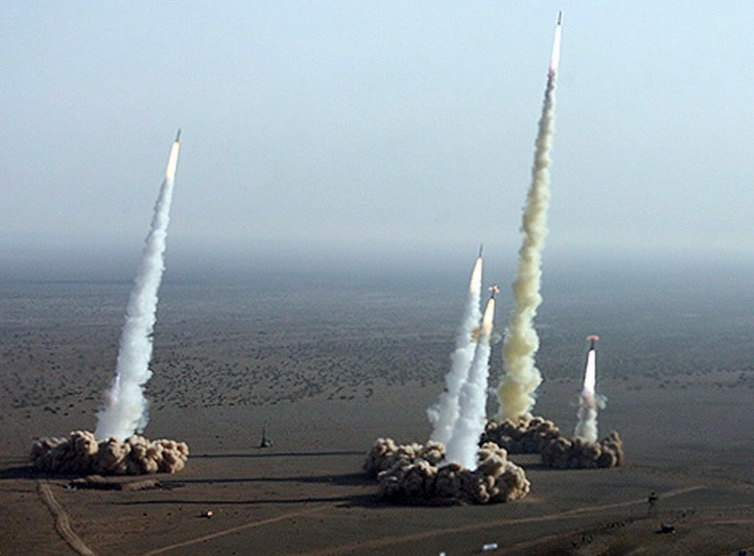
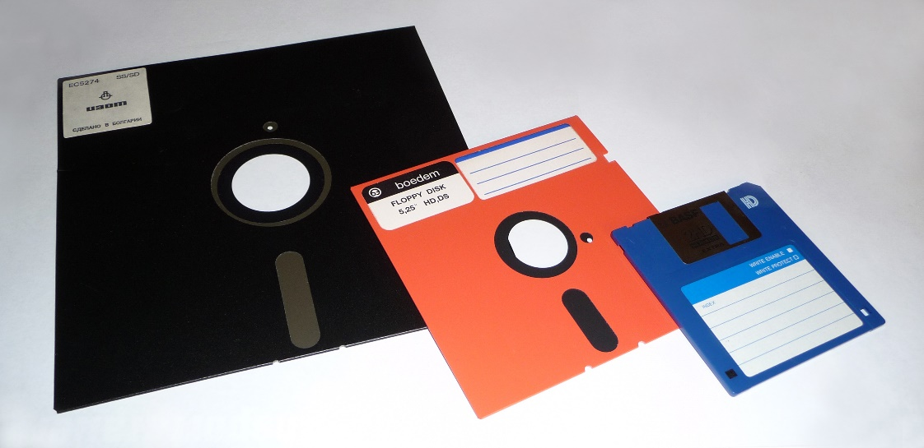
The Perils of Old Technology
Notes:
http://www.cnn.com/2016/05/26/us/pentagon-floppy-disks-nuclear/
http://astar.tv/post/how-to-launch-a-nuclear-missile/
https://en.wikipedia.org/wiki/Floppy_disk

Slide 19
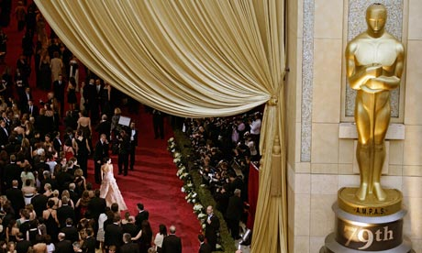
Electronic Voting
February, 2012:
Academy of Motion Picture Arts and Sciences to switch to electronic ballots in 2013.
Notes:
http://www.guardian.co.uk/film/2012/feb/02/oscars-vulnerable-cyber-attack-experts-warn
Some people complained of technical difficulties the first time. I cannot find any newer information.
Okay, so maybe the world won’t end if these elections are compromised. But …. Next slide

Slide 20
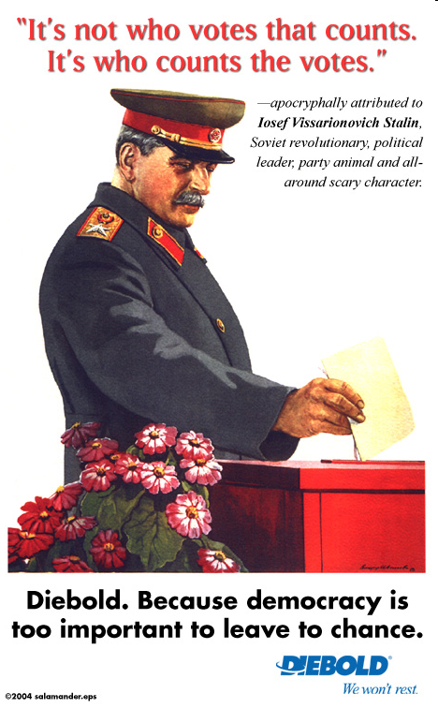
Electronic Voting
http://homepage.mac.com/rcareaga/diebold/adworks.htm
Notes:
Talk about the fact that our entire political system depends on the integrity of the election system.

Slide 21
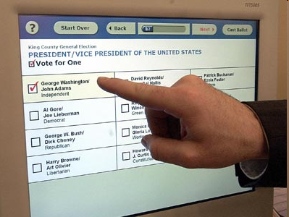
Electronic Voting
It’s complicated. Can we get it right?
What about the bad guys?
Notes:
http://patdollard.com/wp-content/uploads/voting-machine.jpg

Slide 22
Why is It So Hard?
Must enable voters to verify their ballots
Must not allow anyone else to verify ballots

Slide 23
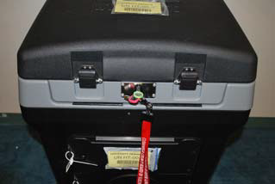
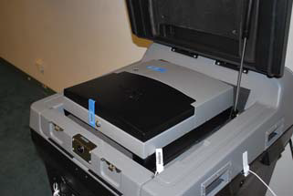
Can We Get It Right?
DS 200 Optical Scanner
Election Day Instructions
Does it work?
Notes:
Voters use paper ballots. All this thing has to do is to scan and count. Yet it makes lots of mistakes. If we can’t even do this, should we be thinking about internet voting? On the other hand, is there any system that has no failure modes?

Slide 24
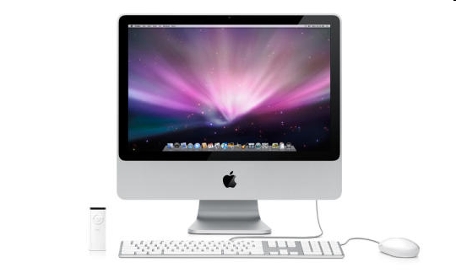
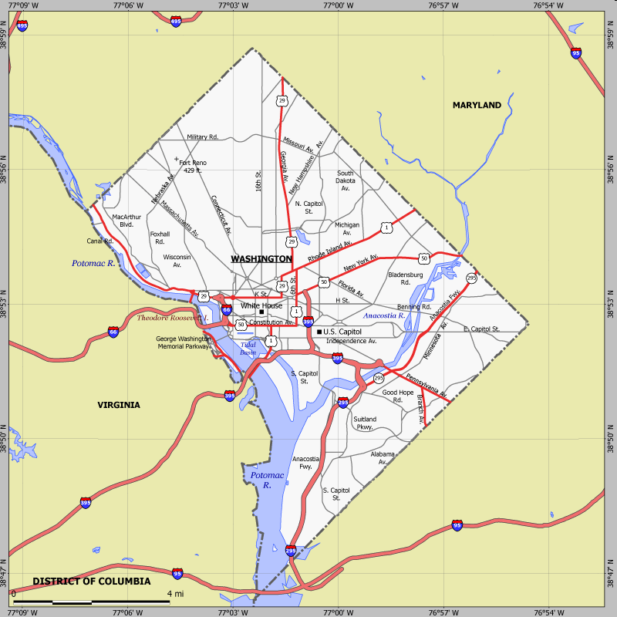
Electronic Voting
http://www.cs.utexas.edu/~ear/cs349/slides/DCVotingMachineBug.html
Notes:
There were at least two issues, one just a bug, the other having to do with security. First the bug: the interaction between pdf and the Safari browser. Next we’ll talk about hacking.
http://news.cnet.com/i/bto/20080528/Apple_iMac_Leopard_540x324.jpg
http://www.sitesatlas.com/Flash/USCan/static/DCFH-800.gif

Slide 25
Electronic Voting
BALLOT
My votes
Safari
browser
.pdf
BALLOT
save as
.pdf
http://www.cs.utexas.edu/~ear/cs349/slides/DCVotingMachineBug.html

Slide 26
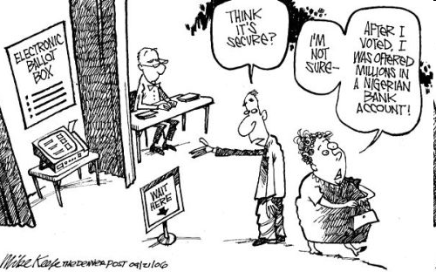
Electronic Voting
Notes:
Now lets consider bad guys and hackers.
http://www.beloblog.com/ProJo_Blogs/shenews/07/mikekeefe_denverpost.jpg

Slide 27
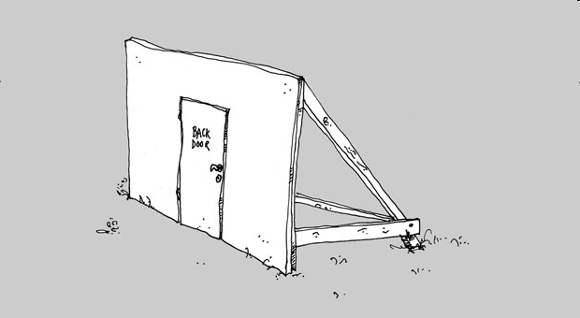

Back to the DC Example…
http://www.computerworld.com/s/article/9189718/D.C._Web_voting_flaw_could_have_led_to_compromised_ballots?taxonomyId=13
Notes:
Investigators hacked into the system so that, after some number of people had voted, it played Hail to the Victors.
Hail to the Victors - http://fightmusic.com/mp3/big10/Michigan__The_Victors_%28Trio%29.mp3
Hail to the Victors – old one I don’t use: http://pdaphonehome.com/forums/kyocera-7135-downloads/22192-hail-victors.html
Back door:http://www.raumlabor.net/wp-content/uploads/2008/09/backdoor01.jpg

Slide 28
Back to the DC Example…
One line of code was the culprit.
The culprit: http://www.fiercegovernmentit.com/story/small-coding-mistake-led-big-internet-voting-system-failure/2012-02-22
Notes:
Investigators hacked into the system so that, after some number of people had voted, it played Hail to the Victors.
Hail to the Victors - http://fightmusic.com/mp3/big10/Michigan__The_Victors_%28Trio%29.mp3
Hail to the Victors – old one I don’t use: http://pdaphonehome.com/forums/kyocera-7135-downloads/22192-hail-victors.html
Back door:http://www.raumlabor.net/wp-content/uploads/2008/09/backdoor01.jpg

Slide 29
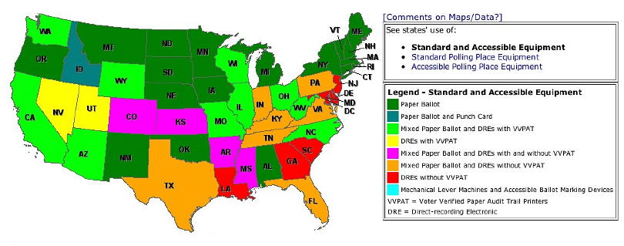

More Information
http://verifiedvoting.org/

Slide 30
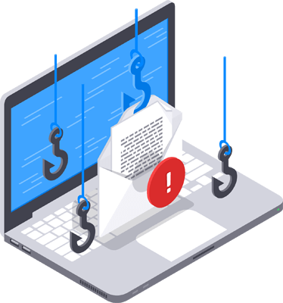
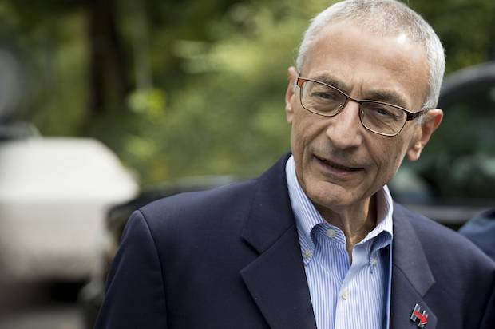

Other Election Risks
Can hackers influence an election without actually tampering with the ballot box?
A: Ethical
E: Highly unethical
Notes:
Ask students whether they think this sort of hacking is ethical (yes, the voters should know absolutely everything possible ) or unethical (it’s stealing).
http://www.salon.com/2016/10/21/hillary-clinton-campaign-chariman-john-podestas-email-was-hacked-because-he-clicked-on-a-phishing-link/
https://wikileaks.org/IMG/rubon32.png?1467279700
https://cdn2.hubspot.net/hubfs/486579/lp/academy/phishing.png?t=1476780917367

Slide 31
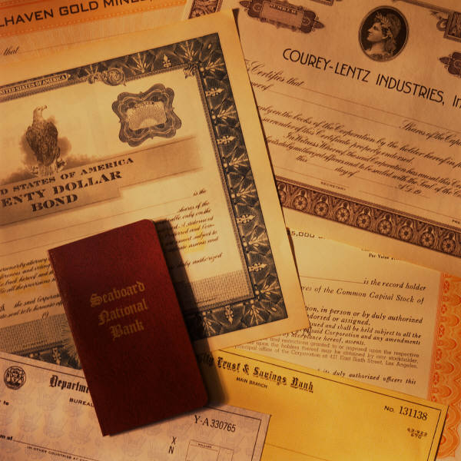

Rating Financial Instruments
Notes:
Moody’s ratings subprime error bug.
Is it really the code that was bad, or the mathematical model?
Either way, the point is that the models are so sophisticated that there’s no choice but to use computers.
Risk before this system: Invest without the knowledge that ratings (usually) give you.

Slide 32
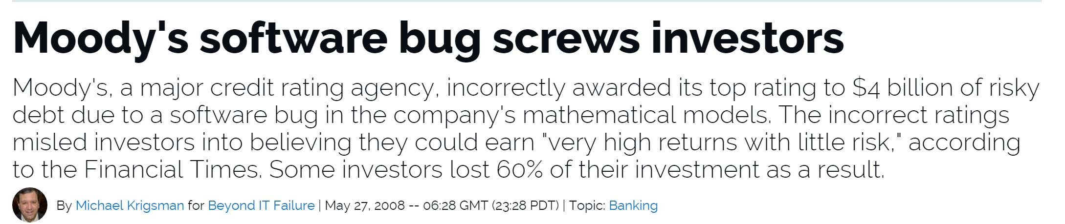
Rating Financial Instruments
Notes:
Moody’s ratings subprime error bug. 2008
http://www.zdnet.com/article/moodys-software-bug-screws-investors/
Is it really the code that was bad, or the mathematical model?
In 2015, Moody’s admitted an error but claimed it was in what numbers were used to calculate expected returns.
Either way, the point is that the models are so sophisticated that there’s no choice but to use computers.
Risk before this system: Invest without the knowledge that ratings (usually) give you.

Slide 33
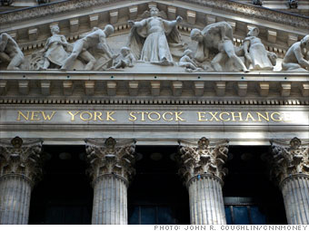

Risks and Rewards
Knight Capital Group installed new software but there was a glitch and they started trading wildly. In 45 minutes on August 1, 2012, they lost $440 million.
http://finance.fortune.cnn.com/2012/08/02/knight-high-frequency-loss/

Slide 34
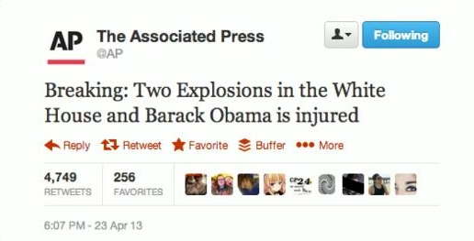
When Technologies Collide with Hackers
Notes:
We already saw these two slides once, back early in Introduction.
http://www.nytimes.com/2013/04/29/business/media/social-medias-effects-on-markets-concern-regulators.html
Twitter image: http://hackread.com/hackers-hack-twitter-of-the-associated-press-claiming-obamas-injury-white-house-blast/
Dow Jones image: http://arstechnica.com/security/2013/04/hacked-ap-twitter-feed-rocks-market-after-sending-false-news-flash/
These two slides repeat in Risk.

Slide 35
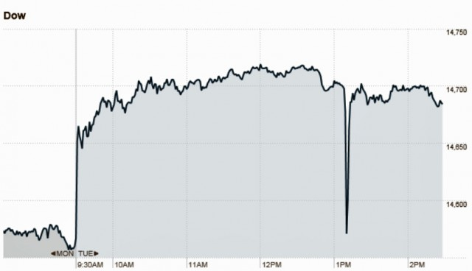
When Technologies Collide with Each Other
Notes:
http://www.nytimes.com/2013/04/29/business/media/social-medias-effects-on-markets-concern-regulators.html
Twitter image: http://hackread.com/hackers-hack-twitter-of-the-associated-press-claiming-obamas-injury-white-house-blast/
Dow Jones image: http://arstechnica.com/security/2013/04/hacked-ap-twitter-feed-rocks-market-after-sending-false-news-flash/

Slide 36
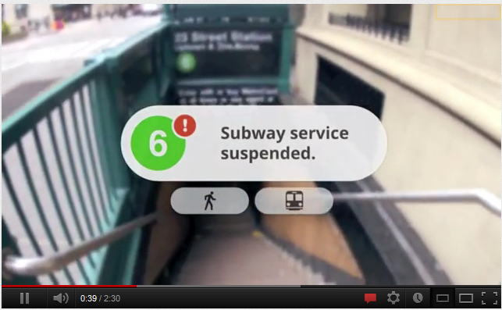
Risks and Rewards
http://www.youtube.com/watch?v=GrfXtAHYoVA
Notes:
Maybe the risk here isn’t “serious”, but would you, as an individual trade off the risk for the reward?
This is the official one.

Slide 37
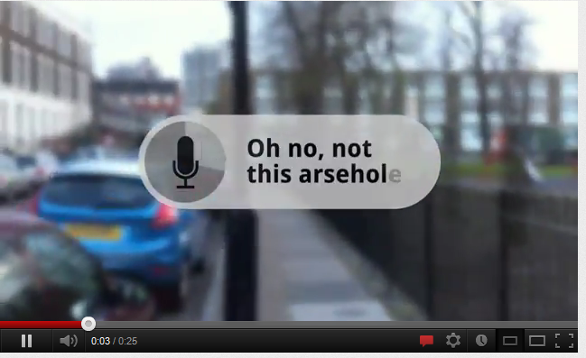
Risks and Rewards
http://www.youtube.com/watch?v=t3TAOYXT840
Notes:
This is a parody showing things that can go wrong.

Slide 38
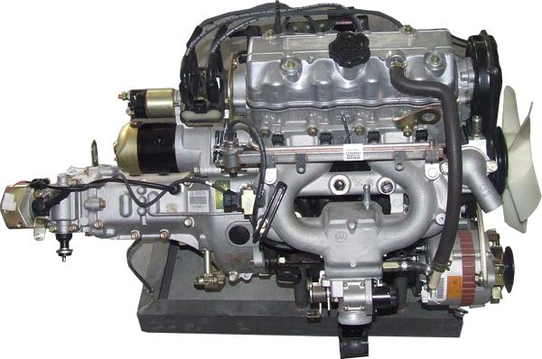
Risk and Trust
Notes:
It’s complicated. Do we trust it? Answer, yes, we’re used to it.
http://www.ecvv.com/product/1404665.html

Slide 39
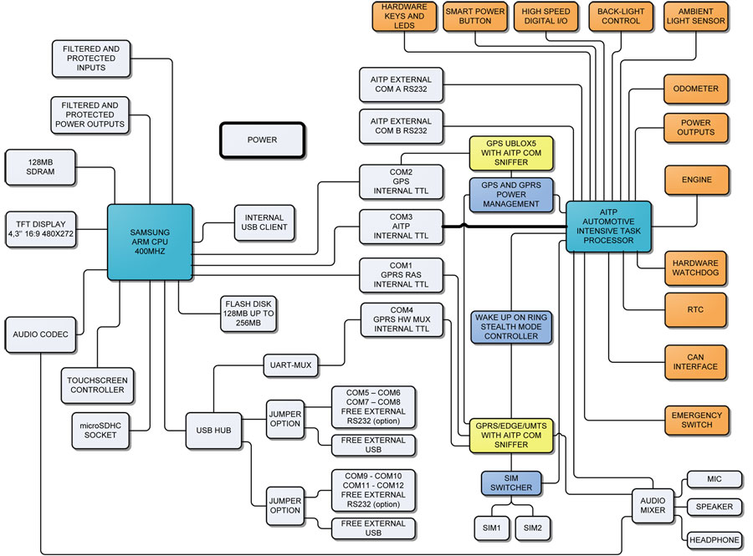
Risk and Trust
Notes:
Now it’s electronic. Do we trust it?
http://en.shematic.net/page-66.html

Slide 40
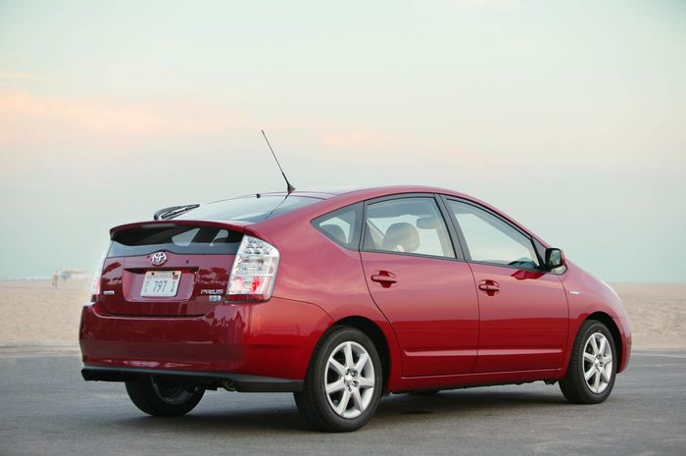
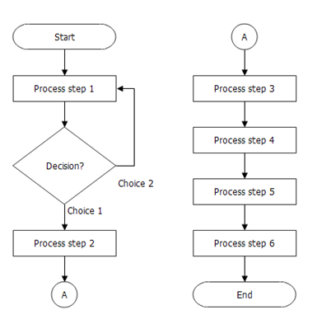
Risk and Trust
Notes:
Now it’s software. Do we trust it?
http://www.breezetree.com/flow-charts/flowchart.htm
http://hembaba.com/reviews/2008/08/automobile/toyota-prius-india/

Slide 41
Risk and Trust
2010: Got recall notice for software patch.
2011: Government report clears electronic components of blame for accelerator problems.
2014: Another Prius software recall
Notes:
The point: we are relying on more and more sophisticated hardware/software systems for critical tasks.
http://www.washingtonpost.com/wp-dyn/content/article/2011/02/08/AR2011020800540.html?nav=rss_email/components
http://hembaba.com/reviews/2008/08/automobile/toyota-prius-india/

Slide 42
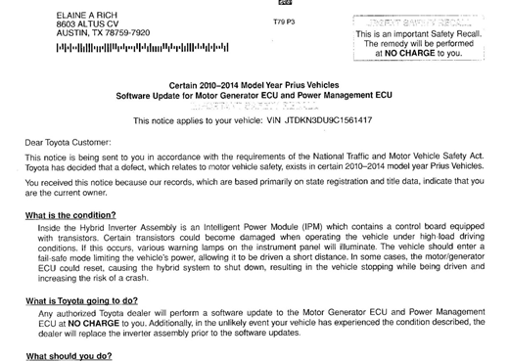
Risk and Trust
Notes:
Date on this is April, 2014.

Slide 43
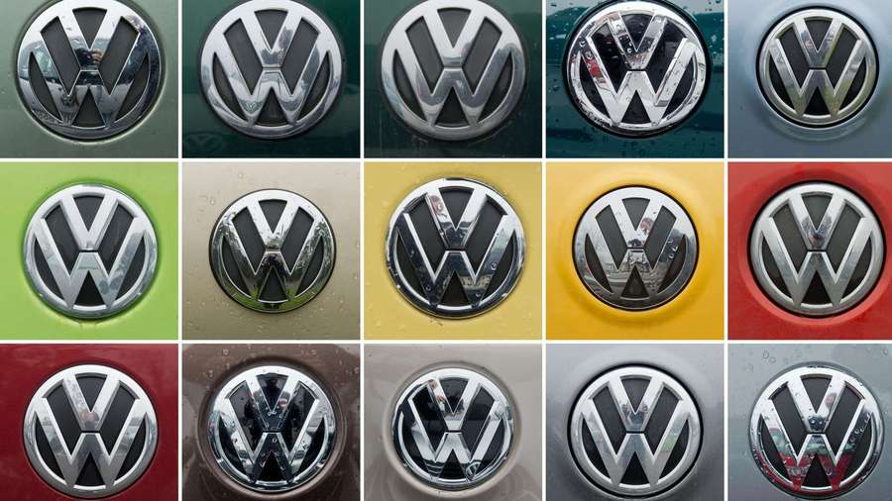
Risk and Trust
2010: Got recall notice for software patch.
2011: Government report clears electronic components of blame for accelerator problems.
2014: Another Prius software recall
2015: Volkswagen diesel emissions scandal
Notes:
http://www.latimes.com/business/autos/la-fi-hy-volkswagen-qa-html-20151007-htmlstory.html

Slide 44
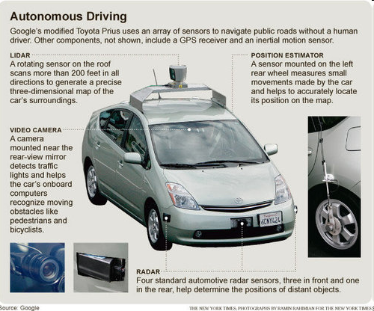
Risk and Trust
Notes:
There is also material on this subject, including the DARPA grand challenge, at the end of the robots lecture.
http://nexus404.com/Blog/2010/10/10/google-working-on-cars-that-drive-themselves-google-said-to-be-working-on-self-driving-cars-have-already-logged-140000-test-miles/

Slide 45
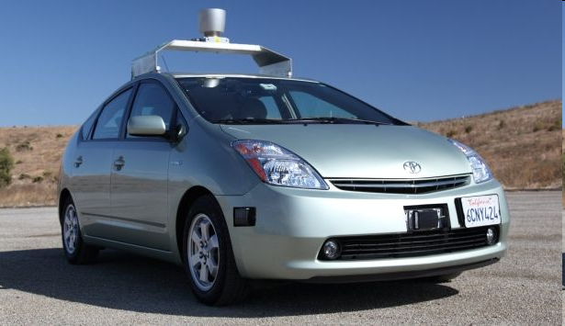
Risk and Trust
2010 Intro: http://www.youtube.com/watch?v=Atmk07Otu9U
Helping the blind: http://www.youtube.com/watch?v=_JP-WTT1y3U
Notes:
http://www.pocket-lint.com/news/36131/google-self-driving-automated-car

Slide 46
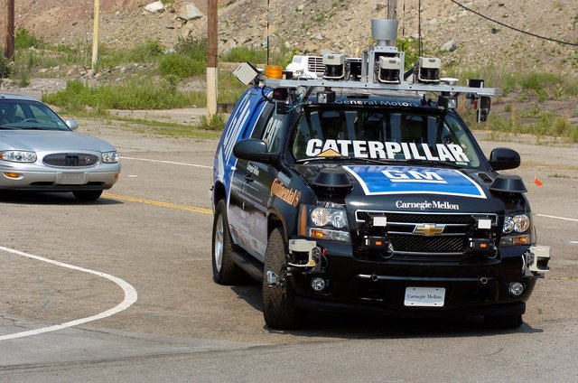
Risk and Trust
http://www.washingtontimes.com/news/2011/mar/8/self-driving-car-on-road-out-of-science-fiction/
2012: GM announces a self-driving Cadillac by 2015.
2013: GM: http://www.cnbc.com/id/101091968
Notes:
CMU GM car. Article has predictions of when GM could sell a fully autonomous car.
Cadillac prediction: http://www.extremetech.com/extreme/126841-cadillac-promises-self-driving-cars-by-2015
Nov 2013: GM says not ready for a while: http://www.usatoday.com/story/money/cars/2013/11/19/gm-exec-tells-congress-self-driving-cars-not-ready/3642727/

Slide 47
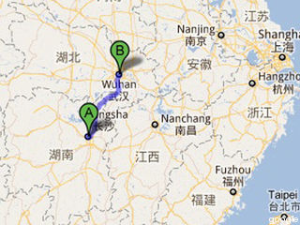
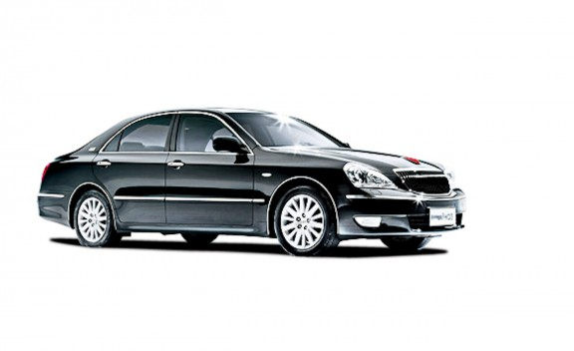
Risk and Trust
Summer, 2011
Notes:
Changsha to Wuhan: http://idealab.talkingpointsmemo.com/2011/08/china-builds-and-tests-its-own-robot-car.php?ref=fpblg
Image from: http://www.caranddriver.com/features/10q1/china_gets_rolling_the_big_players_in_what_will_soon_be_the_largest_car_market_-feature/gallery/faw_hongqi_hq3_photo_81

Slide 48
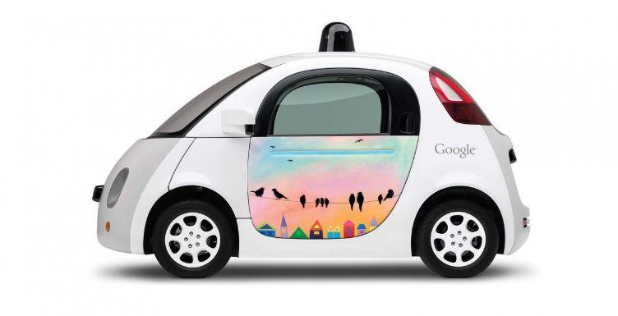
Risk and Reward: Autonomous Vehicles
As of March 2016, Alphabet had test-driven their fleet in autonomous mode a total of 1,500,000 mi.
Based on Alphabet's accident reports, their test cars have been involved in 14 collisions, of which other drivers were at fault 13 times, although in 2016 the car's software caused a crash.
Consulting firm McKinsey & Company estimated that widespread use of autonomous vehicles could "eliminate 90% of all auto accidents in the United States, prevent up to US$190 billion in damages and health-costs annually and save thousands of lives."
Notes:
AKC https://www.washingtonpost.com/news/innovations/wp/2016/02/29/for-the-first-time-googles-self-driving-car-takes-some-blame-for-a-crash/?utm_term=.a832a9e73c7a
https://www.wsj.com/articles/self-driving-cars-could-cut-down-on-accidents-study-says-1425567905

Slide 49
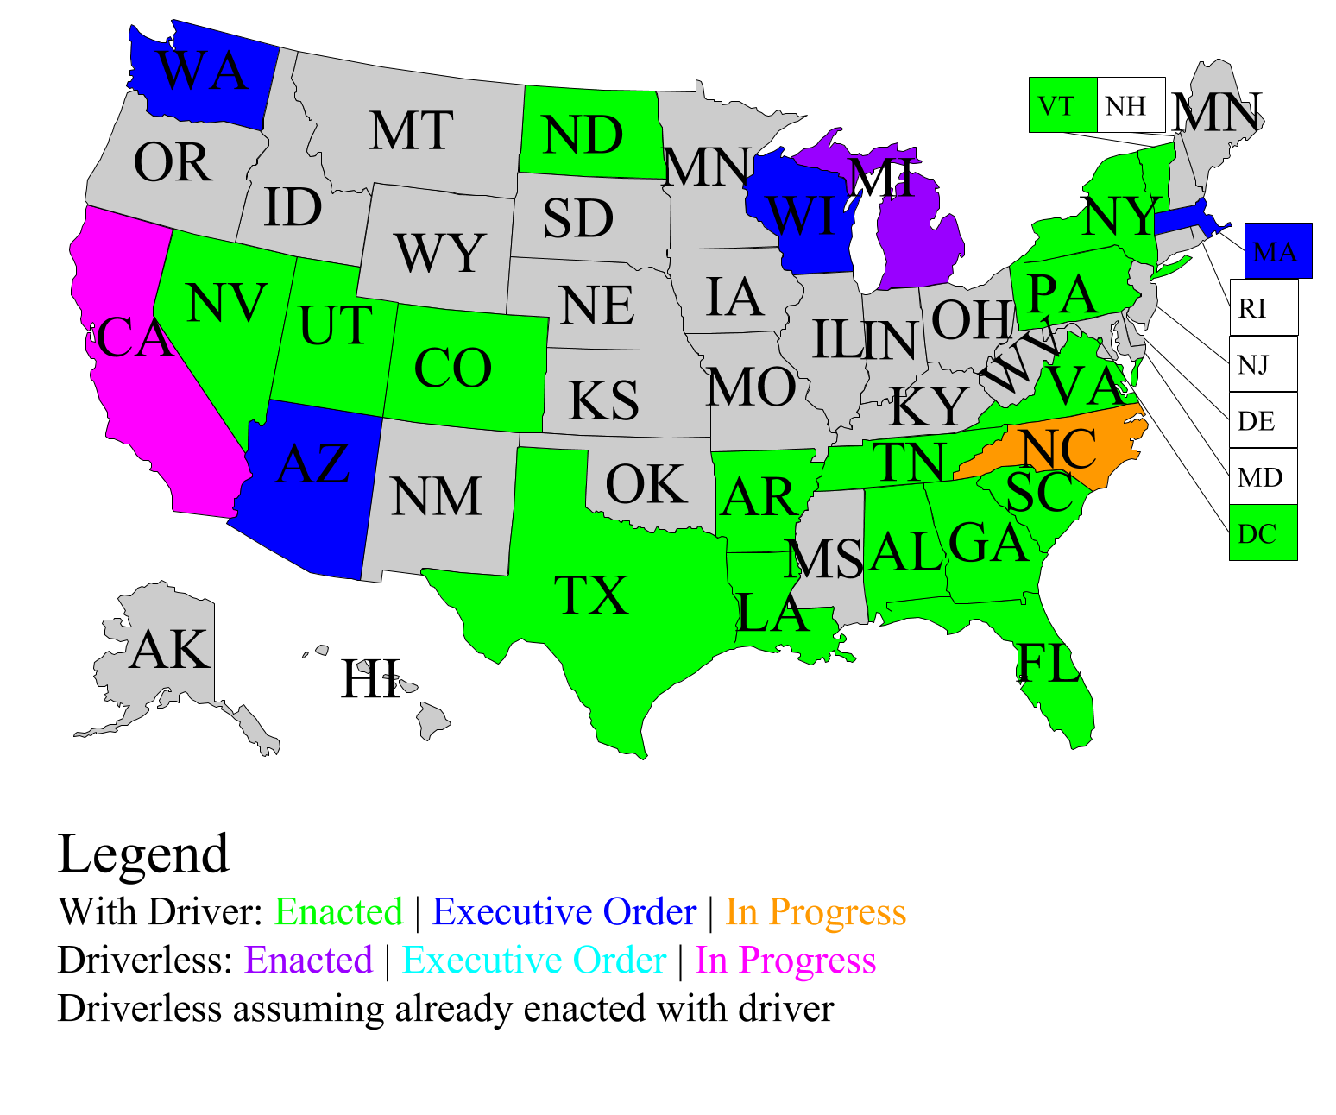
Autonomous Vehicles – Legal Issues
Notes:
https://upload.wikimedia.org/wikipedia/commons/2/2a/Self_Driving_Cars_Legalized_States_in_USA.png AKC

Slide 50
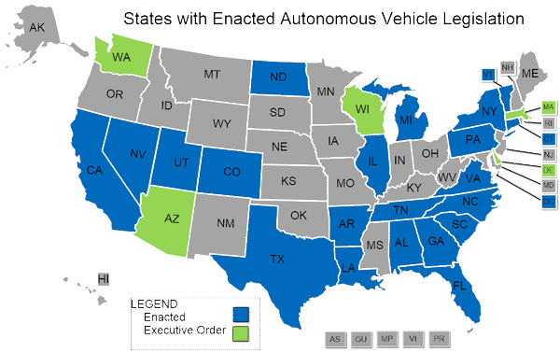
Autonomous Vehicles – Legal Issues
National Conference of State Legislators has a NEW autonomous vehicles legislative database, providing up-to-date, real-time information about state autonomous vehicle legislation that has been introduced in the 50 states and the District of Columbia.
Notes:
http://www.ncsl.org/research/transportation/autonomous-vehicles-self-driving-vehicles-enacted-legislation.aspx AKC

Slide 51
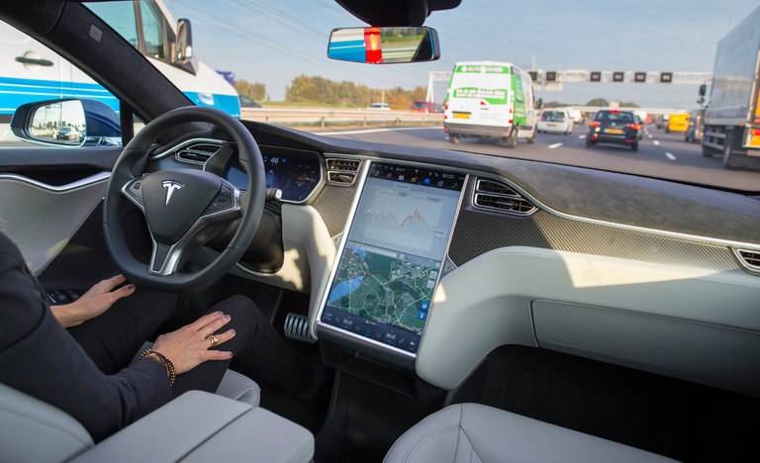
The Risk of Doing Nothing
Self-driving Tesla in accident: 1 person killed
Notes:
EAR
http://www.nytimes.com/2016/07/01/business/self-driving-tesla-fatal-crash-investigation.html?_r=0

Slide 52
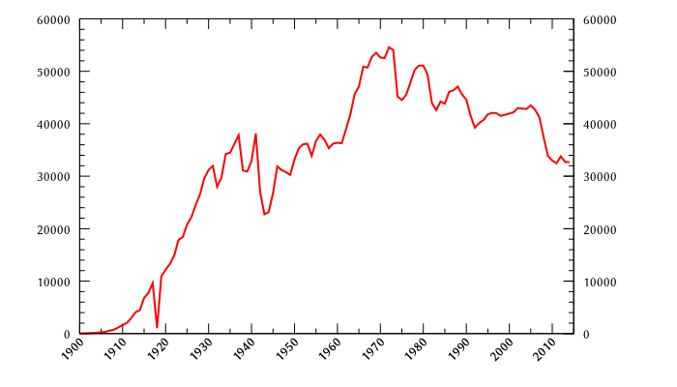
The Risk of Doing Nothing
Human driven cars: people killed per year
Notes:
https://en.wikipedia.org/wiki/List_of_motor_vehicle_deaths_in_U.S._by_year EAR
Why the decline even as passenger miles have increased? http://www.cnn.com/2011/US/04/01/traffic.fatalities/
Experts attribute the change to a variety of reasons, including changes to cars -- such as vehicle rollover protection -- and programs to change driver behavior -- such as campaigns addressing drunk driving, distracted driving and seat belt use. Laws aimed at young people also likely have had an impact, notably older minimum drinking ages and graduated drivers' licenses.

Slide 53
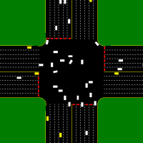
Risk and Trust
Intersection management
http://www.cs.utexas.edu/~aim/?p=video
Or, a scarier scenario:
http://youtu.be/ufK2XRGUjuc

Slide 54

Who’s Worrying?
http://www.cmu.edu/safartint/

Slide 55

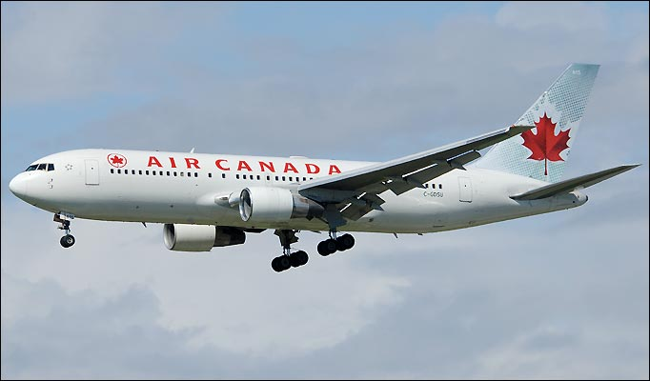
Risk and Trust
Plane or planet? Sleepy pilot can’t tell.
Notes:
And then, after Venus confusion, thought he was on a collision course with a US warplane.
Point here: even with people there’s no such thing as zero risk.
Plane: http://www.flytobarcelona.org/?p=2724
http://www.reuters.com/article/2012/04/16/us-aircanada-incident-idUSBRE83F10120120416

Slide 56
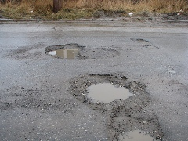
Risk and Trust
In the meantime:
Notes:
Developed in Boston. The app senses vibrations that could mean potholes. It sends those data, plus gps data, to the highway department.
http://www.govtech.com/wireless/Boston-Testing-App-for-Auto-Detecting-Potholes.html

Slide 57
Risk and Trust
In the meantime:
The Android pothole app
Notes:
Developed in Boston. The app senses vibrations that could mean potholes. It sends those data, plus gps data, to the highway department.
http://www.govtech.com/wireless/Boston-Testing-App-for-Auto-Detecting-Potholes.html

Slide 58
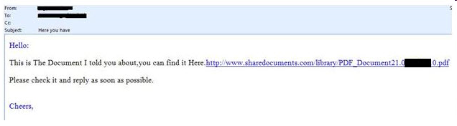
Risk and Reward
Email
Notes:
Email is great but there are risks. Here you have virus outbreak Sept. 2010

Slide 59


Slide 60

Risk and Reward
http://www.youtube.com/watch?v=uE7Yf4bw41E
Notes:
Scientist implants RFID chip in hand. He can infect it with a virus, then pass that virus to other machines.
Photo: http://upload.wikimedia.org/wikipedia/commons/9/99/RFID_hand_1.jpg

Slide 61

Risk and Reward
Who is Responsible?
Oct 21, 2016
Notes:
http://www.computerworld.com/article/3135434/security/ddos-attack-on-dyn-came-from-100000-infected-devices.html
http://fortune.com/2016/10/23/internet-attack-perpetrator/
Hackers used publicly available source code to assemble a bot-net army of internet-enabled devices, and then directed those devices to send massive waves of junk requests to a DNS provider. The attack meant the provider, New Hampshire based Dyn, could not carry out its job of acting as a switchboard for the internet, and consumers could no longer reach popular websites. DDOS attack took down Amazon, Netflix and Twitter, among others, for hours. Caused by malware inserted into objects in the Internet of Things, e.g., cameras, DVRs.

Slide 62

Risk and Reward
Who is Responsible?
A: Panasonic, Samsung, Xerox management
B: Programmers and engineers
C: Regulators
D: Consumers
Notes:
http://images.huffingtonpost.com/2016-07-12-1468314021-5633148-internetofthings.jpg
There’s plenty of blame to go around. But pick the one you blame the most.

Slide 63

Risk and Reward
How Easy Is It to Hack?
https://www.theatlantic.com/technology/archive/2016/10/we-built-a-fake-web-toaster-and-it-was-hacked-in-an-hour/505571/

Slide 64


Risk and Reward:
Linear Accelerator Radiation Machines
Notes:
These machines save lives. But they are complex.
An error can cause the leaves to open inappropriately and too much radiation to be delivered.
Operators may not get enough training and so this can happen.
Image from: http://www.chesapeakepotomaccancer.com/
http://www.nytimes.com/2010/01/24/health/24radiation.html?pagewanted=1&partner=rss&emc=rss
Collimator from: http://www.nytimes.com/interactive/2010/01/22/us/Radiation.html

Slide 65
Risk and Reward – A Case Study
Linear Accelerator Radiation Machines
Social Benefit
Risk
Software Quality
Security
Ethics
Free Speech
Privacy
Law
Government Policy
http://www.nytimes.com/2010/01/24/health/24radiation.html?pagewanted=1&partner=rss&emc=rss
Notes:
Image from: http://www.chesapeakepotomaccancer.com/

Slide 66
Linear Accelerator Radiation Machines
The NYT story:
  http://www.nytimes.com/2010/01/24/health/24radiation.html?pagewanted=1&partner=rss&emc=rss
A follow up with more details:
  http://www.nytimes.com/2010/01/27/us/27radiation.html?pagewanted=1&partner=rss&emc=rss
The slide show:
  http://www.nytimes.com/interactive/2010/01/22/us/Radiation.html

Slide 67

But We Rely on Them More and More
Notes:
http://www.nytimes.com/imagepages/2010/01/27/us/27radiation-graphic1.html?ref=us

Slide 68
Problems Waiting to Happen?

Slide 69
Y2K Problem
Attempt to save storage
Did programmers imagine their code being used 30 years later?
Notes:
3

Slide 70
Y2K Problem
Attempt to save storage
Did programmers imagine their code being used 30 years later?
Will there be a “Year 2038 Problem” when UNIX system time (if stored in seconds since Jan 1, 1970 in a 32 bit signed integer) will overflow?
Notes:
3

Slide 71

Unix 2038 Problem
http://xkcd.com/607/

Slide 72
Microsoft Windows Security
106 security updates in 2010 – one per 3.4 days
17 security updates from Jan 1, 2011 through March 29, 2011 – one per 5.1 days
22 security updates from Jan 1, 2012 through March 31, 2012 – one per 4.1 days
7 security updates in one month ending March 12, 2013 – one per 4.4 days.
Notes:
1

Slide 73

Some Database Errors
Entry and Misinterpretation
A large population – many with similar names
Meet Mikey Hicks
http://www.nytimes.com/2010/01/14/nyregion/14watchlist.html
Notes:
Link is to article. Don’t need to go there.
http://www.nytimes.com/2010/01/14/nyregion/14watchlist.html

Slide 74
Some Database Errors
Entry and Misinterpretation
A large population – many with similar names
Automated processing lacking human/common sense or recognition of special cases
Overconfidence in the accuracy of computer data
Errors – often carelessness - in data entry
Failure to update information and correct errors
Lack of accountability for errors

Slide 75






…and in Texas
Notes:
Dumpster: http://livingontheedge.typepad.com/living_on_the_edge/2008/05/spring-cleaning.html
Pill bottles: http://www.cdc.gov/ncbddd/dvt/images/prescriptionbottles.jpg
Amoxycillin: http://www.designisin.com/1/category/healthcare/1.html
Viagra: http://www.buyviagrawithoutprescription.co.uk/
Prescription: http://www.medicinescomplete.com/mc/bnf/current/images/amoxicillin_prescription.gif

Slide 76
…and in Texas
CVS, Texas settle lawsuit over dumping customers' records
HOUSTON — CVS Caremark Corp. will overhaul its information security system and pay the state of Texas $315,000 to settle a lawsuit that accused the drugstore operator of dumping credit card numbers, medical information and other material from more than 1,000 customers into a garbage container.
Texas Attorney General Greg Abbott, who sued CVS in April, announced the agreement Wednesday.

Slide 77
Yah, but is a that a computer system error?

Slide 78
Some High-Level Causes of Computer Systems Failures
Lack of clear, well-thought-out goals and specifications
Poor management and poor communication among customers, designers, programmers, and so on
Institutional or political pressures that encourage unrealistically low bids, unrealistically low budget requests, and underestimates of time requirements
Use of very new technology, with unknown reliability and problems, perhaps for which software developers have insufficient experience and expertise
Refusal to recognize or admit that a project is in trouble

Slide 79
Some Factors in Computer-System Errors and Failures - 1
1. Design and development
  Inadequate attention to potential safety risks.
  Interaction with physical devices that do not work as expected. Incompatibility of software and hardware or of application software and the operating system.
  Not planning and designing for unexpected inputs or circumstances.
  Insufficient testing.
  Insufficient/unclear documentation
  Reuse of software from another system without adequate checking. Overconfidence in software.
  Carelessness

Slide 80
Some Factors in Computer-System Errors and Failures - 2
2. Management and use
  Data-entry errors.
  Inadequate training of users.
  Errors in interpreting results or output.
  Failure to keep information in databases up to date.
  Overconfidence in software by users.
  Insufficient planning for failures, no backup systems or procedures .

Slide 81
Some Factors in Computer-System Errors and Failures – 3, 4
3. Misrepresentation, hiding problems, and inadequate response to reported problems
4. Insufficient market or legal incentives to do a better job.

Slide 82
Can we ensure quality and reliability?
Criminal and civil penalties
Warranties for consumer software
Regulation and safety-critical applications
Professional licensing
Insurance companies
Taking responsibility

