Slide 1
What Makes Us Us?

Slide 2
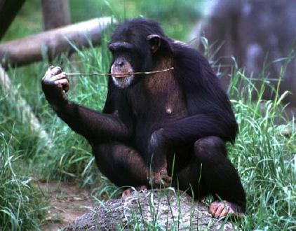
Us and Them
Notes:
Chimp: http://www.cartage.org.lb/en/kids/animalfacts/Chimpanze/chimpanzee.jpg

Slide 3
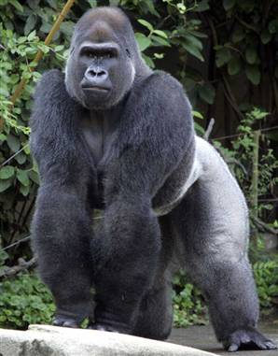
Us and Them
Notes:
Gorilla image: http://www.msnbc.msn.com/id/11450610/

Slide 4
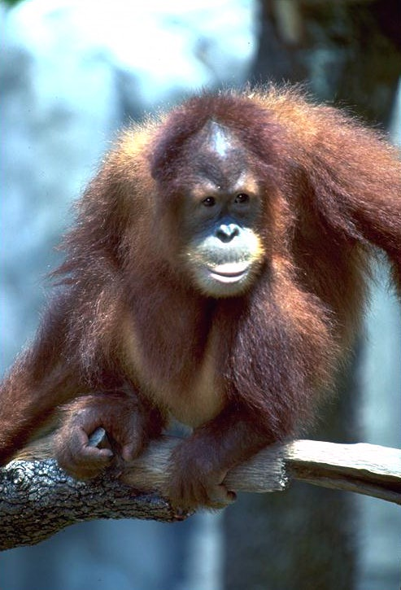
Us and Them
Photograph courtesy of: http://philip.greenspun.com/ Philip Greenspun
Notes:
Orangutan: http://homepage.mac.com/wildlifeweb/primate/photos/Hominidae/orangutan/orangutan-Greenspun04.jpg

Slide 5
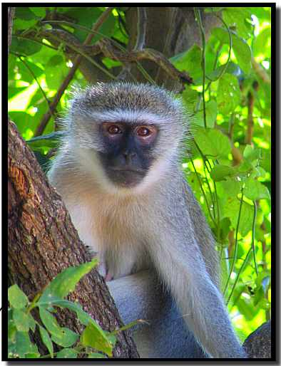
Us and Them
Notes:
Monkey: http://www.african-safari-journals.com/monkey-pictures.html

Slide 6
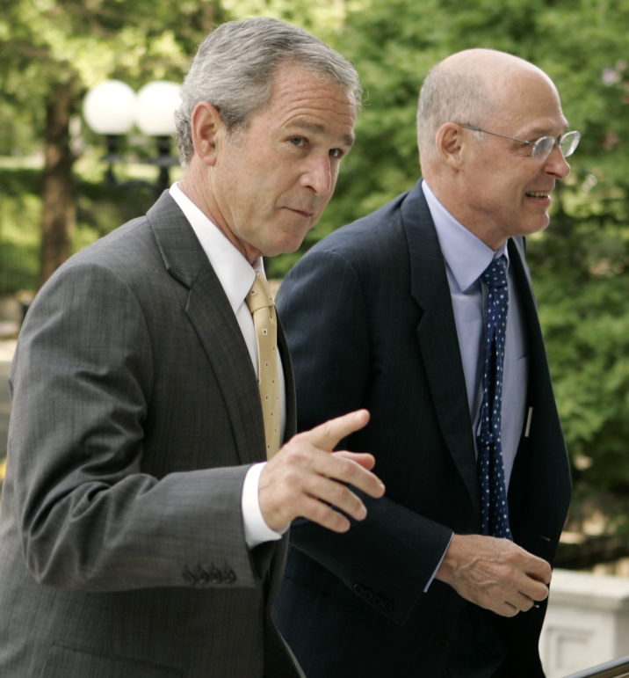
Us and Them
Notes:
Bush and Treasury Secretary Henry Paulson: http://current.com/items/88819259_bush_throws_the_dog_a_bone January, 2008

Slide 7
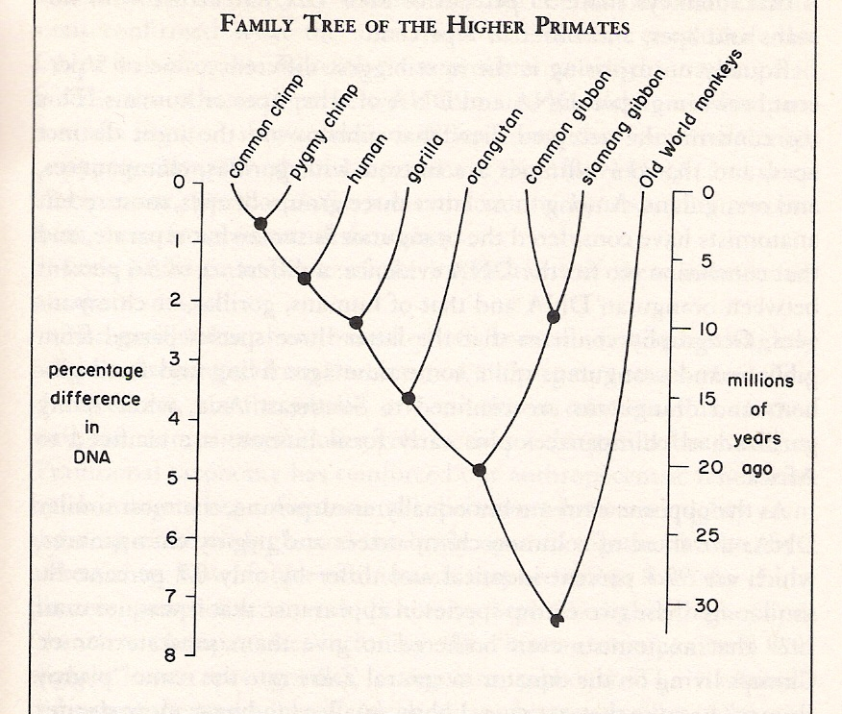
Are We Special?

Slide 8
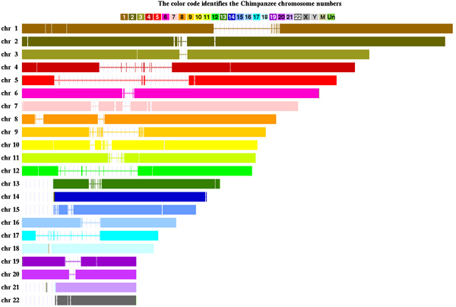
Comparing Genomes – Chimp Mapped onto Human
Source: http://www.cbse.ucsc.edu/research/research_human_chimp_mouse.shtml

Slide 9
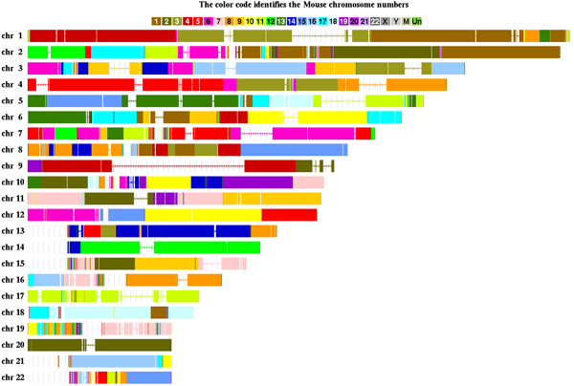
Comparing Genomes: Mouse Mapped onto Human

Slide 10
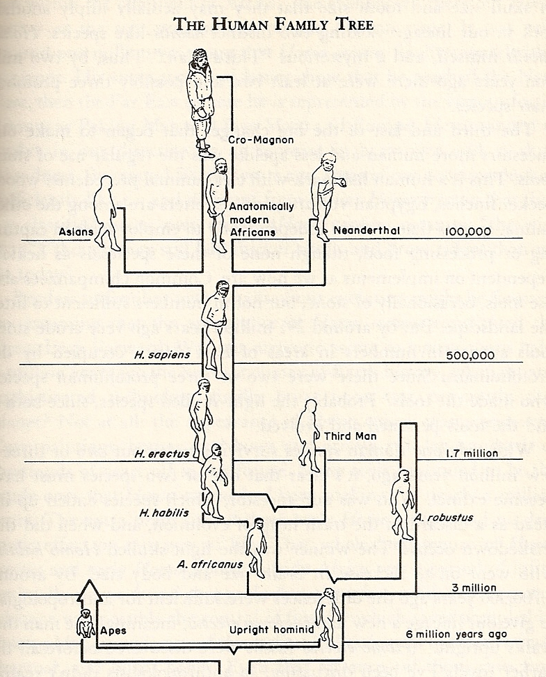
Human Evolution

Slide 11
Human Evolution
The Great Leap Forward
~40,000 year ago

Slide 12
Human Evolution
The Great Leap Forward
~40,000 year ago
Language?

Slide 13
Uniquely Ours?
Consciousness
Arts
Culture
Language
Emotion
Morality
Notes:
Note that by culture we mean not just society but a society that can change its rules over time.

Slide 14
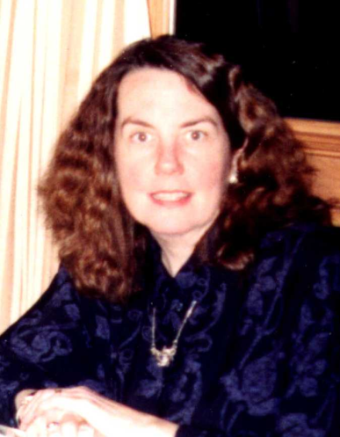
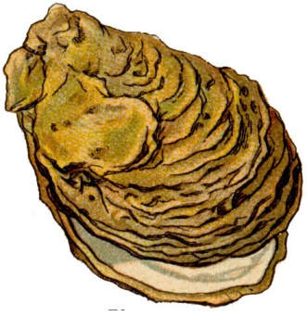
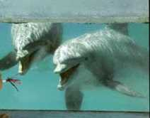
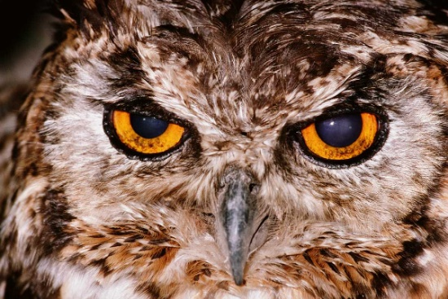

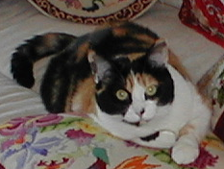
Consciousness
You

Slide 15


Consciousness and Understanding
Searle’s Chinese Room
Notes:
A Commemorative Certificate for ascending the great wall in China. (input)
I have ascended the great wall (output)

Slide 16
Intelligence and Understanding
The Blockhead argument (due to Ned Block):
There are a finite number of first sentences in a conversation, a finite number of second ones, and so forth. So it suffices, to simulate a 30 minute conversation, just to have been programmed with all of them. But is this “intelligence”?

Slide 17
Intelligence and Understanding
The Blockhead argument (due to Ned Block):
There are a finite number of first sentences in a conversation, a finite number of second ones, and so forth. So it suffices, to simulate a 30 minute conversation, just to have been programmed with all of them. But is this “intelligence”?
But can this work: Are there enough electrons in the universe?

Slide 18

Conscious?
http://alice.pandorabots.com/

Slide 19

RankBrain
Notes:
Rankbrain announced Oct, 2015.
Image: http://searchengineland.com/faq-all-about-the-new-google-rankbrain-algorithm-234440

Slide 20
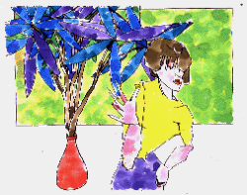

What about Art?

Slide 21
What about Art?
Two paintings done by Harold Cohen’s Aaron program:
Notes:
Much more on Aaron: http://www.aaronshome.com/

Slide 22
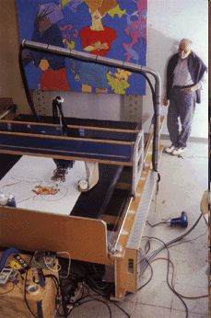
Aaron
Notes:
http://crca.ucsd.edu/~hcohen/

Slide 23
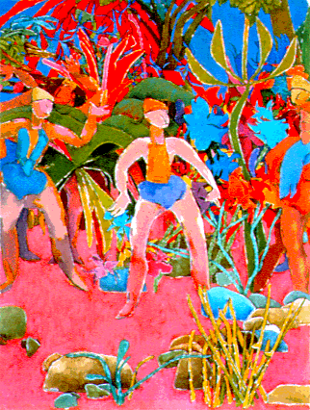
Aaron
http://aaronshome.com/aaron/index.html
http://www.kurzweilcyberart.com/
http://www.kurzweilcyberart.com/aaron/aim_clip_cohen.html
Notes:
On the second one, click “Learn” Then “Watch a Video”. Or go directly to the third link. Same video.

Slide 24
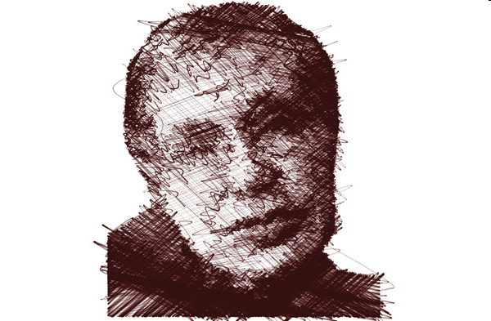
Aikon
https://www.youtube.com/watch?v=8RizeL8_bTg
http://www.newscientist.com/blogs/culturelab/2010/04/life-drawing-robot-could-teach-us-about-art.php

Slide 25
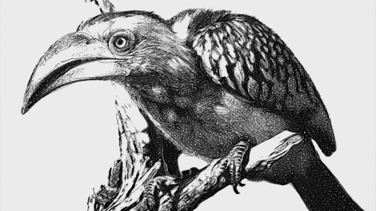
eDavid
http://www.gizmag.com/edavid-robot-artist-painter/28310/

Slide 26

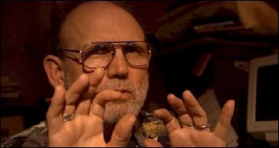
EMI

Slide 27
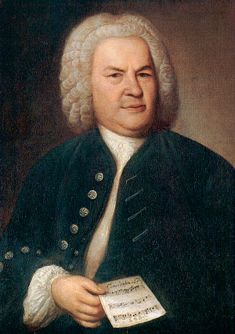
J. S. Bach
An invention
An invention
Notes:
Play the two of them without telling the students which is which. Unplug video.
Answer on next slide.
http://www.carus-verlag.com/index.php3?selSprache=1&BLink=JSBach

Slide 28
J. S. Bach
An EMI invention
A Bach invention
Notes:
http://www.carus-verlag.com/index.php3?selSprache=1&BLink=JSBach

Slide 29
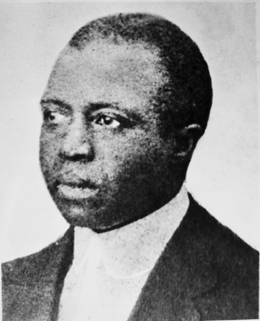
Scott Joplin
A rag
A rag
Notes:
The first one is real. If you just click on it, there will be an ad. Queue it in advance.
http://ctmh.its.txstate.edu/artist.php?cmd=detail&aid=29
Maple Leaf one we used to use: http://en.wikipedia.org/wiki/Image:Maple_Leaf_RagQ.ogg

Slide 30
Scott Joplin
Searchlight Rag
An EMI rag
Notes:
http://ctmh.its.txstate.edu/artist.php?cmd=detail&aid=29

Slide 31
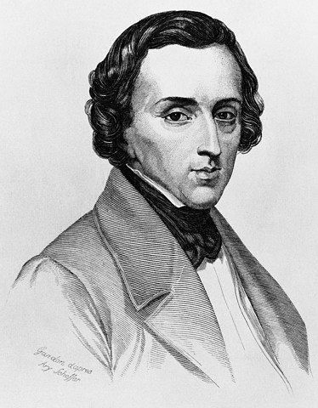
Frederic Chopin
A mazurka
A mazurka
© Corbis
Notes:
http://www.dartmouth.edu/~music33/Mus33projects/nodes/Chopin/portrait1.html Play the second one starting at 12 seconds.

Slide 32
Frederic Chopin
An EMI mazurka
A Chopin mazurka
© Corbis
Notes:
http://www.dartmouth.edu/~music33/Mus33projects/nodes/Chopin/portrait1.html

Slide 33
EMI
Emily Howell
An interview
Notes:
Click on Emily Howell and on the interview.

Slide 34
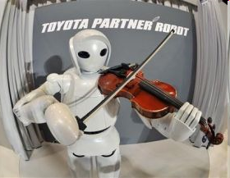
Robot Musicians
http://www.youtube.com/watch?v=qyPAIpXm-nU&feature=PlayList&p=1E88D4F5694F0A63&playnext=1&playnext_from=PL&index=6
A less anthropomorphic (and newer) one: http://www.engadget.com/2015/02/22/ro-bow-violin-robot/
Notes:
Toyota’s violin playing robot

Slide 35
Is it Just about the Words?
Here I want to interject the semantic point that such words as life, purpose, and soul are grossly inadequate to precise scientific thinking. Those terms have gained their significance through our recognition of the unity of a certain group of phenomena, and do not in fact furnish us with any adequate basis to characterize this unity.
Notes:
Weiner, Norbert, The Human Use of Human Beings, 1950, chapter 1.

Slide 36
… Continued
Whenever we find a new phenomenon which partakes to some degree of the nature of those which we have already termed “living phenomena,” but does not conform to all the associated aspects which define the term “life,” we are faced with the problem whether to enlarge the word “life” so as to include them, or to define it in a more restrictive way so as to exclude them. …
Notes:
Weiner, Norbert, The Human Use of Human Beings, 1950, chapter 1.

Slide 37
... Continued
Now that certain analogies of behavior are being observed between the machine and the living organism, the problem as to whether the machine is alive or not is, for our purposes, semantic and we are liberty to answer it one way or another as best suits our convenience.
Notes:
Weiner, Norbert, The Human Use of Human Beings, 1950, chapter 1.

Slide 38
... Continued
Now that certain analogies of behavior are being observed between the machine and the living organism, the problem as to whether the machine is alive or not is, for our purposes, semantic and we are liberty to answer it one way or another as best suits our convenience.
Weiner, Norbert, The Human Use of Human Beings, 1950, chapter 1.

Slide 39
Machine Ethics
Creating an “explicit ethical agent”
Recall one approach:
Notes:
Our formula for the Rights of Persons approach.

Slide 40
Machine Ethics
Fleshing out details:
“Machine Ethics: Creating an Ethical Intelligent Agent”, Michael Anderson and Susan Leigh Anderson, AI Magazine, 28(4): Winter 2007, 15.
“Heuristic Methods for Computer Ethics”, Walter Maner
Notes:
Click on the Maner paper and scroll down a bit to get an attempt at an algorithm.

Slide 41
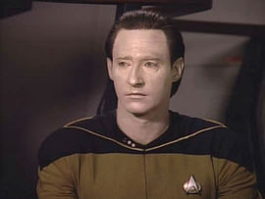
Could Robots Become Us?
http://www.cs.utexas.edu/~ear/cs349/slides/MM3.mp4
http://www.cs.utexas.edu/~ear/cs349/slides/MM4.mp4
https://www.youtube.com/watch?v=vjuQRCG_sUw
Notes:
Episode title: The Measure of a Man The trial starts in 3, about 7/8 of the way in. 4 has some interesting stuff. The key part to show is at the beginning of 5 (MOAM). But I can’t play it so I’ve put in this youtube one, which is perfect if it is still there.

