Slide 1
Induced methods for complex matrix multiplication
Field G. Van Zee
Science of High Performance Computing
The University of Texas at Austin

Slide 2
Science of High Performance Computing (SHPC) research group
Led by Robert A. van de Geijn
Contributes to the science of DLA and instantiates research results as open source software
Long history of support from National Science Foundation
Website: http://shpc.ices.utexas.edu/

Slide 3
SHPC Funding (BLIS)
NSF
  Award ACI-1148125/1340293: SI2-SSI: A Linear Algebra Software Infrastructure for Sustained Innovation in Computational Chemistry and other Sciences. (Funded June 1, 2012 - May 31, 2015.)
  Award CCF-1320112: SHF: Small: From Matrix Computations to Tensor Computations. (Funded August 1, 2013 - July 31, 2016.)
  Award ACI-1550493: SI2-SSI: Sustaining Innovation in the Linear Algebra Software Stack for Computational Chemistry and other Sciences. (Funded July 15, 2016 – June 30, 2018.)

Slide 4
SHPC Funding (BLIS)
Industry (grants and hardware)
  Microsoft
  Texas Instruments
  Intel
  AMD
  HP Enterprise

Slide 5
Publications
“BLIS: A Framework for Rapid Instantiation of BLAS Functionality” (TOMS; in print)
“The BLIS Framework: Experiments in Portability” (TOMS; in print)
“Anatomy of Many-Threaded Matrix Multiplication” (IPDPS; in proceedings)
“Analytical Models for the BLIS Framework” (TOMS; in print)
“Implementing High-Performance Complex Matrix Multiplication via the 3m and 4m methods” (TOMS; in print)
“Implementing High-Performance Complex Matrix Multiplication via the 1m method” (TOMS; in review)

Slide 6
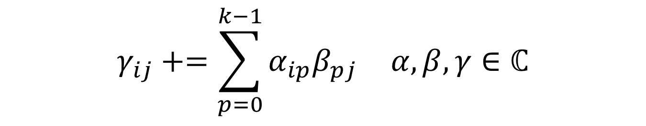
Complex domain matrix multiplication
What is complex domain matrix multiplication?
How is it different than real domain matrix multiplication?
$$γ_{ij}+=\sum_{p=0}^{k−1}{α_{ip}β_{pj}} α, β,γ∈ℂ$$

Slide 7
Complex domain matrix multiplication
Is it commonly used?
  Not as common as real domain, but still important!
Most modern architectures lack machine instructions for arithmetic on complex numbers
Two additional microkernels are needed to support complex level-3 operations (single + double)
  [cz]gemm, [cz]hemm/symm, [cz]herk/syrk, [cz]her2k/syr2k, [cz]trmm

Slide 8
Complex domain matrix multiplication
Life would be simpler if complex domain matrix multiplication was not necessary
Of course, complex matrix multiplication will always be necessary
But what if complex matrix multiplication kernels were found to be unnecessary?

Slide 9
Induced methods
Basic idea
  Compute complex domain matrix multiplication using only real domain matrix multiplication primitives
  The real domain primitive is defined as the fundamental unit of computation (presumably optimized)
  In BLIS, it is most natural to think of the real domain gemm microkernel as the primitive (but there are others!)

Slide 10
Induced methods
Any level of the mm algorithm could be defined as the primitive (including the outer loop)

Slide 11
Induced methods
Motivation: if complex matrix multiplication can be induced…
  fewer kernels need to be written/maintained, and the remaining (real domain) kernels are simpler
  complex domain support becomes portable because it is factored out of the kernel and into the framework
  any performance benefits from improvements in real kernels are inherited into the complex domain (automatically and immediately)

Slide 12
Initial work
“Implementing High-Performance Complex Matrix Multiplication via the 3m and 4m Methods.” ACM Transactions on Mathematical Software. 44(1) 7:1—7:36, 2016.

Slide 13

4m method
Fundamental definition of complex scalar product (and accumulation):
Granted, this is just arithmetic on scalars…
$${γ^{r} := γ^{r}+α^{r}β^{r}−α^{i}β^{i} \atop γ^{i} := γ^{i}+{α^{r}β}^{i}+{α^{i}β}^{r}}$$

Slide 14

4m method
But we can replace the scalars with matrices to arrive at:
$${C^{r} := C^{r}+A^{r}B^{r}−A^{i}B^{i} \atop C^{i} := C^{i}+{A^{r}B}^{i}+{A^{i}B}^{r}}$$

Slide 15
4m method
But we can replace the scalars with matrices to arrive at:
The name “4m” comes from the four matrix products
$${C^{r} := C^{r}+A^{r}B^{r}−A^{i}B^{i} \atop C^{i} := C^{i}+{A^{r}B}^{i}+{A^{i}B}^{r}}$$

Slide 16
4m method
But we can replace the scalars with matrices to arrive at:
The name “4m” comes from the four matrix products
$${C^{r} := C^{r}+A^{r}B^{r}−A^{i}B^{i} \atop C^{i} := C^{i}+{A^{r}B}^{i}+{A^{i}B}^{r}}$$

Slide 17
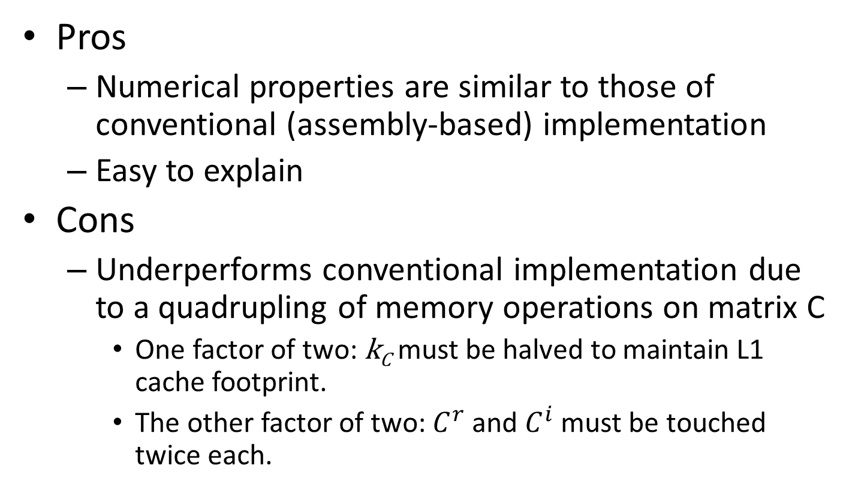
4m method
Pros
  Numerical properties are similar to those of conventional (assembly-based) implementation
  Easy to explain
Cons
  Underperforms conventional implementation due to a quadrupling of memory operations on matrix C
    One factor of two: k_{C} must be halved to maintain L1 cache footprint.
    The other factor of two: $C^{r}$ and $C^{i}$ must be touched twice each.

Slide 18
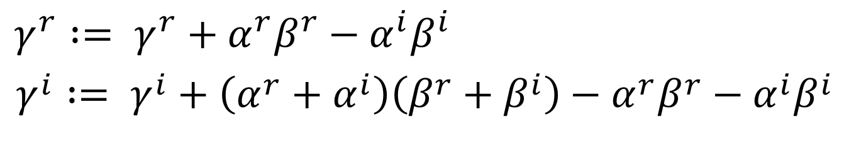
3m method
4m definition can be re-expressed algebraically:
$${γ^{r} := γ^{r}+α^{r}β^{r}−α^{i}β^{i} \atop γ^{i} := γ^{i}+{{\left(α^{r}+α^{i}\right)\left(β^{r}+β^{i}\right)−α}^{r}β}^{r}−{α^{i}β}^{i}}$$

Slide 19
3m method
4m definition can be re-expressed algebraically:
This reduces the number of products from four to three; two are reused once each
$${γ^{r} := γ^{r}+α^{r}β^{r}−α^{i}β^{i} \atop γ^{i} := γ^{i}+{{\left(α^{r}+α^{i}\right)\left(β^{r}+β^{i}\right)−α}^{r}β}^{r}−{α^{i}β}^{i}}$$

Slide 20
3m method
4m definition can be re-expressed algebraically:
This reduces the number of products from four to three; two are reused once each
$${γ^{r} := γ^{r}+α^{r}β^{r}−α^{i}β^{i} \atop γ^{i} := γ^{i}+{{\left(α^{r}+α^{i}\right)\left(β^{r}+β^{i}\right)−α}^{r}β}^{r}−{α^{i}β}^{i}}$$

Slide 21
3m method
4m definition can be re-expressed algebraically:
This reduces the number of products from four to three; two are reused once each
The price? three additional accumulations
$${γ^{r} := γ^{r}+α^{r}β^{r}−α^{i}β^{i} \atop γ^{i} := γ^{i}+{{\left(α^{r}+α^{i}\right)\left(β^{r}+β^{i}\right)−α}^{r}β}^{r}−{α^{i}β}^{i}}$$

Slide 22
3m method
4m definition can be re-expressed algebraically:
This reduces the number of products from four to three; two are reused once each
The price? three additional accumulations
$${γ^{r} := γ^{r}+α^{r}β^{r}−α^{i}β^{i} \atop γ^{i} := γ^{i}+{{\left(α^{r}+α^{i}\right)\left(β^{r}+β^{i}\right)−α}^{r}β}^{r}−{α^{i}β}^{i}}$$

Slide 23
3m method
4m definition can be re-expressed algebraically:
This reduces the number of products from four to three; two are reused once each
The price? three additional accumulations
This is a good tradeoff if the cost of a multiply is much greater than the cost of an accumulation
$${γ^{r} := γ^{r}+α^{r}β^{r}−α^{i}β^{i} \atop γ^{i} := γ^{i}+{{\left(α^{r}+α^{i}\right)\left(β^{r}+β^{i}\right)−α}^{r}β}^{r}−{α^{i}β}^{i}}$$

Slide 24
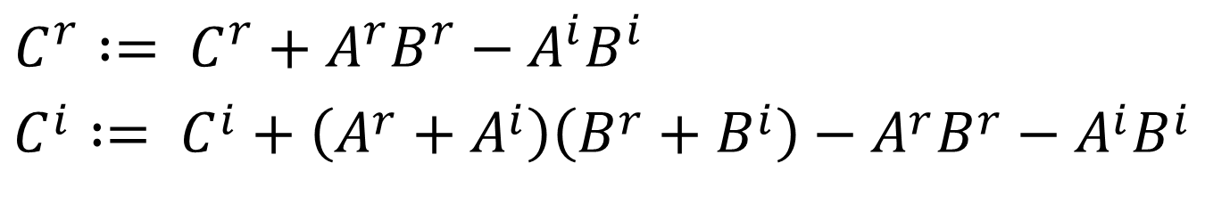
3m method
Again, we can replace scalars with matrices:
For large enough k dimensions, the cost of the additional accumulations are small relative to the avoided cost of the matrix product
$${C^{r} := C^{r}+A^{r}B^{r}−A^{i}B^{i} \atop C^{i} := C^{i}+{{\left(A^{r}+A^{i}\right)\left(B^{r}+B^{i}\right)−A}^{r}B}^{r}−{A^{i}B}^{i}}$$

Slide 25
3m method
Pros
  Strassen-like potential to exceed peak performance
Cons
  Requires workspace to store intermediate products
  Does not make sense for small k
  Slightly different (less favorable) numerical properties
  Best performing algorithm (3m_h) is somewhat mt-constrained because there are three synchronization points (can’t thread across matrix products)

Slide 26
Further work
“Implementing High-Performance Complex Matrix Multiplication via the 1m Method.” ACM Transactions on Mathematical Software. Submitted.

Slide 27

1m method
Let’s return to first principles:
$${γ^{r} := γ^{r}+α^{r}β^{r}−α^{i}β^{i} \atop γ^{i} := γ^{i}+{α^{r}β}^{i}+{α^{i}β}^{r}}$$

Slide 28
1m method
Let’s return to first principles:
What is holding 4m back?
$${γ^{r} := γ^{r}+α^{r}β^{r}−α^{i}β^{i} \atop γ^{i} := γ^{i}+{α^{r}β}^{i}+{α^{i}β}^{r}}$$

Slide 29

1m method
Let’s return to first principles:
What is holding 4m back? Storage of $C$
$${γ^{r} := γ^{r}+α^{r}β^{r}−α^{i}β^{i} \atop γ^{i} := γ^{i}+{α^{r}β}^{i}+{α^{i}β}^{r}}$$

Slide 30
1m method
Let’s return to first principles:
What is holding 4m back? Storage of $C$
$${γ^{r} := γ^{r}+α^{r}β^{r}−α^{i}β^{i} \atop γ^{i} := γ^{i}+{α^{r}β}^{i}+{α^{i}β}^{r}}$$

Slide 31
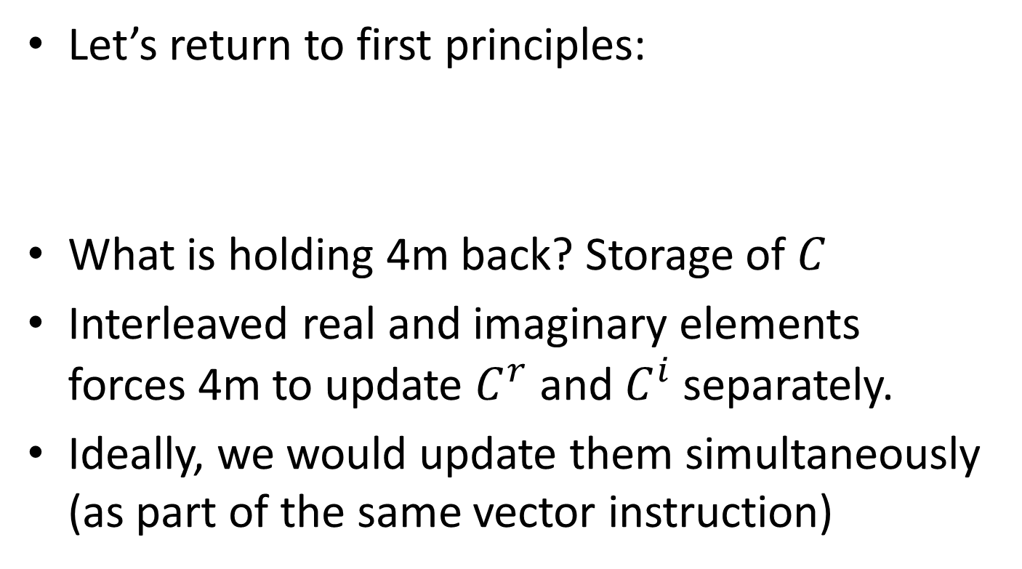
1m method
Let’s return to first principles:
What is holding 4m back? Storage of $C$
Interleaved real and imaginary elements forces 4m to update $C^{r}$ and $C^{i}$ separately.
Ideally, we would update them simultaneously (as part of the same vector instruction)
$${γ^{r} := γ^{r}+α^{r}β^{r}−α^{i}β^{i} \atop γ^{i} := γ^{i}+{α^{r}β}^{i}+{α^{i}β}^{r}}$$

Slide 32
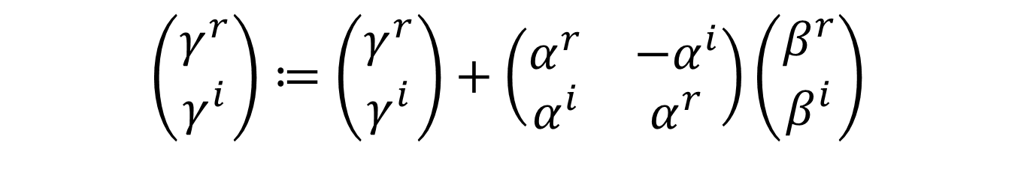
1m method
Original expression:
Let’s recast in terms of matrix/vector notation
$${γ^{r} := γ^{r}+α^{r}β^{r}−α^{i}β^{i} \atop γ^{i} := γ^{i}+{α^{r}β}^{i}+{α^{i}β}^{r}}$$
$$\left(\begin{matrix}γ^{r} \\ γ^{i}\end{matrix}\right)≔\left(\begin{matrix}γ^{r} \\ γ^{i}\end{matrix}\right)+\left(\begin{matrix}α^{r} & {−α}^{i} \\ α^{i} & α^{r}\end{matrix}\right)\left(\begin{matrix}β^{r} \\ β^{i}\end{matrix}\right)$$

Slide 33
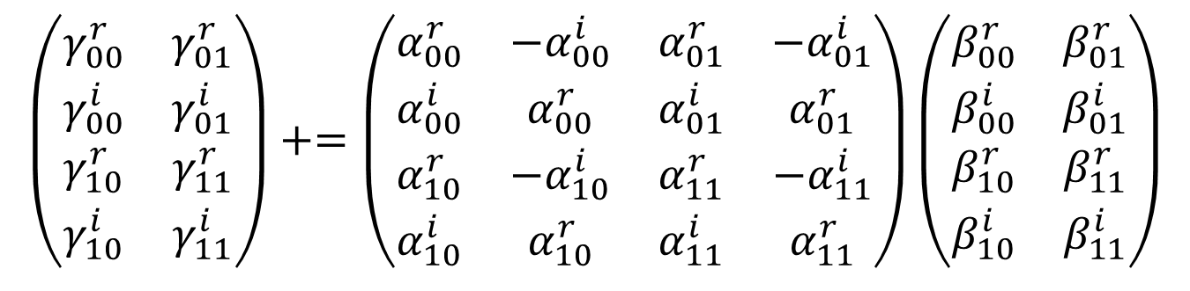
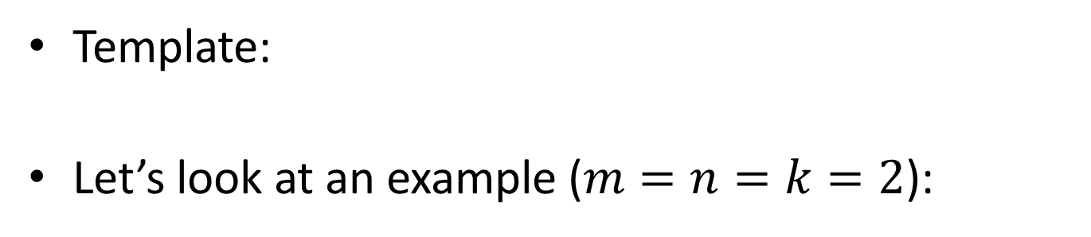

1m method
$$\left(\begin{matrix}γ^{r} \\ γ^{i}\end{matrix}\right)+=\left(\begin{matrix}α^{r} & {−α}^{i} \\ α^{i} & α^{r}\end{matrix}\right)\left(\begin{matrix}β^{r} \\ β^{i}\end{matrix}\right)$$
Template:
Let’s look at an example ($m=n=k=2$):
$$\left(\begin{matrix}γ_{00}^{r} & γ_{01}^{r} \\ γ_{00}^{i} & γ_{01}^{i} \\ γ_{10}^{r} & γ_{11}^{r} \\ γ_{10}^{i} & γ_{11}^{i}\end{matrix}\right)+=\left(\begin{matrix}α_{00}^{r} & {−α}_{00}^{i} & α_{01}^{r} & {−α}_{01}^{i} \\ α_{00}^{i} & α_{00}^{r} & α_{01}^{i} & α_{01}^{r} \\ α_{10}^{r} & {−α}_{10}^{i} & α_{11}^{r} & {−α}_{11}^{i} \\ α_{10}^{i} & α_{10}^{r} & α_{11}^{i} & α_{11}^{r}\end{matrix}\right)\left(\begin{matrix}β_{00}^{r} & β_{01}^{r} \\ β_{00}^{i} & β_{01}^{i} \\ β_{10}^{r} & β_{11}^{r} \\ β_{10}^{i} & β_{11}^{i}\end{matrix}\right)$$

Slide 34
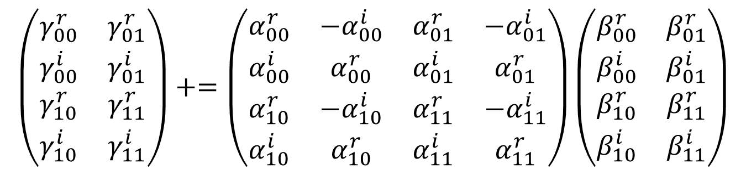

1m method
Now let’s consider this problem is being executed by a microkernel ($m_{R}^{ℂ}=n_{R}^{ℂ}=k_{C}^{ℂ}=2$)
$$\left(\begin{matrix}γ_{00}^{r} & γ_{01}^{r} \\ γ_{00}^{i} & γ_{01}^{i} \\ γ_{10}^{r} & γ_{11}^{r} \\ γ_{10}^{i} & γ_{11}^{i}\end{matrix}\right)+=\left(\begin{matrix}α_{00}^{r} & {−α}_{00}^{i} & α_{01}^{r} & {−α}_{01}^{i} \\ α_{00}^{i} & α_{00}^{r} & α_{01}^{i} & α_{01}^{r} \\ α_{10}^{r} & {−α}_{10}^{i} & α_{11}^{r} & {−α}_{11}^{i} \\ α_{10}^{i} & α_{10}^{r} & α_{11}^{i} & α_{11}^{r}\end{matrix}\right)\left(\begin{matrix}β_{00}^{r} & β_{01}^{r} \\ β_{00}^{i} & β_{01}^{i} \\ β_{10}^{r} & β_{11}^{r} \\ β_{10}^{i} & β_{11}^{i}\end{matrix}\right)$$

Slide 35

1m method
Now let’s consider this problem is being executed by a microkernel ($m_{R}^{ℂ}=n_{R}^{ℂ}=k_{C}^{ℂ}=2$)
What are the packing formats of A and B ?
$$\left(\begin{matrix}γ_{00}^{r} & γ_{01}^{r} \\ γ_{00}^{i} & γ_{01}^{i} \\ γ_{10}^{r} & γ_{11}^{r} \\ γ_{10}^{i} & γ_{11}^{i}\end{matrix}\right)+=\left(\begin{matrix}α_{00}^{r} & {−α}_{00}^{i} & α_{01}^{r} & {−α}_{01}^{i} \\ α_{00}^{i} & α_{00}^{r} & α_{01}^{i} & α_{01}^{r} \\ α_{10}^{r} & {−α}_{10}^{i} & α_{11}^{r} & {−α}_{11}^{i} \\ α_{10}^{i} & α_{10}^{r} & α_{11}^{i} & α_{11}^{r}\end{matrix}\right)\left(\begin{matrix}β_{00}^{r} & β_{01}^{r} \\ β_{00}^{i} & β_{01}^{i} \\ β_{10}^{r} & β_{11}^{r} \\ β_{10}^{i} & β_{11}^{i}\end{matrix}\right)$$

Slide 36
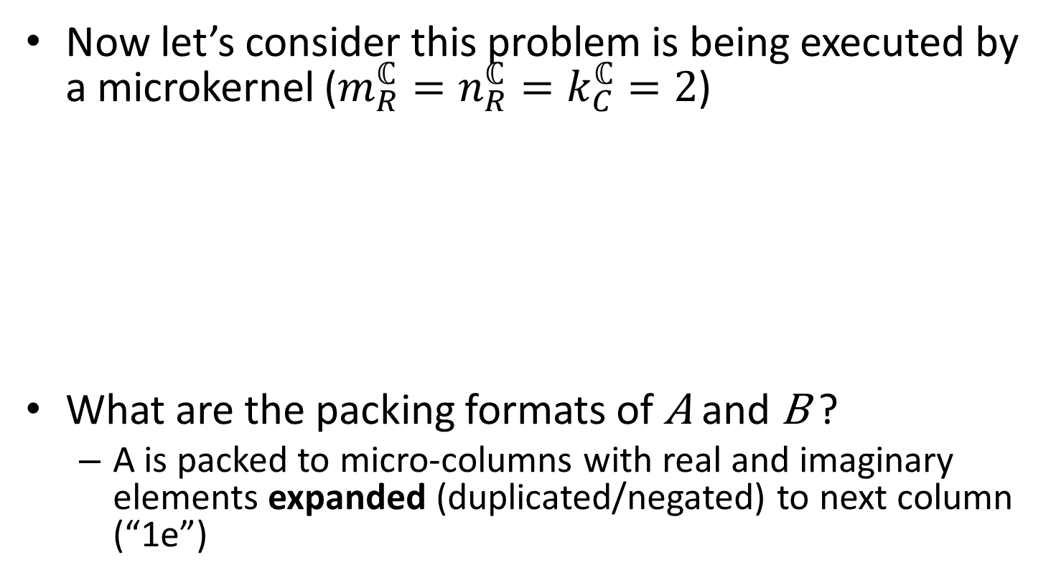
1m method
Now let’s consider this problem is being executed by a microkernel ($m_{R}^{ℂ}=n_{R}^{ℂ}=k_{C}^{ℂ}=2$)
What are the packing formats of A and B ?
  A is packed to micro-columns with real and imaginary elements expanded (duplicated/negated) to next column (“1e”)
$$\left(\begin{matrix}γ_{00}^{r} & γ_{01}^{r} \\ γ_{00}^{i} & γ_{01}^{i} \\ γ_{10}^{r} & γ_{11}^{r} \\ γ_{10}^{i} & γ_{11}^{i}\end{matrix}\right)+=\left(\begin{matrix}α_{00}^{r} & {−α}_{00}^{i} & α_{01}^{r} & {−α}_{01}^{i} \\ α_{00}^{i} & α_{00}^{r} & α_{01}^{i} & α_{01}^{r} \\ α_{10}^{r} & {−α}_{10}^{i} & α_{11}^{r} & {−α}_{11}^{i} \\ α_{10}^{i} & α_{10}^{r} & α_{11}^{i} & α_{11}^{r}\end{matrix}\right)\left(\begin{matrix}β_{00}^{r} & β_{01}^{r} \\ β_{00}^{i} & β_{01}^{i} \\ β_{10}^{r} & β_{11}^{r} \\ β_{10}^{i} & β_{11}^{i}\end{matrix}\right)$$

Slide 37

1m method
Now let’s consider this problem is being executed by a microkernel ($m_{R}^{ℂ}=n_{R}^{ℂ}=k_{C}^{ℂ}=2$)
What are the packing formats of A and B ?
  A is packed to micro-columns with real and imaginary elements expanded (duplicated/negated) to next column (“1e”)
  B is packed to micro-rows where imaginary elements are reordered to next row (“1r”)
$$\left(\begin{matrix}γ_{00}^{r} & γ_{01}^{r} \\ γ_{00}^{i} & γ_{01}^{i} \\ γ_{10}^{r} & γ_{11}^{r} \\ γ_{10}^{i} & γ_{11}^{i}\end{matrix}\right)+=\left(\begin{matrix}α_{00}^{r} & {−α}_{00}^{i} & α_{01}^{r} & {−α}_{01}^{i} \\ α_{00}^{i} & α_{00}^{r} & α_{01}^{i} & α_{01}^{r} \\ α_{10}^{r} & {−α}_{10}^{i} & α_{11}^{r} & {−α}_{11}^{i} \\ α_{10}^{i} & α_{10}^{r} & α_{11}^{i} & α_{11}^{r}\end{matrix}\right)\left(\begin{matrix}β_{00}^{r} & β_{01}^{r} \\ β_{00}^{i} & β_{01}^{i} \\ β_{10}^{r} & β_{11}^{r} \\ β_{10}^{i} & β_{11}^{i}\end{matrix}\right)$$

Slide 38
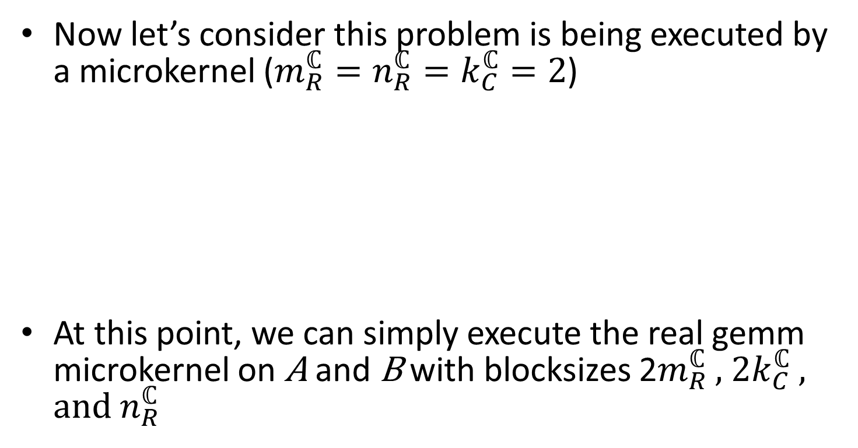
1m method
Now let’s consider this problem is being executed by a microkernel ($m_{R}^{ℂ}=n_{R}^{ℂ}=k_{C}^{ℂ}=2$)
At this point, we can simply execute the real gemm microkernel on A and B with blocksizes 2$m_{R}^{ℂ}$ , 2$k_{C}^{ℂ}$ , and $n_{R}^{ℂ}$
$$\left(\begin{matrix}γ_{00}^{r} & γ_{01}^{r} \\ γ_{00}^{i} & γ_{01}^{i} \\ γ_{10}^{r} & γ_{11}^{r} \\ γ_{10}^{i} & γ_{11}^{i}\end{matrix}\right)+=\left(\begin{matrix}α_{00}^{r} & {−α}_{00}^{i} & α_{01}^{r} & {−α}_{01}^{i} \\ α_{00}^{i} & α_{00}^{r} & α_{01}^{i} & α_{01}^{r} \\ α_{10}^{r} & {−α}_{10}^{i} & α_{11}^{r} & {−α}_{11}^{i} \\ α_{10}^{i} & α_{10}^{r} & α_{11}^{i} & α_{11}^{r}\end{matrix}\right)\left(\begin{matrix}β_{00}^{r} & β_{01}^{r} \\ β_{00}^{i} & β_{01}^{i} \\ β_{10}^{r} & β_{11}^{r} \\ β_{10}^{i} & β_{11}^{i}\end{matrix}\right)$$

Slide 39
1m method
Notice that this packing configuration assumes C is column-stored:
We call this variant “1m_c”
But what if C is row-stored?
$$\left(\begin{matrix}γ_{00}^{r} & γ_{01}^{r} \\ γ_{00}^{i} & γ_{01}^{i} \\ γ_{10}^{r} & γ_{11}^{r} \\ γ_{10}^{i} & γ_{11}^{i}\end{matrix}\right)+=\left(\begin{matrix}α_{00}^{r} & {−α}_{00}^{i} & α_{01}^{r} & {−α}_{01}^{i} \\ α_{00}^{i} & α_{00}^{r} & α_{01}^{i} & α_{01}^{r} \\ α_{10}^{r} & {−α}_{10}^{i} & α_{11}^{r} & {−α}_{11}^{i} \\ α_{10}^{i} & α_{10}^{r} & α_{11}^{i} & α_{11}^{r}\end{matrix}\right)\left(\begin{matrix}β_{00}^{r} & β_{01}^{r} \\ β_{00}^{i} & β_{01}^{i} \\ β_{10}^{r} & β_{11}^{r} \\ β_{10}^{i} & β_{11}^{i}\end{matrix}\right)$$

Slide 40
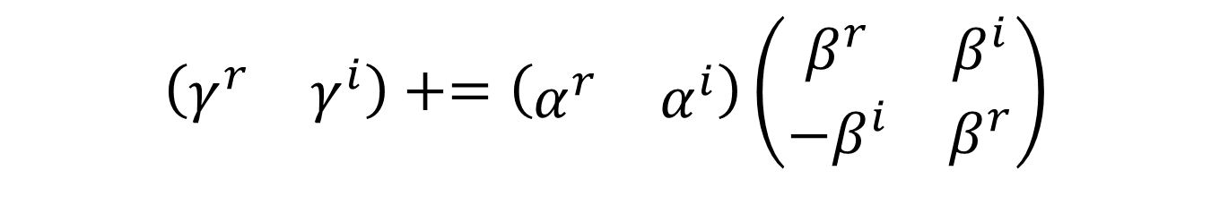

1m method
Recall our original matrix/vector expression:
Alternate expression:
$$\left(\begin{matrix}γ^{r} \\ γ^{i}\end{matrix}\right)+=\left(\begin{matrix}α^{r} & {−α}^{i} \\ α^{i} & α^{r}\end{matrix}\right)\left(\begin{matrix}β^{r} \\ β^{i}\end{matrix}\right)$$
$$\left(\begin{matrix}γ^{r} & γ^{i}\end{matrix}\right)+=\left(\begin{matrix}α^{r} & α^{i}\end{matrix}\right)\left(\begin{matrix}β^{r} & β^{i} \\ {−β}^{i} & β^{r}\end{matrix}\right)$$

Slide 41
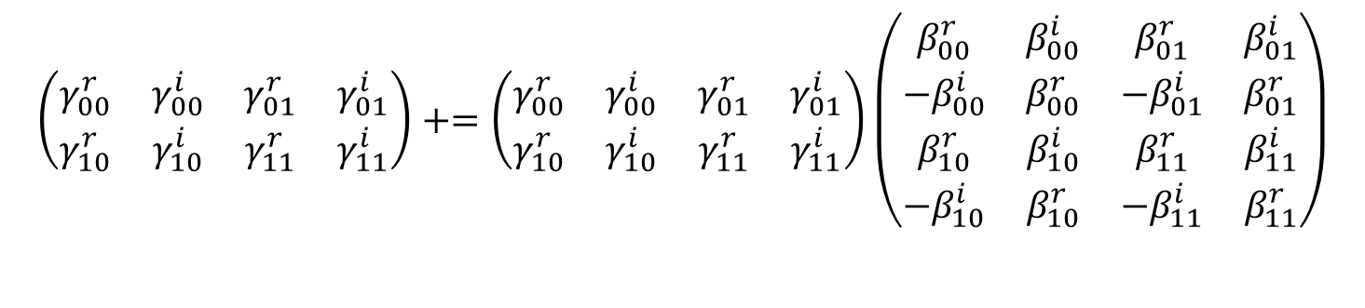
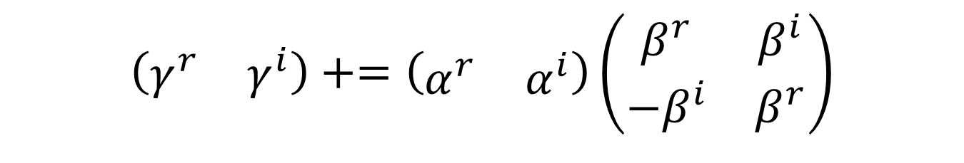
1m method
$$\left(\begin{matrix}γ^{r} & γ^{i}\end{matrix}\right)+=\left(\begin{matrix}α^{r} & α^{i}\end{matrix}\right)\left(\begin{matrix}β^{r} & β^{i} \\ {−β}^{i} & β^{r}\end{matrix}\right)$$
Template:
Let’s look at an example ($m=n=k=2$):
$$\left(\begin{matrix}γ_{00}^{r} & γ_{00}^{i} & γ_{01}^{r} & γ_{01}^{i} \\ γ_{10}^{r} & γ_{10}^{i} & γ_{11}^{r} & γ_{11}^{i}\end{matrix}\right)+=\left(\begin{matrix}γ_{00}^{r} & γ_{00}^{i} & γ_{01}^{r} & γ_{01}^{i} \\ γ_{10}^{r} & γ_{10}^{i} & γ_{11}^{r} & γ_{11}^{i}\end{matrix}\right)\left(\begin{matrix}β_{00}^{r} & β_{00}^{i} & β_{01}^{r} & β_{01}^{i} \\ {−β}_{00}^{i} & β_{00}^{r} & {−β}_{01}^{i} & β_{01}^{r} \\ β_{10}^{r} & β_{10}^{i} & β_{11}^{r} & β_{11}^{i} \\ −β_{10}^{i} & β_{10}^{r} & −β_{11}^{i} & β_{11}^{r}\end{matrix}\right)$$

Slide 42
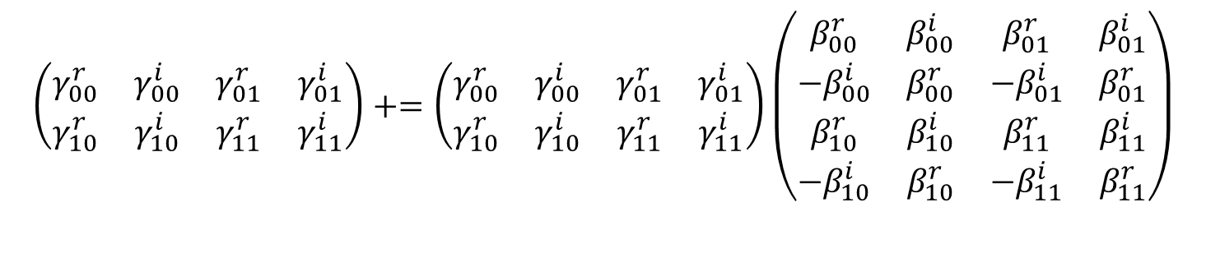
1m method
Now let’s consider this problem is being executed by a microkernel ($m_{R}^{ℂ}=n_{R}^{ℂ}=k_{C}^{ℂ}=2$)
$$\left(\begin{matrix}γ_{00}^{r} & γ_{00}^{i} & γ_{01}^{r} & γ_{01}^{i} \\ γ_{10}^{r} & γ_{10}^{i} & γ_{11}^{r} & γ_{11}^{i}\end{matrix}\right)+=\left(\begin{matrix}γ_{00}^{r} & γ_{00}^{i} & γ_{01}^{r} & γ_{01}^{i} \\ γ_{10}^{r} & γ_{10}^{i} & γ_{11}^{r} & γ_{11}^{i}\end{matrix}\right)\left(\begin{matrix}β_{00}^{r} & β_{00}^{i} & β_{01}^{r} & β_{01}^{i} \\ {−β}_{00}^{i} & β_{00}^{r} & {−β}_{01}^{i} & β_{01}^{r} \\ β_{10}^{r} & β_{10}^{i} & β_{11}^{r} & β_{11}^{i} \\ −β_{10}^{i} & β_{10}^{r} & −β_{11}^{i} & β_{11}^{r}\end{matrix}\right)$$

Slide 43

1m method
Now let’s consider this problem is being executed by a microkernel ($m_{R}^{ℂ}=n_{R}^{ℂ}=k_{C}^{ℂ}=2$)
What are the packing formats of A and B ?
$$\left(\begin{matrix}γ_{00}^{r} & γ_{00}^{i} & γ_{01}^{r} & γ_{01}^{i} \\ γ_{10}^{r} & γ_{10}^{i} & γ_{11}^{r} & γ_{11}^{i}\end{matrix}\right)+=\left(\begin{matrix}γ_{00}^{r} & γ_{00}^{i} & γ_{01}^{r} & γ_{01}^{i} \\ γ_{10}^{r} & γ_{10}^{i} & γ_{11}^{r} & γ_{11}^{i}\end{matrix}\right)\left(\begin{matrix}β_{00}^{r} & β_{00}^{i} & β_{01}^{r} & β_{01}^{i} \\ {−β}_{00}^{i} & β_{00}^{r} & {−β}_{01}^{i} & β_{01}^{r} \\ β_{10}^{r} & β_{10}^{i} & β_{11}^{r} & β_{11}^{i} \\ −β_{10}^{i} & β_{10}^{r} & −β_{11}^{i} & β_{11}^{r}\end{matrix}\right)$$

Slide 44

1m method
Now let’s consider this problem is being executed by a microkernel ($m_{R}^{ℂ}=n_{R}^{ℂ}=k_{C}^{ℂ}=2$)
What are the packing formats of A and B ?
  A is packed to micro-columns where imaginary elements are reordered to next column (“1r”)
$$\left(\begin{matrix}γ_{00}^{r} & γ_{00}^{i} & γ_{01}^{r} & γ_{01}^{i} \\ γ_{10}^{r} & γ_{10}^{i} & γ_{11}^{r} & γ_{11}^{i}\end{matrix}\right)+=\left(\begin{matrix}γ_{00}^{r} & γ_{00}^{i} & γ_{01}^{r} & γ_{01}^{i} \\ γ_{10}^{r} & γ_{10}^{i} & γ_{11}^{r} & γ_{11}^{i}\end{matrix}\right)\left(\begin{matrix}β_{00}^{r} & β_{00}^{i} & β_{01}^{r} & β_{01}^{i} \\ {−β}_{00}^{i} & β_{00}^{r} & {−β}_{01}^{i} & β_{01}^{r} \\ β_{10}^{r} & β_{10}^{i} & β_{11}^{r} & β_{11}^{i} \\ −β_{10}^{i} & β_{10}^{r} & −β_{11}^{i} & β_{11}^{r}\end{matrix}\right)$$

Slide 45
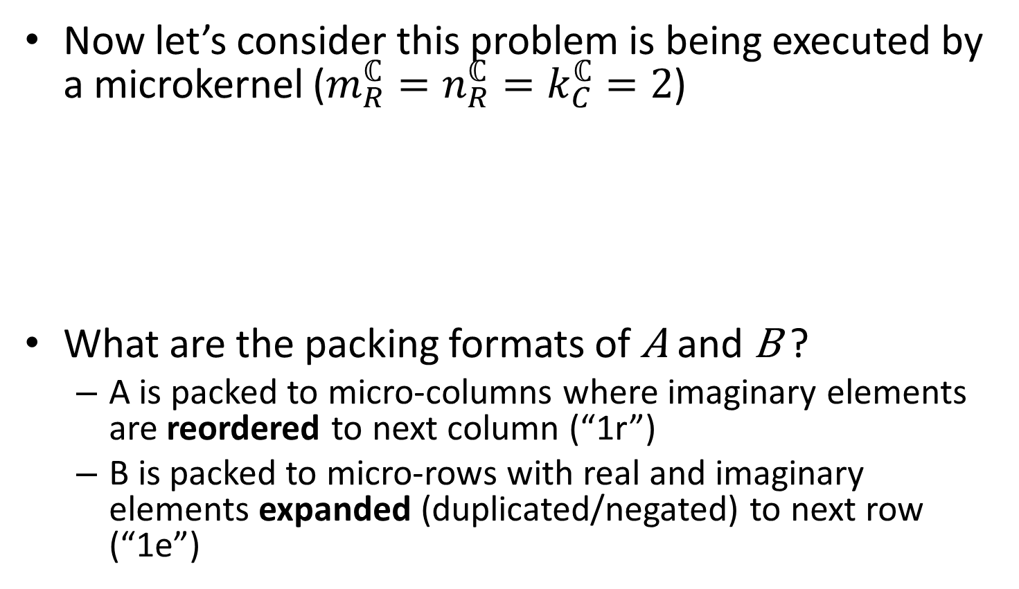
1m method
Now let’s consider this problem is being executed by a microkernel ($m_{R}^{ℂ}=n_{R}^{ℂ}=k_{C}^{ℂ}=2$)
What are the packing formats of A and B ?
  A is packed to micro-columns where imaginary elements are reordered to next column (“1r”)
  B is packed to micro-rows with real and imaginary elements expanded (duplicated/negated) to next row (“1e”)
$$\left(\begin{matrix}γ_{00}^{r} & γ_{00}^{i} & γ_{01}^{r} & γ_{01}^{i} \\ γ_{10}^{r} & γ_{10}^{i} & γ_{11}^{r} & γ_{11}^{i}\end{matrix}\right)+=\left(\begin{matrix}γ_{00}^{r} & γ_{00}^{i} & γ_{01}^{r} & γ_{01}^{i} \\ γ_{10}^{r} & γ_{10}^{i} & γ_{11}^{r} & γ_{11}^{i}\end{matrix}\right)\left(\begin{matrix}β_{00}^{r} & β_{00}^{i} & β_{01}^{r} & β_{01}^{i} \\ {−β}_{00}^{i} & β_{00}^{r} & {−β}_{01}^{i} & β_{01}^{r} \\ β_{10}^{r} & β_{10}^{i} & β_{11}^{r} & β_{11}^{i} \\ −β_{10}^{i} & β_{10}^{r} & −β_{11}^{i} & β_{11}^{r}\end{matrix}\right)$$

Slide 46

1m method
Now let’s consider this problem is being executed by a microkernel ($m_{R}^{ℂ}=n_{R}^{ℂ}=k_{C}^{ℂ}=2$)
At this point, we can simply execute the real gemm microkernel on A and B with blocksizes $m_{R}^{ℂ}$ , 2$k_{C}^{ℂ}$ , and ${2n}_{R}^{ℂ}$
$$\left(\begin{matrix}γ_{00}^{r} & γ_{00}^{i} & γ_{01}^{r} & γ_{01}^{i} \\ γ_{10}^{r} & γ_{10}^{i} & γ_{11}^{r} & γ_{11}^{i}\end{matrix}\right)+=\left(\begin{matrix}γ_{00}^{r} & γ_{00}^{i} & γ_{01}^{r} & γ_{01}^{i} \\ γ_{10}^{r} & γ_{10}^{i} & γ_{11}^{r} & γ_{11}^{i}\end{matrix}\right)\left(\begin{matrix}β_{00}^{r} & β_{00}^{i} & β_{01}^{r} & β_{01}^{i} \\ {−β}_{00}^{i} & β_{00}^{r} & {−β}_{01}^{i} & β_{01}^{r} \\ β_{10}^{r} & β_{10}^{i} & β_{11}^{r} & β_{11}^{i} \\ −β_{10}^{i} & β_{10}^{r} & −β_{11}^{i} & β_{11}^{r}\end{matrix}\right)$$

Slide 47
1m method
Notice that this packing configuration assumes C is row-stored:
We call this variant “1m_r”
$$\left(\begin{matrix}γ_{00}^{r} & γ_{00}^{i} & γ_{01}^{r} & γ_{01}^{i} \\ γ_{10}^{r} & γ_{10}^{i} & γ_{11}^{r} & γ_{11}^{i}\end{matrix}\right)+=\left(\begin{matrix}γ_{00}^{r} & γ_{00}^{i} & γ_{01}^{r} & γ_{01}^{i} \\ γ_{10}^{r} & γ_{10}^{i} & γ_{11}^{r} & γ_{11}^{i}\end{matrix}\right)\left(\begin{matrix}β_{00}^{r} & β_{00}^{i} & β_{01}^{r} & β_{01}^{i} \\ {−β}_{00}^{i} & β_{00}^{r} & {−β}_{01}^{i} & β_{01}^{r} \\ β_{10}^{r} & β_{10}^{i} & β_{11}^{r} & β_{11}^{i} \\ −β_{10}^{i} & β_{10}^{r} & −β_{11}^{i} & β_{11}^{r}\end{matrix}\right)$$

Slide 48
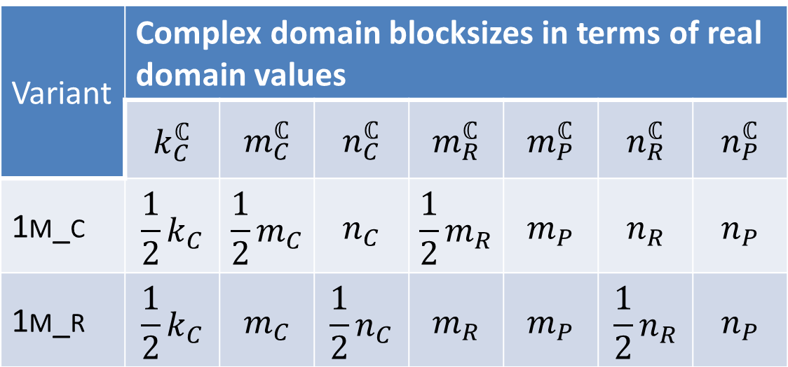
1m method
1m requires special cache and register blocksizes
Variant | Complex domain blocksizes in terms of real domain values
 | $$k_{C}^{ℂ}$$ | $$m_{C}^{ℂ}$$ | $$n_{C}^{ℂ}$$ | $$m_{R}^{ℂ}$$ | $$m_{P}^{ℂ}$$ | $$n_{R}^{ℂ}$$ | $$n_{P}^{ℂ}$$
1m_c | $$\frac{1}{2}k_{C}$$ | $$\frac{1}{2}m_{C}$$ | $$n_{C}$$ | $$\frac{1}{2}m_{R}$$ | $$m_{P}$$ | $$n_{R}$$ | $$n_{P}$$
1m_r | $$\frac{1}{2}k_{C}$$ | $$m_{C}$$ | $$\frac{1}{2}n_{C}$$ | $$m_{R}$$ | $$m_{P}$$ | $$\frac{1}{2}n_{R}$$ | $$n_{P}$$

Slide 49
1m method
Pros
  Avoids virtually all performance issues inherent in 4m (e.g. redundant memops on C)
  With optional common-case optimization, performance exceeds real domain mm
  Numerical properties identical to assembly-based solution (more “stable” than even 4m)
Cons
  Not agnostic to storage of output matrix; algorithm changes slightly depending on whether C is row- or column-stored

Slide 50
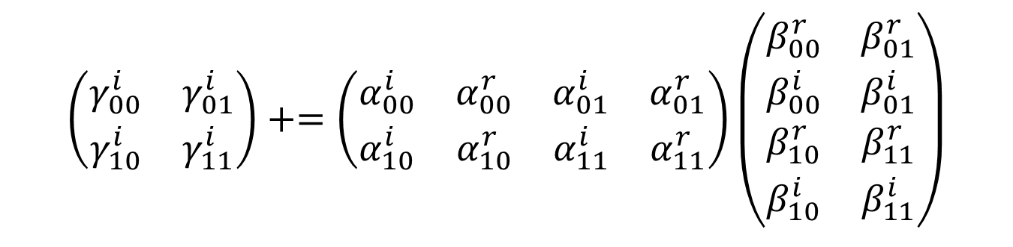
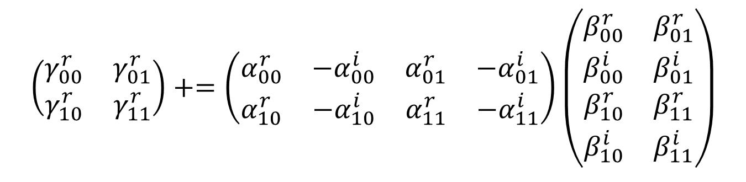
2m method
What if matrices’ real and imaginary components are stored separately?
$$\left(\begin{matrix}γ_{00}^{r} & γ_{01}^{r} \\ γ_{10}^{r} & γ_{11}^{r}\end{matrix}\right)+=\left(\begin{matrix}α_{00}^{r} & {−α}_{00}^{i} & α_{01}^{r} & {−α}_{01}^{i} \\ α_{10}^{r} & {−α}_{10}^{i} & α_{11}^{r} & {−α}_{11}^{i}\end{matrix}\right)\left(\begin{matrix}β_{00}^{r} & β_{01}^{r} \\ β_{00}^{i} & β_{01}^{i} \\ β_{10}^{r} & β_{11}^{r} \\ β_{10}^{i} & β_{11}^{i}\end{matrix}\right)$$
$$\left(\begin{matrix}γ_{00}^{i} & γ_{01}^{i} \\ γ_{10}^{i} & γ_{11}^{i}\end{matrix}\right)+=\left(\begin{matrix}α_{00}^{i} & α_{00}^{r} & α_{01}^{i} & α_{01}^{r} \\ α_{10}^{i} & α_{10}^{r} & α_{11}^{i} & α_{11}^{r}\end{matrix}\right)\left(\begin{matrix}β_{00}^{r} & β_{01}^{r} \\ β_{00}^{i} & β_{01}^{i} \\ β_{10}^{r} & β_{11}^{r} \\ β_{10}^{i} & β_{11}^{i}\end{matrix}\right)$$

Slide 51
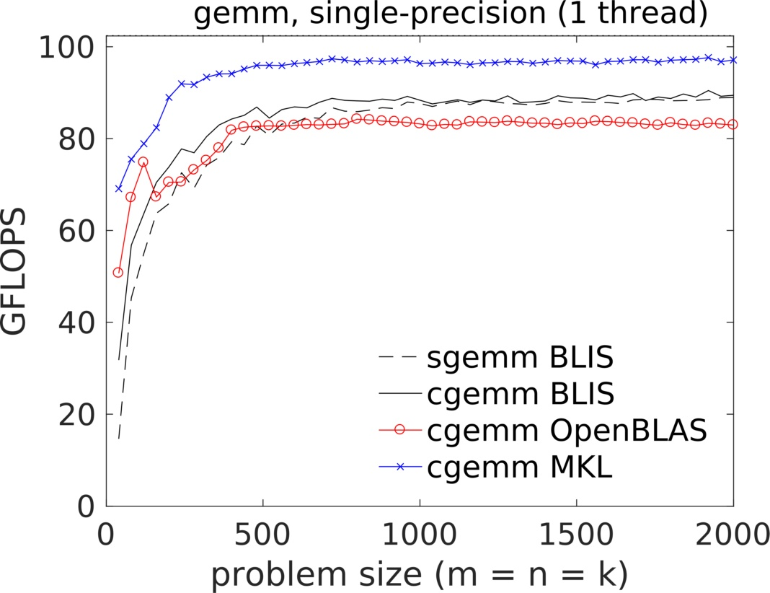
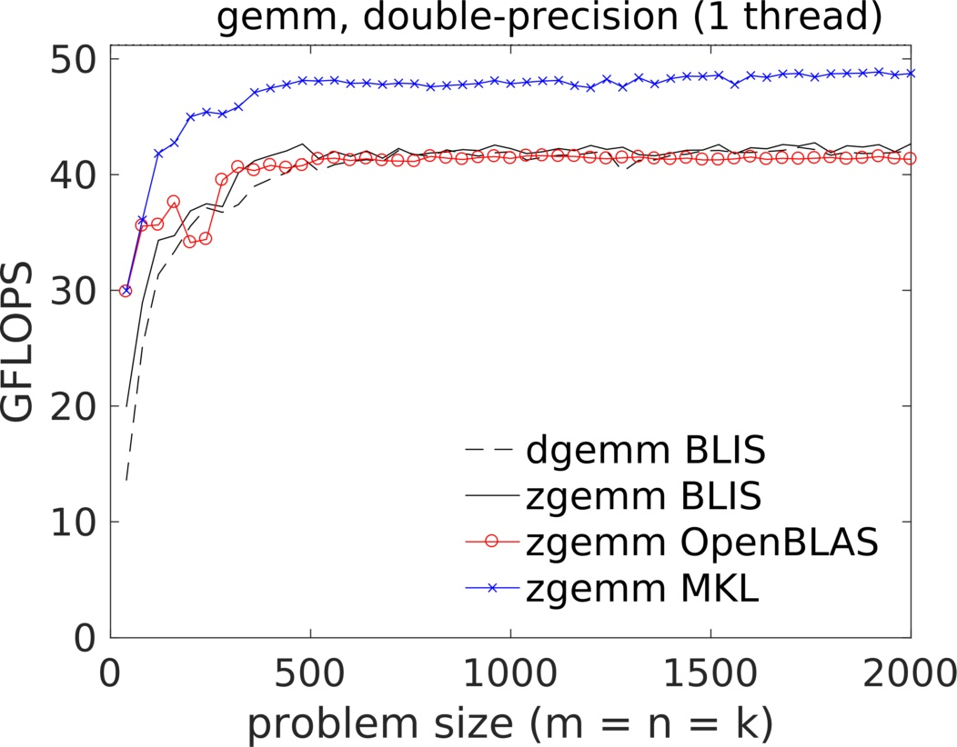
Performance

Slide 52
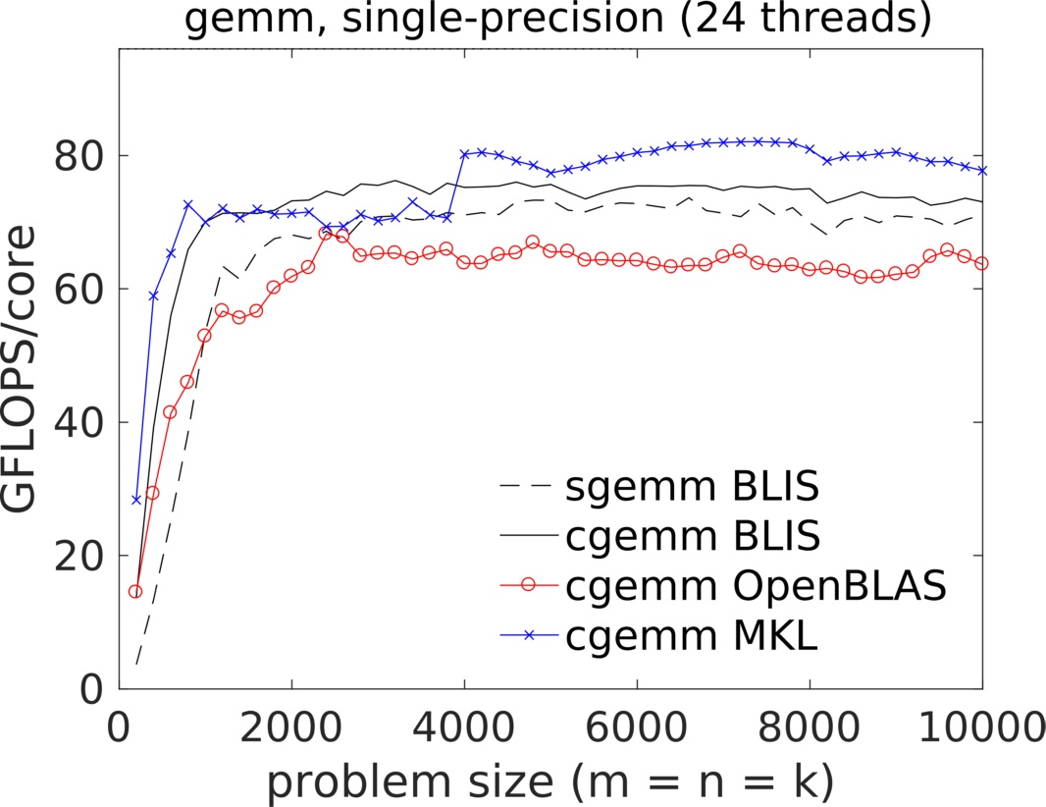
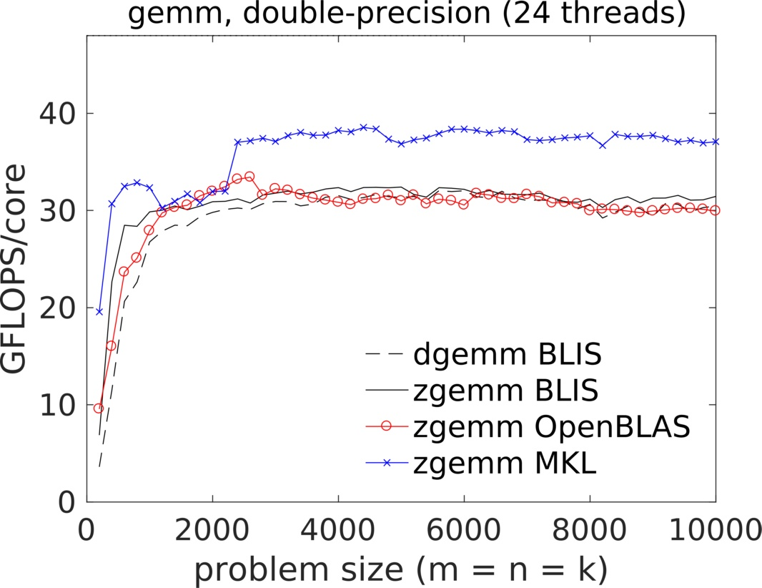
Performance

Slide 53
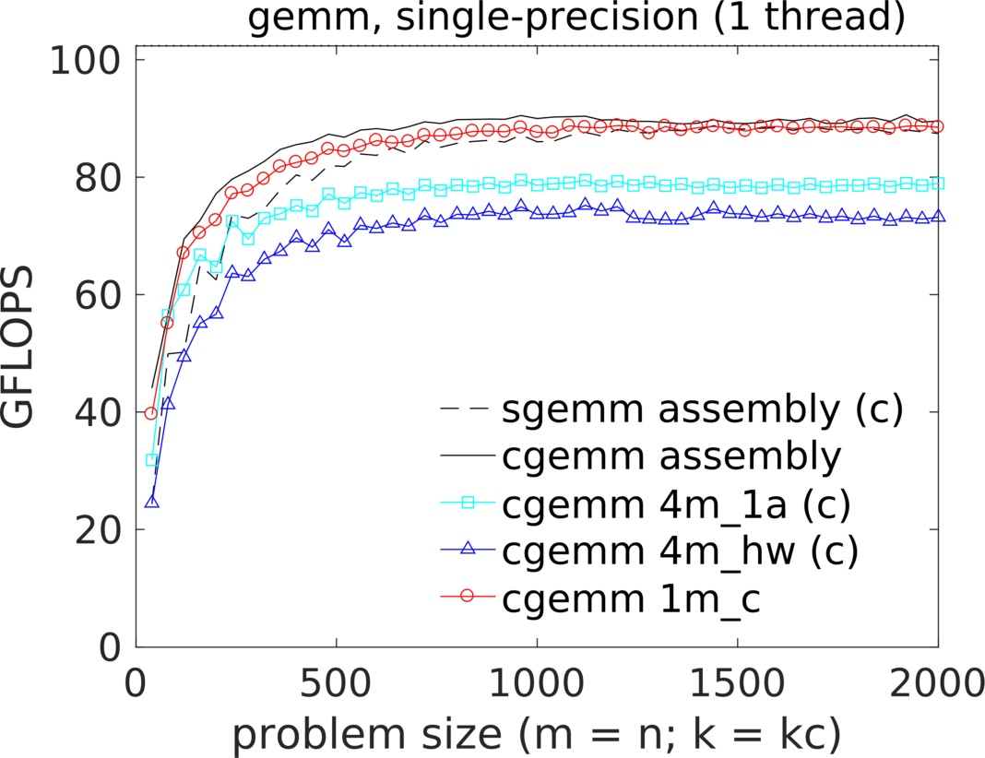

Performance

Slide 54
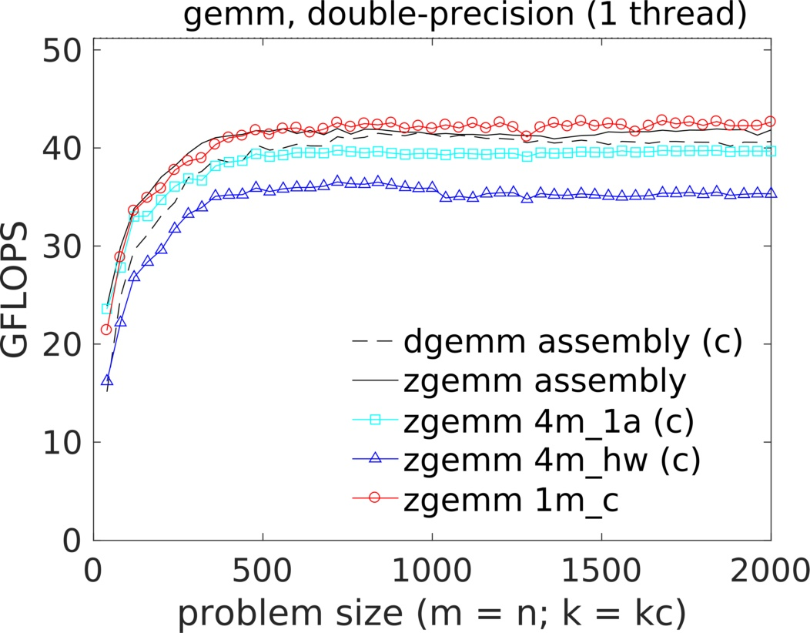
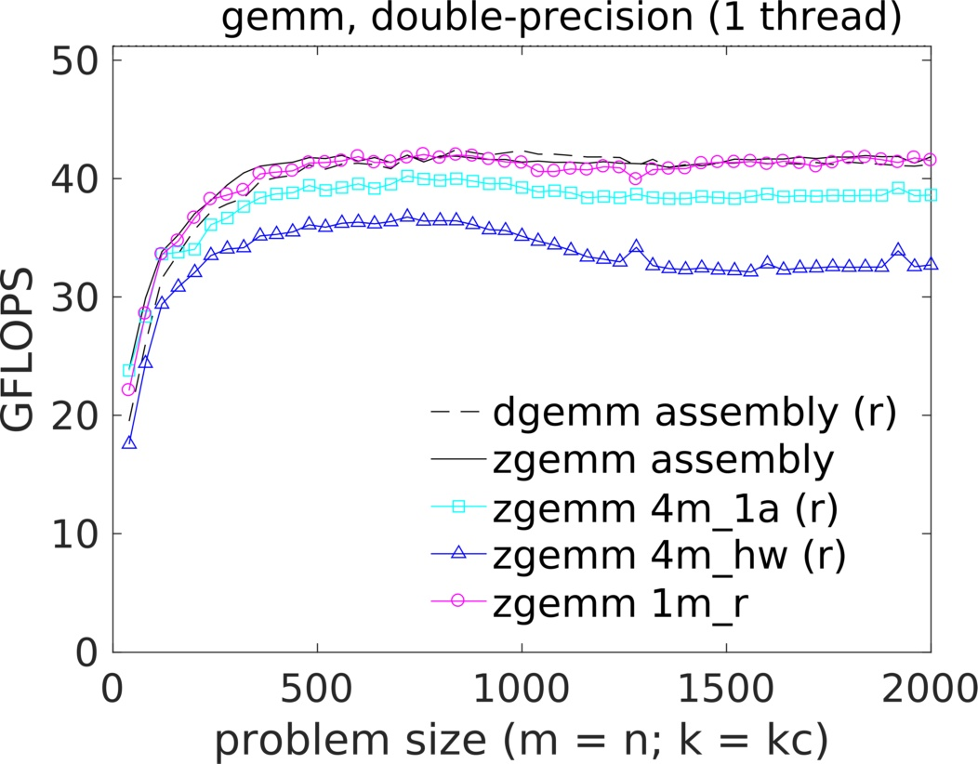
Performance

Slide 55
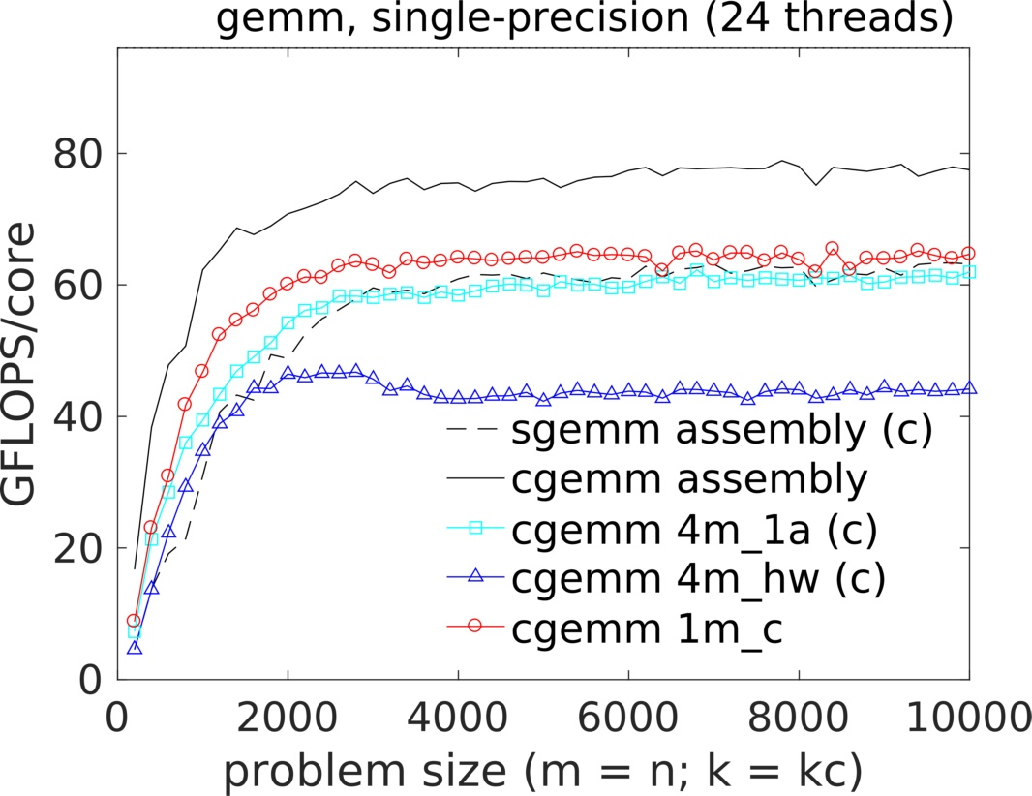
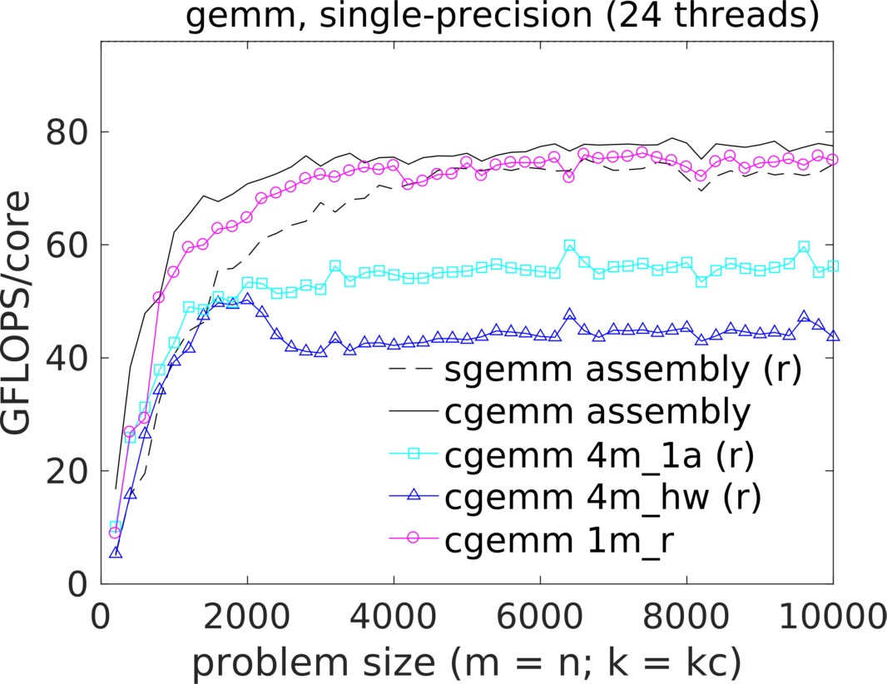
Performance

Slide 56
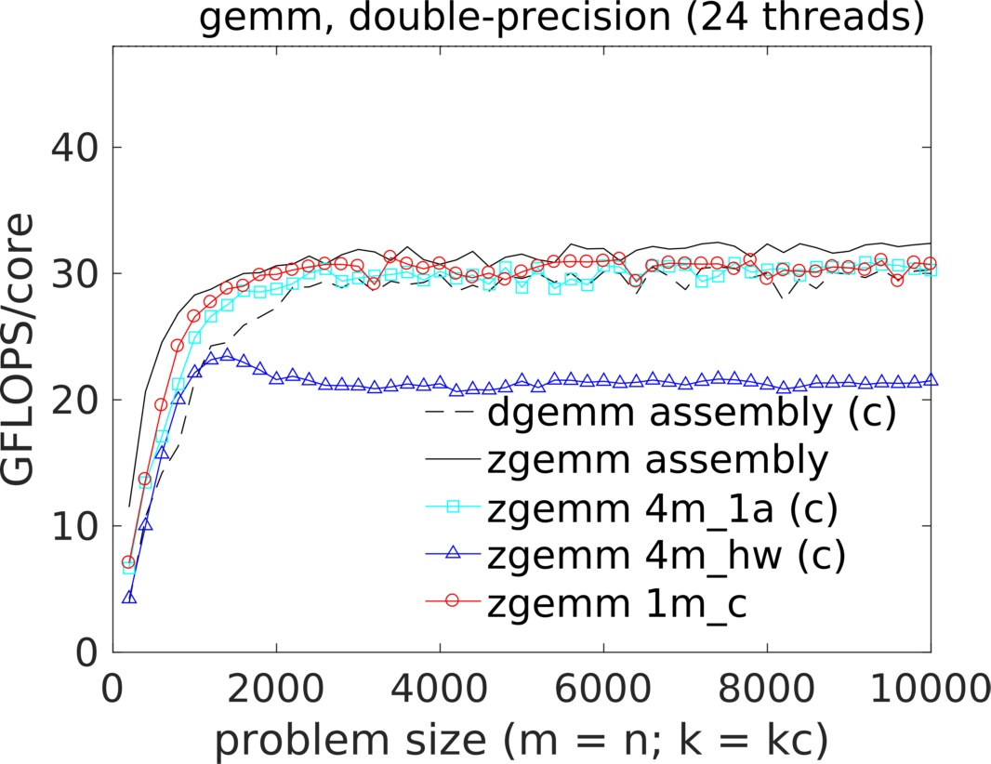
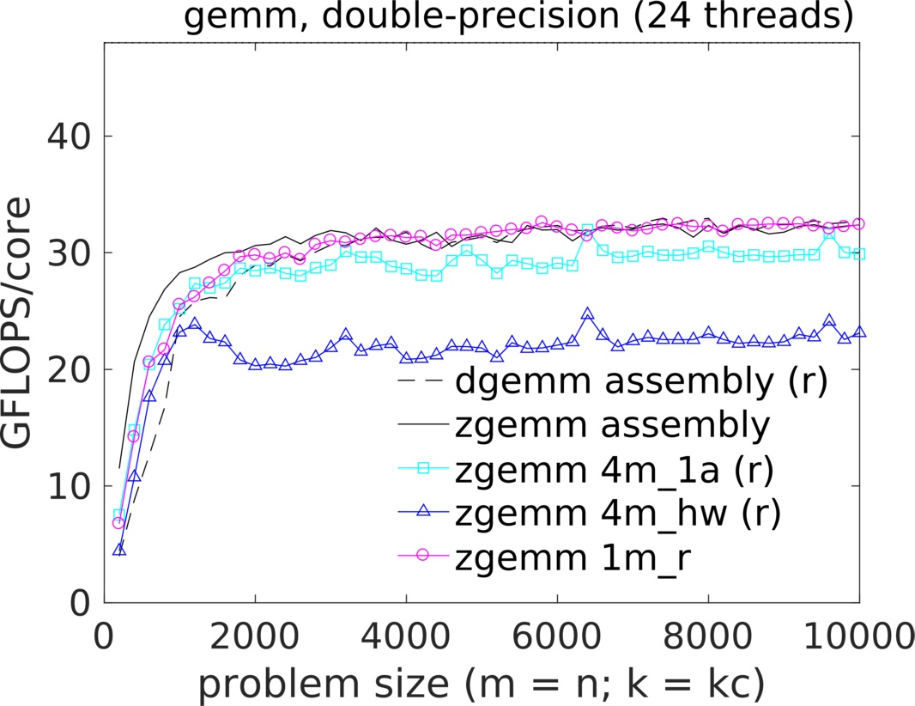
Performance

Slide 57
Conclusion
Key takeaway: the real and imaginary elements can always be reordered to accommodate the fundamental primitive
Family values: we now have a family of solutions, each with pros and cons
  1m method is almost always superior if traditional numerical properties are needed
  3m method is best when numerical behavior can be sacrificed for a faster solution
  2m method can be used if the real and imaginary elements are stored as two separate real matrices (which is rare)

Slide 58
Further Information
Website:
  http://github.com/flame/blis/
Discussion:
  http://groups.google.com/group/blis-devel
  http://groups.google.com/group/blis-discuss
Contact:
  field@cs.utexas.edu

