Slide 1
Quantifier Elimination Via Clause Redundancy
Eugene Goldberg, Pete Manolios
Northeastern University, USA
FMCAD-2013, October 20-23,
Portland, OR, USA

Slide 2
Outline
Introduction
Clause D-sequents
Example
Experimental results
Conclusions

Slide 3
Quantifier Elimination (QE)
Let F be a Boolean CNF formula and X ⊆ Vars(F).
QE problem:
Given ∃X [F ], find a quantifier free CNF formula G
such that G ≡ ∃X [F ]
G ≡ ∃X [F ] means that G_{s} = ∃X [F_{s}]
for every complete assignment s to Vars(F) \ X
QE is important in many areas e.g model checking

Slide 4
SAT-based QE Methods
Enumeration of satisfying assignments:
McMillan 2002, Ganai,Gupta, Ashar 2004,
Jin, Somenzi 2005, Brauer, King, Kriener 2011
Variable elimination:
Davis, Putnam 1960, Jiang 2009, Goldberg, Manolios 2010
Computing redundancy of variables
Goldberg, Manolios 2012

Slide 5
Three Ideas of Our Method
1) Add resolvent-clauses to F until clauses with variables
of X ( X-clauses) are redundant in ∃X [H] , H ⊇ F
Redundancy of X-clause C means ∃X [H] ≡ ∃X [H \ {C} ]
2) Use branching to prove redundancy of X-clauses in
subspaces and merge results of different branches
3) Compute termination condition: (all X-clauses are redundant in ∃X [H]. This is done by machinery of dependency sequents (D-sequents)

Slide 6
Clause And Variable Redundancy
D-sequents based on redundancy of variables (FMCAD-12)
A variable v ∈ X is redundant in ∃X [F ]
if the clauses of F with v are redundant in ∃X [F ]
D-sequents based on clause redundancy (FMCAD-13)
Clause D-sequents can express redundancy of any subset of X-clauses
Derivation of termination condition in terms of clause D-sequents cannot be simulated by variable D-sequents

Slide 7
Outline
Introduction
Clause D-sequents
Example
Experimental results
Conclusions

Slide 8
Clause Dependency Sequents (D-sequents)
Let s be a partial assignment to Vars(F).
Let F^{X} denote the X-clauses of ∃X [F ]
A clause D-sequent (∃X [F ] , s) → R , where R ⊆ F^{X}
states that R is redundant in ∃X [F_{s}] .
We will call s the conditional part of the D-sequent

Slide 9
D-Sequent Calculus
Resolution of clauses
Initial clauses
of F
(∃X [F ] , ∅) → F^{X}
Atomic D-sequents
Operation Compose
Operation Join

Slide 10
Atomic D-sequents
Let C be an X-clause of ∃X [F ],
Atomic D-sequent (∃X [F ], s) → {C }
is derived when C is
satisfied
by s
blocked
(cannot be resolved
with clauses of F_{s})
subsumed
by C′ ∈ F_{s}

Slide 11
Outline
Introduction
Clause D-sequents
Example
Experimental results
Conclusions

Slide 12
A Run of DCDS on a Simple Formula
Derivation of Clause D-Sequents (DCDS)
Consider ∃x [F ] where
F = C₁ ∧ C₂ ,
C₁= ~y₁ ∨ x ,
C₂= y₂ ∨ ~x ,
~y₁ ∨ y₂ is a solution to the QE problem i.e.
~y₁ ∨ y₂ ≡ ∃x (~y₁ ∨ x ) ∧ (y₂ ∨ ~x )

Slide 13
Decision Tree Built by DCDS
C₃ =~y₁ ∨ y₂ is a solution to QE
∃x [F ],
F = C₁ ∧ C₂ ,
C₁= ~y₁ ∨ x ,
C₂= y₂ ∨ ~x ,
y₁
0
1
C₁ is satisf.
C₂ is blocked
y₂
0
1
C₂ is satisf.
C₁ is blocked
confl. clause C₃ =~y₁ ∨ y₂ is added
x
C₁, C₂ are sub-sumed by C₃

Slide 14
D-sequents Built by DCDS
∃x [F ],
F = C₁ ∧ C₂ ,
C₁= ~y₁ ∨ x ,
C₂= y₂ ∨ ~x ,
S₉, S₁₀
y₁
1
0
y₂
S₇, S₈
S₁, S₂
0
1
S₃, S₄
x
S₅, S₆
Join operation:
S₃: (y₁ = 1, y₂=0)→ {C₁},
S₅: (y₂ = 1)→ {C₁},
-------------------------
S₇: (y₁ = 1)→ {C₁},
S₁: (y₁ = 0)→ {C₁}, S₂: (y₁ = 0)→ {C₂}
S₃: (y₁ = 1, y₂=0)→ {C₁}, S₄: (y₁ = 1,y₂=0)→ {C₂}
S₅: (y₂ = 1)→ {C₁}, S₆: (y₂ = 1)→ {C₂}
S₇: (y₁ = 1)→ {C₁}, S₈: (y₁ = 1)→ {C₂}
S₉: ∅ → {C₁}, S₁₀: ∅ → {C₂}

Slide 15
Outline
Introduction
Clause D-sequents
Example
Experimental results
Conclusions

Slide 16
Re-using D-sequents
Current implementation of DCDS lacks a few optimizations
Most importantly, D-sequents are not re-used
Parent D-sequents are discarded after a join operation
Re-using D-sequents should drastically boost performance

Slide 17
Backward Model Checking
758 benchmarks of HWMCC-10. Time limit is 2,000 s.
We compared three algorithms:
MC-DDS is based on our QE algorithm of FMCAD-12
MC-DCDS is based on our QE algorithm of FMCAD-13
MC-BDD is based on PdTrav
Model checker | MC-DDS | MC-DCDS | MC-BDD
Solved | 247 | 258 | 374

Slide 18
Comparison On Benchmarks Solved by MC-DDS or MC-DCDS
Number of benchmarks is 259
Time limit is 2,000 s.
Model checker | MC-DDS | MC-DCDS | MC-BDD
Solved | 247 | 258 | 193
#timeouts | 12 | 1 | 66
Time for solved by all (s.) | 11,293 | 1,698 | 9,080

Slide 19
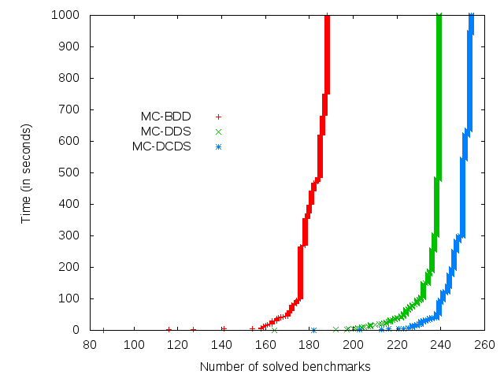
Cactus Plots For Benchmarks Solved by MC-DDS or MC-DCDS

Slide 20
Conclusions
We introduced the machinery of clause D-sequents that can be used in many applications
We showed how it works for quantifier elimination
A model checker based on clause D-sequents can solve examples that are hard for BDDs
We are still at the stage where adding a new technique (e.g. re-using D-sequents) can lead to drastic improvements

