Slide 1
Georg Hofferek, Ashutosh Gupta, Bettina Könighofer, Jie-Hong Roland Jiang and Roderick Bloem
Synthesizing Multiple Boolean Functions using Interpolation on a Single Proof

Slide 2

Motivation: Concurrency Issues
Synthesizing Multiple Boolean Functions using Interpolation on a Single Proof
Image Source: http://www.gabenies.com/tips-tools/does-multitasking-really-work/
Concurrency needs careful control!

Slide 3




Example: Sequential Execution
Synthesizing Multiple Boolean Functions using Interpolation on a Single Proof

Slide 4
Example: Concurrent Execution
Synthesizing Multiple Boolean Functions using Interpolation on a Single Proof

Slide 5
Abstraction
Synthesizing Multiple Boolean Functions using Interpolation on a Single Proof
( )
( )
“Black” Boxes ⬄ Uninterpreted Functions

Slide 6
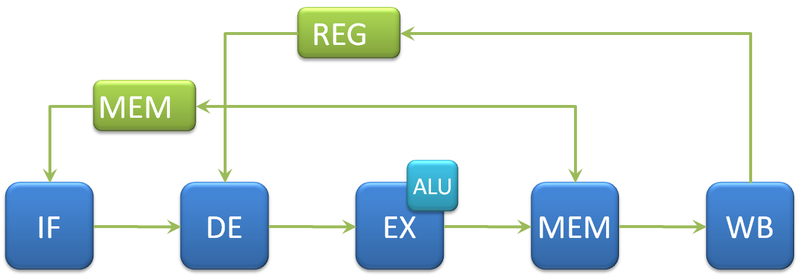
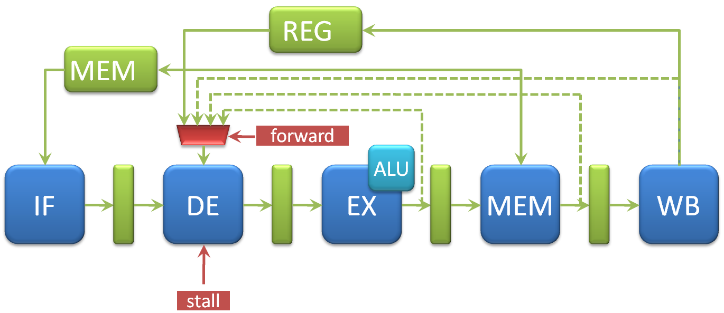
Application Example: Pipelined Processors
Synthesizing Multiple Boolean Functions using Interpolation on a Single Proof
Basic elements are the same
use uninterpreted
functions
=
Burch & Dill Paradigm
(see Hofferek, Bloem, MemoCODE’11)

Slide 7
Overview
Synthesizing Multiple Boolean Functions using Interpolation on a Single Proof
Motivation: Pipeline Controller
Synthesis Problem → Quantified Formulas
Interpolation
  Single
  Multiple
Proof Requirements
  Colorable
  Local-First
Proof Transformations
Results & Conclusion

Slide 8
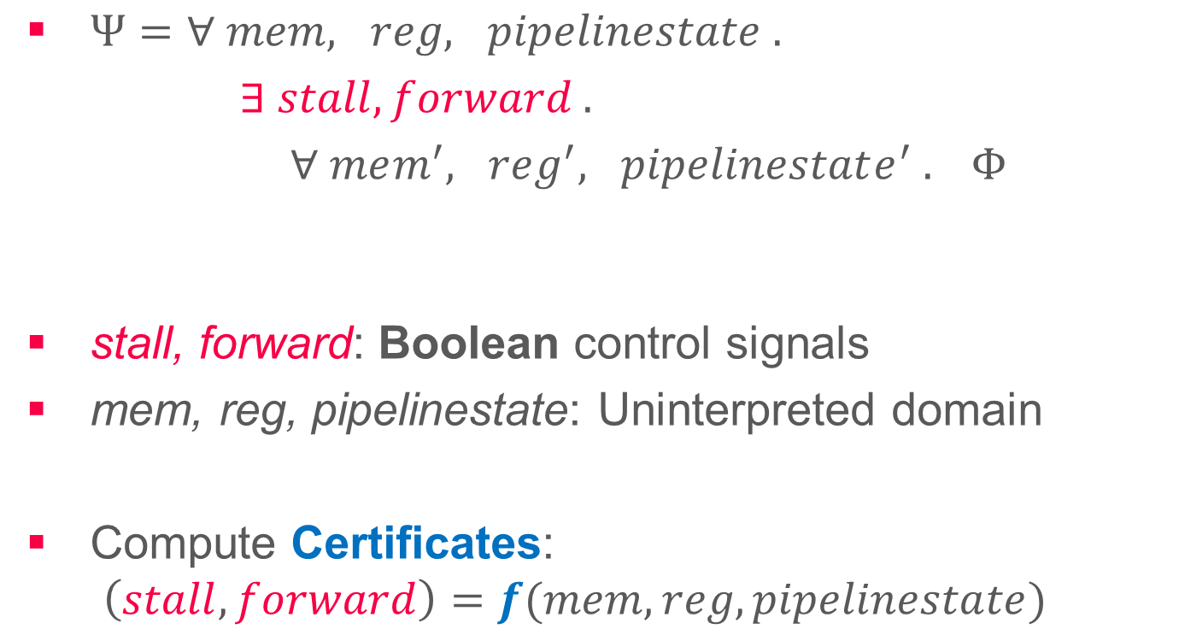
Synthesis Problem → Quantified Formulas
Synthesizing Multiple Boolean Functions using Interpolation on a Single Proof
$Ψ=∀ mem, reg, pipelinestate .$
$∃ stall, forward .$
$∀ mem^{′}, reg^{′}, pipelinestate^{′} . Φ$
stall, forward: Boolean control signals
mem, reg, pipelinestate: Uninterpreted domain
Compute Certificates:
$\left(stall, forward\right)=f(mem, reg, pipelinestate)$

Slide 9

Craig Interpolant
Synthesizing Multiple Boolean Functions using Interpolation on a Single Proof
9
$$CNF\left(Φ\right)=C_{1} ∧ C_{2} ∧ C_{3} ∧…∧ C_{n−1} ∧ C_{n}= ⊥$$
Interpolant $I$:
$A→I$
$I→¬B$, in other words: $I∧B= ⊥$
$V\left(I\right)⊆V\left(A\right) ∩ V(B)$
A
B
B
I
A

Slide 10


Expanding Formula for Single Interpolation
Synthesizing Multiple Boolean Functions using Interpolation on a Single Proof
10
$∀\overset{⃑}{a} ∃c ∀ \overset{⃑}{b} . Φ \left(\overset{⃑}{a},c,\overset{⃑}{b}\right)$ is valid
$\left(¬Φ\left(\overset{⃑}{a},{0,\overset{⃑}{b}}_{0}\right)∧¬Φ\left(\overset{⃑}{a},1,{\overset{⃑}{b}}_{1}\right)\right)$ is unsatisfiable
Expansion of $∃$
Renaming of $\overset{⃑}{b}$
Negation

Slide 11
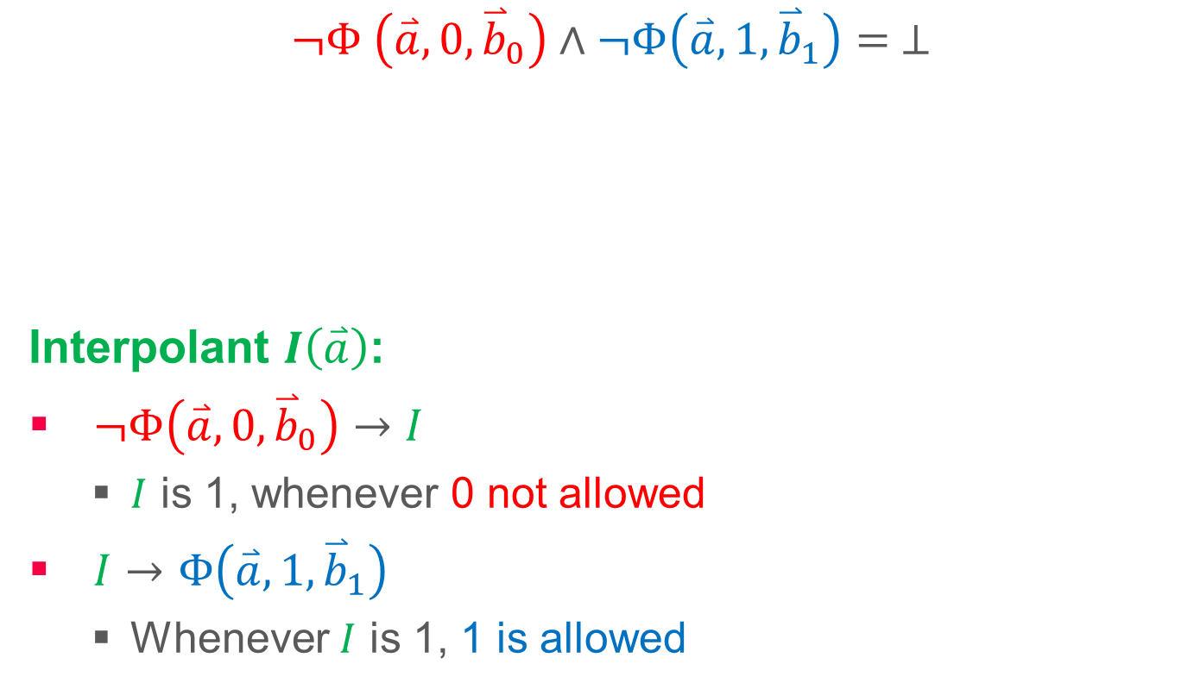
Certificate via Interpolation
Synthesizing Multiple Boolean Functions using Interpolation on a Single Proof
11
$¬Φ \left(\overset{⃑}{a},0,{\overset{⃑}{b}}_{0}\right)∧¬Φ\left(\overset{⃑}{a},1,{\overset{⃑}{b}}_{1}\right)= ⊥$
Interpolant $I\left(\overset{⃑}{a}\right)$:
$¬Φ\left(\overset{⃑}{a}, 0,{\overset{⃑}{b}}_{0}\right)→I$
  $I$ is 1, whenever 0 not allowed
$I→Φ\left(\overset{⃑}{a},{1,\overset{⃑}{b}}_{1}\right)$
  Whenever $I$ is 1, 1 is allowed
A
B
0 not allowed
1 not allowed
Boolean Case: see Jiang et al., ICCAD’09

Slide 12
Multiple Control Signals
Synthesizing Multiple Boolean Functions using Interpolation on a Single Proof
12
Interdependence!
  e.g. two signals must have same value
Iterative Resubstitution
  Many SMT calls
  Increasing “difficulty”
Multiple Coordinated Interpolants
  ☺ Only one proof required
  ☹ Special requirements towards proof

Slide 13
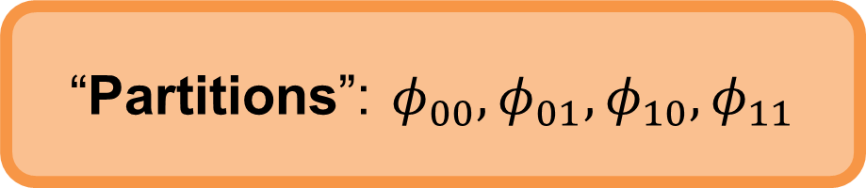

Expansion for Multiple Interpolants
Synthesizing Multiple Boolean Functions using Interpolation on a Single Proof
13
Formula:
$∀\overset{⃑}{a} ∃c_{0},c_{1} ∀ \overset{⃑}{b} . Φ \left(\overset{⃑}{a},\overset{⃑}{b},c_{0},c_{1}\right)=⊤$
Expansion:
$$¬Φ \left(\overset{⃑}{a},{\overset{⃑}{b}}_{00},0,0\right) ∧ ¬Φ\left(\overset{⃑}{a},{\overset{⃑}{b}}_{10},1,0\right)∧$$
$$¬Φ\left(\overset{⃑}{a},{\overset{⃑}{b}}_{01},0,1\right)∧ ¬Φ\left(\overset{⃑}{a},{\overset{⃑}{b}}_{11},1,1\right)= ⊥$$
“Partitions”: $φ_{00}, φ_{01}, φ_{10},φ_{11}$

Slide 14
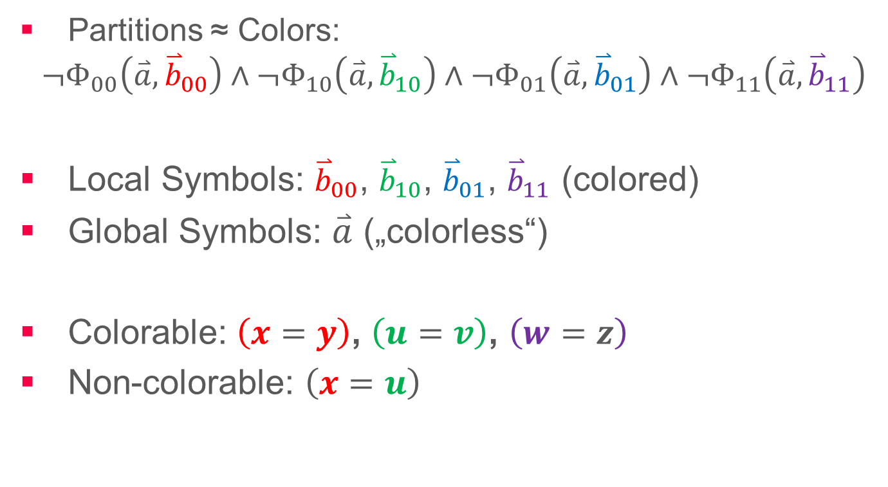
Definitions: Colorable, Local, Global
Synthesizing Multiple Boolean Functions using Interpolation on a Single Proof
14
Partitions ≈ Colors:
$$¬Φ_{00}\left(\overset{⃑}{a},{\overset{⃑}{b}}_{00}\right)∧¬Φ_{10}\left(\overset{⃑}{a},{\overset{⃑}{b}}_{10}\right)∧¬Φ_{01}\left(\overset{⃑}{a},{\overset{⃑}{b}}_{01}\right)∧¬Φ_{11}\left(\overset{⃑}{a},{\overset{⃑}{b}}_{11}\right)$$
Local Symbols: ${\overset{⃑}{b}}_{00}$, ${\overset{⃑}{b}}_{10}$, ${\overset{⃑}{b}}_{01}$, ${\overset{⃑}{b}}_{11}$ (colored)
Global Symbols: $\overset{⃑}{a}$ („colorless“)
Colorable: $\left(x=y\right)$, $\left(u=v\right)$, $\left(w=z\right)$
Non-colorable: $\left(x=u\right)$
Generalization of notions for single interpolation

Slide 15
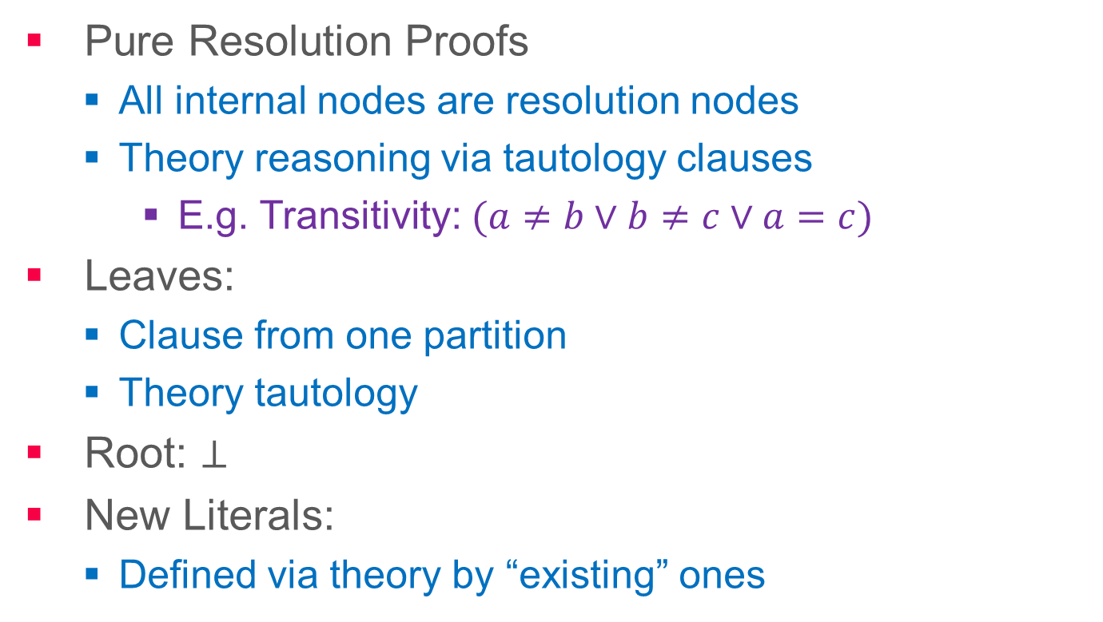
(Reasonable) Assumptions on Proofs
Synthesizing Multiple Boolean Functions using Interpolation on a Single Proof
15
Pure Resolution Proofs
  All internal nodes are resolution nodes
  Theory reasoning via tautology clauses
    E.g. Transitivity: $(a≠b∨b≠c∨a=c)$
Leaves:
  Clause from one partition
  Theory tautology
Root: $⊥$
New Literals:
  Defined via theory by “existing” ones
veriT Solver
[www.verit-solver.org]

Slide 16
Requirements towards Proof
Synthesizing Multiple Boolean Functions using Interpolation on a Single Proof
16
Colorability
  “No literals or leaves with symbols from two partitions”
  Achieved in two steps
    Remove non-colorable literals
    Split non-colorable leaves
Local-first
  “Local literals are resolved before global literals”
  Achieved by standard reordering

Slide 17




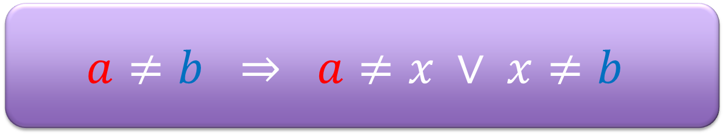
Removing non-colorable Literals
Synthesizing Multiple Boolean Functions using Interpolation on a Single Proof
17
$$a≠b ⇒ a≠x ∨ x≠b$$
Tautology (Transitivity),
“defining” $a≠b$
Tautology (Transitivity),
“using” $a≠b$
$$a≠x ∨ x≠b ∨ a=b$$
$$a≠b ∨ b≠y ∨ a=y$$
Replace

Slide 18
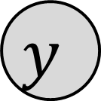





Split Non-Colorable Leaves
Synthesizing Multiple Boolean Functions using Interpolation on a Single Proof
18
$$a≠x ∨ x≠y ∨ a=y$$
$$x≠b ∨ b≠y ∨ x=y$$
$$a≠x ∨ x≠b ∨ b≠y ∨ a=y$$
$$x$$
$$a$$
$$b$$
$$y$$

Slide 19
Making Proof Local-First
Synthesizing Multiple Boolean Functions using Interpolation on a Single Proof
19
Standard Pivot Reordering Techniques
e.g. D’Silva, Kroening, Purandare, and Weissenbacher, VMCAI 2010

Slide 20


Computing Multiple Interpolants
Synthesizing Multiple Boolean Functions using Interpolation on a Single Proof
20
$$¬φ \left(\overset{⃑}{a},{\overset{⃑}{b}}_{0},0,0\right) ∧ ¬φ \left(\overset{⃑}{a},{\overset{⃑}{b}}_{1},1,0\right)∧¬φ \left(\overset{⃑}{a},{\overset{⃑}{b}}_{2},0,1\right)∧ ¬φ \left(\overset{⃑}{a},{\overset{⃑}{b}}_{3},1,1\right)$$
Local Literals 0
Local Literals 1
Local Literals 2
Local Literals 3
Global Literals
$$⊥$$
$I_{0}$ $I_{1}$

Slide 21

Computing Multiple Interpolants
Synthesizing Multiple Boolean Functions using Interpolation on a Single Proof
21
$$¬φ \left(\overset{⃑}{a},{\overset{⃑}{b}}_{0},0,0\right) ∧ ¬φ \left(\overset{⃑}{a},{\overset{⃑}{b}}_{1},1,0\right)∧¬φ \left(\overset{⃑}{a},{\overset{⃑}{b}}_{2},0,1\right)∧ ¬φ \left(\overset{⃑}{a},{\overset{⃑}{b}}_{3},1,1\right)$$
Constants
0, 0
Constants
1, 0
Constants
0, 1
Constants
1, 1
Multiplexer
Cf. Pudlaks’ Interpolation Procedure (JSL’97)
$$⊥$$
$I_{0}$ $I_{1}$

Slide 22
Experimental Results
Synthesizing Multiple Boolean Functions using Interpolation on a Single Proof
22
pipe: Illustrative pipeline example (MemoCODE’11)
  1.6 seconds instead of 14 hours
proc: Simple 2-stage pipelined processor
  2 control signals
  28.1 seconds
illu02-08: Scalable illustrative example
  2-8 control signals
  Mutual interdependence

Slide 23
Scalability: illu02-08
Synthesizing Multiple Boolean Functions using Interpolation on a Single Proof
08: 1270s

Slide 24
Conclusion
Synthesizing Multiple Boolean Functions using Interpolation on a Single Proof
24
Multiple Coordinated Interpolants
  just one proof
Uninterpreted Functions
  Good abstraction
    Concurrency issues
  Full potential unleashed
    No reductions to propositional logic
    Improvement: Several orders of magnitude
Future work
  Colorable and/or local-first proofs from SMT solver
  More theories (e.g. linear arithmetic)

Slide 26
Appendix
Synthesizing Multiple Boolean Functions using Interpolation on a Single Proof
Detailed slide on some issues that were left out of the main presentation for time reasons

Slide 27
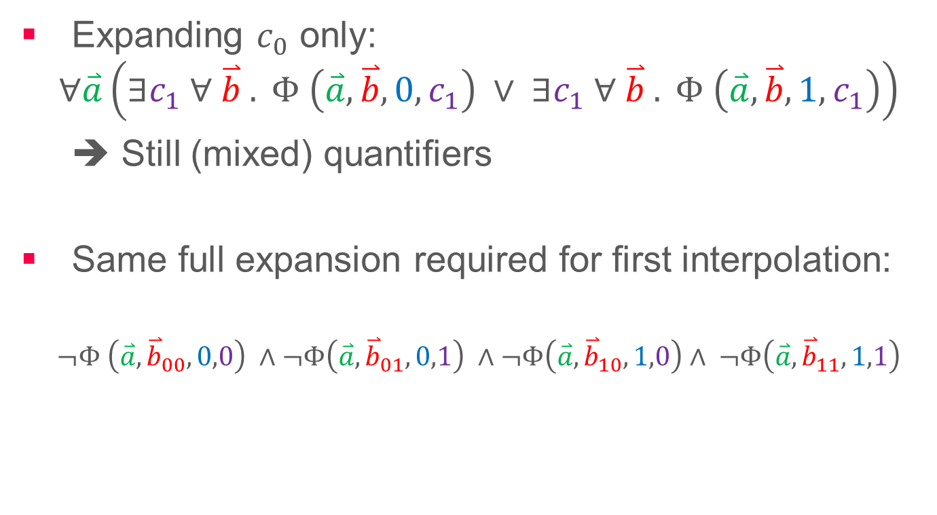
Resubstitution
Synthesizing Multiple Boolean Functions using Interpolation on a Single Proof
Expanding $c_{0}$ only:
$$∀\overset{⃑}{a}\left(∃c_{1} ∀ \overset{⃑}{b} . Φ \left(\overset{⃑}{a},\overset{⃑}{b},0,c_{1}\right) ∨ ∃c_{1} ∀ \overset{⃑}{b} . Φ \left(\overset{⃑}{a},\overset{⃑}{b},1,c_{1}\right)\right)$$
➔ Still (mixed) quantifiers
Same full expansion required for first interpolation:
$$¬Φ \left(\overset{⃑}{a},{\overset{⃑}{b}}_{00},0,0\right) ∧¬Φ\left(\overset{⃑}{a},{\overset{⃑}{b}}_{01},0,1\right) ∧¬Φ\left(\overset{⃑}{a},{\overset{⃑}{b}}_{10},1,0\right)∧ ¬Φ\left(\overset{⃑}{a},{\overset{⃑}{b}}_{11},1,1\right)$$
A
B

Slide 28

A Processor
Synthesizing Multiple Boolean Functions using Interpolation on a Single Proof
28
REG
MEM
ALU
IF
DE
EX
MEM
WB
How do I pipeline that?
Tough:
64-bit datapath
very complex arithmetic logic unit

Slide 29
A Pipelined Processor
Synthesizing Multiple Boolean Functions using Interpolation on a Single Proof
29
REG
MEM
ALU
IF
DE
EX
MEM
WB
That’s trivial!

Slide 30
A Pipelined Processor
Synthesizing Multiple Boolean Functions using Interpolation on a Single Proof
30
r1 = 1
r2 = 2
r1 = 15
r2 = 2
r1 = 15
r2 = 17
Instructions:
r1 := mem[1]
r2 := r1 + r2
REG
MEM
15
mem[1] = 15
ALU
IF
DE
EX
MEM
WB
r1 := mem[1]
r1 := mem[1]
r1 := mem[1]
r1 := 15
r2 := r1 + r2
r2 := 15 + 2
r2 := 17
r2 := 17
stall
15
forward

Slide 31
A Pipelined Processor
Synthesizing Multiple Boolean Functions using Interpolation on a Single Proof
31
REG
MEM
forward
ALU
IF
DE
EX
MEM
WB
Not so trivial!
stall
☹ Hard to implement
☹ Hard to test
☺ Easy to specify

Slide 32
Sufficient Condition: Commutative Diagram
Synthesizing Multiple Boolean Functions using Interpolation on a Single Proof
32
Burch & Dill, for verification
non-
pipelined
instr1
instr2
instr3
=
flush
flush
=
instr1
instr2
instr3
pipelined
flushed
flushed
Pipelined and non-pipelined processor give same result for any instruction sequence

Slide 33
Commutative Diagram in Logic
Synthesizing Multiple Boolean Functions using Interpolation on a Single Proof
33
Burch & Dill, for verification
non-
pipelined
instr
flush
flush
ALU
instr
EX
pipelined
ψ =
(mem’,reg’) = flush ⋅ non-pipe-instr (mem,reg) ∧
(mem’’,reg’’) = pipe-instr ⋅ flush (mem,reg)
→ (mem’,reg’) = (mem’’,reg’’)
Pipeline correct iff ψ valid.

Slide 34
Commutative Diagram in Logic
Synthesizing Multiple Boolean Functions using Interpolation on a Single Proof
34
Burch & Dill, for verification
non-
pipelined
instr
flush
flush
ALU
instr
EX
pipelined
ψ written in logic with uninterpreted functions, arrays, and equality
Part of ψ:
res_ex = ALU(opc_de, arg1_de, arg2_de)

Slide 35

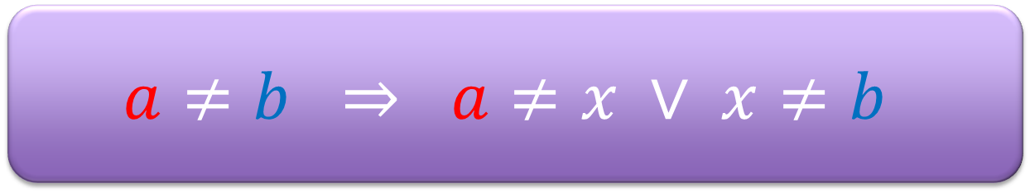
Removing non-colorable Literals
Synthesizing Multiple Boolean Functions using Interpolation on a Single Proof
35
$$a≠b ⇒ a≠x ∨ x≠b$$
Tautology (Transitivity)
Tautology (Transitivity)
$$a≠x ∨ x≠b ∨ a=b$$
$$a≠b ∨ b≠y ∨ a=y$$
Replace
$$a≠x ∨ x≠b ∨ b≠y ∨ a=y$$

