Slide 1
Firmware Validation: Challenges & Opportunities
Jim Grundy

Slide 2
THIS PRESENTATION CONTAINS THE GENERAL INSIGHTS AND OPINIONS OF INTEL CORPORATION (INTEL). THE INFORMATION IN THIS PRESENTATION IS PROVIDED FOR INFORMATION ONLY AND IS NOT TO BE RELIED UPON FOR ANY OTHER PURPOSE THAN EDUCATIONAL. USE AT YOUR OWN RISK! INTEL MAKES NO REPRESENTATIONS OR WARRANTIES REGARDING THE ACCURACY OR COMPLETENESS OF THE INFORMATION IN THIS PRESENTATION. INTEL ACCEPTS NO DUTY TO UPDATE THIS PRESENTATION BASED ON MORE CURRENT INFORMATION. INTEL IS NOT LIABLE FOR ANY DAMAGES, DIRECT OR INDIRECT, CONSEQUENTIAL OR OTHERWISE, THAT MAY ARISE, DIRECTLY OR INDIRECTLY, FROM THE USE OR MISUSE OF THE INFORMATION IN THIS PRESENTATION.

Slide 3
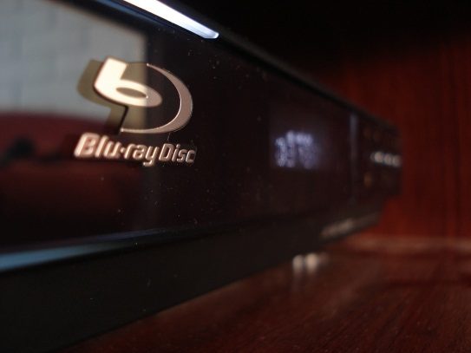
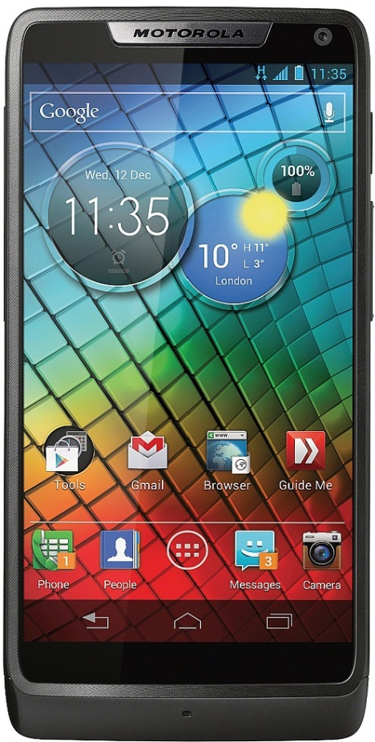
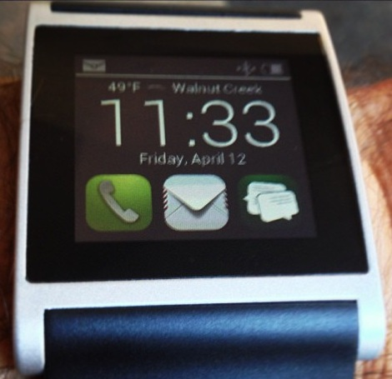
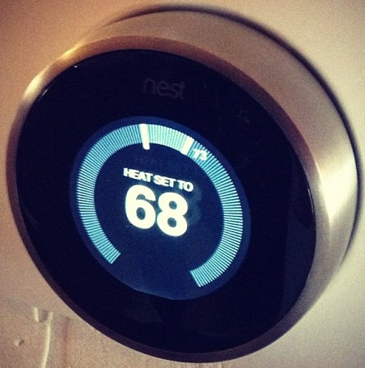
Firmware is everywhere
Image © 2008 Diego Correa
Used under the terms of the
Creative Commons – Attribution 2.0 License
Image © 2012 Intel Corporation
Image © 2013 Michael Sheehan
Used under the terms of the
Creative Commons – Attribution 2.0 License
Image © 2012 Aaron Miszalski
Used under the terms of the
Creative Commons – Attribution 2.0 License
Image © 2013 Intel Corporation
* Other names and brands may be claimed as the property of others.

Slide 4
But … is anything really “firmware”?
Smart devices sport capable processors and general purpose operating systems.
Is software for smart devices different to traditional software?
Table 1. Technical Specifications
High-performance Processors | • 2.0 GHz (Z2580) • 1.6 GHz (Z2560)
Intel® Atom™ Microarchitecture | • Intel® Smart Cache, 512 KB per core • Advanced 32nm, dual-core Intel architecture …
System Memory Interface | • Total capacity up to 2 GB • Supports up to 1066 MT/s (533MHz) data rate
Source: Product Brief – Intel® AtomTM Processors Z2580, Z2560, Z2520 for Smartphones and Tablets

Slide 5
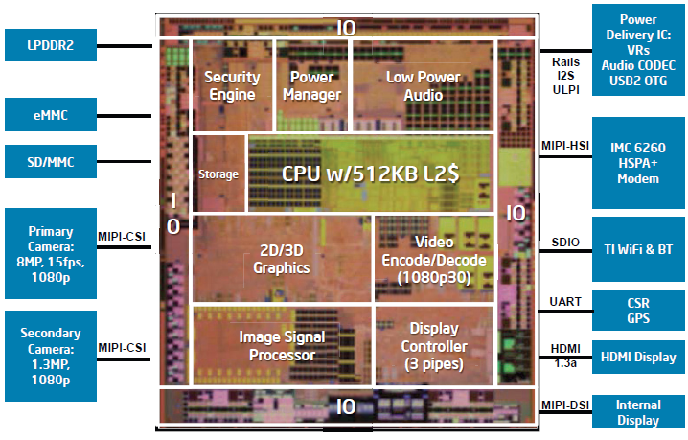
That isn’t firmware
Intel® AtomTM Z2480 Processor Block Diagram
This is firmware…
“[a] micro-controller called the Power Manager handles … fine-grained control of the … power islands. The operating system … controls power only indirectly by specifying the desired … states to the Power Manager.”
Source: R. Zhair, M. Ewert, H Seshardri. The Medfield Smartphone: Intel® Architecture in a Handheld Form Factor. IEEE Micro. 2013.

Slide 6
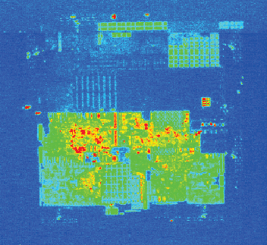
Firmware in action
Q: Media is playing … the CPU is powered off … how?
Source: R. Zhair, M. Ewert, H Seshardri. The Medfield Smartphone: Intel® Architecture in a Handheld Form Factor. IEEE Micro. 2013.
A: The devices are getting smarter.

Slide 7
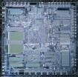
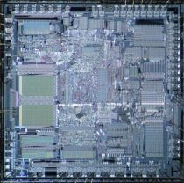
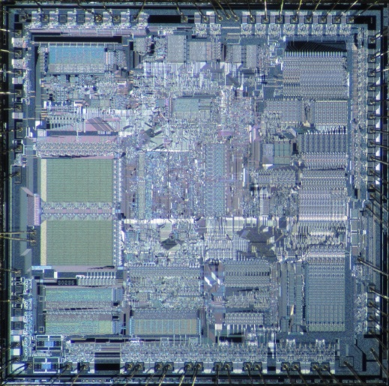
The problem of programming tiny machines is not going away
Image © 2013 Pauli Rautakorpi
Used under the terms of the Creative Commons – Attribution 2.0 License

Slide 8
Outline
What is firmware?
What makes firmware validation so important?
What does firmware look like?
Research needs
Case studies for researchers

Slide 9
(non-technical) Definition of Firmware
A software component that
Must be functional before the associate hardware ships
Is difficult/costly/undesirable to patch after shipping
So defined
Includes the lowest level software in a product
Software that interacts directly with hardware
May include some of the higher-level software as well
Says nothing about what firmware looks like.
But this definition is useful because
People get an immediate sense of its importance.
We can find technical commonalities in such software.

Slide 10
Outline
What is firmware?
What makes firmware validation so important?
What does firmware look like?
Research needs
Case studies for researchers

Slide 11
Amount of firmware is growing fast
Reduce design cost and add schedule predictability
Moving control to firmware simplifies the hardware.
Configurability allows hardware to function in many products.
Firmware is easily updated prior to shipping.
Makes first silicon more likely to be production silicon.
More efficiently process data at the edge
Efficient to process data with silicon accelerators.
Minimizes traffic to locate those accelerators in the devices.
Requires richer control algorithms in the devices.
More sophisticated behavior than possible through software visible interfaces.
HW/SW interfaces are standards. They change slowly.
OS power management is an example.

Slide 12
Firmware Validation Criticality is Higher Than Software
From the definition that firmware is software that:
Is difficult/costly/undesirable to patch after shipping
Then it is also the software you particularly want to get right before shipping
Why?
Q: Can’t firmware be patched?
A: Yes, but firmware typically isn’t patched once the product is in the customer’s hands.
Q: My <insert-device> installs updates all the time. Aren’t those firmware update?
A: Those are mostly software updates (by definition).

Slide 13
Why is firmware hard to update?
A technical reason: Criticality
Failed updates are a remote but inescapable possibility.
Lower level failed updates are harder to recover from.
Lower level updates must meet a risk/reward analysis.
Often left to users to install rather than being pushed.
The real reason: Rich supply chains
Devices reach customers though deep chains. My phone:
Is sold by a carrier that handles customer and network issues
Is made by a vendor
Runs an operating system from another vendor
On an SoC from yet another vendor
That integrates IP blocks from multiple vendors: radio, usb, …
Only the top layer(s) maintain a connection to the device.

Slide 14
Firmware Validation Schedule Criticality is Higher than Software
Schedule predictability is important for hardware and software projects. But, more critical for hardware:
Threshold for software update is lower
Last features can be added and last bugs fixed post launch.
Post release update relieves schedule pressure.
Hardware manufacturing capacity is expensive.
Efficient manufacturing capacity scheduling is vital.
Manufacturing efficiency increases schedule pressure.
From the definition that firmware is software that
Must be functional before the associate hardware ships
Firmware schedule criticality is like that of hardware.

Slide 15
Opportunity to test firmware is smaller than software
Pre-silicon: you must
Use a software model of the silicon – takes effort
Use a simulator – takes time
Use an emulator – takes money
Post-silicon: you must
Resolve issues quickly
In an environment with less observability than software.

Slide 16
Firmware/Hardware interfaces are “dynamic”
When two software modules are integrated in a system and one hasn’t followed the interface:
The offending module is fixed
The interface is unchanged
When hardware and firmware are integrated, and the hardware hasn’t followed the interface:
The interface is revised
The firmware is “fixed”

Slide 17
Opportunity for Formal Methods (the non-technical ones)
Firmware needs your research
Quality must be high.
Hard to achieve the needed quality through testing.
The challenge is to develop methods that:
Deliver understandable confidence in predictable time.
Are fast to re-apply when there is change.

Slide 18
Opportunity for Formal Methods: Examples
Static Analysis: Easiest technique to propagate
Needs little integration with development environment
Assurance achieved is understandable
Time to apply is predictable
Deals well with change
Maximizes value of pre-Si test by removing bugs first
Dynamic Analysis: Can formal choose the best tests?
Pre-Si dynamic analysis is expensive
Can static analysis be used to increase the effectiveness?
Many practically challenges … see later slides.

Slide 19
Outline
What is firmware?
What makes firmware validation so important?
What does firmware look like?
Research needs
Case studies for researchers

Slide 20
Firmware: Language & Runtime
Firmware is written in C
With essential use of embedded assembler
Pre-Si test rigs model hardware in a variety of languages
Firmware runs directly on a microcontroller
Most applications have no OS or runtime
Usually only a single thread of execution
Firmware runs with limited resources
Do not assume 32-bit μ-controllers
Do not assume the μ-controller is fast
May need more memory than μ-controller has address bits
Stack depth can be limited

Slide 21
Firmware/Hardware interaction
Software uses standard abstractions to interact
Software/software uses standard abstraction: call/return
Compilers ensure consistent call/return for each interface
No standard abstraction to encapsulate interaction
Many firmware/hardware interaction patterns exist: interrupts, memory mapped IO, special purpose registers
Interactions typically have a temporal aspect
This occurs in software too – at the problematic interfaces
Easy | Hard
time_t time(time_t*)
lock
Unlocked
Locked
access
unlock

Slide 22
Firmware/Hardware Concurrency
Firmware operates concurrently with its hardware.
Firmware operates concurrently with other agents.
Agent
Agent
Agent
Agent
Firmware
Hardware

Slide 23
Radio Firmware
Power Manager
Radio
CPU
Audio
Call
Request CPU
Wake
Awake
Done
Incoming Call
Goto Call Power State
Wake
Wake
Awake
Awake
Done
Answer

Slide 24
So firmware is like software but…
Like the software in one agent of a concurrent system.
But with low-level interface code written by hand.
Resources are in short supply, and you have to manage them manually.

Slide 25
Transition to Oxford interface example

Slide 26
Interface Checking Example
TMP 105 Temperature Sensor
Effective Validation of Firmware
Tom Melham
University of Oxford

Slide 27
Project Approach
Firmware
Φ
Verilog
C + x86
HW Model
Hardware
Host Model
C
CBMC

Slide 28
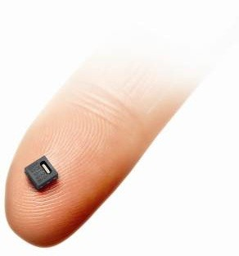
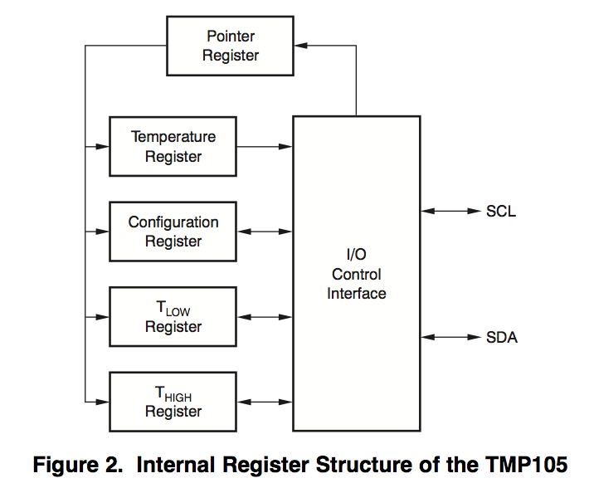
TMP105 - Temperature Sensor
http://www.envirotech-online.com/news/environmental-laboratory/7/sensirion/new_low-cost_humidity_and_temperature_sensor_for_high_production_volumes/20127/
http://www.ti.com/lit/ds/symlink/tmp105.pdf
Notes:
Depending on the level of detail you want to dive into, this slide might help to usher people into thinking about firmware from a more technical perspective.
Here are some things to think about:
* There are four external registers of different sizes.
* Most are readable and writeable (rw), but at least one is read-only.
* Temperature measurements can be continuous or not (shutdown mode)
…
But how could we specify the hardware/software interface so the specification becomes part of the development lifecycle?

Slide 29
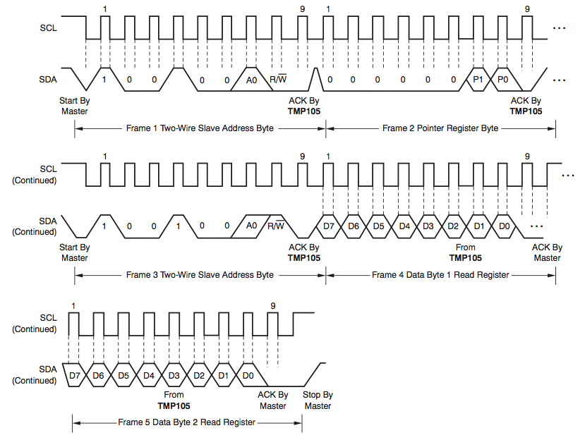
Protocol to Read a Register
http://www.ti.com/lit/ds/symlink/tmp105.pdf
Notes:
The point of this diagram is this: how should hardware and software teams communicate hardware/software interfaces? The wave form above gives semi cycle-accurate details about the I2C protocol for interacting with the temperature sensor. But what does this mean from a firmware developer’s perspective in the early stages of development? When creating a new product, a higher-level description of the protocol is sought (see next slide).

Slide 30
Early Abstraction
Write byte over bus
to select register
from which to read

Slide 31
Early Abstraction
Write byte over bus
to select register
from which to read
2) First, read most
significant byte

Slide 32
Early Abstraction
Write byte over bus
to select register
from which to read
2) First, read most
significant byte
3) Optionally, read
another byte …

Slide 33
Early Abstraction
Protocol Constraints
What registers are
readable (step 1).
How many bytes can be read (step 2, 3).
Conditions under which read can be done.

Slide 34
Project Approach
Firmware
Φ
Verilog
C + x86
HW Model
Hardware
?
Host Model
C
CBMC

Slide 35
QEMU Virtual Prototype
Firmware
Φ
C
C + x86
HW Model
QEMU
Host Model
C
Open source virtual machine emulator
CBMC

Slide 36
TMP105 in QEMU
QEMU code of the TMP105 hardware model
=
language to express interface properties
At most two bytes can be read or written of the temperature threshold registers.
Exactly one configuration byte can be read or written.
Each read of the temperature register is preceded by a write of a 1 to the MSB of the configuration register if and only if its LBS is a 1 (i.e. shutdown mode).
But when the MSB of the configuration register is read, it is 0 regardless of any previous writes to it.
Notes:
Unlike mathematical formulas, the QEMU code is a language more developers are familiar with. The semantics of the code is given by a given through symbolic execution and the theory (e.g. bit vectors or LIA) to which the formulas below.

Slide 37
TMP105 in QEMU
Benefits of properties as runtime assertions
Code more familiar to developers than formulas
Properties can be also checked by simulation (appeals to existing testing disciplines)
Unrestricted flexibility
Downsides
No independent logical semantics
Extra information may need to be carried in hardware models to check properties

Slide 38
Return to Intel firmware talk

Slide 39
Outline
What is firmware?
What makes firmware validation so important?
What does firmware look like?
Research needs
Case studies for researchers

Slide 40
Research: Interface Capture
We lack a precise language to capture how hardware and firmware request services of each other.
IP-XACT* (IEEE 1685*) captures physical aspects
Where are the ports (memory addresses, registers, ...).
What is their bit-wise layout, and read/write permission.
Required use patterns are not captured by current languages. E.g., to set the power/frequency of an attached device:
Write a byte (describing a voltage) to some register, then
Write the low-byte of a frequency to another register, then
Write high-byte of the frequency to the same register, then
Write a byte (voltage-domain-id) to a third register
* Other names and brands may be claimed as the property of others.

Slide 41
Research: Interface Exploitation
Can we check firmware complies with the interface?
Like driver/OS checking work, but on two temporal levels
Sequences of operations to request a service
Sequences of service requests
Can we generate code from the interface to raise the service request abstraction to something like a call?
Generate functions for firmware to request a hardware service.
Generate polling/interrupt code to call programmer written functions for hardware to request a firmware service.
Can we generate deep test collateral from interfaces?
Tests from IP-XACT exercise only shallow properties.
Generating validation collateral from the interface will reduce inconsistency and firmware adaptation later.

Slide 42
Research: Firmware Semantic Tools
C semantics is rich, but well understood
But, firmware combines C with inline assembler
Tool support is all but absent
Must be reasoned about with its environment.
The environment is hardware.
Has a different execution model to (single threaded) C.
Hardware models exist in challenging languages
C++, SystemC, RTL
Another reason to capture an abstraction of the interface

Slide 43
Research: System Level Sketches
Can system-level use cases help validate agent firmware?
Infer allowable sequences of messages at each agent.
Does agent respond to all legal incoming request sequences?
Can agent produce illegal sequences of outgoing requests?
Can we generate firmware tests?
Long legal prefixes more valuable than random traffic.
System-level validation is hard.
Can system-level use cases find system-level bugs with agent level analysis?

Slide 44
Research Needs: Solutions To “Solved” Problems
Powerful processors, operating systems, and run-times have banished whole classes of bugs from software.
Virtual memory vs. manual paging.
Garbage collection vs. manual memory management.
Pre-emptive scheduling vs. manual scheduling.
Can formal solve resource problems another way?
Generate or check paging code.
Check memory allocation and return.
Generate or check static scheduling of code.

Slide 45
Research: Languages
C dominates: can we do no better after 40 years?
Domain favors static analysis; can a language enables more static analysis?
Eco-system (libraries, debuggers, …) and experience too valuable. Keep ABI:
Object file format – Data sizes, alignments – Calling conventions
C dominates because it fits the domain
Procedural/imperative programming
Small runtime (essential libraries)
Opportunity: Reduce the need for inline assembly
Raise the abstraction level and avoids bugs
Blocks formal analysis at a key point: the hardware/software interface
Why do people still write assembly?
Precise memory accesses: reads, writes, and their order effect hardware
Precise bit-level layout: bit-fields give insufficient control of layout and access
μ-controller specific IO features (instructions/registers/interrupts)
Opportunity: Type systems add value without dynamic overhead
Correct operation sequencing is key, can types help?
Pointer manipulation remains error prone, types can help.
Resource uncertainty drives impacts programming and hinder reuse.

Slide 46
Experience: Concolic Firmware Test
What:
Test generation to maximize code coverage by symbolic analysis of concrete traces
Why:
Developers understand testing and coverage
Finds bugs without complete specifications
Can scale to firmware and can find bugs. But…
#1 issue is understanding the HW/SW interface
Every firmware project has a different HW/SW interface
Software models of hardware may exist, but maybe not C
Embedded assembly impacts source or IR trace analysis

Slide 47
Outline
What is firmware?
What makes firmware validation so important?
What does firmware look like?
Research needs
Case studies for researchers

Slide 48
Research Case Study Selection
Hard to find case studies to drive firmware research
Embody full and realistic firmware systems
Are open to academic examination
Few open source firmware projects
Most have a single agent rather than a system of agents
Most assume a full embedded Linux stack
Researchers need to develop own case studies
Large enough to include elements of real firmware
Small/modular/fun enough to be built by student teams

Slide 49
Open Source Inspiration: RockBox
Open source firmware for personal music players
Can serve as an exemplar of firmware code
Programmed in C with a little assembler
Assumes relatively constrained resources
Provides its own runtime and scheduler
Abstracts device communication steps into services
Hardware interface models are absent
Application and device interaction combined
Single agent style of firmware

Slide 50
Open Source Inspiration: QEMU
Software model of a PC, including common devices
Can serve as a source of analyzable device models
Firmware/Hardware issues recur at Device/Driver
Driver/Kernel interaction well studied but Device/Driver less
Not all Hardware/Firmware issues recur with Drivers
Firmware exists to abstract interfaces for drivers
Firmware has finer grained control than exposed to drivers
Firmware runs in resource constrained environment
Drivers have less need for embedded assembly
Faux OO coding style is atypical of firmware

Slide 51
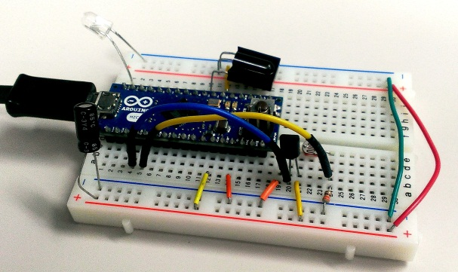
Realistic Firmware Case Study
Multiple 8-bit/16-bit μ-controllers
Attached devices
All device control local
FPGA a bonus
Small Microcontroller Image Copyright 2013 Sho Hashimoto.
Used under the terms of the Creative Commons – Attribution 2.0 License
* Other names and brands may be claimed as the property of others.

Slide 52
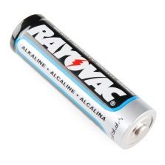
Realistic Firmware Case Study
A limited power budget for them
Battery Image Copyright 2013 SparkFun electronics.
Used under the terms of the Creative Commons – Attribution 2.0 License
* Other names and brands may be claimed as the property of others.

Slide 53
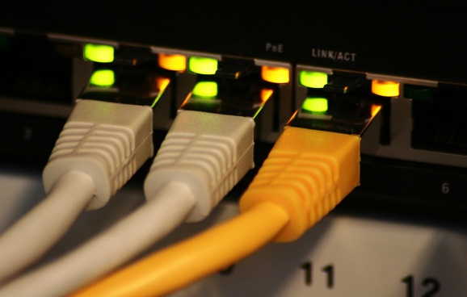
Realistic Firmware Case Study
An “on-die” network
Switch Image Copyright 2007 Felix Triller.
Used under the terms of the Creative Commons – Attribution 2.0 License
* Other names and brands may be claimed as the property of others.

Slide 54
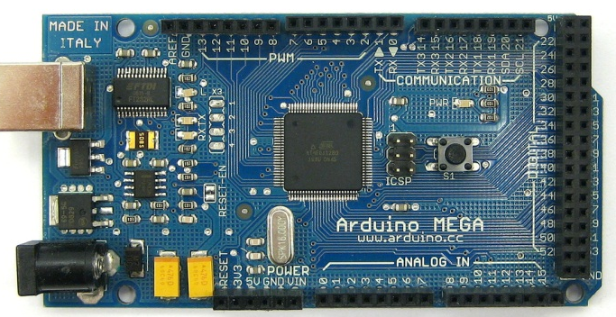
Realistic Firmware Case Study
Central power controller
Large Microcontroller Image Copyright 2007 Felix Triller.
Used under the terms of the Creative Commons – Attribution 2.0 License
* Other names and brands may be claimed as the property of others.

Slide 55
Realistic Firmware Case Study
CPU for application level functionality
Phone Image Copyright 2013 Intel Corporation.
* Other names and brands may be claimed as the property of others.

Slide 56
Example: Multi-zone audio service
Per-room firmware
8-bit/16-bit $μ$-controller
Decode audio streams locally
Sensors detect presence of listeners for power savings
Basic function (play/pause?) that requests high level help
Central firmware services
Power management
Audio storage and streaming
Firmware update and distribution
Check firmware updates are authentic, consistent, fresh
Application services
User interface

Slide 57
Questions?

