Slide 1
Verifying Periodic Programs with Priority Inheritance Locks
Sagar Chaki¹, Arie Gurfinkel¹,
Ofer Strichman²
FMCAD, October 22, 2013
¹Software Engineering Institute, CMU
²Technion, Israel Institute of Technology

Slide 2
Copyright 2013 Carnegie Mellon University
This material is based upon work funded and supported by the Department of Defense under Contract No. FA8721-05-C-0003 with Carnegie Mellon University for the operation of the Software Engineering Institute, a federally funded research and development center.
Any opinions, findings and conclusions or recommendations expressed in this material are those of the author(s) and do not necessarily reflect the views of the United States Department of Defense.
NO WARRANTY. THIS CARNEGIE MELLON UNIVERSITY AND SOFTWARE ENGINEERING INSTITUTE MATERIAL IS FURNISHEDON AN “AS-IS” BASIS. CARNEGIE MELLON UNIVERSITY MAKES NO WARRANTIES OF ANY KIND, EITHER EXPRESSED OR IMPLIED, AS TO ANY MATTER INCLUDING, BUT NOT LIMITED TO, WARRANTY OF FITNESS FOR PURPOSE OR MERCHANTABILITY, EXCLUSIVITY, OR RESULTS OBTAINED FROM USE OF THE MATERIAL. CARNEGIE MELLON UNIVERSITY DOES NOT MAKE ANY WARRANTY OF ANY KIND WITH RESPECT TO FREEDOM FROM PATENT, TRADEMARK, OR COPYRIGHT INFRINGEMENT.
This material has been approved for public release and unlimited distribution except as restricted below.
This material may be reproduced in its entirety, without modification, and freely distributed in written or electronic form without requesting formal permission. Permission is required for any other use. Requests for permission should be directed to the Software Engineering Institute at permission@sei.cmu.edu.
DM-0000695

Slide 3
Periodic Embedded Real-Time Software
Avionics Mission System*
Rate Monotonic Scheduling (RMS)
Task | Period
weapon release | 10ms
radar tracking | 40ms
target tracking | 40ms
aircraft flight data | 50ms
display | 50ms
steering | 80ms
Domains: Avionics, Automotive
OS: OSEK, VxWorks, RTEMS
We call them periodic programs
*Locke, Vogel, Lucas, and Goodenough. “Generic Avionics Software Specification”. SEI/CMU Technical Report CMU/SEI-90-TR-8-ESD-TR-90-209, December, 1990

Slide 4
Context: Time-Bounded Verification [FMCAD’11, VMCAI’13]
Periodic Program
  Collection of periodic tasks
    Execute concurrently with preemptive priority-based scheduling
    Priorities respect RMS
    Communicate through shared memory
Time-Bounded Verification
  Assertion A violated within X ms of a system’s execution from initial state I?
    A, X , I are user specified
    Time bounds map naturally to program’s functionality (e.g., air bags)
Locks
    CPU-locks, priority ceiling protocol locks [FMCAD’11, VMCAI’13]
    priority inheritance protocol locks
Main focus of this paper
Notes:
PIP locks cause blocking and deadlocks

Slide 5
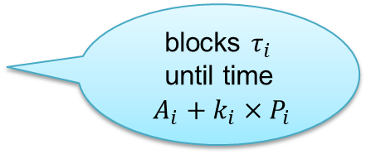

Periodic Program (PP)
An N-task periodic program PP is a set of tasks {τ₁, …, τ_{N}}
A task τ is a tuple ⟨I, T, P, C, A⟩, where
  I is a task identifier = its priority
  T is a task body (i.e., code)
  P is a period
  C is the worst-case execution time
  A is the release time: the time at which task becomes first enabled
Semantics of PP bounded by time X is given by an asynchronous concurrent program:
k_{i} = 0;
while (k_{i} < J_{i} && Wait(τ_{i}, k_{i}))
T_{i} ();
k_{i} = k_{i} + 1;
blocks $τ_{i}$
until time
$A_{i}+k_{i}×P_{i}$
parallel
execution
w/ priorities
$$J_{i}= \frac{X}{P_{i}}$$

Slide 6
Priority Inheritance Protocol (PIP)
Ensure mutual exclusion when accessing shared resources
Works by dynamically raising and lowering thread priorities
  Lock:
    If lock, is available, grab it.
    Otherwise, block; the thread holding the lock “inherits” my priority
  Unlock: Release lock. Return to normal priority.
Provably avoids the priority inversion problem
  High-priority task is blocked on a lock held by low-priority task
However, incorrect usage leads to deadlocks
  In contrast to priority ceiling locks and CPU locks [FMCAD’11, VMCAI’13]

Slide 7
Our Contributions
Time-bounded verification of reachability properties of PP with PIP locks
  Based on sequentialization [LR08], but supports PIP locks
  Challenge: # sequentialization rounds needed for completeness cannot be statically determined
  Insight: whether more rounds needed can be statically determined
  Solution: Iterative-deepening search with fixed point check
Deadlock detection in PPs with PIP locks
  Builds dynamically the Task-Resource Graph
  Aborts if a cycle in that graph is detected
Implementation and Empirical Evaluation

Slide 8





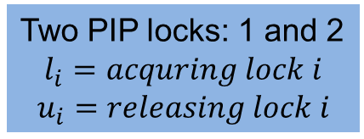

Example: A Periodic Program
Two PIP locks: 1 and 2
$$l_{i}=acquring lock i$$
$$u_{i}=releasing lock i$$
0
1
2
3
4
5
6
7
8
9
10
$l_{2} u_{2}$
$$τ_{2}$$
2
Priority Level
$l_{2} l_{1}{ u}_{2} { u}_{1}$
$$τ_{1}$$
1
0
$l_{1} u_{1}$
$$τ_{0}$$
Task | Prio (I₁) | WCET (C_{i}) | Period (P_{i}) | Arrival Time (A_{i})
τ₂ | 2 | 2 | 10 | 2
τ₁ | 1 | 4 | 20 | 1
τ₀ | 0 | 3 | 40 | 0

Slide 9





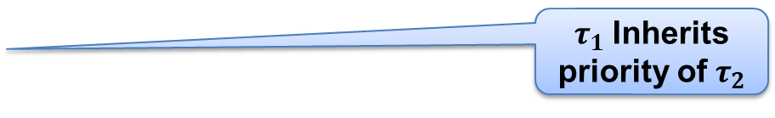


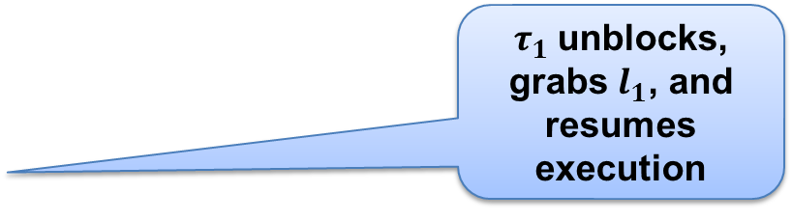






Example: One Schedule
$τ_{1}$unblocks, grabs $l_{1}$, and resumes execution
0
1
2
3
4
5
6
7
8
9
10
2
$l_{2}^{∗}$
$l_{1}^{∗}$
$u_{1}$
$u_{2}^{}$
$u_{2}$
$τ_{1}$Inherits priority of $τ_{2}$
Priority Level
$l_{2}$
$u_{1}$
1
0
$l_{1}$
$$↑$$
$$↑$$
$$∗$$
$$∗$$
$$↑$$
$$↑$$
$$↓$$
$$↓$$
$$↓$$
Note: A scheduling point is either a preemption ($↑$), a block (*), or a job end ($↓$)

Slide 10
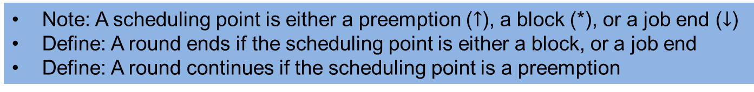

Example: Viewing as a Round-Based Schedule
0
1
2
3
4
5
6
7
8
9
10
2
$l_{2}^{∗}$
$l_{1}^{∗}$
$u_{1}$
$u_{2}^{}$
$u_{2}$
Priority Level
$l_{2}$
$u_{1}$
1
0
$l_{1}$
$↑ ↑ ∗ ∗ ↑ ↑ ↓ ↓ ↓$
Note: A scheduling point is either a preemption ($↑$), a block (*), or a job end ($↓$)
Define: A round ends if the scheduling point is either a block, or a job end
Define: A round continues if the scheduling point is a preemption

Slide 11
Example: Viewing as a Round-Based Schedule
0
0
1
2
3
4
1
2
3
4
5
6
7
8
9
10
2
$l_{2}^{∗}$
$l_{1}^{∗}$
$u_{1}$
$u_{2}^{}$
$u_{2}$
Priority Level
$l_{2}$
$u_{1}$
1
0
$l_{1}$
$↑ ↑ ∗ ∗ ↑ ↑ ↓ ↓ ↓$
Note: A scheduling point is either a preemption ($↑$), a block (*), or a job end ($↓$)
Define: A round ends if the scheduling point is either a block, or a job end
Define: A round continues if the scheduling point is a preemption

Slide 12



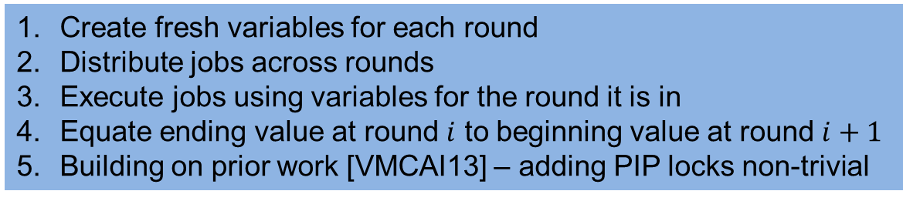


Sequentialization With PIP locks and fixed #Rounds
0
0
1
2
3
4
1
2
3
4
5
6
7
8
9
10
2
$l_{2}^{∗}$
$l_{1}^{∗}$
$u_{1}$
$u_{2}^{}$
$u_{2}$
Priority Level
$l_{2}$
$u_{1}$
1
0
$l_{1}$
$$V_{0}$$
=
$$V_{1}$$
=
$$V_{2}$$
$$V_{3}$$
$$V_{4}$$
=
=
Create fresh variables for each round
Distribute jobs across rounds
Execute jobs using variables for the round it is in
Equate ending value at round $i$ to beginning value at round $i+1$
Building on prior work [VMCAI13] – adding PIP locks non-trivial

Slide 13
Complete Algorithm: Iteratively Increase #Rounds
0
0
1
2
3
4
1
2
3
4
5
6
7
8
9
10
2
$l_{2}^{∗}$
$l_{1}^{∗}$
$u_{1}$
$u_{2}^{}$
$u_{2}$
Priority Level
$l_{2}$
$u_{1}$
1
0
$l_{1}$
$↑ ↑ ∗ ∗ ↑ ↑ ↓ ↓ ↓$
Challenge: Different schedules have different number of rounds
  #Rounds = #Jobs + #Blocks
  #Blocks depends on the execution and preemption
Solution: Start with a small number of rounds (equal to #Jobs)
  Add more rounds iteratively till counterexample found, or fixed-point reached

Slide 14
Overall Algorithm
Aborts if a job blocks but all R rounds already allocated

Slide 15


Implementing $VerifRounds(C,R)$
Supports C programs w/ tasks, priorities, priority ceiling protocol, shared variables
Works in two stages:
  Sequentialization – reduction to sequential program w/ prophecy variables
  Bounded program analysis: bounded C model checker (CBMC, HAVOC, …)
Periodic Program in C
Sequentialization
CBMC
SAFE
Construct $S_{a}(C,R)$ and $S_{b}(C,R)$
Check $\left[S_{a}\left(C,R\right)\right]=∅$ and $\left[S_{b}\left(C,R\right)\right]=∅$
UNSAFE
+ CEX
INCROUNDS
Uses non-determinism (prophecy variables) to allow all possible interleavings between jobs and R – |J| job block events
Periods, WCETs, Initial Condition, Time bound

Slide 16
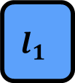
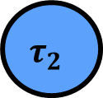
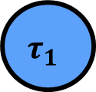
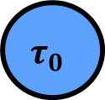
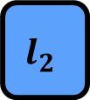
Deadlock Detection: Encoding TRG
Ownership Edge
0
1
2
3
4
5
6
7
8
9
10
Blocking Edge
2
$l_{2}^{∗}$
$l_{1}^{∗}$
$u_{1}$
Priority Level
$l_{2}$
1
0
$l_{1}$
$$↑$$
$$↑$$
$$∗$$
$$∗$$
$$τ_{2}$$
$$l_{2}$$
$$τ_{1}$$
$$l_{1}$$
$$τ_{0}$$
TRG: Node = task/lock; Edge = blocking/ownership; Cycle = deadlock
Transitive closure of TRG maintained and updated dynamically
Program aborts if TRG becomes cyclic (i.e., transitive closure has self-loop)

Slide 17
Deadlock Detection: Encoding TRG
Ownership Edge
0
1
2
3
4
5
6
7
8
9
10
Blocking Edge
2
$l_{2}^{∗}$
$l_{1}^{∗}$
$u_{1}$
$u_{2}^{}$
Priority Level
$l_{2}$
1
0
$l_{1}$
$$↑$$
$$↑$$
$$∗$$
$$∗$$
$$↑$$
$$τ_{2}$$
$$l_{2}$$
$$τ_{1}$$
$$l_{1}$$
$$τ_{0}$$
TRG: Node = task/lock; Edge = blocking/ownership; Cycle = deadlock
Transitive closure of TRG maintained and updated dynamically
Program aborts if TRG becomes cyclic (i.e., transitive closure has self-loop)

Slide 18
Deadlock Detection: Encoding TRG
Ownership Edge
0
1
2
3
4
5
6
7
8
9
10
Blocking Edge
2
$l_{2}^{∗}$
$l_{1}^{∗}$
$u_{1}$
$u_{2}^{}$
$u_{2}$
Priority Level
$l_{2}$
1
0
$l_{1}$
$$↑$$
$$↑$$
$$∗$$
$$∗$$
$$↑$$
$$↑$$
$$τ_{2}$$
$$l_{2}$$
$$τ_{1}$$
$$l_{1}$$
$$τ_{0}$$
TRG: Node = task/lock; Edge = blocking/ownership; Cycle = deadlock
Transitive closure of TRG maintained and updated dynamically
Program aborts if TRG becomes cyclic (i.e., transitive closure has self-loop)

Slide 19
Deadlock Detection: Encoding TRG
Ownership Edge
0
1
2
3
4
5
6
7
8
9
10
Blocking Edge
2
$l_{2}^{∗}$
$l_{1}^{∗}$
$u_{1}$
$u_{2}^{}$
$u_{2}$
Priority Level
$l_{2}$
$u_{1}$
1
0
$l_{1}$
$$↑$$
$$↑$$
$$∗$$
$$∗$$
$$↑$$
$$↑$$
$$↓$$
$$τ_{2}$$
$$l_{2}$$
$$τ_{1}$$
$$l_{1}$$
$$τ_{0}$$
TRG: Node = task/lock; Edge = blocking/ownership; Cycle = deadlock
Transitive closure of TRG maintained and updated dynamically
Program aborts if TRG becomes cyclic (i.e., transitive closure has self-loop)

Slide 20
Deadlock Detection: Encoding TRG
Ownership Edge
0
1
2
3
4
5
6
7
8
9
10
Blocking Edge
2
$l_{2}^{∗}$
$l_{1}^{∗}$
$u_{1}$
$u_{2}^{}$
$u_{2}$
Priority Level
$l_{2}$
$u_{1}$
1
0
$l_{1}$
$$↑$$
$$↑$$
$$∗$$
$$∗$$
$$↑$$
$$↑$$
$$↓$$
$$↓$$
$$τ_{2}$$
$$l_{2}$$
$$τ_{1}$$
$$l_{1}$$
$$τ_{0}$$
TRG: Node = task/lock; Edge = blocking/ownership; Cycle = deadlock
Transitive closure of TRG maintained and updated dynamically
Program aborts if TRG becomes cyclic (i.e., transitive closure has self-loop)

Slide 21
Deadlock Detection: Encoding TRG
Ownership Edge
0
1
2
3
4
5
6
7
8
9
10
Blocking Edge
2
$l_{2}^{∗}$
$l_{1}^{∗}$
$u_{1}$
$u_{2}^{}$
$u_{2}$
Priority Level
$l_{2}$
$u_{1}$
1
0
$l_{1}$
$$↑$$
$$↑$$
$$∗$$
$$∗$$
$$↑$$
$$↑$$
$$↓$$
$$↓$$
$$↓$$
$$τ_{2}$$
$$l_{2}$$
$$τ_{1}$$
$$l_{1}$$
$$τ_{0}$$
TRG: Node = task/lock; Edge = blocking/ownership; Cycle = deadlock
Transitive closure of TRG maintained and updated dynamically
Program aborts if TRG becomes cyclic (i.e., transitive closure has self-loop)

Slide 22
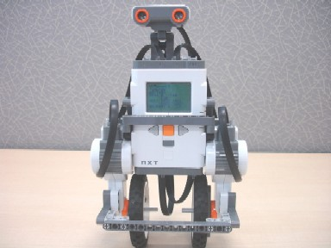
NXTway-GS: a 2 wheeled self-balancing robot
Original: nxt (2 tasks)
  balancer (4ms)
    Keeps the robot upright and responds to BT commands
  obstacle (50ms)
    monitors sonar sensor for obstacle and communicates with balancer to back up the robot
Ours: aso (3 tasks)
  balancer as above but no BT
  obstacle as above
  bluetooth (100ms)
    responds to BT commands and communicates with the balancer
Verified consistency of communication between tasks

Slide 23
Experimental Results

Slide 24
Related, Ongoing and Future Work
Related Work
  Sequentialization of Periodic Programs with CPU locks and priority ceiling protocol locks (FMCAD’11, VMCAI’13)
  Sequentialization of Concurrent Programs (Lal & Reps ‘08, and others)
  Sequentialization of Periodic Programs (Kidd, Jagannathan, Vitek ’10)
  Verification of periodic programs using SPIN (Florian, Gamble, & Holzmann ‘12)
  Verification of Time Properties of (Models of) Real Time Embedded Systems
  Model Checking Real-Time Java using JPF (Lindstrom, Mehlitz, and Visser ‘05)
Ongoing and Future Work
  Verification without the time bound
  Memory Consistency based Sequentialization
  Abstraction / Refinement
  Modeling physical aspects (i.e., environment) more faithfully
  More Examples

Slide 25
Contact Information
Presenter Sagar Chaki SSD Telephone: +1 412-268-5800 Email: chaki@sei.cmu.edu | U.S. mail: Software Engineering Institute Customer Relations 4500 Fifth Avenue Pittsburgh, PA 15213-2612 USA
Web: www.sei.cmu.edu http://www.sei.cmu.edu/contact.cfm | Customer Relations Email: info@sei.cmu.edu Telephone: +1 412-268-5800 SEI Phone: +1 412-268-5800 SEI Fax: +1 412-268-6257

Slide 26
QUESTIONS?

