Slide 1
How to stop driving women out of computing
What happens in your backyard matters!

Slide 2
Panelists
Sarita Adve, Illinois
James Allan, UMass Amherst
Kathryn S McKinley, Google
Bobby Schnabel, Colorado
Moshe Vardi, Rice

Slide 3
Fostering Research Integrity
National Academies 2017
objectivity
honesty
openness
accountability
fairness
stewardship

Slide 4
Fostering Research Integrity
National Academies 2017
objectivity
honesty
openness
accountability
fairness
stewardship
bias, sexism,
gender & sexual harassment
do not fit in

Slide 5
Format: 2 Sections with discussion
1. Driving women out
Climate
Harassment
2. Bias in research evaluation
Data on societies, conferences, and awards
Mobilizing your community

Slide 6
How We Lost the Women in Computing
Moshe Y. Vardi
Rice University

Slide 7
By the Numbers

Slide 8
Common Perception
“Women are just not interested in computing”
James Damore, 2017: “The distribution of preferences and abilities of men and women differ in part due to biological causes and these differences may explain why we don’t see equal representation of women in tech and leadership.”
Stuart Reges, 2018: “Men and women are different, and they make different choices. The different choices they make explain a lot of what we see in terms of lower percentages of women going into tech.”

Slide 9
Women in Computing - History
Reality
Women were pervasive, even dominant, in the early days of computing.
The social environment of computing has been and is quite hostile for women.
Men can be quite oblivious to the existence of such a hostile environment.
Women did not just leave, they were pushed out.

Slide 10
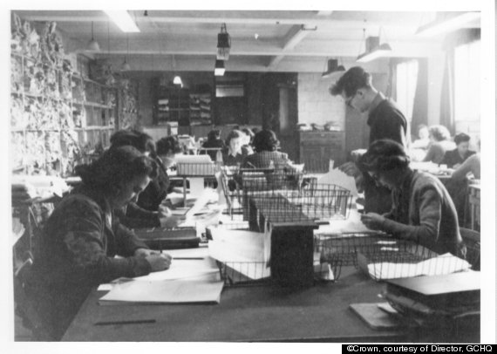
Bletchley Park - WWII
About 8,000 women worked in Bletchley Park. Women constituted roughly 75% of the workforce there.

Slide 11
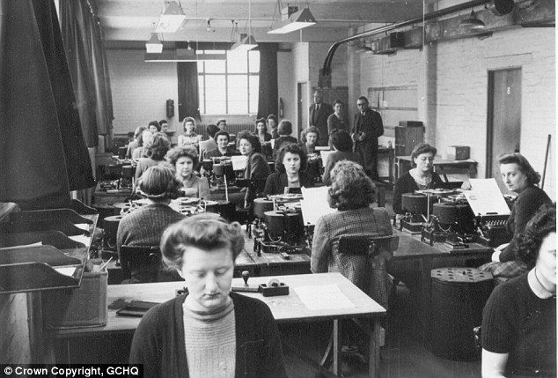
Code Girls, 2017
Over 11,000 women, who comprised more than 70% of U.S. code breakers, served during WWII.

Slide 12
ENIAC, 1946

Slide 13
Women of NASA -- 1955

Slide 14
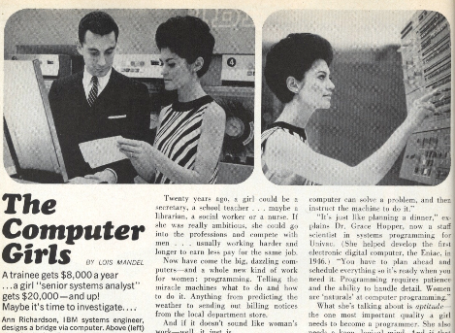
Cosmopolitan, 1967
“A whole new kind of work for women.”

Slide 15
Programmed Inequality, 2017
The British Civil Service sought to create a job category designed to deskill workers and depress wages – creating an intentional gender wage gap.
“It is evident to common sense that women workers do not regard their career as offering an alternative career to marriage and motherhood”.
As late as the 1980s, computer trade shows in the UK still used scantily clad young women as marketing gimmicks on their stands.

Slide 16
Brotopia, 2018
“A well-researched history of how Silicon Valley became a glorified frat house”:
Discriminatory hiring practices
Documented by a recent Stanford Study
Continual micro-aggressions and challenges that are hard to pinpoint and harder to call out
women’s ideas more harshly scrutinized; female engineers 35 % more code rejections
Sexual harassment and online trolling

Slide 17
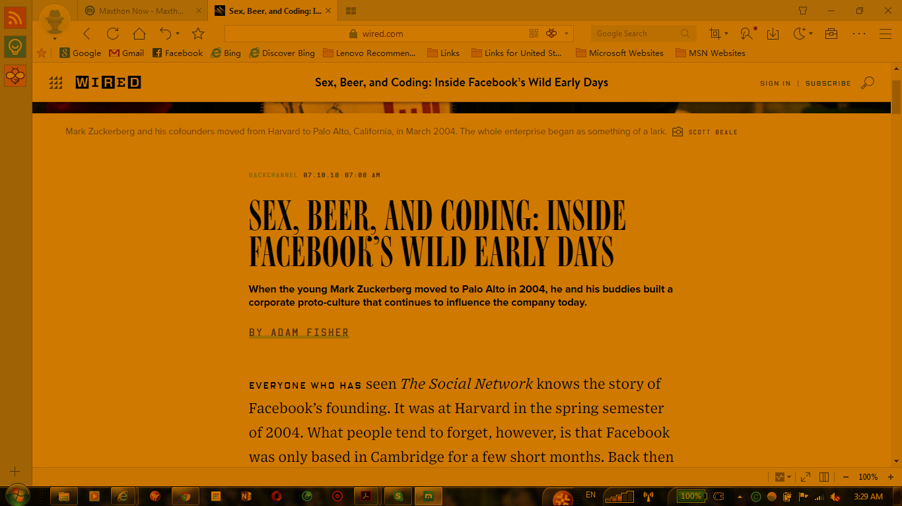

Slide 18
Women in CS is not only a pipeline problem

Slide 19
% CS Degrees to Women
Yet Women Full Professors ~15%
Masters
PhD
Undergraduates
1994
2015

Slide 20
Sexual Harassment
In 25 years in academia I have seen/heard of no instance of sexual harassment.
BUT
2018 National Academies Report: “In a survey conducted by the University of Texas System, more than a quarter of female engineering students experienced sexual harassment from faculty or staff.”
Bottom Line: It is very easy to be oblivious!

Slide 21
Kathryn S McKinley, Google

Slide 22
Harassment in your backyard
Sexual Harassment of Women: Climate, Culture, and Consequences in Academic Sciences, Engineering, and Medicine,” National Academies, 2018.
Recent harassment in our community

Slide 23
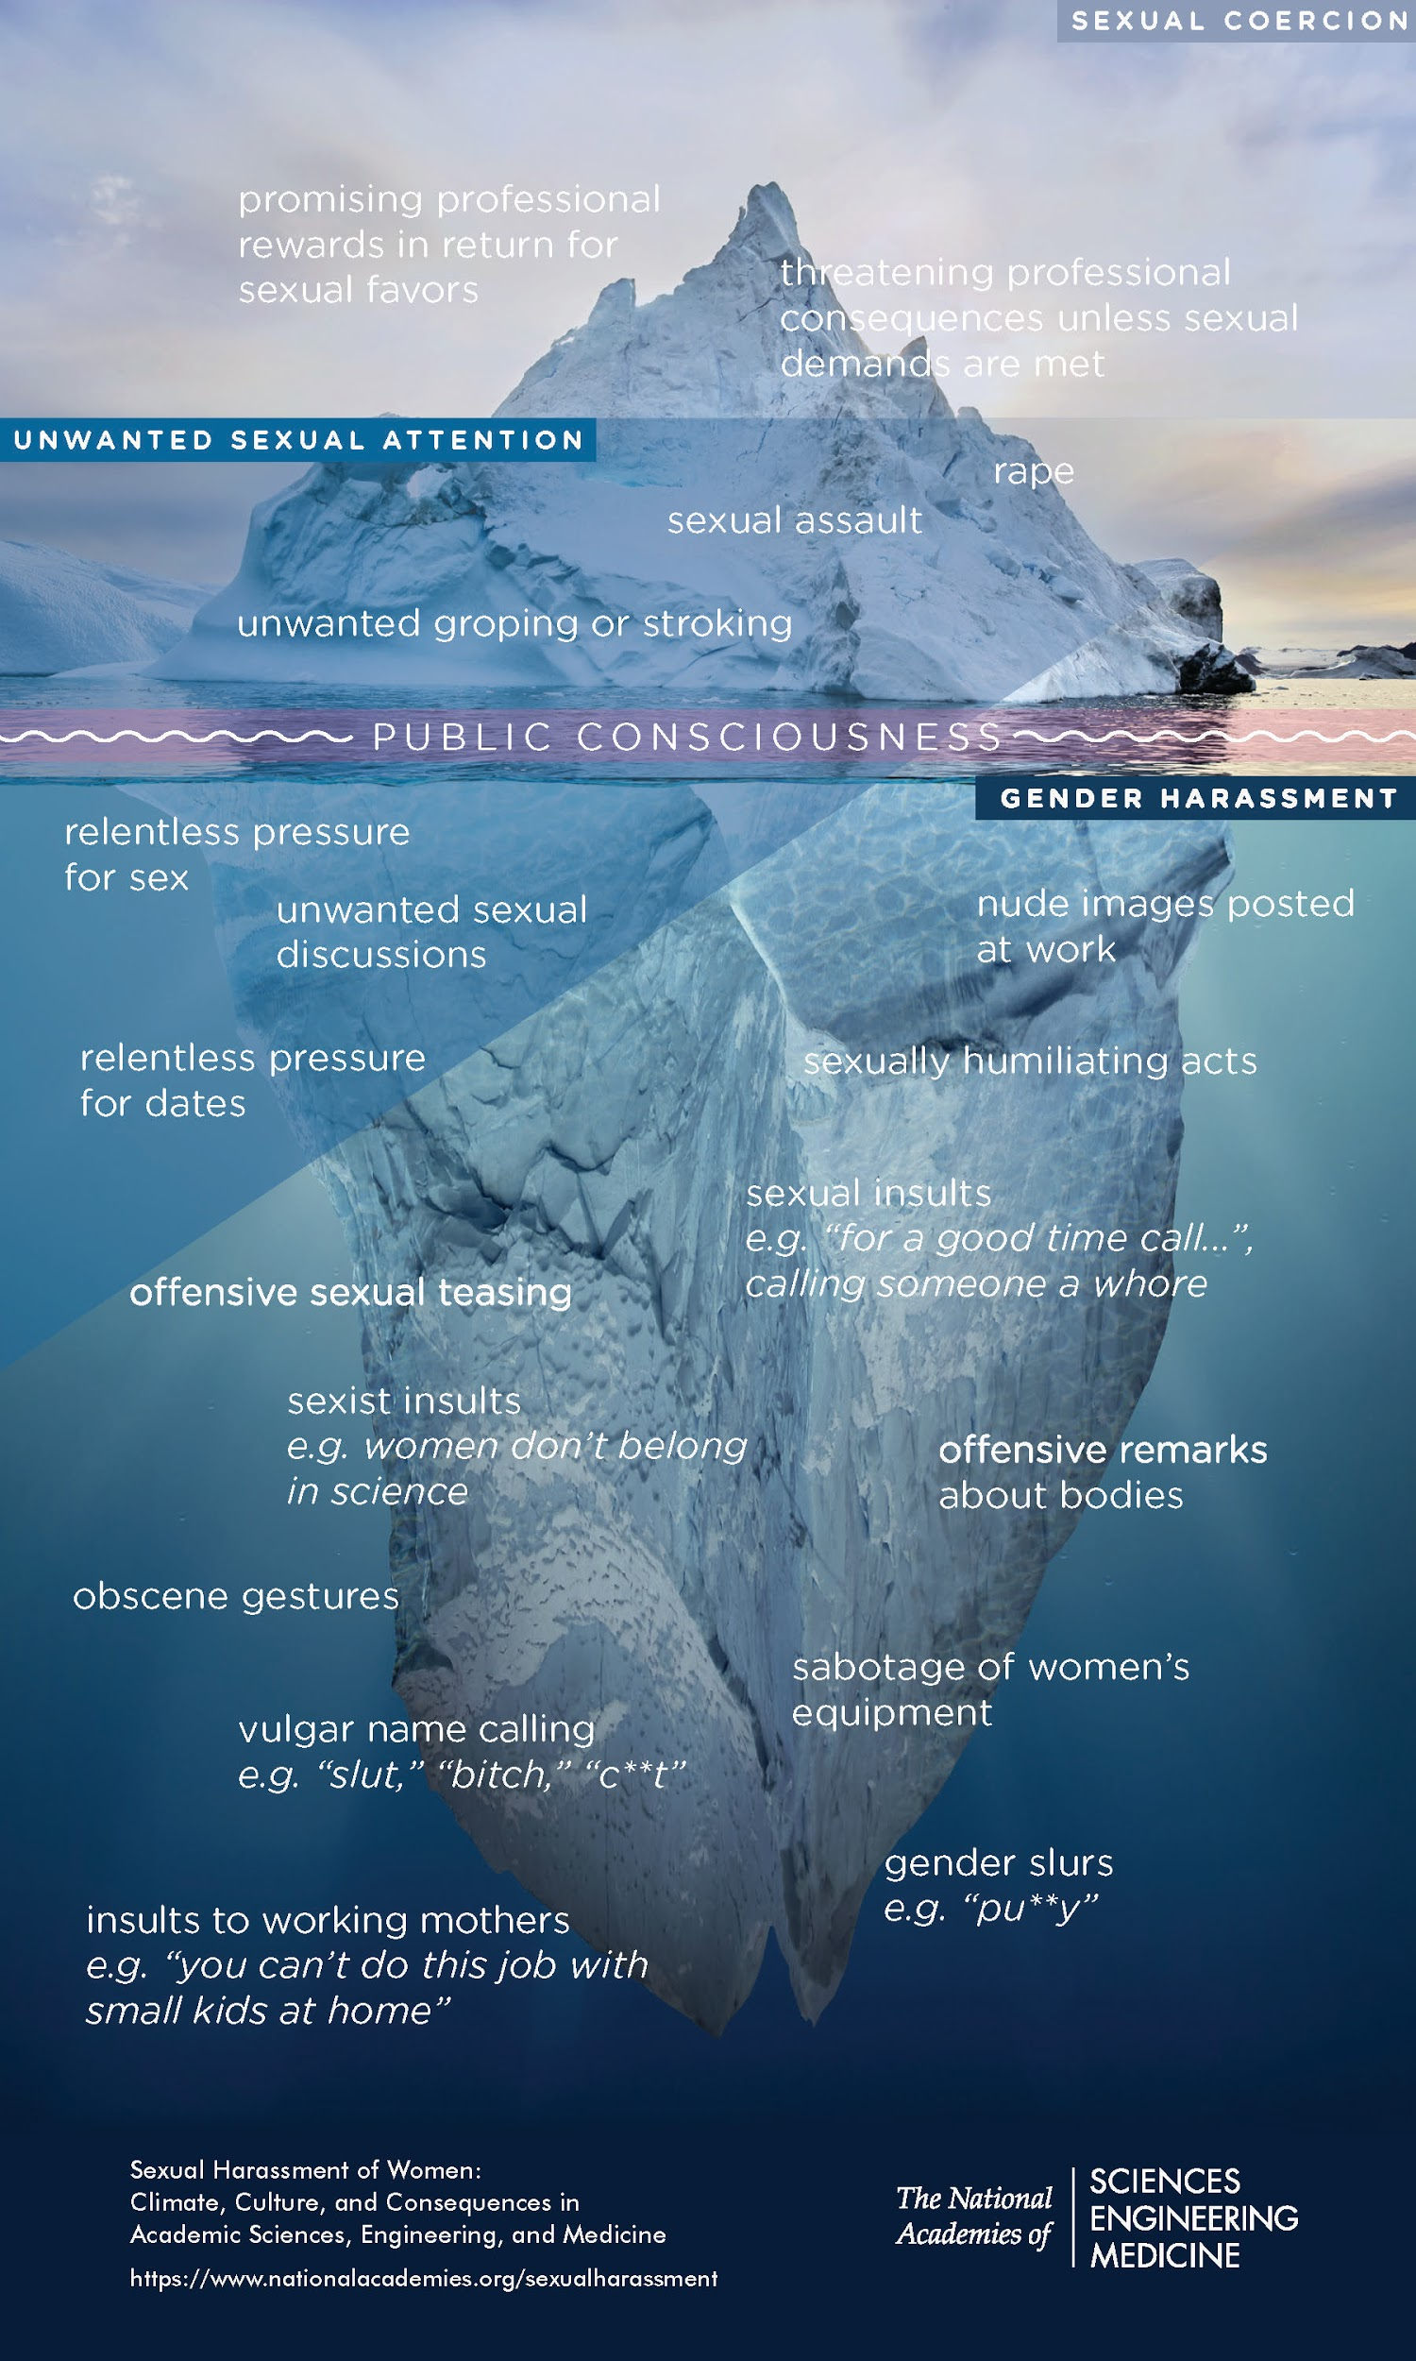
Harassment is
Sexual coercion
Unwanted sexual attention
Gender harassment
Sexual Harassment of Women: Climate, Culture, and Consequences in Academic Sciences, Engineering, and Medicine,” National Academies, 2018.

Slide 26
Finding
Sexual harassment is common in academic science, engineering, and medicine
50% of women faculty and staff experience it (meta analysis 2003)
20 to 50% of students experience it from faculty & staff
Rates of harassment are NOT decreasing

Slide 27
Finding and Recommendations
The legal system alone is inadequate for reducing or preventing harassment
Recommendations
Go beyond protecting the “University/institutions”
Address culture and climate.
Add a code of ethics and research integrity.
Hold PIs of Federal grants responsible.
Professional societies have a role.

Slide 28
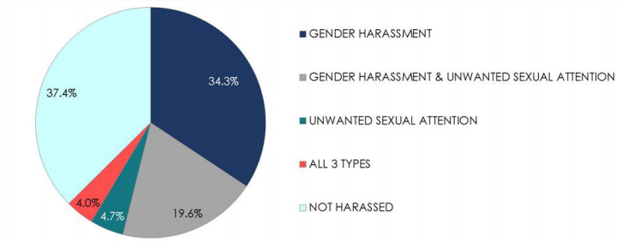
Women University Employees
Sciences, Engineering & Medicine
Adapted from Schneider, Swan, Fitzgerald 1997
Notes:
2003 Meta study (58% of faculty and staff harassed). The only worse workplace is the Military. University of Texas study finds: Female Engineering students (40%, 25% Gender, 9% Crude, 4% Sexual harassment, 1 % coersion)

Slide 29
Severe or frequent gender harassment can result in the same level of negative professional and psychological outcomes as isolated instances of sexual coercion.

Slide 30
Finding
Sexual harassment undermines women’s professional and education attainment and mental and physical health.
The cumulative effect is significant damage to research integrity and a costly loss of talent

Slide 31
Finding
Two characteristics most associated with high rates of sexual harassment are
(a) male-dominated gender ratios and leadership
(b) organizational climate that communicates tolerance of sexual harassment
Organizational climate is the greatest predictor

Slide 32
for Institutions
Create diverse, inclusive, respectful environments
Diffuse hierarchical and dependent relations between trainees and faculty
Provide support for targets
Improve transparency and accountability
Strive for strong and diverse leadership
Make the entire academic community responsible for reducing and preventing harassment

Slide 33
In your backyard
PhD student at NIPS by famous Google researcher
Princeton PhD student by Princeton advisor.
Light Penalty
Some rally to his defense
Fired by Google

Slide 34
In your backyard
MIT PhD student at SIGGRAPH by famous Berkeley Professor
Research Excellent Assoc. Prof at PC meeting by Assist. Prof.
Under investigation
Not reported
Notes:
“Contrapower” harassment 42% experience this, including from students.

Slide 35
Findings on reporting harassment
Estimated 11% of harassment reported
Retaliation
No consequences, no transparency
Reliving harassment many, many times
Legal requirements Title IX office of offenders at US Universities, regardless of target’s affiliation. US human resource offices everywhere

Slide 36
for Broader Community
Title IX reports back to funding agencies
NSF new policy on reporting
Geo physical society policies on ethics and sexual harassment
ACM new policy with consequences such as losing publishing rights
SIGARCH / SIGMICRO CARES committee

Slide 37
Discussion

Slide 38
Bias in Research Evaluation
Is CS evaluation really a meritocracy?

Slide 39
Bobby Schnabel,
University of Colorado, Boulder

Slide 41
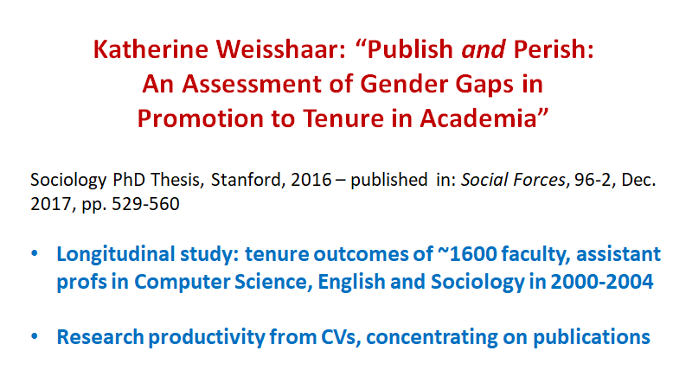

Slide 42
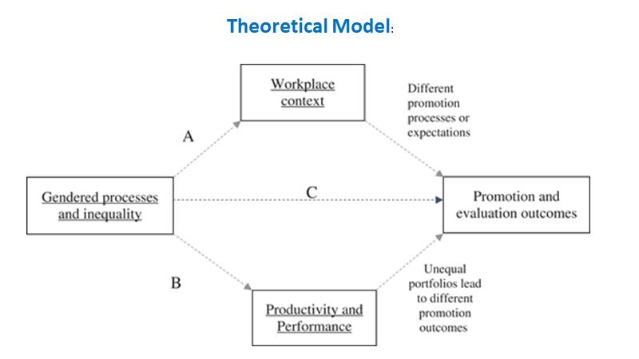

Slide 43
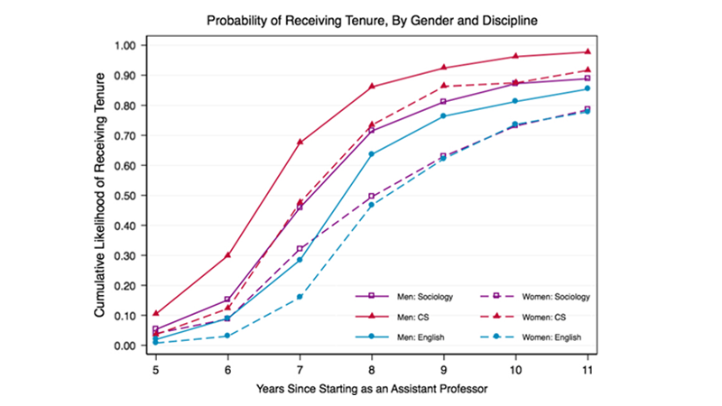

Slide 45
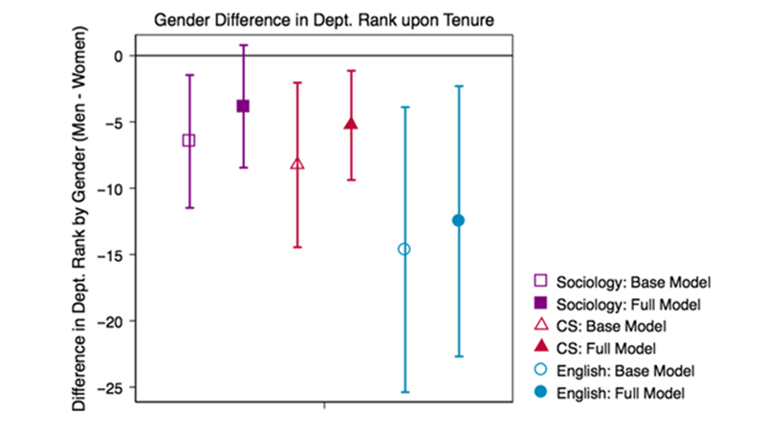

Slide 48
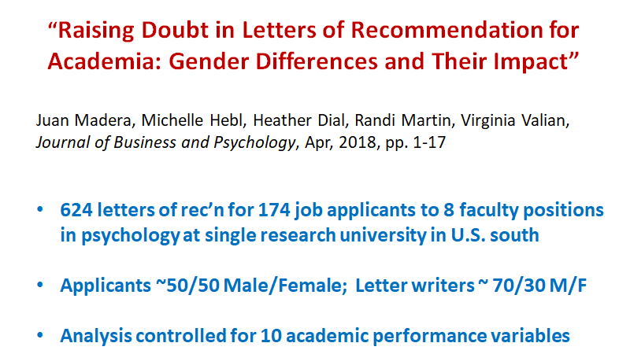

Slide 51
Bias in Awards and Honors
James Allan
Univ. of Massachusetts Amherst

Slide 52
Looking at society level
Organization level
ACM, IEEE, AAAI, …
SIG-level awards (“in your backyard”)
SIGPLAN, SIGMOD, …

Slide 53
A word about the data
Few groups keep data at this level
Some scraped by hand
Tedious and error-prone
Thank you to my fellow panelists
Some provided by representatives
Thank you to Greg Byrd, Jim Crowley, Carol Hamilton, Brian Noble, John White, and probably others
Take all numbers with a grain of salt

Slide 54
SIAM (major awards)
Award | Year(s) | Men | Women | Pct women
Major awards | 1970-1979 |  |  | 0%
(not those given out | 1980-1989 |  |  | 0%
by activity groups) | 1990-1999 |  |  | 7.1%
 | 2000-2009 |  |  | 14.3%
 | 2010- |  |  | 25.4%
Notes:
Appear to be lots of “major prizes”, some of which are multiple instances per year but some of which are only given out every few years

Slide 55
IEEE Computer Society
Award | Men | Women | Pct women
Technical Achievement, CS | 75 | 14 | 16%
Entrepreneur, Entrpreneurship | 24 | 2 | 8%
Harry H. Goode, Information Processing | 51 | 1 | 2%
W. Wallace McDowell, CS | 50 | 1 | 2%
Harlan D. Mills, Information Science | 13 | 5 | 28%
Pioneer, CS | 94 | 7 | 7%
Sidney Fernbach, High Performance Computers | 25 | 1 | 4%
Seymour Cray, High Performance Comp Sys | 18 | 0 | 0%
B. Ramakrishna Rau, Microarchitecture | 7 | 0 | 0%

Slide 56
IEEE Computer Society
Award | Men | Women | Pct women
Ken Kennedy (with ACM), HPC Prog/Prod | 5 | 4 | 44%
Hans Karlsson, Standards | 14 | 2 | 13%
Charles Babbage, Parallel Computing | 26 | 1 | 4%
Eckert-Mauchly (with ACM), Computer Arch. | 39 | 1 | 3%
Watts S. Humphrey (with SEI), Software Process | 32 | 10 | 24%
Undergraduate teaching | 14 | 4 | 22%
Taylor Booth (CSE education) | 26 | 2 | 7%
Total | 513 | 55 | 10%

Slide 57
IEEE CS, by level
Level | % women
Fellow | 7.1%
Senior Member | 7.8%
Other Member | 7.5%
Student | 28.0%
TOTAL | 9.1%

Slide 58
Usenix
Award | Year(s) | Men | Women | Pct women
FLAME (lifetime achievement) |  | 15 | 1 | 6%
LISA (outstanding contribution) |  | 21 | 7 | 25%

Slide 59
AAAI awards
Award | Year(s) | Men | Women | Pct women
Fellows | 2013-2018 | 38 | 10 | 21%
Classic paper | 2013-2018 | 10 | 3 | 23%
Distinguished service | 2016-2017 | 2 | 1 | 33%
Feigenbaum Prize | 2011-2017 | 3 | 0 | 0%
Engelmore award | 2003-2018 | 14 | 1 | 7%
Senior member (self-nominated) | 2015-2018 | 36 | 10 | 21%

Slide 60
ACM-level awards
Award | Year(s) | Men | Women | Pct women
Across 16 major awards | 16 years | 281 | 61 | 18%
Turing |  | 21 | 3 | 13%
Research (incl. Turning) |  | 198 | 39 | 16%
Research (w/o Athena) |  | 198 | 23 | 10%
Doctoral dissertation |  | 16 | 0 | 0%
Education |  | 21 | 4 | 16%
Service |  | 46 | 18 | 28%
Fellows | 25 years | 889 | 132 | 13%
 | 2017 only | 42 | 12 | 22%
Notes:
E = Karlstrom and Lawler (latter is very broad)
S = Distinguished Service, contribution to ACM, Kennedy, and Presidential
R = Turing, ACM Prize, Software systems, hopper, newell, kanellakis, Athena, Eckert-mauchly, SIAM-ACM

Slide 61
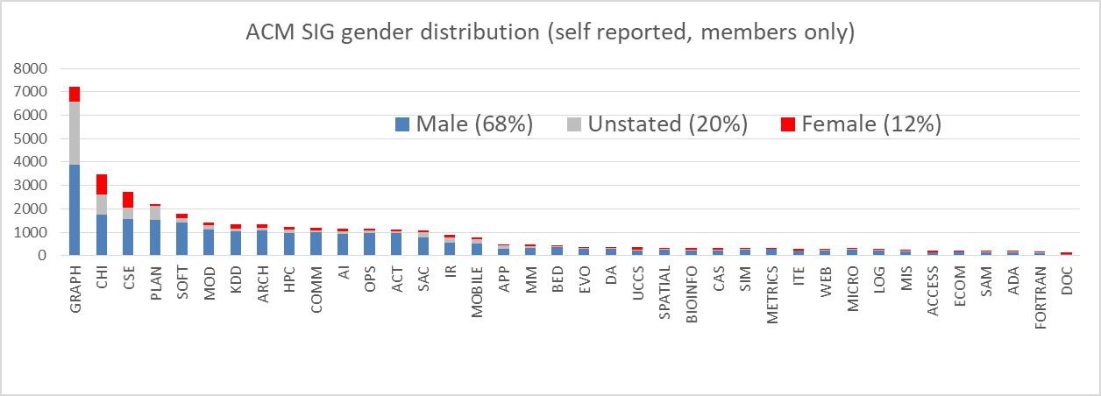
Gender distribution in ACM SIGs
Interpret cautiously

Slide 62
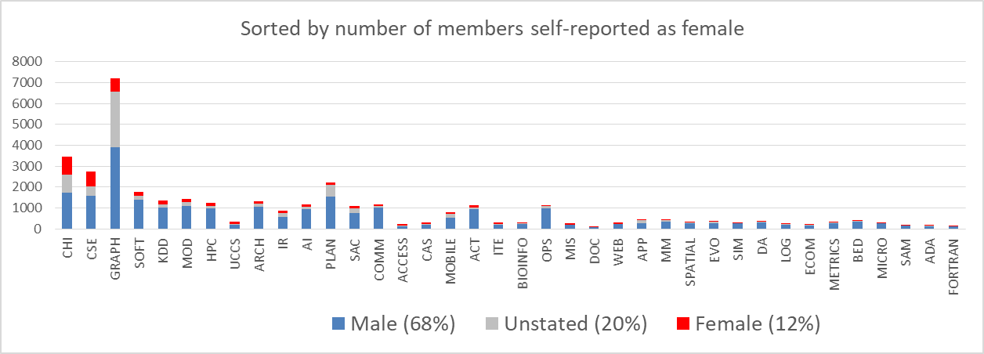
Gender distribution in ACM SIGs

Slide 63
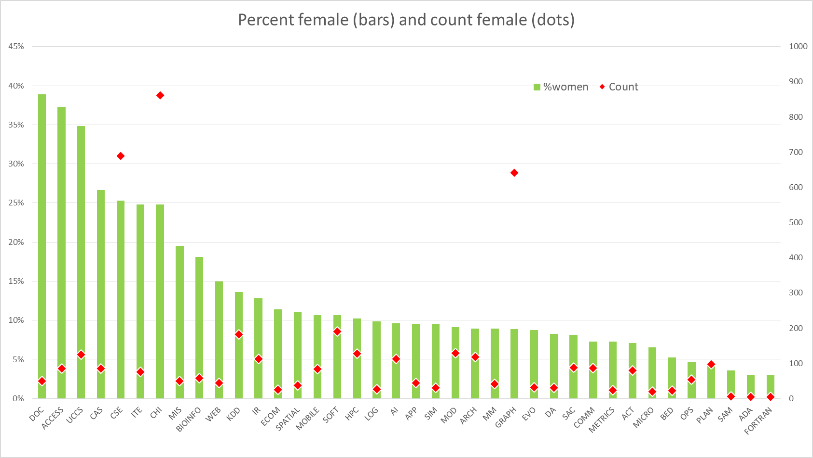
Gender distribution in ACM SIGs
Avg
(13%)

Slide 64
Gender distribution in ACM SIGs
Avg
(13%)

Slide 65
SIGPLAN (programming languages)
Award | Year(s) | Men | Women | Pct women
PL Achievement | 1997-2017 | 21 | 6 (3 joint) | 30%
Milner Young Researcher | 2012-2017 | 5 | 1 | 17%
Reynolds Dissertation | 2001-2017 | 19 | 0 | 0%
Service | 1996-2016 | 15 | 7 | 32%
Total |  | 60 | 17 | 22%
Total research |  | 45 | 10 | 18%

Slide 66
SIGOPS (operating systems)
Award | Year(s) | Men | Women | Pct women
Mark Weiser (innovation) | 2001-2017 | 17 | 1 | 6%
Ritchie (dissertation) | 2013-2017 | 4 | 1 | 20%
SIGACT (theory)
Award | Year(s) | Men | Women | Pct women
Knuth (contributions) | 1996-2017 | 16 | 1 | 6%

Slide 67
SIGMOD (management of data)
Award | Year(s) | Men | Women | Pct women
Codd Innovations award | 1992-2018 | 24 | 3 | 11%
Jim Gray Dissertation award | 2006-2018 | 13 | 0 | 0%

Slide 68
SIGIR (information retrieval)
Award | Year(s) | Men | Women | Pct women
Salton (lifetime achievement) | Triennial | 10 | 2 | 17%
Test of time | Since 1980 | 23 | 17 | 42%
Female lead/sole author |  | 33 | 7 | 18%
Best paper awards | Since 1996 | 18 | 5 | 22%
Female lead/sole author |  | 22 | 1 | 4%
SIGDOC (design of communication)
Award | Year(s) | Men | Women | Pct women
Rigo award (lifetime contribution) | 1998-2018 | 15 | 12 | 44%

Slide 69
SIGCHI (human-computer interaction)
Award | Year(s) | Men | Women | Pct women
CHI Academy |  | 87 | 38 | 30%
 | 2001-2005 | 26 | 5 | 16%
 | 2006-2010 | 24 | 8 | 25%
 | 2011-2015 | 26 | 12 | 32%
 | 2016-2018 | 11 | 13 | 54%

Slide 70
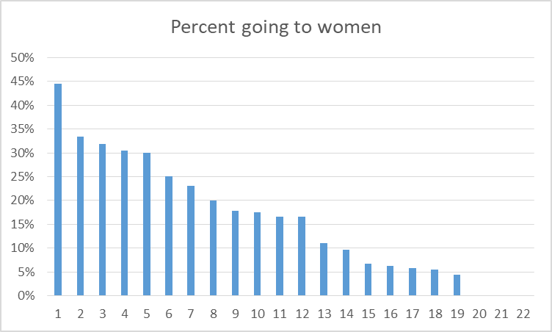
Summary of those tables
~20% of PhDs go to women (~18 years)
Around 15% of awards go to women
Varies widely
Is that OK?

Slide 71
What can you do as chair/head?
Most awards drawn from nominees
Nominate women
Awards Committee?
(Check language used in nominations!)
Many awards require membership
Encourage joining ACM, IEEE, …
And now… more ideas

Slide 72
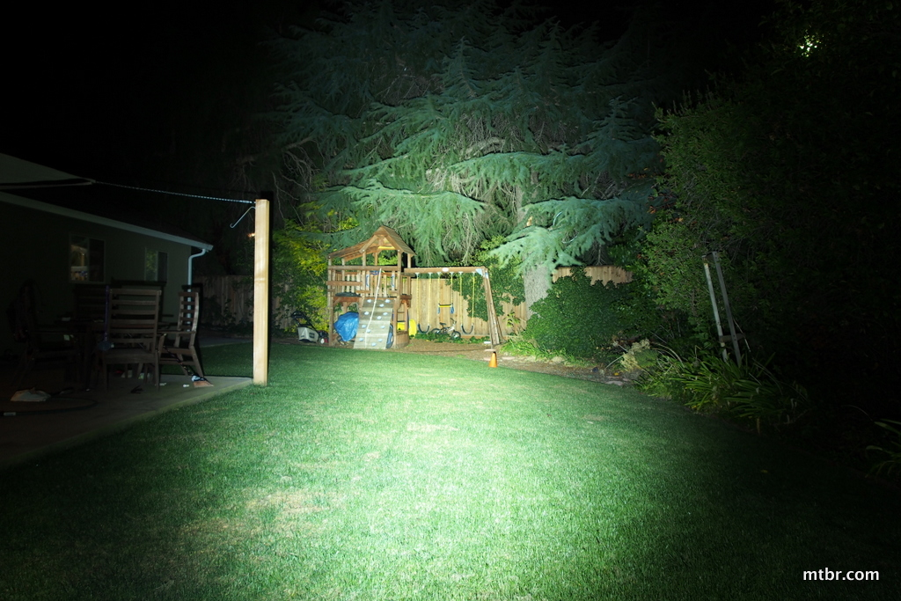
What’s in Your Backyard? What Can You Do About It?
Experiences from the Architecture Community
Sarita Adve
University of Illinois
Core collaborators:
Kim Hazelwood, Natalie Enright Jerger, Margaret Martonosi, Kathryn McKinley
Plus SIGARCH EC and Many Supporters

Slide 73
In the last year,
my community shone a light
in its backyard
We found some dark corners
Not because we are worse,
but because we looked
And now we can fix
Takeaways: Please look in your own backyard
There is a lot we can do to fix what’s broken

Slide 74
Architecture Community
Architecture community =
ACM SIGARCH, ACM SIGMICRO, IEEE TCCA, IEEE TCuarch
Four main conferences
ISCA → SIGARCH + TCCA
Micro → SIGMICRO + Tcuarch
HPCA → TCCA
ASPLOS → SIGARCH + SIGPLAN + SIGOPS

Slide 75
Key Events Last Year in Architecture Community
Study shows poor gender ratios
Keynotes, PC chairs, Awards
All conferences must improve
Micro stands out
Micro50: Legends of Micro panel
All white, all male
Reading of Diversity Statement
Call to action
Clear public support for change
Personal accounts of harassment
SIGARCH works for diversity
But study is wakeup call
Diversity in conference governance
Institution, academic lineage, …

Slide 76
Key Events Last Year in Architecture Community
Study shows poor gender ratios
Keynotes, PC chairs, Awards
All conferences must improve
Micro stands out
Micro50: Legends of Micro panel
All white, all male
Reading of Diversity Statement
Call to action
Clear public support for change
Personal accounts of harassment
SIGARCH CARES:
To help report harassment
SIGARCH works for diversity
But study is wakeup call
WICArch is SIGARCH subcommittee
Web portal w/ searchable directory
Strategize diversity efforts
CRA-W + CRA as a template
SIGMICRO joins CARES
Diversity in conference governance
Institution, academic lineage, …

Slide 77
What’s in your backyard?
What can you do?

Slide 78
Some Lessons from the Architecture Community
Data speaks louder than vague perceptions, but HARD to get -- GET DATA!
SIGARCH Blog: A digital meeting space for the community
It takes a village to make change: many and diverse supporters
Sometimes it takes a public statement
Sometimes it takes personal stories
Change in large organizations is hard, but small steps matter
Much work remains but impact already visible
Hallway discussions at conferences, panels, bias busting workshop, keynotes, bylaws, …
CARES, WICArch
Micro instituting new policies
Broader engagement: ACM, CRA, NSF, this session, ...
Yes, we can
make a difference

Slide 79
Personal Epiphany: Good Intentions Not Enough
I thought we (SIGARCH) were doing a lot
Careful policies for program chairs, steering committees (for flagship conferences)
Strong oversight of flagship events
Many programs to increase diversity
Pioneered travel grants for childcare, people with disabilities
Adjusted eligibility criteria for awards to consider family related leaves
Support for CRA-W grad cohort
WICArch: Women in Computer Architecture
But still much room for improvement
Women: No recent ISCA keynotes, only one career award, few PC chairs
Anecdotal reports of harassment
More work needed
Need a strong foundation of institutional policies

Slide 80
Institutional Policies
Research Society Leaders
Conference governance, awards, honors - Bylaws for processes
Code of conduct, reporting violations, enforcing sanctions - CARES
Awareness, training - Bias busting workshop at ISCA’18
DATA - ACM will now collect demographic data at registration and membership
Funding Agencies
NSF’s new harassment related policies
Department Chairs, Universities
Awareness and training
Awards, honors, compensation processes
Recognition of efforts to improve diversity - this is hard work!
Individuals: Acknowledge biases, watch out for your own and for others
What’s left to do?
A LOT!

Slide 81
Takeaways
What’s in your backyard?
Get data first!
What can you do about it?
A LOT!

Slide 82
Discussion

Slide 83
Resources
Sexual Harassment of Women: Climate, Culture, and Consequences in Academic Sciences, Engineering, and Medicine (2018), National Academies
Gender Diversity in Computer Architecture, Natalie Enright Jerger and Kim Hazelwood
What Happens to Us Does Not Happen to Most of You, Kathryn S. McKinley
Statistics, we have a problem, Kristian Lum
A member of the Theory Community Speaks out, #Metoo, Anonymous post
Software engineer recalls impact of alleged sex assault from UC Berkeley professor James O’Brien, Anjali Shrivastava
How we Lost the Women in Computing, Moshe Vardi
Sexual Harassment Explains a Lot About Why Women Get Paid Less, Rebecca Greenfield and Laura Colby
Summary and Thoughts on the Diversity Conversations in the Architecture Community

Slide 84
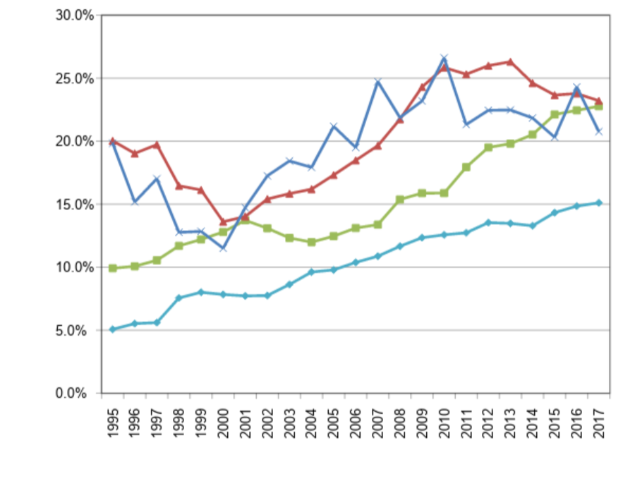
% CS/CE Women Faculty - Taulbee
Assistant
Tenure track hires
Associate
Full
1995
2017

