Slide 1
Finding Your Dream Job
Kathryn McKinley
University of Texas at Austin & Microsoft Research
Erika S. Poole
The Pennsylvania State University

Slide 2
Our Goals Today

Slide 3
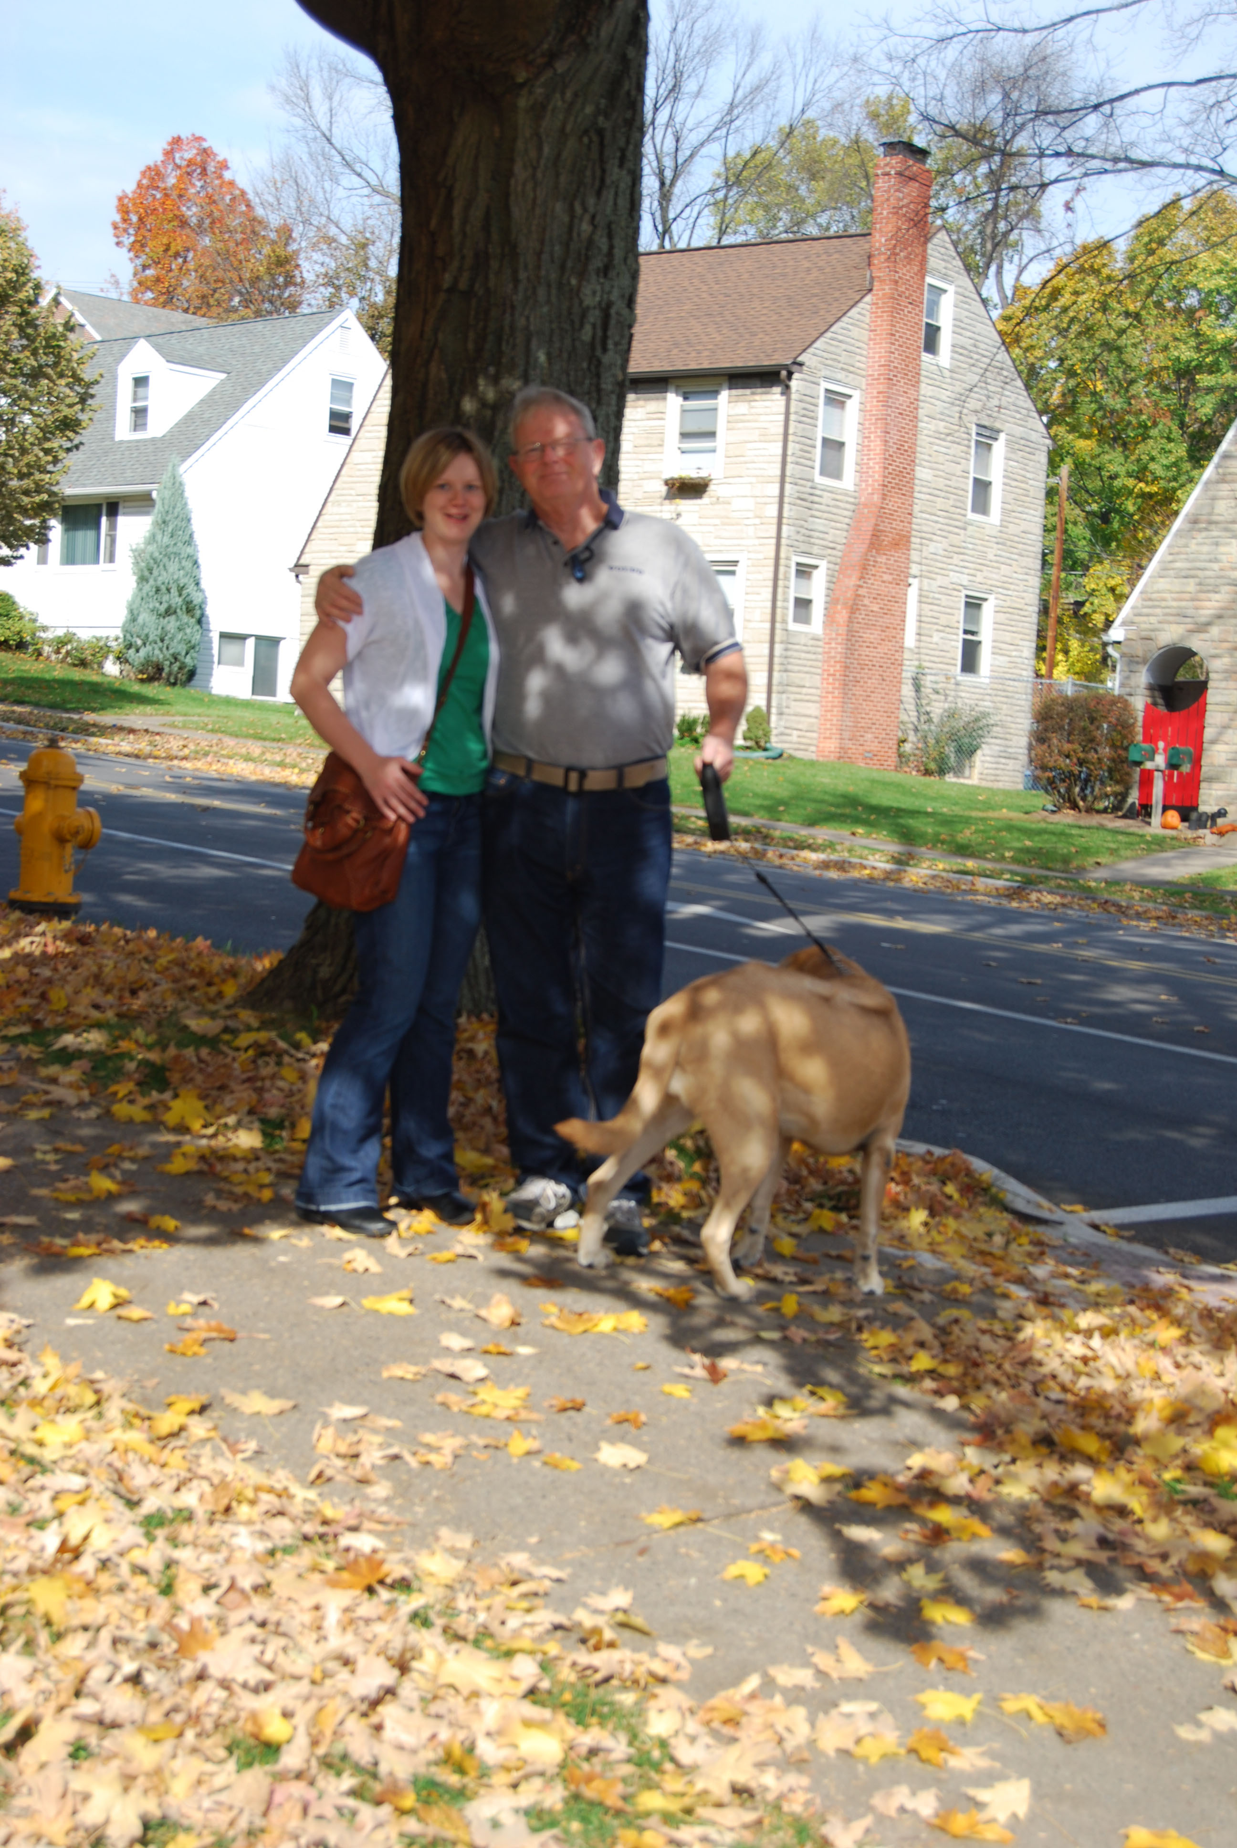
About Erika

Slide 4
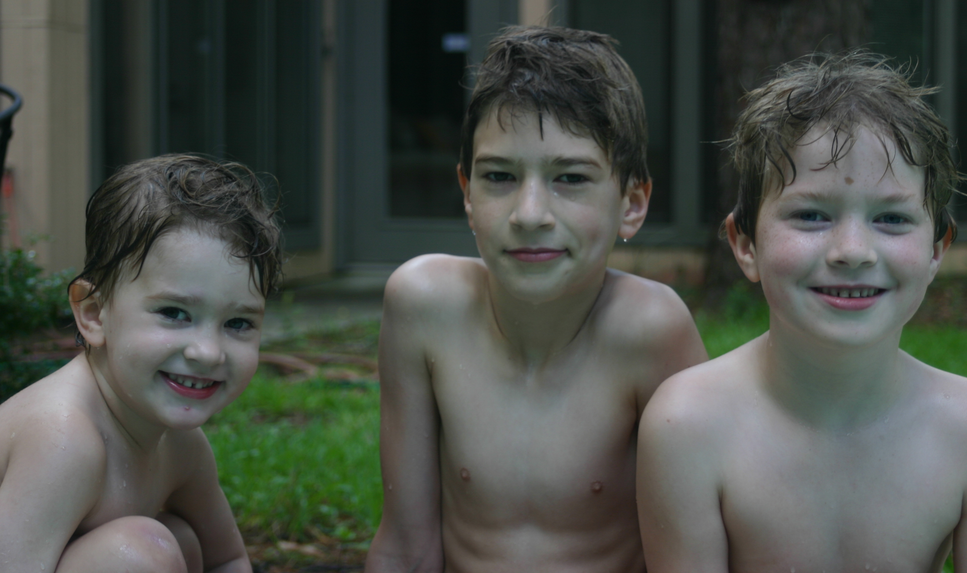
About Kathryn
ACM Fellow
Notes:
Love math
Computer Science
Love boys
UG Research Summer
Marry Scotty 1985
Love research
Rice PhD 1992
& France
Post Doc, Ecole des Mines
Asst Prof UMass 1993
Tenure 1999
Assoc Prof UT Austin 01
Full Prof UT Austin 07
Principal Researcher, Microsoft
Love boys
Cooper 1995
Dylan 1998
Wyatt 2001

Slide 5
What about you?
What do you value?
Teaching?
Salary?
Fame?
Community outreach?
Research?
Relaxation?
A geographic location?
Something else?
Notes:
What are your values in life?
Do you like teaching?
Do you like research?
What is your risk tolerance?
How important is salary?
How hard do you want to work?

Slide 6
What do employers value?
Research University & Company
Papers in top conferences
Great letters
Spark
Teaching College
Papers in conferences
Teaching experience/enthusiasm
Development
Papers on topics they need

Slide 7
The application process

Slide 8
The Application
Timeline
Typically Fall-Winter for CS academic jobs
Communications/Information departments may have earlier deadlines & conference interviews
Resources: www.cra.org/jobs, www.chronicle.com/jobs, ACM job announcements mailing list
Teaching CS schools may not have budget for ad placement. Subscribe to SIGCSE mailing list
What’s in a job packet?
Teaching statement
Research statement
Cover letters
Recommendation letters
How do I know if I’m doing it right?
Get example packets from colleagues and the web
Serve as a student rep on a search committee
Have experts and non-experts read your materials

Slide 9
Manage the process

Slide 10
The truth? MANY factors are out of your control.

Slide 11
What can you do?
Take care of yourself!
Sleeping
Eating
Exercising
Be prepared to feel uneasy.
There will be times when you feel nervous, anxious, and scared. It’s normal.
Avoid comparisons and gossiping with your peers. You won’t feel any better. Seriously.
Focus on what you CAN control

Slide 12
Congrats! You got an interview!

Slide 13
The Interview Process
Goal: Convince them that you will improve their company or department (But play nice. Don’t insinuate you are better than them, know how to solve their problems, etc).

Slide 14
The Talk
Goal:
Goal: convince them you are
smart, & an excellent
teacher, researcher
Assume a smart but general audience
Clearly state problem and your contributions
Have enough details to convince the one expert
Show that you have ideas about what you will do when you step foot in the door
Practice, practice, practice

Slide 15
One-on-One
Goal:
Before the interview, investigate
Read/skim their papers
Check out their websites, research groups, grants, awards
A two-way evaluation
Do you want to work with them?
Do they want to work with you?
Even if your research has no connection, show them that you’d be the kind of person they’d want down the hall.
Tip: Go to the ladies room often. Jump up and down.
Tip: Do not let them do all the talking.
THEY NEED TO REMEMBER YOU.

Slide 16
Learning about the Culture (Indirectly)
Collegiality & Culture
Who do you collaborate with?
What did you do yesterday?
What do you do for fun?
What does it take to be successful here?
What do you like best about your job? The least?
What do you wish you could change about your department/university?
Students
Where are last year’s PhD graduates working?
Do the undergraduates go to grad school?
Where do they go? Do you track them?
How are graduate students typically supported?
The college/university
Why is this position available?
What was the last important decision the department made? How?
How does the Dean view the department?
When was the last department review? What happened?
What is the financial condition of the college?
What is the vision for the college direction and growth?

Slide 17
Questions to ask about teaching
How Much
What's the pre/post tenure teaching load?
What courses would I teach?
Do faculty ever “buy out” of courses?
Freedom and Flexibility
How much control would I have over course content?
Can I create new courses?
Support and Evaluation
In what cases would I have TA support?
What resources are available for improving teaching skills?
How is teaching evaluated?

Slide 18
Questions to ask about research
Tenure
What are the expectations for tenure?
How many people were denied/granted tenure in recent years? Why?
Have women with children been granted tenure?
Research Culture
What hours do you work?
What does it take to be successful here?
Who do you work with in the department?
Do you work with other University faculty?
Grants
What are the expectations about grant submission?
What types of funding to faculty typically seek?
What assistance is available for grant submission?
How are research assistants supported within the department?

Slide 19
Offer!

Slide 20
Negotiations
Starting date & time until tenure
January start may buy you extra time on tenure clock.
Pre-tenure sabbatical?
Teaching
teaching release, which courses
Money
Salary, summer
Career: Students, equipment, travel, etc.
Get EVERYTHING in writing

Slide 21
Money: Salary
Amount
Being off-scale
Pay raises
Summer salary
Benefits
Subsidized housing

Slide 22
Money: Career startup
Getting your faculty career started
Research equipment
Travel
Students
Books and memberships
Class/lab equipment
Intellectual property rights

Slide 23
What if things don’t go as you expect?
Advice from recent job seekers:
“Search for both your dream job and a good enough job at the same time. Dream jobs can take more than one iteration”
Don’t compare yourself! “Your peers are your support group, sustain yourself and your relationships.”

Slide 24
Conclusions
If you never hear “no” you are not asking for enough
But don’t go overboard

