Slide 1
Networking Building Your Research Village
Kathryn S McKinley
Senior Researcher, Google

Slide 2
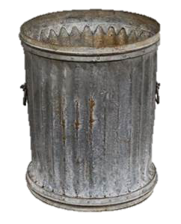
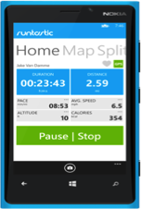
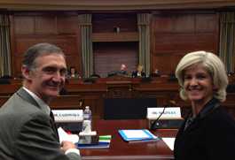
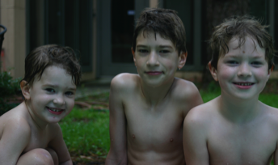
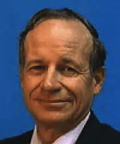
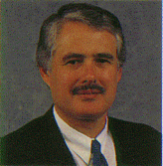
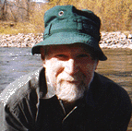
Kathryn McKinley
Research
Congressional Testimony
Mentors
Family
Notes:
My junior year at Rice, I wanted to stay in Houston for the summer, so I asked Prof. Don Johnson if I could work for him and he said yes. He introduced me to the world of research, answering questions when no one knows the answers or sometimes the questions. His initial encouragement and my advisor Ken Kennedy changed the course of my life. One of the highlights of my career was on Valentines day this year, I had the opportunity to speak to the Congressional Science Committee with Ed Lazowska about how the innovations of our field continue to changing the world.
That same summer I started my research career, I started dating my husband. It was a good summer. We started our family when I was an assistant Professor at Umass, and my department chair, Dave Stemple, made his own policies that helped me combine family and work. During this period, I limited my attention to work and family. This year we sent our oldest son off to college, where he is meeting professors who are encouraging him to reach his potential. Professors and TA s don’t underestimate your influence!

Slide 3
Networking is …
Building and sustaining professional relationships
Participating in a research community
Notes:
Network = your community, you are a good citizen in your community

Slide 4
Networking is not …
Using people or a substitute for quality research
Notes:
High quality research is an entre into your community and your community helps you improve your work.

Slide 5
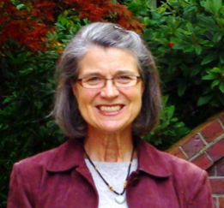
Career Relationships
Susan Eggers
Me: talk at UW
Susan: Interview at UW (no offer!)
Susan: ASPLOS PC member
Me: proposal advice
Susan: ASPLOS Program Chair
Me (UMass): tenure letter
Susan: talk advice
Random people
Me, rejection
Lesson: start with a complement & question/topic

Slide 6
But I am horrible at small talk!
You have CS in common
Networking is not genetic
It is a research skill
Practice
Meet people Learn Go places Volunteer!

Slide 7
Networking …
Makes you known
Makes your work known
Source of new research ideas &
different slants on old ideas
Feedback on your research
New collaborations
Letters of recommendation
Professional opportunities
Notes:
Why should you network?

Slide 8
It takes a village …
And you get to create your own.
Notes:
Research village: under graduates, graduate students, asst. professors, associate, full., industry. We all need each other.

Slide 9
Creating your own village
All villages need elders
All villages need regular Joes
All villages need diversity
Learn different strokes from different folks
All villages need uniformity
Similar folks have similar issues
John S. Davis, IBM, 2003

Slide 10
Networking up & down
Go to talks, go to conferences, …
Introduce yourself to
Established Researchers
Researchers in all areas!
Researchers junior to you
Peers!

Slide 11
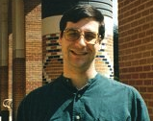
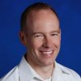
Networking across & down
Chuck Koebel
Post doc at Rice
NSF program manager
Doug Burger
Interviewed @Umass
Hired me @UT
Hired me @ Microsoft

Slide 12
Conference networking
Prepare a research talk (write it down, practice)
“Elevator talk” (1 & 3 minute versions)
Why is it an interesting problem?
Why is it important?
Why is your solution unique?
Prepare
Who will be there? Who do you want to meet? What do you want to ask them? Read their papers.
Take notes! Who you met, plan next steps

Slide 13
At the Conference
Use your EQ
You all have CS in common
Find people you connect with
One conversation is not enough
Reconnect
Be open and ask questions
Move on to the next conversation
Don’t only hang around with your friends
Don’t interrupt private conversations

Slide 14
After the conference
Follow up!
Read their work! Send comments
Send pointers to your related papers
Share software and workloads
Do joint work together
Invite them to give a talk
Ask to give a talk there (as appropriate)

Slide 15
Informal networking
Serendipity happens: Talk to people you meet by chance. Talk to people you like.
Convey excitement about your research and theirs.
Talk to people about their lives as well as their work.
Ask questions & listen!

Slide 16
Homework
Practice today with your peers & beyond
Meet at least 10 people in your institution this month
Introduce yourself with handshake (caveat), smile, and your name
Write down their names
Network Forward – network your network
Follow-up with email, Linked-In, or Facebook
Network Forward Make connections “You should meet Hermione Granger from Hogworts…”

Slide 17
Questions?

Slide 18
10 Minute Speed Dating
1 minute Quick Intros
Shake hands, eye contact, & smile
“My name is Kathryn…Happy to meet you, Jane”
Write down their name!
Listener: Ask a question
Respondent: Answer the question!
Listener listens actively, eye contact, notes are OK
Listener mirrors what she has heard & responds directly, relating to the answer
Swap Roles. Lather, Rinse, Repeat!.

Slide 19
What to talk about?
What is your research area? What attracts you to this subject area?
What research problem(s) are you working on right now?
What is your greatest (professional or personal) challenge right now?
What is your next step in your career?
What do you hope to get out of this meeting?
What was the most important lesson you learned from your advisor?
What do you enjoy doing when you’re not doing CS?
What are you passionate about?
Notes:
Sample questions!

Slide 20
Thank you!

Slide 21
Activities & Resources
Arrange networking events at your home institution!

Slide 22
Resources
www.cra-w.org
CRA-W Career Mentoring Workshops, Workshop reports and transcripts,
From a summer internship to a permanent position by Keith Farkus, DEC WRL
Finding real world problems by Dirk Grunwald, U Colorado
Networking for your students by Ken Kennedy, Rice
Go outside your department by Jan Cuny, U Oregon
Developing business contacts by Maria Klawe, UBC
Networking at NSF by Caroline Wardle, NSF
Populating a start-up by Dave Ditzel, Transmeta
The ONR program director by Susan Eggers, UW

Slide 23
Acknowledgements
Thanks for sharing their presentations
Jan Cuny, NSF
Susan Eggers, University of Washington
John Davis, IBM
Mary Jean Harrold, Georgia Tech
Valerie Taylor, Texas A&M
Who did they thank?
Susan Owicki, Joan Feigenbaum, Judy Goldsmith, Naomi Nishimura, David Johnson, Peter Shor, David Applegate, Richard Beigel

