Slide 1
What Programming Languages Researchers Do and How
Kathryn S McKinley

Slide 2
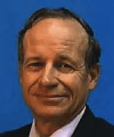
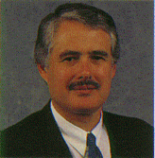
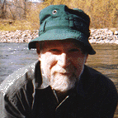
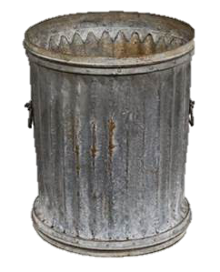
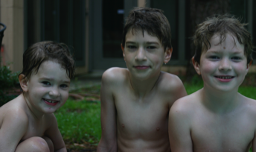
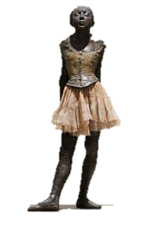
About me
Mentors
Research
improve the performance, programmability, correctness, security, and energy efficiency of computer systems
Career
life
Family
Notes:
Now that you know me a little, a few quick questions for you. Please raise your hand if you are an undergraduate. Graduate student?

Slide 3
Researchers solve problems & ask questions

Slide 4
My undergraduate & graduate research
1983 What is the bottleneck in a local area network?
1984 TED A Text EDitor to help Fortran programmers produce correct programs
1992 Interactive and automatic parallelization
Performance
Programmer Tools
Optimization

Slide 5
Programming language researchers
Help people make computers do stuff

Slide 6
Classic topics I
Design programming languages
Correctness, expressiveness, efficiency
Specify semantics for languages & programs
Prove properties about languages & programs
Programming language implementation

Slide 7
Programming languages timeline
https://www.levenez.com/lang/lang.pdf

Slide 8
Classic topics II
Compilers & interpreters
map high level to low level languages
correct, secure, etc.
Finding bugs in programs
Performance of programs
Profiling, benchmarks, measurements

Slide 9
Classic topics III

Slide 10
Classic topics III
Tools for programmers, users, & PL researchers
writing programs
writing programming languages
proving things about programs
compiling & optimizing programs
debugging programs
profiling programs

Slide 11
Techniques PL researchers use
Language grammars & tools
Lambda calculus
Type theory
Data flow analysis
Static analysis
Dynamic analysis
Simulation
Proof languages
Model checking
Proof assistants
SMT solvers
Synthesis

Slide 12
Applications & Hardware Change
but… they always need a
programming language and implementation

Slide 13
PLDI 06 & 07 Topics Submitted/Accepted

Slide 14
Hot Topics in CS become PL topics
Big data & streaming
Approximation
Machine learning
Probabilistic programming
Human computation
Spreadsheets as programs
Hardware
Multicore
GPUs, accelerators
Non volatile memory

Slide 15
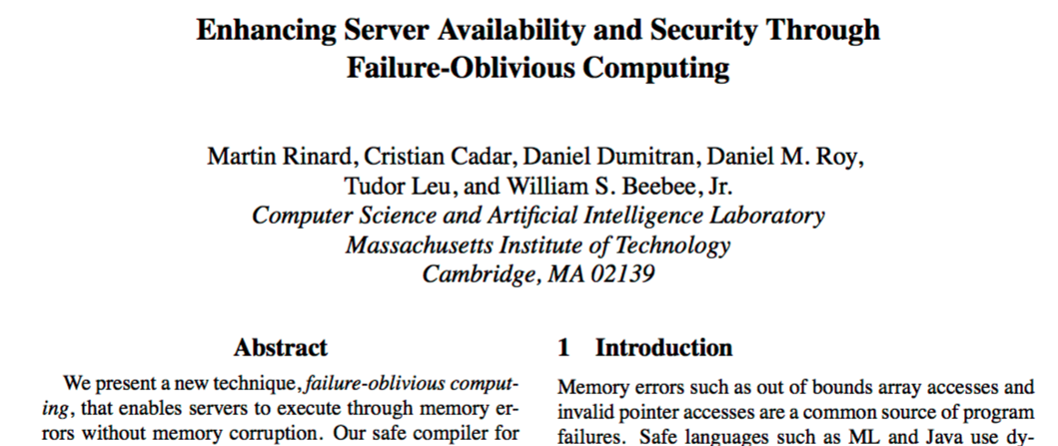
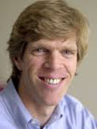
Exploring new topics
Rejected for
3 years from
PL venues
First paper
failure oblivious ➔ approximate computing
OSDI 2004

Slide 16
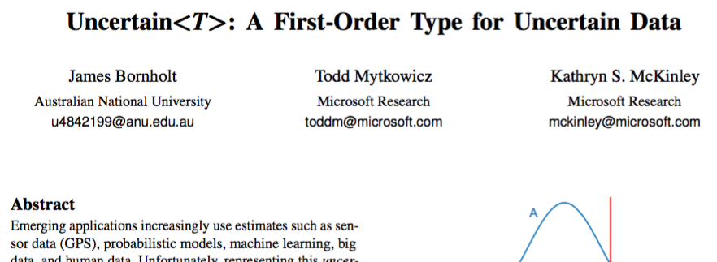
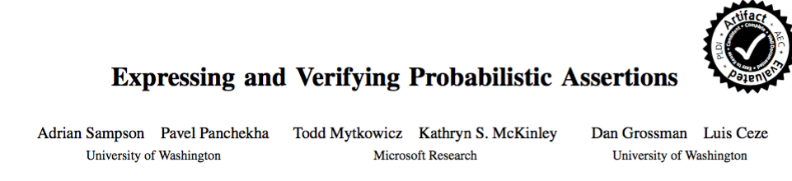
Exploring new topics
Rejected next papers for
3 years from
PL & ML venues
ASPLOS 2014
Two papers
probabilistic programming for the rest of us
PLDI 2014

Slide 17
Sample reviews
… damage the field ....
This is utter nonsense.
It seems heavily based on Uncertain<T>

Slide 18
Graduate school is a roller coaster of success and failure
"I have missed more than 9000 shots in my career. I have lost almost 300 games. On 26 occasions I have been entrusted to take the game winning shot... and missed. And I have failed over and over and over again in my life. And that is why I succeed." -- Michael Jordan

Slide 19
Learning from Failure and Success
Admitted without funding
Failed my qualifying exams
Research papers accepted
Research papers rejected
Bad teaching reviews

Slide 20
Researcher characteristics
thick skin
growth mind set
persistence

Slide 21
PL is fundamental to CS

Slide 22
Resources
Want to try out research?
www.cra-w.org
Are you considering graduate school?
http://conquer.cra.org
Need support in graduate school and beyond?
www.cra-w.org

