Slide 1
Cloud Control Workshop Keynote
ICAC/SASO Keynote
PLDI Chairs Remark
June 2019
Acknowledgements
This talk was modeled on Radhika Nagpal’s 2019 CRA-W Grad Cohort Talk. I am inspired by my colleagues and fellow CRA-W Board Members

Slide 2
Better Computing Culture
=
More Innovation
Kathryn S McKinley
as a scientist
Notes:
Better culture will result in more innovative research, and not just in general, for you personally.
In this talk, I will show you some science around teams and culture, discuss my story, and give you some tips on how you can improve the culture of computing.
go/research-culture-external-2019

Slide 3
Computing Culture
FACTS
MYTHS

Slide 4
Myth of the isolated genius

Slide 5
Facts Partnerships and Teams

Slide 6
Teams?

Slide 7
Measure Team Performance on McGrath Circumplex Tasks
Woolley & Malone
Science 2010
Teams: 190 ad-hoc groups of 2-5 people
Measure: solutions, interactions, IQ, gender, etc.
Predictors of team performance
Average social sensitivity of group
Equality of conversational turn taking
Number of women in group
Not maximum individual IQ or average IQ
Notes:
8 task types: Intellectual, executive, creative, group decision making, etc.

Slide 8
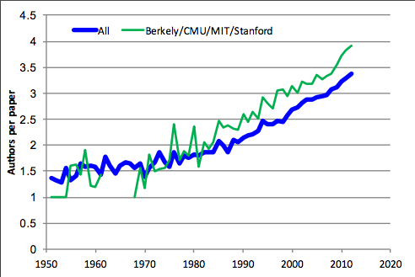
ACM Paper Authors Blackburn & McKinley 2015
Notes:
Another measure of team work is papers and authors on papers. Over time the number of citations to each paper has increased, but at the top ranked computer science departments, Berkeley, CMU, MIT and Stanford in the late 1980s, their papers had more than the average number of authors. They collaborate more. Together this data tells us good science is collaborative and slightly larger teams with women have more influence.

Slide 9
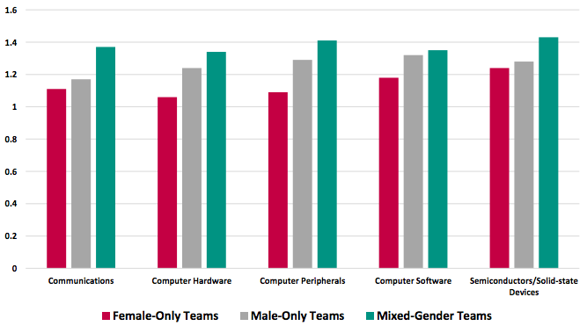
Citations to Patents 1980-2010 Ashcraft & Breitzman 2012
Mixed gender patents
have more citations
Notes:
Patents are another measure of innovation and citations to patents are a measure of impact. Mixed sex teams have more citations. Ashcraft and Breitzman (2012) normalizes individual patent citation counts by technology class and year granted to account for technologies with higher average citation counts than others and that older patents have longer to accrue citations. Source: Ashcraft and Breitzman (2012).

Slide 10
Myth
Women are not interested in computing

Slide 11
Art Analogy
95% of Artists are Men in Modern Art sections
of the Metropolitan Museum
85% of the nudes are women

Slide 12
Women are not interested in computing,
art, film, and fashion
x

Slide 13
Myth
It’s a pipeline problem

Slide 14
It’s a pipeline problem
x
36% of 1986 Computing Undergraduates were Women, but Women do not make up 36% of Computing Leadership today

Slide 15
My Research Culture
Notes:
Research and computing culture starts with you.
Encourage at least as many women as you encourage men undergraduates
Hire diverse students into your lab
Learn how to be a better mentor.
Better research

Slide 16
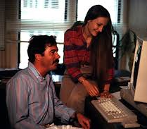
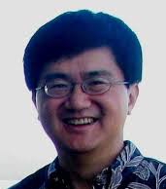
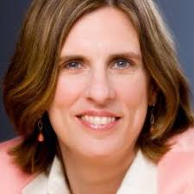
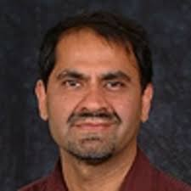

Slide 17
Students fall down
Help them
Notes:
In the Rice Research Culture, we helped each other. When I failed my qualifying exam, the obvious next step was to leave graduate school. The students created reading groups. Exchanged papers and ideas, no professor needed to tell us to do it, we had agency

Slide 18
Research Cultural Journey
Expect and learn from mistakes and failures
Personal agency
Listen
Ask questions, even if when I have some answers
Acknowledge and repeat what other people say
Scientists have no one “look” or personality

Slide 19
Better Culture
=
More Innovation
Go slow to counter bias
Hire diversely
Encourage students equally
Equal air time, listen
Learn to mentor
Notes:
Computing and research culture starts with you.
Better culture will result in more innovative research, and not just in general, for you personally.
Encourage at least as many women as you encourage men undergraduates
Hire diverse students into your lab
Learn how to be a better mentor.
The results will benefit you and your research

