Slide 1
A Research Mindset
Kathryn S McKinley

Slide 2
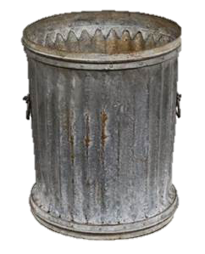
2 of 4
Good
Men
Known for
My job
Efficiency

Slide 3
My CV Does not
include failures
Known for
My job
Efficiency

Slide 4
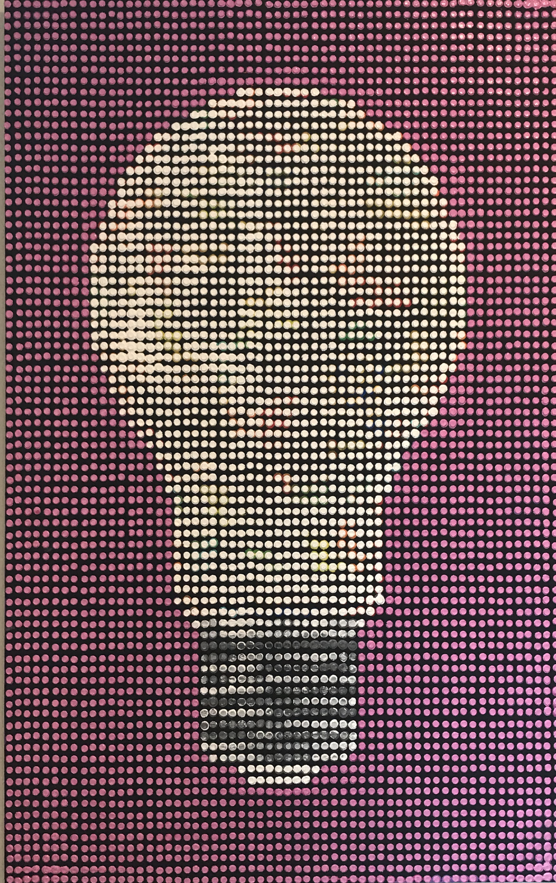
A Research Mindset
I will
Examine and counter my biases
Learn from failures
Learn emotional resilience
Learn & innovate technically

Slide 5
My Mindset / Strategies
For bias
Look ahead of the bandwagon
Classic problems never go out of style, they just have new contexts
For research setbacks
Don’t wait for external feedback, self identify problems
Limit feeling sad to X days, then consciously channel sad to response
Synthesize feedback to adjust strategy
Strategize with collaborators, ask advice more broadly
For managing my emotions
Daily exercise, sleep, fruits & vegies, family time
For creativity
Create unscheduled work time (sadly still often on weekends)
Read a lot and critically; what did they forget? logical next 4 steps/papers?

Slide 6
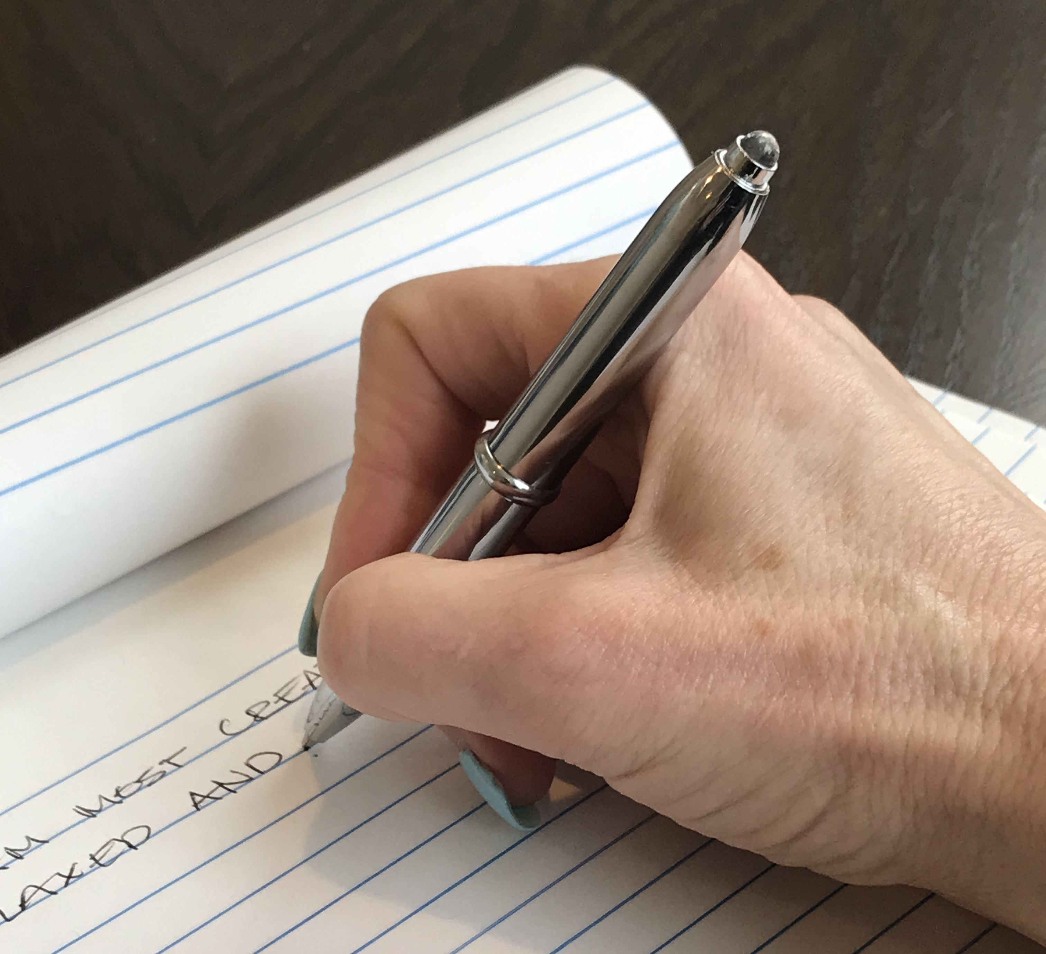
Reflection
Write down
A recent creative idea
What were the circumstances (when, where, why, etc.)?
Circumstances under which you feel least creative

Slide 7
What’s Next?
Concepts
Cognitive bias and creativity
Flexible optimism for perseverance
Growth Mindset
Interspersed with reflections
Discussion & Questions

Slide 8
Bias
A cognitive bias is a pattern judgment, which humans need to function and at the same time leads to illogical conclusions
Bias arises from various processes and are difficult to distinguish
use of information-processing shortcuts (heuristics, generalizations)
mental noise
the mind's limited information processing capacity
emotional and moral motivations
social influence
Notes:
As scientists, we need to examine our biases and take action to reduce their impact (fast vs slow thinking).
As humans we have to generalize to get through our day.

Slide 9
Example Biases
Stereotypes
Survivor
Anchoring
Confirmation
Exposure & Recency
Attention (repetition)
Conservative (Bayesian)
Gamblers’ fallacy
Authority
Bandwagon
Dunning-Kruger effect newbies overestimate, experts underestimate
Framing
Von Restorff effect remember surprises
Curse of Knowledge
Congruence (one hypothesis)
Notes:
Stereotype: Assuming physical characteristics or social preferences influence ability
Survivor bias: neglects the people things that did not make it
Anchor: one piece of knowledge
Confirmation: fits into your mental model
Attention is your mind versus external exposure
New or contrary evidence is harder to assimilate
Gambler: assuming the past affects the future of independent events, e.g., a coin flip
Curse of knowledge: experts find it hard to think of problems from the point of view of non experts
Congruence: only test one thing versus considering multiple hypotheses

Slide 10
Example Biases
Stereotypes
Survivor
Anchoring
Confirmation
Exposure & Recency
Attention (repetition)
Conservative (Bayesian)
Gamblers’ fallacy
Authority
Bandwagon
Dunning-Kruger effect newbies overestimate, experts underestimate
Framing
Von Restorff effect remember surprises
Curse of Knowledge
Congruence (one hypothesis)
Creative thinking
“outside The Bias box”
Notes:
Limited evidence slowing down counters people stereotypes, but you can “blind” people processes. Research creativity and designing experiments is different than generalizing about people.

Slide 11
Example Biases
Stereotypes
Survivor
Anchoring
Confirmation
Exposure & Recency
Attention (repetition)
Conservative (Bayesian)
Gamblers’ fallacy
Authority
Bandwagon
Dunning-Kruger effect newbies overestimate, experts underestimate
Framing
Von Restorff effect remember surprises
Curse of Knowledge
Congruence (one hypothesis)
Creative thinking
“outside The Bias box”
Slow Down
Examine your Biases
Notes:
Limited evidence slowing down counters people stereotypes, but you can “blind” people processes. Research creativity and designing experiments is different than generalizing about people.

Slide 12
Reflection & Discussion
Write down
Was overcoming bias a factor in your creativity?
Are other circumstances holding you back? For example, spending time doing what you know (homework) versus new skills (research, writing)

Slide 13
Life Happens

Slide 14
Real Life is Unpredictable
World events
Local events
Family & Friends
Relationships
Health
good / bad

Slide 15
Research Events Are Predictable
Have ideas
Work on ideas
Discuss ideas informally
Write up ideas
Submit paper
Give talk / teach class
Receive feedback
Receive structured feedback
good / bad
succeed / fail
well / poorly
well / poorly
accept / reject
well / poorly
positive / negative
positive / negative

Slide 16
Reflection & Discussion
Write down
A recent positive event
Your feelings about what contributed most to that event

Slide 17
Reflection & Discussion
Write down
A recent negative event
Your feelings about what contributed most to that event

Slide 18
Keeping Positive
I will
learn and execute strategies to overcome failures and obstacles
learn and execute emotional resiliency strategies to manage myself in times of stress and failures

Slide 19
Pessimism versus Optimism
What is optimism?
What is pessimism?
Can optimism be learned?
Is optimism a biased view of reality?
Is optimism always the better choice than pessimism?

Slide 20
Explanatory Style
Permanence (time)
Pervasiveness (space)
Personalization (you or not you)

Slide 21
Explain to Yourself
Permanence (time)
Pervasiveness (space)
Personalization (you or not you)
Your paper gets accepted
Your paper gets rejected

Slide 22
Permanence (time)
Optimistic
Good events have permanent causes
Bad events have temporary causes / specific to situation
Pessimistic
Good events have temporary causes
Bad events have permanent causes / specific to situation

Slide 23
Pervasiveness (space)
Optimistic
Good events caused by general / universal factors
Bad events caused by specific factors
Pessimistic
Good events caused by specific factors
Bad events caused by general / universal factors

Slide 24
Personalization
Optimistic
Good events caused by me & other factors
Bad events caused by circumstances, luck, others
Pessimistic
Good events by circumstances, luck, others
Bad events caused by me

Slide 25
Pessimists
believe bad events / misfortune
will last a long time
will undermine everything they do
are their own fault
Pessimistic explanatory style produces passiveness from believing action is futile

Slide 26
Optimists
believe bad events / misfortune
is a temporary set back
is limited to this one event
is not my fault, other people, circumstances, bad luck
Optimistic explanatory style produces action, trying harder, particularly after a defeat or under pressure or given a challenge

Slide 27
Delusions
It is never your fault
Optimism is always positive and desired in all situations
Optimistic people face less failures overall in their work
Optimism is a character trait and cannot be learned
Success favors the most talented
Flexible optimism
Success needs both optimism and occasionally some pessimism
Success does not always favor the most talented, but rather the adequately talented that are also optimists!

Slide 28
Report back
Permanence (time)
Pervasiveness (space)
Personalization (you or not you)
Your paper gets accepted
Your paper gets rejected

Slide 29
Next Layer

Slide 30
Fixed versus Growth Mindset
Fixed Mindset
I am smart or not
I am athletic or not
I am empathetic or not … etc.
Success is because I am X
Failure is because I am not X or I am not X enough
Growth Mindset
If I work hard, I can learn X

Slide 31
Research Mindset for Research Life Events
I will
Counter my biases
Learn from failures
Learn emotional resilience
Learn & innovate technically
Have ideas
Work on ideas
Discuss ideas informally
Write up ideas
Submit paper
Give talk / teach class
Receive verbal feedback
Receive formal evaluation

Slide 32
Discussion & Questions
Acknowledgements
Inspired by Professor Samuel Kounev’s course notes
Professor Lori Pollock
Resources
Carol Dwick, “Mindset: The New Psychology of Success”
Martin Seligman, Learned Optimism, Questionaire
Daniel Kahneman, “Fast versus Slow Thinking”
Implicit Bias Testing, https://implicit.harvard.edu/
Olivia Goldhill, “The World is Relying on a Flawed Psychological test to Fight Racism”

Slide 33
Homework I Review your answers
Permanence (time)
Pervasiveness (space)
Personalization (you or not you)
Recent positive experience
Recent negative experience
Your paper gets accepted
Your paper gets rejected

Slide 34
Homework II pick a positive and negative event where your responses tend to pessimism and work to make them more optimistic
Have ideas
Work on ideas
Discuss ideas informally
Write up ideas
Submit paper
Give talk / teach class
Receive verbal feedback
Receive formal evaluation
good / bad
succeed / fail
well / poorly
well / poorly
accept / reject
well / poorly
positive / negative
positive / negative

