Slide 1
How’s the Parallel Computing Revolution Going?
Kathryn S. McKinley
The University of Texas at Austin
Notes:
Today I am going to start with a history lesson
Over the past 40 years, hardware designers created technologies that essentially doubled number of transistors on a chip about every two years, as predicted by Gordon Moore, resulting in exponential improvements in computer systems that changed how we entertain ourselves, communicate, do business, science, government, and manufacturing! How did that happen?

Slide 2
20th Century Simplicity
Hardware
software does not change
it just runs faster
Notes:
Hardware took a simplistic view of the world. We need to keep running the same software, since rewriting it for every new processor is too costly.

Slide 3
20th Century Simplicity
Software
hardware does not change
it just runs faster
Notes:
Software designers and developers

Slide 4
How could they pretend?

Slide 5
Sequential interface hid explosion in capability & complexity
sequential interface
sequential interface
Hardware Capabilities &
Complexity
Software
Capabilities & Complexity
20th Century Virtuous Cycle

Slide 6
20th Century Languages insufficient for software complexity
Native
Programming Languages

Slide 7
21st Century Managed Language Revolution
PHP

Slide 8
sequential interface
sequential interface
Hardware Capabilities &
Complexity
Managed Languages
Software
Capabilities
20th Century Virtuous Cycle
Notes:
Computer architects

Slide 9
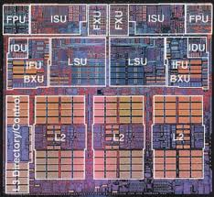
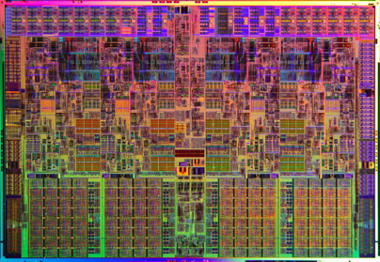
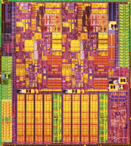
Processor Evolution
Power 4
1.3 GHz
130nm
174M Tr.
267 mm²
2 Cores
2001
Power 5
2.3 GHz
90nm
276M Tr.
389 mm²
2 Cores
2005
i7
2.7 GHz
45nm
731M Tr.
263mm²
4 Cores x 2 SMT
2008
i5
3.4 GHz
32nm
382M Tr.
81mm²
2C x 2T
2010

Slide 10
Processor Evolution
why multicore?

Slide 11
Processor Evolution
why multicore?
on chip power constraints & wire delay slowed clock scaling

Slide 12
20th Century Virtuous Cycle
✗
✗
sequential interface
sequential interface
Hardware Capabilities &
Complexity
Managed Languages
Software
Capabilities
Notes:
Computer architects

Slide 13
21st Century Virtuous Cycle?
Parallel interface
Parallel interface
?
Managed Languages
Parallel Hardware Capabilities
Software
Capabilities
Notes:
Computer architects

Slide 14
21st Century Virtuous Cycle ?
parallel interface
combines time and space
wicked to program
CPU
CPU
CPU
CPU
CPU
CPU
CPUs
8KB L1
32KB
32KB
32KB
32KB
32KB
32KB
32KB
32KB
512KB L2
4MB L2
4MB L2
256KB
256KB
256KB
256KB
8MB L3
system bus
Pentium 4
w/ SMT
Core 2 Quad
Core i7
Notes:
Computation and data define computer performance

Slide 15
How is this new virtuous cycle going?

Slide 16
What should we measure?

Slide 17
performance power energy native languages managed languages sequential & parallel programs

Slide 18
How do we measure power?

Slide 19
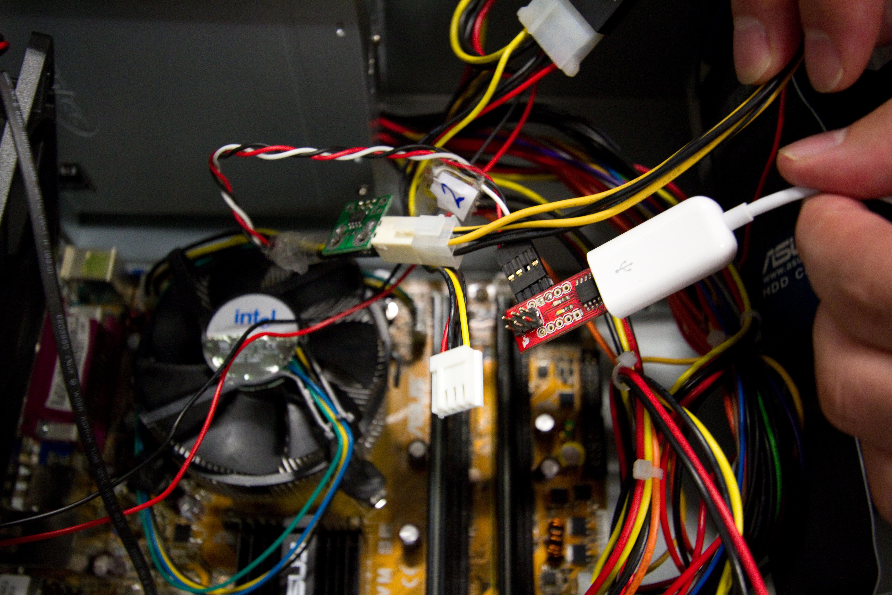

Slide 20
Looking Back on the Language & Hardware Revolutions: Measured Power, Performance, and Scaling ASPLOS 2011
Hadi Esmaeilzadeh
University of Washington
Ting Cao
Australian National University
Xi Yang
Australian National University
Stephen M. Blackburn
Australian National University
Kathryn S. McKinley
University of Texas at Austin
Notes:
Need text here

Slide 21
Workload 4 groups weighed equally 61 benchmarks from 6 suites
Native Non-Scalable: SPECcpu 2006
Native Scalable: PARSEC 2008
Java Non-Scalable:
SPECjvm98, JBB’05 DaCapo’06
Java Scalable: DaCapo’09

Slide 22
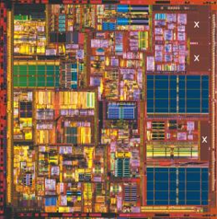
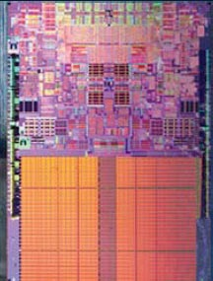
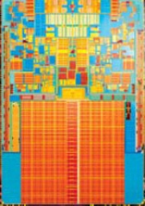
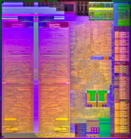
Intel Processors 5 technology generations from similar price points
Pentium 4
130nm
55M Tr.
131mm²
1C x 2T
2003
Core 2 D
65nm
291M Tr.
143mm²
2C
2006
i7
45nm
731M Tr.
263mm²
4C x 2T
2008
Atom
45nm
47M Tr.
36mm²
1C x 2T
2008
Core 2 D
45nm
228M Tr.
82mm²
2C
2009
Atom D
45nm
176M Tr.
87mm²
2Cx2T+GPU
2009
i5
32nm
382M Tr.
81mm²
2C x 2T
2010

Slide 23
TDP & Measured Power

Slide 24
Measured Power vs Performance
2003
2008
Pentium 4 (130)
i7 (45)
2006
Core 2 Duo (65)
i5 (32)
?
2010
Core 2 Duo (45)
?
2008

Slide 25
How is this new virtuous cycle going for native non-scalable?

Slide 26
Native Non-Scalable Performance

Slide 27
Native Non-Scalable Energy

Slide 28
How is this new virtuous cycle going for Java single threaded?

Slide 29
Java Single Threaded Performance

Slide 30
Java Single Threaded Energy

Slide 31
How is this new virtuous cycle going for native scalable?

Slide 32
Native Scalable Performance

Slide 33
Native Scalable Energy

Slide 34
How is this new virtuous cycle going for Java scalable?

Slide 35
Java Multithreaded Performance

Slide 36
Java Multithreaded Energy

Slide 37
Is there hope?

Slide 38
parallel interface
combines time and space
wicked to program
CPU
CPU
CPU
CPU
CPU
CPU
CPUs
8KB L1
32KB
32KB
32KB
32KB
32KB
32KB
32KB
32KB
512KB L2
4MB L2
4MB L2
256KB
256KB
256KB
256KB
8MB L3
system bus
Pentium 4
w/ SMT
Core 2 Quad
Core i7

Slide 39
Vision
Algorithms must be space and time efficient
Scalable Runtimes
Runtime & application parallelism & concurrency
CMP aware runtime improves application scalability
Communication
Cache coherency is expensive and performance sensitive
Memory bandwidth scaling is problematic
Heterogeneity
Move non-critical path off power-hungry cores
Smarter, more aggressive analysis
Specialization?
Tuned cores? Special purpose cores?

Slide 40
Managed Languages Challenges & Opportunities

Slide 41
Must start with a scalable managed runtime

Slide 42
Sequential Managed Programs
time
Application
Managed Runtime
Single
Core
Profiling
Dynamic Analysis
Compilation
Garbage Collection
Other Helper Threads
……

Slide 43
Steps towards scalability
Step 1. Parallel application
time
Core 0
Core 1
Core 2
Application
Core 3
Threads
Core 4
Core 5
Core 6
Unused cores
Core 7
Each thread has different running time

Slide 44
Steps towards scalability
Step 2. Parallel runtime
time
Core 0
Core 1
Core 2
Application
Managed
Application
Core 3
Threads
Runtime
Threads
Core 4
Core 5
Core 6
Core 7
Runtime waits for all application threads to pause

Slide 45
Steps towards scalability
Step 3. Parallel & concurrent runtime
time
Core 0
Core 1
Core 2
Application
Managed
Application
Core 3
Threads
Runtime
Threads
Core 4
Core 5
Core 6
Core 7
Managed runtime on application’s critical path
may perturb performance

Slide 46
Steps towards scalability Ideal model
Step 4. Minimize perturbation
time
Core 0
Core 1
Core 2
Application
Analysis
Application
Core 3
Threads
Threads
Threads
Core 4
Core 5
Whole runtime task taken off critical path
Core 6
Core 7
Offload work to concurrent runtime threads

Slide 47
Steps towards scalability Ideal model
Step 4. Minimize perturbation
time
Core 0
Core 1
Core 2
Application
Analysis
Application
Core 3
Threads
Threads
Threads
Core 4
Core 5
Core 6
Core 7
Worst case is parallel & concurrent

Slide 48
Scalable VM Services
Profiling (feedback directed optimization)
Concurrent analysis
More invasive analysis on low-power cores
J. Ha et al. OOPSLA’09, Bond et al., PLDI’10, etc.
GC
High performance parallel & concurrent GC
High performance mostly non-moving GC
Reduced synchronization overheads
Distributed & scratchpad GC
Blackburn et al. PLDI’10,CACM’08,PLDI’08,SIGMETRICS’04, etc.
JIT
Concurrent, parallel JIT
Cost-benefit shift with low-power cores
Ha et al. PESPMA’09
Architecture
Tuned and/or specialized cores for runtime services
Coherence tailored for restricted, common case of GC

Slide 49
Today
Profiling (feedback directed optimization)
Concurrent analysis
More invasive analysis on low-power cores
J. Ha et al. OOPSLA’09, Bond et al., PLDI’10, etc.
GC
High performance parallel & concurrent GC
High performance mostly non-moving GC
Reduced synchronization overheads
Distributed & scratchpad GC
Blackburn et al. PLDI’10,CACM’08,PLDI’08,SIGMETRICS’04, etc.
JIT
Concurrent, parallel JIT
Cost-benefit shift with low-power cores
Ha et al. PESPMA’09
Architecture
Tuned and/or specialized cores for runtime services
Coherence tailed for restricted, common case of GC

Slide 50
Garbage Collection
Notes:
Garbage collectors allocate objects in memory on behalf of programs and then automatically reclaim memory when the program stops referencing objects
The time it takes directly affects performance
Less obvious, is that how it lays out objects in memory directly affects every application’s time and space
Thus garbage collection is a critical component for all modern applications that use managed languages, such as C#, Java, JavaScript, and PHP
These characteristics make it an excellent exemplar

Slide 51
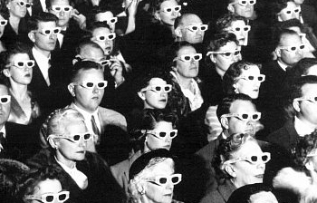
Isn’t Garbage Collection retro?
Mark-Sweep
McCarthy, 1960
Mark-Compact
Styger, 1967
Semi-Space
Cheney, 1970
canonical algorithms
Notes:
In 1960, John McCarthy invited the mark-sweep garbage collection algorithm—fittingly like the McCarthy era, mark-sweep suffers from fragmentation—it scatters objects in memory.
The summer of love in 1967 brought us together—the mark-compact algorithm trades computation to eliminate fragmentation
In the era of the third Jackson 5 album, the semi-space algorithm went the other way—it trades space to reduce fragmentation.
GC algorithms mix and match these canonical algorithms, starting from Steele & Djkstra’s concurrent collectors up through to modern generational collectors
Although GC went out of fashion for a while, modern developers prefer garbage collected languages

Slide 52
Programmer Productivity
Notes:
Why? because GC eliminates both a programming task and a class of bugs

Slide 53
Programmer Productivity & Performance?
Notes:
and programmers were willing to suffer space and time overheads

Slide 54
GC Fundamentals Algorithmic Components
Allocation
Identification
Reclamation
`
Sweep-to-Free
Tracing
(implicit)
Free List
Compact
Reference Counting
(explicit)
Bump Allocation
Evacuate
3
1
Notes:
A GC algorithm can be broken down into of three algorithmic components. How objects are allocated, how garbage is identified, and how space is reclaimed.

Slide 55
GC Fundamentals Canonical Garbage Collectors
Mark-Sweep [McCarthy 1960]
Free-list + trace + sweep-to-free
`
Sweep-to-Free
Mark-Compact [Styger 1967]
Bump allocation + trace + compact
Compact
Evacuate
Semi-Space [Cheney 1970]
Bump allocation + trace + evacuate

Slide 56
Performance Pathologies Mark-Sweep, Mark-Compact, Semi-Space
Semi-Space
Space inefficient
Mark-Sweep
Poor locality
Mark-Compact expensive multi-pass
Geometric mean of DaCapo’06, jvm98, and jbb2000 on 2.4GHz Core 2 Duo
Notes:
Can one algorithm do it all?

Slide 57
Can we have space and time efficiency?

Slide 58
Mark-Region PLDI 2008
Kathryn S. McKinley Stephen M. Blackburn
University of Texas at Austin Australian National University
Notes:
Need text here

Slide 59
Mark-Region with Sweep-To-Region
Reclamation
Mark-Sweep
Free-list + trace + sweep-to-free
Sweep-to-Free
`
Compact
Mark-Compact
Bump allocation + trace + compact
Evacuate
Semi-Space
Bump allocation + trace + evacuate
Mark-Region
Bump + trace + sweep-to-region
Sweep-to-Region
Notes:
We do this by identifying a fourth reclamation strategy, sweep-to-region. It works by dividing the space into regions, and freeing any region with no live objects in it. Regions can then be used for contiguous bump allocation. Mark-region is a canonical collector combining contiguous bump allocation with tracing and sweep-to-region reclamation.

Slide 60
Naïve Mark-Region
0
Contiguous allocation into regions
Excellent locality
Objects cannot span regions
Simple mark phase
Mark objects and their region
Free unmarked region

Slide 61
Region Size?
Lines and Blocks
Large Regions
✓ More contiguous allocation
✗ Fragmentation (false marking)
Small Regions
✗ Increased metadata o/h
✗ Fragmentation (can’t fill blocks)
✗ Constrained object sizes
N pages
Lines & Blocks
approx 1 cache line
Free
Recyclable lines
Free
Recyclable lines
0
• TLB locality, cache locality
• Block > 4 X max object size
• Objects span lines
• Lines marked with objects
✓ Less fragmentation
✓ Fast common case
Notes:
Not to scale! 64K/128 (2^16/2^7) => 512 lines per block!! LOS used for large objects. Freed pages may be reused by other components, such as the LOS

Slide 62
Allocation Policy (Recycling)
Recycle partially marked blocks first
Minimizes fragmentation
Maximizes sharing of freed blocks

Slide 63
Immix Mark-Region
Parallel
Opportunistic defragmentation
Overflow allocation
Implicit marking

Slide 64
Immix Mark-Region Bump Allocation + Trace + Sweep-to-Region
Good locality
Space efficient
✓
✓
Excellent
performance
✓
Simple, very fast collection
✓
Geometric mean of DaCapo’06, jvm98, and jbb2000 on 2.4GHz Core 2 Duo
Notes:
This exemplar shows systematic algorithm understanding combined with new fundamentals can yield more space and time efficient algorithms

Slide 65
Space & time efficiency Why now?
Notes:
To conclude, I want to return to why new space and time efficient algorithms are so critical to the future of computing

Slide 66
The Present
Parallel interface
combines space & time
wicked to program
CPU
CPU
CPU
CPU
CPU
CPU
CPUs
8KB L1
32KB
32KB
32KB
32KB
32KB
32KB
32KB
32KB
512KB L2
4MB L2
4MB L2
256KB
256KB
256KB
256KB
8MB L3
system bus
Pentium 4
w/ SMT
Core 2 Quad
Core i7
Notes:
parallelism ties computation and space together; where data is located in these systems is a primary contributor to computation time.
To parallelizing an algorithm, programmers must divide and coordinate space and time, making parallel systems wicked to program.

Slide 67
The Future
A parallel ecosystem?
space time efficiency
Parallel software stack
runtime
applications
algorithms
Notes:
To drive the next generation of technological advances, computer scientists must help create a new virtuous cycle with a parallel ecosystem

Slide 68
Software Challenges and Opportunities
Communication (efficient coherency)
Analysis (off critical path, new analyses)
GC (concurrent, parallel, high throughput)
JIT (concurrent, parallel, more aggressive)
Heterogeneity (exploit it)
Memory (PCM, bandwidth limits)

Slide 69
Hardware Challenges and Opportunities
Heterogeneity
Tune cores to specific workloads?
Specialize for workloads?
Coherence
SMT coherency does not scale
Software guarantees for simplified protocols?
Memory/Cache
Optimize access behavior of managed languages

Slide 70
The Future?
Thank you

