Slide 1
Measuring and Optimizing Tail Latency
Kathryn S McKinley, Google
Xi Yang, Stephen M Blackburn,
Md Haque, Sameh Elnikety, Yuxiong He, Ricardo Bianchini
Notes:
Thank you. It is really a pleasure to be here today. Why am I even here today?
Today I am going to talk about how to understand and optimize tail latency and server efficiency for large scale web services. My talk includes research with my colleagues from ANU and my former employer, Microsoft, as well as drawing widely from the literature and practice.

Slide 2




Slide 3

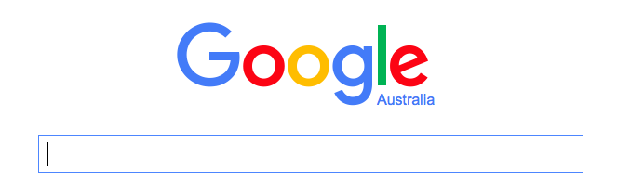
Tail Latency Matters
TOP PRIORITY
Two second slowdown reduced revenue/user by 4.3%. [Eric Schurman, Bing]
400 millisecond delay decreased searches/user by 0.59%. [Jack Brutlag, Google]
Notes:
*As we all know that the tail latency of web services matters.
Even Small increases in 99 percentile latency causes users to abandon the service, and providers to lose money.
One of the ways providers control latency is by over provisioning.

Slide 4

Efficiency Matters Too
Photo: Google/Connie Zhou
Notes:
Efficiency matters too

Slide 5
Tail Latency
BOTH ?!
Efficiency
Notes:
This talk is going to examine how to understand sources of tail latency and when it is possible to deliver low tail latency to users efficiently, which is good for providers bottom line and the planet.
Let’s first dig in a bit on characteristics of interactive web services.

Slide 6
Server architecture
client
aggregator
workers
Notes:
Interactive services, use a client server architecture.
These software architectures use an aggregator and workers.
They typically use parallelism and replication for reliability, scale, and throughput.
The aggregator farms out requests, waits for workers to respond and then, return a result to the user.
Since the overall response depends on the slowest worker, each worker has a strict latency constraints such as 99% of requests must finish in 200 milliseconds, which is commonly called tail latency.

Slide 7

Characteristics of interactive services
LC
Bursty, diurnal
CDF changes slowly
Slowest server dictates tail
Orders of magnitude diff
average & tail - 99th %tile
Notes:
Interactive services are highly engineered systems

Slide 8
What is in the tail?
?

Slide 9
Roadmap
Diagnosing the tail with continuous profiling
Noise systems are not perfect
Queuing too much load is bad, but so is over provisioning
Work some requests are long
Insights Use the CDF off line
Long requests reveal themselves, treat them specially

Slide 10
Prior state of the art
Dick Site, Google, 2015
https://www.youtube.com/watch?v=QBu2Ae8-8LM

Slide 11
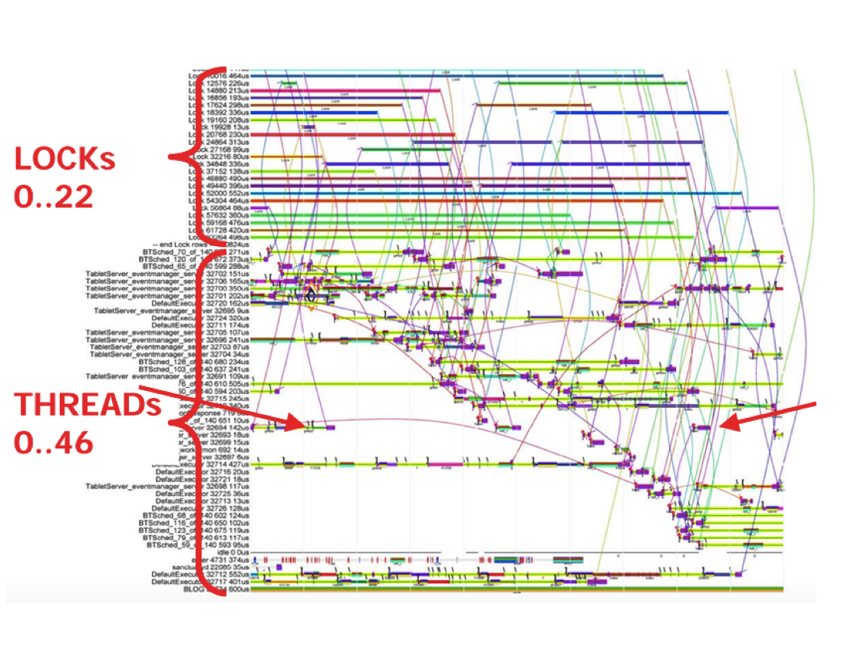
@ Google 2015 Open source Google SchedViz tool coming soon!
Hand instrument application
1% on-line budget
sample
Off-line schematics
Have insight
Improve the system

Slide 12
Request profiling
Hand instrument application
1% on-line budget
sample
Off-line schematics
Have insight
Improve the system

Slide 13
Request profiling
✗
Hand instrument application
1% on-line budget
sample
Off-line schematics
Have insight
Improve the system
Automated instrumentation
1% on-line budget
continuous on-line profiling
Off-line schematics
Have insight
Improve the system
+ On-line optimization
✗

Slide 14
Automated cycle-level on-line profiling
[ISCA’15 (Top Picks HM), ATC’16]
Insight Hardware & software generate signals
hardware signals
software signals
performance counters
memory locations
counters
tags
✓
✓
✓
✓
14

Slide 15
SHIM Design
ISCA’15 (Top Picks HM), ATC’16

Slide 16

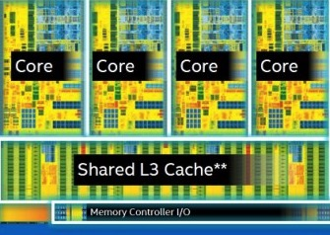
Observe global state from other core
while (true):
for counter in LLC misses, cycles:
buf[i++] = readCounter(counter)
LLC misses per cycle
16

Slide 17
Observe local state with SMT hardware
while (true):
for counter in HT2 SHIM, Core, Cycles:
buf[i++] = readCounter(counter);
HT1 IPC
HT1
Core IPC
HT2
HT2 SHIM IPC
HT1 IPC = Core IPC – HT2 SHIM IPC
17

Slide 18
Correlate hardware & software events
while (true):
for counter in HT2 SHIM, Core, cycles:
buf[i++] = readCounter(counter);
tid = thread on HT1
buf[i++] = tid.method;
HT1 IPC
HT1
Core IPC
HT2
HT2 SHIM IPC
C()
B()
A()

Slide 19
Fidelity

Slide 20

Raw samples
% of samples
(log scale)
IPC (log scale)
Notes:
Existing profilers share a same problem, low sampling rate.
Low sampling rate -> 1) can’t observe fine granularity events, 2) can’t

Slide 21
Problem: samples are not atomic
IPC Counters C: cycles R: retired instructions
✓
✓
✗
IPC₁
IPC₂
IPC₃
time

Slide 22
Solution: use clock as ground truth
IPC Counters C: cycles R: retired instructions
✓
✓
✗
IPC₁
IPC₂
IPC₃
time
C^{s}_{t} – C^{s}_{t-1} = Ce_{t} – Ce_{t-1}
C^{s}_{t} – C^{s}_{t-1} != Ce_{t} – Ce_{t-1}

Slide 23

Filtering Lusearch IPC samples
% of samples (log scale)
---- raw IPC
---- filtered IPC
---- raw CPC
---- filtered CPC in [0.99,1.01]
Notes:
after filitering with CPC metric, we can trust those samples, and they are in the valid range
This is the completed design of our tool, you can check it out from github

Slide 24
Overheads
113MHz: 3+ orders of magnitude
over interrupt ‘maximum’
3MHz: 1+ order of magnitude over interrupt ‘maximum’
Normalized to
without SHIM
method and loop IDs
Overheads from write invalidations on other core
Notes:
method and loop IDs are very high frequency signals

Slide 25

IPC of Lucene methods
IPC
top 10 methods (74% total execution time)
Notes:
if we increase the frequency 100x more, then we see very interesting pictures.
20 for legends, keys, 28 font size for words, title 36

Slide 26
Understanding Tail Latency with SHIM
Configure SHIM on Requests
thread ids
request id – configure
time stamps, PC
Configure SHIM on System threads
thread ids
time stamp, PC

Slide 27
All requests

Slide 28
The Tail Longest 200 requests
Network & other
Idle
CPU work
Queuing at worker
}
noise
Network imperfections
OS imperfections
Long requests
Overload
}
not noise
latency

Slide 29
Insight
Long requests reveal themselves
Regardless of the cause

Slide 30
Noise Replicate & reissue
The Tail at Scale, Dean & Barroso, CACM’13
All requests?
Too expensive
CFD for cost & potential
Fixed issue time
Still not cheap
5% reissued
10 % reissued
noise
30

Slide 31
Probabilistic reissue
Optimal Reissue Policies for Reducing Tail Latencies, Kaler, He, & Elnickety , SPAA’17
Adding randomness to reissue makes one earlier reissue time d (vs n) optimal
Probability is proportional to reissue budget & noise in tail
Cheaper
5% reissued
1-3% reissue w/ prob. p
noise
31

Slide 32
Reissue is Useless & Wasteful When
Tail is Work
work

Slide 33
Work Speed up the tail efficiently
Judicious, Incremental parallelism
[ASPLOS’15]
DVFS faster on the tail
[DISC’14, MICRO’17]
Asymmetric multicore
[DISC’14, MICRO’17]
work

Slide 34
Work Parallelism
Parallelism historically for throughput
Idea
Parallelism for tail latency
0
0
0
0
0
0
0
0
0
0
0
0
0
0
0
0
Notes:
* Let’s consider the servers.
They are multicore and use their parallelism for throughput.
Our work uses this hardware parallelism for individual requests to optimize their tail latency.
Unfortunately, simply parallelizing every request quickly oversubscribes resources.

Slide 35
Parallelism, but Incremental [ASPLOS’15]
Parallelism historically for throughput
Idea
Parallelism for tail latency
0
0
0
0
Insight
Long requests reveal themselves
0
0
0
0
0
0
0
0
Approach
Incrementally add parallelism to
long requests – the tail –
based on request progress & load
Notes:
* Let’s consider the servers.
They are multicore and use their parallelism for throughput.
Our work uses this hardware parallelism for individual requests to optimize their tail latency.
Unfortunately, simply parallelizing every request quickly oversubscribes resources.

Slide 36
Parallelism, but Incremental [ASPLOS’15]
Parallelism historically for throughput
Idea
Parallelism for tail latency
0
0
0
0
Insight
Long requests reveal themselves
0
0
0
0
0
0
0
0
Approach
Incrementally add parallelism to
long requests – the tail –
based on request progress & load
Notes:
* Let’s consider the servers.
They are multicore and use their parallelism for throughput.
Our work uses this hardware parallelism for individual requests to optimize their tail latency.
Unfortunately, simply parallelizing every request quickly oversubscribes resources.

Slide 37
Queuing theory
Optimizing average latency maximizes throughput
But not the tail!
Shortening the tail reduces queuing latency

Slide 38
Incremental Parallelism
Incrementally add parallelism to long requests based on progress (distribution) & load
Fixed add thread every d ms
Long delay good at high load
Short delay good at low load
Load
aware
parallelism

Slide 39
Evaluation 2x8 64 bit 2.3 GHz Xeon, 64 GB
Incremental Parallelism
Few to Many
Sequential
21% fewer servers
or reduce tail by 28%
Notes:
* Our evaluation shows Few to Many improves tail latency.
* Furthermore, for a given latency, it delivers higher throughput, which means you can buy fewer servers.

Slide 40
Work speed up the tail efficiently
Judicious parallelism [ASPLOS’15]
✔
work

Slide 41
Work speed up the tail efficiently
DVFS faster on the tail [DISC’14, MICRO’17]
Asymmetric multicore (AMP) [DISC’14, MICRO’17]
all requests @ 2.3 MHz
work

Slide 42
Speed up the tail efficiently
DVFS faster on the tail [DISC’14, MICRO’17]
+ available in servers today
0.5 MHz
3 MHz

Slide 43
Speed up the tail efficiently
DVFS faster on the tail [MICRO’17]
+ available in servers today
Asymmetric multicore (AMP) [DISC’14, MICRO’17]
+ much more energy efficient
+ hyper-threading is a form
- core competition
0
0
0
0
0
0
0
0
0
0

Slide 44
Adaptive Slow to Fast Framework
Slow to fast migration is energy optimal [ICAC’13]
Goal
  Minimize energy consumption and satisfy a tail latency target
Challenges
  When to migrate?
  What if the core speed is not available?
Insight
  Use big core just enough th+(l₉₉-th)/sp ≤ target
  Migrate oldest first and migrate early under load!

Slide 45
Efficient Tail Latency
Diagnosing the tail with continuous profiling
Noise replicate, systems are not perfect
Queuing not today!
Work judicious use of resources on long requests
Request latency CDF is a powerful tool
Tail efficiency ≠ average or throughput
Hardware heterogeneity
Thank you

Slide 46
Tail Latency
BOTH !
Efficiency

Slide 47
Backup Slides

Slide 48
Requirements pull for heterogeneity!
[DISC’14, ICAC’13, MICRO’17]
Heterogeneous hardware dominates homogeneous hardware for throughput, performance, and energy with a fixed power budget & variable request demand
Slow-to-Fast sacrifice average a bit to reduce energy & tail latency
Notes:
We set the theoretical foundations for this algorithm in prior work, where for multiple latency constraints, e.g., tail and average, on Frequency scaled or Heterogeneous cores, we prove that the optimal schedule migrates jobs from slower to faster processors. Furthermore this result means that heterogeneous hardware is provably better than homogeneous servers for tail latency.
Prior work predicts the tail, but this approach adds complexity to the critical path, can never be fully accurate, and as we have just shown, is insufficient.
The Google search engine uses request replication to optimize the tail, but that solves the different problem of random failures and slowdowns, rather than speeding up compute intensive requests.
.

Slide 49
Problem: samples are not atomic
Counters C: cycles R: retired instructions
IPC = (R_{t} – R_{t-1}) / (C_{t} – C_{t-1})
✓
✓
✗
IPC₁
IPC₂
IPC₃
time
R₀ C₀
R₁ C₁
R₂ C₂
R₃ C₃

Slide 50
Solution: use clock as ground truth
CPC = (Ce_{t} – Ce_{t-1}) / (C^{s}_{t} – C^{s}_{t-1}) this should be 1!
CPC₁ = 1.0 +/- 1%
CPC₂ = 1.0 +/- 1%
CPC₃ != 1.0 +/- 1%
✓
✓
✗
IPC₁
IPC₂
IPC₃
time
C^{s}₀R₀C₀Ce₀
C^{s}₁R₁C₁Ce₁
C^{s}₂R₂C₂Ce₂
C^{s}₃R₃C₃Ce₃

Slide 51
Simplified life of a request
request
response
client application / OS
network
aggregator SW / OS
network
worker OS / VM
worker OS / VM
worker OS / VM
Java VM
Java VM
…
Java VM
application
application
application
Notes:
* Many interactive services, use a client server architecture.
These software architectures use an aggregator that farms out requests, waits for workers to respond and then, return a result to the client.
Consequently, each server has a strict latency constraints such as 99% of requests must finish in 100 milliseconds, which is commonly called tail latency.
Historically in this setting, parallelism is used for scale and throughput.

Slide 52
Offline
Interval Table
Profiles
  Sequential & parallel demand distribution
  Efficiency of parallelism
Choose maximum target parallelism
  Utilize available hardware resources
Exhaustively explore parallelism given set of time
intervals t & load find best tail latency & parallelism
Notes:
* Heuristically choose interval size.

Slide 53
Online self scheduling
0
0
0
0
0
0
|requests| | Interval₀ = 0 | Interval_{1,2} = 50, 100
≤ 2 | @ 0 parallelism = 3
3 | @ 0 parallelism = 1 | @ 50, parallelism = 3
4 - 6 | @ 50 parallelism = 1 | @ 100, parallelism = 3
≥ 7 | @ exit parallelism = 1 | @ 100, parallelism = 3

Slide 54
Controller design
load
Controller
System
Threshold
Error
Target
Tail latency

Slide 55
Policies
All-cores
  Pegasus adjust all-core frequencies for load
  [Towards Energy Proportional…, Google & Stanford, ISCA'14]
Per-core approaches
  TL minimize tail latency using 0 threshold
  EETL energy efficient with target tail latency

Slide 56
Lucene with DVFS on Broadwell

Slide 57
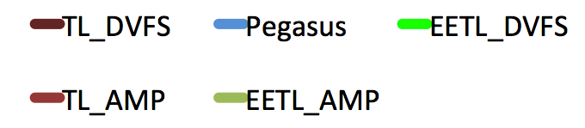
Lucene on emulated AMP and DVFS

Slide 58

Hardware heterogeneity – opportunity & challenge
big
DDR NVM
flash
0
0
0
0
0
0
0
0
0
0
0
0
0
0
0
0
0
0
0
0
0
0
0
0
0
0
0
0
little
custom
PIM paired
Processors Memory

Slide 59
Parallelism
Parallelism historically for throughput
Idea
Parallelism for tail latency
0
0
0
0
0
0
0
0
0
0
0
0
  degrades
  at high load
0
0
0
0
  improves
  at low load
Notes:
* Let’s consider the servers.
They are multicore and use their parallelism for throughput.
Our work uses this hardware parallelism for individual requests to optimize their tail latency.
Unfortunately, simply parallelizing every request quickly oversubscribes resources.

Slide 60
Software & hardware
Lucene open source enterprise search Wikipedia English
  10 GB index of 33 million pages
  10k queries from Lucene nightly tests
Bing web search with one Index Serving Node (ISN)
  160 GB web index in SSD, 17 GB cache
  30k Bing user queries
Hardware 2x8 64 bit 2.3 GHz Xeon, 64 GB Windows
  15 request servers, 1 core issues requests
  Target parallelism = 24 threads
Notes:
* We evaluate FM Few to Many parallelism using Bing web search and Lucene enterprise search, which means it returns all results, whereas web search returns the most relevant resluts.
* We evaluate a single worker server, because to control tail latency at the aggregation node, the workers have to control tail latency.

Slide 61
Policies
Sequential
N way single degree of parallelism for each request
Adaptive Select parallelism degree when
request starts using system load [EUROSYS’13]
Request Clairvoyant parallelizes long requests by
perfect prediction of tail
FM Few to Many incrementally add parallelism
Notes:
* We compare FM with several other policies. Sequential and simple N way degree parallelism treat all requests the same.
The Adaptive scheduler is the state of the art policy from Euorsys 2013, Adaptive selects the parallelism degree of each request based on the instantaneous system load, but does not consider request progress.
The Request Clairvoyant performs perfect prediction on each query and only parallelizes long queries. This scheduler is the best case policy for prediction. However, it does not consider system load
FM adds parallelism based on request progress, load, using the pre-computed interval table..

Slide 62
Load variation
Alternate between high & low load
FM adapts to bursts with low variance

Slide 63
Fewer servers: Total Cost of ownership
21%
9%
Notes:
* At 44 RPS, FM is 40% better than sequential and 60% better than 4 way parallelism
* At 44 RPS, FM is 30% better than adaptive & 36% better than RC

Slide 64
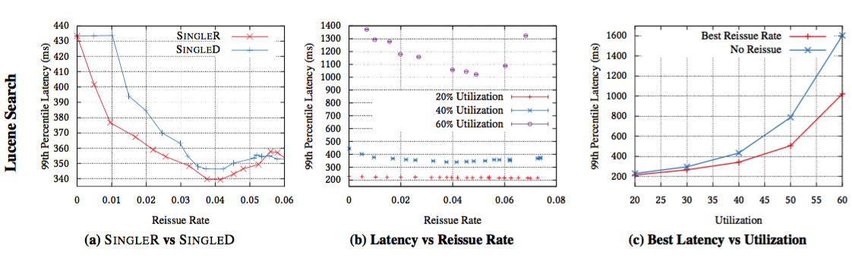
Single R Probabilistic reissue
Optimal Reissue Policies for Reducing Tail Latencies, Kaler, He, & Elnickety , SPAA’17

Slide 65
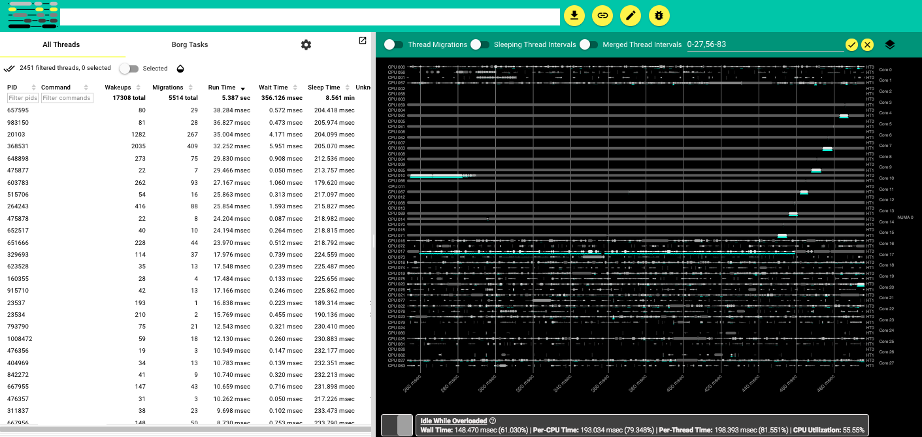
Google SchedViz (open source soon)
Wait Time

Slide 66
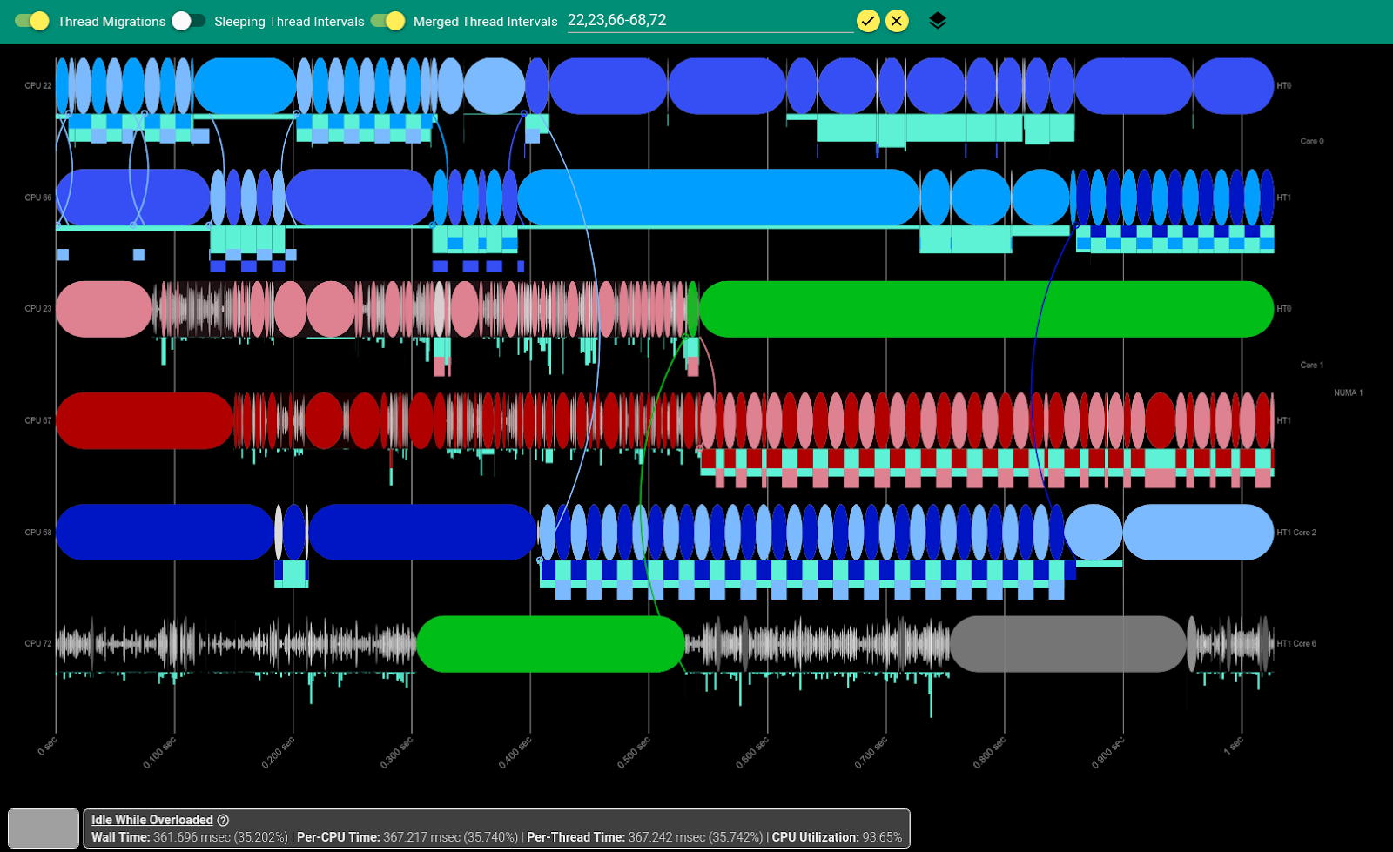

Slide 67
IPC of Lucene methods
IPC
top 10 methods (74% total execution time)
Notes:
if we increase the frequency 100x more, then we see very interesting pictures.
20 for legends, keys, 28 font size for words, title 36

