Slide 1
Collecting Highly Parallel Data for Paraphrase Evaluation
David L. Chen
The University of Texas at Austin
William B. Dolan
Microsoft Research
The 49th Annual Meeting of the Association for Computational Linguistics: Human Language Technologies (ACL)
June 20, 2011

Slide 2
Machine Paraphrasing
Goal: Semantically equivalent content
Many applications:
Machine Translation
Query Expansion
Summary Generation
Lack of standard datasets
No “professional paraphrasers”
Lack of standard metric
BLEU does not account for sentence novelty

Slide 3
Two-pronged Solution
Crowdsourced paraphrase collection
Highly parallel data
Corpus released for community use
Simple n-gram based metric
BLEU for semantic adequacy and fluency
New metric PINC for lexical dissimilarity

Slide 4
Outline
Data collection through Mechanical Turk
New metric for evaluating paraphrases
Correlation with human judgments

Slide 5
Annotation Task
Describe video in a single sentence

Slide 6
Data Collection
Descriptions of the same video
natural paraphrases
YouTube videos submitted by workers
Short
Single, unambiguous action/event
Bonus: Descriptions in different languages
translations

Slide 7
Example Descriptions
Someone is coating a pork chop in a glass bowl of flour.
A person breads a pork chop.
Someone is breading a piece of meat with a white powdery substance.
A chef seasons a slice of meat.
Someone is putting flour on a piece of meat.
A woman is adding flour to meat.
A woman is coating a piece of pork with breadcrumbs.
A man dredges meat in bread crumbs.
A person breads a piece of meat.
A woman is breading some meat.
A woman coats a meat cutlet in a dish.

Slide 8
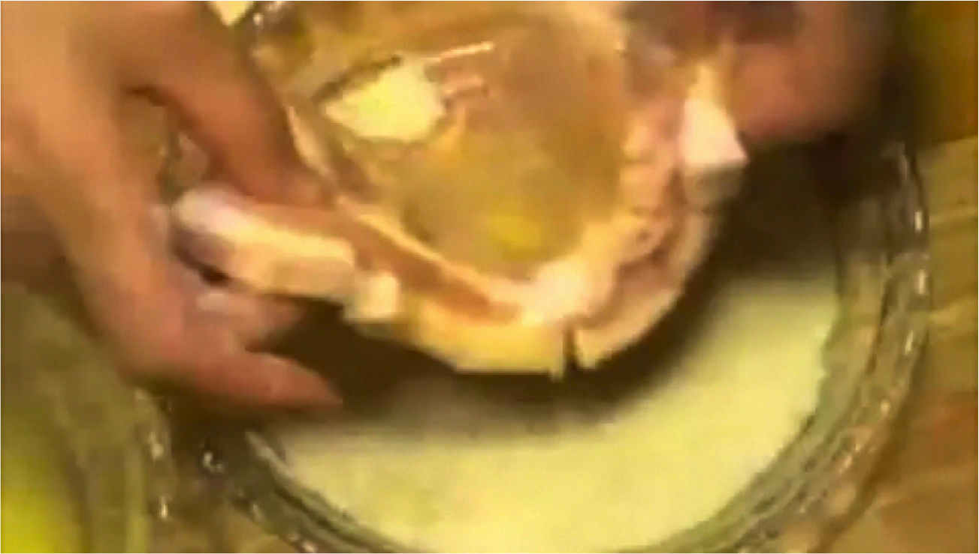
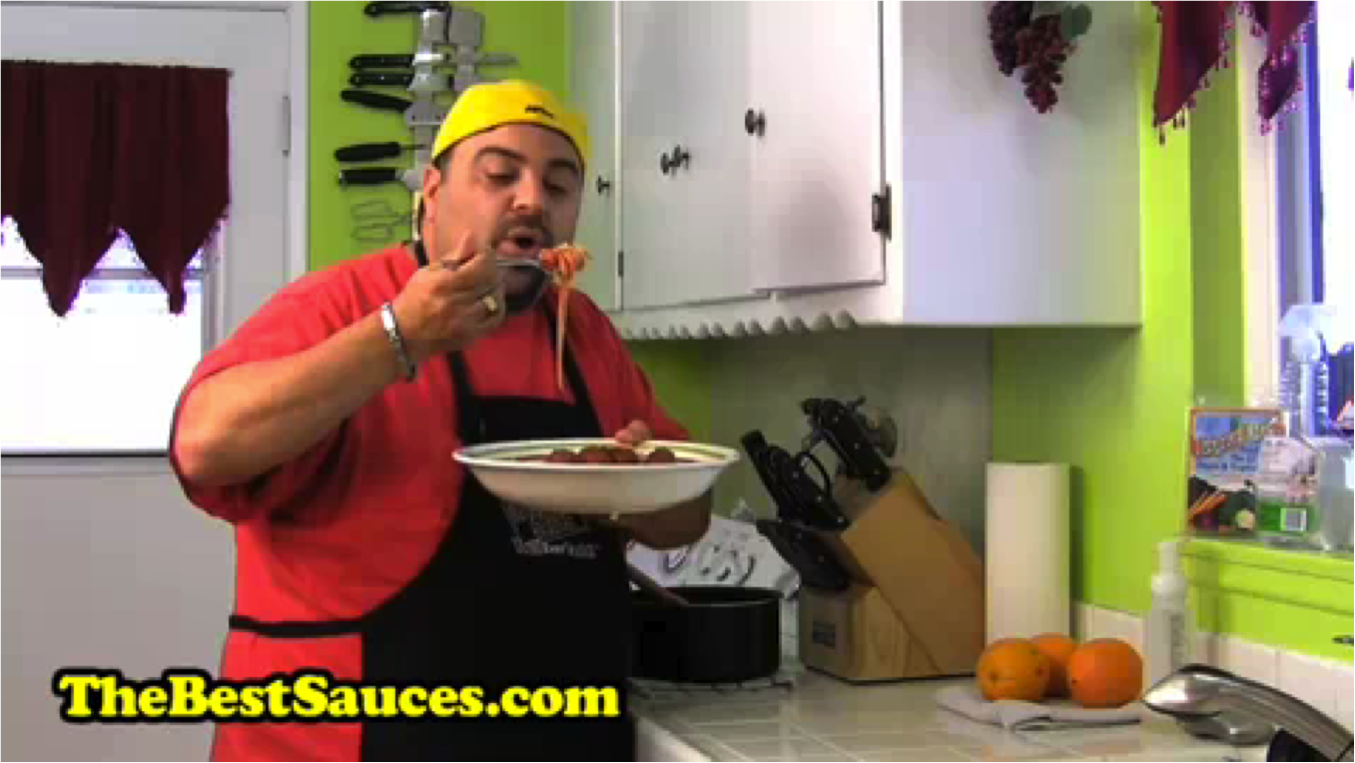
Quality Control
Tier 2
$0.05 per description
Tier 1
$0.01 per description
Initially everyone only has access to Tier-1 tasks

Slide 9
Quality Control
Tier 2
$0.05 per description
Tier 1
$0.01 per description
Good workers are promoted to Tier-2 based on # descriptions, English fluency, quality of descriptions

Slide 10
Quality Control
Tier 2
$0.05 per description
Tier 1
$0.01 per description
The two tiers have identical tasks but have different pay rates

Slide 11
Statistics of data collected
122K descriptions for 2089 videos
Spent around $5,000

Slide 12
Paraphrase Evaluations
Human judges
ParaMetric (Callison-Burch 2005)
Precision/recall of paraphrases discovered between two parallel documents
Paraphrase Evaluation Metric (PEM) (Liu et al. 2010)
Pivot language for semantic equivalence
SVM trained on human ratings to combine semantic adequacy, fluency and lexical dissimilarity scores

Slide 13
Semantic Adequacy and Fluency
Use BLEU score with multiple references
Highly parallel data captures a wide space of equivalent sentences
Natural distribution of descriptions

Slide 14
Lexical Dissimilarity
Paraphrase In N-gram Changes (PINC)
% n-grams that differ
For source s and candidate c:

Slide 15
PINC Example
Source:
a man fires a revolver at a practice range.
Candidates: | PINC
a man fires a gun at a practice range | 36.41
a man shoots a gun at a practice range | 56.75
someone is practice shooting at a gun range | 87.05

Slide 16
Building Paraphrase Model
Source Sentence | Paraphrase
A person breads a pork chop. | A woman is adding flour to meat.
A chef seasons a slice of meat. | A person breads a piece of meat.
A woman is adding flour to meat. | A woman is breading some meat.
Training data
Moses
(English to English)

Slide 17
Constructing Training Pairs
Descriptions of the same video
A person breads a pork chop.
A chef seasons a slice of meat.
Someone is putting flour on a piece of meat.
A woman is adding flour to meat.
A man dredges meat in bread crumbs.
A person breads a piece of meat.
A woman is breading some meat.
For each source sentence, randomly select n descriptions of the same video as target paraphrases

Slide 18
Constructing Training Pairs
Descriptions of the same video
Training pairs
A person breads a pork chop.
A chef seasons a slice of meat.
Someone is putting flour on a piece of meat.
A woman is adding flour to meat.
A man dredges meat in bread crumbs.
A person breads a piece of meat.
A woman is breading some meat.
A person breads a pork chop.
A woman is adding flour to meat..
A person breads a pork chop.
A person breads a piece of meat.
For n = 2

Slide 19
Constructing Training Pairs
Descriptions of the same video
Training pairs
A person breads a pork chop.
A chef seasons a slice of meat.
Someone is putting flour on a piece of meat.
A woman is adding flour to meat.
A man dredges meat in bread crumbs.
A person breads a piece of meat.
A woman is breading some meat.
A person breads a pork chop.
A woman is adding flour to meat..
A person breads a pork chop.
A person breads a piece of meat.
Move to the next sentence as the source

Slide 20
Constructing Training Pairs
Descriptions of the same video
Training pairs
A person breads a pork chop.
A chef seasons a slice of meat.
Someone is putting flour on a piece of meat.
A woman is adding flour to meat.
A man dredges meat in bread crumbs.
A person breads a piece of meat.
A woman is breading some meat.
A person breads a pork chop.
A woman is adding flour to meat..
A person breads a pork chop.
A person breads a piece of meat.
A chef seasons a slice of meat.
A person breads a pork chop.
A chef seasons a slice of meat.
A woman is adding flour to meat.
Move to the next sentence as the source

Slide 21
Constructing Training Pairs
Descriptions of the same video
Training pairs
A person breads a pork chop.
A chef seasons a slice of meat.
Someone is putting flour on a piece of meat.
A woman is adding flour to meat.
A man dredges meat in bread crumbs.
A person breads a piece of meat.
A woman is breading some meat.
A person breads a pork chop.
A woman is adding flour to meat..
A person breads a pork chop.
A person breads a piece of meat.
A chef seasons a slice of meat.
A person breads a pork chop.
A chef seasons a slice of meat.
A woman is adding flour to meat.
Someone is putting flour on a piece of meat.
A person breads a pork chop.
Someone is putting flour on a piece of meat.
A person breads a piece of meat.
Repeat so each sentence as the source once

Slide 22
Testing
Descriptions of the same video
A person breads a pork chop.
A chef seasons a slice of meat.
Someone is putting flour on a piece of meat.
A woman is adding flour to meat.
A man dredges meat in bread crumbs.
A person breads a piece of meat.
A woman is breading some meat.
Moses
(English to English)
A person breads a piece of meat.
Use each sentence in the test set once as the source

Slide 23
Testing
Descriptions of the same video
A person breads a pork chop.
A chef seasons a slice of meat.
Someone is putting flour on a piece of meat.
A woman is adding flour to meat.
A man dredges meat in bread crumbs.
A person breads a piece of meat.
A woman is breading some meat.
Moses
(English to English)
A person seasons some pork.
Use each sentence in the test set once as the source

Slide 24
Testing
Descriptions of the same video
A person breads a pork chop.
A chef seasons a slice of meat.
Someone is putting flour on a piece of meat.
A woman is adding flour to meat.
A man dredges meat in bread crumbs.
A person breads a piece of meat.
A woman is breading some meat.
Moses
(English to English)
A person breads meat.
Use each sentence in the test set once as the source

Slide 25
Testing
Descriptions of the same video
A person breads a pork chop.
A chef seasons a slice of meat.
Someone is putting flour on a piece of meat.
A woman is adding flour to meat.
A man dredges meat in bread crumbs.
A person breads a piece of meat.
A woman is breading some meat.
Moses
(English to English)
A person breads meat.
Reference sentences for BLEU
Use all sentences in the same set as references

Slide 26
Testing
Descriptions of the same video
A person breads a pork chop.
A chef seasons a slice of meat.
Someone is putting flour on a piece of meat.
A woman is adding flour to meat.
A man dredges meat in bread crumbs.
A person breads a piece of meat.
A woman is breading some meat.
Moses
(English to English)
A person breads meat.
Source sentences for PINC
Compute PINC with just the selected source

Slide 27
Paraphrase experiment
Split videos into 90% for training, 10% for testing
Use only Tier-2 sentences
Train: 28785 source sentences
Test: 3367 source sentences
Train on different number of pairs
n=1: 28,758 pairs
n=5: 143,776 pairs
n=10: 287,198 pairs
n=all: 449,026 pairs

Slide 28
Example paraphrase output
n=1 | n=all
a bunny is cleaning its paw
a rabbit is licking its paw | a rabbit is cleaning itself
a boy is doing karate
a man is doing karate | a boy is doing martial arts
a big turtle is walking
a huge turtle is walking | a large tortoise is walking
a guy is doing a flip over a park bench
a man does a flip over a bench |  | a man is doing stunts on a bench

Slide 29
Paraphrase Evaluation

Slide 30
Human Judgments
Two fluent English speakers
200 randomly selected sentences
Candidates from two systems:
n=1
n=all
Rated 1 to 4 on the following categories:
Semantic Equivalence
Lexical Dissimilarity
Overall
Measure correlation using Pearson’s coefficient

Slide 31
Correlation with Human Judgments
 | Semantic Equivalence | Lexical Dissimilarity | Overall
Judge A vs. B | 0.7135 | 0.6319 | 0.4920
BLEU vs. Human | 0.5095 | N/A | 0.2127
PINC vs. Human | N/A | 0.6672 | 0.0775
PEM (Liu et al. 2010) vs. Human | N/A | N/A | 0.0654
Correlation strength: Strong Medium Weak None

Slide 32
Combined BLEU/PINC vs. Human
 | Overall
Arithmetic Mean | 0.3173
Geometric Mean | 0.3003
Harmonic Mean | 0.3036
Correlation strength: Strong Medium Weak None

Slide 33
Conclusion
Introduced a novel paraphrase collection framework using crowdsourcing
Data available for download at
http://www.cs.utexas.edu/users/ml/clamp/videoDescription/
Or search for “Microsoft Research Video Description Corpus”
Described a way of utilizing BLEU and a new metric PINC to evaluate paraphrases

Slide 34
Backup Slides

Slide 35
Video Description vs. Direct Paraphrasing
Randomly selected 1000 sentences and asked the same pool of workers to paraphrase them
92% found video descriptions more enjoyable
75% found them easier
50% preferred the video description task versus only 16% that preferred direct paraphrasing
More divergence, PINC 78.75 vs. 70.08
Only drawback is the time to load the videos

Slide 36
Example video

Slide 37
English Descriptions
A man eats sphagetti sauce.
A man is eating food.
A man is eating from a plate.
A man is eating something.
A man is eating spaghetti from a large bowl while standing.
A man is eating spaghetti out of a large bowl.
A man is eating spaghetti.
A man is eating spaghetti.
A man is eating.
A man is eating.
A man is eating.
A man tasting some food in the kitchen is expressing his satisfaction.
The man ate some pasta from a bowl.
The man is eating.
The man tried his pasta and sauce.

Slide 38
Statistics of data collected
Total money spent: $5000
Total number of workers: 835

Slide 39
Quality Control
Worker has to prove actual task competence
Novotney and Callison-Burch, NAACL 2010 AMT workshop
Promote workers based on work submitted
# submissions
English fluency
Describing the videos well

Slide 40
PINC vs. Human (BLEU > threshold)
Threshold | Lexical Dissimilarity | Overall
0 | 0.6541 | 0.1817
30 | 0.6493 | 0.1984
60 | 0.6815 | 0.3986
90 | 0.7922 | 0.4350
Correlation strength: Strong Medium Weak None

Slide 41
Combined BLEU/PINC vs. Human
 | Overall
Arithmetic Mean | 0.3173
Geometric Mean | 0.3003
Harmonic Mean | 0.3036
PINC × Oracle Sigmoid(BLEU) | 0.3532
Correlation strength: Strong Medium Weak None

Slide 42
Correlation with Human Judgments

