Slide 1
Building a Persistent Workforce on Mechanical Turk for Multilingual Data Collection
David L. Chen
The University of Texas at Austin
William B. Dolan
Microsoft Research
The 3rd Human Computation Workshop (HCOMP)
August 8, 2011

Slide 2
Introduction
Collect translation and paraphrase data
Statistical machine translation systems require large amounts of parallel corpora
Professional translators are expensive
E.g. $0.36/word to create a Tamil-English corpus [Germann, ACL 2001 Workshop]
No similar resource for paraphrases

Slide 3
Variety of Natural Language Processing tasks done on Mechanical Turk
Collecting paraphrase data
Buzek et al., NAACL 2010 AMT workshop
Denkowski et al., NAACL 2010 AMT workshop
Collecting translation data
Ambati and Vogel, NAACL 2010 AMT workshop
Omar Zaidan and Chris Callison-Burch, ACL 2011
Evaluating machine translation quality
Callison-Burch, EMNLP 2009
Denkowski and Lavie, NAACL 2010 AMT workshop

Slide 4
Issues of using Mechanical Turk
Catching people using machine translations
Collect and check against online translations
Use an image instead of text
Improving poor translations
Ask other workers to edit the translations
Ask other workers to rank the translations

Slide 5
Issues of using Mechanical Turk
Attracting workers
Higher pay doesn’t always mean higher quality
More likely to cheat if pay is high
Making tasks simple and quick enough
Difficult to collect data where input is required rather than selecting buttons
More difficult to translate whole sentences than short phrases

Slide 6
Use video to collect language data
Collect descriptions of videos (Chen and Dolan, ACL 2011)
Parallel descriptions in different languages
Translation data
Parallel descriptions in the same language
Paraphrase data
Also useful as video annotation data

Slide 7
Video description task
Show a short YouTube video to the user
Ask them to write a single-sentence description in any language
Removes incentive to cheat
Only require monolingual speakers
Similar to work by Hu et al. [CHI 2011]

Slide 8
Annotation Task
Describe video in a single sentence

Slide 9
Example Descriptions
Someone is coating a pork chop in a glass bowl of flour.
A person breads a pork chop.
Someone is breading a piece of meat with a white powdery substance.
A chef seasons a slice of meat.
Someone is putting flour on a piece of meat.
A woman is adding flour to meat.
A woman is coating a piece of pork with breadcrumbs.
A man dredges meat in bread crumbs.
A person breads a piece of meat.
A woman is breading some meat.
A woman coats a meat cutlet in a dish.

Slide 10
Example Descriptions
Ženska panira zrezek. (Slovene)
правење шницла (Macedonian)
Jemand wendet ein Stück Fleisch in Paniermehl (German)
Une femme trempe une cotelette de porc dans de la chapelure. (French)
cineva da o felie de carne prin pesmet (Romanian)
गोश में कुछ ओत्ता मिला रहा हे (Hindi)
ქალი ხორცს ავლებს რაღაცაში (Georgian)
Dame haalt lap vlees door bloem. (Dutch)
Šnicla mesa se valja u smesu začina (Serbian)
Unas manos embadurnan un trozo de carne en un recipiente (Spanish)

Slide 11
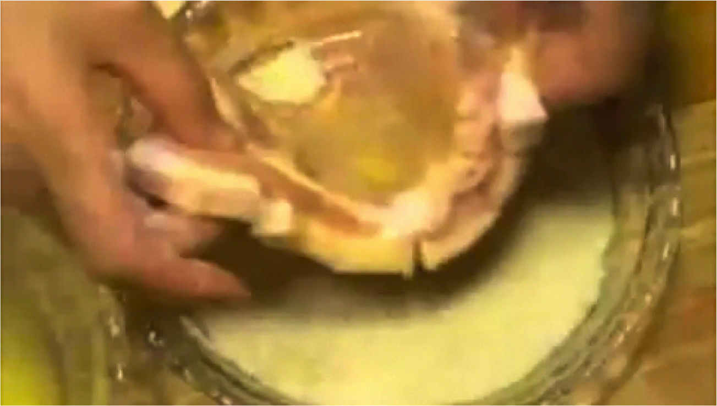
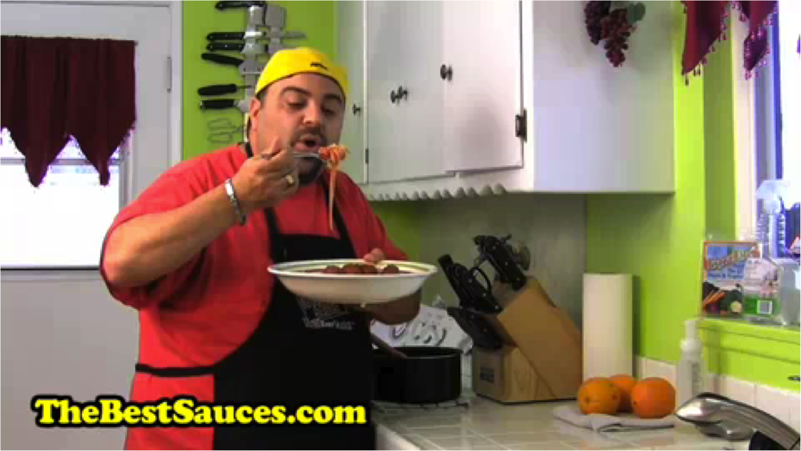
Quality Control
Tier 2
$0.05 per description
Tier 1
$0.01 per description
Initially everyone only has access to Tier-1 tasks

Slide 12
Quality Control
Tier 2
$0.05 per description
Tier 1
$0.01 per description
Good workers are promoted to Tier-2 based on # descriptions, English fluency, quality of descriptions

Slide 13
Quality Control
Tier 2
$0.05 per description
Tier 1
$0.01 per description
The two tiers have identical tasks but have different pay rates

Slide 14
Video collection task
Ask workers to submit video clips from YouTube
Single, unambiguous action/event
Short (4-10 seconds)
Generally accessible
No dialogues
No words (subtitles, overlaid text, titles)
Also uses multi-tiered payment system

Slide 15
Daily number of descriptions collected

Slide 16
Distribution of languages collected
English | 85550 (33855) | Spanish | 1883
Hindi | 6245 | Gujarati | 1437
Romanian | 3998 | Russian | 1243
Slovene | 3584 | French | 1226
Serbian | 3420 | Italian | 953
Tamil | 2789 | Georgian | 907
Dutch | 2735 | Polish | 544
German | 2326 | Chinese | 494
Macedonian | 1915 | Malayalam | 394
Other: Tagalog, Portuguese, Norwegian, Filipino, Estonian, Turkish, Arabic, Urdu, Hungarian, Indonesian, Malay, Bulgarian, Danish, Bosnian, Marathi, Swedith, Albanian

Slide 17
Statistics of data collected
Total money spent: $5000
Total number of workers: 835

Slide 18
Number of descriptions submitted
Sorted histogram of the top 255 workers

Slide 19
Persistent workforce
Return workers who continually work on our task
Several workers annotated all available videos, even both Tier-1 and Tier-2 tasks
Easier to model and evaluate workers when they submit many annotations
Identified good workers require little or no supervision

Slide 20
Sample worker responses
“The speed of approval gave me confidence that you would pay me for future work.”
“Posters on Turker Nation recommended it as both high-paying and interesting. Both ended up being true.”
“I consider this task pretty enjoyable. some videos are funny, others interesting.”
“Fast, easy, really fun to do it.”

Slide 21
Lessons learned
Design the tasks well
Short, simple, easy, accessible, and fun
Learn from worker responses
Compensate the workers fairly
Communicate
Quick task approval
Explain rejections
Respond to comments and emails

Slide 22
Conclusion
Introduced a novel way to collect translation and paraphrase data
Conducted a successful pilot data collection on Mechanical Turk
Tiered payment system
High-quality persistent workforce
All data (including most of the videos) available for download at
http://www.cs.utexas.edu/users/ml/clamp/videoDescription/

