Slide 1
An Analysis of Using Semantic Parsing for Speech Recognition
Rodolfo Corona

Slide 2
Outline
Introduction
Background
Related Work
Methodology
Experiment
Dataset
Experimental Set-up
Experiments & Results
Conclusion
Future Work
Concluding Remarks

Slide 3
Outline
Introduction
Background
Related Work
Methodology
Experiment
Dataset
Experimental Set-up
Experiments & Results
Conclusion
Future Work
Concluding Remarks

Slide 4
Introduction
Automatic Speech Recognition (ASR) becoming more prominent.
Performance beginning to allow wider adoption.
There is still room to grow.

Slide 5
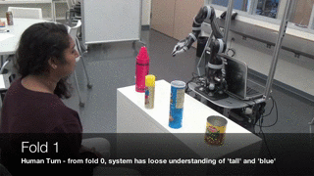
Introduction
Motivation: Would like a language-understanding pipeline in BWI lab.
Speech would allow for greater user-friendliness.

Slide 6
Introduction
Utterance: The speech signal given by the user.
Transcription: The correct text representation of the utterance.
Hypothesis: The ASR approximation of the transcription.

Slide 7
Introduction
Our approach: Use semantic parsing to re-rank the n-best list from ASR.
Additionally, use re-ranking scheme to generate new training examples for re-training system.
Most “meaningful” parse likely to be correct hypothesis.
Notes:
Add slide in beginning to motivate BWI & why we want to add speech to it.
Maybe use a GIF from Jesse’s talk.
Re-word: True hypothesis might also be most “meaningful” to parser ➔ Most meaningful parse likely to be correct hypothesis.
Include slide to define terminology (DO NOT use “phrase”, define “hypothesis”, “utterance”, and “transcription”)

Slide 8
Introduction
Results: We show that language understanding is improved despite decrease in transcription performance.
Notes:
Re-word: Improves understanding despite decreasing transcription accuracy.

Slide 9
ASR
Process user utterance $U$ and compute a hypothesis $H$ of it from candidates $W$ in our language (i.e. English).
Uses language and acoustic models in tandem.
Formally: $H=argmax_{w}P\left(U | W\right)P(W)$
Notes:
Define U and W

Slide 10
ASR
Utterance
Hypotheses
Output
Hypothesis
Please take the pizza Dan
Please take the tea to Dan
Please take the Peter Dan
Please take the tea to Dan a
Please take the tea to Dan
Please take the tea to Dan
Notes:
Ask Jesse about his comments on this slide.

Slide 11
Semantic Parsing
Derive computer-interpretable representation of user transcript.
Use formalisms such as first order logic and typed lambda calculus.
Output referred to as semantic form.

Slide 12
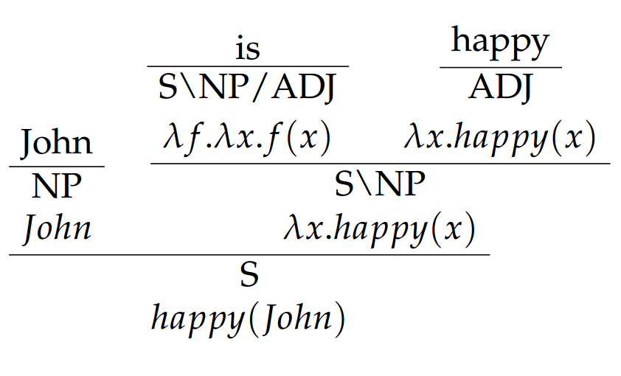
Semantic Parsing
Notes:
Don’t use word “might”. Use declarative statements.

Slide 13
Related Work
Zechner et al. uses part-of-speech (POS) tagging with a chunk-based parser for re-ranking (Zechner et al. 1998)
Erdogan et al. uses semantic parsing to re-rank. Does not produce forms that may be immediately executed by system. (Erdogan et al. 2005).
Peng et al. use Google search on n-best list and extract features from results for re-ranking (Peng et al. 2013)
Notes:
Change “grounded” to “executable form”.

Slide 14
Outline
Introduction
Background
Related Work
Methodology
Experiment
Dataset
Experimental Set-up
Experiments & Results
Conclusion
Future Work
Concluding Remarks

Slide 15
Re-ranking
Use ASR to generate list of n hypotheses for a given utterance.
Use parser to compute a parse for each hypothesis on list.
Use confidence scores from ASR and parser to assign a new score to each hypothesis.
Re-rank (i.e. sort) based on new scores.
Notes:
Explicitly talk about beta, make new slide for beta.
Explicitly mention log likelihood scores (i.e. equation).
Check math for correctness.

Slide 16
Re-ranking
Given hypothesis $h$ with ASR score $s_{a_{i}}$ and parse score $s_{p_{i}}$.
Normalize scores over other hypotheses: $\overline{s_{p_{i}}}=\log\left(s_{p_{i}}\right)−\log\left(\sum_{j=1}^{N}{s_{p_{j}}}\right)$ $\overline{s_{a_{i}}}=\log\left(s_{a_{i}}\right)−\log\left(\sum_{j=1}^{N}{s_{a_{j}}}\right)$
Re-score hypotheses by linearly interpolating ASR and parser confidence scores with a weight $β$: $score_{h}=β⋅\overline{s_{p_{i}}}+\left(1−β\right)⋅\overline{s_{a_{i}}}$
Notes:
Explicitly talk about beta, make new slide for beta.
Explicitly mention log likelihood scores (i.e. equation).
Check math for correctness.

Slide 17
Re-ranking
Hypothesis | ASR Score
Please take the pizza Dan | -1242160
Please take the tea to Dan | -1242202
Please take the Peter Dan | -1242431
Please take the tea to Dan a | -1242544
Hypothesis | Parse | Parse Score
Please take the pizza Dan | walk(the($λ$1:l.(and(possesses(1,jane),office(1))))) | -62.30
Please take the tea to Dan | Bring(tea,dan) | -32.18
Please take the Peter Dan | walk(the(𝜆1:l.(and(possesses(1,jane),office(1))))) | -62.29
Please take the tea to Dan a | None | $$−∞$$
Please take the tea to Dan
ASR
Parser

Slide 18
Re-ranking
Hypothesis | Parse | Parse Score
Please take the pizza Dan | walk(the($λ$1:l.(and(possesses(1,jane),office(1))))) | -62.30
Please take the tea to Dan | Bring(tea,dan) | -32.18
Please take the Peter Dan | walk(the(𝜆1:l.(and(possesses(1,jane),office(1))))) | -62.29
Please take the tea to Dan a | None | $$−∞$$
Hypothesis | Parse | Parse Score
Please take the tea to Dan | Bring(tea,dan) | -32.18
Please take the Peter Dan | walk(the(𝜆1:l.(and(possesses(1,jane),office(1))))) | -62.29
Please take the pizza Dan | walk(the($λ$1:l.(and(possesses(1,jane),office(1))))) | -62.30
Please take the tea to Dan a | None | $$−∞$$
Sort

Slide 19
Re-training
Compute a hypothesis list for an utterance and re-rank.
Generate new training pair consisting of utterance and top hypothesis transcription.
Use set of new examples to adapt ASR acoustic model.

Slide 20
Re-training
Hypothesis
Please take the pizza Dan
Please take the tea to Dan
Please take the Peter Dan
Please take the tea to Dan a
Hypothesis
Please take the tea to Dan
Please take the Peter Dan
Please take the pizza Dan
Please take the tea to Dan a
Re-training Set | Utterances
___________
___________
___________
ASR
Re-rank
Notes:
Explicitly indicate speech signal on animation for pair.

Slide 21
Re-training
Hypothesis
Please take the pizza Dan
Please take the tea to Dan
Please take the Peter Dan
Please take the tea to Dan a
Hypothesis
Please take the tea to Dan
Please take the Peter Dan
Please take the pizza Dan
Please take the tea to Dan a
Re-training Set | Utterances
___________
___________
___________
Please take the tea to Dan
ASR
Re-rank
Notes:
Explicitly indicate speech signal on animation for pair.

Slide 22
Outline
Introduction
Background
Related Work
Methodology
Experiment
Dataset
Experimental Set-up
Experiments & Results
Conclusion
Future Work
Concluding Remarks

Slide 23
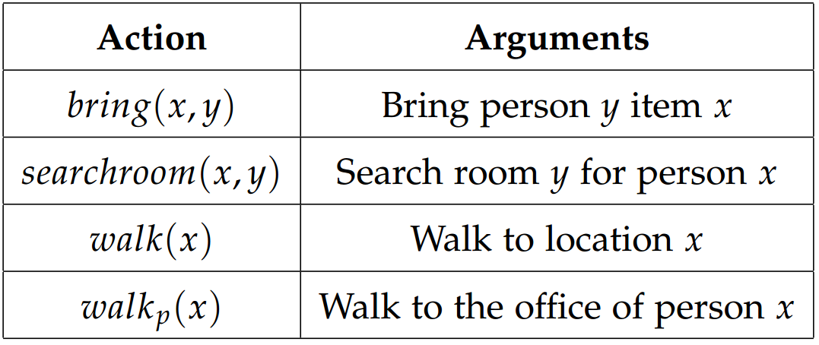
Dataset
Collected corpus from 32 participants.
Tuples of utterance, transcription, and semantic form.
Read randomly generated transcriptions for 25 minutes.
150 tuples contributed on average.
10 word average transcript length.
Action | Template Examples | Number of Templates
$$bring(x,y)$$ | I would like you to please bring x to y … Please take y the x | 74
$$searchroom\left(x,y\right)$$ | Find out if x is in y … Look for x in y | 43
$$walk(x)$$ | Would you please go to x … Run over to x | 39
$$walk_{p\left(x\right)}$$ | Hurry and walk to x’s office … Please go to x’s office | 39

Slide 24
Dataset
11 people, 12 location, and 30 item atoms.
42 noun and 72 adjective predicates allowed for 110K more items (Noun + up to 2 adjectives).
Transcript
Semantic Form
Notes:
Include 2 examples per template (with … ) to show diversity. Also, move to slide 20 to introduce it immediately.
Change “phrase” to transcription and “recording” to “utterance”.

Slide 25
Experiment Set-up
Used CMU Sphinx-4 for ASR (Lamere et al.).
Created in-domain language model and adapted Sphinx acoustic model with our data. Additionally added corpus-specific entries to dictionary.
Used a CCG-based CKY parser (Liang & Potts, 2015), (Artzi & Zettlemoyer, 2013).
Split data set into 8 folds by participant in corpus (32 participants).
(28, 2, 2) dataset split for training, validation, and test sets.

Slide 26
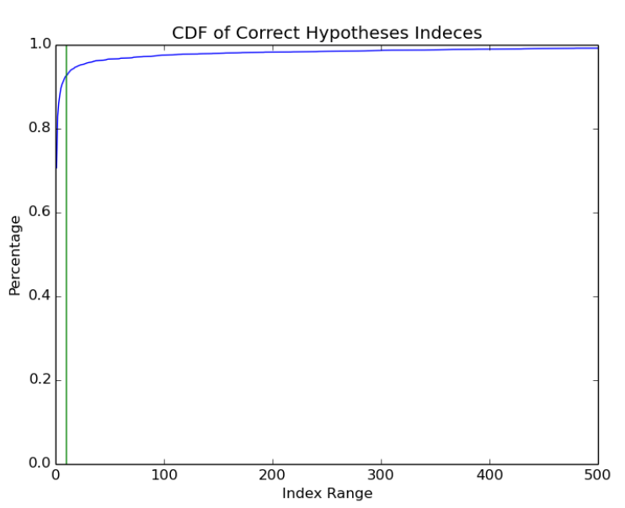
Experiment Set-up
Originally generated 1K hypotheses per utterance.
Correct hypotheses lay in top 10 results in 92% of lists.
Set consequent list lengths to 10.
Used only transcriptions with fewer than 8 words due to computational cost of parsing.

Slide 27
Transcription Evaluation Metrics
Word error rate (WER): Measure of alignment between transcripts. Combines substitutions $s$, deletions $d$, and insertions $i$ to measure accuracy $\left(N=\left|transcription\right|\right)$: $WER\left(p\right)=\frac{s+d+i}{N}$
Recall@1: Top hypothesis correct.
Recall@5: One of top 5 hypotheses correct.
Notes:
Talk less about WER .
Define s, d, I, and N.
Change “Top N” to “recall @ N”.

Slide 28
Semantic Evaluation Metrics
Full Semantic Form: Exact match of predicates in ground truth form.
Recall: $\frac{\#Correct predicates in hypothesis}{\#Correct Predicates}$
Precision: $\frac{\#Correct predicates in hypothesis}{\#Predicates in hypothesis}$
F1: Harmonic mean of precision and recall $\frac{2}{\frac{1}{R}+\frac{1}{P}}$
Notes:
Swap precision and recall (definitions backwards).
Talk less about R & P, just talk about tradeoff between them.

Slide 29
Main Experiment
Baseline with no re-ranking (i.e. $β=0$), denoted ASR.
Main system with no interpolation (i.e. $β=1$), denoted SemP.
Re-trained using validation set over different combinations of conditions.
Ran experiments with 8-fold cross validation.
Notes:
Between slide 26 and 27 add animation to elucidate re-training.

Slide 30
Re-training Condition
Re-ranking Condition
AC
SemP
ASR
Validation Set
ASR
Test
Set
AC
Results
SemP
Training Set
AC
Notes:
Between slide 26 and 27 add animation to elucidate re-training.

Slide 31
Results
Re-training | Re-ranking | WER | R@1 | R@5 | SF | F1 | R | P
None | ASR | 14.55* | 55.31* | 72.47* | 0.334 | 0.482 | 0.484 | 0.504
Notes:
Change CKY to more meaningful name. (Sem P)
Pull up row by row and talk about it as you bring it up.

Slide 32
Results
Re-training | Re-ranking | WER | R@1 | R@5 | SF | F1 | R | P
None | ASR | 14.55* | 55.31* | 72.47* | 0.334 | 0.482 | 0.484 | 0.504
None | SemP | 18.46 | 38.42 | 65.33 | 0.299 | 0.557* | 0.564* | 0.598*
Notes:
Change CKY to more meaningful name. (Sem P)
Pull up row by row and talk about it as you bring it up.

Slide 33
Results
Re-training | Re-ranking | WER | R@1 | R@5 | SF | F1 | R | P
None | ASR | 14.55* | 55.31* | 72.47* | 0.334 | 0.482 | 0.484 | 0.504
None | SemP | 18.46 | 38.42 | 65.33 | 0.299 | 0.557* | 0.564* | 0.598*
ASR | ASR | 22.00 | 45.86 | 59.12 | 0.276 | 0.457 | 0.456 | 0.478
Notes:
Change CKY to more meaningful name. (Sem P)
Pull up row by row and talk about it as you bring it up.

Slide 34
Results
Re-training | Re-ranking | WER | R@1 | R@5 | SF | F1 | R | P
None | ASR | 14.55* | 55.31* | 72.47* | 0.334 | 0.482 | 0.484 | 0.504
None | SemP | 18.46 | 38.42 | 65.33 | 0.299 | 0.557* | 0.564* | 0.598*
ASR | ASR | 22.00 | 45.86 | 59.12 | 0.276 | 0.457 | 0.456 | 0.478
SemP | ASR | 22.22 | 45.92 | 59.58 | 0.283 | 0.440 | 0.443 | 0.455
Notes:
Change CKY to more meaningful name. (Sem P)
Pull up row by row and talk about it as you bring it up.

Slide 35
Results
Re-training | Re-ranking | WER | R@1 | R@5 | SF | F1 | R | P
None | ASR | 14.55* | 55.31* | 72.47* | 0.334 | 0.482 | 0.484 | 0.504
None | SemP | 18.46 | 38.42 | 65.33 | 0.299 | 0.557* | 0.564* | 0.598*
ASR | ASR | 22.00 | 45.86 | 59.12 | 0.276 | 0.457 | 0.456 | 0.478
SemP | ASR | 22.22 | 45.92 | 59.58 | 0.283 | 0.440 | 0.443 | 0.455
ASR | SemP | 25.57 | 30.46 | 52.42 | 0.302 | 0.569 | 0.581 | 0.604
Notes:
Change CKY to more meaningful name. (Sem P)
Pull up row by row and talk about it as you bring it up.

Slide 36
Results
Re-training | Re-ranking | WER | R@1 | R@5 | SF | F1 | R | P
None | ASR | 14.55* | 55.31* | 72.47* | 0.334 | 0.482 | 0.484 | 0.504
None | SemP | 18.46 | 38.42 | 65.33 | 0.299 | 0.557* | 0.564* | 0.598*
ASR | ASR | 22.00 | 45.86 | 59.12 | 0.276 | 0.457 | 0.456 | 0.478
SemP | ASR | 22.22 | 45.92 | 59.58 | 0.283 | 0.440 | 0.443 | 0.455
ASR | SemP | 25.57 | 30.46 | 52.42 | 0.302 | 0.569 | 0.581 | 0.604
SemP | SemP | 25.79 | 29.54 | 52.55 | 0.311 | 0.566 | 0.573 | 0.600
Notes:
Change CKY to more meaningful name. (Sem P)
Pull up row by row and talk about it as you bring it up.

Slide 37
Results
Ran paired Student’s t-tests on results.
Statistically significant increase in partial semantic performance (P, R, F1) over baseline (p < 0.05).
No significant difference in full semantic performance (p = 0.12)
Significant decrease in transcription performance (WER, T1, T5).
Re-training has significant adverse effect on transcription.
No significant difference in partial semantic form performance for re-ranking under different re-training conditions.

Slide 38
Results
Ultimately interested in semantic parsing performance of system.
Notes:
Add example of partial semantic form going up when discussing robot dialogue.

Slide 39
Hypothesis | Semantic Form | Parse Score | ASR Score
Please walk to professor smith a coffee | Walk(l3_516) | -45.40 | -476184
Please walk to professor smith’s office | walk(the($λ$x:l.(and(possesses(x,tom),office(x))))) | -38.55 | -476359
Please walk to professor smith the coffee | Walk(l3_516) | -46.54 | -476378
Notes:
Add example of partial semantic form going up when discussing robot dialogue.

Slide 40
Hypothesis | Semantic Form | Parse Score | ASR Score
Please walk to professor smith’s office | walk(the($λ$x:l.(and(possesses(x,tom),office(x))))) | -38.55 | -476359
Please walk to professor smith a coffee | Walk(l3_516) | -45.40 | -476254
Please walk to professor smith the coffee | Walk(l3_516) | -46.54 | -476378
Notes:
Add example of partial semantic form going up when discussing robot dialogue.

Slide 41
Interpolation Experiments
Additional experiments run with interpolation of ASR and parse confidence scores.
Tested $β∈[0,1]$ at 0.005 intervals on validation set.

Slide 42
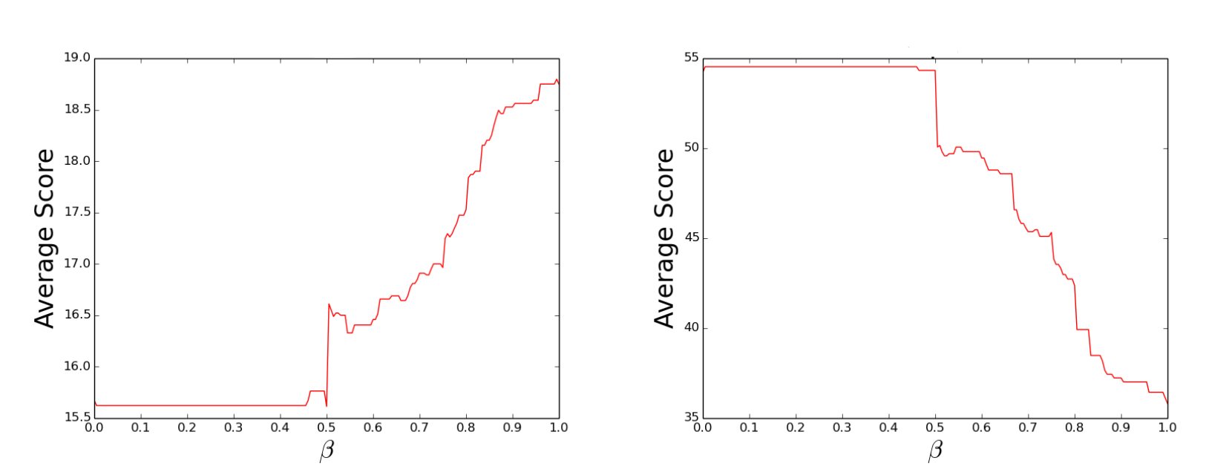
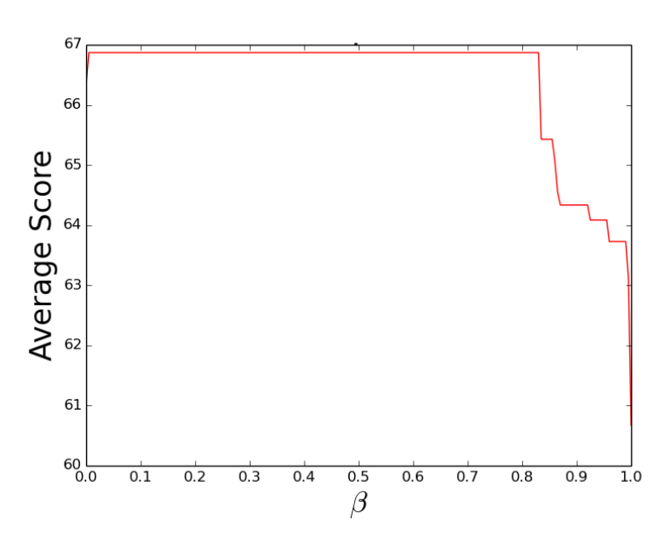
WER
R@1
R@5
Notes:
Put on two different slides.
Add beta = 0.8 to compare validation and test set.

Slide 43
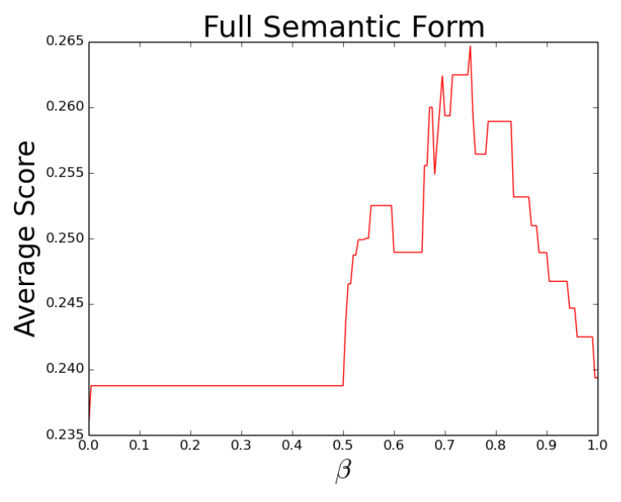
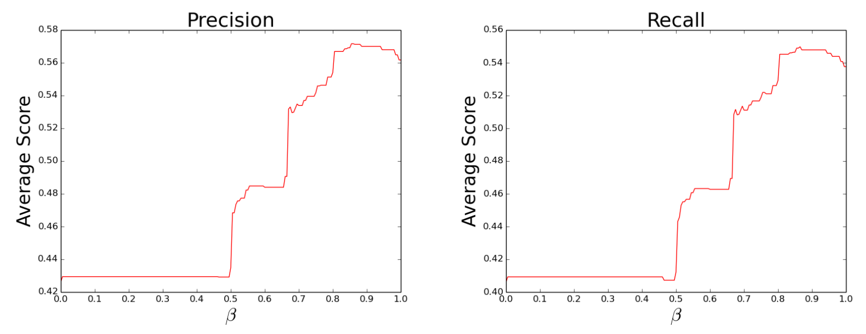
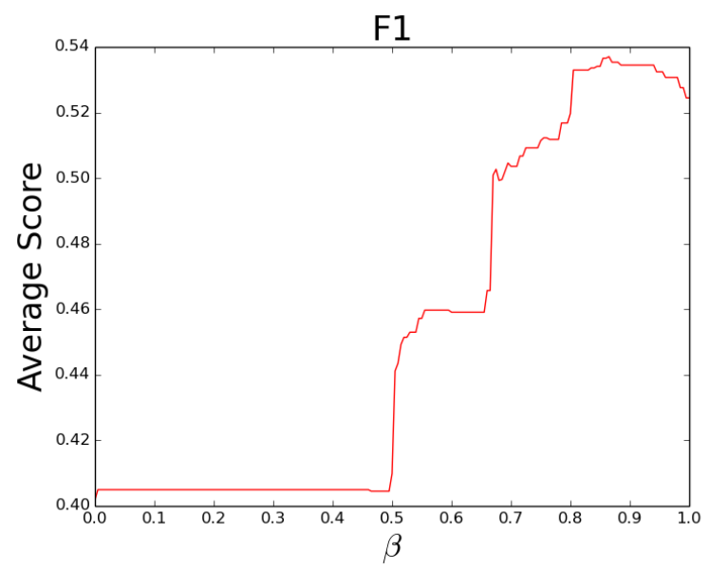
Full Semantic Form
Precision
Recall
F1
Notes:
Put on two different slides.
Add beta = 0.8 to compare validation and test set.

Slide 44
Interpolation Experiments
$β=0.865$ Maximized F1 performance.
Implies signal from both ASR and parser is useful.
No statistical significance between $β=0.865$ and $β=1.0$
Statistical significance results identical to no interpolation case.
Re-training not pursued due to statistical analysis results.
Notes:
Talk about beta = 0.8and not 0.505. Show example

Slide 45
Outline
Introduction
Background
Related Work
Methodology
Experiment
Dataset
Experimental Set-up
Experiments & Results
Conclusion
Future Work
Concluding Remarks

Slide 46
Future Work
Deep learning approaches allow for end-to-end ASR (Graves et al. 2014, Xiong et al. 2016)
Neural parsing technique claims to require less computation time than CKY algorithm (Misra et al. 2016)
Could replace components in pipeline, train jointly.
Use pre-trained models with our dataset for fine-tuning.
Notes:
Link ASR & parser by mentioning backpropagation through entire pipeline. Pre-training plus fine-tuning.
Change #operations to “computation time”
Remove LSTM cell

Slide 47
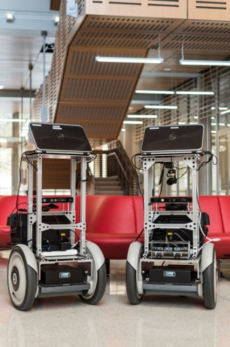
Future Work
Current results motivate pursuit of dialogue-based pipeline (Thomason et al. 2015)
Notes:
Add years to citations.

Slide 48
Future Work
Improved F1 scores could result in shorter disambiguation dialogs.
Correct: walk(the(𝜆x:l.(and(possesses(x,smith),office(x)))))
ASR: walk(l3_516)
SemP: walk(the(𝜆x:l.(and(possesses(x,tom),office(x)))))
Notes:
Add years to citations.

Slide 49
Conclusion
Re-ranking significantly improves partial semantic performance.
Decrease in transcription performance significant.
Current results encouraging for dialogue pipeline potential.

Slide 50
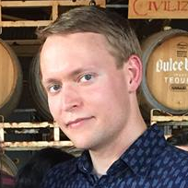
Acknowledgements

Slide 51
An Analysis of Using Semantic Parsing for Speech Recognition
Rodolfo Corona

Slide 52
References
Artzi, Y., & Zettlemoyer, L. (2013a). UW SPF: The University of Washington Semantic Parsing Framework. arXiv preprint arXiv:1311.3011
Erdogan, H., Sarikaya, R., Chen, S. F., Gao, Y., & Picheny, M. (2005). Using Semantic Analysis to Improve Speech Recognition Performance. Computer Speech & Language, 19(3), 321–343.
Graves, A., & Jaitly, N. (2014). Towards End-To-End Speech Recognition with Recurrent Neural Networks. In ICML (Vol. 14, pp. 1764–1772).
Liang, P., & Potts, C. (2015). Bringing Machine Learning and Compositional Semantics Together. Annu. Rev. Linguist., 1(1), 355–376.
Misra, D. K., & Artzi, Y. (2016). Neural Shift-Reduce CCG Semantic Parsing. In Proceedings of the Conference on Empirical Methods in Natural Language Processing.
Peng, F., Roy, S., Shahshahani, B., & Beaufays, F. (2013). Search Results Based N-best Hypothesis Rescoring with Maximum Entropy Classification. In ASRU (pp. 422–427).
Thomason, J., Zhang, S., Mooney, R., & Stone, P. (2015). Learning to Interpret Natural Language Commands Through Human-Robot Dialog. In Proceedings of the Twenty-Fourth International Joint Conference on Artificial Intelligence (IJCAI)
Xiong, W., Droppo, J., Huang, X., Seide, F., Seltzer, M., Stolcke, A., . . . Zweig, G. (2016). Achieving Human Parity in Conversational Speech Recognition. arXiv preprint arXiv:1610.05256
Zechner, K., & Waibel, A. (1998). Using Chunk Based Partial Parsing of Spontaneous Speech in Unrestricted Domains for Reducing Word Error Rate in Speech Recognition. In Proceedings of the 17th International Conference on Computational Linguistics-Volume 2 (pp. 1453–1459).

