Slide 1
Improving the Accuracy and Scalability of Discriminative Learning Methods for Markov Logic Networks
Tuyen N. Huynh
Adviser: Prof. Raymond J. Mooney
PhD Defense
May 2nd, 2011

Slide 2
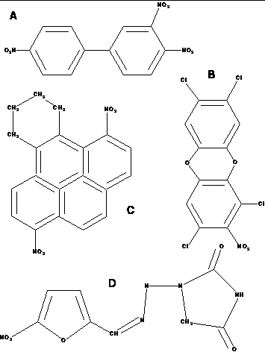
Biochemistry
Predicting mutagenicity
[Srinivasan et. al, 1995]

Slide 3
Natural language processing
Citation segmentation [Peng & McCallum, 2004]
D. McDermott and J. Doyle. Non-monotonic Reasoning I. Artificial Intelligence, 13: 41-72, 1980.
D. McDermott and J. Doyle. Non-monotonic Reasoning I. Artificial Intelligence, 13: 41-72, 1980.
D. McDermott and J. Doyle. Non-monotonic Reasoning I. Artificial Intelligence, 13: 41-72, 1980.
D. McDermott and J. Doyle. Non-monotonic Reasoning I. Artificial Intelligence, 13: 41-72, 1980.
D. McDermott and J. Doyle. Non-monotonic Reasoning I. Artificial Intelligence, 13: 41-72, 1980.
D. McDermott and J. Doyle. Non-monotonic Reasoning I. Artificial Intelligence, 13: 41-72, 1980.
D. McDermott and J. Doyle. Non-monotonic Reasoning I. Artificial Intelligence, 13: 41-72, 1980.
Semantic role labeling [Carreras & Màrquez, 2004]
[_{A0} He] [_{AM-MOD} would] [_{AM-NEG} n’t] [_{V} accept]
[_{A1} anything of value] from [_{A2} those he was writing about]
[_{A0} He] [_{AM-MOD} would] [_{AM-NEG} n’t] [_{V} accept]
[_{A1} anything of value] from [_{A2} those he was writing about]
[_{A0} He] [_{AM-MOD} would] [_{AM-NEG} n’t] [_{V} accept]
[_{A1} anything of value] from [_{A2} those he was writing about]
[_{A0} He] [_{AM-MOD} would] [_{AM-NEG} n’t] [_{V} accept]
[_{A1} anything of value] from [_{A2} those he was writing about]
[_{A0} He] [_{AM-MOD} would] [_{AM-NEG} n’t] [_{V} accept]
[_{A1} anything of value] from [_{A2} those he was writing about]
[_{A0} He] [_{AM-MOD} would] [_{AM-NEG} n’t] [_{V} accept]
[_{A1} anything of value] from [_{A2} those he was writing about]
[_{A0} He] [_{AM-MOD} would] [_{AM-NEG} n’t] [_{V} accept]
[_{A1} anything of value] from [_{A2} those he was writing about]

Slide 4
Characteristics of these problems
Have complex structures such as graphs, sequences, etc…
  Contain multiple objects and relationships among them
There are uncertainties:
  Uncertainty about the type of an object
  Uncertainty about relationships between objects
Usually contain a large number of examples
Discriminative task: predict the values of some output variables based on observable input data

Slide 5
Generative vs. Discriminative learning
Generative learning: learn a joint model over all variables P(x,y)
Discriminative learning: learn a conditional model of the output variables given the input variables P(y|x)
  directly learn a model for predicting the output variables
  → More suitable for discriminative problems and has better predictive performance on the output variables

Slide 6
Statistical relational learning (SRL)
SRL attempts to integrate methods from rich knowledge representations with those from probabilistic graphical models to handle those noisy, structured data.
Some proposed SRL models:
  Stochastic Logic Programs (SLPs) [Muggleton, 1996]
  Probabilistic Relational Models (PRMs) [Friedman et al., 1999]
  Bayesian Logic Programs (BLPs) [Kersting & De Raedt, 2001]
  Relational Markov Networks (RMNs) [Taskar et al., 2002]
  Markov Logic Networks (MLNs) [Richardson & Domingos, 2006]

Slide 7
Pros and cons of MLNs
Pros:
  Expressive and powerful formalism
    Can represent any probability distribution over a finite number of objects
  Can easily incorporate domain knowledge
Cons:
  Learning is much harder due to a huge search space
  Most existing learning methods for MLNs are
    Generative: while many real-world problems are discriminative
    Batch methods: computationally expensive to train on large datasets with thousands of examples

Slide 8
Thesis contributions
Improving the accuracy:
  Discriminative structure and parameter learning for MLNs [Huynh & Mooney, ICML’2008]
  Max-margin weight learning for MLNs [Huynh & Mooney, ECML’2009]
Improving the scalability:
  Online max-margin weight learning for MLNs [Huynh & Mooney, SDM’2011]
  Online structure learning for MLNs [In submission]
  Automatically selecting hard constraints to enforce when training [In preparation]

Slide 9
Outline
Motivation
Background
  First-order logic
  Markov Logic Networks
Online max-margin weight learning
Online structure learning
Efficient learning with many hard constraints
Future work
Summary

Slide 10
First-order logic
Constants: objects. E.g.: Anna, Bob
Variables: range over objects. E.g.: x,y
Predicates: properties or relations. E.g.: Smoke(person), Friends(person,person)
Atoms: predicates applied to constants or variables. E.g.: Smoke(x), Friends(x,y)
Literals: Atoms or negated atoms. E.g.: ¬Smoke(x)
Grounding: E.g.: Smoke(Bob), Friends (Anna, Bob)
(Possible) world : Assignment of truth values to all ground atoms
Formula: literals connected by logical connectives
Clause: a disjunction of literals. E.g: ¬Smoke(x) v Cancer(x)
Definite clause: a clause with exactly one positive literal

Slide 11
Markov Logic Networks
[Richardson & Domingos, 2006]
Set of weighted first-order formulas
Larger weight indicates stronger belief that the formula should hold.
The formulas are called the structure of the MLN.
MLNs are templates for constructing Markov networks for a given set of constants
MLN Example: Friends & Smokers
*Slide from [Domingos, 2007]

Slide 12
Example: Friends & Smokers
Two constants: Anna (A) and Bob (B)
*Slide from [Domingos, 2007]

Slide 13
Example: Friends & Smokers
Two constants: Anna (A) and Bob (B)
Friends(A,B)
Friends(A,A)
Smokes(A)
Smokes(B)
Friends(B,B)
Cancer(A)
Cancer(B)
Friends(B,A)
*Slide from [Domingos, 2007]

Slide 14
Example: Friends & Smokers
Two constants: Anna (A) and Bob (B)
Friends(A,B)
Friends(A,A)
Smokes(A)
Smokes(B)
Friends(B,B)
Cancer(A)
Cancer(B)
Friends(B,A)
*Slide from [Domingos, 2007]

Slide 15
Example: Friends & Smokers
Two constants: Anna (A) and Bob (B)
Friends(A,B)
Friends(A,A)
Smokes(A)
Smokes(B)
Friends(B,B)
Cancer(A)
Cancer(B)
Friends(B,A)
*Slide from [Domingos, 2007]

Slide 16
Probability of a possible world
a possible world
Weight of formula i
No. of true groundings of formula i in x
A possible world becomes exponentially less likely as the total weight of all the grounded clauses it violates increases.

Slide 17
Existing weight learning methods in MLNs
Generative: maximize the (Pseudo) Log-Likelihood [Richardson & Domingos, 2006]
Discriminative :
  maximize the Conditional Log- Likelihood (CLL) [Singla & Domingos, 2005], [Lowd & Domingos, 2007]
  maximize the separation margin [Huynh & Mooney, 2009]: log of the ratio of the probability of the correct label and the probability of the closest incorrect one

Slide 18
Existing structure learning methods for MLNs
Top-down approach:
  MSL[Kok & Domingos, 2005], DSL[Biba et al., 2008]
  Start from unit clauses and search for new clauses
Bottom-up approach:
  BUSL [Mihalkova & Mooney, 2007], LHL [Kok & Domingos, 2009], LSM [Kok & Domingos , 2010]
  Use data to generate candidate clauses

Slide 19
Online Max-Margin Weight Learning

Slide 20
State-of-the-art
Existing weight learning methods for MLNs are in the batch setting
  Need to run inference over all the training examples in each iteration
  Usually take a few hundred iterations to converge
  May not fit all the training examples in main memory
  → do not scale to problems having a large number of examples
Previous work just applied an existing online algorithm to learn weights for MLNs but did not compare to other algorithms
Introduce a new online weight learning algorithm and extensively compare to other existing methods

Slide 21
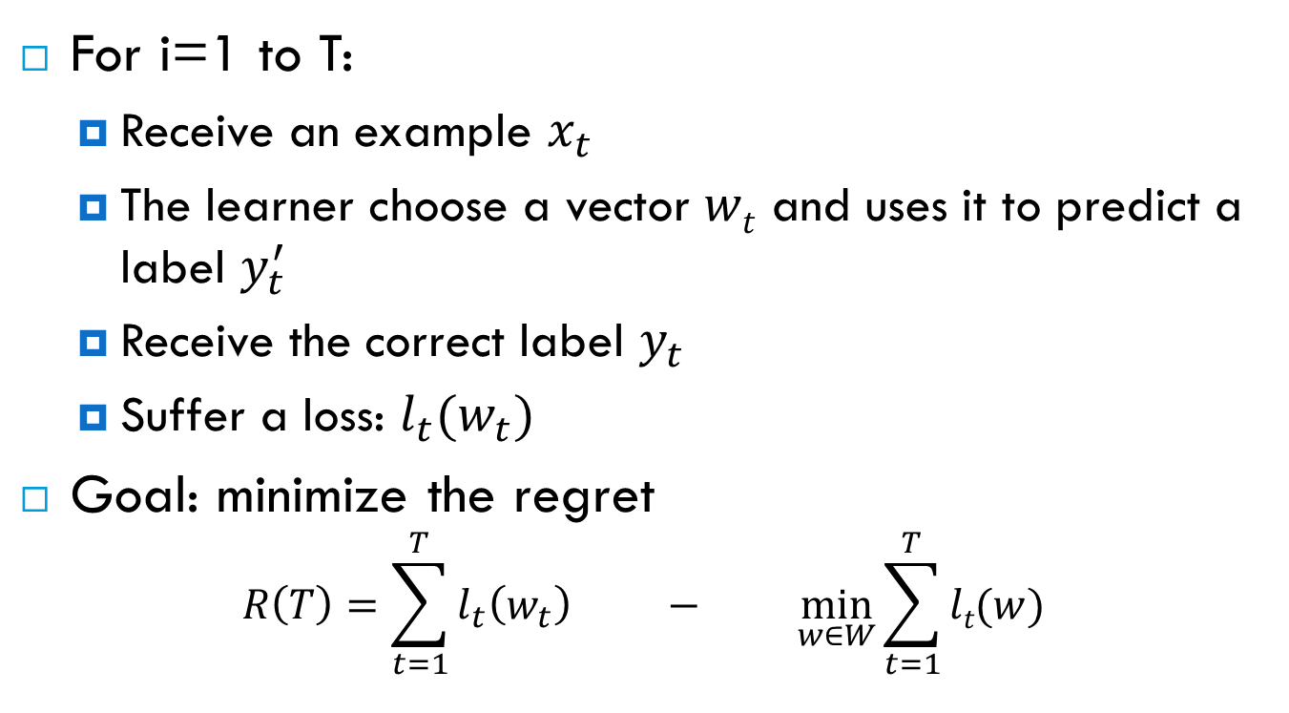
Online learning
For i=1 to T:
  Receive an example $x_{t}$
  The learner choose a vector $wt$ and uses it to predict a label $y_{t}^{′}$
  Receive the correct label $y_{t}$
  Suffer a loss: $l_{t}(w_{t})$
Goal: minimize the regret
$$R\left(T\right)=\sum_{t=1}^{T}{l_{t}\left(w_{t}\right) − \min_{w∈W}{\sum_{t=1}^{T}{lt(w)}}}$$
The accumulative loss of the online learner
The accumulative loss of the best batch learner
Notes:
Note:
The loss function is a function to measure the error

Slide 22
Primal-dual framework for online learning
[Shalev-Shwartz et al., 2006]
A general and latest framework for deriving low-regret online algorithms
Rewrite the regret bound as an optimization problem (called the primal problem), then considering the dual problem of the primal one
Derive a condition that guarantees the increase in the dual objective in each step
→ Incremental-Dual-Ascent (IDA) algorithms. For example: subgradient methods [Zinkevich, 2003]

Slide 23
Primal-dual framework for online learning (cont.)
Propose a new class of IDA algorithms called Coordinate-Dual-Ascent (CDA) algorithm:
  The CDA update rule only optimizes the dual w.r.t the last dual variable (the current example)
  A closed-form solution of CDA update rule → CDA algorithm has the same cost as subgradient methods but increase the dual objective more in each step → better accuracy

Slide 24
Steps for deriving a new CDA algorithm
Define the regularization and loss functions
Find the conjugate functions
Derive a closed-form solution for the CDA update rule
CDA algorithm
for max-margin structured prediction

Slide 25
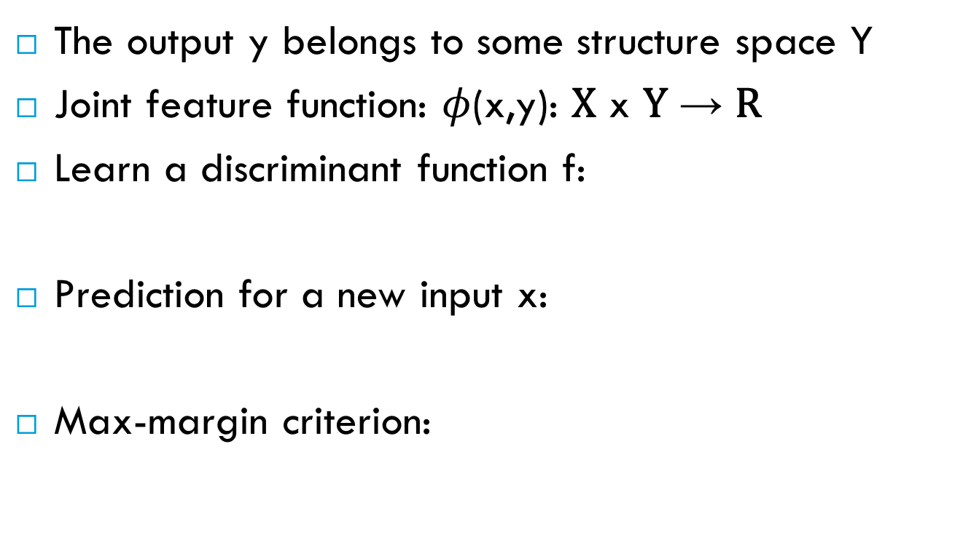
Max-margin structured prediction
The output y belongs to some structure space Y
Joint feature function: $φ$(x,y): X x Y → R
Learn a discriminant function f:
Prediction for a new input x:
Max-margin criterion:
MLNs: n(x,y)

Slide 26
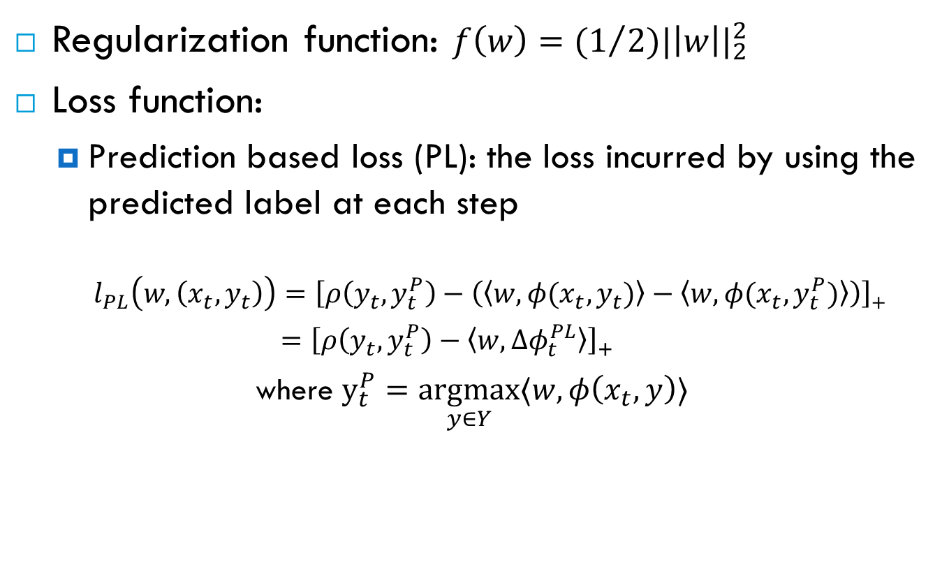
1. Define the regularization and loss functions
Regularization function: $f\left(w\right)={(1}/{2){|\left|w\right||}_{2}^{2}}$
Loss function:
  Prediction based loss (PL): the loss incurred by using the predicted label at each step
    $l_{PL}\left(w,\left(x_{t},y_{t}\right)\right)=\left[ρ\left(y_{t},y_{t}^{P}\right)−\left(\left\langle w,φ(x_{t},y_{t})\right\rangle −\left\langle w,φ(x_{t},y_{t}^{P})\right\rangle \right)\right]$₊
    $={\left[ρ\left(y_{t},y_{t}^{P}\right)−〈w,Δφ_{t}^{PL}〉\right]}_{+}$
  where $y_{t}^{P}=\underset{y∈Y}{argmax}{〈w,φ\left(x_{t},y\right)〉}$
Label loss function

Slide 27
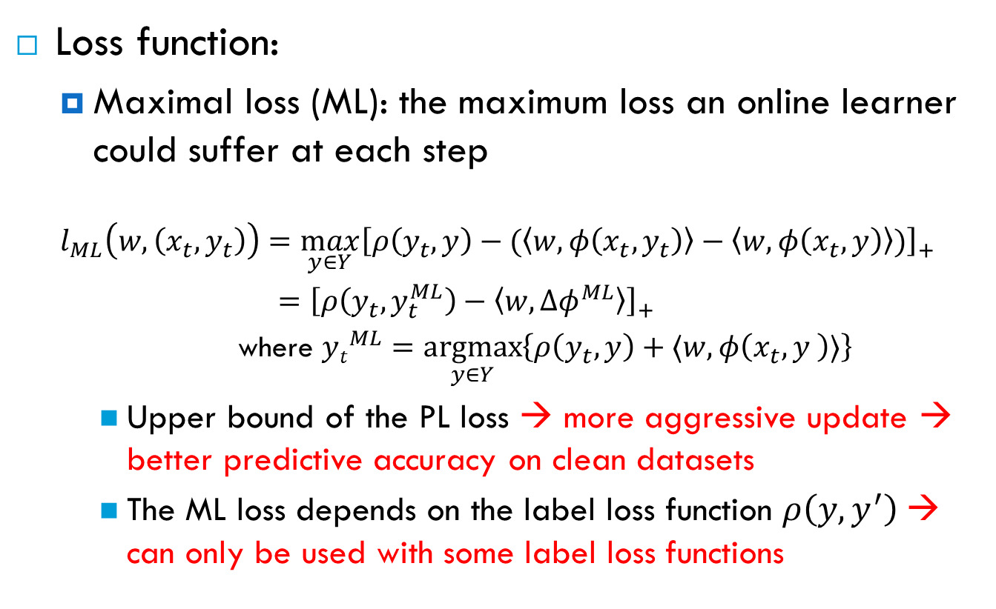
1. Define the regularization and loss functions (cont.)
Loss function:
  Maximal loss (ML): the maximum loss an online learner could suffer at each step
  $$l_{ML}\left(w,\left(x_{t},y_{t}\right)\right)=\max_{y∈Y}{{\left[ρ\left(y_{t},y\right)−(\left\langle w,φ\left(x_{t},y_{t}\right)\right\rangle −\left\langle w,φ\left(x_{t},y\right)\right\rangle )\right]}_{+}}$$
    $=$ ${\left[ρ\left(y_{t},y_{t}^{ML}\right)−〈w,Δφ^{ML}〉\right]}_{+}$
    where ${yt}_{}^{ML}=\underset{y∈Y}{argmax}\left\{ρ\left(y_{t},y\right)+〈w,φ\left(x_{t},y \right)〉\right\}$
    Upper bound of the PL loss → more aggressive update → better predictive accuracy on clean datasets
    The ML loss depends on the label loss function $ρ\left(y,y^{′}\right)$→ can only be used with some label loss functions

Slide 28
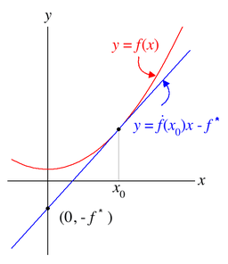

2. Find the conjugate functions
Conjugate function:
$$f^{∗}\left(θ\right)=\sup_{w∈W}\left[〈w,θ〉−f(w)\right]$$
  1-dimension: $f^{∗}\left(p\right)$ is the negative of the y-intercept of the tangent line to the graph of f that has slope $p$

Slide 29
2. Find the conjugate functions (cont.)
Conjugate function of the regularization function f(w):
  f(w)=(1/2)||w||₂² → f*(µ) = (1/2)||µ||₂²

Slide 30
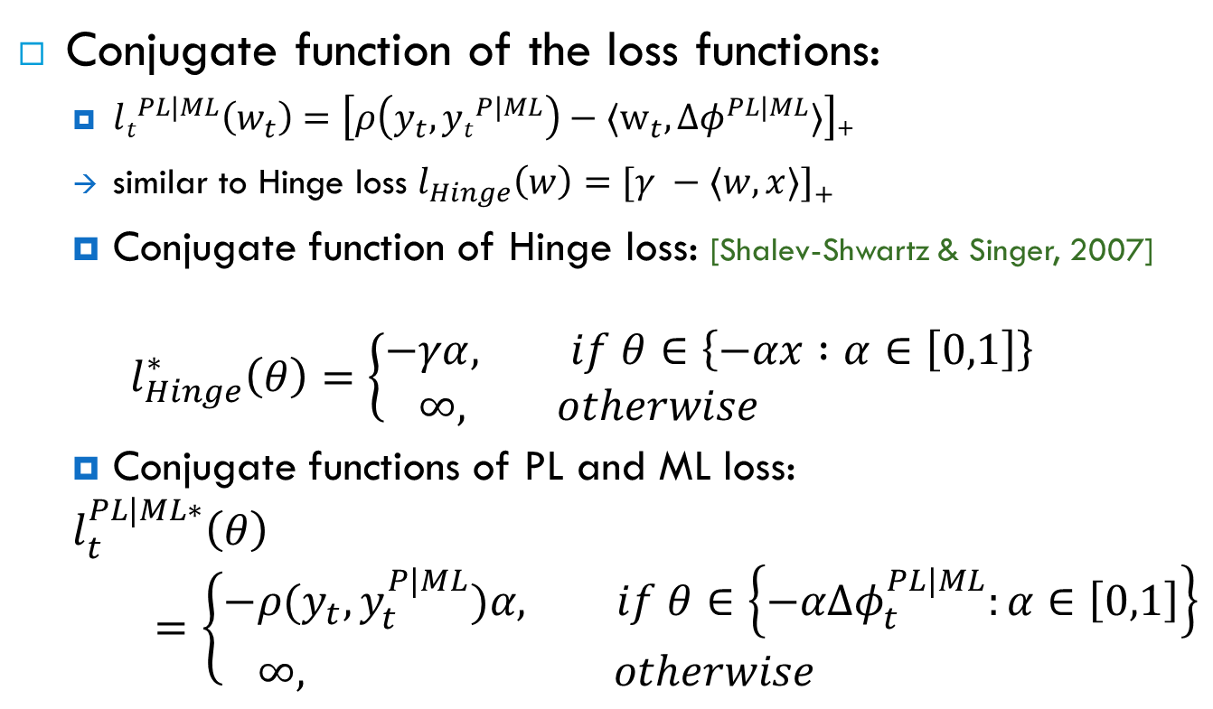
2. Find the conjugate functions (cont.)
Conjugate function of the loss functions:
  $lt^{PL|ML}\left(w_{t}\right)=\left[ρ\left(y_{t},{yt}^{P|ML}\right)−〈w_{t}, {Δφ}^{PL|ML}〉\right]$₊
  similar to Hinge loss $l_{Hinge}\left(w\right)=[γ −〈w,x〉]$₊
  Conjugate function of Hinge loss: [Shalev-Shwartz & Singer, 2007]
  $$l_{Hinge}^{∗}\left(θ\right)=\left\{\begin{aligned}−&γα, if θ∈\left\{−αx :α∈\left[0,1\right]\right\} \\ &∞, otherwise\end{aligned}\right.$$
  Conjugate functions of PL and ML loss:
  $$l_{t}^{PL|ML∗}\left(θ\right)=\left\{\begin{aligned}−&ρ(y_{t},y_{t}^{P|ML})α, if θ∈\left\{−αΔφ_{t}^{PL|ML}:α∈\left[0,1\right]\right\} \\ &∞, otherwise\end{aligned}\right.$$

Slide 31

3. Closed-form solution for the CDA update rule
CDA’s update formula:
$$w_{t+1}={\frac{t−1}{t}w}_{t}+\min\left\{\frac{1}{σt},\frac{{\left[ρ\left(y_{t},y_{t}^{P|ML}\right)−\frac{t−1}{t}〈w_{t},Δφ_{t}^{PL|ML}\right]}_{+}}{{\left|\left|Δφ_{t}^{PL|ML}\right|\right|}_{2}^{2}}\right\}Δφ^{PL|ML}$$
Compare with the update formula of the simple update, subgradient method [Ratliff et al., 2007]:
$$w_{t+1}=\frac{t−1}{t}w_{t}+\frac{1}{σt}Δφ^{ML}$$
CDA’s learning rate combines the learning rate of the subgradient
method with the loss incurred at each step

Slide 32
Experimental Evaluation
Citation segmentation
Search query disambiguation
Semantic role labeling

Slide 33
Citation segmentation
Citeseer dataset [Lawrence et.al., 1999] [Poon and Domingos, 2007]
1,563 citations, divided into 4 research topics
Task: segment each citation into 3 fields: Author, Title, Venue
Used the MLN for isolated segmentation model in [Poon and Domingos, 2007]

Slide 34
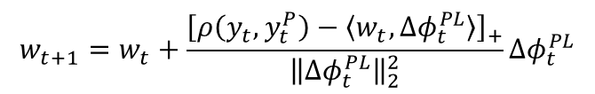
Experimental setup
4-fold cross-validation
Systems compared:
  MM: the max-margin weight learner for MLNs in batch setting [Huynh & Mooney, 2009]
  1-best MIRA [Crammer et al., 2005]
  Subgradient
  CDA
    CDA-PL
    CDA-ML
  Metric:
    F₁, harmonic mean of the precision and recall
$$w_{t+1}=w_{t}+\frac{{\left[ρ\left(y_{t},y_{t}^{P}\right)−\left\langle w_{t},Δφ_{t}^{PL}\right\rangle \right]}_{+}}{{\left\|Δφ_{t}^{PL}\right\|}_{2}^{2}}Δφ_{t}^{PL}$$

Slide 35
Average F₁on CiteSeer

Slide 36
Average training time in minutes

Slide 37
Search query disambiguation
Used the dataset created by Mihalkova & Mooney [2009]
Thousands of search sessions where ambiguous queries were asked: 4,618 sessions for training, 11,234 sessions for testing
Goal: disambiguate search query based on previous related search sessions
Noisy dataset since the true labels are based on which results were clicked by users
Used the 3 MLNs proposed in [Mihalkova & Mooney, 2009]

Slide 38
Experimental setup
Systems compared:
  Contrastive Divergence (CD) [Hinton 2002] used in [Mihalkova & Mooney, 2009]
  1-best MIRA
  Subgradient
  CDA
    CDA-PL
    CDA-ML
Metric:
  Mean Average Precision (MAP): how close the relevant results are to the top of the rankings

Slide 39
MAP scores on Microsoft query search

Slide 40
Semantic role labeling
CoNLL 2005 shared task dataset [Carreras & Marques, 2005]
Task: For each target verb in a sentence, find and label all of its semantic components
90,750 training examples; 5,267 test examples
Noisy labeled experiment:
  Motivated by noisy labeled data obtained from crowdsourcing services such as Amazon Mechanical Turk
  Simple noise model:
    At p percent noise, there is p probability that an argument in a verb is swapped with another argument of that verb.

Slide 41
Experimental setup
Used the MLN developed in [Riedel, 2007]
Systems compared:
  1-best MIRA
  Subgradient
  CDA-ML
Metric:
  F₁ of the predicted arguments [Carreras & Marques, 2005]

Slide 42
F₁ scores on CoNLL 2005

Slide 43
Online Structure Learning

Slide 44
State-of-the-art
All existing structure learning algorithms for MLNs are also batch ones
  Effectively designed for problems that have a few “mega” examples
  Not suitable for problems with a large number of smaller structured examples
No existing online structure learning algorithms for MLNs
The first online structure learner for MLNs

Slide 45
Online Structure Learner (OSL)
x_{t}
MLN
y^{P}_{t}
Max-margin structure learning
y_{t}
New clauses
Old and new clauses
L₁-regularized
weight learning
New weights

Slide 46
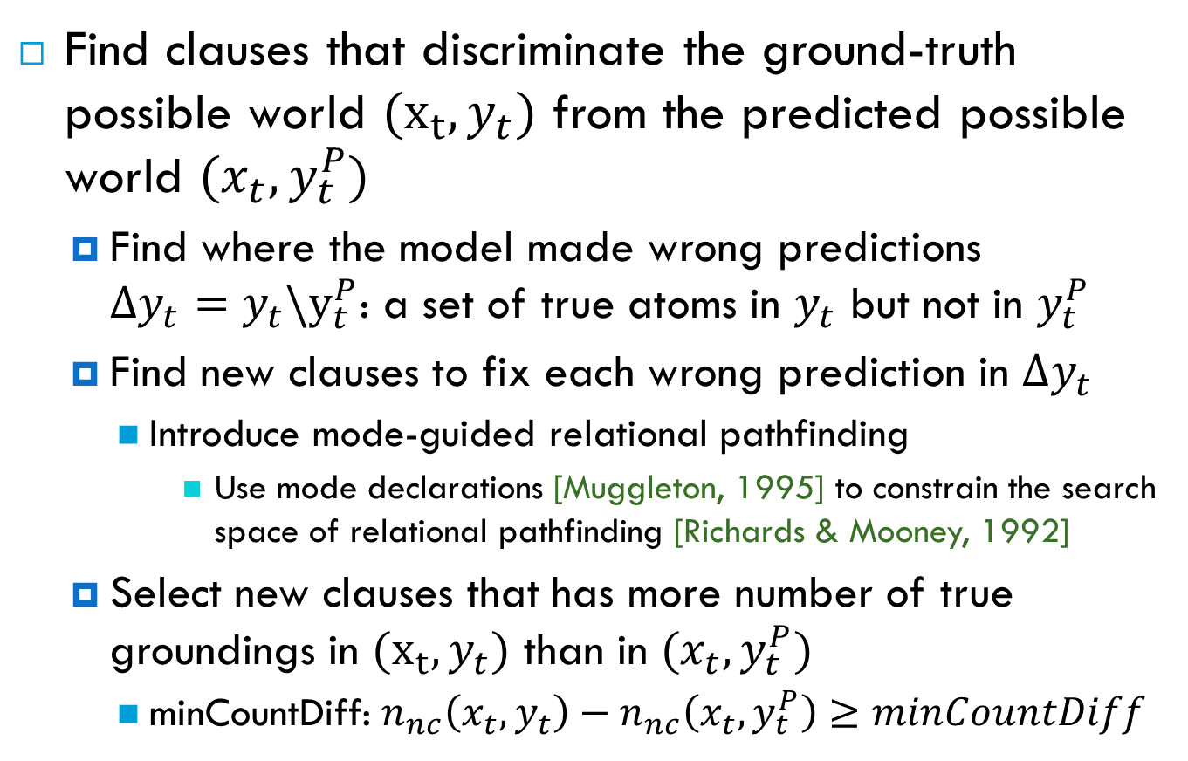
Max-margin structure learning
Find clauses that discriminate the ground-truth possible world ${(x}_{t},y_{t})$ from the predicted possible world $(x_{t},y_{t}^{P})$
  Find where the model made wrong predictions $Δy_{t}={y_{t}\backslash y}_{t}^{P}$: a set of true atoms in $y_{t}$ but not in $y_{t}^{P}$
  Find new clauses to fix each wrong prediction in $Δy_{t}$
    Introduce mode-guided relational pathfinding
      Use mode declarations [Muggleton, 1995] to constrain the search space of relational pathfinding [Richards & Mooney, 1992]
  Select new clauses that has more number of true groundings in ${(x}_{t},y_{t})$ than in $(x_{t},y_{t}^{P})$
    minCountDiff: $n_{nc}\left(x_{t}, y_{t}\right)−n_{nc}\left(x_{t},y_{t}^{P}\right)≥minCountDiff$

Slide 47
Relational pathfinding [Richards & Mooney, 1992]
Learn definite clauses:
  Consider a relational example as a hypergraph:
    Nodes: constants
    Hyperedges: true ground atoms, connecting the nodes that are its arguments
  Search in the hypergraph for paths that connect the arguments of a target literal.
Alice
Parent:
Married:
Uncle(Tom, Mary)
Bob
Joan
Tom
Carol
Mary
Fred
Ann
Parent(Joan,Mary) ∧ Parent(Alice,Joan) ∧ Parent(Alice,Tom) ⇒ Uncle(Tom,Mary)
Parent(x,y) ∧ Parent(z,x) ∧ Parent(z,w) ⇒ Uncle(w,y)
→ Exhaustive search over an exponential number of paths
*Adapted from [Mooney, 2009]

Slide 48
Mode declarations [Muggleton, 1995]
A language bias to constrain the search for definite clauses
A mode declaration specifies:
  whether a predicate can be used in the head or body
  the number of appearances of a predicate in a clause
  constraints on the types of arguments of a predicate

Slide 49
Mode-guided relational pathfinding
Use mode declarations to constrain the search for paths in relational pathfinding:
  introduce a new mode declaration for paths, modep(r,p):
    r (recall number): a non-negative integer limiting the number of appearances of a predicate in a path to r
      can be 0, i.e don’t look for paths containing atoms of a particular predicate
    p: an atom whose arguments are
      Input(+): bounded argument, i.e must appear in some previous atoms
      Output(-): can be free argument
      Don’t explore(.): don’t expand the search on this argument
Notes:
An atom containing an input argument can only be added to the current path if that argument has been appeared in some previous atoms in the path

Slide 50
Mode-guided relational pathfinding (cont.)
Example in citation segmentation: constrain the search space to paths connecting true ground atoms of two consecutive tokens
  InField(field,position,citationID): the field label of the token at a position
  Next(position,position): two positions are next to each other
  Token(word,position,citationID): the word appears at a given position
modep(2,InField(.,–,.)) modep(1,Next(–, –)) modep(2,Token(.,+,.))

Slide 51
Mode-guided relational pathfinding (cont.)
InField(Title,P09,B2)
Wrong prediction
P09 → {
Token(To,P09,B2),
Next(P08,P09),
Next(P09,P10),
LessThan(P01,P09)
…
}
Hypergraph
{InField(Title,P09,B2),Token(To,P09,B2)}
Paths

Slide 52
Mode-guided relational pathfinding (cont.)
InField(Title,P09,B2)
Wrong prediction
P09 → {
Token(To,P09,B2),
Next(P08,P09),
Next(P09,P10),
LessThan(P01,P09)
…
}
Hypergraph
{InField(Title,P09,B2),Token(To,P09,B2)}
{InField(Title,P09,B2),Token(To,P09,B2),Next(P08,P09)}
Paths

Slide 53
Generalizing paths to clauses
Paths
Modes
{InField(Title,P09,B2),Token(To,P09,B2),
Next(P08,P09),InField(Title,P08,B2)}
…
modec(InField(c,v,v))
modec(Token(c,v,v))
modec(Next(v,v))
…
Conjunctions
InField(Title,p1,c) ∧ Token(To,p1,c) ∧ Next(p2,p1) ∧ InField(Title,p2,c)
C1: ¬InField(Title,p1,c) ˅ ¬Token(To,p1,c) ˅ ¬Next(p2,p1) ˅ ¬ InField(Title,p2,c)
C2: InField(Title,p1,c) ˅ ¬Token(To,p1,c) ˅ ¬Next(p2,p1) ˅ ¬ InField(Title,p2,c)
Token(To,p1,c) ∧ Next(p2,p1) ∧ InField(Title,p2,c) ⇒ InField(Title,p1,c)
Clauses

Slide 54
L₁-regularized weight learning
Many new clauses are added at each step and some of them may not be useful in the long run
→ Use L₁-regularization to zero out those clauses
Use a state-of-the-art online L₁-regularized learning algorithm named ADAGRAD_FB [Duchi et.al., 2010], a L₁-regularized adaptive subgradient method

Slide 55
Experiment Evaluation
Investigate the performance of OSL on two scenarios:
  Starting from a given MLN
  Starting from an empty knowledge base
Task: citation segmentation on CiteSeer dataset

Slide 56
Input MLNs
A simple linear chain CRF (LC_0):
  Only use the current word as features
  Transition rules between fields
  Next(p1,p2) ∧ InField(+f1,p1,c) ⇒ InField(+f2,p2,c)
Token(+w,p,c) ⇒ InField(+f,p,c)

Slide 57
Input MLNs (cont.)
Isolated segmentation model (ISM) [Poon & Domingos, 2007], a well-developed linear chain CRF:
  In addition to the current word feature, also has some features that based on words that appear before or after the current word
  Only has transition rules within fields, but takes into account punctuations as field boundary:
  Next(p1,p2) ∧ ¬HasPunc(p1,c) ∧ InField(+f,p1,c) ⇒ InField(+f,p2,c)
  Next(p1,p2) ∧ HasComma(p1,c) ∧ InField(+f,p1,c) ⇒ InField(+f,p2,c)

Slide 58
Systems compared
ADAGRAD_FB: only do weight learning
OSL-M2: a fast version of OSL where the parameter minCountDiff is set to 2
OSL-M1: a slow version of OSL where the parameter minCountDiff is set to 1

Slide 59
Experimental setup
OSL: specify mode declarations to constrain the search space to paths connecting true ground atoms of two consecutive tokens:
  A linear chain CRF:
    Features based on current, previous and following words
    Transition rules with respect to current, previous and following words
4-fold cross-validation
Average F₁

Slide 60
Average F₁ scores on CiteSeer

Slide 61
Average training time on CiteSeer

Slide 62
Some good clauses found by OSL on CiteSeer
OSL-M1-ISM:
  The current token is a Title and is followed by a period then it is likely that the next token is in the Venue field
OSL-M1-Empty:
  Consecutive tokens are usually in the same field
InField(Title,p1,c) ∧ FollowBy(PERIOD,p1,c) ∧ Next(p1,p2)
⇒ InField(Venue,p2,c)
Next(p1,p2) ∧ InField(Author,p1,c) ⇒ InField(Author,p2,c)
Next(p1,p2) ∧ InField(Title,p1,c) ⇒ InField(Title,p2,c)
Next(p1,p2) ∧ InField(Venue,p1,c) ⇒ InField(Venue,p2,c)

Slide 63
Automatically selecting hard constraints
Deterministic constraints arise in many real-world problems:
  A Venue token cannot appear right after the an Author token
  A Title token cannot appear before an Author token
  →Add new interactions or factors among the output variables
  →Increase the complexity of the learning problem
  →Significantly increase the training time

Slide 64
Automatically selecting hard constraints (cont.)
Propose a simple heuristic to detect ``inexpensive’’ hard constraints based on the number of factors and the size of each factor introduced by a constraint → only include ``inexpensive’’ constraints during training
Achieve the best predictive accuracy while still allowing efficient training on the citation segmentation task

Slide 65
Future work
Online structure learning
  Reduce the number of new clauses added at each step
  Other forms of language bias
Online max-margin weight learning:
  Learning with partially observable data
Learning with large mega-examples
Other applications:
  Natural language processing: entity and relation extraction…
  Computer vision: scene understanding…
  Web and social media: streaming data

Slide 66
Summary
Improving the accuracy and scalability of discriminative learning methods:
  Discriminative structure and parameter learning for MLNs with non-recursive clauses
  Max-margin weight learning for MLNs
  Online max-margin weight learning for MLNs
  Online structure learning for MLNs
  Automatically selecting hard constraints to enforce when training

Slide 67
Thank you!
Questions?

Slide 68
Average num. of non-zero clauses on CiteSeer

