Slide 1
Online Structure Learning for Markov Logic Networks
Tuyen N. Huynh and Raymond J. Mooney
Department of Computer Science
The University of Texas at Austin
ECML-PKDD-2011, Athens, Greece

Slide 2
Large-scale structured/relational learning
Citeseer Citation segmentation [Peng & McCallum, 2004]
D. McDermott and J. Doyle. Non-monotonic Reasoning I. Artificial Intelligence, 13: 41-72, 1980.
D. McDermott and J. Doyle. Non-monotonic Reasoning I. Artificial Intelligence, 13: 41-72, 1980.
D. McDermott and J. Doyle. Non-monotonic Reasoning I. Artificial Intelligence, 13: 41-72, 1980.
D. McDermott and J. Doyle. Non-monotonic Reasoning I. Artificial Intelligence, 13: 41-72, 1980.
D. McDermott and J. Doyle. Non-monotonic Reasoning I. Artificial Intelligence, 13: 41-72, 1980.
D. McDermott and J. Doyle. Non-monotonic Reasoning I. Artificial Intelligence, 13: 41-72, 1980.
D. McDermott and J. Doyle. Non-monotonic Reasoning I. Artificial Intelligence, 13: 41-72, 1980.
Craigslist ad segmentation [Grenager et al., 2005]
Modern, clean, quiet, $750 up--BIG pool, parking, laundry, elevator. Open viewing SAT/SUN, 10am-6pm, at 1720 12 Avenue, corner East 17 St. Other times call first: Sam, 510-534-0558.
Modern, clean, quiet, $750 up--BIG pool, parking, laundry, elevator. Open viewing SAT/SUN, 10am-6pm, at 1720 12 Avenue, corner East 17 St. Other times call first: Sam, 510-534-0558.
Modern, clean, quiet, $750 up--BIG pool, parking, laundry, elevator. Open viewing SAT/SUN, 10am-6pm, at 1720 12 Avenue, corner East 17 St. Other times call first: Sam, 510-534-0558.
Modern, clean, quiet, $750 up--BIG pool, parking, laundry, elevator. Open viewing SAT/SUN, 10am-6pm, at 1720 12 Avenue, corner East 17 St. Other times call first: Sam, 510-534-0558.
Modern, clean, quiet, $750 up--BIG pool, parking, laundry, elevator. Open viewing SAT/SUN, 10am-6pm, at 1720 12 Avenue, corner East 17 St. Other times call first: Sam, 510-534-0558.
Modern, clean, quiet, $750 up--BIG pool, parking, laundry, elevator. Open viewing SAT/SUN, 10am-6pm, at 1720 12 Avenue, corner East 17 St. Other times call first: Sam, 510-534-0558.
Modern, clean, quiet, $750 up--BIG pool, parking, laundry, elevator. Open viewing SAT/SUN, 10am-6pm, at 1720 12 Avenue, corner East 17 St. Other times call first: Sam, 510-534-0558.
Modern, clean, quiet, $750 up--BIG pool, parking, laundry, elevator. Open viewing SAT/SUN, 10am-6pm, at 1720 12 Avenue, corner East 17 St. Other times call first: Sam, 510-534-0558.

Slide 3
Motivation
Markov Logic Networks (MLNs) [Richardson & Domingos, 2006] are an elegant and powerful formalism for handling complex structured/relational data.
All existing structure learning algorithms for MLNs are batch learning methods.
  Effectively designed for problems that have a few “mega” examples.
  Do not scale to problems with a large number of smaller structured examples.
No existing online structure learning algorithms for MLNs.
The first online structure learner for MLNs

Slide 4
Outline
Motivation
Background
  Markov Logic Networks
OSL: Online structure learning algorithm
Experiment Evaluation
Summary

Slide 5
Background

Slide 6
Markov Logic Networks (MLNs)
[Richardson & Domingos, 2006]
An MLN is a weighted set of first-order formulas.
Larger weight indicates stronger belief that the clause should hold.
Probability of a possible world (a truth assignment to all ground atoms) x:
10 InField(f,p1,c) ∧ Next(p1,p2) ⇒ InField(f,p2,c)
5 Token(t,p,c) ∧ IsInitial(t) ⇒ InField(Author,p,c) ˅ InField(Venue,p,c)
Weight of formula i
No. of true groundings of formula i in x
Notes:
1st clause: Initial tokens is either in Author or Venue field.
2nd clause: Consecutive tokens may belong to the same field.

Slide 7
Existing structure learning methods for MLNs
Top-down approach:
  MSL[Kok & Domingos, 2005], DSL[Biba et al., 2008]
  Start from unit clauses and search for new clauses
Bottom-up approach:
  BUSL[Mihalkova & Mooney, 2007], LHL[Kok & Domingos, 2009], LSM[Kok & Domingos , 2010]
  Use data to generate candidate clauses

Slide 8
OSL: Online Structure Learner for MLNs

Slide 9
Online Structure Learner (OSL)
x_{t}
MLN
y^{P}_{t}
Max-margin structure learning
y_{t}
New clauses
Old and new clauses
L₁-regularized
weight learning
New weights
Notes:
Animate the flow

Slide 10
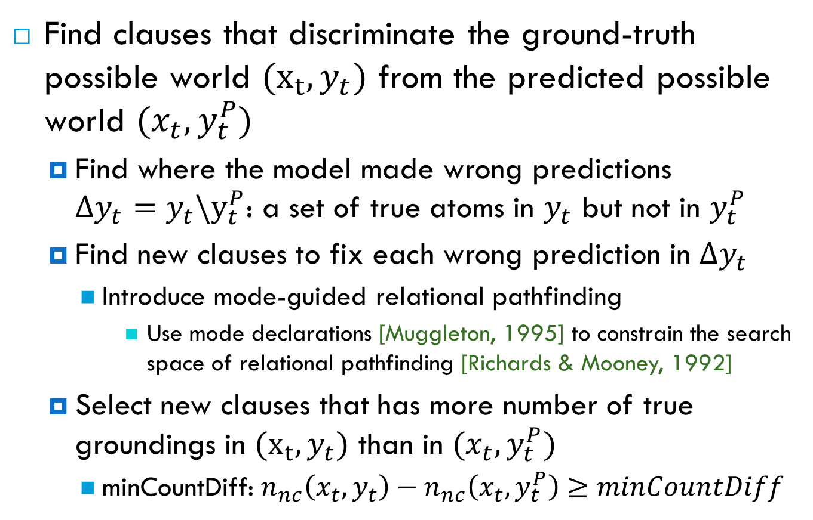
Max-margin structure learning
Find clauses that discriminate the ground-truth possible world ${(x}_{t},y_{t})$ from the predicted possible world $(x_{t},y_{t}^{P})$
  Find where the model made wrong predictions $Δy_{t}={y_{t}\backslash y}_{t}^{P}$: a set of true atoms in $y_{t}$ but not in $y_{t}^{P}$
  Find new clauses to fix each wrong prediction in $Δy_{t}$
    Introduce mode-guided relational pathfinding
      Use mode declarations [Muggleton, 1995] to constrain the search space of relational pathfinding [Richards & Mooney, 1992]
  Select new clauses that has more number of true groundings in ${(x}_{t},y_{t})$ than in $(x_{t},y_{t}^{P})$
    minCountDiff: $n_{nc}\left(x_{t}, y_{t}\right)−n_{nc}\left(x_{t},y_{t}^{P}\right)≥minCountDiff$

Slide 11
Relational pathfinding
[Richards & Mooney, 1992]
Learn definite clauses:
  Consider a relational example as a hypergraph:
    Nodes: constants
    Hyperedges: true ground atoms, connecting the nodes that are its arguments
  Search in the hypergraph for paths that connect the arguments of a target literal.
Alice
Parent:
Married:
Uncle(Tom, Mary)
Bob
Joan
Tom
Carol
Mary
Fred
Ann
Parent(Joan,Mary) ∧ Parent(Alice,Joan) ∧ Parent(Alice,Tom) ⇒ Uncle(Tom,Mary)
Parent(x,y) ∧ Parent(z,x) ∧ Parent(z,w) ⇒ Uncle(w,y)

Slide 12
Relational pathfinding (cont.)
We use a generalization of the relational pathfinding:
  A path does not need to connect arguments of the target atom.
  Any two consecutive atoms in a path must share at least one input/output argument.
Similar approach used in LHL [Kok & Domingos, 2009] and LSM [Kok & Domingos , 2010].
→ Can result in an intractable number of possible paths

Slide 13
Mode declarations [Muggleton, 1995]
A language bias to constrain the search for definite clauses.
A mode declaration specifies:
  The number of appearances of a predicate in a clause.
  Constraints on the types of arguments of a predicate.

Slide 14
Mode-guided relational pathfinding
Use mode declarations to constrain the search for paths in relational pathfinding:
  Introduce a new mode declaration for paths, modep(r,p):
    r (recall number): a non-negative integer limiting the number of appearances of a predicate in a path to r
      can be 0, i.e don’t look for paths containing atoms of a particular predicate
    p: an atom whose arguments are:
      Input(+): bound argument, i.e must appear in some previous atom
      Output(-): can be free argument
      Don’t explore(.): don’t expand the search on this argument

Slide 15
Mode-guided relational pathfinding (cont.)
Example in citation segmentation: constrain the search space to paths connecting true ground atoms of two consecutive tokens
  InField(field,position,citationID): the field label of the token at a position
  Next(position,position): two positions are next to each other
  Token(word,position,citationID): the word appears at a given position
modep(2,InField(.,–,.)) modep(1,Next(–, –)) modep(2,Token(.,+,.))

Slide 16
Mode-guided relational pathfinding (cont.)
InField(Title,P09,B2)
Wrong prediction
P09 → {
Token(To,P09,B2),
Next(P08,P09),
Next(P09,P10),
LessThan(P01,P09)
…
}
Hypergraph
{InField(Title,P09,B2),Token(To,P09,B2)}
Paths

Slide 17
Mode-guided relational pathfinding (cont.)
InField(Title,P09,B2)
Wrong prediction
P09 → {
Token(To,P09,B2),
Next(P08,P09),
Next(P09,P10),
LessThan(P01,P09)
…
}
Hypergraph
{InField(Title,P09,B2),Token(To,P09,B2)}
{InField(Title,P09,B2),Token(To,P09,B2),Next(P08,P09)}
Paths

Slide 18
Generalizing paths to clauses
Paths
Modes
{InField(Title,P09,B2),Token(To,P09,B2),
Next(P08,P09),InField(Title,P08,B2)}
…
modec(InField(c,v,v))
modec(Token(c,v,v))
modec(Next(v,v))
…
Conjunctions
InField(Title,p1,c) ∧ Token(To,p1,c) ∧ Next(p2,p1) ∧ InField(Title,p2,c)
C1: ¬InField(Title,p1,c) ˅ ¬Token(To,p1,c) ˅ ¬Next(p2,p1) ˅ ¬ InField(Title,p2,c)
C2: InField(Title,p1,c) ˅ ¬Token(To,p1,c) ˅ ¬Next(p2,p1) ˅ ¬ InField(Title,p2,c)
Token(To,p1,c) ∧ Next(p2,p1) ∧ InField(Title,p2,c) ⇒ InField(Title,p1,c)
Clauses

Slide 19
L₁-regularized weight learning
Many new clauses are added at each step and some of them may not be useful in the long run.
→ Use L₁-regularization to zero out those clauses
Use a state-of-the-art online L₁-regularized learning algorithm named ADAGRAD_FB [Duchi et.al., 2010], a L₁-regularized adaptive subgradient method.

Slide 20
Experiment Evaluation
Investigate the performance of OSL on two scenarios:
  Starting from a given MLN
  Starting from an empty MLN
Task: natural language field segmentation
Datasets:
  CiteSeer: 1,563 citations, 4 disjoint subsets corresponding 4 different research areas
  Craigslist: 8,767 ads, but only 302 of them were labeled

Slide 21
Input MLNs
A simple linear chain CRF (LC_0):
  Only use the current word as features
  Transition rules between fields
  Next(p1,p2) ∧ InField(+f1,p1,c) ⇒ InField(+f2,p2,c)
Token(+w,p,c) ⇒ InField(+f,p,c)

Slide 22
Input MLNs (cont.)
Isolated segmentation model (ISM) [Poon & Domingos, 2007], a well-developed MLN for citation segmentation :
  In addition to the current word feature, also has some features that based on words that appear before or after the current word
  Only has transition rules within fields, but takes into account punctuations as field boundary:
  ¬HasPunc(p1,c) ∧ InField(+f,p1,c) ∧ Next(p1,p2) ⇒ InField(+f,p2,c)
  HasComma(p1,c) ∧ InField(+f,p1,c) ∧ Next(p1,p2) ⇒ InField(+f,p2,c)

Slide 23
Systems compared
ADAGRAD_FB: only do weight learning
OSL-M2: a fast version of OSL where the parameter minCountDiff is set to 2
OSL-M1: a slow version of OSL where the parameter minCountDiff is set to 1

Slide 24
Experimental setup
OSL: specify mode declarations to constrain the search space to paths connecting true ground atoms of two consecutive tokens:
  A linear chain CRF:
    Features based on current, previous and following words
    Transition rules with respect to current, previous and following words
4-fold cross-validation
Average F₁

Slide 25
Average F₁ scores on CiteSeer

Slide 26
Average training time on CiteSeer

Slide 27
Some good clauses found by OSL on CiteSeer
OSL-M1-ISM:
  The current token is a Title and is followed by a period then it is likely that the next token is in the Venue field
OSL-M1-Empty:
  Consecutive tokens are usually in the same field
InField(Title,p1,c) ∧ FollowBy(PERIOD,p1,c) ∧ Next(p1,p2)
⇒ InField(Venue,p2,c)
Next(p1,p2) ∧ InField(Author,p1,c) ⇒ InField(Author,p2,c)
Next(p1,p2) ∧ InField(Title,p1,c) ⇒ InField(Title,p2,c)
Next(p1,p2) ∧ InField(Venue,p1,c) ⇒ InField(Venue,p2,c)

Slide 28
Summary
The first online structure learner (OSL) for MLNs:
  Can either enhance an existing MLN or learn an MLN from scratch.
  Can handle problems with thousands of small structured training examples.
  Outperforms existing algorithms on CiteSeer and Craigslist information extraction datasets.

Slide 29
Thank you!
Questions?

