Slide 1
Online Max-Margin Weight Learning for Markov Logic Networks
Tuyen N. Huynh and Raymond J. Mooney
Machine Learning Group
Department of Computer Science
The University of Texas at Austin
SDM 2011, April 29, 2011

Slide 2
Motivation
Citation segmentation
D. McDermott and J. Doyle. Non-monotonic Reasoning I. Artificial Intelligence, 13: 41-72, 1980.
D. McDermott and J. Doyle. Non-monotonic Reasoning I. Artificial Intelligence, 13: 41-72, 1980.
D. McDermott and J. Doyle. Non-monotonic Reasoning I. Artificial Intelligence, 13: 41-72, 1980.
D. McDermott and J. Doyle. Non-monotonic Reasoning I. Artificial Intelligence, 13: 41-72, 1980.
D. McDermott and J. Doyle. Non-monotonic Reasoning I. Artificial Intelligence, 13: 41-72, 1980.
D. McDermott and J. Doyle. Non-monotonic Reasoning I. Artificial Intelligence, 13: 41-72, 1980.
D. McDermott and J. Doyle. Non-monotonic Reasoning I. Artificial Intelligence, 13: 41-72, 1980.
Semantic role labeling
[_{A0} He] [_{AM-MOD} would] [_{AM-NEG} n’t] [_{V} accept]
[_{A1} anything of value] from [_{A2} those he was writing about]
[_{A0} He] [_{AM-MOD} would] [_{AM-NEG} n’t] [_{V} accept]
[_{A1} anything of value] from [_{A2} those he was writing about]
[_{A0} He] [_{AM-MOD} would] [_{AM-NEG} n’t] [_{V} accept]
[_{A1} anything of value] from [_{A2} those he was writing about]
[_{A0} He] [_{AM-MOD} would] [_{AM-NEG} n’t] [_{V} accept]
[_{A1} anything of value] from [_{A2} those he was writing about]
[_{A0} He] [_{AM-MOD} would] [_{AM-NEG} n’t] [_{V} accept]
[_{A1} anything of value] from [_{A2} those he was writing about]
[_{A0} He] [_{AM-MOD} would] [_{AM-NEG} n’t] [_{V} accept]
[_{A1} anything of value] from [_{A2} those he was writing about]
[_{A0} He] [_{AM-MOD} would] [_{AM-NEG} n’t] [_{V} accept]
[_{A1} anything of value] from [_{A2} those he was writing about]

Slide 3
Motivation (cont.)
Markov Logic Networks (MLNs) [Richardson & Domingos, 2006] is an elegant and powerful formalism for handling those complex structured data
Existing weight learning methods for MLNs are in the batch setting
  Need to run inference over all the training examples in each iteration
  Usually take a few hundred iterations to converge
  May not fit all the training examples in main memory
  → do not scale to problems having a large number of examples
Previous work applied an existing online algorithm to learn weights for MLNs but did not compare to other algorithms
Introduce a new online weight learning algorithm and extensively compare to other existing methods

Slide 4
Outline
Motivation
Background
  Markov Logic Networks
  Primal-dual framework for online learning
New online learning algorithm for max-margin structured prediction
Experiment Evaluation
Summary

Slide 5
Markov Logic Networks
[Richardson & Domingos, 2006]
Set of weighted first-order formulas
Larger weight indicates stronger belief that the formula should hold.
The formulas are called the structure of the MLN.
MLNs are templates for constructing Markov networks for a given set of constants
MLN Example: Friends & Smokers
*Slide from [Domingos, 2007]

Slide 6
Example: Friends & Smokers
Two constants: Anna (A) and Bob (B)
*Slide from [Domingos, 2007]

Slide 7
Example: Friends & Smokers
Two constants: Anna (A) and Bob (B)
Friends(A,B)
Friends(A,A)
Smokes(A)
Smokes(B)
Friends(B,B)
Cancer(A)
Cancer(B)
Friends(B,A)
*Slide from [Domingos, 2007]

Slide 8
Example: Friends & Smokers
Two constants: Anna (A) and Bob (B)
Friends(A,B)
Friends(A,A)
Smokes(A)
Smokes(B)
Friends(B,B)
Cancer(A)
Cancer(B)
Friends(B,A)
*Slide from [Domingos, 2007]

Slide 9
Example: Friends & Smokers
Two constants: Anna (A) and Bob (B)
Friends(A,B)
Friends(A,A)
Smokes(A)
Smokes(B)
Friends(B,B)
Cancer(A)
Cancer(B)
Friends(B,A)
*Slide from [Domingos, 2007]

Slide 10
Probability of a possible world
a possible world
Weight of formula i
No. of true groundings of formula i in x
A possible world becomes exponentially less likely as the total weight of all the grounded clauses it violates increases.

Slide 11
Max-margin weight learning for MLNs
[Huynh & Mooney, 2009]
maximize the separation margin: log of the ratio of the probability of the correct label and the probability of the closest incorrect one
Formulate as 1-slack Structural SVM [Joachims et al., 2009]
  Use cutting plane method [Tsochantaridis et.al., 2004] with an approximate inference algorithm based on Linear Programming

Slide 12
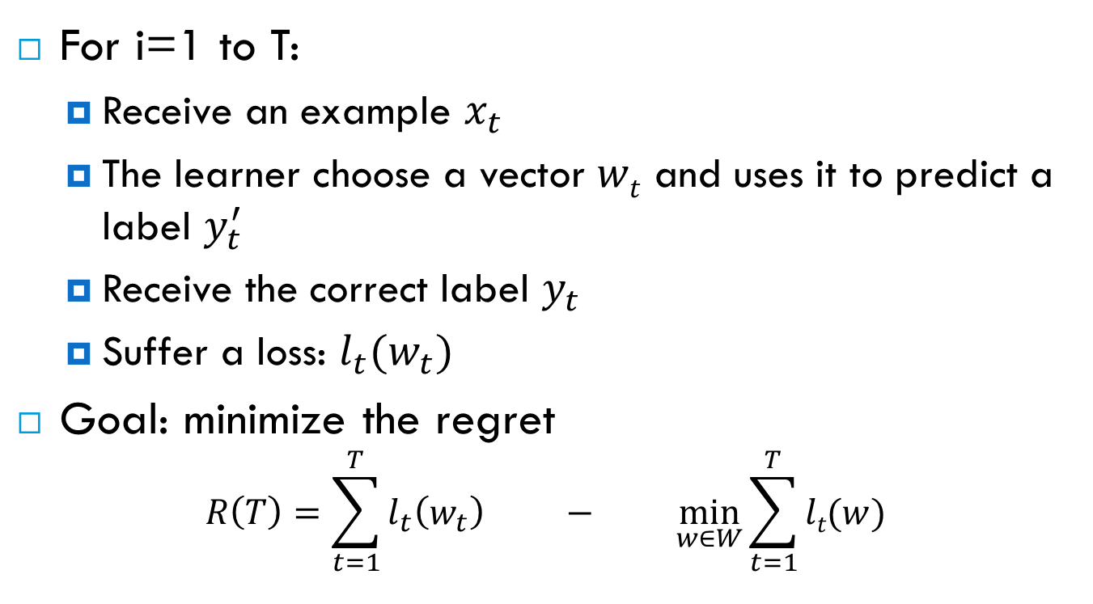
Online learning
For i=1 to T:
  Receive an example $x_{t}$
  The learner choose a vector $wt$ and uses it to predict a label $y_{t}^{′}$
  Receive the correct label $y_{t}$
  Suffer a loss: $l_{t}(w_{t})$
Goal: minimize the regret
$$R\left(T\right)=\sum_{t=1}^{T}{l_{t}\left(w_{t}\right) − \min_{w∈W}{\sum_{t=1}^{T}{lt(w)}}}$$
The accumulative loss of the online learner
The accumulative loss of the best batch learner
Notes:
Note:
The loss function is a function to measure the error

Slide 13
Primal-dual framework for online learning
[Shalev-Shwartz et al., 2006]
A general and latest framework for deriving low-regret online algorithms
Rewrite the regret bound as an optimization problem (called the primal problem), then considering the dual problem of the primal one
Derive a condition that guarantees the increase in the dual objective in each step
→ Incremental-Dual-Ascent (IDA) algorithms. For example: subgradient methods [Zinkevich, 2003]

Slide 14
Primal-dual framework for online learning (cont.)
Propose a new class of IDA algorithms called Coordinate-Dual-Ascent (CDA) algorithm:
  The CDA update rule only optimizes the dual w.r.t the last dual variable (the current example)
  A closed-form solution of CDA update rule → CDA algorithm has the same cost as subgradient methods but increase the dual objective more in each step → better accuracy

Slide 15
Steps for deriving a new CDA algorithm
Define the regularization and loss functions
Find the conjugate functions
Derive a closed-form solution for the CDA update rule
CDA algorithm
for max-margin structured prediction

Slide 16
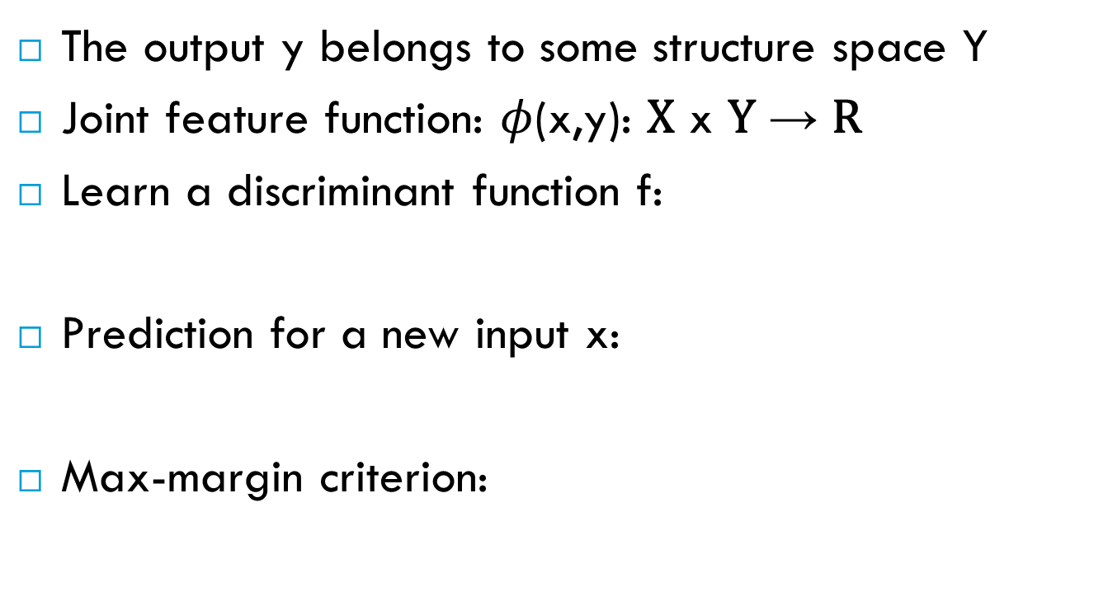
Max-margin structured prediction
The output y belongs to some structure space Y
Joint feature function: $φ$(x,y): X x Y → R
Learn a discriminant function f:
Prediction for a new input x:
Max-margin criterion:
MLNs: n(x,y)

Slide 17
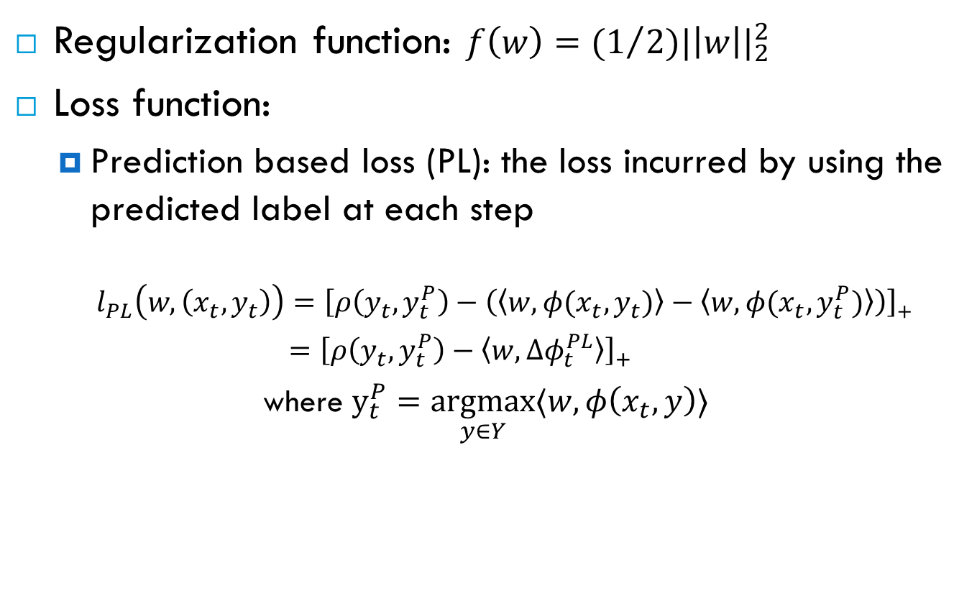
1. Define the regularization and loss functions
Regularization function: $f\left(w\right)={(1}/{2){|\left|w\right||}_{2}^{2}}$
Loss function:
  Prediction based loss (PL): the loss incurred by using the predicted label at each step
    $l_{PL}\left(w,\left(x_{t},y_{t}\right)\right)=\left[ρ\left(y_{t},y_{t}^{P}\right)−\left(\left\langle w,φ(x_{t},y_{t})\right\rangle −\left\langle w,φ(x_{t},y_{t}^{P})\right\rangle \right)\right]$₊
    $={\left[ρ\left(y_{t},y_{t}^{P}\right)−〈w,Δφ_{t}^{PL}〉\right]}_{+}$
  where $y_{t}^{P}=\underset{y∈Y}{argmax}{〈w,φ\left(x_{t},y\right)〉}$
Label loss function

Slide 18
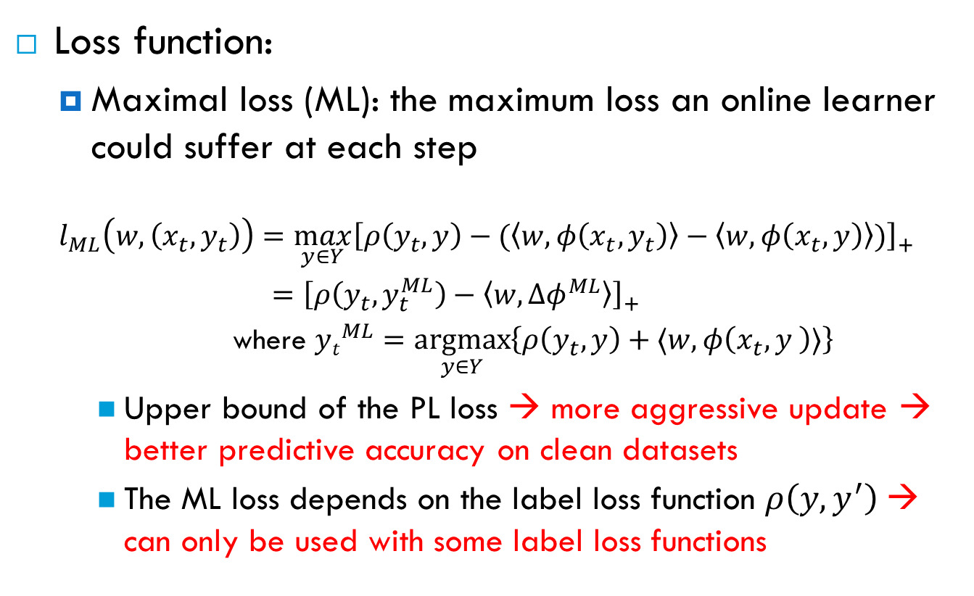
1. Define the regularization and loss functions (cont.)
Loss function:
  Maximal loss (ML): the maximum loss an online learner could suffer at each step
  $$l_{ML}\left(w,\left(x_{t},y_{t}\right)\right)=\max_{y∈Y}{{\left[ρ\left(y_{t},y\right)−(\left\langle w,φ\left(x_{t},y_{t}\right)\right\rangle −\left\langle w,φ\left(x_{t},y\right)\right\rangle )\right]}_{+}}$$
    $=$ ${\left[ρ\left(y_{t},y_{t}^{ML}\right)−〈w,Δφ^{ML}〉\right]}_{+}$
    where ${yt}_{}^{ML}=\underset{y∈Y}{argmax}\left\{ρ\left(y_{t},y\right)+〈w,φ\left(x_{t},y \right)〉\right\}$
    Upper bound of the PL loss → more aggressive update → better predictive accuracy on clean datasets
    The ML loss depends on the label loss function $ρ\left(y,y^{′}\right)$→ can only be used with some label loss functions

Slide 19
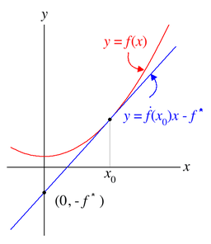

2. Find the conjugate functions
Conjugate function:
$$f^{∗}\left(θ\right)=\sup_{w∈W}\left[〈w,θ〉−f(w)\right]$$
  1-dimension: $f^{∗}\left(p\right)$ is the negative of the y-intercept of the tangent line to the graph of f that has slope $p$

Slide 20
2. Find the conjugate functions (cont.)
Conjugate function of the regularization function f(w):
  f(w)=(1/2)||w||₂² → f*(µ) = (1/2)||µ||₂²

Slide 21
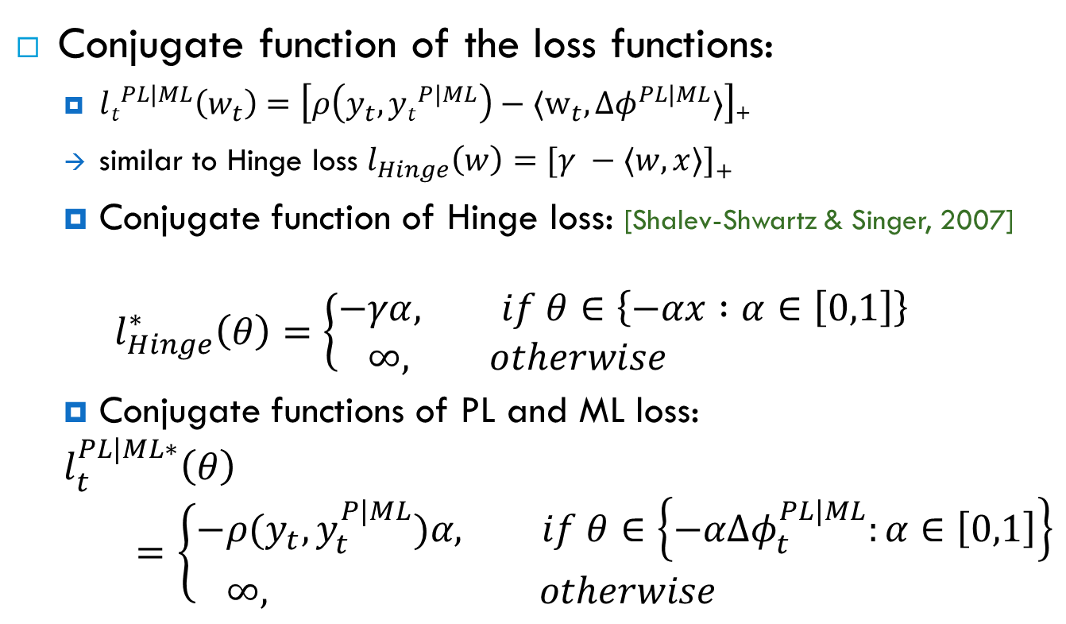
2. Find the conjugate functions (cont.)
Conjugate function of the loss functions:
  $lt^{PL|ML}\left(w_{t}\right)=\left[ρ\left(y_{t},{yt}^{P|ML}\right)−〈w_{t}, {Δφ}^{PL|ML}〉\right]$₊
  similar to Hinge loss $l_{Hinge}\left(w\right)=[γ −〈w,x〉]$₊
  Conjugate function of Hinge loss: [Shalev-Shwartz & Singer, 2007]
  $$l_{Hinge}^{∗}\left(θ\right)=\left\{\begin{aligned}−&γα, if θ∈\left\{−αx :α∈\left[0,1\right]\right\} \\ &∞, otherwise\end{aligned}\right.$$
  Conjugate functions of PL and ML loss:
  $$l_{t}^{PL|ML∗}\left(θ\right)=\left\{\begin{aligned}−&ρ(y_{t},y_{t}^{P|ML})α, if θ∈\left\{−αΔφ_{t}^{PL|ML}:α∈\left[0,1\right]\right\} \\ &∞, otherwise\end{aligned}\right.$$

Slide 22

3. Closed-form solution for the CDA update rule
CDA’s update formula:
$$w_{t+1}={\frac{t−1}{t}w}_{t}+\min\left\{\frac{1}{σt},\frac{{\left[ρ\left(y_{t},y_{t}^{P|ML}\right)−\frac{t−1}{t}〈w_{t},Δφ_{t}^{PL|ML}\right]}_{+}}{{\left|\left|Δφ_{t}^{PL|ML}\right|\right|}_{2}^{2}}\right\}Δφ^{PL|ML}$$
Compare with the update formula of the simple update, subgradient method [Ratliff et al., 2007]:
$$w_{t+1}=\frac{t−1}{t}w_{t}+\frac{1}{σt}Δφ^{ML}$$
CDA’s learning rate combines the learning rate of the subgradient
method with the loss incurred at each step

Slide 23
Experiments

Slide 24
Experimental Evaluation
Citation segmentation on CiteSeer dataset
Search query disambiguation on a dataset obtained from Microsoft
Semantic role labeling on noisy CoNLL 2005 dataset

Slide 25
Citation segmentation
Citeseer dataset [Lawrence et.al., 1999] [Poon and Domingos, 2007]
1,563 citations, divided into 4 research topics
Task: segment each citation into 3 fields: Author, Title, Venue
Used the MLN for isolated segmentation model in [Poon and Domingos, 2007]

Slide 26
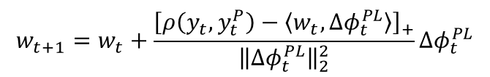
Experimental setup
4-fold cross-validation
Systems compared:
  MM: the max-margin weight learner for MLNs in batch setting [Huynh & Mooney, 2009]
  1-best MIRA [Crammer et al., 2005]
  Subgradient
  CDA
    CDA-PL
    CDA-ML
  Metric:
    F₁, harmonic mean of the precision and recall
$$w_{t+1}=w_{t}+\frac{{\left[ρ\left(y_{t},y_{t}^{P}\right)−\left\langle w_{t},Δφ_{t}^{PL}\right\rangle \right]}_{+}}{{\left\|Δφ_{t}^{PL}\right\|}_{2}^{2}}Δφ_{t}^{PL}$$

Slide 27
Average F₁on CiteSeer

Slide 28
Average training time in minutes

Slide 29
Search query disambiguation
Used the dataset created by Mihalkova & Mooney [2009]
Thousands of search sessions where ambiguous queries were asked: 4,618 sessions for training, 11,234 sessions for testing
Goal: disambiguate search query based on previous related search sessions
Noisy dataset since the true labels are based on which results were clicked by users
Used the 3 MLNs proposed in [Mihalkova & Mooney, 2009]

Slide 30
Experimental setup
Systems compared:
  Contrastive Divergence (CD) [Hinton 2002] used in [Mihalkova & Mooney, 2009]
  1-best MIRA
  Subgradient
  CDA
    CDA-PL
    CDA-ML
Metric:
  Mean Average Precision (MAP): how close the relevant results are to the top of the rankings

Slide 31
MAP scores on Microsoft query search

Slide 32
Semantic role labeling
CoNLL 2005 shared task dataset [Carreras & Marques, 2005]
Task: For each target verb in a sentence, find and label all of its semantic components
90,750 training examples; 5,267 test examples
Noisy labeled experiment:
  Motivated by noisy labeled data obtained from crowdsourcing services such as Amazon Mechanical Turk
  Simple noise model:
    At p percent noise, there is p probability that an argument in a verb is swapped with another argument of that verb.

Slide 33
Experimental setup
Used the MLN developed in [Riedel, 2007]
Systems compared:
  1-best MIRA
  Subgradient
  CDA-ML
Metric:
  F₁ of the predicted arguments [Carreras & Marques, 2005]

Slide 34
F₁ scores on CoNLL 2005

Slide 35
Summary
Derived CDA algorithms for max-margin structured prediction
  Have the same computational cost as existing online algorithms but increase the dual objective more
Experimental results on several real-world problems show that the new algorithms generally achieve better accuracy and also have more consistent performance.

Slide 36
Thank you!
Questions?

