Slide 1
Generative Models of Grounded Language Learning with Ambiguous Supervision
Joohyun Kim
Supervising Professor: Raymond J. Mooney
Doctoral Dissertation Proposal
May 29, 2012

Slide 2
Outline
Introduction/Motivation
Grounded Language Learning in Limited Ambiguity
Grounded Language Learning in High Ambiguity
Proposed Work
Conclusion

Slide 3
Language Grounding
The process to acquire the semantics of natural language with respect to relevant perceptual contexts
Human child grounds language to perceptual contexts via repetitive exposure in statistical way (Saffran et al. 1999, Saffran 2003)
Ideally, we want computational system to learn from the similar way

Slide 4
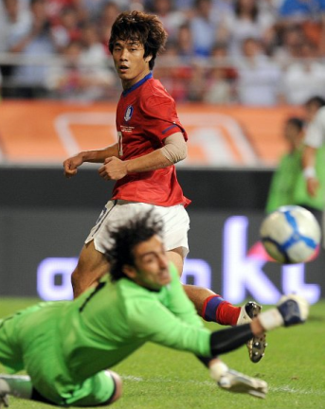
Language Grounding: Machine
Iran’s goalkeeper blocks the ball

Slide 5
Language Grounding: Machine
Iran’s goalkeeper blocks the ball
Block(IranGoalKeeper)
Machine

Slide 6
Language Grounding: Machine
Language Learning
Computer Vision
Iran’s goalkeeper blocks the ball
Block(IranGoalKeeper)

Slide 7
Natural Language and Meaning Representation
Iran’s goalkeeper blocks the ball
Block(IranGoalKeeper)

Slide 8
Natural Language and Meaning Representation
Natural Language (NL)
Iran’s goalkeeper blocks the ball
Block(IranGoalKeeper)
NL: A language that arises naturally by the innate nature of human intellect, such as English, German, French, Korean, etc

Slide 9
Natural Language and Meaning Representation
Meaning Representation Language (MRL)
Natural Language (NL)
Iran’s goalkeeper blocks the ball
Block(IranGoalKeeper)
NL: A language that arises naturally by the innate nature of human intellect, such as English, German, French, Korean, etc
MRL: Formal languages that machine can understand such as logic or any computer-executable code

Slide 10
Semantic Parsing and Surface Realization
NL
MRL
Iran’s goalkeeper blocks the ball
Block(IranGoalKeeper)
Semantic Parsing (NL → MRL)
Semantic Parsing: maps a natural-language sentence to a complete, detailed semantic representation → Machine understands natural language

Slide 11
Semantic Parsing and Surface Realization
NL
Surface Realization (NL ← MRL)
MRL
Iran’s goalkeeper blocks the ball
Block(IranGoalKeeper)
Semantic Parsing (NL → MRL)
Semantic Parsing: maps a natural-language sentence to a complete, detailed semantic representation → Machine understands natural language
Surface Realization: Generates a natural-language sentence from a meaning representation. → Machine communicates with natural language

Slide 12
Conventional Language Learning Systems
Requires manually annotated corpora
Time-consuming, hard to acquire, and not scalable
Semantic Parser Learner
Manually Annotated
Training Corpora
(NL/MRL pairs)
Semantic Parser
NL
MRL

Slide 13
Learning from Perceptual Environment
Motivated by how children learn language in rich, ambiguous perceptual environment with linguistic input
Advantages
Naturally obtainable corpora
Relatively easy to annotate
Mimic natural process of human language learning

Slide 14
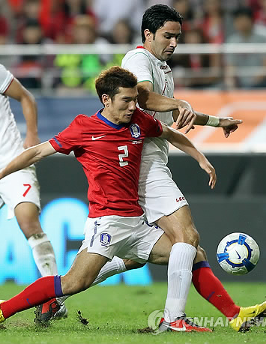
Learning from Perceptual Environment
한국팀의 슛을 이란 골키퍼가 막아냅니다.
(Iran’s goalkeeper blocks the shot of Korean team.)

Slide 15
Learning from Perceptual Environment
Challenge
turnover(IranPlayer10, KoreanPlayer2)
??
pass(KoreanPlayer13, KoreanPlayer25)
한국팀의 슛을 이란 골키퍼가 막아냅니다.
(Iran’s goalkeeper blocks the shot of Korean team.)
block(IranGoalkeeper)

Slide 16
Thesis Contributions
Generative models for grounded language learning from ambiguous, perceptual environment
Unified probabilistic model incorporating linguistic cues and MR structures (vs. previous approaches)
General framework of probabilistic approaches that learn NL-MR correspondences from ambiguous supervision
Disambiguates the training data
Provides full-sentence semantic parsing
Resolves language learning problem in different levels of ambiguity
Limited 1 NL – multiple MR ambiguity
Exponential number of MR possibilities

Slide 17
Outline
Introduction/Motivation
Grounded Language Learning in Limited Ambiguity
Grounded Language Learning in High Ambiguity
Proposed Work
Conclusion

Slide 18
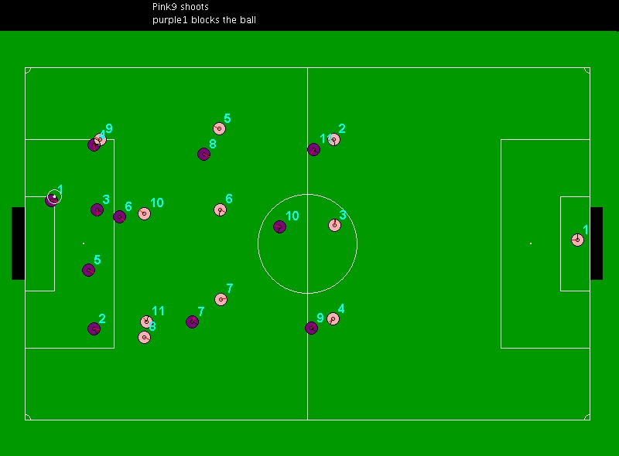
Learning to sportscast
Chen & Mooney (2008)
Train machine sportscaster with Robocup Simulation Soccer Games
Purple goalie blocked the ball
보라 골키퍼가 공을 막습니다.

Slide 19
Challenges
NLs and MRs are collected separately and have only weak correspondence according to time stamp.
NL commentary is commentated only by watching simulated visual games (English / Korean)
MR events are automatically extracted independently
NL sentence is ambiguously paired with multiple potential MR events (within 5 seconds window)
True matching is unknown in training stage
Finding correct matching (alignment) between NL-MR is crucial for accurate language learning systems
Gold standard is constructed for evaluation purpose only

Slide 20
Learning to sportscast
Sample data trace (English)
Natural Language
Purple9 prepares to attack
Purple9 passes to Purple6
Purple6's pass was defended by Pink6
Pink6 makes a short pass to Pink3
Pink goalie now has the ball
Meaning Representation
pass ( PurplePlayer9 , PurplePlayer6 )
defense ( PinkPlayer6 , PinkPlayer6 )
turnover ( purple6 , pink6 )
ballstopped
kick ( PinkPlayer6 )
pass ( PinkPlayer6 , PinkPlayer3 )
playmode ( free_kick_r )
pass ( PinkPlayer3 , PinkPlayer1 )

Slide 21
Proposed Solution (Kim and Mooney, 2010)
Generative model for grounded language learning
Probabilistic model of finding NL-MR correspondences
Structural information (Linguistic syntax of NLs, Grammatical structure of MRs)
Semantic alignment between NL-MR and semantic parsing for ambiguous supervision in perceptual environments
Disambiguate true NL-MR matchings
Learn semantic parsers of mapping NL sentences to complete MR forms

Slide 22
Generative Model
Estimate p(w|s)
w: an NL sentence, s: world state containing a set of possible MRs that can be matched to w
Intended to align correct NL-MR matching AND map NL sentences to MRs (semantic parsing)
Combined model of the two submodels
Event selection p(e|s) (Liang et al., 2009)
Choose MR event e from s to be matched to NL w
Natural language generation p(w|e) (Lu et al., 2008)
How likely is to generate NL w from the selected event e

Slide 23
Event Selection Model
Specifies probability distribution p(e|s) for picking an event likely to be commented on (Liang et al., 2009)
Models “salience” (what to describe)
Some events are more likely to be described
t_{e}: event type of e (pass, kick, shoot, …)
|s(t_{e})|: number of events with event type t_{e}
Event type to describe
1
p(e|s) = p(t_{e})
|s(t_{e})|
Uniformly select when
there are multiple same types

Slide 24
Natural Language Generation Model
Defines probability distribution p(w|e) of NL sentences given an MR (selected by event selection model)
Uses generative semantic parsing model (Lu et al. 2008) for probability estimation
Hybrid tree structure depicting how MR components are related to NL words
p(w|e) = ∑ p(T,w|e)
T over (w,e)

Slide 25
Generative Model
s
turnover ( purple2, pink10)
kick ( pink10 )
pass ( pink10 , pink11 )
ballstopped
e
Event Selection
p(e|s)
S
S: pass(PLAYER, PLAYER)
pass(pink10, pink11)
PLAYER
PLAYER
PLAYER: pink10
PLAYER: pink11

Slide 26
Generative Model
NL Generation
p(w|e)
S
S: pass(PLAYER, PLAYER)
Hybrid tree
over NL/MR pair (w,e)
PLAYER
passes the ball to
PLAYER
PLAYER: pink10
PLAYER: pink11
pink10
pink11
NL: pink10 passes the ball to pink11
MRL: pass(pink10, pink11)

Slide 27
Learning
Standard Expectation-Maximization (EM) on training data for parameter optimization

Slide 28
Data
Robocup Sportscasting Dataset (English and Korean)
Collected human textual commentary for the 4 Robocup championship games from 2001-2004.
Each sentence matched to all events within previous 5 seconds.
Manually annotated with correct matchings of sentences to MRs (for evaluation purposes only).
 | English | Korean
Avg # sentences/game | 509 | 500
Avg # events/game | 2613 | 2667
Avg # MRs/sentence | 2.5 | 2.4

Slide 29
Experiments
Tasks
Matching (Semantic Alignment)
Disambiguate ambiguous supervision
Semantic Parsing
As backup slides due to time constraints
Surface Realization
End-goal of this task
4 fold (leave one game out) cross validation
3 games for training and 1 game for testing
Following Chen & Mooney (2008)

Slide 30
Matching
Find most probable NL/MR pair for ambiguous examples (one NL – multiple MRs pair)
Evaluated against gold-standard matching
Gold matching is not used in training stage (evaluation purpose only)
Metric:
Precision: % of system’s alignment that are correct
Recall: % of gold-standard alignment correctly produced
F-measure: Harmonic mean of precision & recall

Slide 31
Compared Systems
Best published result (Iterative retraining of semantic
parser learners)
Chen and Mooney (2008):
Chen et al. (2010):
Liang et al. (2009)
Generative alignment model of making probabilistic correspondences between NL words and MR constituents
Our model

Slide 32
Matching Results
F-measure

Slide 33
Matching Results
F-measure

Slide 34
Surface Realization
Measure how accurately produces NL sentences from given MRs in the test set.
Use gold-standard NL-MR matches for evaluation
Metric:
BLEU score (Papineni et al, 2002)
Based on n-gram matchings between target and candidate

Slide 35
Compared Systems
Chen and Mooney (2008):
Chen et al. (2010):
Surface realizer learner + output matchings
WASP⁻¹ (Wong and Mooney, 2007) + Liang et al.
WASP⁻¹ + our matching
Best published result

Slide 36
Surface Realization Results
BLEU

Slide 37
Surface Realization Results
BLEU

Slide 38
Discussions
Improvement particularly on matching
Unified method of probabilistic selection of MRs along with modeling NL-MR correspondences
Better disambiguation with linguistic cues and MR grammar structure
Lead to better surface realization

Slide 39
Outline
Introduction/Motivation
Grounded Language Learning in Limited Ambiguity
Grounded Language Learning in High Ambiguity
Proposed Work
Conclusion

Slide 40
Navigation Example
Alice:
식당에서 우회전 하세요
Bob
Slide from David Chen

Slide 41
Navigation Example
Alice:
병원에서 우회전 하세요
Bob
Slide from David Chen

Slide 42
Navigation Example
Scenario 1
식당에서 우회전 하세요
Scenario 2
병원에서 우회전 하세요
Slide from David Chen

Slide 43
Navigation Example
Scenario 1
병원에서 우회전 하세요
Scenario 2
식당에서 우회전 하세요
Slide from David Chen

Slide 44
Navigation Example
Scenario 1
병원에서 우회전 하세요
Scenario 2
식당에서 우회전 하세요
Make a right turn
Slide from David Chen

Slide 45
Navigation Example
Scenario 1
식당에서 우회전 하세요
Scenario 2
병원에서 우회전 하세요
Slide from David Chen

Slide 46
Navigation Example
Scenario 1
식당
Scenario 2
Slide from David Chen

Slide 47
Navigation Example
Scenario 1
식당에서 우회전 하세요
Scenario 2
병원에서 우회전 하세요
Slide from David Chen

Slide 48
Navigation Example
Ambiguity!
Scenario 1
Scenario 2
병원
Slide from David Chen

Slide 49
Navigation Task (Chen and Mooney, 2011)
Learn to interpret and follow navigation instructions
e.g. Go down this hall and make a right when you see an elevator to your left
Use virtual worlds and instructor/follower data from MacMahon et al. (2006)
Difficulties
No prior linguistic knowledge
Infer language semantics by observing how humans follow instructions

Slide 50
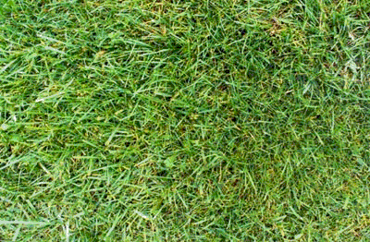
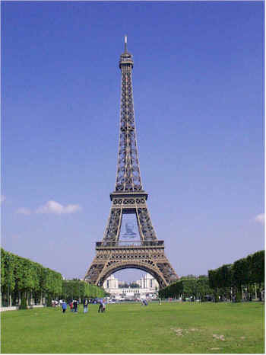
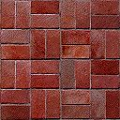
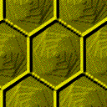
Sample Environment
H
H – Hat Rack
L – Lamp
E – Easel
S – Sofa
B – Barstool
C - Chair
L
E
E
C
S
S
C
B
H
L

Slide 51
Goal
Learn the underlying meanings of instructions by observing human actions for the instructions
Learn to map instructions (NL) into correct formal plan of actions (MR)
Learn from high ambiguity
Training input of NL instruction / landmarks plan (Chen and Mooney, 2011) pairs
Landmarks plan
Describe actions in the environment along with notable objects encountered on the way
Overestimate the meaning of the instruction, including unnecessary details
Only subset of the plan is true for the instruction

Slide 52
Challenges
Instruction: | "at the easel, go left and then take a right onto the blue path at the corner"
Landmarks plan: | Travel ( steps: 1 ) , Verify ( at: EASEL , side: CONCRETE HALLWAY ) , Turn ( LEFT ) , Verify ( front: CONCRETE HALLWAY ) , Travel ( steps: 1 ) , Verify ( side: BLUE HALLWAY , front: WALL ) , Turn ( RIGHT ) , Verify ( back: WALL , front: BLUE HALLWAY , front: CHAIR , front: HATRACK , left: WALL , right: EASEL )

Slide 53
Challenges
Instruction: | "at the easel, go left and then take a right onto the blue path at the corner"
Landmarks plan: | Travel ( steps: 1 ) , Verify ( at: EASEL , side: CONCRETE HALLWAY ) , Turn ( LEFT ) , Verify ( front: CONCRETE HALLWAY ) , Travel ( steps: 1 ) , Verify ( side: BLUE HALLWAY , front: WALL ) , Turn ( RIGHT ) , Verify ( back: WALL , front: BLUE HALLWAY , front: CHAIR , front: HATRACK , left: WALL , right: EASEL )

Slide 54
Challenges
Instruction: | "at the easel, go left and then take a right onto the blue path at the corner"
Correct plan: | Travel ( steps: 1 ) , Verify ( at: EASEL , side: CONCRETE HALLWAY ) , Turn ( LEFT ) , Verify ( front: CONCRETE HALLWAY ) , Travel ( steps: 1 ) , Verify ( side: BLUE HALLWAY , front: WALL ) , Turn ( RIGHT ) , Verify ( back: WALL , front: BLUE HALLWAY , front: CHAIR , front: HATRACK , left: WALL , right: EASEL )
Exponential Number of Possibilities! (considering all subsets of actions and arguments)
→ Combinatorial matching problem between instruction and landmarks plan

Slide 55
Previous Work (Chen and Mooney, 2011)
Circumvent combinatorial NL-MR correspondence problem
Constructs supervised NL-MR training data by refining landmarks plan with learned semantic lexicon
Greedily select high-score lexemes to choose probable MR components out of landmarks plan
Trains supervised semantic parser to map novel instruction (NL) to correct formal plan (MR)
Loses information during refinement
Deterministically select high-score lexemes, no probabilistic relationship
Ignores possibly useful low-score lexemes

Slide 56
Proposed Solution (Kim and Mooney, 2012)
Learn probabilistic semantic parser directly from ambiguous training data
Disambiguate input + learn to map NL instructions to formal MR plan
Semantic lexicon (Chen and Mooney, 2011) as basic building block for NL-MR correspondences
Forms the problem into standard PCFG (Probabilistic Context-Free Grammar) induction model with semantic lexemes as nonterminals and NL words as terminals

Slide 57
Probabilistic Context-Free Grammar (PCFG)
Describes generative process of syntactic structure of language strings in probabilistic way
Components
Terminals: strings of language
Nonterminals: intermediate symbols representing syntactic categories
Start symbol: root nonterminal
Rules: rewriting rules describing transformation from a nonterminal to a sequence of terminals and nonterminals with probability weights

Slide 58
PCFG Example
S → NP VP 1.0 VP → V NP 0.7 VP → VP PP 0.3 PP → P NP 1.0 P → with 1.0 V → saw 1.0 | NP → NP PP 0.4 NP → astronomers 0.1 NP → ears 0.18 NP → saw 0.04 NP → stars 0.18 NP → telescope 0.1
S
NP
VP
V
NP
$$p\left(T\right)=\prod_{r ∈Rules(T)}{p(r)}$$
NP
PP
P
NP
$$p\left(sent\right)=\sum_{all T for sent}{p(T)}$$
astronomers saw stars with ears
Slides from Chris Manning (2007)

Slide 59
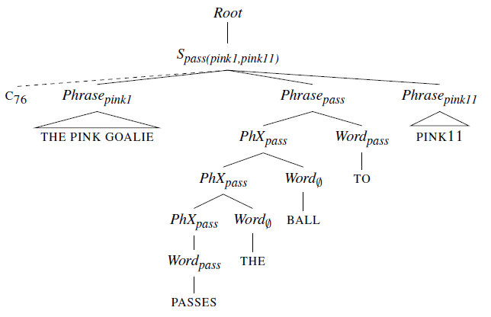
PCFG Induction Model for Grounded Language Learning (Borschinger et al. 2011)
PCFG rules to describe generative process from MR components to corresponding NL words

Slide 60
PCFG Induction Model for Grounded Language Learning (Borschinger et al. 2011)
Generative process
Select complete MR to describe
Generate atomic MR constituents in order
Each atomic MR generates NL words by unigram Markov process
Optimized by EM (Inside-Outside algorithm)
Parse new NL sentences by reading top MR nonterminal from parse tree
Output MRs only included in PCFG rule set constructed from training data

Slide 61
Our Model
Limitations of Borschinger et al. 2011
Only work in low ambiguity settings (1 NL – n MRs)
Only output MRs included in the constructed PCFG from training data
Produces intractable size of PCFG with complex MRs
Proposed model
Use semantic lexemes as building blocks of semantic concepts
Disambiguate NL-MR correspondences in semantic concept (lexeme) level
Maintain tractable size of PCFG, and work for infinite MR languages
Disambiguate much higher level of ambiguous supervision
Output novel MRs not appearing in the PCFG by composing MR parse with semantic lexeme MRs

Slide 62
Semantic Lexicon (Chen and Mooney, 2011)
Pair of NL phrase w and MR subgraph g
Based on correlations between NL instructions and context MRs (landmarks plans)
How MR graph g is probable given seeing phrase w
Examples
“to the stool”, Travel(), Verify(at: BARSTOOL)
“black easel”, Verify(at: EASEL)
“turn left and walk”, Turn(), Travel()
cooccurrence of g and w
general occurrence of g without w

Slide 63
Lexeme Hierarchy Graph (LHG)
Hierarchy of semantic lexicon entries by subgraph relationship
Lexeme MRs = semantic concepts
Lexeme hierarchy = semantic concept hierarchy
Shows how complicated semantic concepts hierarchically generate smaller concepts, and further connected to NL word groundings

Slide 64
Context Graph (Landmarks plan)
Lexeme MRs
Turn
Verify
Travel
Verify
Turn
Verify
Travel
RIGHT
side:
HATRACK
[1]
RIGHT
side:
HATRACK
front:
SOFA
steps:
3
at:
EASEL
turn toward the hatrack
NL: Turn toward the hatrack and go
forward till you see the easel.
Turn
Verify
[2]
side:
HATRACK
toward the hatrack
Travel
Verify
[3]
at:
EASEL
go forward till
Verify
[4]
at:
EASEL
the easel
Turn
[5]
turn toward

Slide 65
Lexeme Hierarchy Graph
Lexeme MRs
Turn
Verify
Travel
Verify
RIGHT
side:
HATRACK
front:
SOFA
steps:
3
at:
EASEL
[1]
Turn
Verify
Turn
Verify
Travel
[2]
side:
HATRACK
RIGHT
side:
HATRACK
Travel
Verify
[3]
at:
EASEL
Verify
[4]
at:
EASEL
Turn
[5]

Slide 66
Lexeme Hierarchy Graph
Lexeme MRs
Turn
Verify
Travel
Verify
RIGHT
side:
HATRACK
front:
SOFA
steps:
3
at:
EASEL
[1]
Turn
Verify
Travel
RIGHT
side:
HATRACK
Travel
Verify
[2]
[3]
at:
EASEL
Turn
Verify
side:
HATRACK
Verify
[4]
at:
EASEL
Turn
[5]

Slide 67
Lexeme Hierarchy Graph
Lexeme MRs
Turn
Verify
Travel
Verify
RIGHT
side:
HATRACK
front:
SOFA
steps:
3
at:
EASEL
[1]
[3]
Turn
Verify
Travel
Travel
Verify
RIGHT
side:
HATRACK
at:
EASEL
[2]
Turn
Verify
side:
HATRACK
Verify
[4]
at:
EASEL
Turn
[5]

Slide 68
Lexeme Hierarchy Graph
Lexeme MRs
Turn
Verify
Travel
Verify
RIGHT
side:
HATRACK
front:
SOFA
steps:
3
at:
EASEL
[1]
[3]
Turn
Verify
Travel
Travel
Verify
RIGHT
side:
HATRACK
at:
EASEL
[2]
[4]
Turn
Verify
Verify
side:
HATRACK
at:
EASEL
[5]
Turn

Slide 69
PCFG Construction
Add rules per each node in LHG
Each complex concept chooses which subconcepts to describe that will finally be connected to NL instruction
Each node generates all k-permutations of children nodes – we do not know which subset is correct
NL words are generated by lexeme nodes by unigram Markov process (Borschinger et al. 2011)
PCFG rule weights are optimized by EM

Slide 70
PCFG Construction
$$Root→S_{c}, ∀c∈contexts$$
$∀non−leaf node and its MR$m
$$S_{m}→ \left\{S_{m_{1}},…,S_{m_{n}}\right\},$$
$$where m_{1}, …, m_{n}:children lexeme MR of m,$$
$\left\{∙\right\}:all k−permutations for k=1,…,n$
$$∀lexeme MR m$$
$$S_{m}→Phrase_{m}$$
$${Phrase}_{m}→Word_{m}$$
$${Phrase}_{m}→PhX_{m} Word_{m}$$
$${Phrase}_{m}→{Ph}_{m} Word_{∅}$$
$$PhX_{m}→Word_{m}$$
$$PhX_{m}→Word_{∅}$$
$$Word_{m}→s, ∀s s.t. \left(s,m\right)∈lexicon L$$
$$Word_{m}→w, ∀word w∈s s.t. \left(s,m\right)∈lexicon L$$
$$Word_{∅}→w, ∀word w∈NLs$$
Child concepts are generated from parent concepts selectively
$$PhX_{m}→PhX_{m} Word_{m}$$
$$PhX_{m}→PhX_{m} Word_{∅}$$
$${Ph}_{m}→PhX_{m} Word_{m}$$
$${Ph}_{m}→Ph_{m} Word_{∅}$$
$$Ph_{m}→Word_{m}$$
All semantic concepts generate relevant NL words
Each semantic concept generates at least one NL word

Slide 71
Parsing New NL Sentences
PCFG rule weights are optimized by Inside-Outside algorithm with training data
Obtain the most probable parse tree for each test NL sentence from the learned weights using CKY algorithm
Compose final MR parse from lexeme MRs appeared in the parse tree
Consider only the lexeme MRs responsible for generating NL words
From the bottom of the tree, mark only responsible MR components cascade back to the top level
Able to compose novel MRs never seen in the training data

Slide 72
Most probable parse tree for a test NL instruction
Turn
Verify
Travel
Verify
Turn
LEFT
front:
BLUE
HALL
front:
SOFA
steps:
2
at:
SOFA
RIGHT
Turn
Verify
Travel
Verify
Turn
LEFT
front:
SOFA
steps:
2
at:
SOFA
RIGHT
Turn
Travel
Verify
Turn
LEFT
at:
SOFA
NL:
Turn left and
find the sofa
then turn around
the corner

Slide 73
Turn
Verify
Travel
Verify
Turn
LEFT
front:
BLUE
HALL
front:
SOFA
steps:
2
at:
SOFA
RIGHT
Turn
Verify
Travel
Verify
Turn
LEFT
front:
SOFA
steps:
2
at:
SOFA
RIGHT
Turn
Travel
Verify
Turn
LEFT
at:
SOFA

Slide 74
Turn
Verify
Travel
Verify
Turn
LEFT
front:
BLUE
HALL
front:
SOFA
steps:
2
at:
SOFA
RIGHT
Turn
Travel
Verify
Turn
LEFT
at:
SOFA

Slide 75
Data Statistics
3 maps, 6 instructors, 1-15 followers/direction
Hand-segmented into single sentence steps to make the learning easier
Paragraph
Take the wood path towards the easel. At the easel, go left and then take a right on the the blue path at the corner. Follow the blue path towards the chair and at the chair, take a right towards the stool. When you reach the stool, you are at 7.
Turn, Forward, Turn left, Forward, Turn right, Forward x 3, Turn right, Forward
Single sentence
Take the wood path towards the easel.
At the easel, go left and then take a right on the the blue path at the corner.
…
Turn
Forward, Turn left, Forward, Turn right

Slide 76
Data Statistics
 | Paragraph | Single-Sentence
# Instructions | 706 | 3236
Avg. # sentences | 5.0 (±2.8) | 1.0 (±0)
Avg. # words | 37.6 (±21.1) | 7.8 (±5.1)
Avg. # actions | 10.4 (±5.7) | 2.1 (±2.4)

Slide 77
Evaluations
Leave-one-map-out approach
2 maps for training and 1 map for testing
Parse accuracy & Plan execution accuracy
Compared with Chen and Mooney, 2011
Ambiguous context (landmarks plan) is refined by greedy selection of high-score lexemes
Semantic parser KRISP (Kate and Mooney, 2006) trained on the resulting supervised data

Slide 78
Parse Accuracy
Evaluate how well the learned semantic parsers can parse novel sentences in test data
Use partial parse accuracy as metric
 | Precision | Recall | F1
Chen and Mooney, 2011 | *88.36 | 57.03 | 69.31
Our model | 87.58 | *65.41 | *74.81
* Denotes statistically significant difference by Wilcoxon signed-rank test (p < .01)

Slide 79
End-to-End Execution Evaluations
Test how well the formal plan from the output of semantic parser reaches the destination
Strict metric: Only successful if the final position matches exactly
Also consider facing direction in single-sentence
Paragraph execution is affected by even one single-sentence execution
 | Single Sentences | Paragraphs
Chen and Mooney (2011) | 54.40% | 16.18%
Our model | *57.22% | *20.17%
* Denotes statistically significant difference by Wilcoxon signed-rank test (p < .01)

Slide 80
Discussions
Better recall than Chen and Mooney, 2011 in parsing
Our probabilistic model uses useful but low score lexemes as well → more coverage
Unified model does not suffer intermediate information loss
Novel than Borschinger et al. 2011
Overcome intractability in complex MRL
18,000 rules vs. combinatorially many (> 20!) rules
Lexeme MRs as building block for learning correspondences with NL words in semantic concept level
Novel MR parses never seen during training
Learn from more general, complex ambiguity

Slide 81
Example Full Parse
Instruction: | Place your back against the wall of the 'T' intersection. Go forward one segment to the intersection with the blue-tiled hall. This interesction contains a chair. Turn left. Go forward to the end of the hall. Turn left. Go forward one segment to the intersection with the wooden-floored hall. This intersection conatains an easel. Turn right. Go forward two segments to the end of the hall.
Parse from our model: | Turn ( ) , Verify ( back: WALL ) , Travel ( steps: 1 ) , Verify ( side: BLUE HALLWAY ) , Turn ( LEFT ) , Travel ( ) , Verify ( front: WALL ) , Turn ( LEFT ) , Travel ( steps: 1 ) , Verify ( side: WOOD HALLWAY ), Turn ( RIGHT ) , Travel ( steps: 2 ) , Verify ( front: WALL ) ,
Parse from Chen and Mooney, 2011: | Turn ( ) , Verify ( back: WALL ), Travel ( steps: 1 ), Turn ( LEFT ), Turn ( ) , Verify ( front: WALL ) , Verify ( front: EASEL ), Turn ( LEFT ), Travel ( steps: 4 ), Verify ( front: EASEL ) Turn ( RIGHT ), Travel ( steps: 2 ) , Verify ( front: WALL ),

Slide 82
Outline
Introduction/Motivation
Grounded Language Learning in Limited Ambiguity
Grounded Language Learning in High Ambiguity
Proposed Work
Conclusion

Slide 83
Improved Lexicon Training
Our PCFG induction model relies on the quality of semantic lexicon
Basic component to make correspondences with NL words
Correlational lexicon learning is limited
NL phrase can typically occur in certain contexts
Lexeme may contain unnecessary semantics
Better lexicon training algorithm would enhance our PCFG model

Slide 84
Improved Lexicon Training
Lexicon refining with Part-of-Speech(POS) tags (Guo and Mooney, unpublished)
Remove lexemes when violating verb-action noun-object rule
Use prior knowledge that verbs mainly refer to actions in MR and nouns refer to objects or arguments
POS tagger trained on external corpus
Joint learning of unsupervised POS-tags and semantic lexicon
Without prior linguistic knowledge
Infer fine-grained level of relationship among NL words / POS tags / MR subgraphs (or elements)
Ex) front: BARSTOOL – IN DET NN – toward the barstool

Slide 85
Discriminative Reranking
Common machine learning method to improve the final output of generative models
Additional discriminative model reranks top-k outputs of original generative model
Easy to add useful global features
Takes both advantages of discriminative and generative models

Slide 86
Discriminative Reranking
Averaged perceptron algorithm (Collins, 2002)
GEN: top-k parse trees for each NL sentence
$Φ$: feature function that maps a NL sentence and a parse tree into feature vector
Reference parse tree: gold-standard parse tree for each NL sentence

Slide 87
Discriminative Reranking
Averaged perceptron algorithm (Collins, 2002)
GEN: top-k parse trees for each NL sentence
$Φ$: feature function that maps a NL sentence and a parse tree into feature vector
Reference parse tree: gold-standard parse tree for each NL sentence
Navigation task does not have gold-standard data
Can infer which candidate parse is the better plan through execution evaluation

Slide 88
Discriminative Reranking
Averaged perceptron algorithm (Collins, 2002)
GEN: top-k parse trees for each NL sentence
$Φ$: feature function that maps a NL sentence and a parse tree into feature vector
Execution evaluation function: evaluate parse tree by how well the derived MR reaches the final destination given by human follower data
Pseudo-gold parse tree out of candidate parses which performs best in the execution evaluation

Slide 89
Pseudo-Gold Parse Tree
Human Follower Data
Candidate Parses $y$
MR Output
Execution Score
Pseudo-gold parse tree $y_{}^{∗}$
context₁
MR₁
0.85
context₂
MR₂
0.75
GEN
context₃
MR₃
0.60
NL: Go forward until you see the sofa.
…
…
…
context_{k}
MR_{k}
0.35

Slide 90
Incorporating MR Language Structure
Lexemes as building block
Coarse-grained semantic parsing
Highly rely on the quality of lexicon
MR grammar rules as building block
Every MR can be represented as a tree of grammar structure showing component generation
Use MR structure instead of LHG
Fine-grained semantic parsing with our PCFG model connecting each rule to NL words
Only MR grammar rules responsible for generating NL words are selected

Slide 91
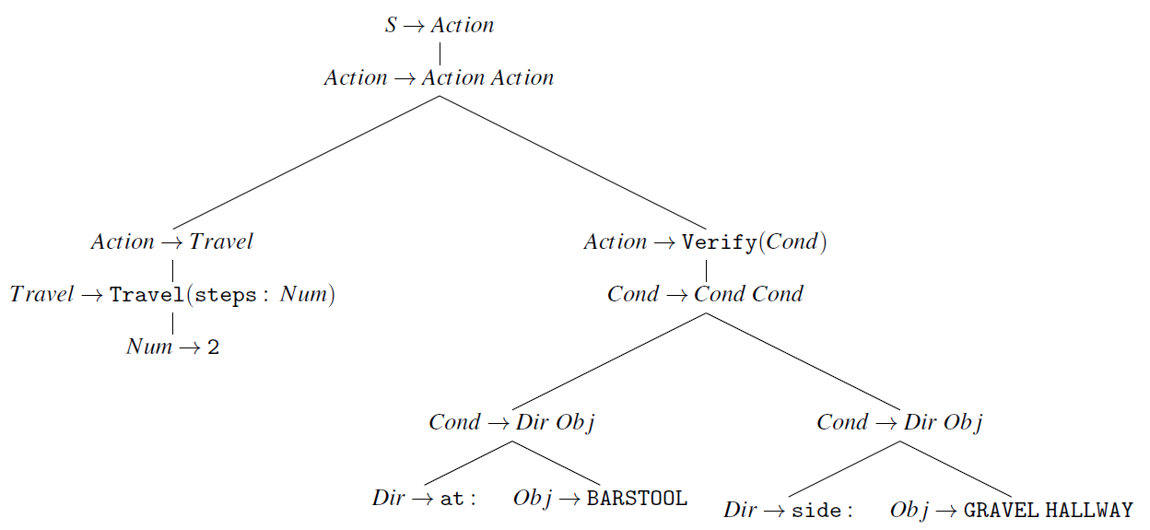
Incorporating MR Language Structure
NL: Move to the second alley
Landmarks plan: Travel(steps:2), Verify(at:BARSTOOL, side:GRAVEL HALLWAY)

Slide 92
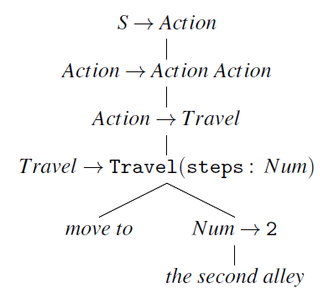
Incorporating MR Language Structure
NL: Move to the second alley
Landmarks plan: Travel(steps:2), Verify(at:BARSTOOL, side:GRAVEL HALLWAY)

Slide 93
Incorporating MR Language Structure
NL: Move to the second alley
Correct MR parse: Travel(steps:2)

Slide 94
Outline
Introduction/Motivation
Grounded Language Learning in Limited Ambiguity
Grounded Language Learning in High Ambiguity
Proposed Work
Conclusion

Slide 95
Conclusion
Conventional language learning is expensive and not scalable due to annotation of training data
Grounded language learning from relevant, perceptual context is promising and easy to generalize
Our completed work provides general framework of full probabilistic model for learning NL-MR correspondences with ambiguous supervision
Future extensions will focus on performance improvement and expressive power, as well as application in more general area

Slide 96
Thank You!

