Slide 1
Sparse Meets Dense: A Hybrid Approach to Enhance Scientific Document Retrieval
Priyanka Mandikal, Raymond Mooney
University of Texas at Austin

Slide 2
Traditional IR
Encodes documents and queries as sparse, high-dimensional “Bag of Words” (BoW) TF-IDF weighted vectors.
Performs document retrieval using an inverted index to efficiently find documents whose sparse vector has high cosine-similarity with the query vector.
Weakness: No use of linguistic syntax or semantics.

Slide 3
Deep-Learning based Retrieval
Use a transformer-based LLM to encode documents and queries into dense lower-dimensional vectors.
Again, use vector similarity (Euclidean or cosine) to find document vectors that are close to the query.
Strength: LLM uses syntax and semantics to produce a more nuanced vector representation.
Weakness: Does not necessarily sufficiently account for exact token matching.

Slide 4
Hybrid Retrieval
We found that for a small, classic IR benchmark in a medical domain (cystic fibrosis), that modern dense retrieval did not perform better than a classical sparse approach.
However, a very simple hybrid approach that combines similarity in both the sparse and dense vector spaces performs significantly better than either alone.

Slide 5
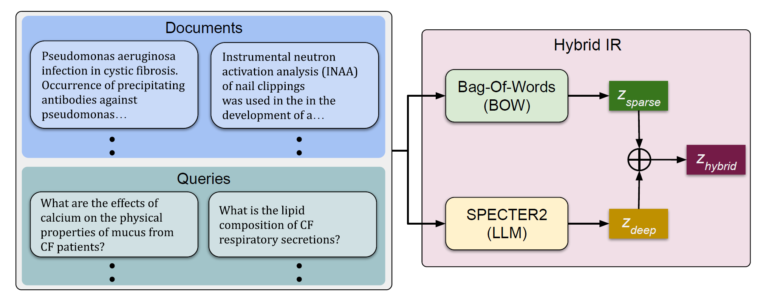
Hybrid Architecture

Slide 6
Medical IR Benchmark
1,239 documents published from 1974 to 1979 discussing Cystic Fibrosis.
Just abstracts and major and minor topic lists
100 full-sentence queries.
“Can one distinguish between the effects of mucus hypersecretion and infection on the submucosal glands of the respiratory tract in CF?”
Each query has been annotated with ratings from four domain experts, where each document is assigned a relevance score:
0: not relevant, 1: marginally relevant, 2: highly relevant.

Slide 7
Sparse Model
A simple classical vector-space IR model implemented for teaching undergrad IR.
Represents documents and queries as BOW vectors with Term-Frequency Inverse-Document-Frequency (TF-IDF) token weights.
Ranks retrievals using cosine similarity.
Similar to BM25

Slide 8
Dense Model
Uses SPECTER2 (Singh et al., 2023) SOTA deep-learned transformer-based language model for science.
Developed at AI2 as a followup to SciBERT and SPECTER models trained on scientific documents from the Semantic Scholar search engine.
A contrastive learning approach is used to encourage similar 768-dimensional dense embeddings for an article and its direct citations.
Trained on 6M triplets spanning 23 fields of study.

Slide 9
Hybrid Model
Use a weighted linear combination of distance in sparse and dense spaces to rank retrievals

Slide 10
Evaluation Metrics
Precsion/Recall curves
Counts any document marked as relevant by any judge as relevant.
Normalized Discounted Cummulative Gain (NDCG)
Uses average relevance rating across all judges as the gold-standard continuous relevance score used to compute gain.

Slide 11
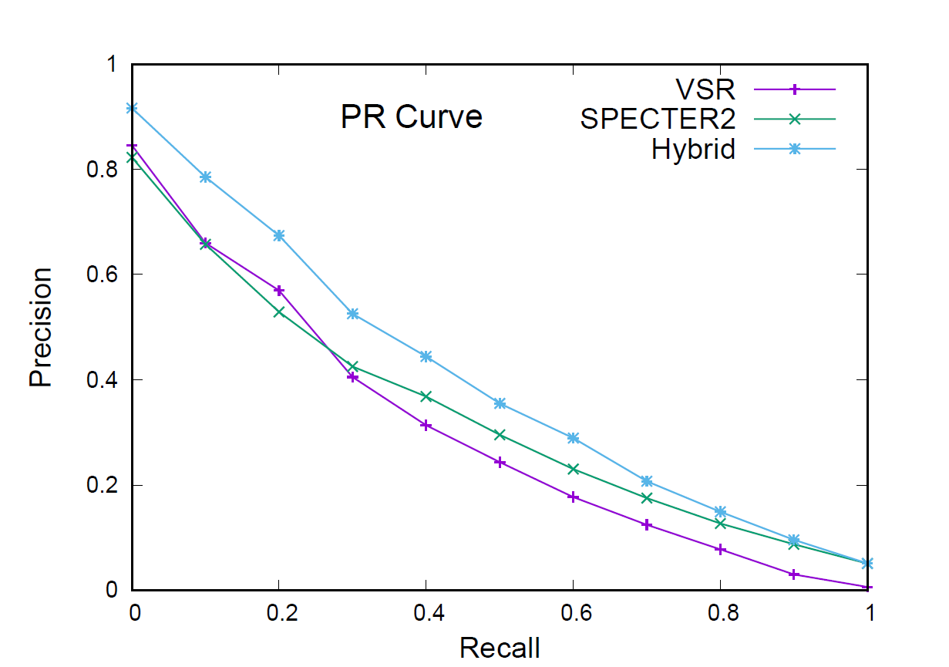
Precision Recall Results

Slide 12
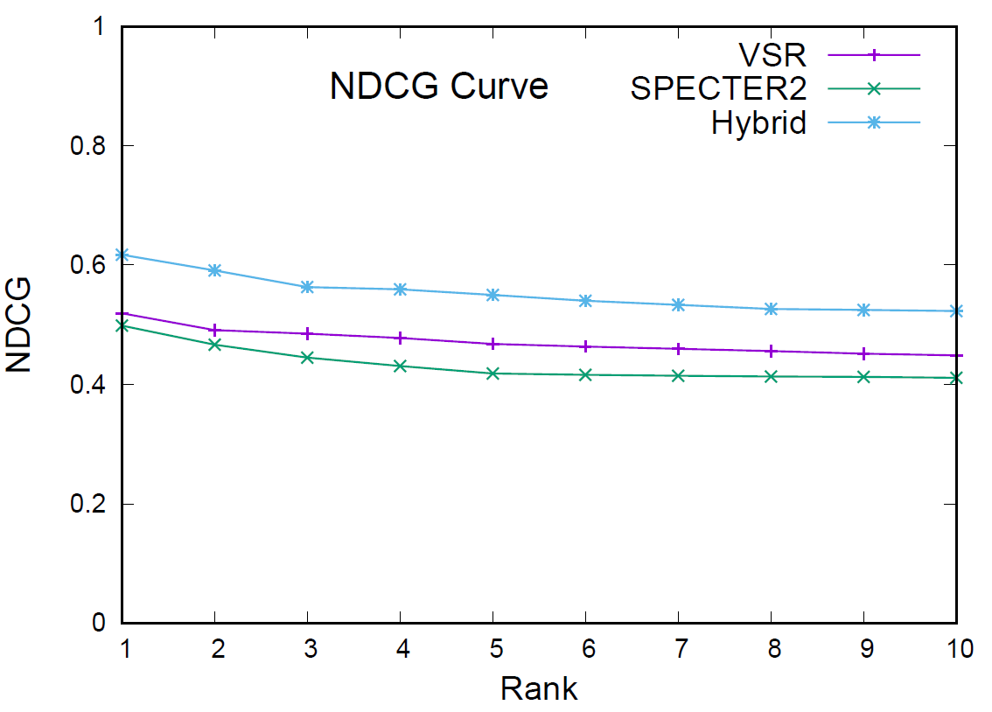
NDCG Results

Slide 13
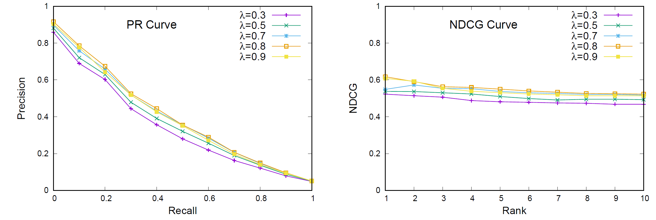
Hyperparameter Search

Slide 14
Conclusions
Modern dense retrieval using a SOTA science-based LLM does not improve performance on a classic medical IR problem over traditional sparse retrieval.
A simple hybrid of sparse and dense retrieval does significantly improve results.
Future work: Test hybrid approaches on other SDU problems.

