Slide 1
Generating Natural-Language Video Descriptions Using Text-Mined Knowledge
Ray Mooney
Department of Computer Science
University of Texas at Austin
Joint work with
Niveda Krishnamoorthy Girish Malkarmenkar.
Kate Saenko Sergio Guadarrama..

Slide 2
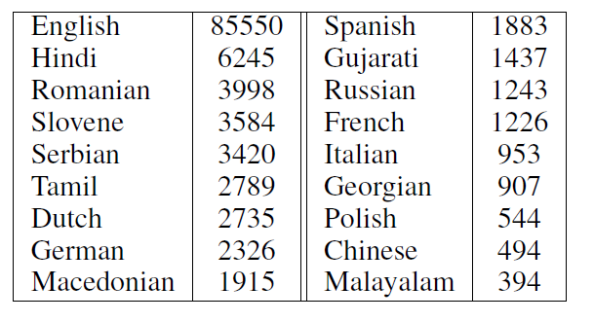
Video Description Dataset (Chen & Dolan, ACL 2011)
2,089 YouTube videos with 122K multi-lingual descriptions.
Originally collected for paraphrase and machine translation examples.
Available at: http://www.cs.utexas.edu/users/ml/clamp/videoDescription/

Slide 3
Sample Video

Slide 4
Sample M-Turk Human Descriptions (average ~50 per video)
A MAN PLAYING WITH TWO DOGS
A man takes a walk in a field with his dogs.
A man training the dogs in a big field.
A person is walking his dogs.
A woman is walking her dogs.
A woman is walking with dogs in a field.
A woman is walking with four dogs outside.
A woman walks across a field with several dogs.
All dogs are going along with the woman.
dogs are playing
Dogs follow a man.
Several dogs follow a person.
some dog playing each other
Someone walking in a field with dogs.
very cute dogs
A MAN IS GOING WITH A DOG.
four dogs are walking with woman in field
the man and dogs walking the forest
Dogs are Walking with a Man.
The woman is walking her dogs.
A person is walking some dogs.
A man walks with his dogs in the field.
A man is walking dogs.
a dogs are running
A guy is training his dogs
A man is walking with dogs.
a men and some dog are running
A men walking with dogs.
A person is walking with dogs.
A woman is walking her dogs.
Somebody walking with his/her pets.
the man is playing with the dogs.
A guy training his dogs.
A lady is roaming in the field with his dogs.
A lady playing with her dogs.
A man and 4 dogs are walking through a field.
A man in a field playing with dogs.
A man is playing with dogs.

Slide 5
Our Video Description Task
Generate a short, declarative sentence describing a video in this corpus.
First generate a subject (S), verb (V), object (O) triplet for describing the video.
<cat, play, ball>
Next generate a grammatical sentence from this triplet.
A cat is playing with a ball.

Slide 6
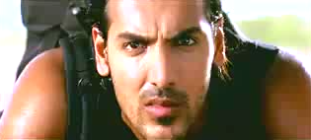
SUBJECT
VERB
OBJECT
person
ride
motorbike
A person is riding a motorbike.
Notes:
This can be done by correctly identifying the subject, the verb and the object in the video.

Slide 7
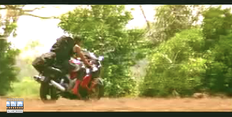
OBJECT DETECTIONS
table
0.07
dog
0.15
aeroplane
0.05
car
0.29
cow
0.11
person
0.42
motorbike
0.51
train
0.17
Notes:
We start by running object detectors on each video frame.

Slide 8
SORTED OBJECT DETECTIONS
motorbike
0.51
person
0.42
car
0.29
…
…
aeroplane
0.05
Notes:
These detections are then sorted by their confidence scores.

Slide 9
VERB DETECTIONS
move
0.34
slice
0.13
dance
0.05
ride
0.19
hold
0.23
drink
0.11
climb
0.17
shoot
0.07
Notes:
Similarly, we run verb detectors trained on the spatio-temporal interest points in the video. These points, indicated by yellow circles, show us where interesting events occur.

Slide 10
SORTED VERB DETECTIONS
move
0.34
hold
0.23
ride
0.19
…
…
dance
0.05
Notes:
The verb detections are also sorted by their confidence scores.

Slide 11
SORTED OBJECT DETECTIONS
SORTED VERB DETECTIONS
move
motorbike
0.34
0.51
person
0.42
hold
0.23
ride
car
0.19
0.29
…
…
…
…
aeroplane
0.05
dance
0.05
Notes:
Now that we have the sorted object and verb detections,

Slide 12
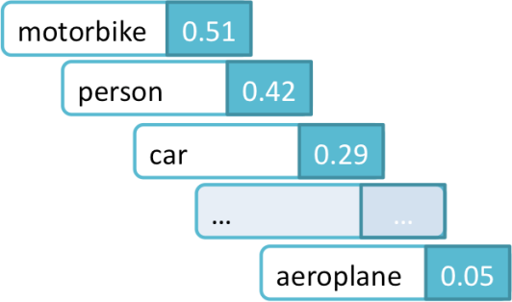
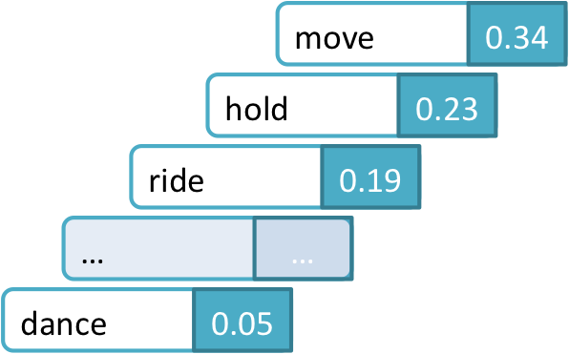
OBJECTS
VERBS
EXPAND VERBS
move 1.0
walk 0.8
pass 0.8
ride 0.8
Notes:
we expand each verb with its most similar verbs to generate a larger set of potential words for describing the action.

Slide 13
OBJECTS
VERBS
EXPAND VERBS
hold 1.0
keep 1.0

Slide 14
OBJECTS
VERBS
EXPAND VERBS
ride 1.0
go 0.8
move 0.8
walk 0.7

Slide 15
OBJECTS
VERBS
EXPAND VERBS
dance 1.0
turn 0.7
jump 0.7
hop 0.6

Slide 16
Web-scale text corpora
GigaWord, BNC, ukWaC, WaCkypedia, GoogleNgrams
OBJECTS
VERBS
GET Dependency Parses
A man rides a horse
det(man-2, A-1)
nsubj(rides-3, man-2)
root(ROOT-0, rides-3)
det(horse-5, a-4)
dobj(rides-3, horse-5)
EXPANDED VERBS
<person, ride, horse>
Subject-Verb-Object triplet
Notes:
Since vision detections can be noisy especially while dealing challenging YouTube videos, we need to incorporate some real world knowledge that reflects the likelihood of various entities being the subject or object of a given activity. This can be learnt from web-scale text corpora by mining for subject, verb , object triplets via dependency parses.

Slide 17
Web-scale text corpora
GigaWord, BNC, ukWaC, WaCkypedia, GoogleNgrams
OBJECTS
VERBS
<person, ride, horse>
<person, walk, dog>
<person, hit, ball>
.
.
.
EXPANDED VERBS
SVO Language Model
Notes:
We then train a language model on these subject, verb, object triplets using Kneser-Ney smoothing. A language model assigns a probability to judge how likely a person would be to say such a sentence. This S-V-O language model is now capable of ranking triplets by their real world likelihood.

Slide 18
Web-scale text corpora
GigaWord, BNC, ukWaC, WaCkypedia, GoogleNgrams
OBJECTS
VERBS
<person, ride, horse>
<person, walk, dog>
<person, hit, ball>
.
.
.
EXPANDED VERBS
Regular
Language
Model
SVO Language Model
Notes:
We also train a regular language model on the Google n gram corpus.

Slide 19
Web-scale text corpora
GigaWord, BNC, ukWaC, WaCkypedia, GoogleNgrams
OBJECTS
VERBS
SVO Language Model
REGULAR Language Model
EXPANDED VERBS
CONTENT PLANNING: <person, ride, motorbike>
Notes:
The best triplet can now be selected by combining the vision detection scores with the score from the language model.

Slide 20
Web-scale text corpora
GigaWord, BNC, ukWaC, WaCkypedia, GoogleNgrams
OBJECTS
VERBS
SVO Language Model
REGULAR Language Model
EXPANDED VERBS
CONTENT PLANNING: <person, ride, motorbike>
SURFACE REALIZATION: A person is riding a motorbike.
Notes:
In the final step we generate a set of candidate descriptions using a template based approach on the Subject, Verb, Object triplet. The regular language model picks the best description for the video from these candidate descriptions.

Slide 21
Selecting SVO Just Using Vision (Baseline)
Top object detection from vision = Subject
Next highest object detection = Object
Top activity detection = Verb

Slide 22
Sample SVO Selection
Top object detections:
person: 0.67
motorbike: 0.56
dog: 0.11
Top activity detections:
ride: 0.41
keep_hold: 0.32
lift: 0.23
Vision triplet: (person, ride, motorbike)

Slide 23
Evaluating SVO Triples
A ground-truth SVO for a test video is determined by picking the most common S, V, and O used to describe this video (as determined by dependency parsing).
Predicted S, V, and O are compared to ground-truth using two metrics:
Binary: 1 or 0 for exact match or not
WUP: Compare predicted word to ground truth using WUP semantic word similarity score from WordNet Similarity (0≤WUP≤1)

Slide 24
Test Data
Selected 185 test videos that contain one of the 20 detectable objects and 58 detectable activities based on their words (or synonyms) appearing in their human descriptions.

Slide 25
Baseline SVO Results
Binary Accuracy
 | Subject | Verb | Object | All
Vision baseline | 71.35% | 8.65% | 29.19% | 1.62%
WUP Accuracy
 | Subject | Verb | Object | All
Vision baseline | 87.76% | 40.20% | 61.18% | 63.05%

Slide 26
Vision Detections are Faulty!
Top object detections:
motorbike: 0.67
person: 0.56
dog: 0.11
Top activity detections:
go_run_bowl_move: 0.41
ride: 0.32
lift: 0.23
Vision triplet: (motorbike, go_run_bowl_move, person)

Slide 27
Using Text-Mining to Determine SVO Plausibility
Build a probabilistic model to predict the real-world likelihood of a given SVO.
P(person,ride,motorbike) > P(motorbike,run,person)
Run the Stanford dependency parser on a large text corpus, and extract the S, V, and O for each sentence.
Train a trigram language model on this SVO data, using Kneyser-Ney smoothing to back-off to SV and VO bigrams.

Slide 28
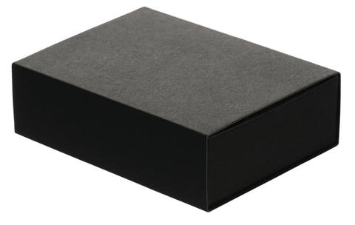
<person, park, bat>
<car, move, bag>
person hit ball -1.17
<person, ride, motorcycle>
person ride motorcycle -1.3
<person, hit, ball>
<car, move, motorcycle>
<person, walk, dog>
person walk dog -2.18
person park bat -4.76
SVO Language Model
car move bag -5.47
car move motorcycle -5.52

Slide 29
Integrated Scoring of SVOs
Consider the top n=5 detected objects and the top k=10 verb detections (plus their verb expansions) for a given test video.
Construct all possible SVO triples from these nouns and verbs.
Pick the best overall SVO using a metric that combines evidence from both vision and language.

Slide 30
Combining SVO Scores
Linearly interpolate vision and language-model scores:
Compute SVO vision score assuming independence of components and taking into account similarity of expanded verbs.

Slide 31
Sample Reranked SVOs
person,ride,motorcycle -3.02
person,follow,person -3.31
person,push,person -3.35
person,move,person -3.42
person,run,person -3.50
person,come,person -3.51
person,fall,person -3.53
person,walk,person -3.61
motorcycle,come,person -3.63
person,pull,person -3.65
Baseline Vision triplet: motorbike, march, person

Slide 32
Sample Reranked SVOs
person,walk,dog -3.35
person,follow,person -3.35
dog,come,person -3.46
person,move,person -3.46
person,run,person -3.52
person,come,person -3.55
person,fall,person -3.57
person,come,dog -3.62
person,walk,person -3.65
person,go,dog -3.70
Baseline Vision triplet: person, move, dog

Slide 33
SVO Accuracy Results (w₁ = 0)
Binary Accuracy
 | Subject | Activity | Object | All
Vision baseline | 71.35% | 8.65% | 29.19% | 1.62%
SVO LM (No Verb Expansion) | 85.95% | 16.22% | 24.32% | 11.35%
SVO LM (Verb Expansion) | 85.95% | 36.76% | 33.51% | 23.78%
WUP Accuracy
 | Subject | Activity | Object | All
Vision baseline | 87.76% | 40.20% | 61.18% | 63.05%
SVO LM (No Verb Expansion) | 94.90% | 63.54% | 69.39% | 75.94%
SVO LM (Verb Expansion) | 94.90% | 66.36% | 72.74% | 78.00%

Slide 34
Surface Realization: Template + Language Model
Input:
The best SVO triplet from the content planning stage
Best fitting preposition connecting the verb & object (mined from text corpora)
Template:
Determiner + Subject + (conjugated Verb) + Preposition(optional) + Determiner + Object
Generate all sentences fitting this template and rank them using a Language Model trained on Google NGrams

Slide 35
Automatic Evaluation of Sentence Quality
Evaluate generated sentences using standard Machine Translation (MT) metrics.
Treat all human provided descriptions as “reference translations”

Slide 36
Human Evaluation of Descriptions
Asked 9 unique MTurk workers to evaluate descriptions of each test video.
Asked to choose between vision-baseline sentence, SVO-LM (VE) sentence, or “neither.”
When preference expressed, 61.04% preferred SVO-LM (VE) sentence.
For 84 videos where the majority of judges had a clear preference, 65.48% preferred the SVO-LM (VE) sentence.

Slide 37
Examples where we outperform the baseline

Slide 38
Examples where we underperform the baseline

Slide 39
Conclusions
We have developed a simple, preliminary broad-scale video description system.
An SVO language model trained on large-scale parsed text, improves performance across multiple evaluations.
Many directions for improving the complexity and coverage of both language and vision components.

