Slide 1
Learning Statistical Scripts
with
LSTM Recurrent Neural Networks
Karl Pichotta & Raymond J. Mooney
Department of Computer Science
The University of Texas at Austin
AAAI 2016

Slide 2
Motivation
Following the Battle of Actium, Octavian invaded Egypt. As he approached Alexandria, Antony's armies deserted to Octavian on August 1, 30 BC.
Did Octavian defeat Antony?

Slide 3
Motivation
Following the Battle of Actium, Octavian invaded Egypt. As he approached Alexandria, Antony's armies deserted to Octavian on August 1, 30 BC.
Did Octavian defeat Antony?

Slide 4
Motivation
Antony’s armies deserted to Octavian ⇒ Octavian defeated Antony
Not simply a paraphrase rule!
Need world knowledge.

Slide 5
Scripts
Scripts: models of events in sequence.
“Event”: verb + arguments.
Events don’t appear in text randomly, but according to world dynamics.
Scripts try to capture these dynamics.
Enable automatic inference of implicit events, given events in text (e.g. Octavian defeated Antony).

Slide 6
Outline
Background
Methods
Experiments
Conclusion
Background
Methods
Experiments
Conclusion

Slide 7
Outline
Background
Statistical Scripts
Recurrent Neural Nets
Background
Statistical Scripts
Recurrent Neural Nets

Slide 8
Background: Statistical Scripts
Statistical Scripts: Statistical Models of Event Sequences.
Non-statistical scripts date back to the 1970s [Schank & Abelson 1977].
Statistical script learning is a small-but-growing subcommunity [e.g. Chambers & Jurafsky 2008].
Model the probability of an event given prior events.

Slide 9
Background: Statistical Script Learning
Millions
of
Documents
NLP Pipeline
• Syntax
• Coreference
Millions of
Event Sequences
Train a
Statistical Model

Slide 10
Background: Statistical Script Inference
NLP Pipeline
• Syntax
• Coreference
Single
Event Sequence
New Test
Document
Inferred Probable
Events
Query Trained
Statistical Model

Slide 11
Outline
Background
Statistical Scripts
Recurrent Neural Nets
Background
Statistical Scripts
Recurrent Neural Nets

Slide 12
Background: RNNs
Recurrent Neural Nets (RNNs): Neural Nets with cycles in computation graph.
RNN Sequence Models: Map inputs x1, …, xt to outputs o1, …, ot via learned latent vector states z1, …, zt.

Slide 13
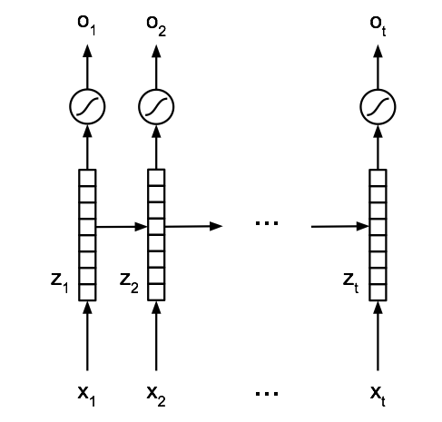
Background: RNNs
[Elman 1990]

Slide 14
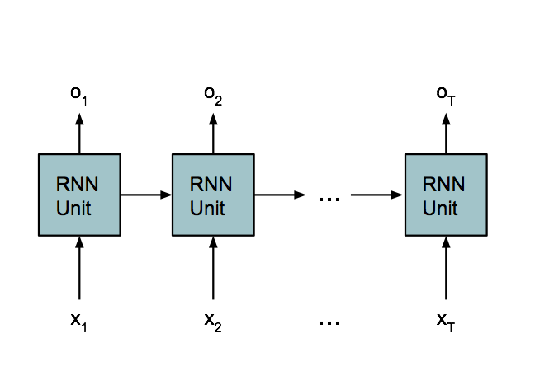
Background: RNNs
Hidden Unit can be arbitrarily complicated, as long as we can calculate gradients!

Slide 15
Background: LSTMs
Long Short-Term Memory (LSTM): More complex hidden RNN unit. [Hochreiter & Schmidhuber, 1997]
Explicitly addresses two issues:
Vanishing Gradient Problem.
Long-Range Dependencies.

Slide 16
Background: LSTMs
LSTMs recently successful on many hard NLP tasks:
Machine Translation [Kalchbrenner & Blunsom 2013, Bahdanau et al. 2015].
Captioning Images/Videos [Donahue et al. 2015, Venugopalan et al. 2015].
Language Modeling [Sundermeyer et al. 2012, Kim et al. 2016].
Question Answering [Hermann et al. 2015, Gao et al. 2015].
Parsing [Vinyals et al. 2015].

Slide 17
Outline
Background
Methods
Experiments
Conclusion
Background
Methods
Experiments
Conclusion

Slide 18
Outline
Background
Methods
Experiments
Conclusion
Background
Methods
Experiments
Conclusion

Slide 19
LSTM Script models
Train LSTM sequence model on event sequences.
Events are (verbs + arguments).
Arguments can have noun info, coref info, or both.
To infer events, the model generates likely events from sequence.

Slide 20
LSTM Script models
Mary’s late husband Matthew, whom she married at 21 because she loved him, …
[marry, mary, matthew, at, 21]; [love, she, him]

Slide 21
LSTM Script models
Mary’s late husband Matthew, whom she married at 21 because she loved him, …
[marry, mary, matthew, at, 21]; [love, she, him]
[ ]
[ ]

Slide 22
LSTM Script models
Mary’s late husband Matthew, whom she married at 21 because she loved him, …
[ ]
[ ]
verb subj obj prep prep verb subj obj prep prep
- 1 2 - - - 1 2 - -

Slide 23
Outline
Background
Methods
Experiments
Conclusion
Background
Methods
Experiments
Conclusion

Slide 24
Experimental Setup
Train on English Wikipedia.
Use Stanford CoreNLP to extract event sequences.
Train LSTM using Batch Stochastic Gradient Descent with Momentum.
To infer next events, have the LSTM generate additional events with highest probability.

Slide 25
Evaluation
“Narrative Cloze” (Chambers & Jurafsky, 2008): from an unseen document, hold one event out, try to infer it given remaining document.
“Recall at k” (Jans et al., 2012): make k top inferences, calculate recall of held-out events.
(More metrics in the paper.)

Slide 26
Evaluation
Three Systems:
Unigram: Always guess most common events.
Bigram: Variations of Pichotta & Mooney (2014)
Uses event co-occurrence counts.
Best-published system on task.
LSTM: LSTM script system (this work).

Slide 27
Results: Predicting
Verbs & Coreference Info
Recall at 25 for inferring Verbs & Coref info

Slide 28
Results: Predicting
Verbs & Nouns
Recall at 25 for inferring Verbs & Nouns

Slide 29
Human Evaluations
Solicit judgments on individual inferences on Amazon Mechanical Turk.
Have annotators rate inferences from 1-5 (or mark “Nonsense,” scored 0).
More interpretable.

Slide 30
Results: Crowdsourced Eval
“Unlikely”
“Neutral”
“Likely”
“Nonsense”
“Very Unlikely”

Slide 31
Generated “Story”
Generated event tuples
English Descriptions
(bear, ., ., kingdom, into)
(attend, she, brown, graduation, after)
(earn, she, master, university, from)
(admit, ., she, university, to)
(receive,she,bachelor,university,from)
(involve, ., she, production, in)
(represent, she, company, ., .)
Born into a kingdom,…
…she attended Brown after graduation
She earned her Masters from the University
She was admitted to a University
She had received a bachelors from a University
She was involved in the production
She represented the company.

Slide 32
Conclusion
Presented a method for inferring implicit events with LSTMs.
Superior performance on reconstructing held-out events and inferring novel events.

Slide 33
Thanks!

