Slide 1
Advances in Statistical Script Learning
Karl Pichotta
PhD Defense
UT Austin
July 20, 2017

Slide 2
Event Inference: Motivation
Suppose we want to build a Question Answering system…

Slide 3
Event Inference: Motivation
The Convention ordered the arrest of Robespierre.… Troops from the Commune, under General Coffinhal, arrived to free the prisoners and then marched against the Convention itself. –Wikipedia
Was Robespierre arrested?

Slide 4
Event Inference: Motivation
The Convention ordered the arrest of Robespierre.… Troops from the Commune, under General Coffinhal, arrived to free the prisoners and then marched against the Convention itself. –Wikipedia
Was Robespierre arrested?

Slide 5
Event Inference: Motivation
The Convention ordered the arrest of Robespierre.… Troops from the Commune, under General Coffinhal, arrived to free the prisoners and then marched against the Convention itself. –Wikipedia
Was Robespierre arrested?

Slide 6
Event Inference: Motivation
The Convention ordered the arrest of Robespierre.… Troops from the Commune, under General Coffinhal, arrived to free the prisoners and then marched against the Convention itself. –Wikipedia
Was Robespierre arrested? Very probably!

Slide 7
Event Inference: Motivation
The Convention ordered the arrest of Robespierre.… Troops from the Commune, under General Coffinhal, arrived to free the prisoners and then marched against the Convention itself. –Wikipedia
Was Robespierre arrested? Very probably!
…But this needs to be inferred.

Slide 8
Event Inference: Motivation
Question answering requires inference of probable implicit events.
We’ll investigate such event inference systems.

Slide 9
Outline
Introduction
Work from Proposal
Multi-Argument Event Scripts
Sequence-Level RNN Models for Scripts
Sentence-Level Text Models for Scripts
Scripts for Coreference
Future Work
Conclusions

Slide 10
Outline
Introduction
Work from Proposal
Multi-Argument Event Scripts
Sequence-Level RNN Models for Scripts
Sentence-Level Text Models for Scripts
Scripts for Coreference
Future Work
Conclusions

Slide 11
Outline
Introduction
Statistical Scripts
Recurrent Neural Nets
Work from Proposal
Multi-Argument Event Scripts
Sequence-Level RNN Models for Scripts
Sentence-Level Text Models for Scripts
Scripts for Coreference
Future Work
Conclusions

Slide 12
Outline
Introduction
Statistical Scripts
Recurrent Neural Nets
Work from Proposal
Multi-Argument Event Scripts
Sequence-Level RNN Models for Scripts
Sentence-Level Text Models for Scripts
Scripts for Coreference
Future Work
Conclusions

Slide 13
Scripts
Scripts: models of events in sequence.
Events don’t appear in text randomly, but according to world dynamics.
Scripts try to capture these dynamics.
Enable automatic inference of implicit events, given events in text (e.g. Robespierre was arrested).

Slide 14
Background: Statistical Scripts
Statistical Scripts: Statistical Models of Event Sequences.
Non-statistical scripts date back to the 1970s [Schank & Abelson 1977].
Statistical script learning is a small-but-growing subcommunity [e.g. Chambers & Jurafsky 2008].
Model the probability of an event, given other events in a document.

Slide 15
Background: Statistical Script Learning
Millions
of
Documents
NLP Pipeline
• Syntax
• Coreference
Millions of
Event Sequences
Train a
Statistical Model

Slide 16
Background: Statistical Script Inference
NLP Pipeline
• Syntax
• Coreference
Single
Event Sequence
New Test
Document
Inferred Probable
Events
Query Trained
Statistical Model

Slide 17
Background: Statistical Scripts
Central Questions:
What is an “Event?”
Which models work well?
What can they do?

Slide 18
Outline
Introduction
Statistical Scripts
Recurrent Neural Nets
Work from Proposal
Multi-Argument Event Scripts
Sequence-Level RNN Models for Scripts
Sentence-Level Text Models for Scripts
Scripts for Coreference
Future Work
Conclusions

Slide 19
Outline
Introduction
Statistical Scripts
Recurrent Neural Nets
Work from Proposal
Multi-Argument Event Scripts
Sequence-Level RNN Models for Scripts
Sentence-Level Text Models for Scripts
Scripts for Coreference
Future Work
Conclusions

Slide 20
Background: RNNs
Recurrent Neural Nets (RNNs): Neural Nets with cycles in computation graph.
RNN Sequence Models: Map inputs x1, …, xt to outputs o1, …, ot via learned latent vector states z1, …, zt.

Slide 21
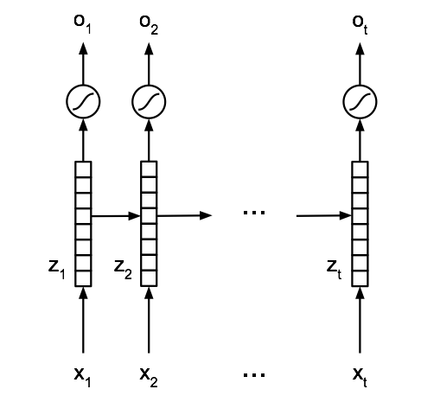
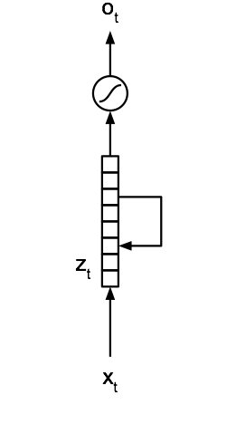
Background: RNNs
[Elman 1990]

Slide 22
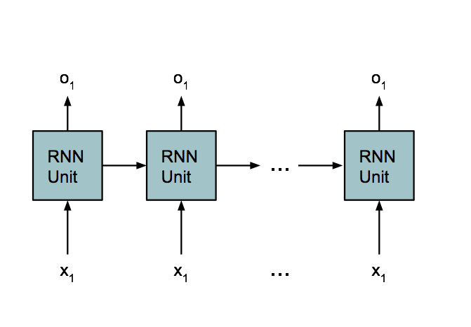
Background: RNNs
Hidden Unit can be arbitrarily complicated, as long as we can calculate gradients!

Slide 23
Background: LSTMs
Long Short-Term Memory (LSTM): More complex hidden RNN unit. [Hochreiter & Schmidhuber, 1997]
Explicitly addresses two issues:
Vanishing Gradient Problem.
Long-Range Dependencies.

Slide 24
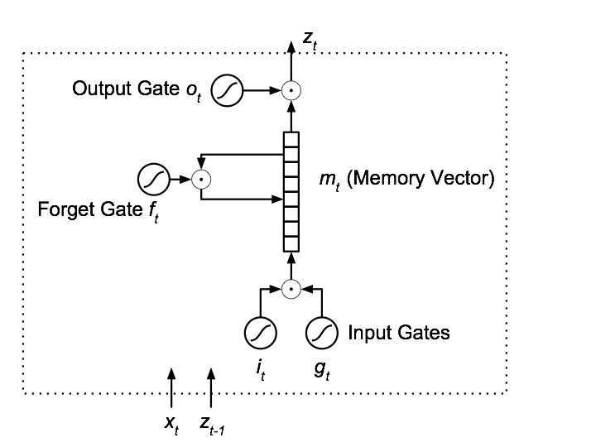
Background: LSTM

Slide 25
Background: LSTMs
LSTMs successful for many hard NLP tasks recently:
Machine Translation [Kalchbrenner and Blunsom 2013, Bahdanau et al. 2015].
Captioning Images/Videos [Donahue et al. 2015, Venugopalan et al. 2015].
Language Modeling [Sundermeyer et al. 2012, Melis et al. 2017].
Question Answering [Hermann et al. 2015, Gao et al. 2015].
Basically every other problem.

Slide 26
RNN Training Setups: Sequence Models
Build a sequence model by iteratively predicting the next timetep’s input.

Slide 27
RNN Training Setups: Sequence-to-Sequence Encoder-Decoder
A sequence model with an initial encoding stage (with no outputs).
Transduces from sequences to sequences.

Slide 28
Outline
Introduction
Work from Proposal
Multi-Argument Event Scripts
Sequence-Level RNN Models for Scripts
Sentence-Level Text Models for Scripts
Scripts for Coreference
Future Work
Conclusions

Slide 29
Outline
Introduction
Work from Proposal
Multi-Argument Event Scripts
Sequence-Level RNN Models for Scripts
Sentence-Level Text Models for Scripts
Scripts for Coreference
Future Work
Conclusions

Slide 30
Outline
Introduction
Work from Proposal
Multi-Argument Event Scripts
Sequence-Level RNN Models for Scripts
Sentence-Level Text Models for Scripts
Scripts for Coreference
Future Work
Conclusions

Slide 31
Events
To model “events,” we need a formal definition.
For us, it will be variations of “verbs with participants.”

Slide 32
Pair Events
Some prior work uses (verb, dependency) pair events [Chambers & Jurafsky 2008; 2009; Jans et al. 2012; Rudinger et al. 2015].
Captures how an entity relates to a verb.
(vb, dep)
Verb
Syntactic Dependency

Slide 33
Pair Events
Napoleon remained married to Marie Louise, though she did not join him in exile on Elba and thereafter never saw her husband again.
N.
M.L.
(remain_married, subj)
(not_join, obj)
(not_see, obj)
(remain_married, prep)
(not_join, subj)
(not_see, subj)
(remain_married, subj)
(not_join, obj)
(not_see, obj)
(remain_married, prep)
(not_join, subj)
(not_see, subj)
…Doesn’t capture interactions between entities.

Slide 34
Multi-Argument Events [Pichotta & Mooney, EACL 2014]
We represent events as tuples:
Entities may be null (“·”).
Entities have only coreference information.
v (es, eo, ep)
Verb
Subject Entity
Object Entity
Prepositional Entity

Slide 35
Multi-Argument Events
Napoleon remained married to Marie Louise, though she did not join him in exile on Elba and thereafter never saw her husband again.
remain_married(N, ·, to ML)
not_join(ML, N, ·)
not_see(ML, N, ·)
Incorporate entities into events as variables.
Captures pairwise interaction between entities.

Slide 36
Evaluation
“Narrative Cloze” (Chambers & Jurafsky, 2008): from an unseen document, hold one event out, try to infer it given remaining document.
“Recall at k” (Jans et al., 2012): make k top inferences, calculate recall of held-out events.

Slide 37
Systems
“Unigram:” always infer the most common events, ignoring other events.
“Protagonist:” (verb, dependency) pair events co-occurrence model.
“Joint:” multi-argument event co-occurrence model.

Slide 38
Results: Pair Events
Recall at 10 for inferring (verb, dependency) events.

Slide 39
Results: Multi-Argument Events
Recall at 10 for inferring Multi-argument events.

Slide 40
Outline
Introduction
Work from Proposal
Multi-Argument Event Scripts
Sequence-Level RNN Models for Scripts
Sentence-Level Text Models for Scripts
Scripts for Coreference
Future Work
Conclusions

Slide 41
Outline
Introduction
Work from Proposal
Multi-Argument Event Scripts
Sequence-Level RNN Models for Scripts
Sentence-Level Text Models for Scripts
Scripts for Coreference
Future Work
Conclusions

Slide 42
Co-occurrence Model Shortcomings
The co-occurrence-based method has shortcomings:
“x married y” and “x is married to y” are unrelated events.
Nouns are ignored. (she sits on the chair vs she sits on the board of directors).
We’ll decompose events into components to address these shortcomings.

Slide 43
LSTM Script models [Pichotta & Mooney, AAAI 2016]
Feed event sequences into LSTM sequence model.
To infer events, have the model generate likely events from sequence.
Can input noun info, coref info, or both.

Slide 44
LSTM Script models
In April 1866 Congress again passed the bill. Johnson again vetoed it.
[pass, congress, bill, in, april]; [veto, johnson, it, ·, ·]

Slide 45
LSTM Script models
In April 1866 Congress again passed the bill. Johnson again vetoed it.
[pass, congress, bill, in, april]; [veto, johnson, it, ·, ·]
[
]
[ ]

Slide 46
LSTM Script models
In April 1866 Congress again passed the bill. Johnson again vetoed it.
[ ]
[ ]
v es eo ep p v es eo ep p
- S 1 S - - S 1 - -

Slide 47
Results: Predicting
Verbs & Coreference Info
Recall at 25 for inferring Verbs & Coref info

Slide 48
Results: Predicting
Verbs & Nouns
Recall at 25 for inferring Verbs & Nouns

Slide 49
Results: Crowdsourced Eval
Filtered Human judgments of top inferences (5 Max, higher better)

Slide 50
Outline
Introduction
Work from Proposal
Multi-Argument Event Scripts
Sequence-Level RNN Models for Scripts
Sentence-Level Text Models for Scripts
Scripts for Coreference
Future Work
Conclusions

Slide 51
Outline
Introduction
Work from Proposal
Multi-Argument Event Scripts
Sequence-Level RNN Models for Scripts
Sentence-Level Text Models for Scripts
Scripts for Coreference
Future Work
Conclusions

Slide 52
Event Sequence Learning
Millions
of
Documents
NLP Pipeline
• Syntax
• Coreference
Millions of
Event Sequences
Train a
Statistical Model

Slide 53
Event Sequence Inference
NLP Pipeline
• Syntax
• Coreference
Single
Event Sequence
New Test
Document
Inferred Probable
Events
Query Trained
Statistical Model

Slide 54
Event Sequence Inference
New Test
Document
Single
Event Sequence
Inferred Probable
Events
Query Trained
Statistical Model

Slide 55
Event Sequence Inference
New Test
Document
Single
Text Sequence
Inferred Probable
Events
Query Trained
Statistical Model

Slide 56
Event Sequence Inference
New Test
Document
Single
Text Sequence
Inferred Probable
Text
Query Trained
Statistical Model

Slide 57
Event Sequence Inference
New Test
Document
Single
Text Sequence
Parse Events
from Text
Inferred Probable
Text
Query Trained
Statistical Model

Slide 58
Event Sequence Inference
Single
Text Sequence
New Test
Document
What if we use raw text
as our event representation?
[Pichotta & Mooney, ACL 2016]
Parse Events
from Text
Inferred Probable
Text
Query Trained
Statistical Model

Slide 59
Sentence-Level
Language Models
[Kiros et al. NIPS 2015]: “Skip-Thought Vectors”
Encode whole sentences into low-dimensional vectors…
…trained to decode previous/next sentences.

Slide 60
Sequence-Level Language Models
ti-1
RNN
ti
RNN
ti+1
[word sequence
for sentence i]
[word sequence
for sentence i+1]

Slide 61
Sentence-Level Language Models
[Kiros et al. 2015] use sentence-embeddings for other tasks.
We use them directly for inferring text.
Central Question: How well can sentence-level language models infer events?

Slide 62
Systems
Two Tasks:
Inferring Events from Events
Inferring Text from Text

Slide 63
Systems
Two Tasks:
Inferring Events from Events …and optionally expanding into text.
Inferring Text from Text …and optionally parsing into events.

Slide 64
Systems
Two Tasks:
Inferring Events from Events …and optionally expanding into text.
Inferring Text from Text …and optionally parsing into events.

Slide 65
Event Systems
Predict an event from a sequence of events.
jumped(jim, from plane);
opened(he, parachute)
≈ [P. & Mooney (AAAI 2016)]
LSTM
landed(jim, on ground)
LSTM
“Jim landed on the ground.”

Slide 66
Text Systems
Predict text from text.
“Jim jumped from the plane and
opened his parachute.”
≈ [Kiros et al. 2015]
LSTM
“Jim landed on the ground.”
Parser
landed(jim, on ground)

Slide 67
Outline
Background & Methods
Experiments
Task Setup
Results

Slide 68
Outline
Background & Methods
Experiments
Task Setup
Results

Slide 69
Experimental Setup
Train + Test on English Wikipedia.
LSTM encoder-decoders trained with batch SGD with momentum.
Parse events with Stanford CoreNLP.
Events are verbs with head noun arguments.
Evaluate on Event Prediction & Text Prediction.

Slide 70
Predicting Events: Evaluation
Narrative Cloze [Chambers & Jurafsky 2008]: Hold out an event, judge a system on inferring it.
Accuracy: “For what percentage of the documents is the top inference the gold standard answer?”
Partial credit: “What is the average percentage of the components of argmax inferences that are the same as in the gold standard?”

Slide 71
Predicting Events: Systems
Most Common: Always guess the most common event.
e1 -> e2: events to events.
t1 -> t2 -> e2: text to text to events.

Slide 72
Results: Predicting Events

Slide 73
Predicting Text: Evaluation
BLEU: Geometric mean of modified ngram precisions.
Word-level analog to Narrative Cloze.

Slide 74
Predicting Text: Systems
t1 -> t1: Copy/paste a sentence as its predicted successor.
e1 -> e2 -> t2: events to events to text.
t1 -> t2: text to text.

Slide 75
Results: Predicting Text

Slide 76
Bidirectional Models

Slide 77
Results: Bidirectional Models

Slide 78
Results: Bidirectional Models

Slide 79
Human Evaluations
(5 max, higher is better)

Slide 80
Human Evaluations
(Percentage of each rating given, higher is better)

Slide 81
Example Ratings
Previous | After graduating from college Lawrence embarked on an unplanned male _ career which he _ into both a writing and acting career .
Unidirectional Text | He has a Ph.D. in History in the University of Colorado in 1972 . | 3.7
Bidirectional Text | He was a member of the group 's first member of the band . | 1.7
Unidirectional Event | he joined the band in September 2001 . | 2.3
Bidirectional Event | he was married in the same year . | 3.0

Slide 82
Example Ratings
Previous | Walter Payton met Dupree on some business ventures and urged him to get back into shape to try out for the NFL again in 1990 .
Unidirectional Text | He was also a member of the Detroit Lions . | 4.0
Bidirectional Text | He was also a member of the team , and the team was defeated by the team . | 4.3
Unidirectional Event | he joined in September 2004 , and joined the band . | 3.7
Bidirectional Event | played in the same year , and the team was also a member of the World Cup . | 3.3

Slide 83
Takeaways
In LSTM encoder-decoder event prediction…
Raw text models predict events about as well as event models (and don’t require a parser).
Raw text models predict tokens better than event models.
Humans prefer inferences mediated via raw text.
Conditioning on future events is generally helpful.
Extrinsic evaluations are probably desirable.

Slide 84
Outline
Introduction
Work from Proposal
Multi-Argument Event Scripts
Sequence-Level RNN Models for Scripts
Sentence-Level Text Models for Scripts
Scripts for Coreference
Future Work
Conclusions

Slide 85
Outline
Introduction
Work from Proposal
Multi-Argument Event Scripts
Sequence-Level RNN Models for Scripts
Sentence-Level Text Models for Scripts
Scripts for Coreference
Future Work
Conclusions

Slide 86
Coreference Resolution
Coreference Resolution: cluster a document’s noun phrases into clusters such that two clustered NPs refer to the same thing in the world.

Slide 87
Coreference Resolution

Slide 88
Scripts for Coreference Resolution
“While Tsar Nicholas II was away at war, Rasputin’s influence over Tsarina Alexandra increased. He soon became her confidant and personal adviser....”
To determine he is Rasputin (not Nicholas), you probably need event-event world-knowledge.

Slide 89
Baseline Coreference System
We investigate adding features to the model of Durrett & Klein (EMNLP 2013).
Log-linear model with:
Mention features
Mention-mention pair features.

Slide 90
Additional Features
Per-mention “Proto-script” features:
“The bears ate it.” -> “it” has features encoding:
“is direct object of ate” and
“parent verb has subject bears”
Selectional Preference Information about verbs and arguments.

Slide 91
Additional Features
Text-Level Script Features:
Encode mention’s sentence, use encoder’s RNN state as feature.
Event-Level Script Features:
Same, but with event-level model.
“Swap” features:
Swap candidate mentions into candidate antecedent pronouns, take text-level features.

Slide 92
Top-Level Accuracy

Slide 93
Nominal/Proper Mentions w/ New Heads
Restricted class of very difficult coreference decisions:
“After the election, Johnson was quite concerned about the traditionally ineffective nature of his new office, and set about to assume authority not allotted to the position.”
Non-pronouns whose heads don’t occur in any previous antecedents.

Slide 94
Top-Level Accuracy

Slide 95
Accuracy: Nominal/Proper Mentions w/ New Heads

Slide 96
Accuracy: Nominal/Proper Mentions w/ New Heads
(+0.85% absolute, +12.5% relative improvement)

Slide 97
Accuracy: Nominal/Proper Mentions w/ New Heads (Possibly contained but non-heads in previous mentions)

Slide 98
Accuracy: Nominal/Proper Mentions, Either mention or at Least One Antecedent Proper.

Slide 99
Takeaways
The (limited) set of script features we investigated do not much help the top-level performance of the coreference system we augmented.
However, more limited classes of very difficult coreference decisions were helped by script information.
(For the limited set of features we examined), the event-level features are more empirically helpful than analogous text-level ones.
(i.e. syntactically mediated event models may still be useful for extrinsic tasks).

Slide 100
Outline
Introduction
Work from Proposal
Multi-Argument Event Scripts
Sequence-Level RNN Models for Scripts
Sentence-Level Text Models for Scripts
Scripts for Coreference
Future Work
Conclusions

Slide 101
Outline
Introduction
Work from Proposal
Multi-Argument Event Scripts
Sequence-Level RNN Models for Scripts
Sentence-Level Text Models for Scripts
Scripts for Coreference
Future Work
Conclusions

Slide 102
Future Work
Convolutional Models
Handling Rare/OOV words in inputs
Connections between High-Precision Human-generated scripts, and High-Recall Mined Scripts
New Inference-focused QA Corpus
Other extrinsic evaluations

Slide 103
Conclusions
Contributions:
Modeling multiple arguments in co-occurrence models improves predictive power.
RNNs improve predictive power further.
Modeling at the level of raw text provides inferences that are about as good as syntactically mediated ones.
Script features can be helpful for difficult coreference decisions.

Slide 104
Thanks!

