Slide 1
Adbuctive Markov Logic for Plan Recognition
Parag Singla & Raymond J. Mooney
Dept. of Computer Science
University of Texas, Austin

Slide 2
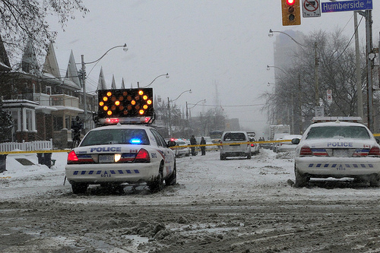

Motivation [ Blaylock & Allen 2005]
Road Blocked!

Slide 3
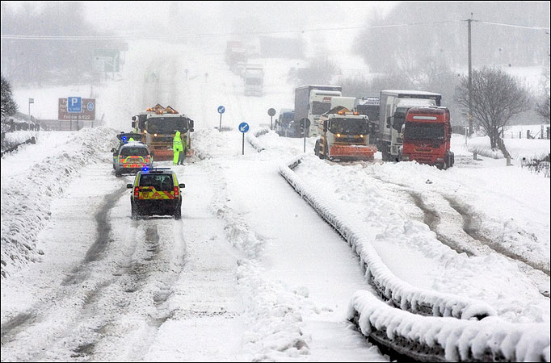
Motivation [ Blaylock & Allen 2005]
Road Blocked!
Heavy Snow; Hazardous Driving

Slide 4
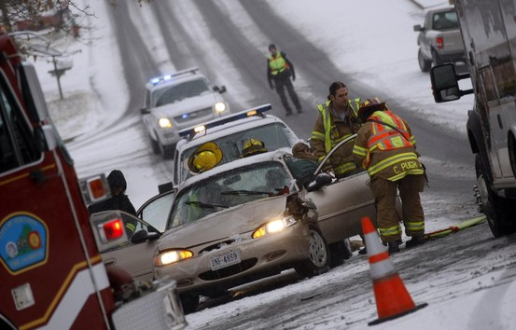
Motivation [ Blaylock & Allen 2005]
Road Blocked!
Heavy Snow; Hazardous Driving
Accident; Crew is Clearing the Wreck

Slide 5
Abduction
Given:
  Background knowledge
  A set of observations
To Find:
  Best set of explanations given the background knowledge and the observations

Slide 6
Previous Approaches
Purely logic based approaches [Pople 1973]
  Perform backward “logical” reasoning
  Can not handle uncertainty
Purely probabilistic approaches [Pearl 1988]
  Can not handle structured representations
Recent Approaches
  Bayesian Abductive Logic Programs (BALP) [Raghavan & Mooney, 2010]

Slide 7
An Important Problem
A variety of applications
  Plan Recognition
  Intent Recognition
  Medical Diagnosis
  Fault Diagnosis
  More..
Plan Recognition
  Given planning knowledge and a set of low-level actions, identify the top level plan

Slide 8
Outline
Motivation
Background
Markov Logic for Abduction
Experiments
Conclusion & Future Work

Slide 9
Markov Logic
[Richardson & Domingos 06]
A logical KB is a set of hard constraints
on the set of possible worlds
Let’s make them soft constraints:
When a world violates a formula,
It becomes less probable, not impossible
Give each formula a weight
(Higher weight ⇒ Stronger constraint)

Slide 10
Definition
A Markov Logic Network (MLN) is a set of pairs (F, w) where
  F is a formula in first-order logic
  w is a real number

Slide 11
Definition
A Markov Logic Network (MLN) is a set of pairs (F, w) where
  F is a formula in first-order logic
  w is a real number
heavy_snow(loc) ∧ drive_hazard(loc) ⇒ block_road(loc)
accident(loc) ∧ clear_wreck(crew, loc) ⇒ block_road(loc)

Slide 12
Definition
A Markov Logic Network (MLN) is a set of pairs (F, w) where
  F is a formula in first-order logic
  w is a real number
1.5 heavy_snow(loc) ∧ drive_hazard(loc) ⇒ block_road(loc)
2.0 accident(loc) ∧ clear_wreck(crew, loc) ⇒ block_road(loc)

Slide 13
Outline
Motivation
Background
Markov Logic for Abduction
Experiments
Conclusion & Future Work

Slide 14
Abduction using Markov logic
Express the theory in Markov logic
  Sound combination of first-order logic rules
  Use existing machinery for learning and inference
Problem
  Markov logic is deductive in nature
  Does not support adbuction as is!

Slide 15
Abduction using Markov logic
Given
heavy_snow(loc) ∧ drive_hazard(loc) ⇒ block_road(loc)
accident(loc) ∧ clear_wreck(crew, loc) ⇒ block_road(loc)
Observation: block_road(plaza)

Slide 16
Abduction using Markov logic
Given
heavy_snow(loc) ∧ drive_hazard(loc) ⇒ block_road(loc)
accident(loc) ∧ clear_wreck(crew, loc) ⇒ block_road(loc)
Observation: block_road(plaza)
Rules are true independent of antecedents
Need to go from effect to cause
  Idea of hidden cause
  Reverse implication over hidden causes

Slide 17
Introducing Hidden Cause
heavy_snow(loc) ∧ drive_hazard(loc) ⇒ block_road(loc)
rb_C1(loc)
Hidden Cause
heavy_snow(loc) ∧ drive_hazard(loc) ⇔ rb_C1(loc)

Slide 18
Introducing Hidden Cause
heavy_snow(loc) ∧ drive_hazard(loc) ⇒ block_road(loc)
rb_C1(loc)
Hidden Cause
heavy_snow(loc) ∧ drive_hazard(loc) ⇔ rb_C1(loc)
rb_C1(loc) ⇒ block_road(loc)

Slide 19
Introducing Hidden Cause
heavy_snow(loc) ∧ drive_hazard(loc) ⇒ block_road(loc)
rb_C1(loc)
Hidden Cause
heavy_snow(loc) ∧ drive_hazard(loc) ⇔ rb_C1(loc)
rb_C1(loc) ⇒ block_road(loc)
accident(loc) ∧ clear_wreck(crew, loc) ⇒ block_road(loc)
rb_C2(loc, crew)
accident(loc) ∧ clear_wreck(crew, loc) ⇔ rb_C2(crew, loc)
rb_C2(crew, loc) ⇒ block_road(loc)

Slide 20
Introducing Reverse Implication
Explanation 1: heavy_snow(loc) ∧ clear_wreck(loc) ⇔ rb_C1(loc)
Explanation 2: accident(loc) ∧ clear_wreck(crew, loc) ⇔ rb_C2(crew, loc)
Multiple causes combined via
reverse implication
block_road(loc) ⇒ rb_C1(loc) v (∃ crew rb_C2(crew, loc))

Slide 21
Introducing Reverse Implication
Explanation 1: heavy_snow(loc) ∧ clear_wreck(loc) ⇔ rb_C1(loc)
Explanation 2: accident(loc) ∧ clear_wreck(crew, loc) ⇔ rb_C2(crew, loc)
Multiple causes combined via
reverse implication
Existential quantification
block_road(loc) ⇒ rb_C1(loc) v (∃ crew rb_C2(crew, loc))

Slide 22
Low-Prior on Hidden Causes
Explanation 1: heavy_snow(loc) ∧ clear_wreck(loc) ⇔ rb_C1(loc)
Explanation 2: accident(loc) ∧ clear_wreck(crew, loc) ⇔ rb_C2(crew, loc)
Multiple causes combined via
reverse implication
Existential quantification
block_road(loc) ⇒ rb_C1(loc) v (∃ crew rb_C2(crew, loc))
-w1 rb_C1(loc)
-w2 rb_C2(loc, crew)

Slide 23
Avoiding the Blow-up
heavy_snow
(Plaza)
accident
(Plaza)
drive_hazard
(Plaza)
clear_wreck
(Tcrew, Plaza)
rb_C1
(Plaza)
rb_C2
(Tcrew, Plaza)
Hidden Cause Model
Max clique size = 3
block_road
(Tcrew, Plaza)

Slide 24
Avoiding the Blow-up
heavy_snow
(Plaza)
accident
(Plaza)
drive_hazard
(Plaza)
clear_wreck
(Tcrew, Plaza)
rb_C1
(Plaza)
rb_C2
(Tcrew, Plaza)
Hidden Cause Model
Max clique size = 3
block_road
(Tcrew, Plaza)
drive_hazard
(Plaza)
accident
(Plaza)
Pair-wise Constraints
[Kate & Mooney 2009]
Max clique size = 5
clear_wreck
(Tcrew, Plaza)
heavy_snow
(Plaza)
block_road
(Tcrew, Plaza)

Slide 25
Constructing Abductive MLN
Given n explanations for Q:

Slide 26
Constructing Abductive MLN
Given n explanations for Q:
Introduce a hidden cause C_{i} for each explanation.

Slide 27
Constructing Abductive MLN
Given n explanations for Q:
Introduce a hidden cause C_{i} for each explanation.
Introduce the following sets of rules:

Slide 28
Constructing Abductive MLN
Given n explanations for Q:
Introduce a hidden cause C_{i} for each explanation.
Introduce the following sets of rules:
Equivalence between clause body
and hidden cause. soft clause

Slide 29
Constructing Abductive MLN
Given n explanations for Q:
Introduce a hidden cause C_{i} for each explanation.
Introduce the following sets of rules:
Equivalence between clause body
and hidden cause. soft clause
Implicating the effect. hard clause

Slide 30
Constructing Abductive MLN
Given n explanations for Q:
Introduce a hidden cause C_{i} for each explanation.
Introduce the following sets of rules:
Equivalence between clause body
and hidden cause. soft clause
Implicating the effect. hard clause
Reverse Implication. hard clause

Slide 31
Constructing Abductive MLN
Given n explanations for Q:
Introduce a hidden cause C_{i} for each explanation.
Introduce the following sets of rules:
Equivalence between clause body
and hidden cause. soft clause
Implicating the effect. hard clause
Reverse Implication. hard clause
Low Prior on hidden causes. soft clause

Slide 32
Adbuctive Model Construction
Grounding out the full network may be costly
Many irrelevant nodes/clauses are created
Complicates learning/inference
Can focus the grounding
  Knowledge Based Model Construction (KBMC)
  (Logical) backward chaining to get proof trees
    Stickel [1988]
  Use only the nodes appearing in the proof trees

Slide 33
Abductive Model Construction
Observation:
block_road(Plaza)

Slide 34
Abductive Model Construction
Observation:
block_road(Plaza)
block_road
(Plaza)

Slide 35
Abductive Model Construction
Observation:
block_road(Plaza)
heavy_snow
(Plaza)
drive_hazard
(Plaza)
block_road
(Plaza)

Slide 36
Abductive Model Construction
Observation:
block_road(Plaza)
heavy_snow
(Plaza)
drive_hazard
(Plaza)
block_road
(Plaza)
Constants:
Mall
heavy_snow
(Mall)
drive_hazard
(Mall)
block_road
(Mall)

Slide 37
Abductive Model Construction
Observation:
block_road(Plaza)
heavy_snow
(Plaza)
drive_hazard
(Plaza)
block_road
(Plaza)
Constants:
Mall, City_Square
heavy_snow
(Mall)
drive_hazard
(Mall)
heavy_snow
(City_Square)
drive_hazard
(City_Square)
block_road
(Mall)
block_road
(City_Square)

Slide 38
Abductive Model Construction
Observation:
block_road(Plaza)
heavy_snow
(Plaza)
drive_hazard
(Plaza)
block_road
(Plaza)
Constants:
…, Mall, City_Square, ...
heavy_snow
(Mall)
drive_hazard
(Mall)
heavy_snow
(City_Square)
drive_hazard
(City_Square)
block_road
(Mall)
block_road
(City_Square)

Slide 39
Abductive Model Construction
Observation:
block_road(Plaza)
heavy_snow
(Plaza)
drive_hazard
(Plaza)
block_road
(Plaza)
Not a part of
abductive
proof trees!
Constants:
…, Mall, City_Square, ...
heavy_snow
(Mall)
drive_hazard
(Mall)
heavy_snow
(City_Square)
drive_hazard
(City_Square)
block_road
(Mall)
block_road
(City_Square)

Slide 40
Outline
Motivation
Background
Markov Logic for Abduction
Experiments
Conclusion & Future Work

Slide 41
Story Understanding
Recognizing plans from narrative text [Charniak and Goldman 1991; Ng and Mooney 92]
25 training examples, 25 test examples
KB originally constructed for the ACCEL system [Ng and Mooney 92]

Slide 42
Monroe and Linux
[Blaylock and Allen 2005]
Monroe – generated using hierarchical planner
  High level plan in emergency response domain
  10 plans, 1000 examples [10 fold cross validation]
  KB derived using planning knowledge
Linux – users operating in linux environment
  High level linux command to execute
  19 plans, 457 examples [4 fold cross validation]
  Hand coded KB
MC-SAT for inference, Voted Perceptron for learning

Slide 43
Models Compared
Model | Description
Blaylock | Blaylock & Allen’s System [Blaylock & Allen 2005]
BALP | Bayesian Abductive Logic Programs [Raghavan & Mooney 2010]
MLN (PC) | Pair-wise Constraint Model [Kate & Mooney 2009]
MLN (HC) | Hidden Cause Model
MLN (HCAM) | Hidden Cause with Abductive Model Construction

Slide 44
Results (Monroe & Linux)
 | Monroe | Linux
Blaylock | 94.20 | 36.10
BALP | 98.80 | -
MLN (HCAM) | 97.00 | 38.94
Percentage Accuracy for Schema Matching

Slide 45
Results (Modified Monroe)
 | 100% | 75% | 50% | 25%
MLN (PC) | 79.13 | 36.83 | 17.46 | 06.91
MLN (HC) | 88.18 | 46.33 | 21.11 | 15.15
MLN (HCAM) | 94.80 | 66.05 | 34.15 | 15.88
BALP | 91.80 | 56.70 | 25.25 | 09.25
Percentage Accuracy for Partial Predictions.
Varying Observability

Slide 46
Timing Results (Modified Monroe)
 | Modified-Monroe
MLN (PC) | 252.13
MLN (HC) | 91.06
MLN (HCAM) | 2.27
Average Inference Time in Seconds

Slide 47
Outline
Motivation
Background
Markov Logic for Abduction
Experiments
Conclusion & Future Work

Slide 48
Conclusion
Plan Recognition – an abductive reasoning problem
A comprehensive solution based on Markov logic theory
Key contributions
  Reverse implications through hidden causes
  Abductive model construction
Beats other approaches on plan recognition datasets

Slide 49
Future Work
Experimenting with other domains/tasks
Online learning in presence of partial observability
Learning abductive rules from data

